Slide 1
Myanmar MIL WORKSHOP SERIES
Unit 3: web search basics
Daw Myat Sann Nyein
MBAPF
May 2016
Notes:
1

Slide 2
Module 3 Overview
Topics Covered:
Web browsers and basic web search.
Questions You Will Be Able to Answer:
What are some different types of websites?
How do I use search engines to search the Web?
How do search engines compare to Facebook?
Notes:
2

Slide 3
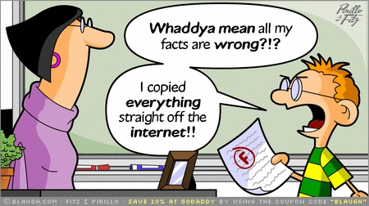
Digital Information Literacy: Locate, evaluate, use effectively
Notes:
3

Slide 4
Evaluate Each Site You Look At For:
Quality
Organization
Bias
Credibility of the author or organization
Security
Timeliness
Notes:
Who is responsible for the site, Identify the author and / or institution, are they well known, what is their reputation
A .gov, .edu, .mil or .org is USUALLY safe
Pay Attention to the Ending
Com is commercial – but have to know that almost everything on web can be bought / sold
Org is organization
Mil is military
Edu is educational
GOV is government
PAGE ranking – Google, bases results on how often this page is back-linked to

Slide 5
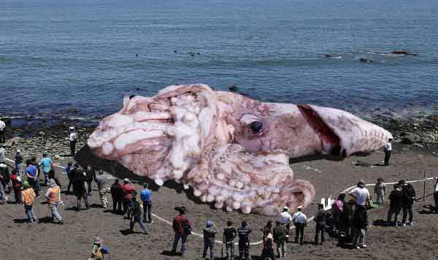
The Giant Squid https://www.youtube.com/watch?v=WmL5jFo11f4
Notes:
The original BBC article. Enjoy the inaccurate and completely meaningless size comparison graphic, particularly the way in which the "colossal squid" image looks absolutely nothing like the specimen in the photo, and a great deal like the "giant squid" image inverted and enlarged slightly
13 m (43 ft) for females and 10 m (33 ft) for males from the posterior fins to the tip of the two long tentacles (second only to the colossal squid at an estimated 14 m(46 ft),
Real 9 meter long found in Spain 2013 October
5

Slide 6



Misinformation vs. Disinformation
Notes:
6

Slide 7


News Satire (video)
The Onion: Deadly Super Rainbow
Click to Play Video
Notes:
7

Slide 8







Websites and Search Engines
Notes:
8

Slide 9
Websites
Directories​
Open Directory – http://www.dmoz.org​/ (Directory of Web)
Foundation directory -- https://fdo.foundationcenter.org/
ipl2 – http://ipl.org​ /
Online Burma Library: http://www.burmalibrary.org
Social Media
  Facebook – www.facebook.com
    Linkedin– www.linkedin.com
    Twitter– https://twitter.com
News​
kyaymon – www.moi.gov.mm/npe/km/​
The Myanmar Times – www.mmtimes.com/​
CNN – www.cnn.com​
Reference Sources​
Merriam-Webster – www.merriam-Webster.com​
      Oxford English Dictionary – www.oed.com
Collaborative knowledge-based websites​ ikipedia – www.wikipedia.org *
Notes:
9

Slide 10

What other types of websites can you think of?​

Slide 11

Search engines
Can you name any search engines you might used?​
Google – www.google.com ​
Bing – www.bing.com
Yahoo – www.yahoo.com ​
https://duckduckgo.com
Ask.com - www.ask.com
Alltheweb – www.alltheweb.com

Slide 12
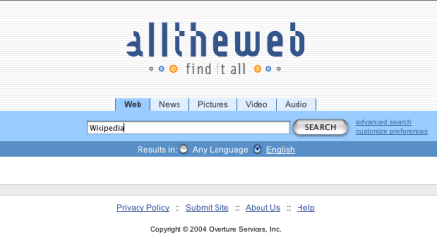

Slide 13
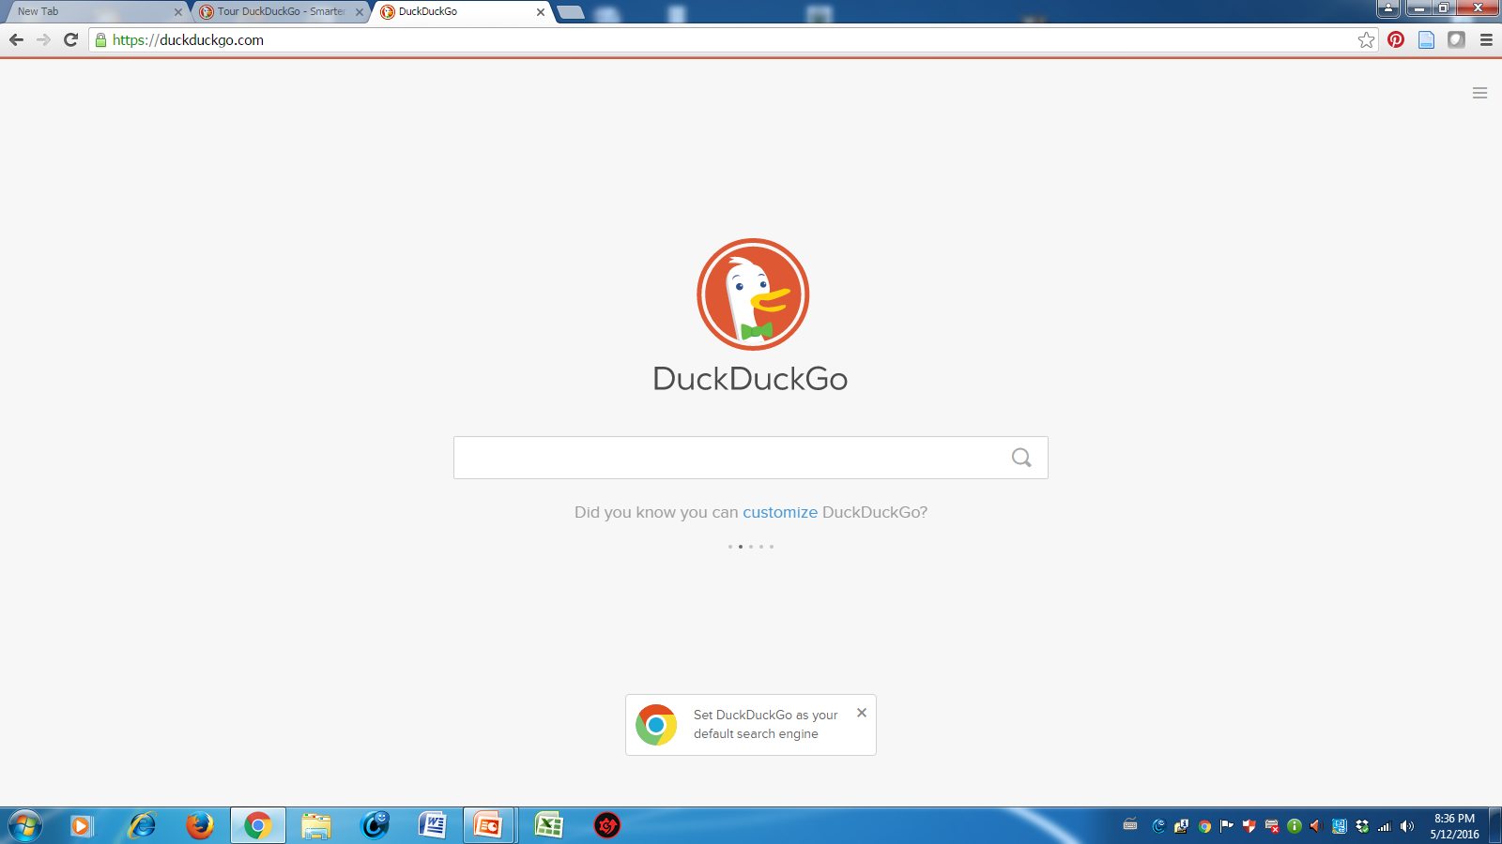

Slide 14


Activity 3.1: Web Browser Apps
Notes:
14

Slide 15

Can you name any web browsers you might used?​
Internet Explorer
Google Chrome
Mozilla Firefox
Opera
Dolphin

Slide 16
Exercises
Let’s download one or two different browsers that you don’t have on your devises.
Can you change the search engine to Google?

Slide 17

Activity 3.2: Web Search Operators
site
*
OR
−
“”
Notes:
17

Slide 18
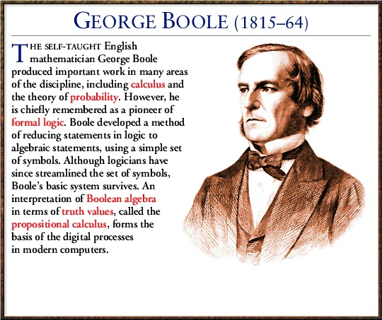
Boolean Operators
Boolean Operators are used to connect and define the relationship between your search terms. When searching electronic databases, you can use Boolean operators to either narrow or broaden your record sets. The three Boolean operators are AND, OR and NOT.
George Boole, who first defined an algebraic
system of logic in the mid 19th century.

Slide 19
Boolean Operators
AND is used between terms to narrow your search
  diabetes and obesity will retrieve references containing both search terms
OR is used between terms to broaden your search
  diet or nutrition will retrieve references containing either search term
NOT is used to omit a term from your search
  cancer not smoking will retrieve references containing the term cancer, but that do not contain the term smoking

Slide 20
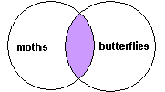
AND
AND
moths AND butterflies
You want to find books that are about both moths AND butterflies

Slide 21
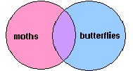
OR
OR
moths OR butterflies
You want to find books that are about moths, books that are about butterflies, and books that discuss both:
OR means MORE.

Slide 22
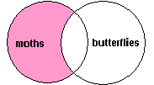
NOT
NOT
moths NOT butterflies
You want to find books that are about moths, but EXCLUDE those that discuss butterflies

Slide 23
Search Tips
The truncation/word stemming device is the asterisk (*)
  dyslexi* will retrieve dyslexia, dyslexic, etc
The single character wildcard is question mark (?)
  organi?ation will retrieve organisation or organization
The multiple character wildcard is the hash (#)
  colo#r will retrieve color or colour
Use quotation marks for “phrase searching”
  “global warming” will retrieve references that contain both terms next to each other, in this exact order

Slide 24
Search Tips using Operators
The highest mountain in the world
The tallest building in the world
The longest river in the world
The largest forest in the world
The weather in Mandalay

Slide 25
Search Tips
The truncation/word stemming device is the asterisk (*)
  dyslexi* will retrieve dyslexia, dyslexic, etc
The single character wildcard is question mark (?)
  organi?ation will retrieve organisation or organization
The multiple character wildcard is the hash (#)
  colo#r will retrieve color or colour
Use quotation marks for “phrase searching”
  “global warming” will retrieve references that contain both terms next to each other, in this exact order

Slide 26


Slide 27
Google search (2)
Site (Get results from certain sites or domains)
bagan site:org ​
bagan site:org OR site:youtube.com
bagan site:gov
bagan site:com
bagan site:edu
  Filetype - to search specific file types such as pdf, ppt​
  bagan filetype:pdf​
Searching in title
intitle: myanmar population
Define:literacy
Sunset/Sunrise: sunset Bagan, Myanmar/
sunrise Bagan, Myanmar

Slide 28
Google Search (3)
Google Scholar Search - http://scholar.google.com
Google news search – http://news.google.com
Google book search - http://books.google.com/
Google Image Search - http://images.google.com
Google Maps Search - http://maps.google.com
Google Product Search - http://www.google.com/products
Google Group Search - http://groups.google.com
Google Finance - http://www.google.com/finance
https://www.google.com/finance/converter

Slide 29

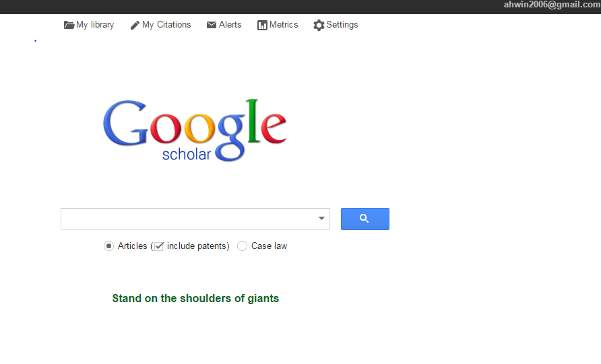
Google Scholar
http://scholar.google.com
Email updates of latest results
Saved
articles
Track citation to your publication

Slide 30
Citation
AMA
(American Medical Assoc.)
Reference List: WALLACE E, BUIL I, de CHERNATONY L, HOGAN M. Who "Likes" You … and Why? A Typology of Facebook Fans. Journal Of Advertising Research [serial online]. March 2014;54(1):92-109. Available from: Business Source Premier, Ipswich, MA. Accessed June 30, 2014.
APA
(American Psychological Assoc.)
References:WALLACE, E., BUIL, I., de CHERNATONY, L., & HOGAN, M. (2014). Who "Likes" You … and Why? A Typology of Facebook Fans. Journal Of Advertising Research, 54(1), 92-109. doi:10.2501/JAR-54-1-092-109
Chicago/Turabian: Author-Date
Reference List:WALLACE, ELAINE, ISABEL BUIL, LESLIE de CHERNATONY, and MICHAEL HOGAN. 2014. "Who "Likes" You … and Why? A Typology of Facebook Fans." Journal Of Advertising Research 54, no. 1: 92-109. Business Source Premier, EBSCOhost (accessed June 30, 2014).
Chicago/Turabian: Humanities
Bibliography:WALLACE, ELAINE, et al. "Who "Likes" You … and Why? A Typology of Facebook Fans." Journal Of Advertising Research 54, no. 1 (March 2014): 92-109. Business Source Premier, EBSCOhost (accessed June 30, 2014)

Slide 31
Harvard
References:WALLACE, E, BUIL, I, de CHERNATONY, L, & HOGAN, M 2014, 'Who "Likes" You … and Why? A Typology of Facebook Fans', Journal Of Advertising Research, 54, 1, pp. 92-109, Business Source Premier, EBSCOhost, viewed 30 June 2014.
MLA
(Modern Language Assoc.)
Works Cited:WALLACE, ELAINE, et al. "Who "Likes" You … And Why? A Typology Of Facebook Fans." Journal Of Advertising Research 54.1 (2014): 92-109. Business Source Premier. Web. 30 June 2014.
Vancouver/ICMJE
References:WALLACE E, BUIL I, de CHERNATONY L, HOGAN M. Who "Likes" You … and Why? A Typology of Facebook Fans. Journal Of Advertising Research [serial on the Internet]. (2014, Mar), [cited June 30, 2014]; 54(1): 92-109. Available from: Business Source Premier.

Slide 32
Some social requisites of democracy: Economic development and political legitimacy
SM Lipset - American political science review, 1959 - Cambridge Univ Press
Cited by 4950 Related articles All 31 versions Cite Save

Slide 33
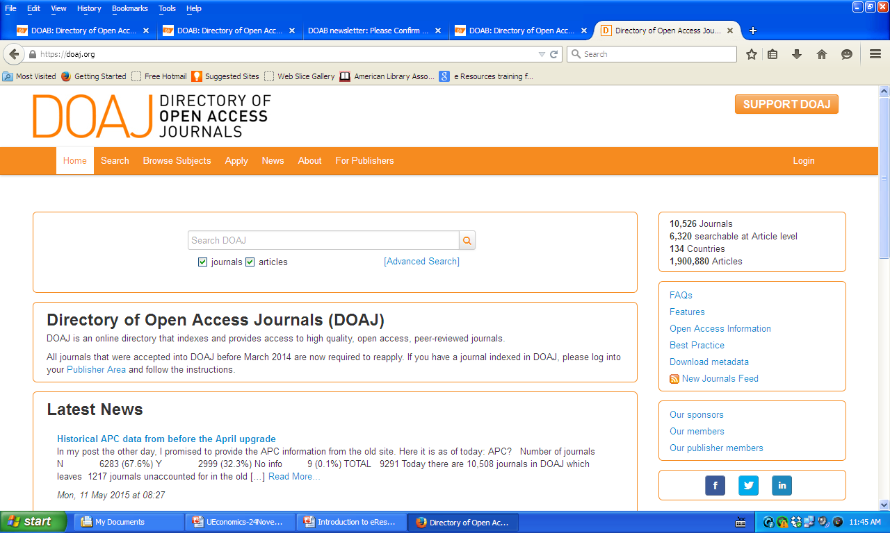
Directory of Open Access Journals www.doaj.org

Slide 34
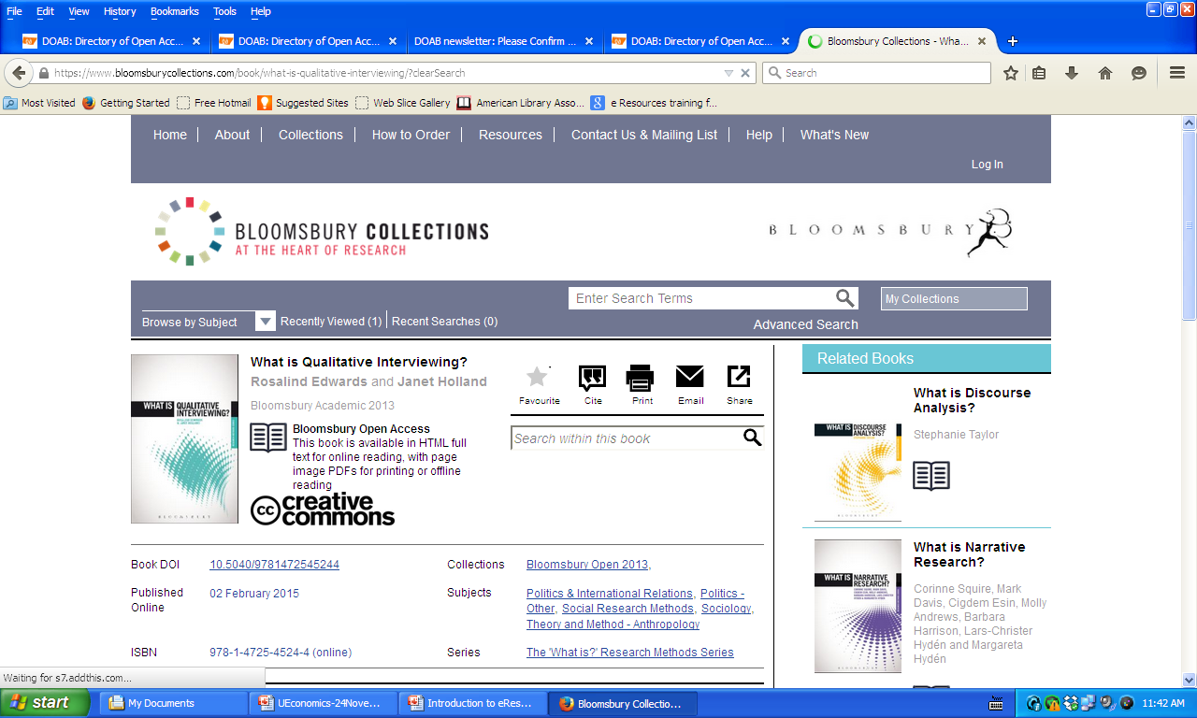
Directory of Open Access Books www.doabooks.org

Slide 35
Searching Exercise:
Return Documents?
Civic Education Thailand
Civil Society U.S.
Civic Education Myanmar
Civil Society in Myanmar
Internet marketing Advertising
Libraries, Librarian, Librarianship
Mahidol University

Slide 36

Activity 3.3: Search Engines vs. FB
Notes:
36

Slide 37
Search Engines vs. FB
exercises
1. Sports websites in Myanmar
2. Sports government websites in Myanmar
3. Sports websites in Myanmar but not government websites
4. Sports websites to get Myanmar government websites, YouTube, and all higher education websites
Google search facebook search
sports site:.mm
Sports site:.gov.mm
Sports site:.mm -.gov
4. Sports site:.mm OR site:youtube.com OR site:.edu

Slide 38
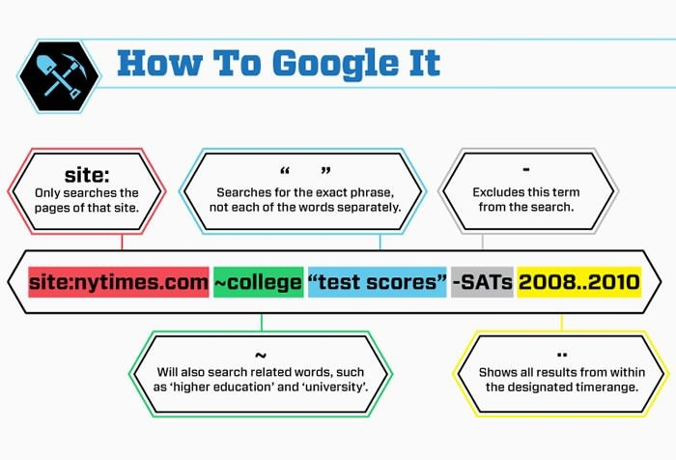
Activity 3.4: Advanced Search
Notes:
38

Slide 39
  Exercises
  Partnership with Organizational site
  2. Taungyi with Government site
  3. Internet Marketing with Commercial site
  4. Sunrise and Sunset time in Chicago USA
  5. Who is the President of Myanmar
  Tell Google to even search for synonyms of a specified word in the search query.
  Tell Google to search Andriod phone cost between $300 and $500
  pdf file free photoshop books
  Tell Google to search Myanmar Times site only

Slide 40
Just For Fun
Google Sphere
Epic Google
Google Guitar
Google underwater
Google Rainbow
elgoog

Slide 41
Review
Topics Covered:
Web browsers and basic web search.
Concepts Learned:
What are some different types of websites?
How do I use search engines to search the Web?
How do search engines compare to Facebook?
Notes:
41

Slide 42

End Unit 3
Congratulations!!! You have completed the Myanmar Digital Information Literacy (DIL) Workshop Module Unit 3: Basic Web Search.
Notes:
42

