Slide 1

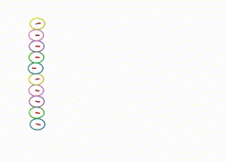
Thesis defense:
Decentralized Trajectory Planning
Author:
Justin Chang*
Committee members:
Mehran Mesbahi*, Robert Breidenthal*
*Department of Aeronautics & Astronautics, University of Washington

Slide 2
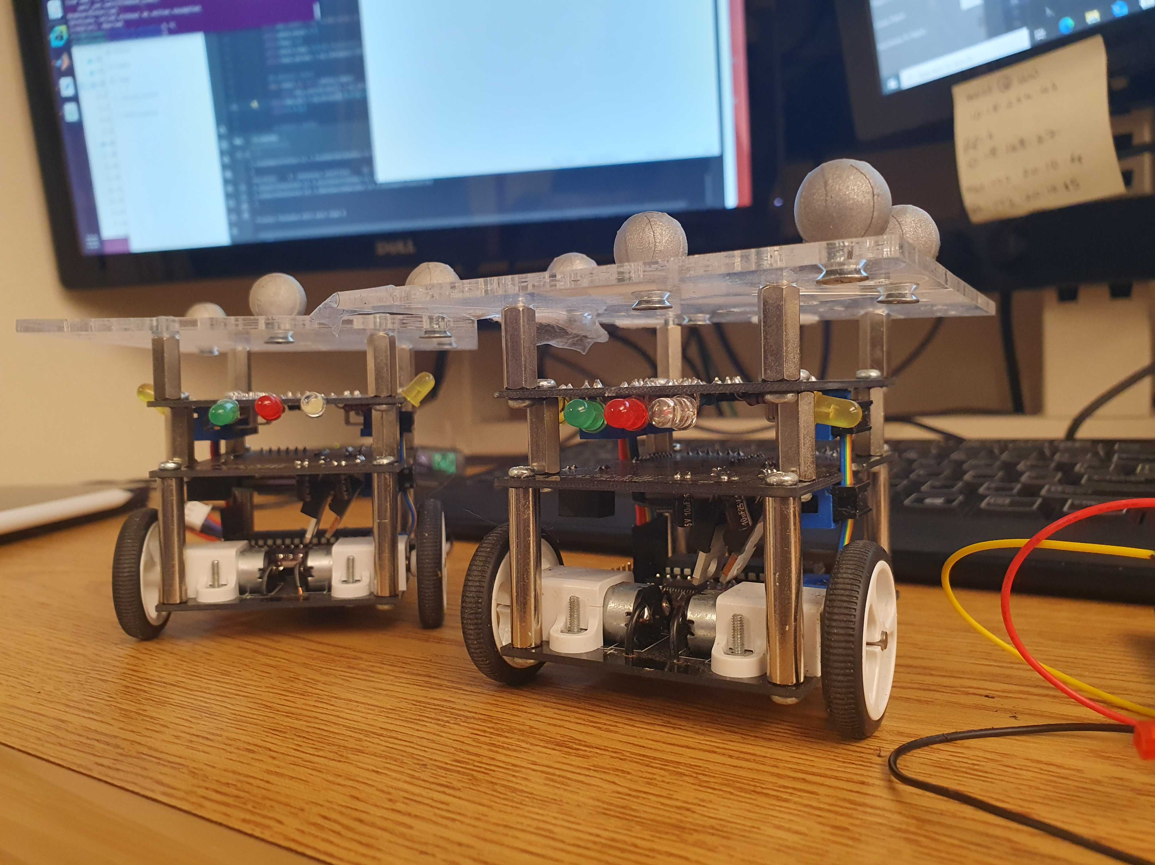
Table of Contents
Problem statement
Contribution
Introduction/ Motivation
Problem formulation
Decentralized trajectory planning
Results
Conclusion/ Future work
Appendix: safe constraints dual reformulation/ convergence analysis
1

Slide 3
Problem statement:
Multiagent trajectory planning
Multiagent safe navigation : Navigate through the obstacles (or other agents) with a certain objective
What we need?
  Consensus protocol
  Optimization (SCVX)
  Dual reformulation
  Biconvex optimization
Decentralized Multiagent Trajectory Planning
Optimization (SCVX)
Consensus
Dual reformulation
Biconvex
optimization
2

Slide 4
Contribution:
Novel safe constraints reformulation, with convergence rate five times faster than existing Successive Convexification (SCVX)
Fully decentralized multiagent trajectory planning algorithm with less sharing variables compared to the existing algorithms
Extensive numerical simulation and hardware experiments with nonlinear system to validate our algorithms
3

Slide 5
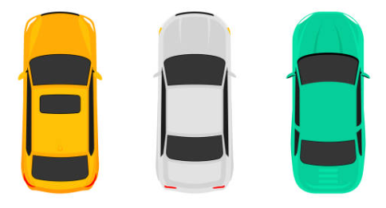
Motivation:
Why safe trajectory planning?
Ever-rising demands for fully autonomous vehicles
Collision-free navigation
4

Slide 6
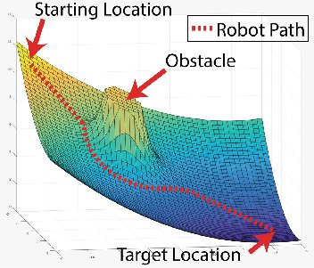
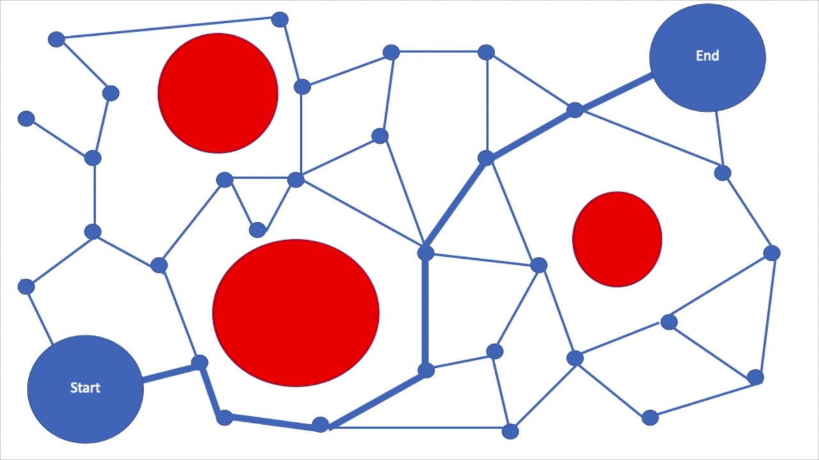

Introduction:
Existing safe trajectory planning methods
Rapidly exploring random tree (RRT)
Artificial potential field (APF)
Control barrier function (CBF)
Sequential Convex Programming (SCP)
Safe set(nonconvex)
Unsafe set
Artificial potential field
Rapidly exploring random tree
Control barrier function
4

Slide 7
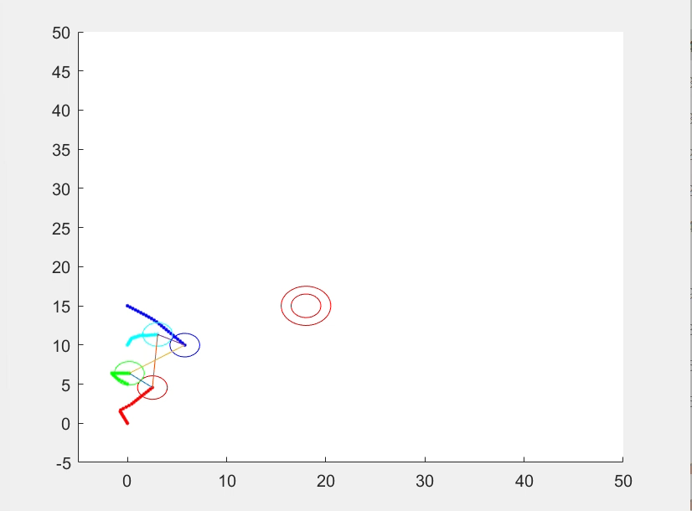
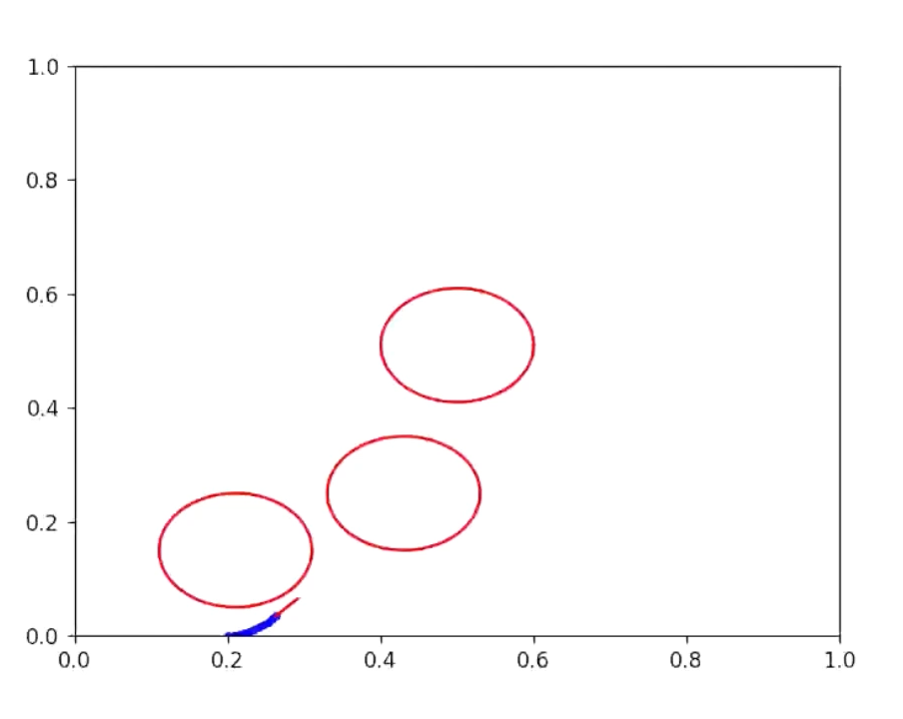
Why optimization over general Lyapunov methods?
Formation
as objective
Foresee the future trajectory
Constraint satisfaction
Different tasks can be assigned by a properly designed objective
More universal
Minimum energy
as objective
5

Slide 8
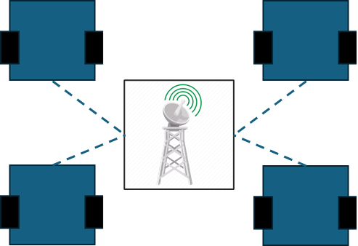
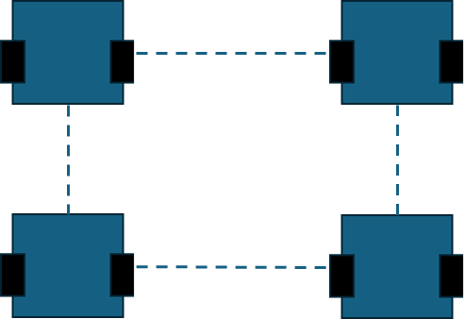
Introduction:
Centralized/ Decentralized Optimizations
Centralized → Good convergence properties / bad scalability, relies on a central node
Decentralized approaches → Better scalability, more robust against node failure/ more restrictive assumptions
Our method
Centralized approach
Decentralized approach
6

Slide 9
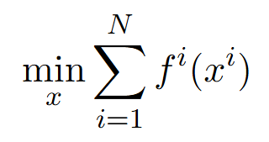
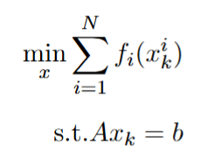
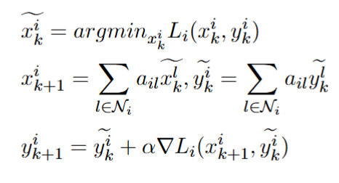
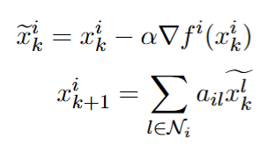
Introduction:
Decentralized optimizations
Primal method: primal problem minimization /relying on the first order consensus
Dual method: alternating between primal minimization and dual maximization /relying on the first order consensus
Primal approach
(Distributed gradient descent)
Dual approach
(Consensus dual decomposition)
Agent
Local problem
Agent
Local problem
Consensus
7

Slide 10
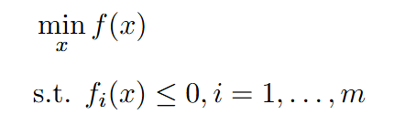



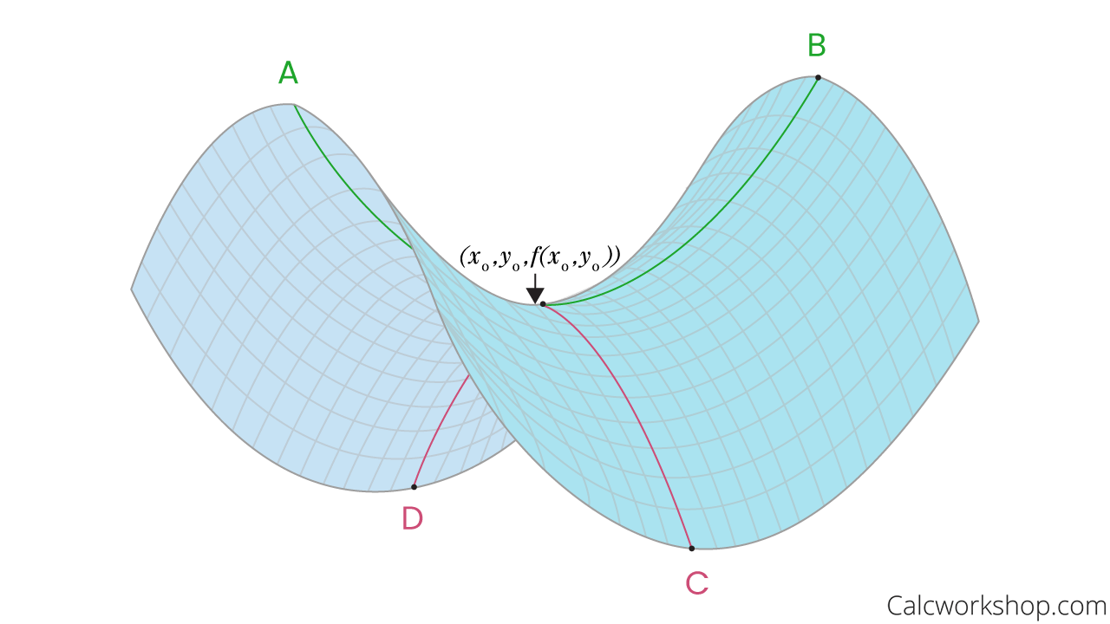
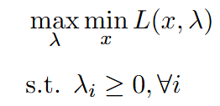
Introduction:
Dual Problem
Consider the problem
Optimal values for primal and dual problems
Has Lagrangian
When duality gap = 0
Which yields the dual problem
8

Slide 11
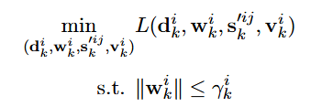
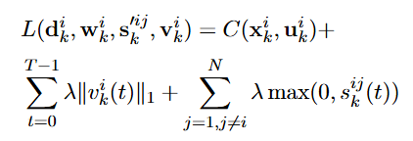

Solving the local problem :
Successive Convexification
A iterative trust region-based algorithm for general nonlinear/nonconvex optimization
Key is to linearize the constraints so that all nonlinear/nonconvex constraints can be approximated by affine constraints
Safe constraint example
Objective$C(x,u)$
Linearized problem
Steepest descent of objective
Obstacle
The only “hard” constraints is imposed by trust region
Optimal states
Linear objective function
Linear approximation of safe constraint
9

Slide 12








Solving the local problem :
Successive Convexification
Linearize around previous trajectory, and add small “perturbation” to refine the solution
$$x_{k+1}= x_{k}+ δ_{k}$$
Obstacle
$$δ_{2}$$
Obstacle
$$δ_{1}$$
$$δ_{0}$$
$$x_{0}$$
$$x_{1}$$
$$x_{2}$$
$$x_{3}$$
10

Slide 13
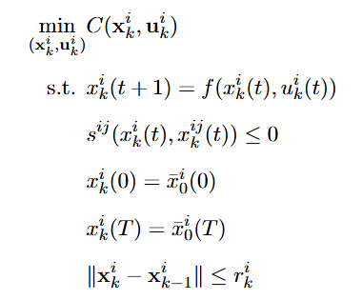
Problem Formulation:
Multiagent trajectory planning
Forming a decentralized optimization problem to satisfy constraints
Multiagent trajectory planning
Objective
Dynamic
Safe constraint
Starting state constraint
Terminal state constraint
Consensus update constraint
11

Slide 14
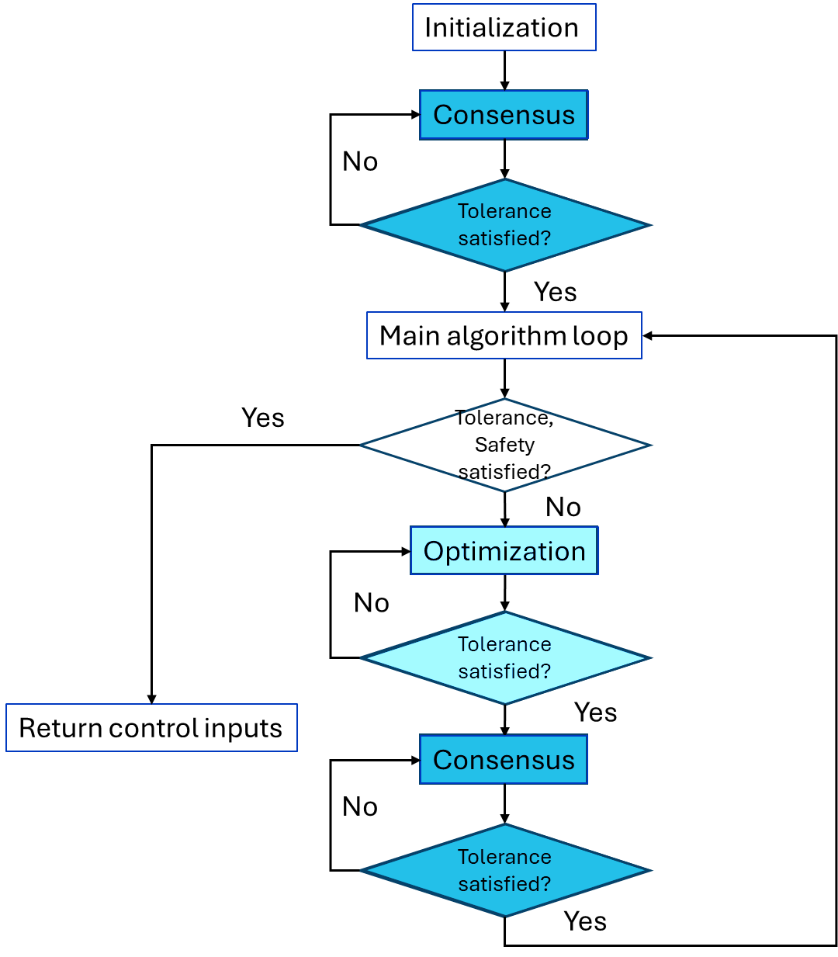
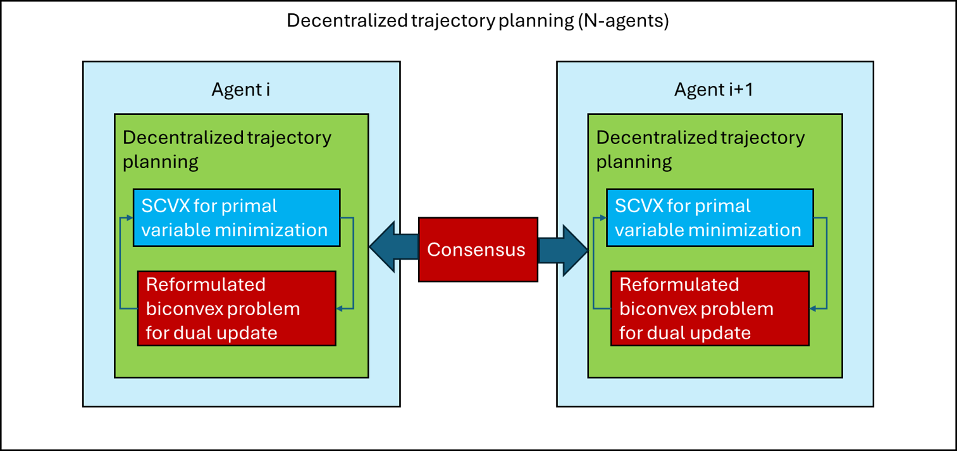
Decentralized trajectory planning algorithm:
Overview
Algorithm flow chart
System level diagram
12

Slide 15
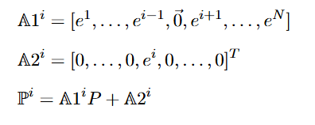
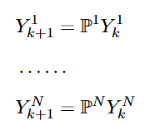
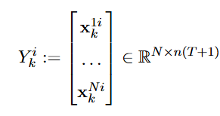
Decentralized trajectory planning algorithm :
Modified consensus
Modified discrete consensus algorithm:
Define the modified Perron matrix by
Modified consensus
Modified Perron matrix
Stacked estimates
13

Slide 16
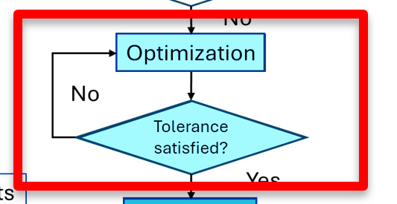
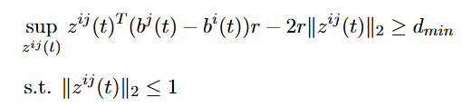
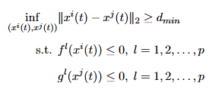
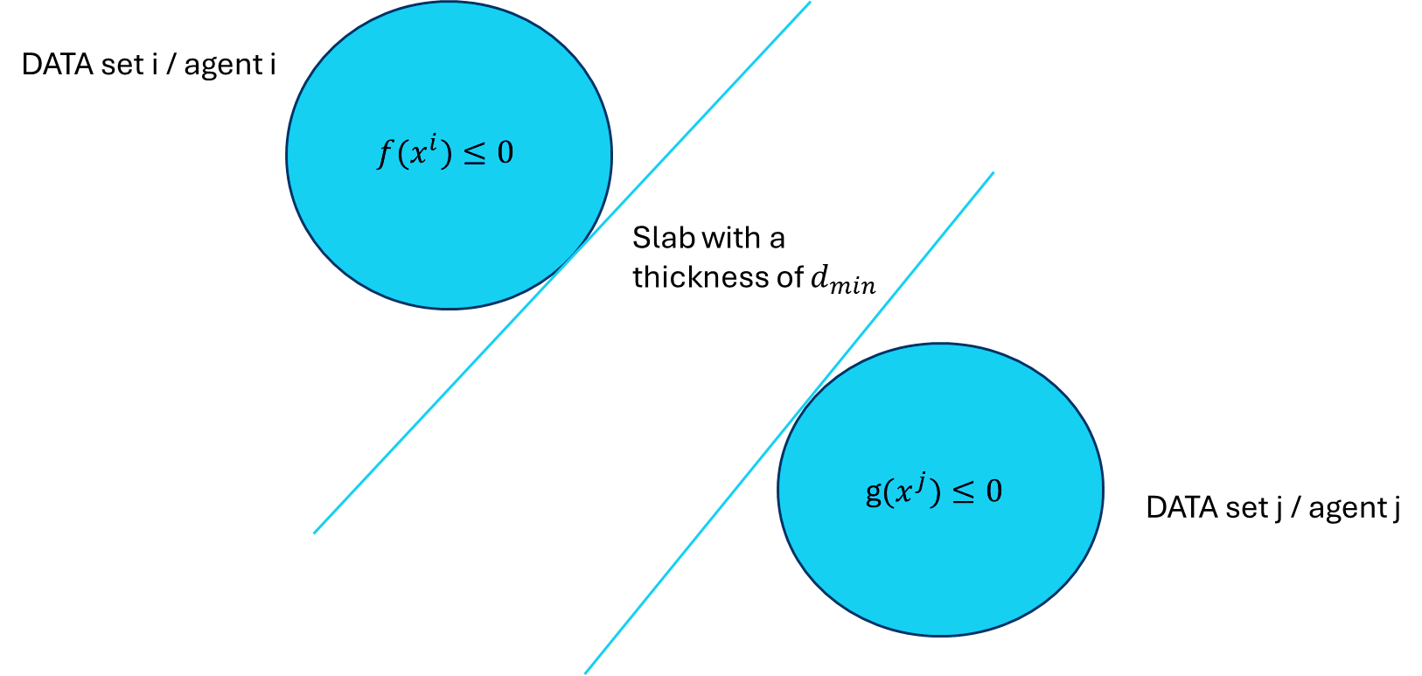
Decentralized trajectory planning algorithm :
Safe constraint reformulation
The idea is that instead of creating a “hole” in the set in the primal sense, the dual reformulation is to create a “supporting hyper slab” separating the agents, whence we name it support vector machine reformulation
Safety constrain expressions
Primal approach
Dual approach
Feasible set
$$r+d_{min}$$
14

Slide 17


Decentralized trajectory planning algorithm :
SVM(partial dual) safe constraint reformulation
The minimum distance between agents:
With circular agents, the dual then becomes:
If agents have ellipsoid shapes
15

Slide 18

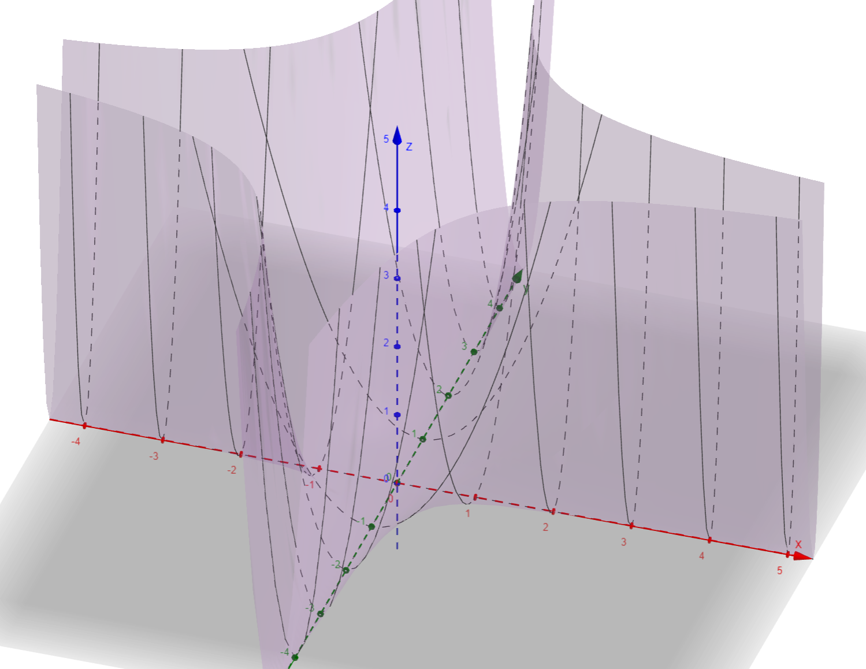
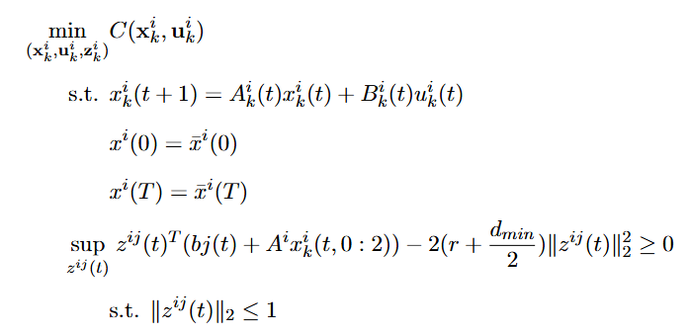
Decentralized trajectory planning algorithm :
Biconvex optimization 1
Suppose we have convex objective function, we have the following problem (biconvex in primal and dual) after constraint reformulation
A biconvex function
Upper level
This constraint is biconvex
Lower level
16

Slide 19
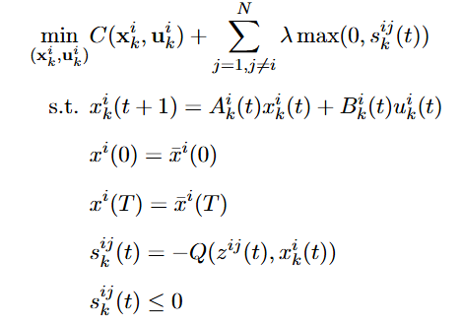
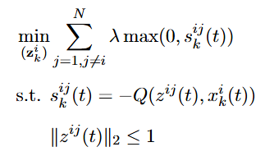
Decentralized trajectory planning algorithm :
Biconvex optimization 2
By using Alternating Convex Search (ACS) method, previous problem can be solved by bilevel subproblems
Upper level subproblem (CVX or solved with SCVX)
Lower level subproblem(convex)
17

Slide 20
Decentralized trajectory planning algorithm :
Biconvex optimization
Solving the biconvex optimization problem
Primal minimization
(Upper level)
Dual update
(Lower level)
18

Slide 21
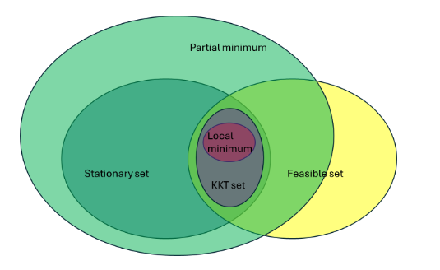
Decentralized trajectory planning algorithm :
Different sets
Note that the solutions returned by algorithms presented in this work only converge to the partial minimum (single agent, complete graph)
Solution is NOT necessarily feasible!
Different sets
19

Slide 22
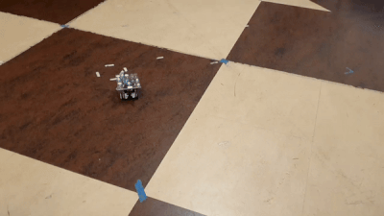
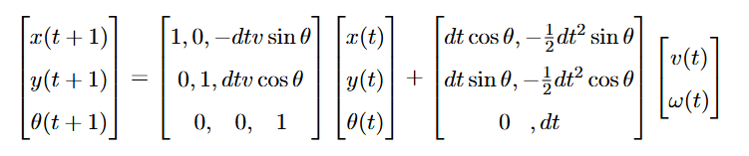
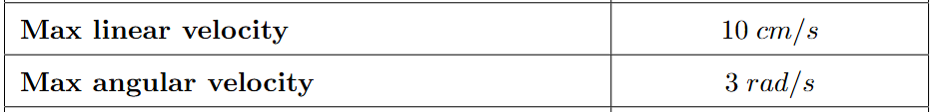
Results:
Unicycle dynamics and Johnny robots
A group of ground robots with unicycle dynamics
Unicycle dynamics
Physical limitations
Lonely Johnny
20

Slide 23
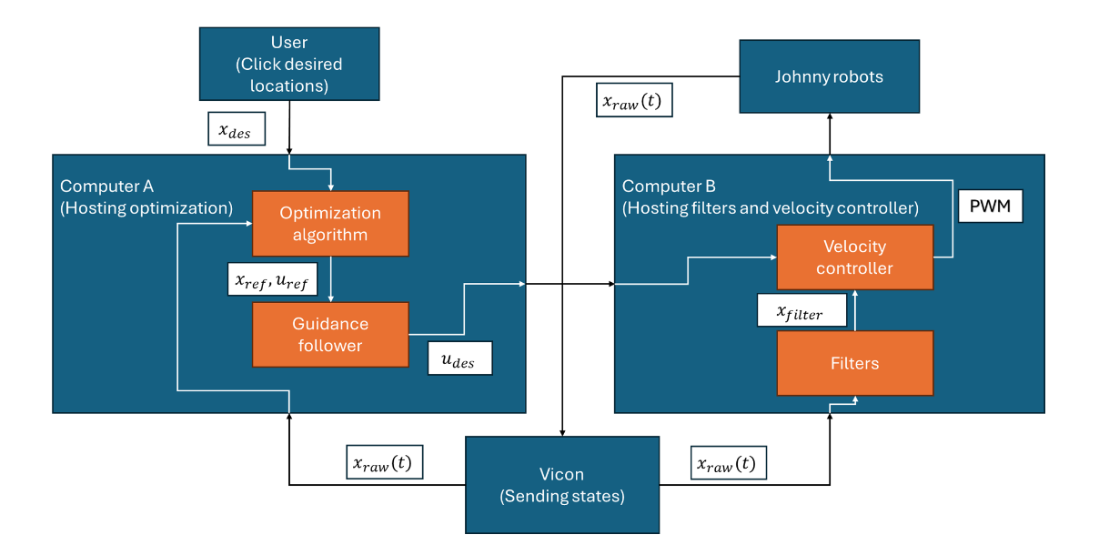
Results:
Johnny system architectures
21

Slide 24
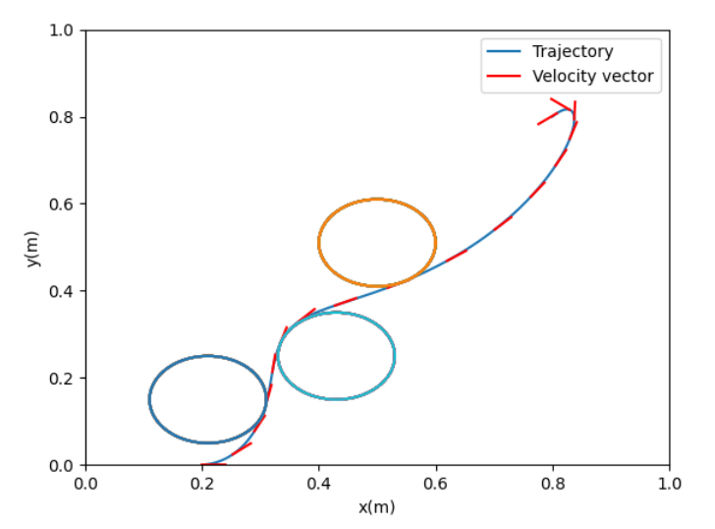
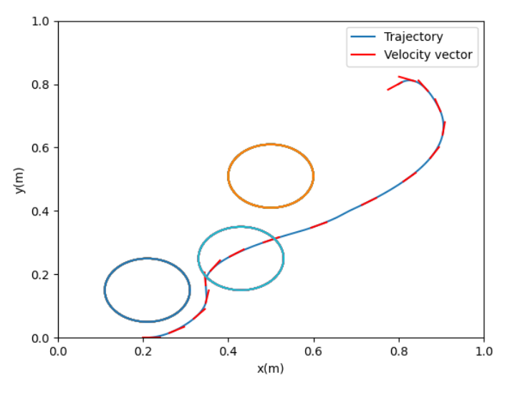
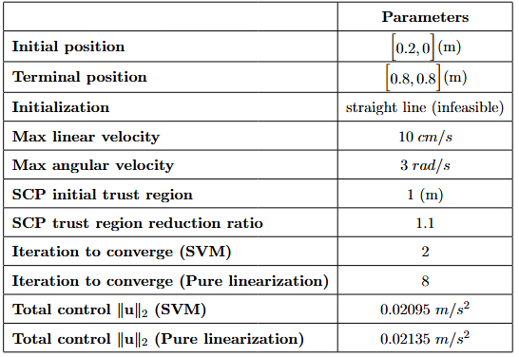

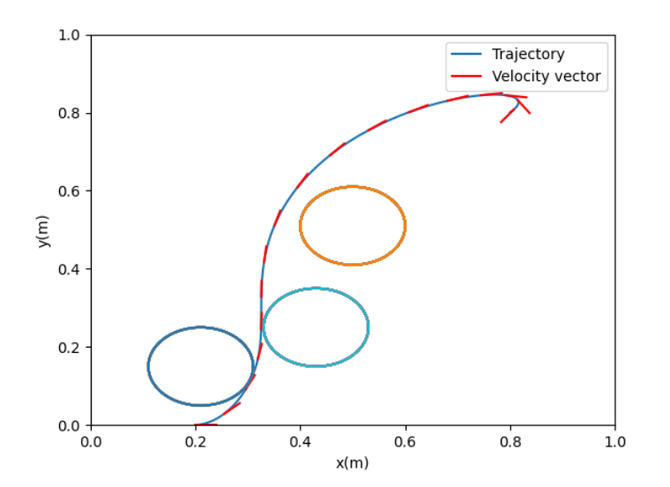
Results:
Single-agent simulation 1
SVM reformulated constraints
Pure linearization
Simulation parameters
After one iteration
After one iteration
After ten iterations
After ten iterations
22

Slide 25
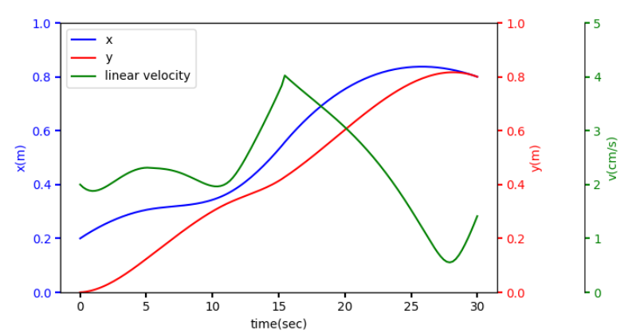
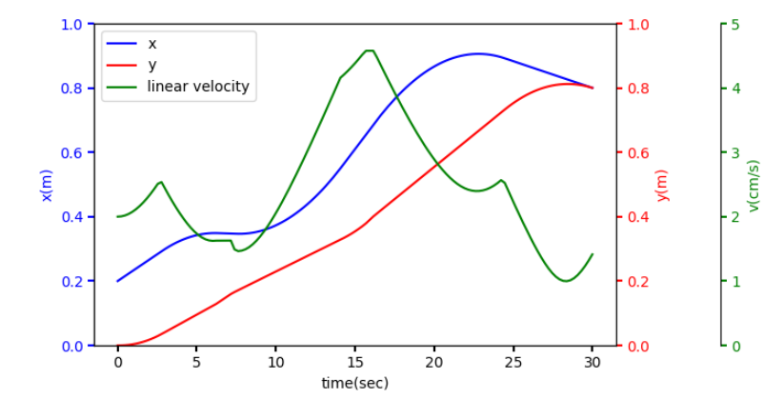
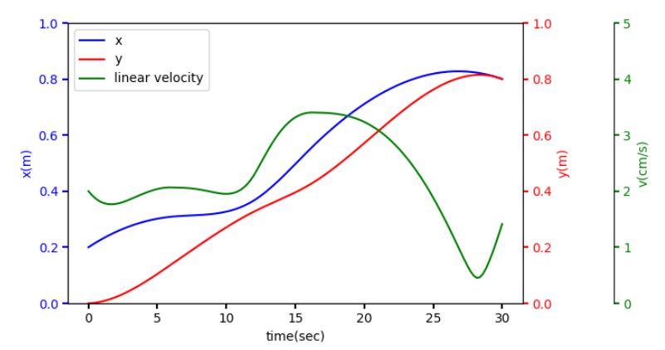
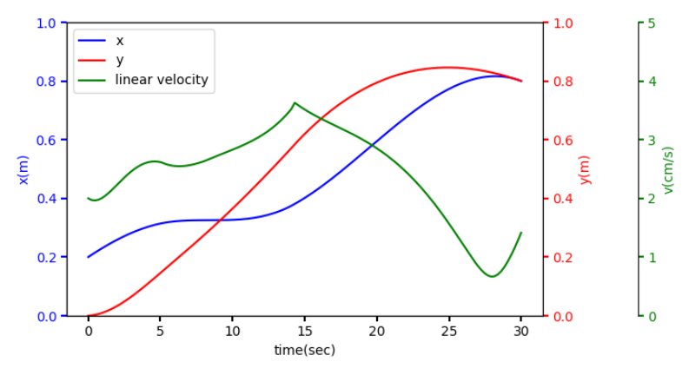
Results:
Single-agent simulation 2
Simulation parameters
SVM reformulated constraints
Pure linearization
After one iteration
After one iteration
After ten iterations
After ten iterations
23

Slide 26
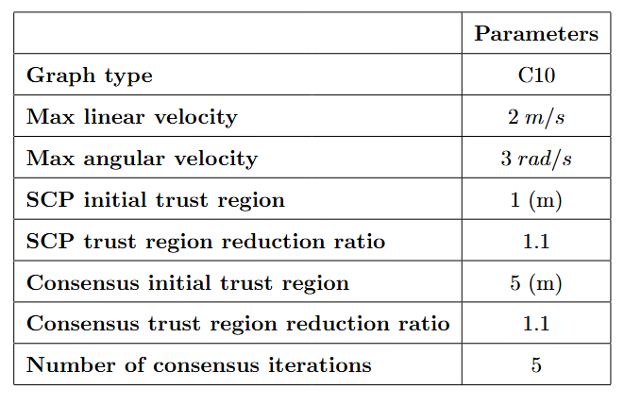
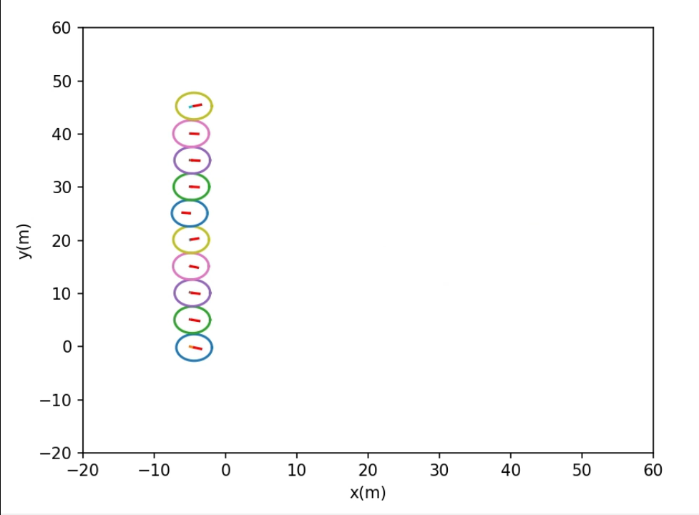
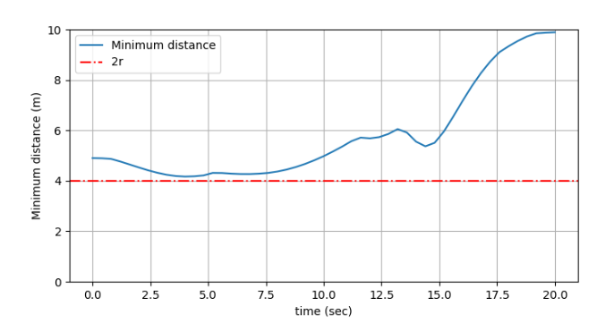
Results:
Ten agents case
Simulation parameters
10 agents forming a circular pattern
Minimum distance between agents
24

Slide 27
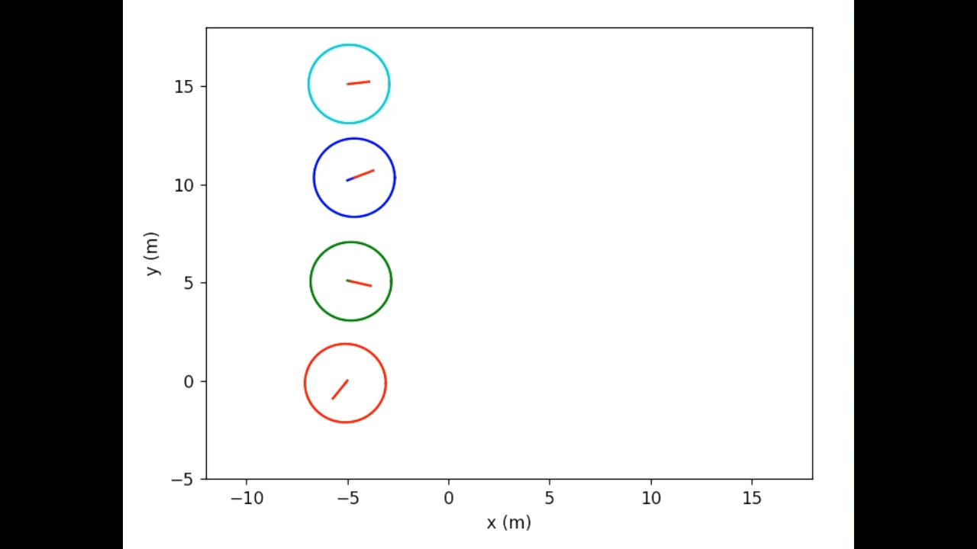
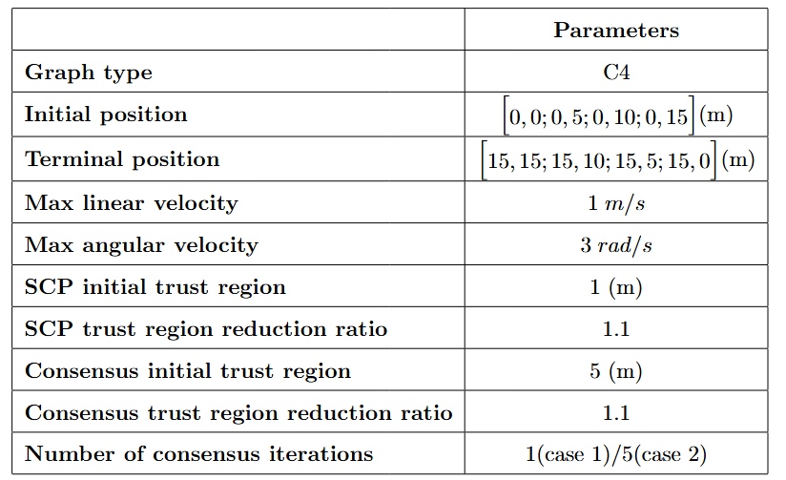

Results:
Four agents cases
Final trajectories after 50 iterations for case 1
Simulation parameters
Final trajectories after 50 iterations for case 2
25

Slide 28


Results:
Four agents cases
Consensus error costs for case 1
Consensus error costs for case 2
26

Slide 29




Results:
Four agents cases
Minimum distance for case 1
Minimum distance for case 2
Consensus trust region for case 1
Consensus trust region for case 2
27

Slide 30



Results:
Hardware experiments
Three agents random tests
Three agents cross case 1
Three agents cross case 2
28

Slide 31
Conclusion:
We proposed a novel partial dual trajectory planning method that can:
  Converge much faster
  Guarantee a safe trajectory
The decentralized consensus-based trajectory planning algorithm has:
  Good scalability
  Minimum data sharing requirements
  Automatic trust region update mechanisms for convergence
We tested our algorithms with various cases:
  Single agent case
  Ten agents C10 graph case
  Four agents C4 graph cases
  Hardware experiments
29

Slide 32
Future work:
Solving the time-varying graph version
Exploring more dual methods for better convergence properties
Applying the same framework to other applications
Adding sequence decision into the problem (Only right decision sequences lead to the feasible solution)
Game theory
30

Slide 33
Thanks for listening
Question time:
Nonlinear?
Nonconvex?
Discontinuity?
Finding the convex hull?
I got a headache now

Slide 34




Convergence analysis:
Biconvex optimization
Consider the biconvex problem
Similarly, the trajectory problem
Which will converge to the partial minimum with ACS
Will converge to the partial minimum

Slide 35




Convergence analysis:
Bounded consensus error cost and Monotonic cost decrease before the critical iteration
Our error dynamics from k to k+1 is given by
From the Lipschitz assumption, the cost due to the consensus error is
From the bounded error cost and assumption on
Sufficient decrease, we have:
The total consensus error that agent i has:

Slide 36



Convergence analysis:
Detectable consensus error cost increase and bounded consensus error cost
Assume that the optimal is reached within finite iterations
Since the consensus error is decreasing at a rate of λ2 →
There exists a positive iteration in which the local consensus error increases
Also assume the safe constraint is active with true data, that is:
Assuming after certain iterations, all the local solutions are feasible, if the consensus error = 0, the corresponding consensus error cost = 0

