Slide 1
Childhood Trauma
Psychoeducation (Information) about the impact it can have
©, 2016 Annika St. John
Without permission of author, this curriculum may not be reproduced in any form. Contact the author at annikasj@uw.edu for permission requests.
Notes:
For Instructors: The intent of this PowerPoint is to inform adolescent aged youth and their caregivers about the impacts of childhood trauma. This PowerPoint is meant to be highly interactive with the participants. Allow time for brainstorming with open ended questions. Take time throughout PowerPoint to allow for questions to be asked. It would be beneficial to have an additional counselor in the room to meet privately with anyone who appears to be triggered by topic/discussion.

Slide 2

Goals
Resiliency
  Risk and Protective Factors
What is Trauma?
Trauma and Physical Health
Trauma and Mental Health
Attachment and Learning to Regulate Emotions
Mindfulness
What can help a youth who has experienced childhood trauma to heal?
Resources
Notes:
For Instructors: Briefly go through the list of topics (goals) that will be discussed during this PowerPoint. Ultimate goal of this is to educate. Knowledge is what______? Knowledge is power, it can allow people the ability to make changes based on what they know.
Allow participants to ask questions at the end of this slide.

Slide 3
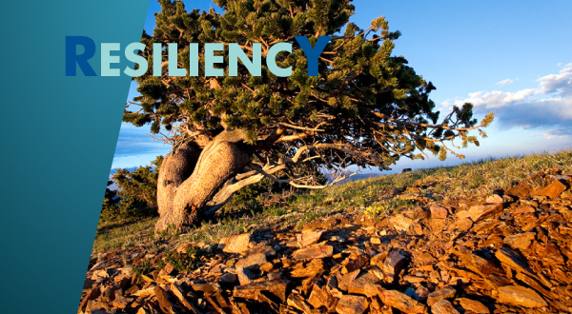
Resiliency
What is resiliency?
What does it look like when someone is not resilient?
Risk Factors for Developing Resiliency
The good news….
(Gerber et. Al, 2014, Wortham, 2014, Simeon et. Al, 2007)
Notes:
For Instructors:
What is resiliency?: Allow participants to brainstorm ideas about what resiliency is.
Resiliency can be a subjective experience for each person. Each person may define it differently. Some researchers have theorized that resiliency is displayed by “individuals [who] take responsibility for their recovery and are able to accept and integrate their experiences” (Gerber, Hogan, Maxwell, Callahan, Ruggero, & Sundberg, 2014 p.113). These researchers further defined resiliency as being able to arrive at a similar level of functioning as before the trauma took place. Other researchers characterized resilience as “the ability to display healthy social interaction, optimism, and emotional control” (Wortham, 2014, p. 59). Resilient people are able to successfully cope and adapt after distressful, life-changing events. It’s not always about being the same exact person prior to traumatic event, those events shape you, many times into a stronger more mature individual. It’s about being able to live through a traumatic event and continue to function in a constructive way.
2. What would it look like if someone was not resilient?: Allow participants to brainstorm.
Example: People who are not resilient may “spiral downward or out of control” each time a challenging experience takes place. They may cope with drugs, alcohol, risky behavior that can result in life-threatening situations and death. They may be unable to manage their emotions, struggle relationally and behaviorally.
3. Brainstorm what “risk factors” mean.
How does resiliency relate to trauma?
In a research study regarding factors associated with resilience in adults, it was found that the greatest risk factor is childhood trauma (Simeon, Yehuda, Cunill, Knutelska, Putnam, & Smith, 2007). This is a consistent finding in many of the research articles observed regarding risk factors.
There is a physiological affect on the brain/body when we experience trauma. When we are young (early childhood development) humans experience important developmental stages, brain patterns and hard wiring that is being formed and can have a lifelong impact on how we will continue to deal with difficult situations. Trauma can have a huge impact on early childhood development and a persons ability to be resilient.
4. The good news: The brain has neuroplasticity it has the ability to form new connections between brain cells throughout a person’s life. There are ways in which we can re-shape patterns of the brain that may have been impacted by trauma or adverse circumstances during early childhood. It is possible for youth to develop into a more resilient person during later developmental stages.

Slide 4

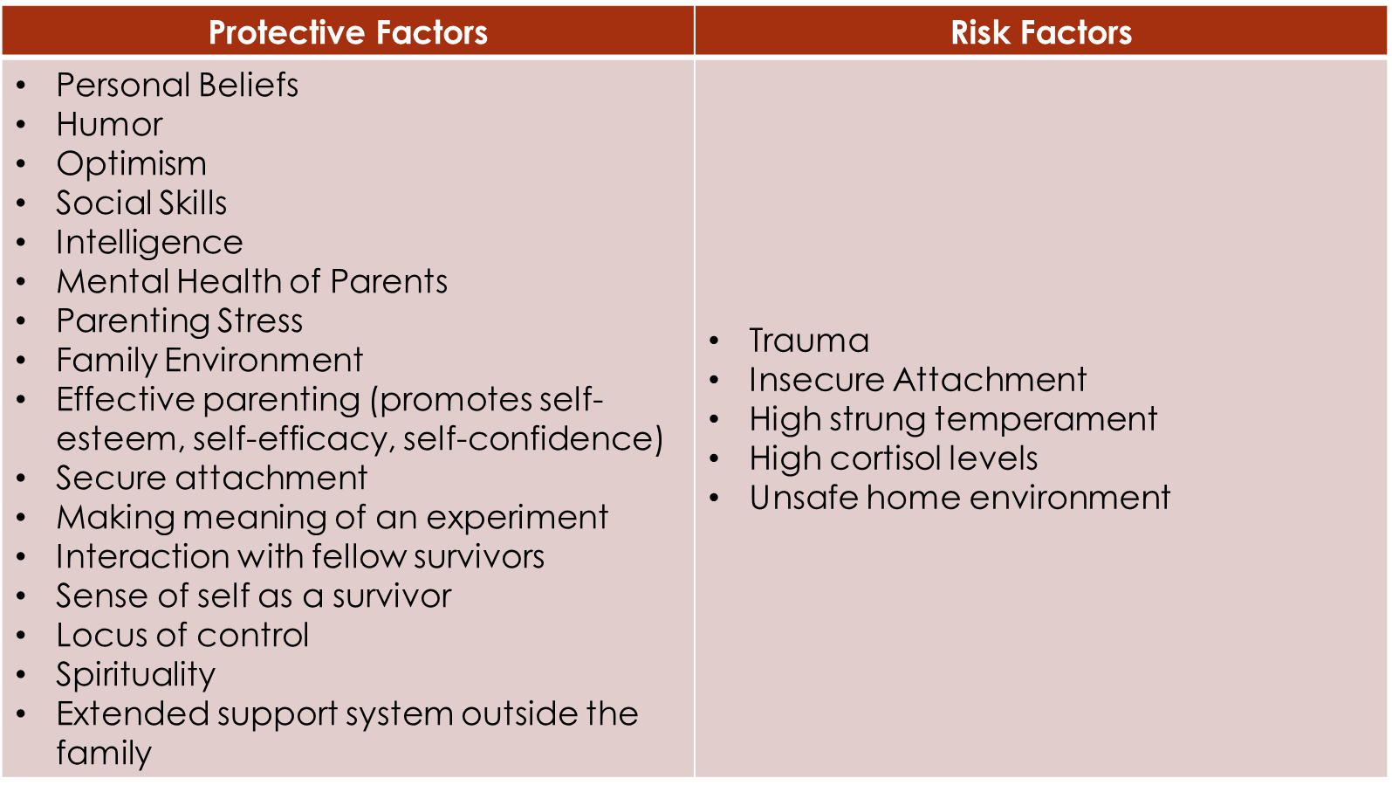
Risk Factors and Protective Factors for Resiliency
(Wortham, 2015, Agaibi &Wilson, 2005, Orbke & Smith, 2013)
Notes:
For Instructors:
What is a protective factor?
2. Protective Factors, “personal beliefs, humor, optimism, intelligence, social skills, mental health of parents, parenting stress, and family environment” (Wortham, 2014, p. 59). Agaibi and Wilson (2005) discussed some of the protective factors related to resilience in a review of the literature on the topic. They stated, the ability to moderate emotions, cope with stressors and manifest positive responsiveness to stressors as protective factors. Additionally, Agaibi and Wilson (2005) highlight that effective parenting increases self-efficacy, self-esteem, and self-confidence, which can help foster a resilient person.
Along with many other articles that were surveyed, the following list presents additional characteristics that help create a resilient person: secure attachment, intellectual skills, social cognitive abilities, the ability to make meaning of an experience, “interaction with fellow survivors”, altruism, sense of self as a survivor, and locus of control (Agaibi & Wilson, 2005). Among these, some other things that can support resiliency are spirituality and extended support systems outside of the family unit (Orbke & Smith, 2013).
3. Risk Factors: It has been conferred that genetic factors such as temperament and personality can have an effect on resiliency ( Orbke & Smith, 2013). A negative home environment and genetic predisposal to a high-strung temperament or personality. Low baseline cortisol levels may be attributed to a higher threat for developing PTSD there is indication that cortisol levels in the body could be raised due to childhood trauma. An insecure attachment is another factor that places a person at risk for resiliency.

Slide 5
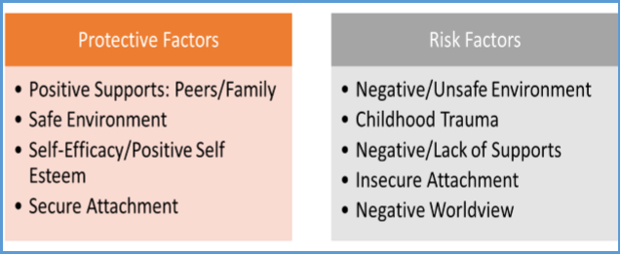
Risk Factors and Protective Factors for Resiliency
(St. John, 2015)
Notes:
1. This is one of the key findings from an unpublished qualitative research study that Annika St. John, MSW (The writer of this PowerPoint) completed in 2015. The diagram above states some of the risk and protective factors identified by clinicians who work with at-risk adolescent aged youth. It was suggested by this study that growing protective factors and decreasing risk factors is an effective intervention. There were limitations to the study, it was a small study, and may have lacked diversity in clinicians many of whom worked in-patient settings.

Slide 6

What is Trauma
What is a traumatic situation?
  Physical or sexual abuse • Abandonment • Neglect • The death or loss of a loved one • Life-threatening illness in a caregiver • Witnessing domestic violence • Automobile accidents or other serious accidents • Bullying • Life-threatening health situations and/or painful medical procedures • Witnessing or experiencing community violence (e.g., shootings, stabbings, robbery, or fighting at home, in the neighborhood, or at school) • Witnessing police activity or having a close relative incarcerated • Life-threatening natural disasters • Acts or threats of terrorism (viewed in person or on television) • Living in chronically chaotic environments in which housing and financial resources are not consistently available
Trauma is a subjective experience
(DSM-5, 2013, www.nctsn.org)
Notes:
For Instructors:
1. Brainstorm with group what a traumatic situation might look like.
2. Allow the group to read through some of the traumatic situations identified by the National Child Traumatic Stress Network. According to National Child Traumatic Stress Network, these are some situations that can be traumatic: • Physical or sexual abuse • Abandonment • Neglect • The death or loss of a loved one • Life-threatening illness in a caregiver • Witnessing domestic violence • Automobile accidents or other serious accidents • Bullying • Life-threatening health situations and/or painful medical procedures • Witnessing or experiencing community violence (e.g., shootings, stabbings, robbery, or fighting at home, in the neighborhood, or at school) • Witnessing police activity or having a close relative incarcerated • Life-threatening natural disasters • Acts or threats of terrorism (viewed in person or on television) • Living in chronically chaotic environments in which housing and financial resources are not consistently available (www.nctsn.org)
3. Read the DSM-5 Definition of Trauma. According to the DSM-5: Childhood trauma can be described as an event that takes place in which normal functioning of life is threatened, thus threatening the development of coping skills. According to the DSM V child trauma under the age of 6 is defined as, “exposure to actual or threatened death, serious injury or sexual violence through directly witnessing event in person as it occurred to others (especially caregiver), or learning that the traumatic event occurred to a parent or caregiving figure” (DSM-5, 2013).
4. Trauma is subjective, not everyone will experience trauma in the same way. What may not be traumatic for one may be traumatic for someone else and vise versa.

Slide 7

Signs of Trauma
Difficulty sleeping and nightmares
Refusing to go to school
Lack of appetite
Bed-wetting or other regression in behavior
Interference with developmental milestones
Anger
Getting into fights at school or fighting more with siblings
Difficulty paying attention to teachers at school and to parents at home
Avoidance of scary situations
Withdrawal from friends or activities
Nervousness or jumpiness
Intrusive memories of what happened
Play that includes recreating the event
(www.nctsn.org)
Notes:
For Instructors
Have group members read through the signs of trauma identified by the National Child Traumatic Stress Network. Individuals begin to exhibit physical signs as noted on this slide.
On a side note for caregivers: Each person has various defense mechanisms that kick into play when we experience trauma. In ego psychology there are dozens of psychological defense mechanisms that a person may use in order to deal with traumatic experiences for example: denial, projection(attributing terrifying anxieties to someone in external world), acting out, dissociation (painful memory separated from the feelings attached to it), regression, repression, reaction formation(transforming an unacceptable with into an acceptable one), displacement, undoing and so forth.
When a student is impacted by trauma, which of these signs might impact their school performance?
Which of these signs might impact a persons social relationships and ultimately their network of support? Remember, network of support is a protective factor for resiliency and therefore the experience of trauma may isolate a person from having that support that is so necessary at overcoming difficult situations.

Slide 8
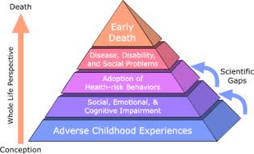
Trauma and Physical Health
There is a link between Adverse Childhood Experiences and chronic health conditions such as:
  Heart failure
  Chronic lung disease
  Liver disease
  High blood pressure
  High levels of C-reactive protein
  Some of these conditions may result in early death.
(Felitti et al., 1998, Center for Substance Abuse Treatment, 2014)
Notes:
For Instructors:
1. Brainstorm if any participants are aware of the ACE study.
2. Discuss the study: ACE (Adverse Childhood Experience) originated in a study by Kaiser Permanente beginning in 1995 that examined childhood abuse and its correlation to being a leading cause in adult deaths (Felitti, Anda, Nordenberg, Williamson, Spitz, Edwards, Koss, & Marks, 1998). Specifically, this study looked at how adverse childhood experiences relate to chronic health conditions such as heart failure, renal failure, high blood pressure, diabetes, and so forth.
3. Healing from trauma can impact a person’s physical health

Slide 9
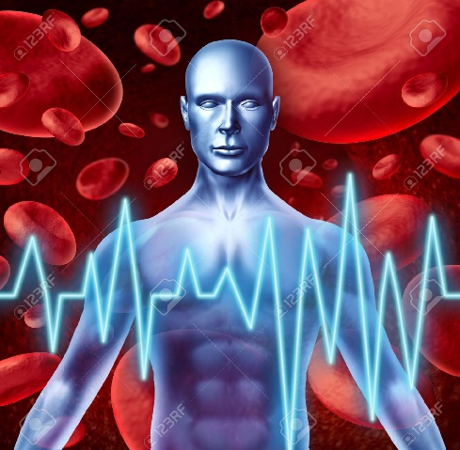
Trauma and Physical Health
Disturbances in:
  Sleep
  gastrointestinal
  cardiovascular
  neurological
  musculoskeletal
  respiratory
Dermatological disorders
Urological problems
Substance use disorders
Hyperarousal, hypervigilance
(Center for Substance Abuse Treatment, 2014)
Notes:
For Instructors:
1. Read through other ways trauma can effect physical health.

Slide 10
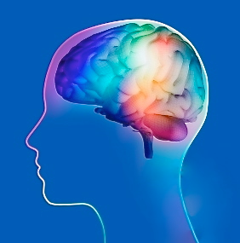
Trauma and Mental Health
Thought Process Changes
  Cognitive Errors, Excessive or Inappropriate Guilt, Idealization, Trauma-Induced Hallucinations or Delusions, Intrusive Thoughts or Memories.
Changes in Limbic System Functioning, Changes in Cortisol Levels, Neurotransmitter-Dysregulation of Arousal
Anxiety
Depression
Suicide Attempts
Acute Stress Disorder
Post-Traumatic Stress Disorder
Eating Disorders
(Center for Substance Abuse Treatment, 2014, Silverman et al., 1996)
Notes:
For Instructors:
1. Read through ways in which trauma effects mental health.

Slide 11
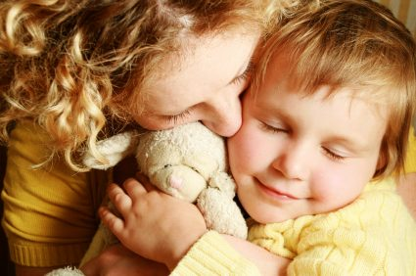
Attachment and Learning to Regulate our Emotions
What is attachment?
How do we learn to regulate our emotions?
How is this related to resiliency and trauma?
(Siegel, 2001)
Notes:
For Instructors:
1. Attachment John Bowlby began theory on attachment (all or nothing process). Mary Ainsworth Strange Situation Procedure with 3 forms of Attachment Styles: Secure, Insecure, Insecure Ambivalent/Resistant. When children go through a traumatic experience at a young age, or perhaps their caregiver experiences the traumatic event at the same time as the child, it may result in the child having an insecure or disorganized attachment to their caregiver. This in turn affects the way a child will relate to others throughout their lives.
2. Siegel (2001) discusses that children who have a disorganized attachment often have “unresolved trauma or grief” (p.77). He further discusses how a child’s relationship to their caregiver is supposed to provide “joy, connection, and emotional soothing which instead offers alarm, fear, and terror and a lack of ability to be soothed” (Siegel, 2001, p. 78). Seigel confers the child is meant to learn how to cope and deal with emotional dysregulation from their caregiver. It is problematic if the adult is unable to display a healthy example of this behavior to their child. Furthermore, Siegel discusses the importance of the developing mind and how integrative processes through secure attachments in the brain are, “at the core of emotional well-being and psychological resilience” (Siegel, 2001, p. 90). The ability to have positive emotional regulation is one of the primary skills that can help a child to cope when distressed. This is a trait that will be needed throughout life internally and externally in social relationships.
3. Your interaction with your caregiver and a secure attachment is fundamental for emotional well-being and psychological resilience.
3. How is attachment related to resiliency and trauma? Brainstorm with the group.

Slide 12
What happens when A stressful situation occurs?
Emotions
Behavior
Relationships
Coping
Stressful Situation
Notes:
For Instructors:
1. When a stressful situation occurs our emotions are impacted, which causes us to behave in a certain way which effects the relationships and interactions with others. From this stressful situation we react by coping with what has happened. There are positive and negative coping habits that we can engage in.
2. Can somebody name a stressful situation you have experienced recently? (Example: bad grade, girlfriend/boyfriend broke up with you)
3. What is a natural reaction to this stressful situation?
4. What are some of the positive ways we can cope with something stressful?
5. What are some negative ways we can cope with something stressful?
6. What might be the difference in the way a person who has experienced childhood trauma vs a person who has not experienced childhood trauma might react when faced with stressful situations?
7. But remember the good news… (The brain has neuroplasticity, it has the ability to grow and form new patterns throughout developmental stages.)

Slide 13
Mindfulness and the Brain
Mindfulness can help to positively shape the part of the brain that causes a person to be resilient.
      https://youtu.be/vESKrzvgA40
      https://youtu.be/LiyaSr5aeho
Notes:
For the Instructors:
Mindfulness is one of the powerful ways to help an individual to develop the part of the brain that causes resilience and aids in building the ability to regulate emotions. I recommend previewing these videos prior to class. You can show one or both of these videos with Neuroscientist Dr. Dan Siegel. In these videos, Dr. Siegel discusses how mindfulness affects the brain in order to build traits that can increase resilience and decrease reactive and destructive behavior.
First Video:
Can start at the beginning. This video describes the benefit mindfulness can have at giving a child the ability to pause and think before reacting to a situation. The more we practice mindfulness the more our brain has the ability to pause and think in a such a way that can promote the best possible outcome. It enables an individual to be empathetic.
Second Video:
Start Video at 11:59
This video can be used if there is time, it also discusses the benefit of mindfulness. This video uses Dan Siegel as well as a teenager and he discusses with the teenager how mindfulness affects the brain.
Questions to Ask:
What are the benefits to being able to pause and reflect before you react?
What are the benefits to being able to tune in to what other people are thinking?
Dan Seigel suggests that reflection and caring and connecting relationships stimulated the growth of the fibers or part of the brain that build resilience. What is your reaction to this?
Other facts about mindfulness:
Mindfulness-based therapies can be successful at treating anxiety and mood problems (Hofmann, Sawyer, Witt, & Oh, 2010). Additionally it can have overall positive health outcomes and better sense of well-being (Davidson et al., 2003)

Slide 14
What can help a youth who has experienced childhood trauma to heal?
Mindfulness
  Martial Arts, Yoga
Dialectical Behavior Therapy (DBT)Skills
Cognitive Behavior Therapy (CBT)
Trauma-Focused Cognitive Behavior Therapy (TF-CBT)
Narrative Therapy
Art Therapy
Eye-Movement Desensitization and Reprocessing (EMDR) Therapy
Notes:
For Instructors:
These are some of the effective treatments that can help a person heal from traumatic experiences.
DBT helps individuals with interpersonal skills (relationally), with distress tolerance (coping with stress), emotional regulation, and problem solving.
CBT helps individuals reshape thinking patterns, people who may have hopeless thoughts can reshape them to be feeling hopeful.
TF-CBT focuses on reshaping thought patterns affected by trauma.
Creating a trauma narrative can give an individual the ability to process trauma and have power in their own voice over the traumtice experience.
Art-therapy can be particularly helpful when working through grief and loss.
EMDR therapy often used with people with PTSD utilizes looking at a light while processing a traumatic event, it is an evidenced based treatment for people who have experienced traumatic events.

Slide 15
Goals
Resiliency
  Risk and Protective Factors
What is Trauma?
Trauma and Physical Health
Trauma and Mental Health
Attachment and Learning to Regulate Emotions
Mindfulness
What can help a youth who has experienced childhood trauma to heal?
Notes:
For Instructors:
Review goals. Reiterate the purpose of this presentation is to provide knowledge about the impacts of trauma. Knowledge is power and it can be used to make changes that can have long-lasting positive effects.
Questions?
Feedback?

Slide 16
Resources
http://www.nctsn.org/
http://www.cdc.gov/violenceprevention/acestudy/index.html
http://childtrauma.org/cta-library/
http://www.childtraumaacademy.com/
http://www.samhsa.gov/trauma-violence
http://www.utexas.edu/research/cswr/tfcbt/therapist.html
https://depts.washington.edu/hcsats/PDF/TF-%20CBT/pages/psychoeducation.html#\
http://www.emdria.org/?page=2
Notes:
PTSD, ASD may need to be further researched for children.

Slide 17
References
Agaibi, A. E., Wilson, J.P. (2005). Trauma, PTSD, and resilience: A review of the literature. Trauma, Violence & Abuse. 6(3), 196-216.
Center for Substance Abuse Treatment , issuing body, publisher. (2014). Trauma-Informed care in behavioral health services : A treatment improvement protocol. (Treatment improvement protocol (TIP) series ; 57).
Davidson, R. J., Kabat-Zinn, J., Schumacher, J., Rosenkranz, M., Muller, D., Santorelli, S. F., et al. (2003). Alterations in brain and immune function produced by mindfulness meditation. Psychosomatic Medicine, 65, 564–570.
Diagnostic and statistical manual of mental disorders: DSM-5. (5th ed.). (2013). Washington, D.C.: American Psychiatric Association.
Felitti, V. J., Anda, R. F., Nordenberg, D., Williamson, D. F., Spitz, A. M., Edwards, V., Koss, M. P., & Marks, J. S. (1998). Relationship of childhood abuse and household dysfunction to many of the leading causes of death in adults: The Adverse Childhood Experiences (ACE) study. American Journal of Preventive Medicine, 14, 245–258.
Gerber, M. M., Hogan, L. R., Maxwell, K., Callahan, J. L., Ruggero, C. J., & Sundberg, T. (2014). Children after war: A novel approach to promoting resilience through music. Traumatology: An International Journal, 20(2), 112-118. doi:10.1037/h0099396
Hofmann, S. G., Sawyer, A. T., Witt, A. A., & Oh, D. (2010). The effect of mindfulness-based therapy on anxiety and depression: A meta-analytic review. Journal of Consulting and Clinical Psychology, 78(2), 169–183.
Orbke, S., Smith, H.L., (2012). A developmental framework for enhancing resiliency in adult survivors of childhood abuse. International Journal of the Advancement of Counseling. 35(1). 45-56. 10.1007/s10447-012-9164-6
Siegel, D.J. (2001). Toward an interpersonal neurobiology of the developing mind: Attachment relationships, “mindsight,” and neural integration. Infant Mental Health Journal, 22(1-2), 67-94.
Silverman, A. B., Reinherz, H. Z., & Giaconia, R. M. (1996). The long-term sequelae of child and adolescent abuse: a longitudinal community study. Child Abuse and Neglect 20(8):709–723.
Simeon, D., Yehuda, R., Cunill, R., Knutelska, M., Putnam, F. W., & Smith, L. M. (2007). Factors associated with resilience in healthy adults. Psychoneuroendocrinology, 32(8-10), 1149-1152. doi:10.1016/j.psyneuen.2007.08.005
St. John, A., (2015). Resiliency: A clinician’s view of childhood adversity and implications for at-risk adolescent intervention. Unpublished manuscript, School of Social Work, University of Washinton Tacoma, Tacoma, Washinton.
Wortham, T. T. (2014). Intimate Partner Violence: Building Resilience with Families and Children. Reclaiming Children & Youth, 23(2), 58-61.

