Slide 1
Bridging the gap:
Building confidence with disability for front staff
Jordan Crowder, Department of Museology, University of Washington
Museum of Pop Culture

Slide 2
Zoom norms
Please mute yourself when not speaking
No pressure to keep your camera on
Use raise hand function if you’d like to comment on something
Feel free to use the chat if you don’t feel comfortable speaking!

Slide 3
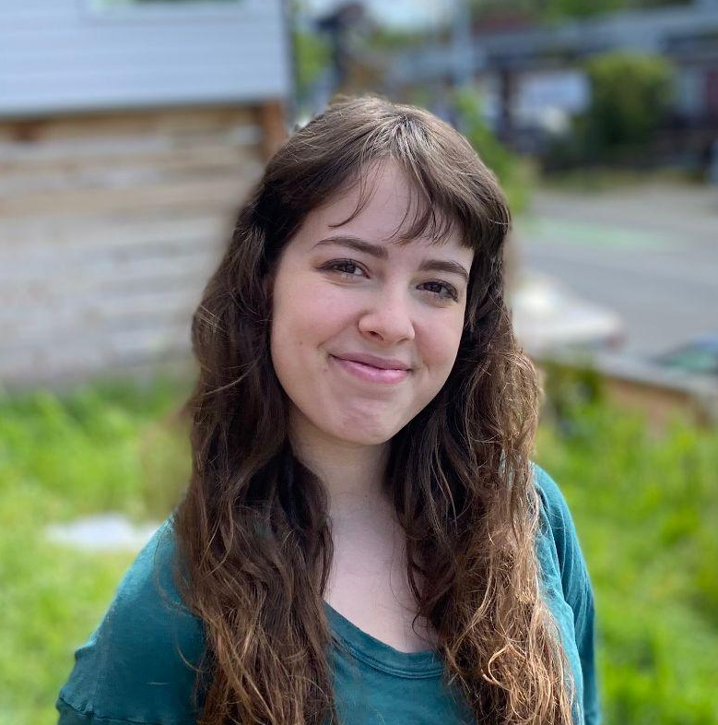
About me
Jordan Crowder.
Second year graduate student in the Museology Department at the University of Washington.
I love crocheting, knitting, and watching cartoons.
I have a chronic illness and identify myself as a part of the disabled community.
I chose to create this workshop because I saw a troubling trend in museums across the world concerning their treatment of disabled visitors.

Slide 4
Accessibility statement
I, and the Museum of Pop Culture, value accessibility and strive to make this program as accessible as possible. If any participants in today’s session need any additional accommodations for this workshop, please inform me at this time. I welcome any feedback on the accessibility of this program. Please alert me if you encounter any accessibility barriers today. Feedback can be sent to jcrowd@uw.edu.

Slide 5
Land acknowledgement
I want to acknowledge that I am facilitating this workshop on the unceded lands of the Coast Salish people. I am giving this land acknowledgement to draw attention to the injustice faced by Native Americans across the country. I hope that by giving this acknowledgement, we feel a duty to support and empower our local indigenous communities.

Slide 6
TABLE OF CONTENTS
01
02
03
04
05
06
Why are we here?
Person 1st vs identity 1st
How to define disability
Common misconceptions
Personal experiences
Group activities

Slide 7
Purpose statement
We are all here today for the same reason: to educate ourselves and be better. I created this program to address a need I have seen in the museum world: disability awareness training for front staff and volunteers.
My goal is that after today, you all will have the information and tools necessary to improve interactions with disabled guests.
This is a learning space. While it would make this workshop more accessible, I have decided not to record this training session so that we can create an environment for openness, vulnerability, and learning. We all must start somewhere, and I want you all to feel comfortable asking questions without fear of judgment. However, hatred and rudeness will not be tolerated. Please treat your colleagues and others with respect and grace.

Slide 8
1,296,026
Adults in washington state have disabilities
That’s 1 out of 5 adults
Source: CDC.gov

Slide 9
“People always assume my wife is my caregiver. They never look at me or talk to me. It feels like I’m not being treated as a human.”

Slide 10
Carousel time
Using Google Jamboard, we will be posting responses to some questions and statements I have set up. Your responses will remain anonymous, so please be honest. We will take a look at the responses later in the training session.

Slide 11
Person first vs identity first language

Slide 12
Person first vs identity first language
Person first means simply that, using the noun “person” before any of their other characteristics. It describes what a person has not what a person is
Person in a wheelchair
Person with autism
Person who is white.
Proponents of person first language prefer this language because it emphasizes the personhood of often marginalized groups.
This is the kind of language you will often find in official documents and has been adopted by many advocacy groups.

Slide 13
Person first Language
Person First Language was popularized by advocacy groups in the 1980s, and being that it was one of the first movements for labeling those with disabilities, it has stuck around for a long time.
Many contemporary disability advocates do not use person first language because they see it as emphasizing the idea that “no one wants to be associated with a disability”.

Slide 14
Person first vs identity first language
Identity first language is the opposite of person first, it places the identity of a person before their personhood.
Disabled person
Austistic person
Obese person
Proponents of identity first language emphasize that their disabilities are a large part of their identity, and don’t want it to be looked over in order to make able bodied people more comfortable.
The goal of identity first language is to take away the negative association with disability labels.
Identity first language is often used by disabled self advocates.

Slide 15
identity first language
Identity First Language is the more modern of the two types presented here, taking off in the 2000s and largely being used by disability justice advocates in response to the popularity of person first language.

Slide 16
So which do i use?
Either is fine!
Everyone has their preference on how they would like to be addressed
If you’re unsure or worried about offending someone, just ask!
There’s no need to make a scene
Notes:
Everyone has their preference on how they would like to be addressed, just like able bodied people. You may agree more with the rationale of one of these types of language, but be sure to use whichever language the disabled person prefers. I personally prefer identity first language, and usually use it when speaking to others unless I am told otherwise.
If you’re unsure or worried about offending someone, just politely ask them how they would like to be addressed. There is no need to make a spectacle of it, it is very similar to asking someone what pronouns they use.

Slide 17
So which do i use?
Everyone has their preference on how they would like to be addressed, just like able bodied people. You may agree more with the rationale of one of these types of language, but be sure to use whichever language the disabled person prefers. I personally prefer identity first language, and usually use it when speaking to others unless I am told otherwise.
If you’re unsure or worried about offending someone, just politely ask them how they would like to be addressed. There is no need to make a spectacle of it, it is very similar to asking someone what pronouns they use.

Slide 18
Additional resources on Pf vs. Id language
Wood, Caitlin. Criptiques, 2014.
Brown, Lydia X. Z., Loree Erickson, Rachel da Silva Gorman, Talila A. Lewis, Lateef McLeod, and Mia Mingus. “Radical Disability Politics.” In Routledge Handbook of Radical Politics, edited by Ruth Kinna and Uri Gordon, 1st ed., 178–93. New York, NY: Routledge, 2019.: Routledge, 2019. https://doi.org/10.4324/9781315619880-15.
Okundaye, J. (2021, May 27). Ask a self-advocate: The pros and cons of person-first and identity-first language. Massachusetts Advocates for Children. Retrieved April 21, 2022, from https://www.massadvocates.org/news/ask-a-self-advocate-the-pros-and-cons-of-person-first-and-identity-first-language#:~:text=Person%2Dfirst%20language%20is%20language,as%20being%20a%20disabled%20person.

Slide 19
Break time!

Slide 20
What is disability?

Slide 21
A brief history
The Oxford dictionary describes disability as meaning “a physical or mental condition that limits a person's movements, senses, or activities.”
The term disability has been used for ages to describe people who abled bodied society perceives as different, and this definition is constantly changing, with people moving in and out of this category in the eyes of able bodied people.
This flexible definition has traditionally been used (specifically in the United States) to exclude anyone that does not fit the cis, white definition of personhood.
The concept of disability varies depending on what kind of cultural area you are in.
Notes:
For example, perceived disability status was used as a barrier to entry for immigrants at Ellis Island. Workers would assess the immigrants to ensure that no “disabled” immigrants were granted entry into the country.
African slaves were also consdiered to be a class of disabled people, and that disability was the justification for denying them their freedom.
For example, in Martha’s Vineyard in the early 18th century, there was a large percentage of deaf people living on the island due to a recessive trait found in the population. Here, they had their own form of sign language that hearing and deaf people learned and used daily. Being deaf was not seen as a disability, just another trait a person had, such as being blonde.

Slide 22
A brief history
Perceived disability status was used as a barrier to entry for immigrants at Ellis Island. Workers would assess the immigrants to ensure that no “disabled” immigrants were granted entry into the country.
African slaves were also consdiered to be a class of disabled people, and that disability was the justification for denying them their freedom.
In Martha’s Vineyard in the early 18th century, there was a large percentage of deaf people living on the island due to a recessive trait found in the population. Here, they had their own form of sign language that hearing and deaf people learned and used daily. Being deaf was not seen as a disability, just another trait a person had, such as being blonde.
It is important to note the ableist history of our country. We can only take steps to improve our situation when we know our history.
  Ableism: discrimination or prejudice against individuals with disabilities

Slide 23
Additional resources for disability history
Leighty, Cheryl A., and Joseph P. Shapiro. “No Pity: People with Disabilities Forging a New Civil Rights Movement.” Michigan Law Review 92, no. 6 (May 1994): 1953. https://doi.org/10.2307/1289622.
Vaughn, J. (2003). Disabled rights: American disability policy and the fight for Equality. Georgetown University Press.

Slide 24
So who is considered disabled?
Generally, we use the term disabled to group a variety of conditions, such as
Physical impairments (limb loss, mobility aid use)
Blindness
Deafness
Mental illness (depression, OCD, schizophrenia)
Cognitive impairments (autism, dyslexia)
Developmental disabilities (cerebral palsy, down syndrome)
Chronic illness (diabetes, lupus, crohn's disease)
Dwarfism
And many more
Notes:
Disability status is a very personal attribute that is informed by a person’s unique life experience; You may find that two people can have the same condition, but have different thoughts on whether they identify as disabled.

Slide 25
So who is considered disabled?
It should be noted that some people in these categories do not consider themselves disabled, and that is ok.
Oftentimes this is due to people not wanting to be viewed in the negative lense we often look at disability through, but disability advocates have fought long and hard to rid themselves of these negative misconceptions.
It is not our job to police people’s identities, just to respect them.
Notes:
Oftentimes, adults who have acquired disabilities in their older years do not see themselves as disabled. Even FDR, who had polio and used a wheelchair when not in public, refused to label himself as disabled.

Slide 26
Additional resources for disability defining
Wendell, S. (2001). Unhealthy Disabled: Treating Chronic Illnesses as Disabilities. Hypatia, 16(4), 17–33. http://www.jstor.org/stable/3810781
Kafer, A. (2013). Feminist, Queer, Crip. Indiana University Press. http://www.jstor.org/stable/j.ctt16gz79x

Slide 27
Social vs medical model of disability
Medical model
Social model
Views disability as the problem of the individual
Views disabled people as inferior to “normal” people.
Largely regarded as an ableist mindset by activists.
Term coined by disability activists in the 1970s
Proposes that the social barriers of society create impairment, not the disability.
“If society was accessible, I would not be considered disabled.”

Slide 28
Intersectionality of disability
It should also be noted that disability is only one facet of a person’s identity, and all disabled people do not have the same life experiences.
It is important to consider intersectionality when looking at the issues of disability rights and accessibility, because a lack of diverse information will leave you just as clueless as when you started.
Someone who is disabled, wealthy, and lives in an accessible city will not have the same experience as a disabled person living in a rural, low income area.
Notes:
For example, the privilege of having a diagnosis is something not all individuals have. Those without insurance can rarely get diagnoses they need, let alone the equipment or treatment needed.
These issues are only exacerbated when looking at income level, race, and other categories.
Different types of disabilities also offer different experiences. A Deaf person may not wish for a cure for their disability, but someone with lupus might.

Slide 29
Intersectionality cont.
For example, the privilege of having a diagnosis is something not all individuals have. Those without insurance can rarely get diagnoses they need, let alone the equipment or treatment needed.
These issues are only exacerbated when looking at income level, race, and other categories.
Different types of disabilities also offer different experiences. A Deaf person may not wish for a cure for their disability, but someone with lupus might.

Slide 30
Additional resources for medical vs social model, and intersectionality
Trent, James & Longmore, Paul & Umansky, Lauri. (2002). The New Disability History: American Perspectives. The Journal of American History. 89. 194. 10.2307/2700798.
Berger, R. J., & Wilbers, L. E. (2013). Introducing disability studies. Lynne Rienner Publishers, Inc.
Oliver, Mike. “THE INDIVIDUAL AND SOCIAL MODELS OF DISABILITY,” n.d., 8.
Collins, Patricia Hill. “‘Toward a New Vision: Race, Class, and Gender as Categories of Analysis and Connection.’” In Inequality in the United States: A Reader, by John Brueggemann, 453–63, 1st ed. Routledge, 2020. https://doi.org/10.4324/9781003071709-39.

Slide 31
Common misconceptions

Slide 32
Myth #1
All disabilities can be seen
Some disabilities are invisible, such as diabetes and chronic illness.

Slide 33
Myth #2
People in wheelchairs cannot walk.
Being in a wheelchair does not mean someone is incapable of walking. Some wheelchair users are ambulatory, meaning they can walk in some circumstances. If you see a wheelchair user stand up for something or walk somewhere, it is not your place to accuse them of pretending to need their wheelchair.

Slide 34
Myth #3
Disabled people can’t live normal lives
Disabled people live just like the rest of us, having relationships, families, going to school, and so much more. Just because their way of living might be different from yours does not mean it doesn’t exist.

Slide 35
Break time!

Slide 36
Carousel time
Let’s look at what we wrote on the board

Slide 37
Personal testimonials

Slide 38
“When I was at a theater, an employee accused me of lying about needing to sit in the accessible seating area because of my size. He asked me to disclose my disability, which is illegal. I told him because I was nervous.”

Slide 39
“I feel like if I don't ask the question (of requesting accommodations) no one will ask me”

Slide 40
“I want to be acknowledged and asked if I need assistance. Look at me, look at my disability, and offer support.”

Slide 41
“I don't like when employees insult my intelligence and talk to me like I’m a child”

Slide 42
“... there is an assumption made by “walking people” that the fact that my legs are not OK, means that there is also some problem with my brains …”

Slide 43
“the employees should be aware that the fact that we can’t see doesn’t mean that we can’t hear. Actually, we can hear much better than others, so there is no need to shout”

Slide 44
“When I volunteered at a zoo, I always appreciated when staff thought about me and my wheelchair without me having to ask.If I needed to go somewhere far or uphill, they always already had another volunteer ready to go with me and help if I needed it”

Slide 45
“When employees come to me first and ask if I need accommodations, it makes me feel like they want me to be there”.

Slide 46
Testimonials
Did you notice any common experiences?
How can we create a positive experience for our disabled guests?
What should we not do with disabled visitors?
What should we consider when working with disabled guests?

Slide 47
Resources/further reading
Project LETS (https://projectlets.org/disability-justice)
The ARC of King County (https://arcofkingcounty.org/)
The Lighthouse for the Blind, Inc. (https://lhblind.org/)
Seattle Cultural Accessibility Consortium (https://www.seattlecac.org/)

Slide 48
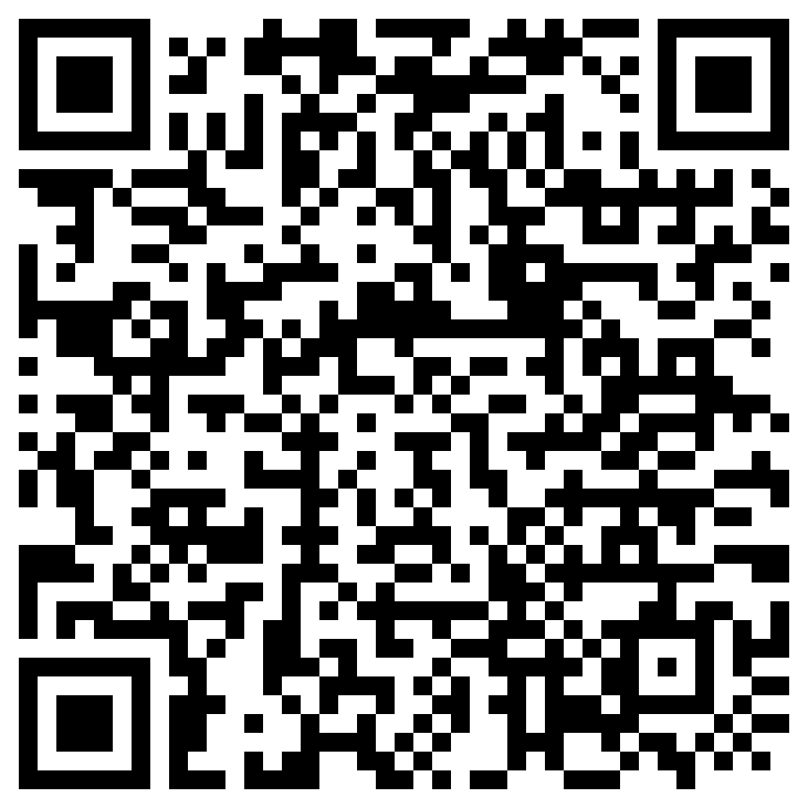
survey
Thank you for your time! Because this program was a part of my thesis research, I would greatly appreciate it if you would fill out this quick survey about your experience today.

Slide 49
THANKS for listening!
If you have any questions, feel free to reach out to me at jcrowd@uw.edu

Slide 50
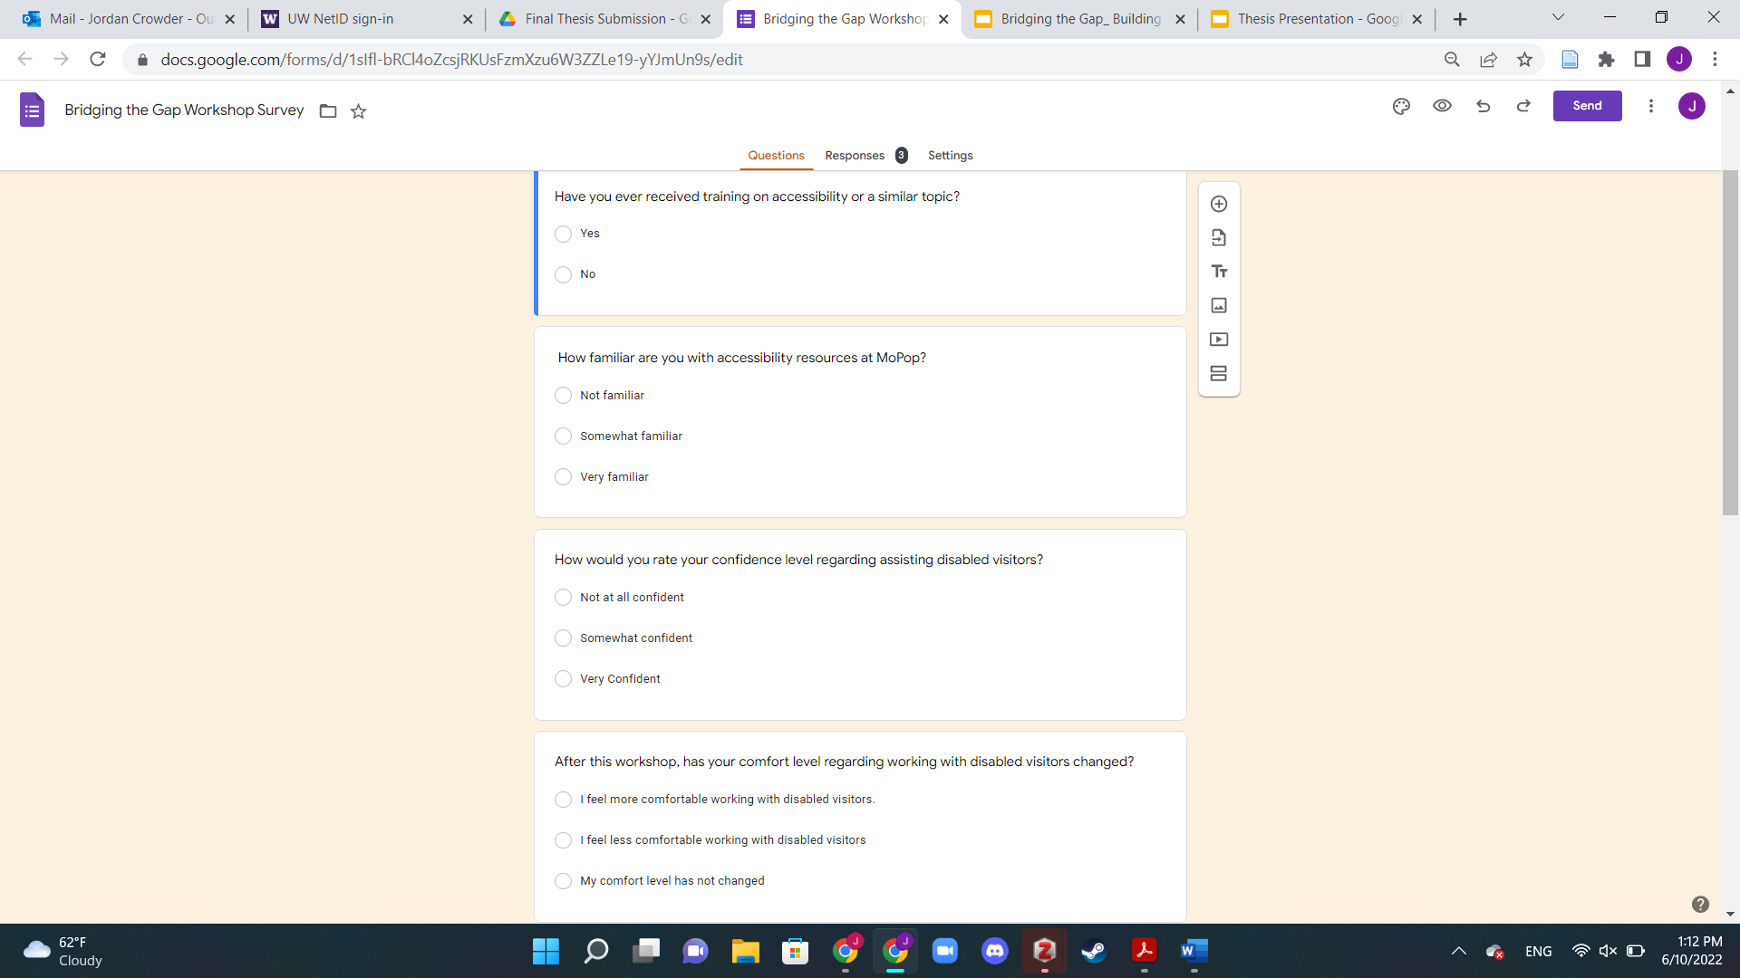
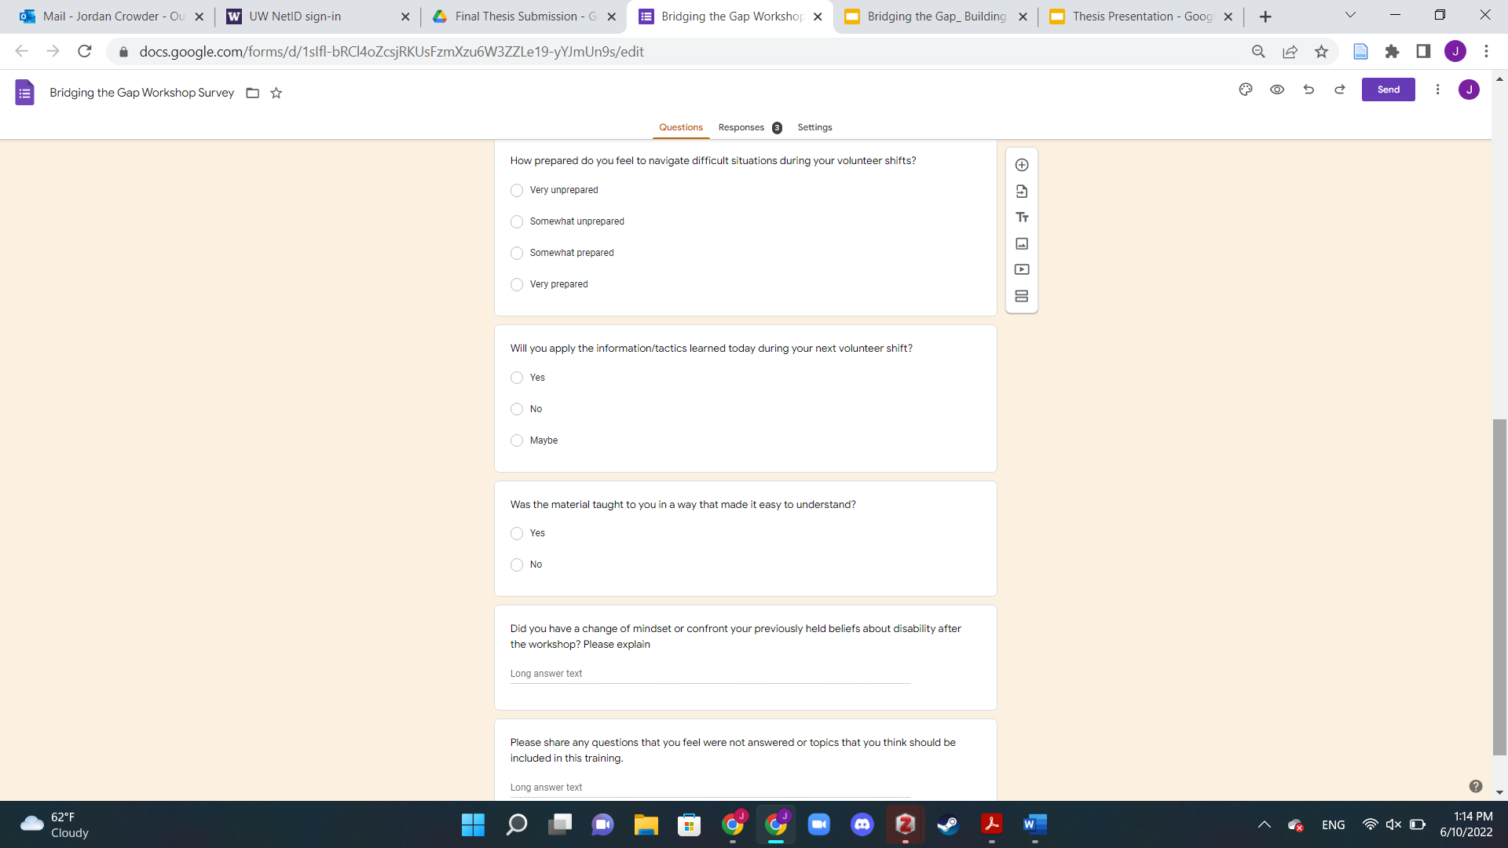
Appendix a: post workshop participant survey

