Slide 1
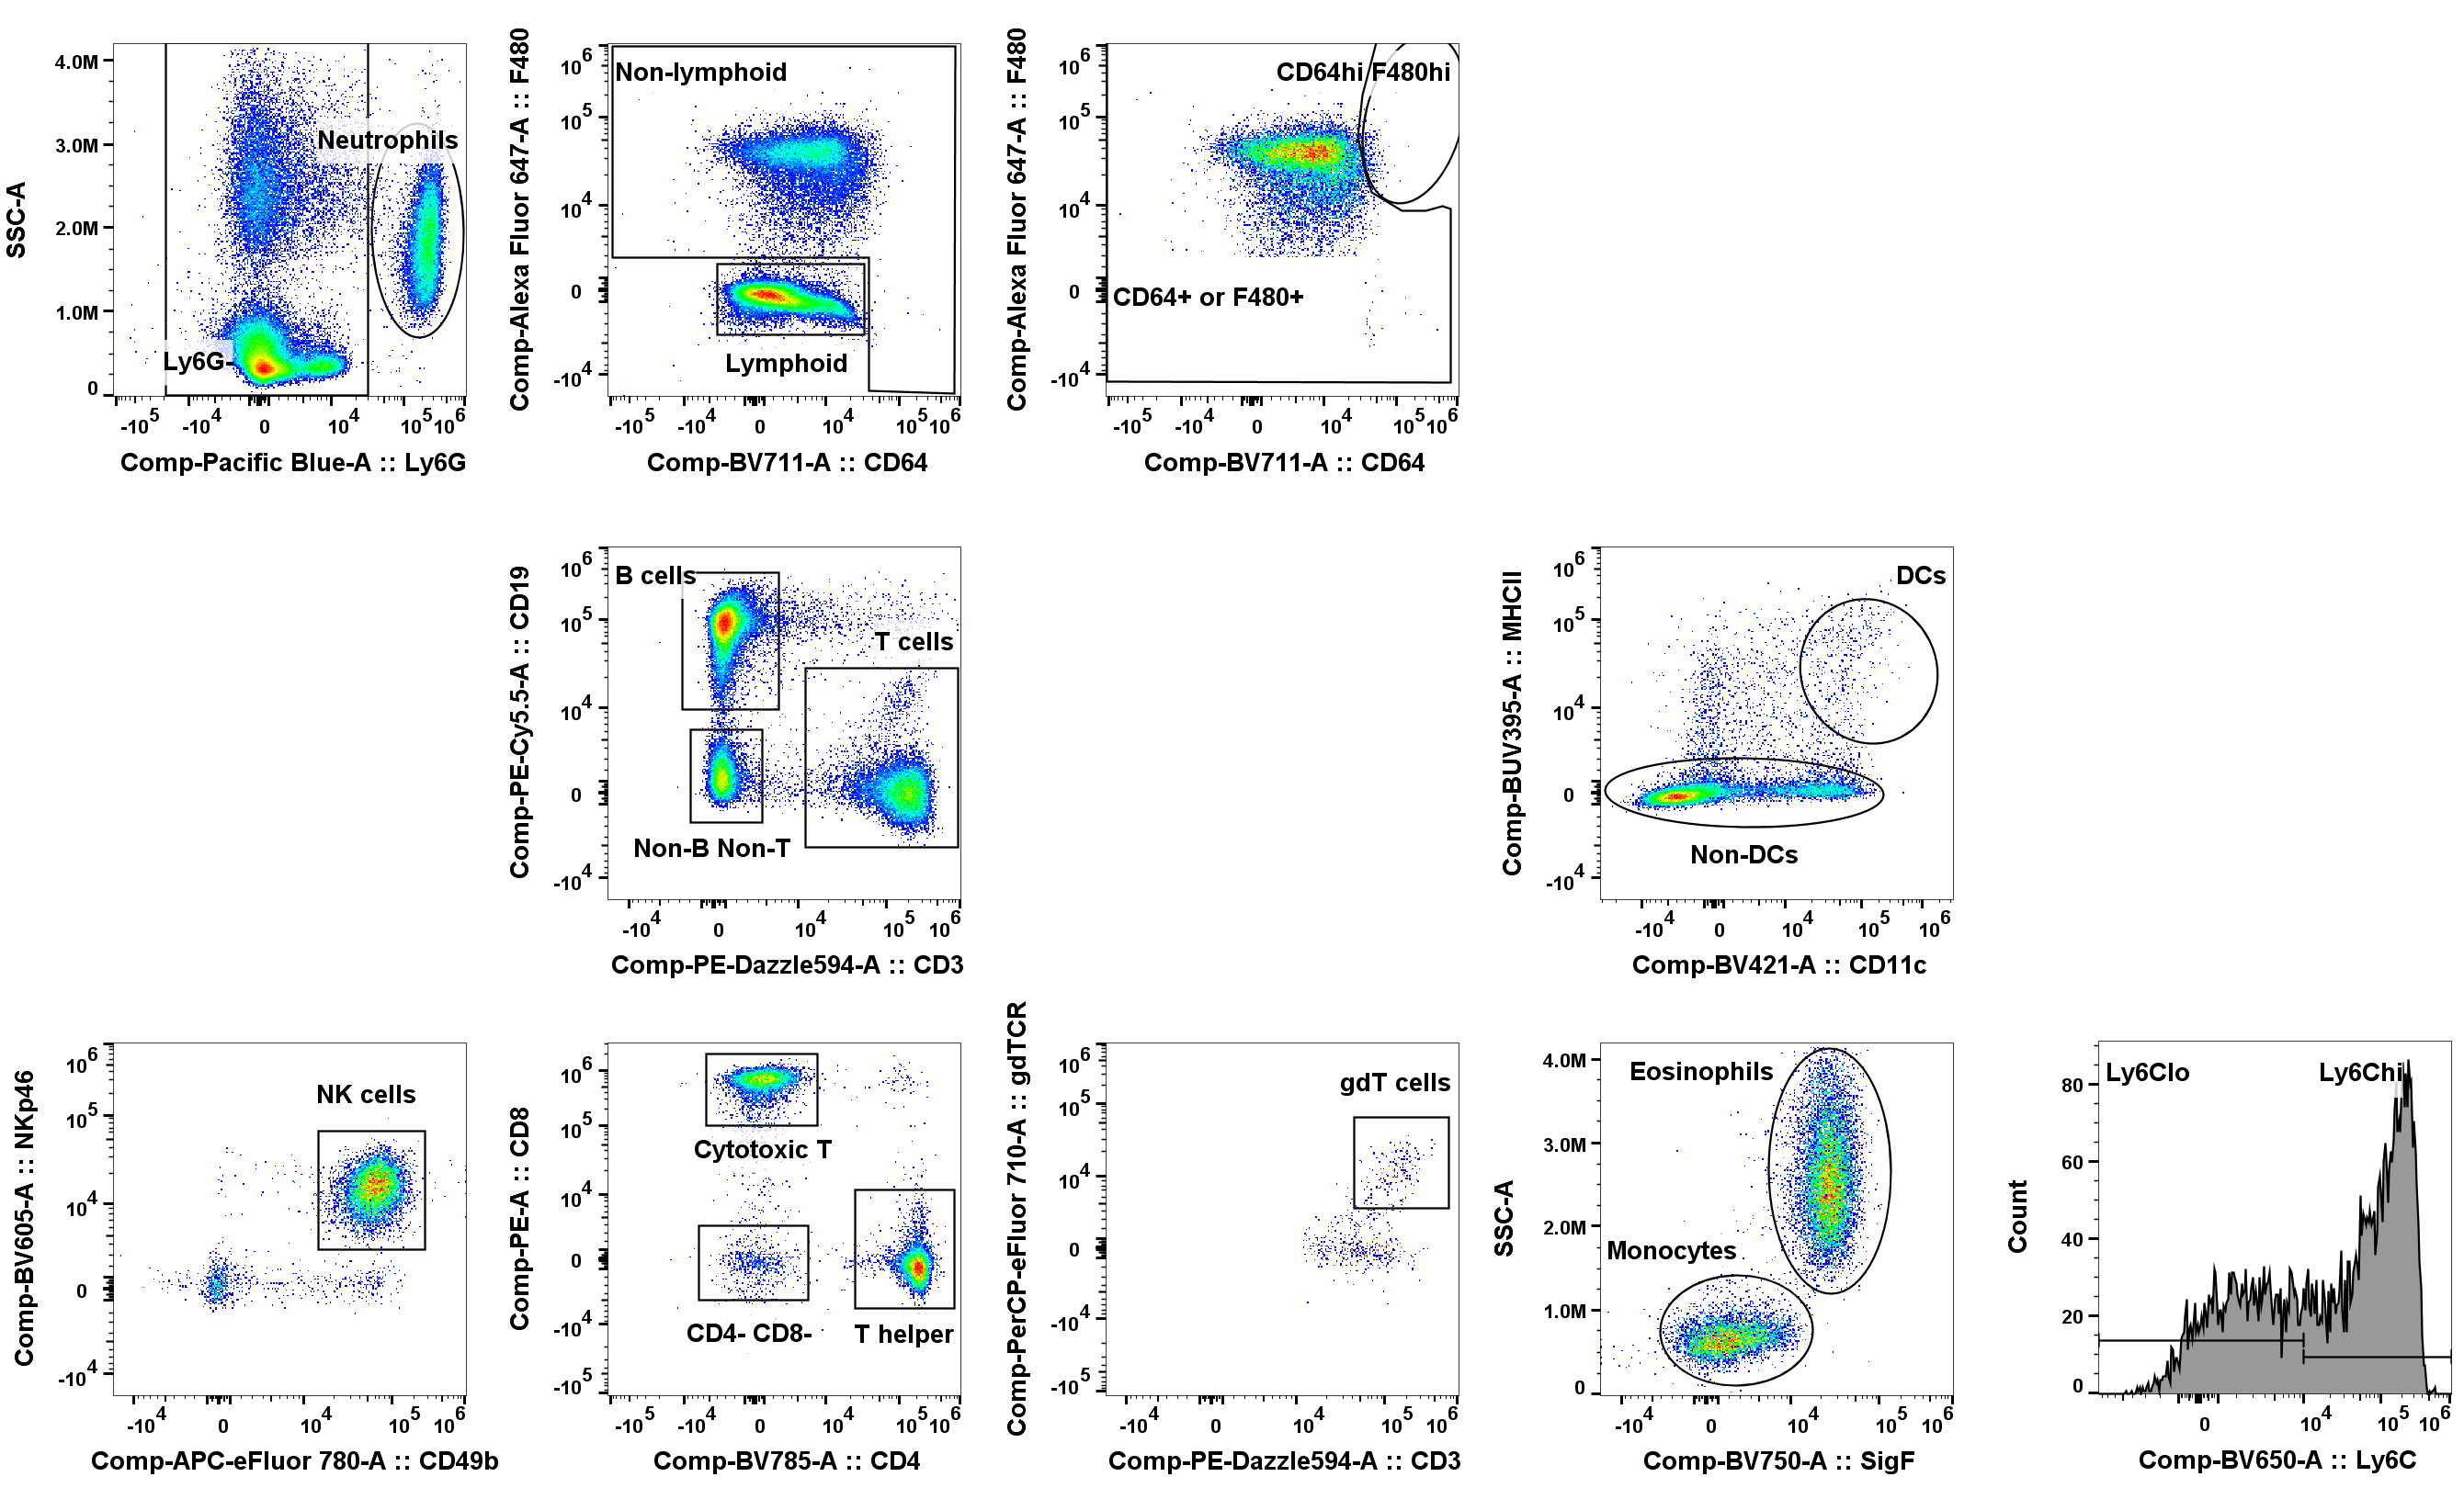
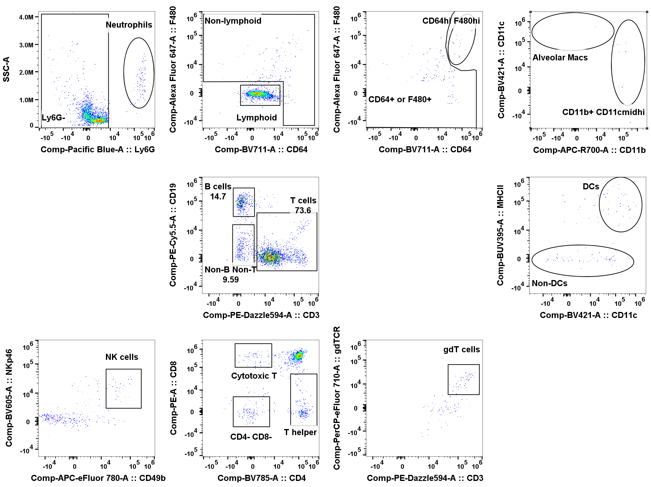
Multi-Compartmental Analysis of the Murine Pulmonary Immune Response by Spectral Flow Cytometry
Chang M.Y., Brune J.E., Black M., Altemeier W.A., and Frevert C.W.
American Journal of Physiology Lung Cellular and Molecular Physiology
A. PBS 9dpi Marginated Vasculature
B. PBS 9dpi Lung Interstitium

Slide 2
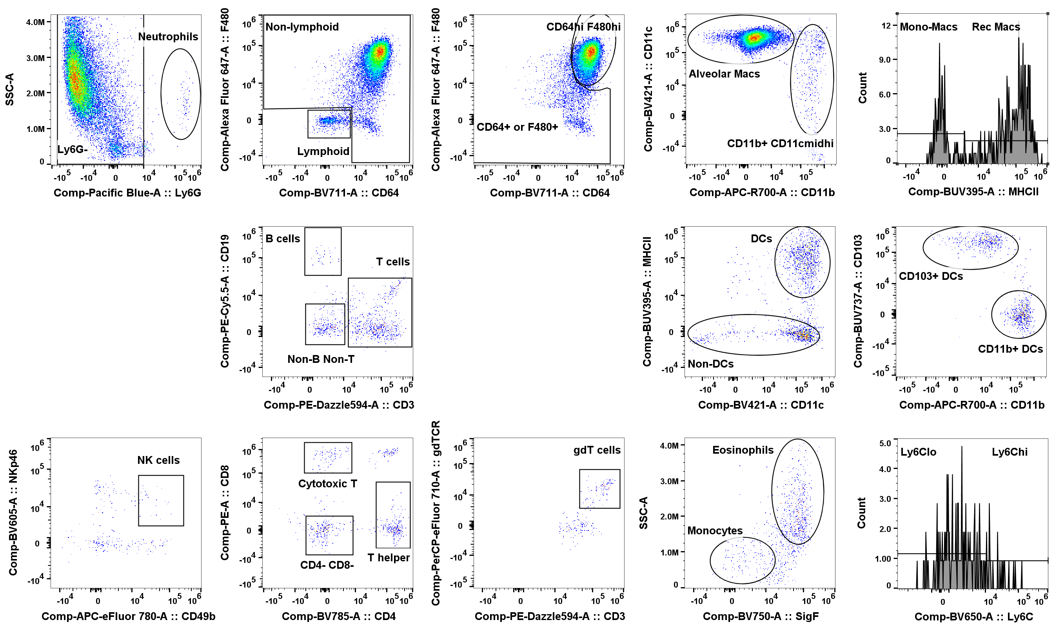
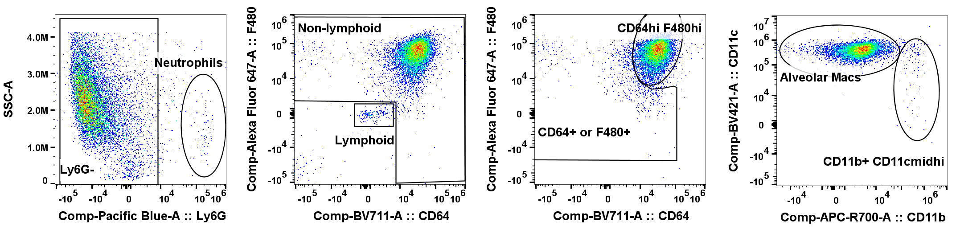
C. PBS 9dpi Non-Lavageable Airway
D. PBS 9dpi Lavageable Airway
Supplemental Figure S3. Gating Tree on PBS Control (9 dpi) Lung and BAL Leukocytes. The supervised gating strategy was applied to single live CD45+ cells from a male control mouse. Representative gating trees are shown for leukocytes in the (A) marginated vasculature; (B) lung interstitium; (C) non-lavageable airway; and (D) lavageable airway. Populations representing <2% of the parent gate were not further characterized. See text for full description of gating strategy.

