Slide 1
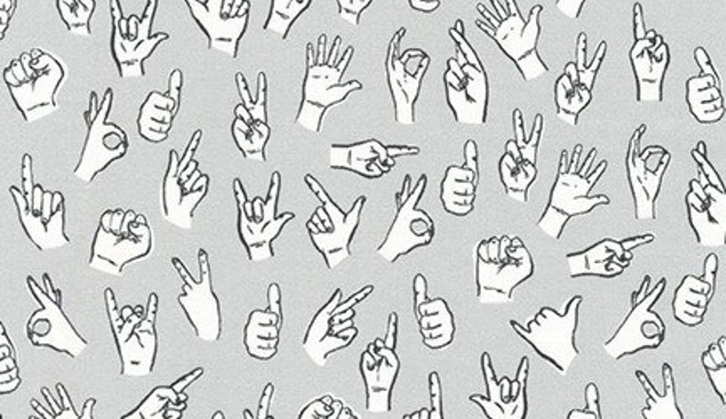
Black
American
Sign Language
(ASL)
Katrina Thulin

Slide 2
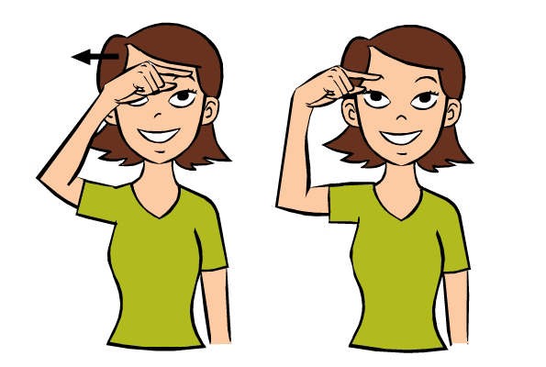
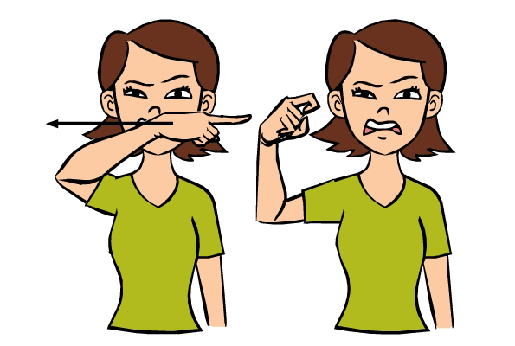
Black ASL: History and Purpose
Racism in ASL
First school for the deaf established in 1817
  Did not admit Black students until 1942
Several signs are based on racist interpretation at the time of mainstream ASL education/development and are still used today.
Mainstream ASL sign for Black:
Index finger of dominant hand drawn in a straight line across forehead. Finger remains extended.
Black ASL – The Roots
Due to Racial segregation Black D/deaf people received no formal education in mainstream ASL
Black ASL developed by need in the continental South of the U.S.A.
It is a living language (like mainstream ASL) but with key differences.
Mainstream ASL sign for Ugly:
Index finger of dominant hand drawn in a straight line across nose/upper lip. Finger curls at end.

Slide 3
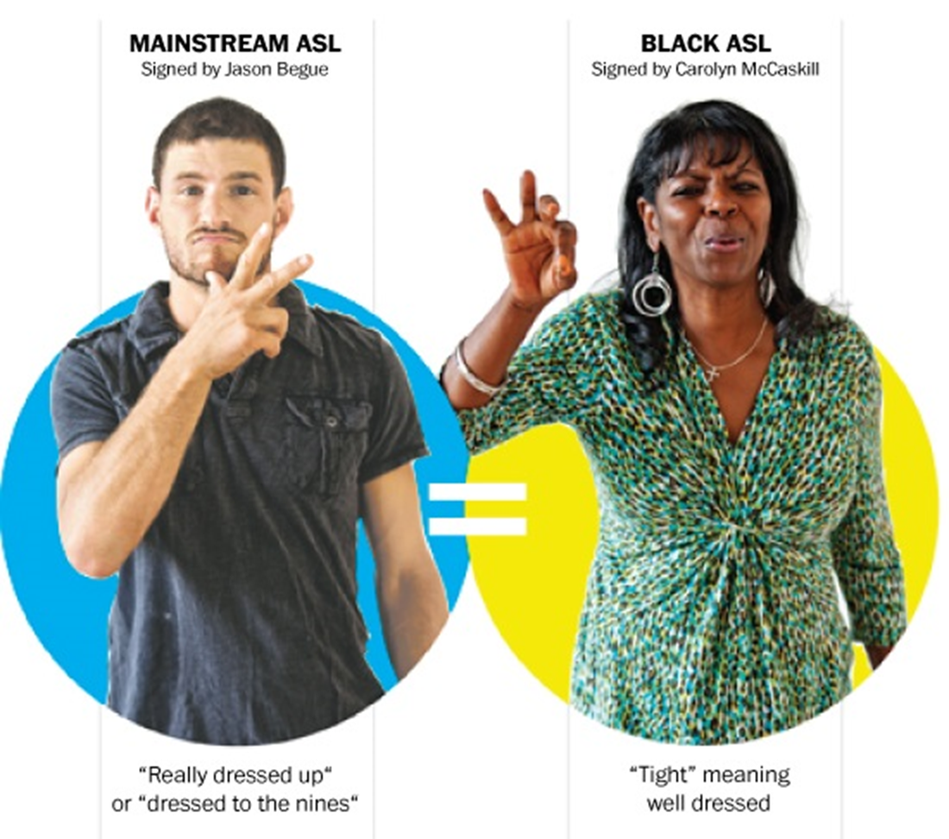
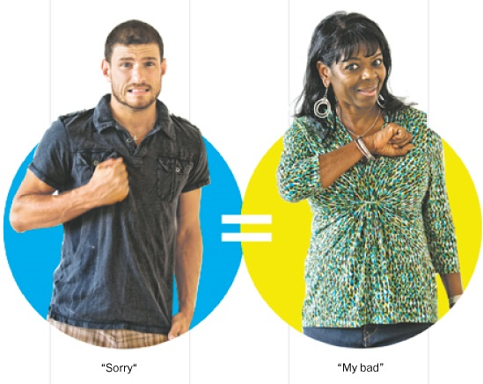
Black ASL & Mainstream ASL
What are the differenceS?
More repetition
Use of traditional two-handed signs
Larger signing space
Signs higher on forehead
Higher usage of current vernacular
Less repetition
Evolved to use mostly single-hand signs
Smaller signing space
Signs lower on forehead and face
Slower to change signs and adopt new signs
So what’s the problem?

Slide 4


The Problems…
Mainstream ASL
White Supremacy
Just like African American Vernacular English isn’t accepted in mainstream White society, Black ASL isn’t accepted in most mainstream D/deaf society. This ties directly into white supremacy ideals and history in the United States of America.
Mainstream ASL
Oppression
Loss of Culture
Due to the progressive adaptation of mainstream signs in lieu of Black ASL many Black D/deaf people are losing their culture. It is similar to how cochlear implants are forcing a loss of mainstream D/deaf culture.
Control

Slide 5
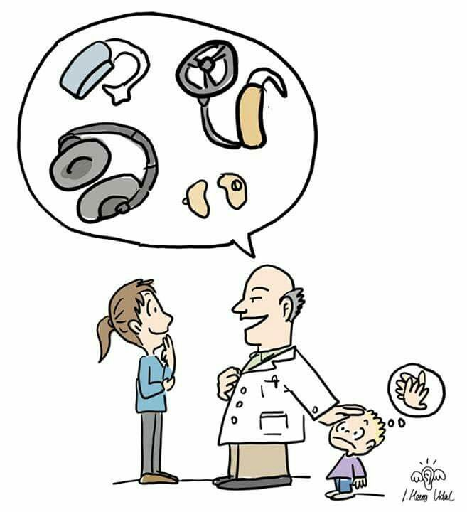

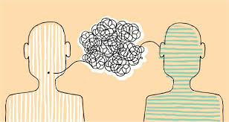
The Problems Continued…
Forced Code-switching
When Black D/deaf people are forced to utilize mainstream ASL in public spaces they are forced to code-switch between their native language and mainstream ASL. This is forcing them to mask their own linguistic identity to fit in and provide comfort to those around them.
Language Barriers
If a D/deaf child of color is taught Black ASL they have a language barrier to other D/deaf communities and, due to the rareness of hearing people knowing any sign language, this is just one more way Black D/deaf people cannot communicate with the world around them.
Emotional Labor
The emotional labor people with disabilities experience is incredibly exhaustive without constant code-switching, racism, and culture genocide that D/deaf Peoples of Color experience every day.

Slide 6

What do we do?
Education
We need education in the D/deaf community about Black ASL and we need education in the hearing community about ASL, Black ASL and their histories.
Representation
Representation of different kinds of signing and signers is as important in the D/deaf communities as representation of race or gender in the hearing community. We also need representation of D/deafness in mainstream media.
Mainstream ASL
Resources
Only 3% of all sign language interpreters are P.O.C. despite there being over 2 million Black D/deaf people in the U.S.A. alone. Black D/deaf people have a harder time getting interpreting support or disability resources due to underfunding and language barriers between Black ASL and mainstream ASL.
Preservation
Just like the D/deaf community wanting to persevere their culture in the face of the cochlear implants Black D/deaf culture needs to be preserved in the face of forced assimilation and loss of history. By ignoring Black ASL, it’s history and purpose, we ignore a large part of U.S.A. history and culture while completely erasing the identities and struggles of Black D/deaf people.
Support

Slide 7
The Takeaways
Black ASL is a real, important, and living language.
The histories of ASL and Black ASL are tied to each other and to hearing history.
Currently there are still studies attempting to learn and document all of the different dialects of Black ASL.
There are currently no online or print resources documenting Black ASL signs, grammar and syntax.
Black D/deaf culture and language is valid and important. It needs to be honored and preserved.

Slide 8
Annotated Bibliography
Blake Renée, and Isabelle Buchstaller. The Routledge Companion to the Work of John R. Rickford. Routledge, 2020.
This provided the history of Black ASL including the reasons for its formation and timeline of entrance of Black D/deaf people into the D/deaf school.
Gallon, Cheryl. 2018. Sophia, https://sophia.stkate.edu/maisce/1/?utm_source=sophia.stkate.edu/maisce/1&utm_medium=PDF&utm_campaign=PDFCoverPages.
This explores microaggressions in mainstream ASL committed by interpreters and helped me understand how those things affect the D/deaf P.O.C. but also how D/deaf P.O.C. are resisting the forced assimilation.
Hill, Joseph. “Sign Language Interpreters: Practicing with a Socially Conscious Approach.” StreetLeverage, 1 June 2017, streetleverage.com/live_presentations/sign-language-interpreters-practicing-socially-conscious-approach/.
Talks about history of Black ASL and the current state of it as well as the sociological implications of interpreting Black ASL versus mainstream ASL.
Marschark, Marc, et al. Diversity in Deaf Education. Oxford University Press, 2016.
A book of ways that diversity included, excluded, and needed in D/deaf education. Talks about a lack of understanding about Black ASL versus mainstream ASL and why there is rejection of Black ASL.

Slide 9
Annotated Bibliography continued
Peters, Russell. “Russell Peters Sign Language.” Dotsub, dotsub.com/view/b8d29f86-41ac-45af-9cec-01e470b27b63.
This is a video of a hearing comedian talking about racism present in mainstream ASL. It helped me better understand the racism present in mainstream ASL and how those signs are still used today.
Stapleton, Lissa D. “Audism and Racism: The Hidden Curriculum Impacting Black d/Deaf College Students in the Classroom.” The Negro Educational Review, vol. 67, no. 1-4, 1 Jan. 2016, pp. 149–168. Academia.edu, https://www.academia.edu/35003418/Audism_and_Racism_The_Hidden_Curriculum_Impacting_Black_d_Deaf_College_Students_in_the_Classroom.
A study on racism, audism, and microaggressions in mainstream ASL with firsthand accounts from D/deaf P.O.C. This helped me see the needs for representation and provided the statistics on D/deaf P.O.C. versus interpreters.
Stretten, Amy. “ASL and Black ASL: Yes, There's a Difference.” Splinter, Splinter, 24 July 2017, splinternews.com/asl-and-black-asl-yes-theres-a-difference-1793840928.
This article addressed the need for code-switching and the effects it has on D/deaf P.O.C. It also addressed how closely related hearing history, mainstream ASL history and Black ASL history are linked.

Slide 10
Annotated Bibliography continued
Syal, Renee Mickelburgh and Rajeev, and Rajeev Syal. “Limp Wrists and Slant Eyes Must Go as Political Correctness Demands New Signs for the Deaf.” The Telegraph, Telegraph Media Group, 21 Mar. 2004, www.telegraph.co.uk/news/uknews/1457400/Limp-wrists-and-slant-eyes-must-go-as-political-correctness-demands-new-signs-for-the-deaf.html.
Documents more racist signs in mainstream ASL and how minoritized groups are demanding changes. Used for historical purpose and to understand the need for mainstream ASL evolution compared with Black ASL.
“US Sign Language Drops Racist Symbols.” South China Morning Post, 5 Jan. 1994, www.scmp.com/article/58202/us-sign-language-drops-racist-symbols.
Chronicles racist signs in mainstream ASL and well as how they are changing providing insight into the speed at which mainstream ASL is adapting.
Zucker Morgenstern, Amy. “Black American Sign Language.” Sermons in Stones, 18 Feb. 2019, sermonsinstones.com/2019/02/17/black-american-sign-language/.
This talks about the need to understand Blask ASL history and the current attitudes towards it in mainstream D/deaf culture

