Slide 1


Teacher Training Course PowerPoint for
Mental Health Group for Elementary-Aged Children
Implementation

Slide 2
Purpose
Why is this mental health group important?
  Gives students mental health skills
    Talk about feelings with classmates and adults
  Better student mental health leads to better academic performance

Slide 3
Outcomes
Goals for students during group sessions:
Outcome 1: Improved relationship with an adult
    Indicator 1a: Expresses feelings in an appropriate manner
    Indicator 1b: Shares experiences or ideas with an adult
Outcome 2: Improved ability to cope with loss
    Indicator 2a: Shares with another in similar circumstances
    Indicator 2b: Able to express feelings

Slide 4
Explaining the Group to your Students
Group Explanation for Students (sample):
Next week we will start having the mental health group on (day of week) at (time of day). During the group, we will sit in a circle and talk about our feelings and losses. Anything said in the group will stay in the group. I will be handing out a consent form that needs to be signed by your parents/guardians so that you can take part in the group.
Wording can be adjusted based on your students’ grade level

Slide 5
Consent Forms
Give to students during/directly after explaining to them about the group
Must be signed by a parent/guardian for a student to participate in the group
Give completed consent forms to the school counselor

Slide 6
Group Guidelines
Reference the “Weekly Groups Activity Schedule” for each session’s activities
Confidentiality: keep what is said within the group (unless child abuse/neglect is reported)
Use a talking stick during group – one person speaks at a time
Duration of Group: 20-30 minutes depending on student age, attention span, participation

Slide 7
Tips for Facilitating the Group
Find a space large enough in your classroom for students to sit in a circle
  Sitting on the ground is preferred – desks make the circle too large
Encourage students to speak, but do not force them to
When someone starts to dominate the session, remind students to leave time for everyone to speak
Lead by example – teacher/school counselor models activity/answer to question first

Slide 8
Session 1
Create group rules
  Ensure that all students present have completed consent forms
  Write these rules on a poster that can be presented during each session
    Have each student, teacher, and school counselor sign the rules
    Ensure rules include:
      Confidentiality
      Use of a talking stick for the speaker
Encourage each student to share how they are currently feelings

Slide 9
Session 2
Students are able to express feelings
  Encourage each student to share how they are currently feelings
  Encourage each student to identify:
    One feeling they have had recently that has been comfortable and why
    One feeling they have had recently that has been uncomfortable and why

Slide 10
Session 3
Students express feelings in an appropriate manner
  Encourage each student to share how they are currently feelings
  Encourage each student to identify:
    A time when they or someone else expressed a feeling appropriately
    A time when they or someone else expressed a feeling inappropriately

Slide 11
Session 4
Students share experiences or ideas with an adult
  Encourage each student to share how they are currently feelings
  Encourage students to identify:
    A time when they went to an adult for help
    3 adults they can go to if they need help

Slide 12
Session 5
Students share with another in similar circumstances
  Encourage each student to share how they are currently feelings
  Have students partner up in pairs and find 3 things they have in common with each other
    Have each pair of students report back to the group

Slide 13
Session 6
Ending Session
  Encourage each student to share how they are currently feelings
  Explain that this is the last group session
  Encourage each student to say 3 things they learned from the group

Slide 14
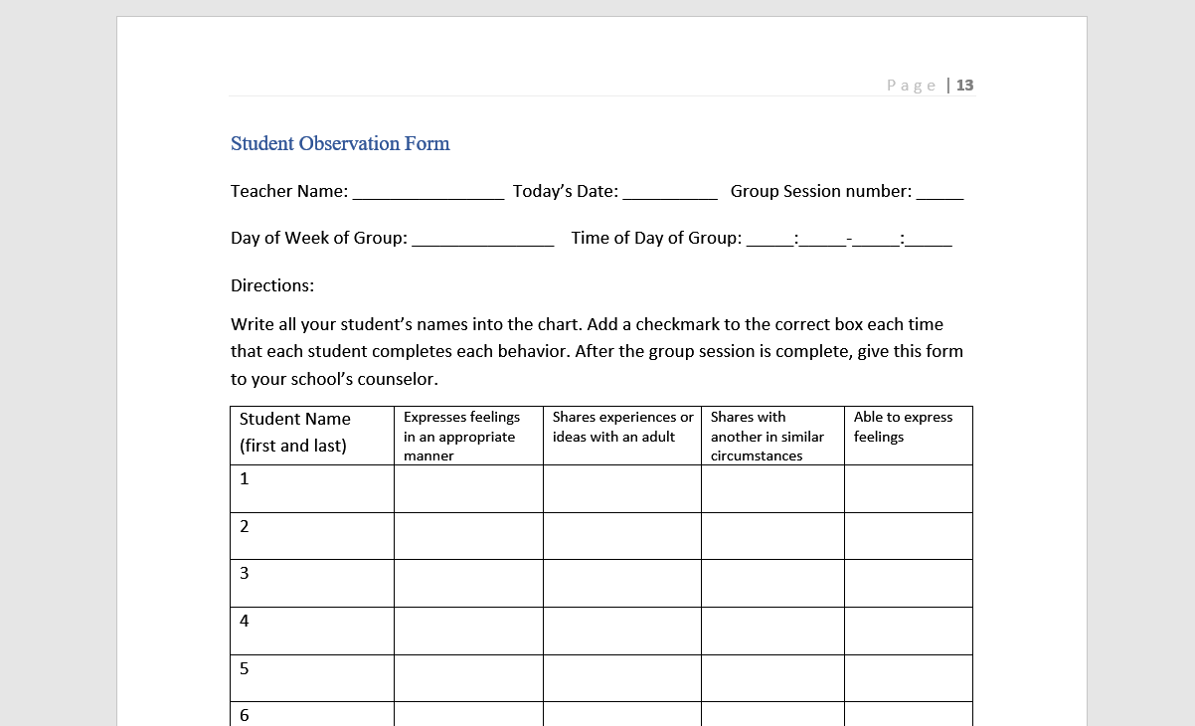
Student Observation Sheets

Slide 15
Focus Group Discussion Summary
Able to express feelings
  What does this behavior look like in children?
  What examples would not count as this behavior and why?
Expresses feelings in an appropriate manner
  What does this behavior look like in children?
  What examples would not count as this behavior and why?
Shares experiences or ideas with an adult
  What does this behavior look like in children?
  What examples would not count as this behavior and why?
Shares with another in similar circumstances
  What does this behavior look like in children?
  What examples would not count as this behavior and why?

Slide 16
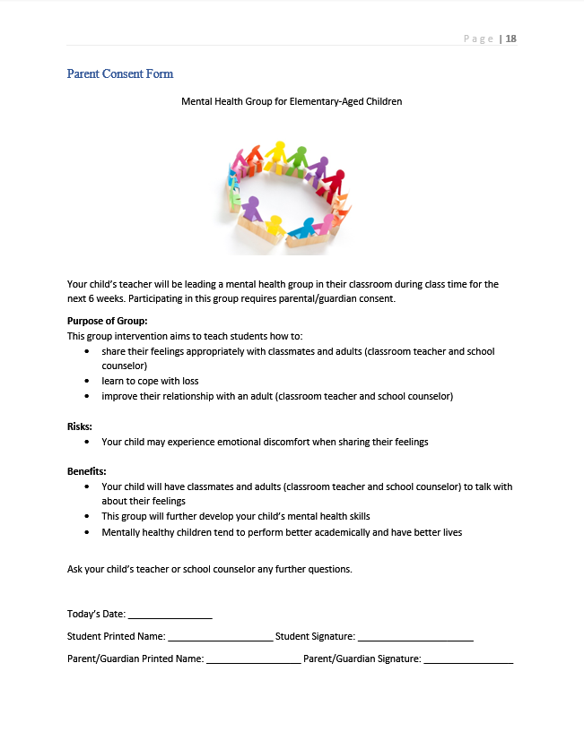
Group Explanation and Consent Forms

Slide 17
Schedule a Time and Place for your Group
What day of the week works best for you?
What time of the day works best for you?
Where in your classroom could group take place?

