Slide 1
MOBILE INFORMATION LITERACY CURRICULUM
Module 4 Slides:
Working Online and Using Information via Mobile Devices

Slide 2
These slides accompany the Mobile Information Literacy Curriculum:
Module 4 Guide: Working Online and Using Information via Mobile Devices
About the Curriculum
As millions of people come online across the globe through mobile devices, mobile information literacy is vital for those who have leapfrogged from traditional media to digital devices that provide instant access to information. Mobile information literacy is necessary to help people learn how to find and evaluate the quality and credibility of information obtained online, understand how to create and share online information effectively, and participate safely and securely. Mobile information literacy is critical to help people better consume, generate, and disseminate trustworthy information through both digital and traditional media.
The curriculum focuses on critical thinking in a digital environment of smart phones, mobile phones, and tablets, filling a critical gap in digital information literacy curricula. Existing curricular models assume people learn on a personal computer (PC). While this has been the case historically, the next billion people coming online will most likely learn on a mobile device. This has huge implications for how people get online, how they access and experience the internet, how much they produce in addition to consume information, and even how they conceptualize the internet itself. For instance, research shows that in Myanmar (and many other countries) more people use Facebook than the internet. Mobile-specific practices, such as zero-rating, mean people are coming online much more frequently through a handful of “walled garden” applications without an understanding of and similar access to the broader internet. Also, some mobile applications and websites don’t offer the full functionality of their PC counterparts. The curriculum aims to address these differences and empower mobile internet users to be equal participants in the online world.
  • Module 1: Introduction to Mobile Information and Communication Technologies (ICTs)
  • Module 2: Introduction to the Mobile Internet
  • Module 3: Basic Web Searching via Mobile Devices
  • Module 4: Working Online and Using Information via Mobile Devices
  • Module 5: Putting It All Together
  • Module 6: Module 5 Project Presentations
More information about this curriculum can be found here: http://tascha.uw.edu/mobile-information-literacy-curriculum
The curriculum materials are offered here with a Creative Commons Attribution-ShareAlike 3.0 license, so others are free to use, adapt, and share the materials with attribution. We are also available to help organizations create customized materials based on their particular country or regional contexts and literacy training needs.
If you have questions on the curriculum or would like more information on how we can help, please email us at tascha@uw.edu. We also encourage individuals and organizations that use and adapt this curriculum and training to provide us with any feedback, ideas, and adapted materials. There are many ways you can do this: email tascha@uw.edu, leave a comment and upload materials on the main Mobile Information Literacy curriculum webpage http://tascha.uw.edu/mobile-information-literacy-curriculum, and/or participate on our Facebook page https://www.facebook.com/MobileInformationLiteracy.
Recommended Citation
Day, S. (2015). Mobile Information Literacy Curriculum Module 4 Guide: Working Online and Using Information via Mobile Devices. Seattle: Henry M. Jackson School of International Studies & the Technology & Social Change Group, University of Washington Information School.

Slide 3
Module 4 Description
Working Online and Using Information via Mobile Devices
This module covers privacy and security measures, online etiquette, referencing online sources, and working in collaborative online environments.
Prerequisites:
Module 1: Introduction to Mobile Information & Communication Technologies (ICTs)
Module 2: A Mobile Lens on the Internet
Module 3: Basic Web Searching via Mobile Devices

Slide 4
Outline
Module overview
Privacy and Security
Netiquette
Credit, Credibility, and Copyright
The Cloud
Activity 4.1: Basic Protection Measures
Activity 4.2: Using Online Content
Activity 4.3: Facebook Groups
Break
Activity 4.4: Intro to Google Docs

Slide 5
Module 4 Overview
Topics covered:
Privacy and security measures
Online etiquette
Referencing online sources
Working collaborative online environments
Questions you will be able to answer at the end of this module:
How do I protect my privacy online?
What are some rules and guidelines for online behavior?
How do I use and reference online sources?
How do I work online with others?
Duration of module:
3 hours (180 minutes)

Slide 6
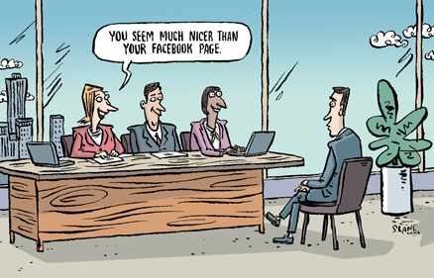
Privacy, Why Bother?
Image source: http://squareone-learning.com/blog/wp-content/uploads/nicer_than_facebook.jpg

Slide 7
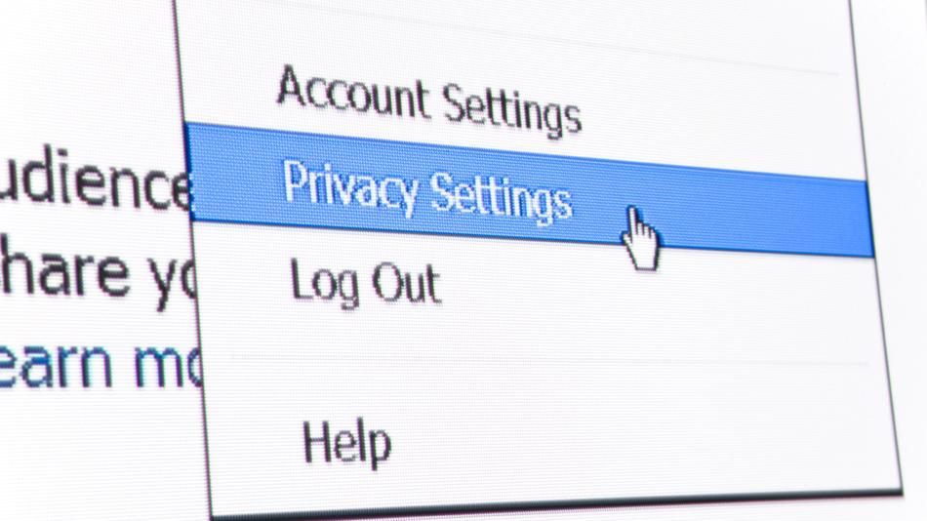
Privacy and Security

Slide 8
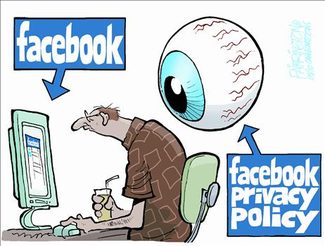
Facebook Privacy Policy
Image source: http://funny-pictures.funmunch.com/pictures/facebook-privacy-policy.jpg

Slide 9
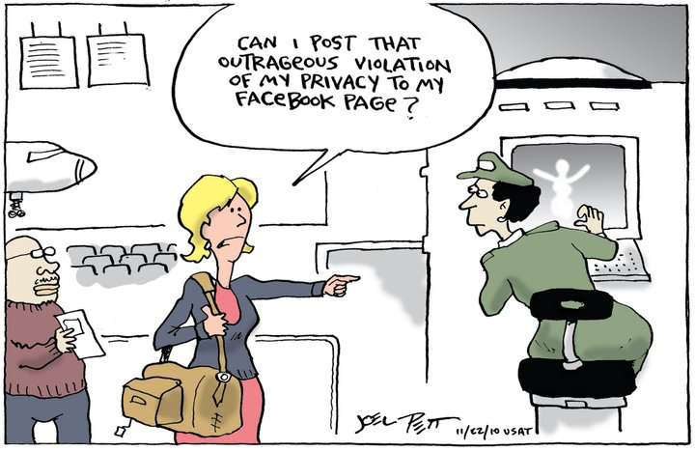
Who is Responsible for Privacy and Security?
Image source: http://adventofdeception.com/wp-content/uploads/2011/06/facebook-privacy.jpg

Slide 10

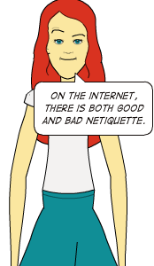

Slide 11

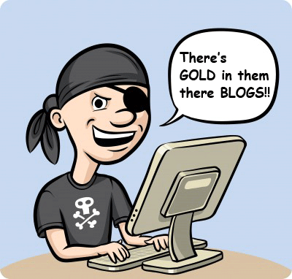

Credit, Credibility, and Copyright
Image source: http://uldissprogis.files.wordpress.com/2014/07/internet-plagiarism-pirate-information-gold-blogs.png?w=625
Image source: http://static.comicvine.com/uploads/scale_medium/5/51078/1007265-popeye.jpg
Image source: http://uldissprogis.files.wordpress.com/2014/07/internet-plagiarism-pirate-information-gold-blogs.png?w=625

Slide 12

The Cloud
SaaS
PaaS
IaaS
Image source: Shutterstock

Slide 13
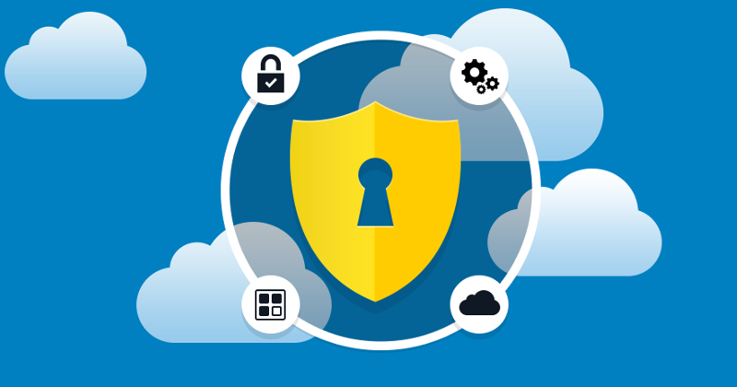
Activity 4.1: Basic Protection Measures
Image source: http://i0.wp.com/www.showmetech.com.br/wp-content/uploads/2015/05/smt-samsungpay-samsung-knox.jpg?resize=720%2C479

Slide 14
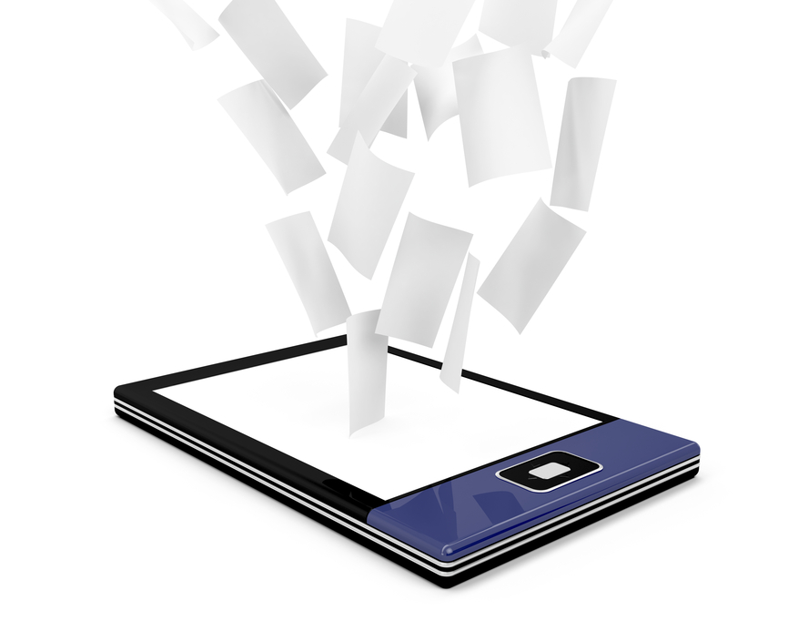
Activity 4.2: Using Online Content
Image source: www.digitaldocumentsllc.com

Slide 15

Activity 4.3: Facebook Groups

Slide 16

Activity 4.4: Intro to Google Docs

Slide 17
Review
Topics Covered:
Privacy and security measures
Online etiquette
Referencing online sources
Working in collaborative online environments.
Concepts Learned:
How do I protect my privacy online?
What some rules and guidelines for online behavior?
How do I use and reference online sources?
How do I work online with others?

Slide 18
End of Module 4
Congratulations!!!
You have completed Module 4: Working Online and Using Information via Mobile Devices

Slide 19

This is a product of the Information Strategies for Societies in Transition program. This program is supported by United States Agency for International Development (USAID), Microsoft, the Bill & Melinda Gates Foundation, and the Tableau Foundation. The program is housed in the University of Washington's Henry M. Jackson School of International Studies and is run in collaboration with the Technology & Social Change Group (TASCHA) in the University of Washington’s Information School, and two partner organizations in Myanmar: the Myanmar Book Aid Preservation Foundation (MBAPF) and Enlightened Research Myanmar (EMR).

