Slide 1
Engaged learning in community: At WACC and in your Canvas course
URL- http://tinyurl.com/y2xqvfpe
Marisa Petrich, UW Tacoma- Instructional Design Librarian
Heather Newcomer, Olympic College- Library Faculty
This presentation by Marisa Petrich and Heather Newcomer is licensed under a Creative Commons Attribution-NonCommercial 4.0 International License, except where otherwise noted
Notes:
Heather

Slide 2

Participants will:
Examine themes in common failures and successes in online instruction
Adapt a discussion prompt
Identify 1-2 best practices they can implement in their own course.
Photo by Markus Spiske, on Unsplash
Notes:
Heather Learning Objectives

Slide 3
To-do list:
Introductions
Pedagogy & the LMS
Presence & Community
Engaging Online Discussions
Tying it all together
Photo by Markus Spiske, on Unsplash
Notes:
Heather- Session outline

Slide 4
Activity (10 minutes)
Introductions
Notes:
Heather

Slide 5


Introductions:
Who we are and what we do
Success and failure in online teaching
Fail
Success
Photo by Steve Johnson, on Unsplash
Photo by Grant Ritchie, on Unsplash
Notes:
Heather

Slide 6
Introductions: Being mindful of time, please share…
Your name and discipline
A success or failure in online teaching
Fail
Success
Photo by Steve Johnson, on Unsplash
Photo by Grant Ritchie, on Unsplash
Notes:
Heather

Slide 7

Session Structure—
We’ll all learn about facilitating engaged learning & we’ll model some techniques.
Photo by Dayne Topkin, on Unsplash
Notes:
Marisa. We’ll be modelling a variety of techniques some that align with best practice and also provide some examples for contrast (ex. Our introductions)

Slide 8

Pedagogy
&
the LMS
Photo by Michael Beckwith, on Unsplash
Notes:
Marisa

Slide 9


Apples are not just bad oranges. (Backer, 2016)
Photo by Timotheus Fröbel, on Unsplash
Photo by Max, on Unsplash
Notes:
Marisa While both apples and oranges are delicious fruits, they are quite different. Likewise, online teaching and learning are significantly different from f2f teaching and learning.

Slide 10

Teach about learning
Be open about pedagogy
Photo by Kevin Gawlik , on Unsplash
Notes:
LMS consideration- Reframe your expectations and techniques to be appropriate for the space you're in and then figure out to get creative. Students may also need coaching or instruction to become adept online learners.

Slide 11

-What is your pedagogical perspective?
-What pedagogical assumptions are embedded in your LMS?
-How can you reconcile the two?
Photo by rawpixel, on Unsplash
Notes:
Marisa Very often there may be differences between your pedagogical perspectives on those embedded with the LMS. Consider these questions.

Slide 12
Activity (15 minutes)
Think - Pair - Share
Notes:
Heather

Slide 13

Take 2 minutes to consider:
Your own pedagogical perspective,
The pedagogical assumptions embedded in your LMS, and
How you reconcile the two?
Photo by Alif Shaari, on Unsplash
Notes:
Heather

Slide 14

Pair up. Take turns with your partner to
share 1 or 2 of your answers, using 2 minute each. Finally, make note of themes in your answers in 2 minutes. Total time- 6 minutes.
Your pedagogical perspective? Pedagogical assumptions in your LMS?
How to reconcile the two?
Photo by Stephen Poore, on Unsplash

Slide 15

Combine your pair with another nearby. Share and compare your answers. Select one idea to share with the larger group and a speaker to share it (2 minutes).
Photo by Stephen Poore, on Unsplash
Notes:
Heather

Slide 16

One speaker from each group will share the highlight of that group’s discussion,
1 minute each.
Photo by Corey Agopian, on Unsplash
Notes:
Heather

Slide 17
Instructor presence
&
creating community
Photo by Michael Beckwith, on Unsplash
Notes:
Heather

Slide 18

“Sage on the stage”
model of education
Photo by Miguel Henriques, on Unsplash
Notes:
Centuries old model- limits active learning options and depends heavily on less effective learning mechanisms

Slide 19
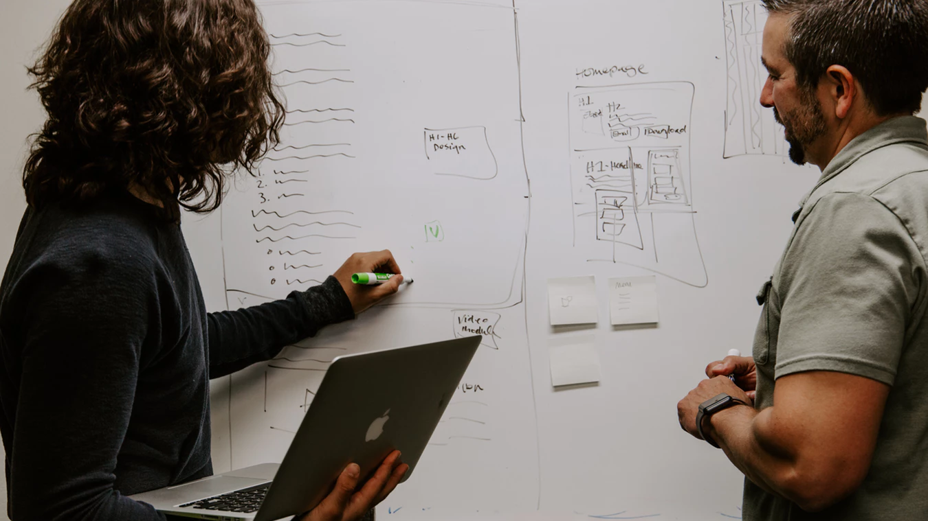
“Guide on the side”
model of education
Photo by Kaleidico, on Unsplash
Notes:
The classic constructivist model- students are encouraged to interact with the material and each other to take advantage of the effectiveness of social learning with the instructor there to act as a guide for the content and the learning process.

Slide 20
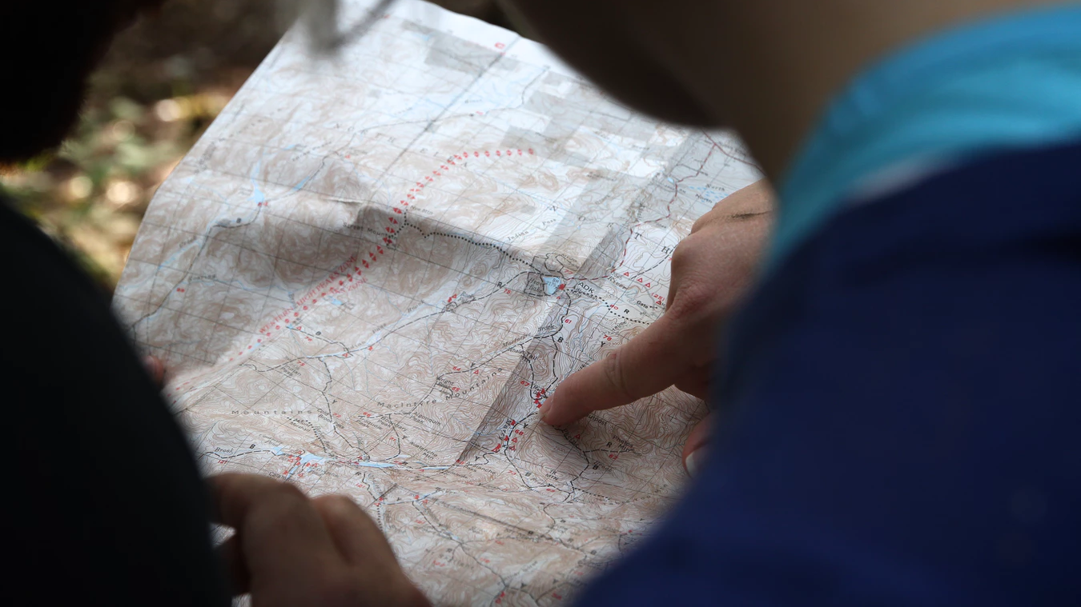
Online education model to avoid;
“Someone left me this map. Which way is north?”
Photo by Jean-Frederic Fortier, on Unsplash
Notes:
Students in online classes can feel adrift, isolated, confused, and overwhelmed. Deliberately cultivating a sense of instructor presence and community among your students can prevent this. Let’s cover one model that offers direction to instructors on doing this effectively.

Slide 21

Cognitive Presence
Social Presence
Instructor Presence
Community of Inquiry Framework, 2000
Photo by rashid khreiss, on Unsplash
Notes:
Learning has a deep, cognitive association with emotion.
(cognitive, social, and teaching presence) Extent to which students are able to make meaning through continual communication, ability to present themselves as real people by projecting personal characteristics through medium of communication, How the teacher designs and facilitates experience to support cognitive and social presence
Teacher Immediacy Behaviors
Verbal immediacy (“our class” or “what we are doing”)
Share examples from personal life (judicious self-disclosure)
Willing to divert from lesson plan based on student discussion
Ask how students feel about assignments, due dates, etc.
Ask questions to solicit opinions and views

Slide 22
Verbal Immediacy-
“our class” or
“what we’re doing this week.”
Photo by rashid khreiss, on Unsplash
Notes:
Teacher Immediacy Behaviors
Verbal immediacy (“our class” or “what we are doing this week”)

Slide 23
Be willing to divert from lesson plan when useful and appropriate.
Photo by rashid khreiss, on Unsplash
Notes:
Willing to divert from lesson plan based on student discussion

Slide 24
Ask how students feel about assignments, due dates, etc.
Photo by rashid khreiss, on Unsplash
Notes:
Ask how students feel about assignments, due dates, etc.

Slide 25
Solicit stories, opinions, and personal perspectives related to content.
Photo by rashid khreiss, on Unsplash
Notes:
Ask questions to solicit stories opinions and personal perspectives

Slide 26
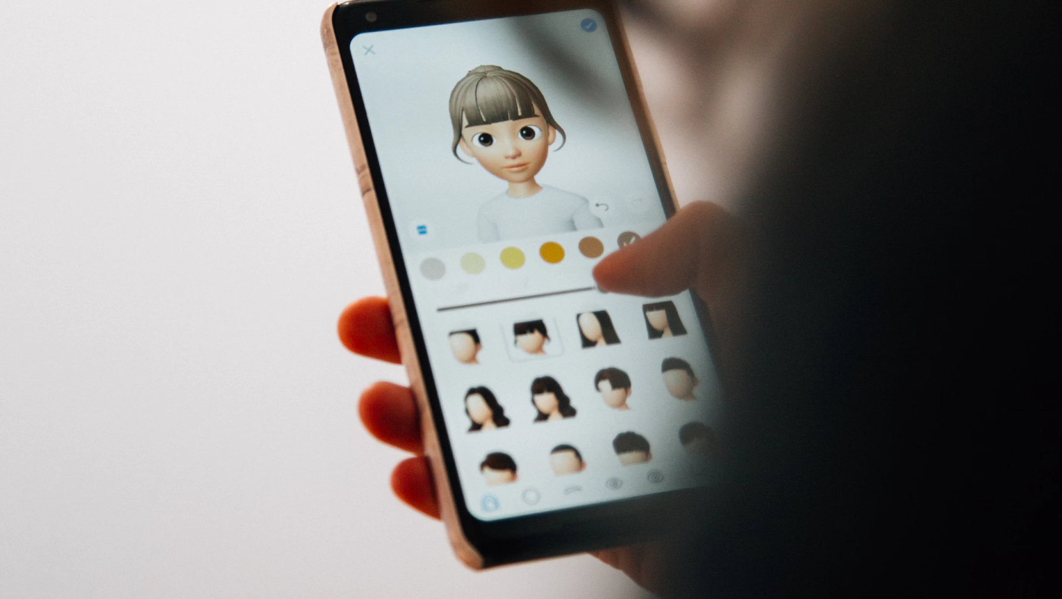
Use your face for profile photos.
Use video introductions, etc.
Be a real person to your students.
Photo by Charles PH, on Unsplash
Notes:
Give a personal detail or two, just to illustrate that you exist in the real world .

Slide 27

That information has been provided in the syllabus.
Notes:
Example of para-language, and example of setting a tone. Actively encourage and use para-language to your comfort level, emoticons, gifs, memes, etc. Think of this as body language or facial expression and do it with accessibility in mind (use alt-text, for example) Tone- remember you are communicating a level of formality and a level of interpersonal accessibility

Slide 28

Be clear from the start about what you expect and what students should expect from you.
Photo by Jamie Templeton, on Unsplash

Slide 29

Timeliness-
Set the expectation;
set the example.
Photo by Kevin Ku, on Unsplash
Notes:
Studies show repeatedly that students particularly value a timely response. Define what students can expect and then be as mindful of that as you expect students to be of due dates.

Slide 30


Photo by raw pixel, on Unsplash
Photo by Nathaniel Dahan, on Unsplash
Students want you to pay attention,
not just pay attention.
Photo by Stephen Poore, on Unsplash
Notes:
Research shows that students want instructors to pay attention and engage with them, not just monitor them, which is often indistinguishable being ignored. At least in grading feedback indicate you read their work by making a detailed reference to it.

Slide 31

Keeping your distance on purpose?
Help students understand why.
Photo by Caleb George, on Unsplash
Notes:
Heather It is always a good idea for your students to know what you are trying to accomplish with assignments. It helps guide their efforts and it helps them give informed feedback about the effectiveness.

Slide 32
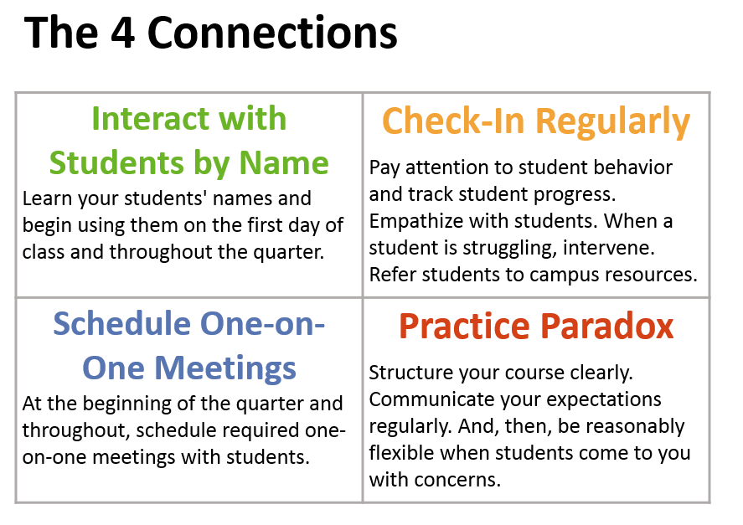

Notes:
Heather The Four Connection offer Evidence-Based model that can be used to incorporate these elements in your class (link available in our resources)

Slide 33
Engaging Online Discussions
Photo by Michael Beckwith, on Unsplash
Notes:
Marisa

Slide 34
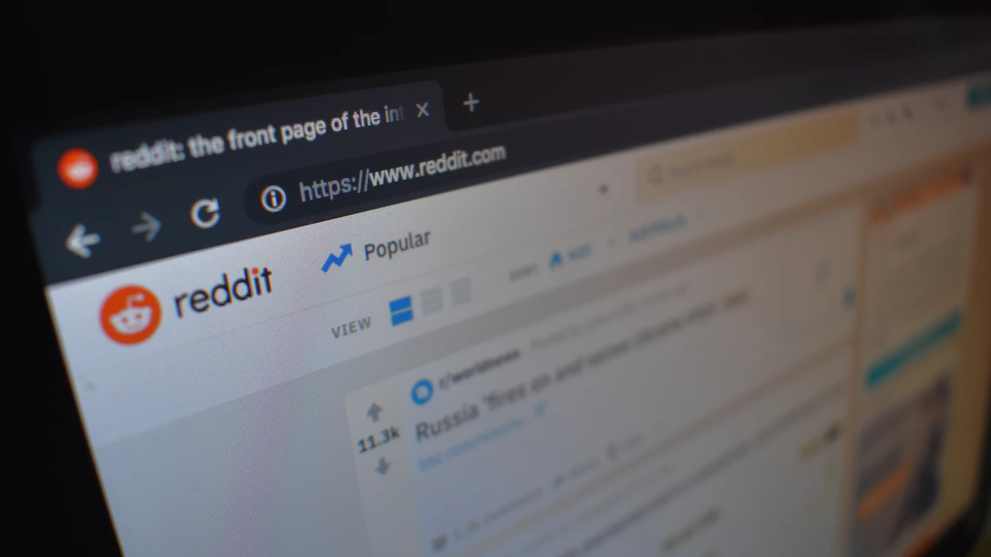
Consider the purpose of your discussion.
Are you assessing learning... or attendance?
Photo by Con Karampeles, on Unsplash
Notes:
Marisa Typically we’re shooting for robust, dynamic conversations but may end up getting demonstrations of a student’s ability to regularly log in to the course and make a perfunctory post. More thoughts on this from Sean Michael Morris and Jesse Stommel in The DIscussion Forum is Dead; Long Live the Discussion Forum.

Slide 35

Scaffolded discussions:
Students complete a prior activity
Discussion forum as reflection
Photo by 贝莉儿 NG, on Unsplash

Slide 36
Reframe questions:
Stay open-ended
Avoid fishing
Remember audience
Photo by Con Karampeles, on Unsplash

Slide 37

Exhibit A:
In a three to five sentence reflection, consider some of the consequences of not evaluating news sources and how they might influence you as a news consumer.
Photo by Camylla Battani, on Unsplash

Slide 38
Exhibit B:
Consider what you’ve learned about the ethical standards for journalism.
How do these compare with your own experiences with news media?
Will this knowledge change how you consume news?
Why or why not?
Photo by Camylla Battani, on Unsplash

Slide 39

Seek opportunities for co-design
Photo by Tim Marshall on Unsplash

Slide 40
Reframe responses:
Discussion roles
Social citation
Socratic questions
Photo by Con Karampeles, on Unsplash

Slide 41

Prior Question of Trust
+
Probing Questions
Examples available on handout
Photo by Emily Morter, on Unsplash

Slide 42

Bigger is not always better
Photo by James Hammond,
on Unsplash
Notes:
Bigger is not always better

Slide 43

Other tools?
Zoom, Skype, Hangouts
Slack
Canvas chat
Big Blue Button
Photo by Russ Ward on Unsplash

Slide 44

Photo by Dominick Martin, on Unsplash
Experiment thoughtfully.
Don’t forget FERPA or UDL
Notes:
Don’t get distracted by the shiny. The goal is to make learning more meaningful not more complicated. As you consider new option be sure any tool (and how you would use it) will respect student privacy and that it would be accessible to all students.

Slide 45

Be adaptive.
Photo by Jehyun Sung on Unsplash
Photo by Brannon Naito, on Unsplash
Notes:
Be flexible

Slide 46
Activity- (5 minutes)
Think-Pair-Share

Slide 47

Take 1 minute to think about your online discussions. How could you use these techniques to adapt a discussion prompt?
Photo by Evan Dennnis, on Unsplash

Slide 48
Partner with the person beside you. In 3 minutes, share your thoughts and discuss how you might apply these techniques.
Photo by Evan Dennnis, on Unsplash

Slide 49
Take 1 minute to write down some key resources or best practices from this workshop so future you isn’t confused.
Photo by Evan Dennnis, on Unsplash

Slide 50
Culminating Activity

Slide 51
Game time!
Cards for Community

Slide 52

Break into groups of 4-5 to play a card game.
You will need table space for the cards.
Each group will receive a pack of cards and printed instructions.
Photo by Andrej Lisakov, on Unsplash

Slide 53
Session Structure-
Review of exemplars in this workshop
Photo by Dayne Topkin, on Unsplash
Notes:
Heather

Slide 54
Recap:
Successes & Failures
Pedagogy & the LMS
Presence & Community
Engaging Online Discussions
Tying it all together
Thanks
for
coming!!
Photo by Markus Spiske, on Unsplash
Notes:
Marisa Session outline

Slide 55

Any Questions?
Research and Resources Link:
https://tinyurl.com/y5uzyrbl
4 Connections:
http://bit.ly/4connections
Images from Unsplash.com except as noted
Photo by Emily Morter, on Unsplash
Photo by Patrick Tomasso, on Unsplash
Notes:
Marisa

