Slide 1
Figure S3.3 - Trend in average values of length, weight and daily growth rate for early- and late-maturing female and male offspring for Family_1 and Family_2. Pink and blue lines represent early- and late-maturing individuals, respectively. Error bars represent standard deviation for each trait. The following graphs illustrate individual trait changes for either early- or late maturing female and male progeny in Family _1 and Family_2:
Figure S3.3.a - Length in Family_1
Figure S3.3.b - Weight in Family_1
Figure S3.3.c - Daily growth rate in Family_1
Figure S3.3.d - Length in Family_2
Figure S3.3.e - Weight in Family_2
Figure S3.3.f - Daily growth rate in Family_2

Slide 2
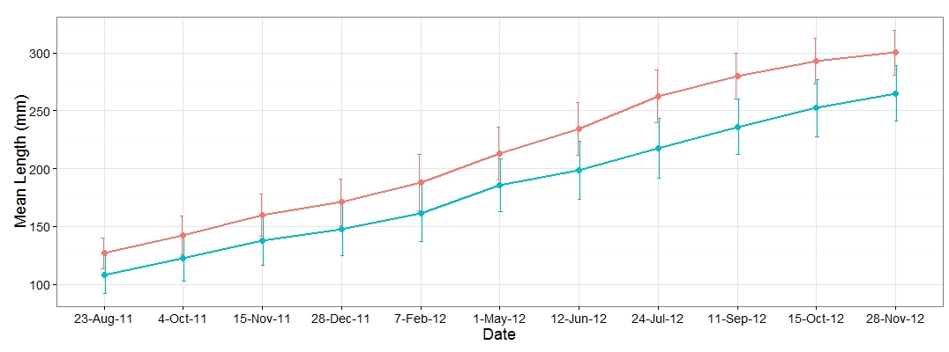
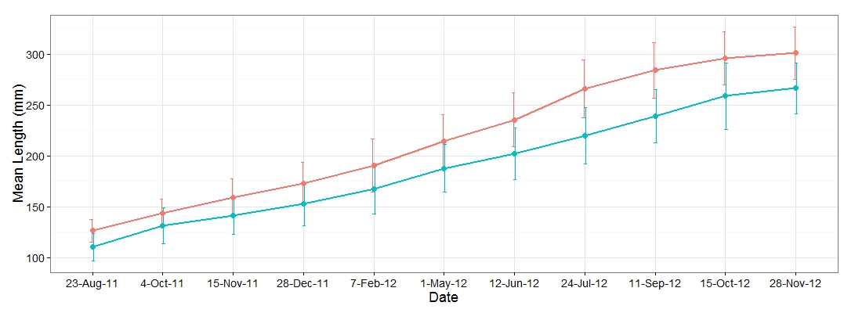
Figure S3.3.a - Length in Family_1
Female
Male

Slide 3
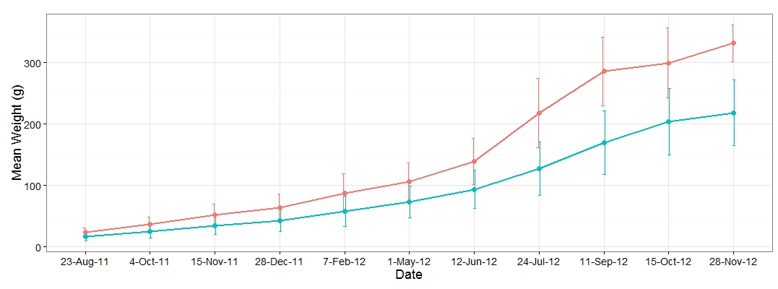
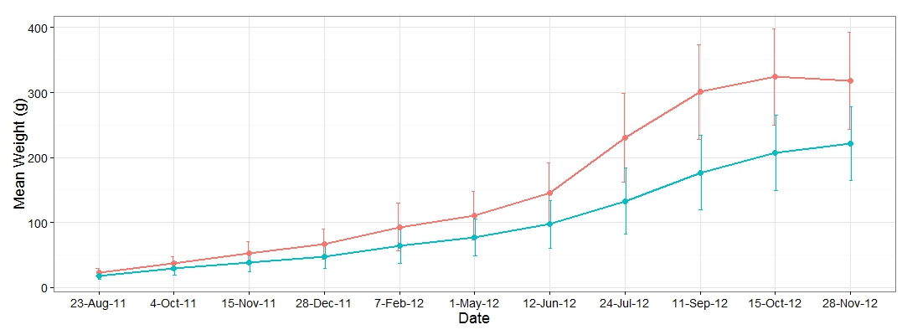
Figure S3.3.b - Weight in Family_1
Female
Male

Slide 4
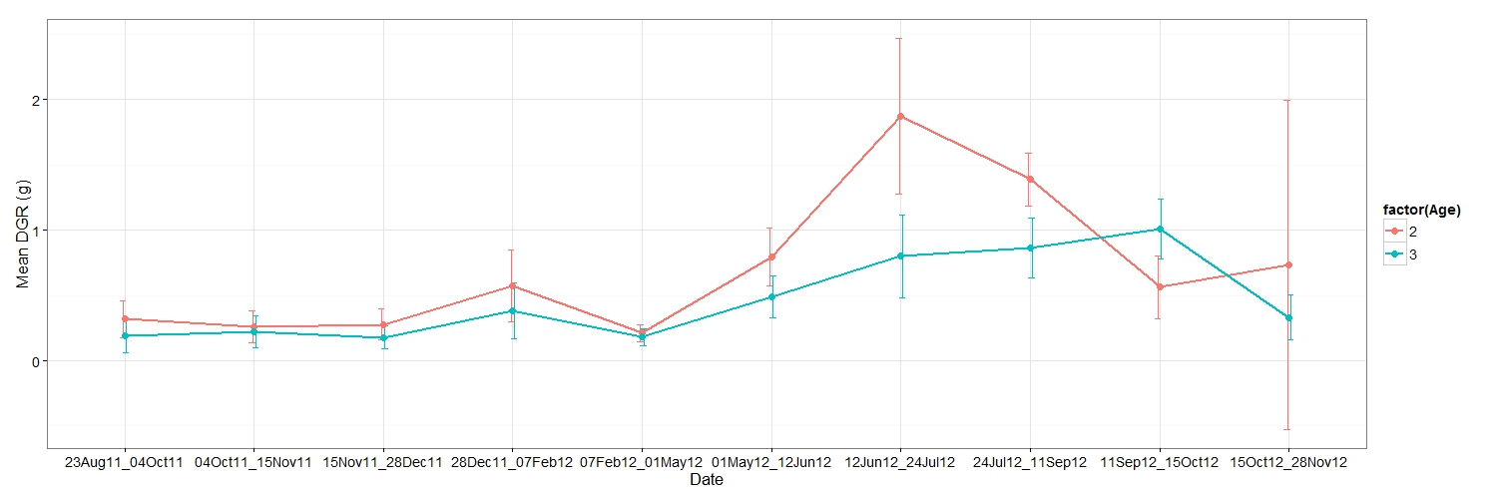
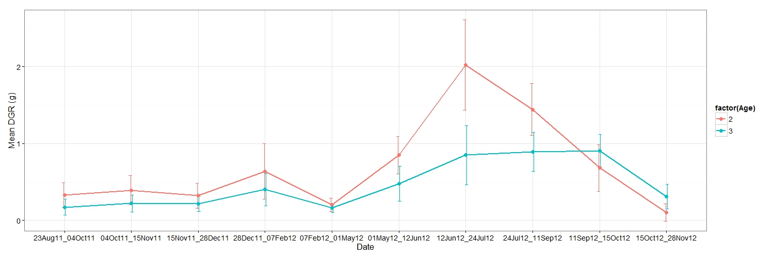
Figure S3.3.c - Daily growth rate in Family_1
Female
Male

Slide 5
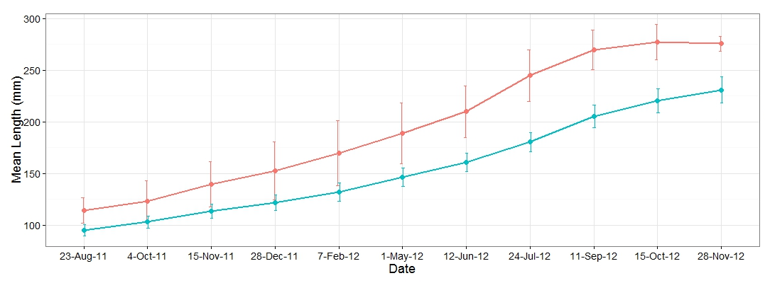
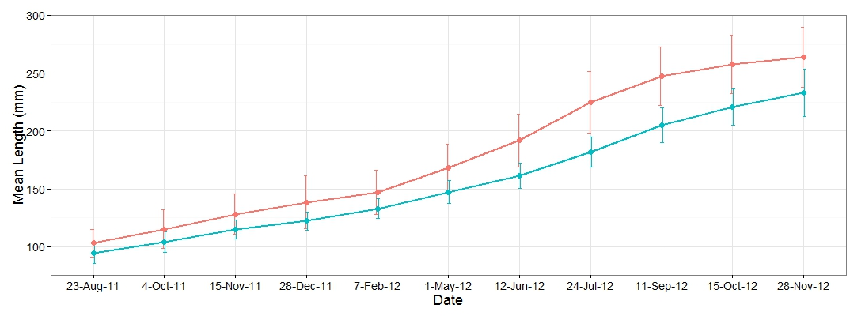
Figure S3.3.d - Length in Family_2
Female
Male

Slide 6
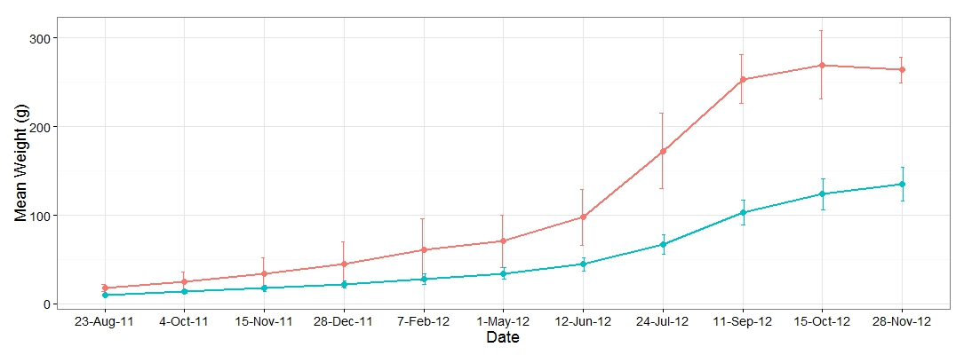
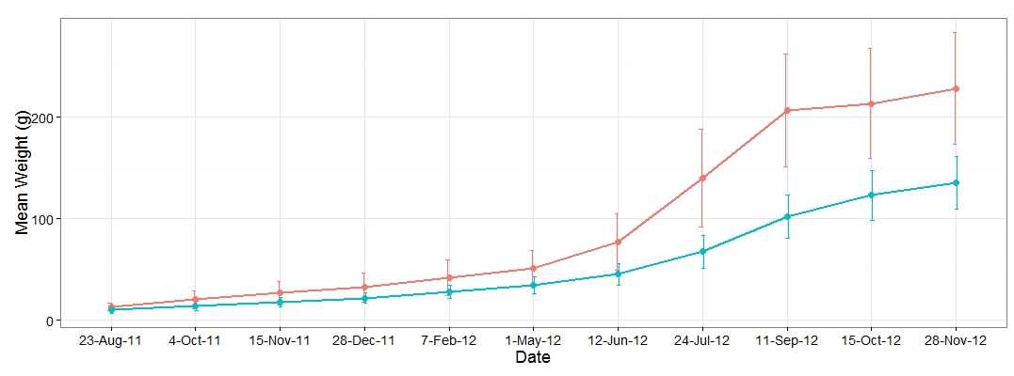
Figure S3.3.e - Weight in Family_2
Female
Male

Slide 7
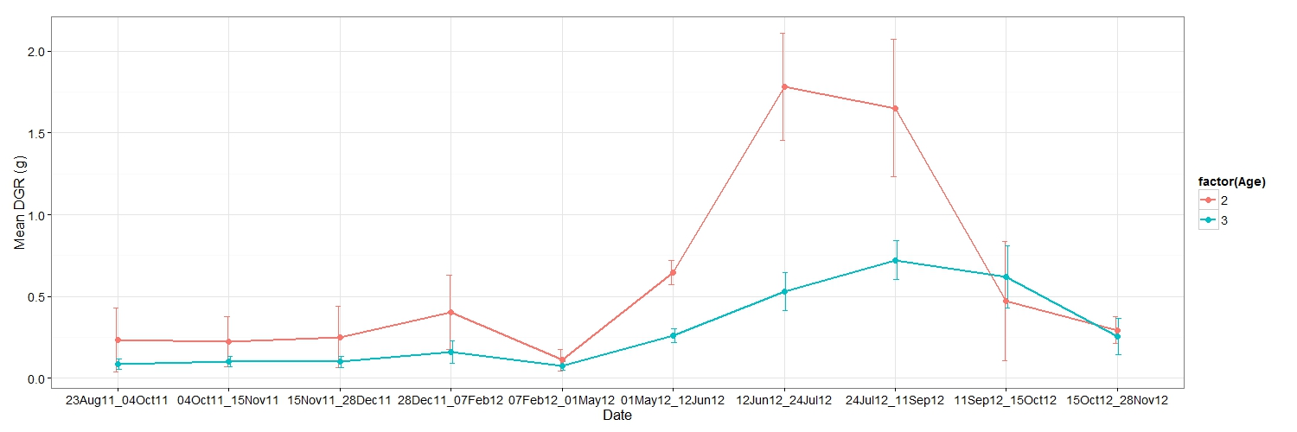
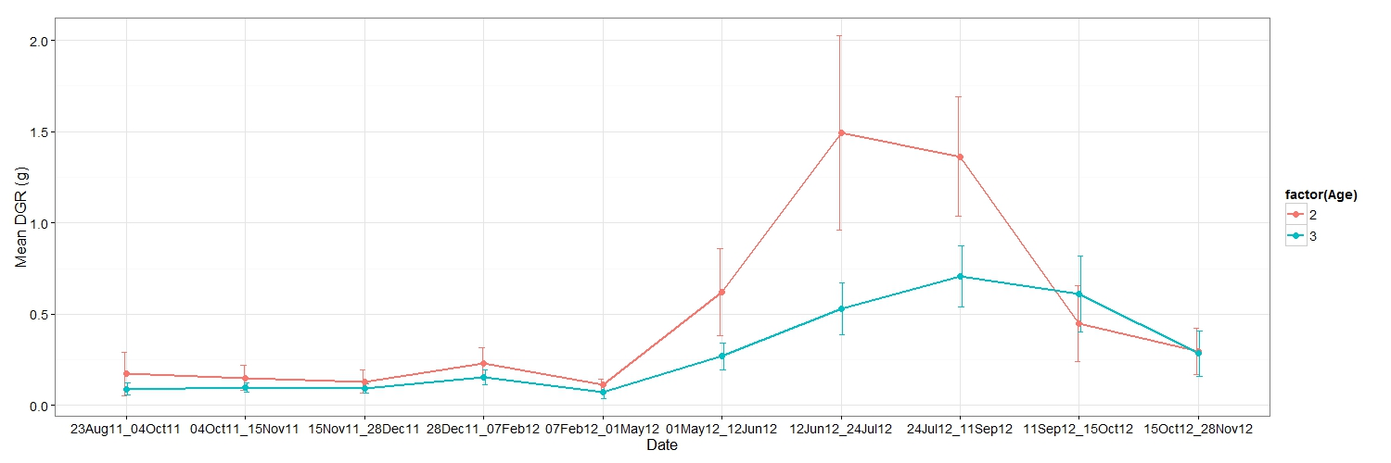
Figure S3.3.f - Daily growth rate in Family_2
Female
Male

