Slide 1
Figure S3.1 - Correlation matrix showing the degree of correlations among measured traits for female and male offspring in each family. Higher positive correlations are depicted by narrower ellipses with darker blue shading, whereas lower positive correlations are depicted by broader ellipses with lighter blue shading. Higher negative correlation are depicted by narrower ellipses with darker red shading, whereas lower negative correlation are depicted by broader ellipses with lighter red shading. Correlations that are close to zero are shown as open, unfilled ellipses that are nearly circular. The following graphs illustrate the degree of phenotypic correlations among traits for either female or male progeny in individual families:
Figure S3.1.a - Female offspring in Family_1
Figure S3.1.b - Male offspring in Family_1
Figure S3.1.c - Female offspring in Family_2
Figure S3.1.d - Male offspring in Family_2
Figure S3.1.e - Female offspring in Family_3
Figure S3.1.f - Male offspring in Family_3
Figure S3.1.g - Female offspring in Family_4
Figure S3.1.h - Male offspring in Family_4

Slide 2
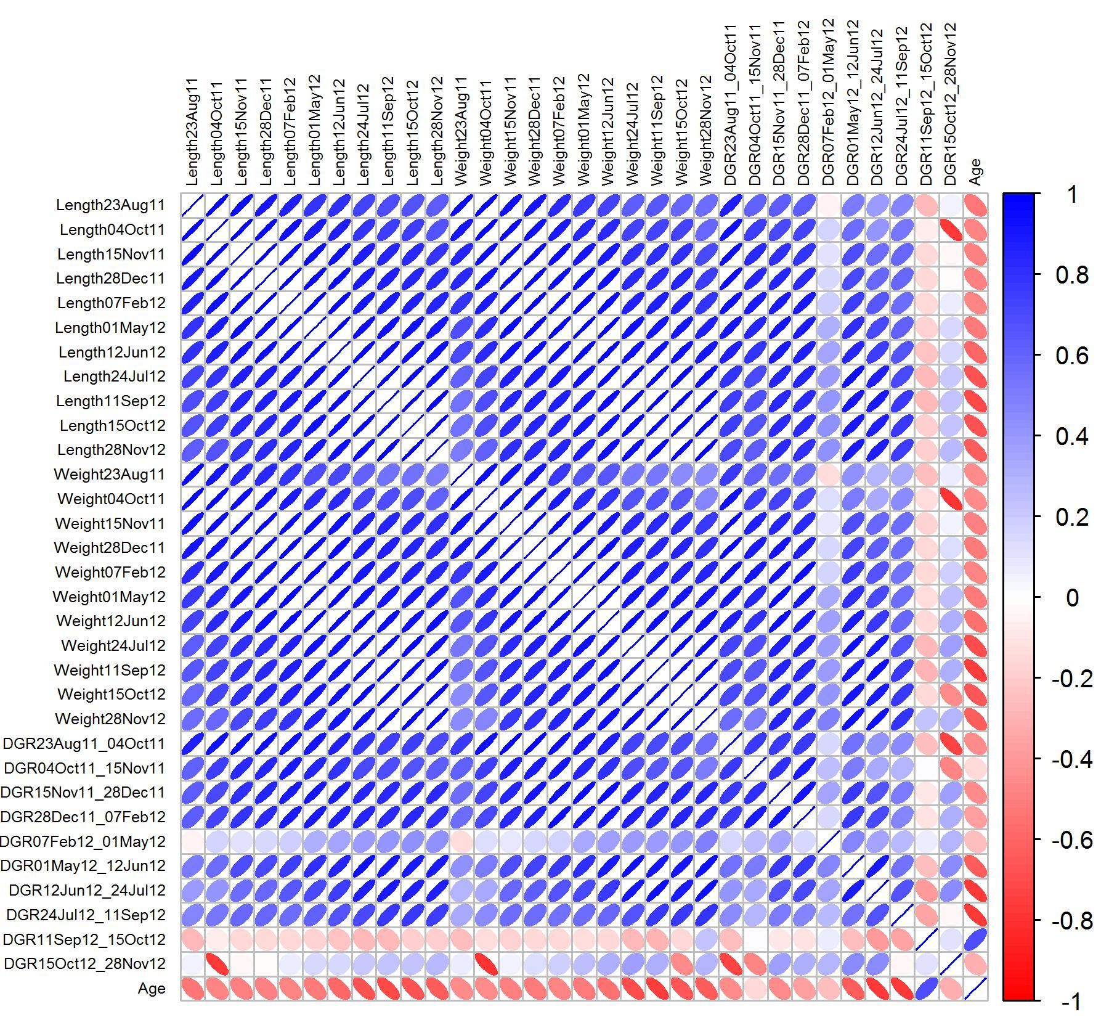
Figure S3.1.a - Female offspring in Family_1

Slide 3
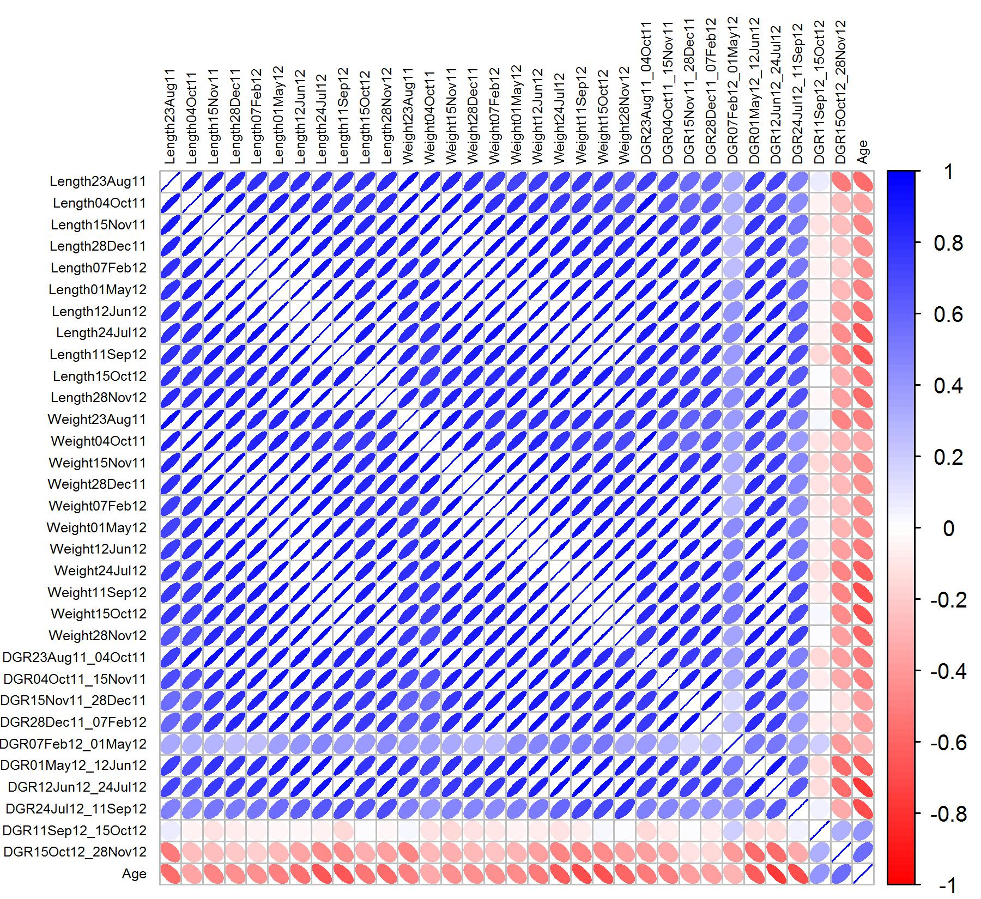
Figure S3.1.b - Male offspring in Family_1

Slide 4
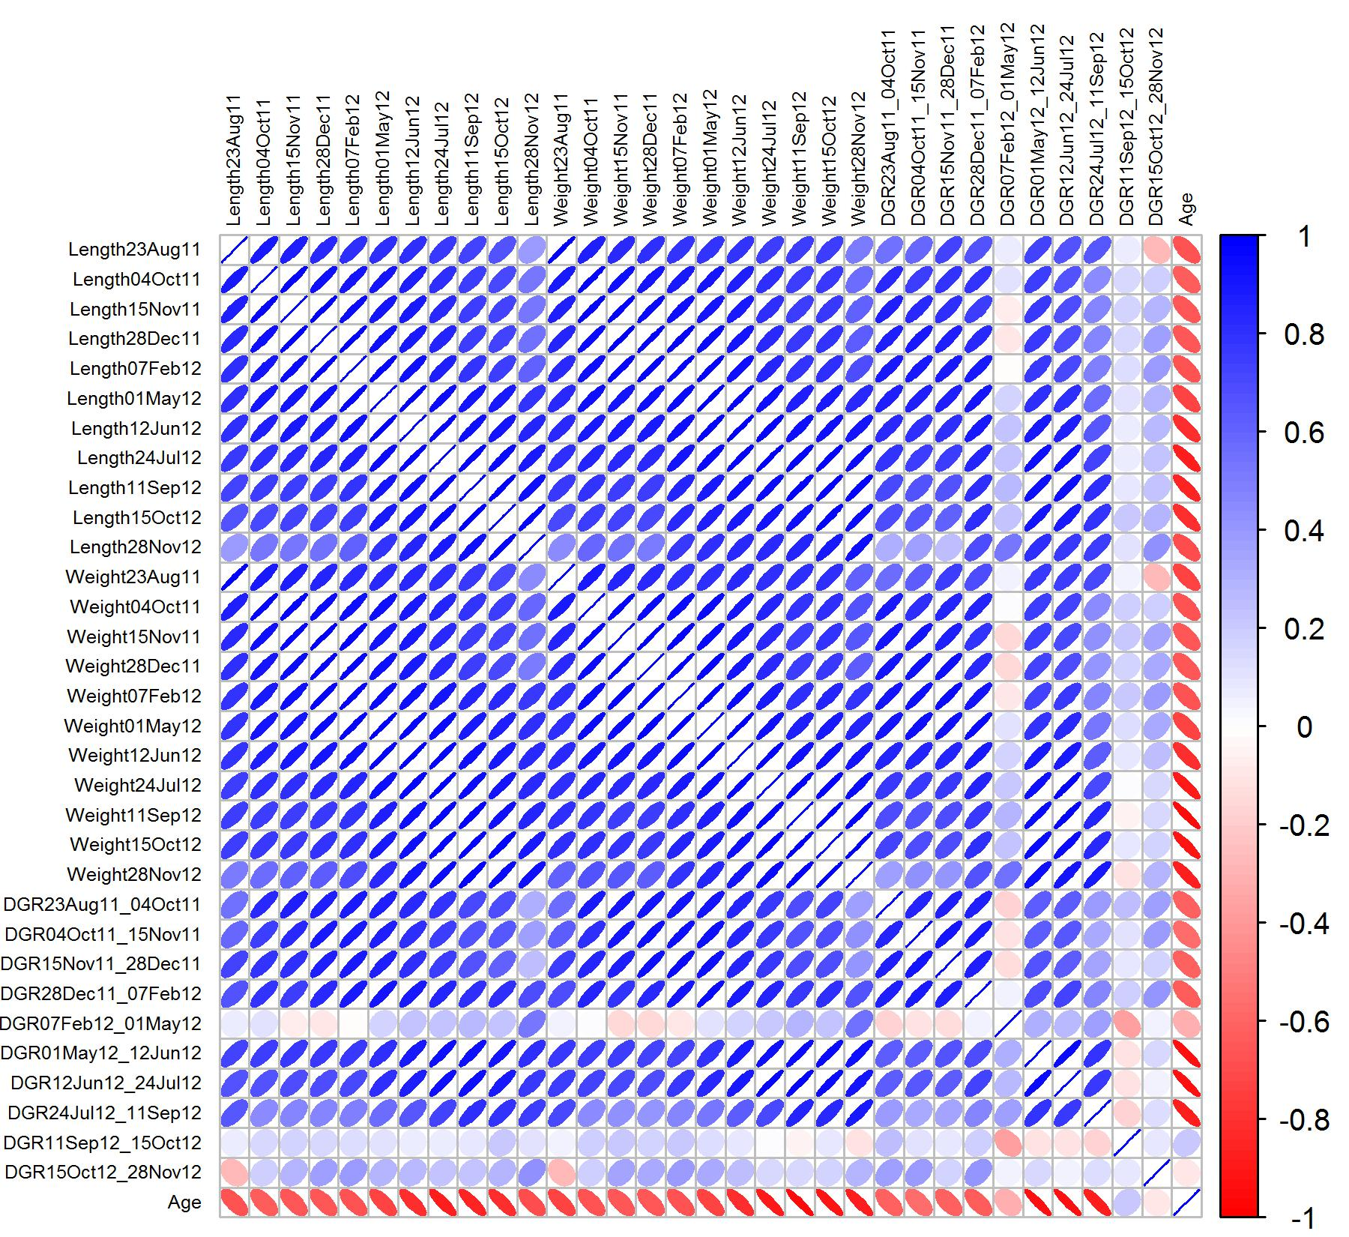
Figure S3.1.c - Female offspring in Family_2

Slide 5
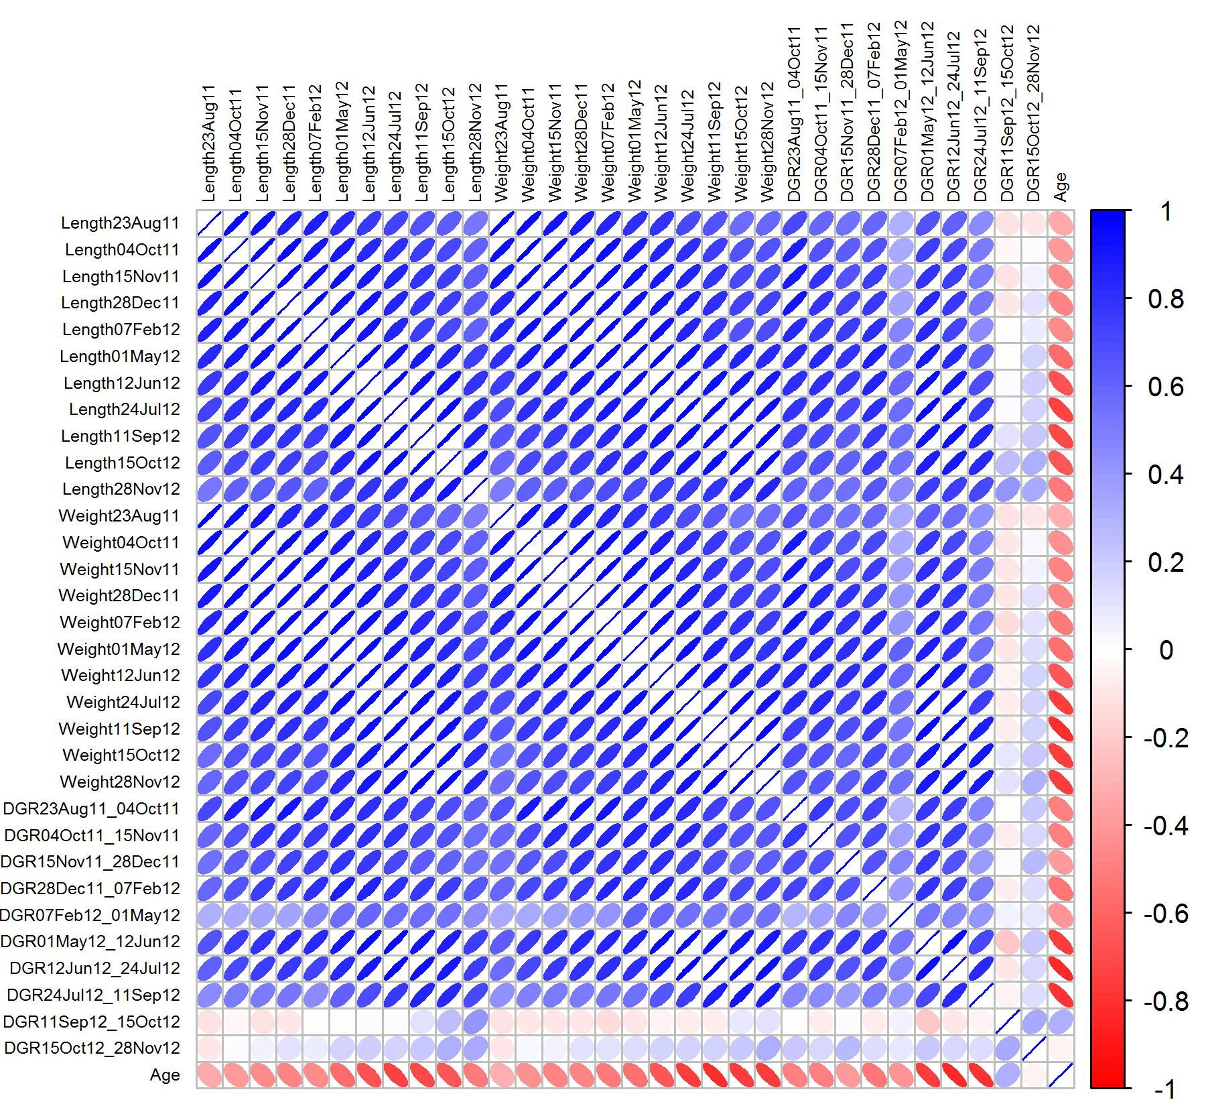
Figure S3.1.d - Male offspring in Family_2

Slide 6
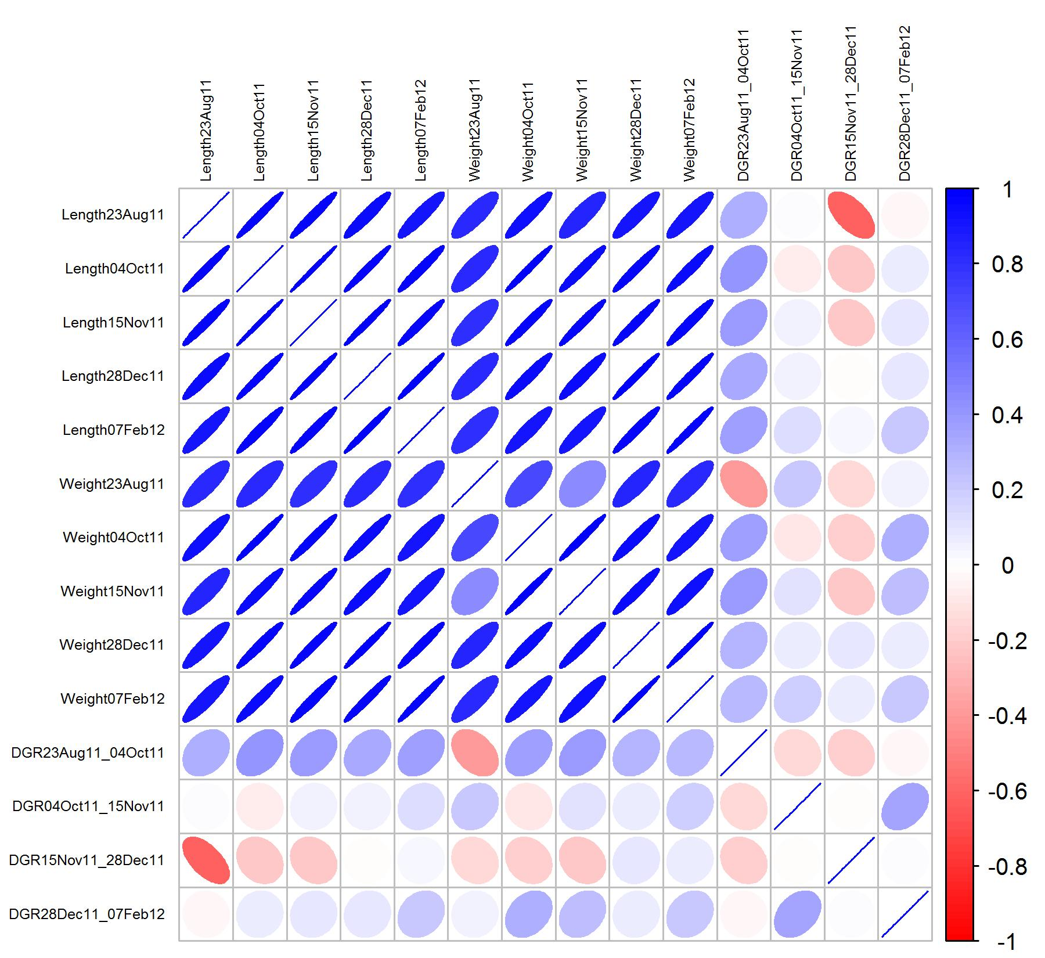
Figure S3.1.e -Female offspring in Family_3

Slide 7
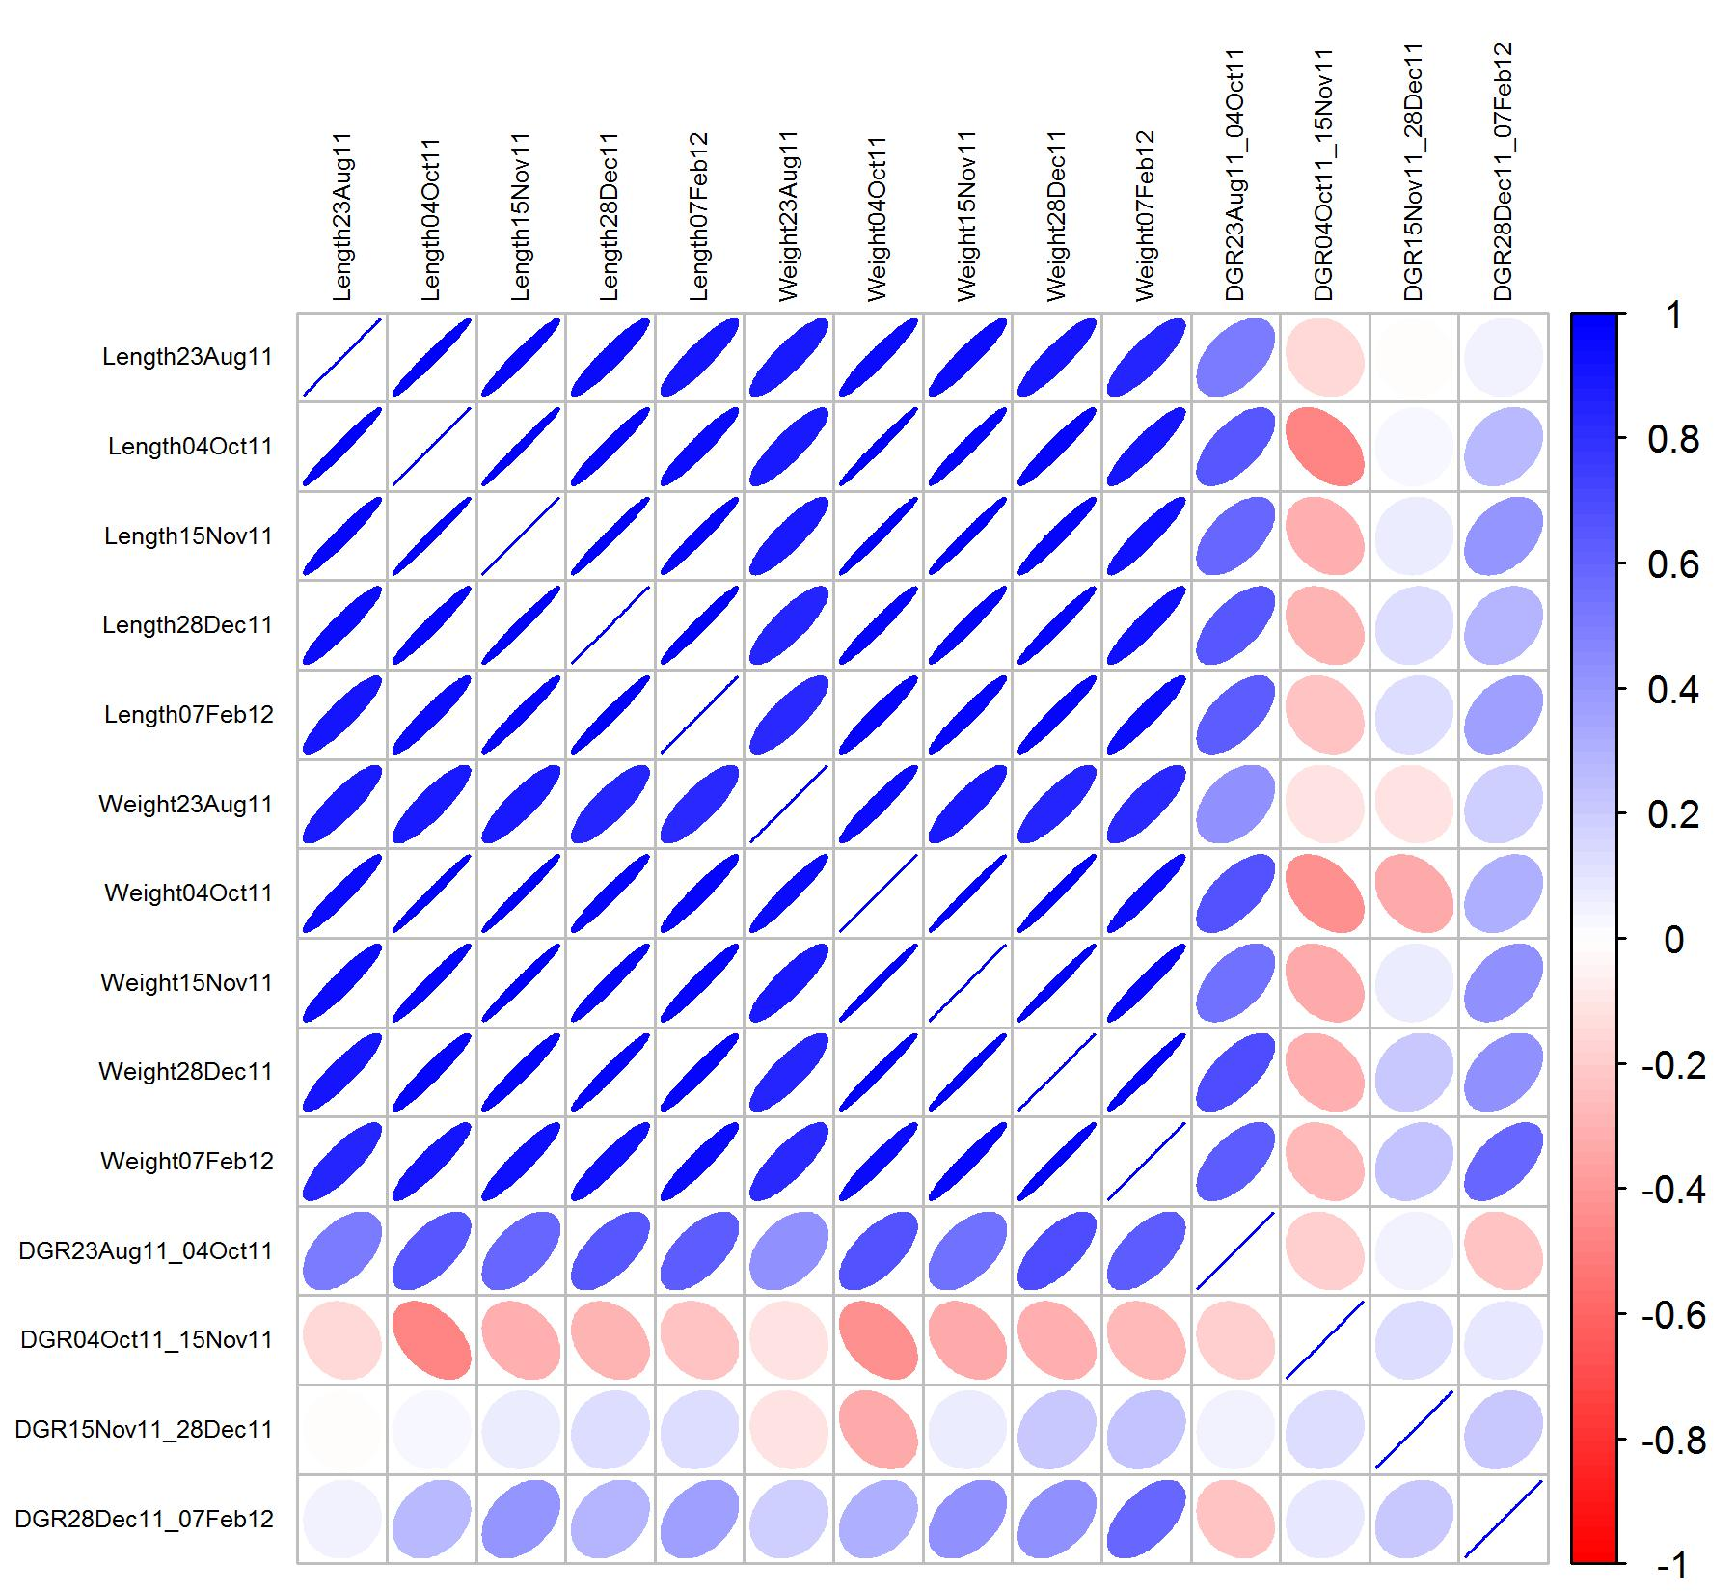
Figure S3.1.f - Male offspring in Family_3

Slide 8
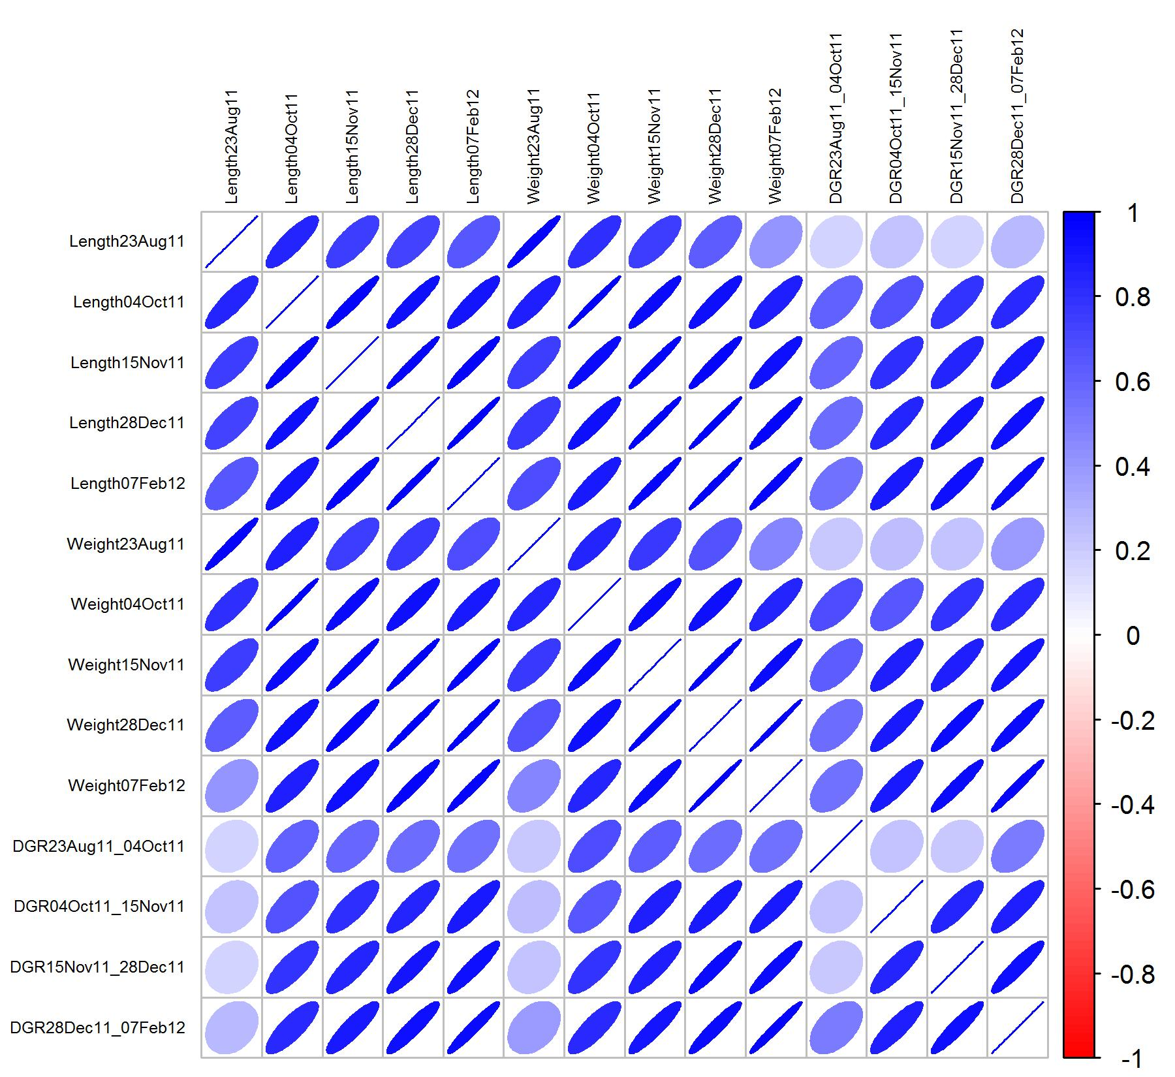
Figure S3.1.g - Female offspring in Family_4

Slide 9
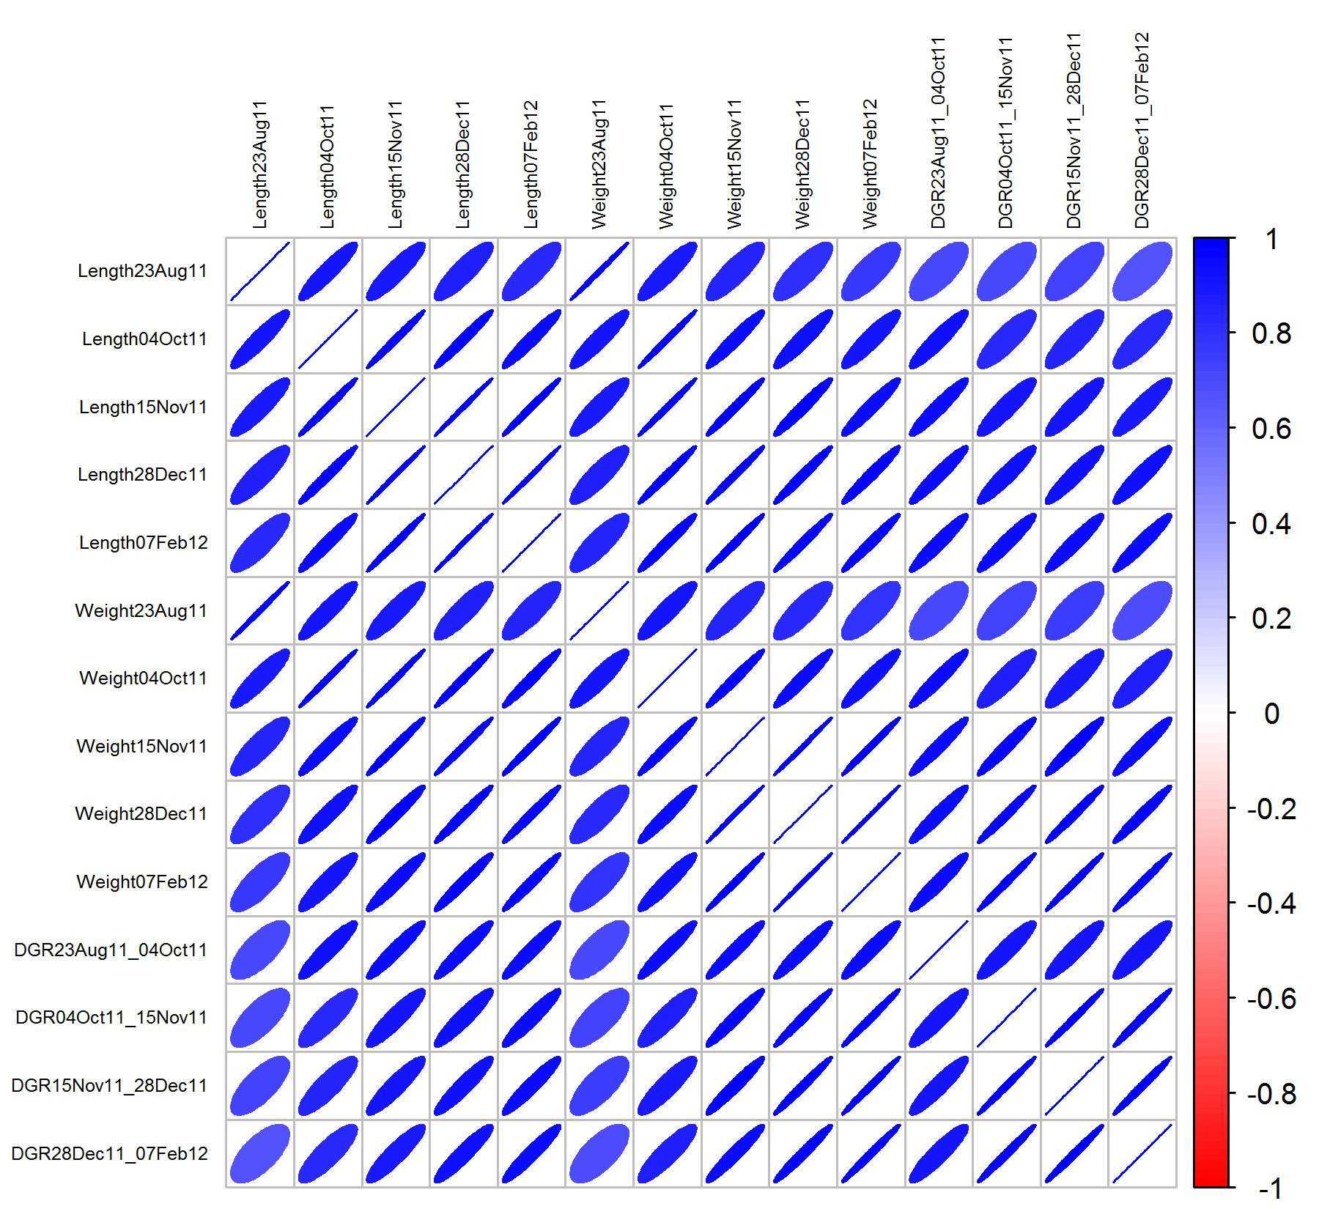
Figure S3.1.h - Male offspring in Family_4

