Slide 1
A Market for Vice: Exploring the Domain of Strategic Corporate Irresponsibility
Oscar Jerome Stewart
UNC Charlotte – Organizational Science
- An in-progress proposal -

Slide 2
Corporate Irresponsibility (CI)
Corporate irresponsibility & CSR are discussed in tandem
  CSR captures corporate “good deeds” (from philanthropy to issues of human rights)
  CI captures corporate “bad deeds” (I’ll come back to this)

Slide 3
Corporate Irresponsibility (CI)
Assumptions
  While CSR is strategically deployed so as to “do well by doing good”, CI is mostly detrimental to the bottom line (not to mention to the rest of society!).
  (e.g. Frooman, 1997; Greve, Palmer, & Pozner, 2010)
  CSR is all positive activity aside from profit, CI has been about sanctioned activity or simply low firm-level CSR.
    e.g. Misconduct: “any publicly disclosed firm action that, under some set of conditions, a stakeholder would deem illegal, unethical, or socially irresponsible and take action to punish” (Barnett, 2014, p. 682).
    e.g. KLD aggregate scores (low vs. high) (e.g. Barnett & Solomon, 2012)
      There are exceptions* - .e. g KLD Concerns

Slide 4
Corporate Irresponsibility
CI is mostly tied to poor performance outcomes
  Except what if this is not always the case?
Can CI be broader than simply illegal behavior (misconduct, corruption, etc.) or low firm-level CSR?
  How else can we classify a corporation as irresponsible?

Slide 5
Institutional Corporate Irresponsibility
CI without the stipulation of stakeholder sanctions
Focus remains on a firm’s violations, rather than on a social control agent’s ability to sanction a firm.
Institutional CI as a violation of a set of normative or ethical norms, conventions, & social realities (i.e. institutions)
  Much scholarship has indirectly conceived of CI this way
  (Campbell, 2007; Jones, Felps, & Bigley, 2007; Muller & Kraussl, 2011)
CI (institutional & otherwise) has no place within a healthy, robust capitalist marketplace (Heath, 2006, 2014; Stout, 2012)

Slide 6
What CI is not
“Low” CSR (firm-level)
  “Low” philanthropy, volunteerism, & community involvement are in the same construct (CI) as poor labor relations, human rights violations, political accountability, etc.
    Hence CI instead of CSI
Poorly constructed policy
  “Policies” are not performance! CI is behavior.
    e.g. Diversity policies do not make a diverse or inclusive organization – KLD limitation

Slide 7
Corporate Irresponsibility
Firm action that a stakeholder would deem to be in violation of relevant institutions, illegal, unethical, or irresponsible.

Slide 8
Strategic CI
Why? What do corporations get out of CI?
  As with CSR and any other path to competitive advantage, firms use CI as a strategic mechanism
  (McWIlliams & Siegel, 2002; Siegel, 2009)
  Competitive advantage
    Resources & capabilities generate competitive advantage when they fit the “VRIN” framework.
    Firms chase competitive advantage to out perform rivals.
      Cost advantage – “aggressive construction of efficient-scale facilities, vigorous pursuit of cost-reductions from experience, tight cost and overhead control…and cost minimization in areas like R&D, service, sales force, advertising and so on” (Porter, 1998, p. 35).
      Differentiation – Unique attributes of a product or service

Slide 9
Strategic CI – Competitive advantage distorted
  Shareholder primacy ideologies create pressures to focus relentlessly on short-term returns
      Extremist interpretations of classic welfare economic and theory of the firm assumptions for competitive advantage
        Cost-advantage: layoffs, wage & benefit cuts, supplier squeezes, environmental externalities, etc.
        Differentiation: product/service deception (e.g. big Pharma)
        (Khurana, 2010; Fligstein & Shin, 2007; Ghoshal, 2005; Ho, 2009, Stout, 2012)

Slide 10
Strategic CI
  Pervasive
    Strategies are firm-level. As such, strategic CI permeates through layers and units of an organization.
    (Ashforth, Gioa, Robinson, & Trevino, 2008)
  Persistent
    Strategies are enduring (though emergent & flexible)
    (Mintzberg, 1990; Porter, 1991)
    Similarly, when it is profitable, firms exhibit sustained CSR
    (Wang & Choi, 2010)
    Persistent and pervasive action across an organization that a stakeholder would deem to be in violation of relevant institutions, illegal, unethical, or irresponsible.

Slide 11
Strategic CI
Hypothesis 1: Firm-level CI will lead to greater levels of competitive advantage.
Enduring, sustained CI solidifies its use as a strategy, which will increase the relationship between CI and competitive advantage.
Hypothesis 2: Greater persistence of CI will strengthen the positive relationship between CI and competitive advantage.

Slide 12
Decoupling mechanisms that obscure strategic CI
Neoinstitutional theory
  Uniformity of organizational structures based on institutions
    Institutions as conventional and routine states of being
  Institutionalized structures (organizational, social, etc.) based on legitimacy as opposed to efficiency
  Loose Coupling - Institutional logics, or “rules of the game” create pressures for organizations to signal conformity, even if actual practices diverge from this ideal
  (DiMaggio & Powell, 1983; Meyer & Rowan, 1977; Scott, 1987; Zucker, 1987)

Slide 13
Decoupling mechanisms that obscure strategic CI
Neoinstitutional theory & responsibility discourse
  (isomorphism) CSR & related discourses of responsibility and ethics is pervasive in both developed & developing economies
  (Campbell, 2007; O’Conner & Shumate, 2010)
  CSR may signal legitimacy to control agents even in the face of corporate bad deeds or poor performance.
  (Godfrey, 2005; Kotchen & Moon, 2012; Muller & Kraussl, 2011)

Slide 14
CI → Peripheral CSR
Ancillary to a firm’s core operation
  (Institutional CSR, Explicit CSR)
  As opposed to embedded, technical, or implicit CSR
  (Aguinis & Glavas, 2013; Godfrey, Merrill, & Hansen, 2009; Matten & Moon, 2008)
  The most visible mechanisms of adherence to norms of corporate responsibility
  Corporate philanthropy
  Corporate community involvement
  CSR Reporting
Hypothesis 3: Strategic CI will lead to greater peripheral CSR.

Slide 15
CI → Peripheral CSR via self-regulation
Also known as “Comply or explain” and soft-law
  Self-regulation has proliferated as a primary alternative to (costly) regulatory mechanisms
    Sends strong legitimacy signals to a firm’s control agents
    Little effectiveness in regulating firm behavior (King & Lenox, 2000)
  It is another peripheral CSR buffer against CI.
    A form of structural elaboration – signaling compliance while allowing for managerial discretion
Hypothesis 4: Strategic CI will lead to greater membership in self-regulatory associations.

Slide 16
Corporate Political Activity
  Corporate involvement in the political process with the hope of enacting and/or changing public policy in ways constructive to corporate goals (Baysinger, 1984)
  i.e. change the boundaries of what is responsible, appropriate, legal, and ethical.
  Constituency Building* (e.g. Walmart’s anti-union efforts)
  Election Contributions (primarily PAC contributions)*
  Lobbying*
  Representation in Government (Revolving Door)
  Advocacy Advertising
  Coalition Building

Slide 17
Corporate Political Activity
CPA is controversial
  It works! (Lux, Crook, & Woehr, 2011; Lux, Crook, & Leap 2012)
  However…. the business sector has obtained influence in Washington disproportionate to its role in society
(Alzola, 2013; Barley, 2010; Scherer & Palazzo, 2007)
While the effects of CPA on the functioning of markets is unclear, it is an indicator of firms that are interested in shifting the boundaries of acceptable business behavior
Hypothesis 5: Strategic CI will be positively associated with CPA.

Slide 18
The domain of Strategic CI
(H1&2) Competitive Advantage
(H3) Explicit CSR (+)
(Philanthropy, Community involvement, & CSR reporting)
Strategic CI
Peripheral CSR
(H4) Self-Regulatory entities (+)
(H5) CPA (+)

Slide 19
The domain of Strategic CI
(H6-10) Liberal Market economy (vs. coordinated) (+)
LEVEL 2
LEVEL 1
(H1&2) Competitive Advantage (+)
(H3) Explicit CSR (+)
(Philanthropy, Community involvement, & CSR reporting)
Strategic CI
Peripheral CSR
(H4) Self-Regulatory entities (+)
(H5) CPA (+)
NOTE: For parsimony, the path from market economy to the oval represents its moderation of each relationship, in lieu of four lines for hypotheses 6-10.

Slide 20
Measures
Sustainalytics - 3rd party socially responsible investing databases of firm CSR related variables
  Similar to KLD (broader coverage & perhaps more utility)
    Financial data, company documentation, independent databases, media, and interviews and surveys with stakeholders and firms.
    Likert scale items (Roughly 200 indicators per firm)
    Weighting option for items
      (e.g. emissions in manufacturing vs. financial services)
    Global coverage (4,000+ firms)

Slide 21
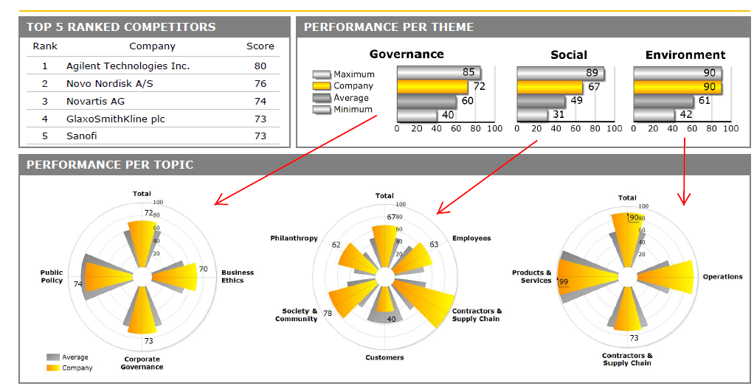

Slide 22
Measures
Sustainalytics as a source for:
  CI
  CSR
    Embedded & Peripheral
    Behavior vs. policy
    Membership in self-regulatory entities
    CPA
  Compustat
    Firm performance measures
      Accounting performance is a better indicator of short-termism

Slide 23
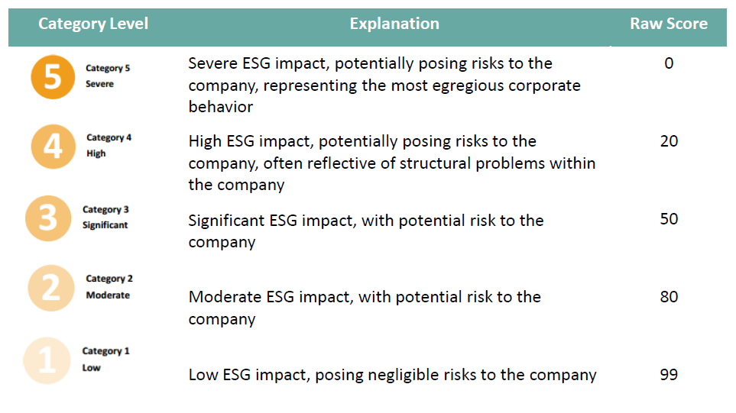
Corporate Irresponsibility
Controversies & Incidents
  10 items on a 5 pt likert scale (low impact to severe impact)
  Captures the severity and remarkability of contentious issues divulged, discussed, and debated publicly.

Slide 24
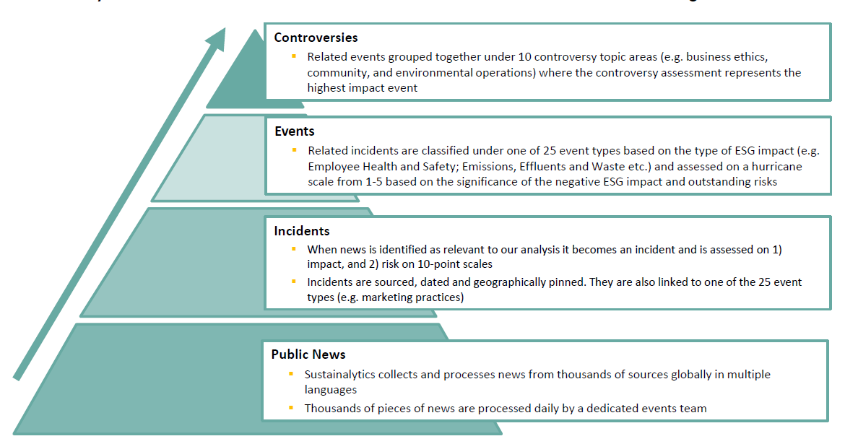
The nuance of the CI measure

Slide 25
Key References
Aguinis, H., & Glavas, A. (2013). Embedded versus peripheral corporate social responsibility: Psychological foundations. Industrial and Organizational Psychology, 6(4), 314–332.
Campbell, J. (2007). Why would corporations behave in socially responsible ways? An institutional theory of corporate social responsibility. Academy of Management Review, 32(3), 946–967.
Frooman, J. (1997). Socially Irresponsible and Illegal Behavior and Shareholder Wealth: A Meta-Analysis of Event Studies. Business & Society, 36(3), 221–249.
Fligstein, N., & Shin, T. (2007). Shareholder value and the transformation of the U.S. economy, 1984-2000. Sociological Forum, 22(4), 399–424.
Greve, H. R., Palmer, D., & Pozner, J. (2010). Organizations Gone Wild: The Causes, Processes, & Consequences of Organizational Misconduct. The Academy of Management Annals, 4(1), 53–107.
Kotchen, M., & Moon, J. J. (2012). Corporate Social Responsibility for Irresponsibility. The B.E. Journal of Economic Analysis & Policy, 12(1), 1–21.
Mishina, Y., Dykes, B., Block, E., & Pollock, T. (2010). Why “good” firms do bad things: The effects of high aspirations, high expectations, and prominence on the incidence of corporate illegality. Academy of Management Journal, 53(4), 701–722.

Slide 26
Analysis
Structural Equation Modeling
If market economy hypotheses stick:
Multilevel regression analysis.
  Level: firm-level predictors that vary within firms across years.
  Level 2: institutional level predictors that vary across firms but that do not vary within firms.

Slide 27
The domain of Strategic CI
(H8-14) Liberal Market economy (vs. coordinated) (+)
LEVEL 2
LEVEL 1
(H1&2) Competitive Advantage (+)
(H5) Embedded CSR (-)
(H3) Explicit CSR (+)
(Philanthropy, Community involvement, & CSR reporting)
Strategic CI
Peripheral CSR
Embedded Responsibility
(H6) Formal commitment to responsibility (-)
(H4) Self-Regulatory entities (+)
(H7) CPA (+)
NOTE: For parsimony, the path from market economy to the oval represents its moderation of each relationship, in lieu of four lines for hypotheses 11-14.

Slide 28
(H 11&12) Liberal Market economy (vs. coordinated) (+)
LEVEL 2
LEVEL 1
(H6) CPA (+)
(H7) Embedded CSR (-)
(H1&2) Competitive Advantage
Embedded CSR
Strategic CI
(H8) Formal commitment to CR (-)
(H3) Explicit CSR (+)
(Philanthropy, Community involvement, & CSR reporting)
(H9) Corporate Responsibility CEO incentives (+)
Peripheral CSR
Governance indicators
(H10) Board committees dedicated to responsibility (-)
(H4) Self-Regulatory entities (+)
NOTE: For parsimony, the path from market economy to the oval represents its moderation of each relationship, in lieu of five lines to H5-9.

Slide 29
Embedded Responsibility - CSR
Embedded/institutional/implicit
  Reliance on core competencies to integrate CSR into strategy, routines, and operations (Aguinis & Glavas, 2013; Godfrey, Merrill, & Hansen, 2009)
Organizational structures & practices matter for adherence to conventions of responsible firm behavior
(Warren, Gaspar, & Laufer, 2014; Weaver, Trevino, Cochran, 1999)
Firms engaged in embedded CSR will find it difficult to depart from such the norms associated with such strategic behavior to engage in strategic CSR (Jones, Felps, & Bigley, 2007)
Hypothesis 5: Embedded CSR will lead to lower levels of Strategic CI.

Slide 30
Embedded Responsibility – Formal Commitments
Formal commitments come (often) via executive & board level committees with goals of ensuring a firm’s legal compliance & meeting CSR standards
(e.g. Blair-Loy, Wharton, & Goodstein, 2011)
Logic of stakeholder centered decision-making
(Jones, Felps, & Bigley, 2007)
Firms with embedded CSR will find CI to conflict strongly with organizational structures & cultures of responsibility
Hypothesis 6: Formal management commitments to responsibility will lead to lower levels of Strategic CI

