Slide 1
Corporate Philanthropic Disaster Response in the Eyes of a Filipino Entrepreneur
Andrea Santiago, De La Salle University
Fernando Roxas, Asian Institute of Management
Philippines

Slide 2
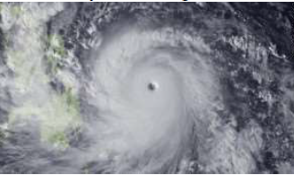
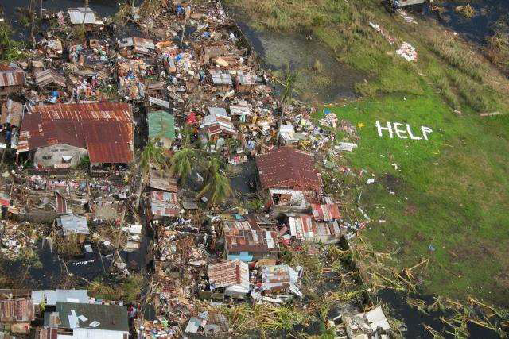
The context

Slide 3

More frequent and intense natural disasters would be the new “normal”
Developing countries are the most vulnerable because of geography and also because of economic factors.
Many developing countries have no disaster mitigation mechanisms in place

Slide 4

Much of the available research focus on large, publicly listed firms
Many of the successes stems from using their core competence in the rebuilding of damaged communities
TNT, DHL & Walmarts of the world

Slide 5

Very little research has been done on SMEs and family businesses
However, in many developing countries, SMEs are the most common business organizations
In Asia, especially in the Philippines, family-owned businesses make up 90% of firms.

Slide 6

Are the drivers for corporate philanthropy,
the same for large businesses as it is for SMEs?
the same for normal circumstances as it is for corporate disaster response

Slide 7
CORPORATE SOCIAL RESPONSIBILITY
CORPORATE PHILANTHROPY
CORPORATE PHILANTHROPIC DISASTER RESPONSE

Slide 8
CSR?
PR?
To be strategic, companies need to be able to integrate the economic and social benefits of their actions.
Porter and Kramer

Slide 9

For SMEs, the challenge has been to align their CSR programs with their core competencies
STRATEGIC versus INTUITIVE

Slide 10
Corporate drivers for humanitarian relief
desire to build a positive brand and to ‘insure’ against potential future political crises
to increase staff motivation
attempt to gather business intelligence
a desire to ‘do good’
Binder & Witte, 2007

Slide 11

The role of media in marshalling support

Slide 12
DISASTER RESPONSE
LOCAL
NATIONAL
REGIONAL
GLOBAL

Slide 13
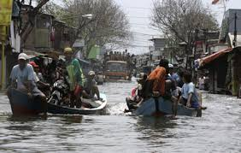
Developing countries rely a lot on developed countries to fund the gaps
Dependence on donations can make recipients complacent and entitled

Slide 14
VERSUS
OPPORTUNISTIC
IMAGE?
UNSYMPATHETIC

Slide 15
CSR
BUDGET
+
DISASTER
RESPONSE

Slide 16

Profitability levels and availability of slack resources generally determine how much firms can contribute
Companies closer to the disaster also contribute more
Coordinating relief operations is a logistical nightmare

Slide 17
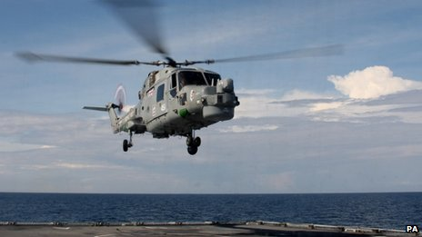
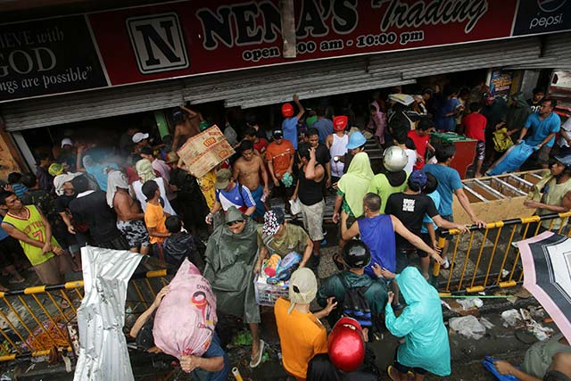
Coordinating relief operations is a logistical nightmare

Slide 18

DISASTER
RELIEF and
REHABILITATION
DISASTER
PREVENTION and
MITIGATION
OR

Slide 19
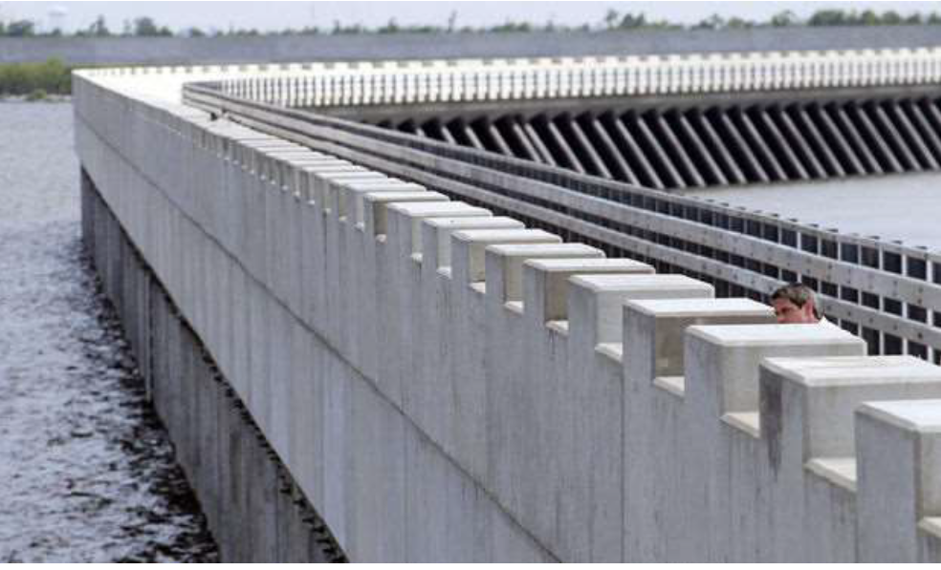

Slide 20
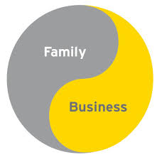
Lähdesmäki and Takala (2012) contend that altruism explains corporate philanthropy especially in small businesses where ownership and management rests with family

Slide 21
Family businesses and altruism
Since the SMEs and family owned businesses are extensions of the owner, the personal preferences of the owner are followed
The personal and moral values of the Owner/CEO are predictors of giving behavior
The process of deciding to donate can be more emotional rather than rational

Slide 22
family businesses are natural philanthropists
They probably have strong roots where their business operates or originated from
Family business owners believe it makes sense to be involved in community development
There exist a virtuous reinforcing loop between giving to the community and company growth

Slide 23

Business leaders determine the strategic direction of CSR programs
A leader’s strong belief in religion may also increase philanthropic giving
Appropriate governance & transparency is required for philanthropic and CSR activities

Slide 24
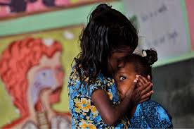
Zhang (2013) discovered that the more women in the Board of Chinese firms, the higher the support for disaster relief, assuming normal profitability.
Other researchers found that men were less altruistic than women in general
Other studies posit that it is diversity in Boards, rather than women who increase altruism in organizations
The Gender Factor

Slide 25
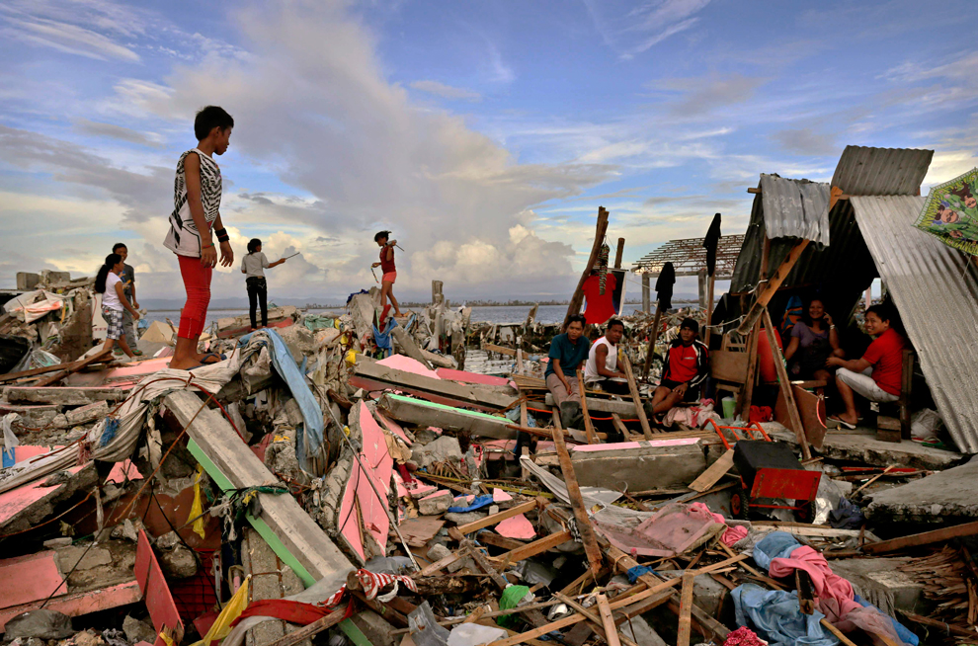
Typhoon Haiyan & The emme group of companies

Slide 26
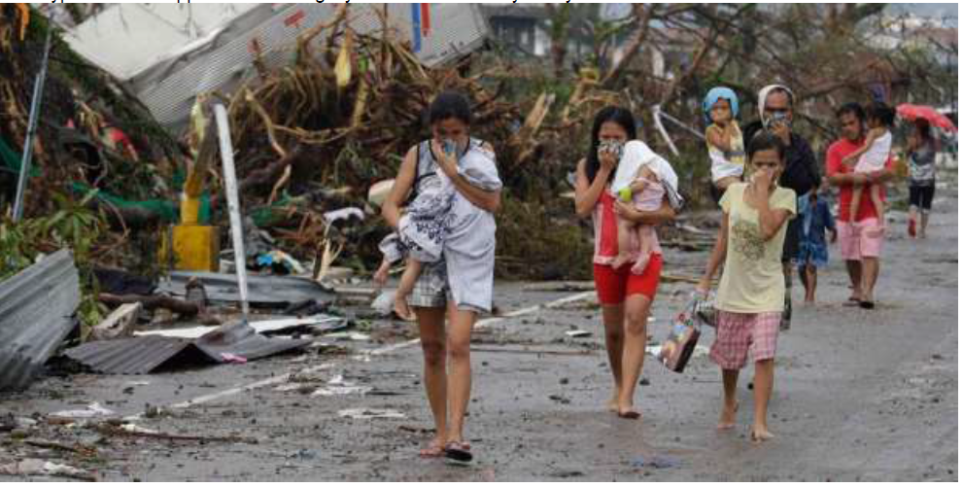
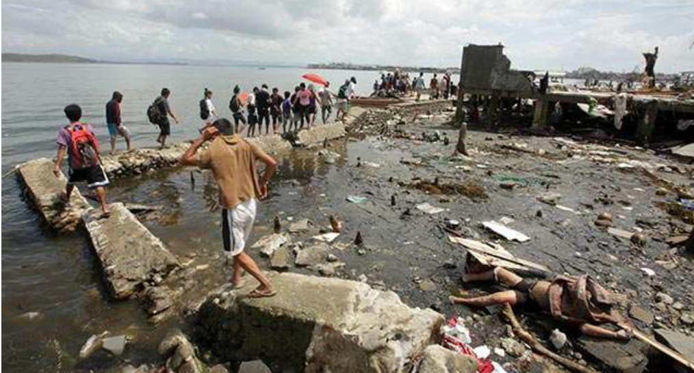
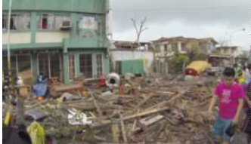
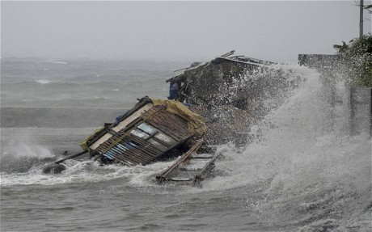
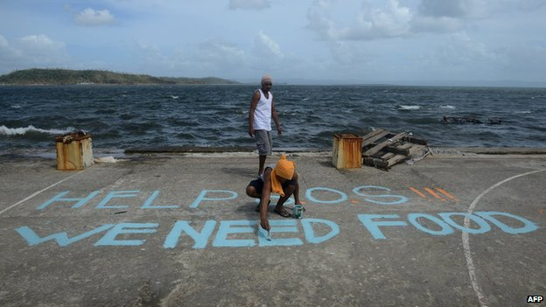
195 miles
per hour
4-storey waves
Damage of
$12.8 Billion
Donations
$1.6 Billion

Slide 27
Emme group of companies
(a) nature of disaster relief operation
(b) motivations to engage in disaster relief operations
(c) decision-making process,
(d) operational challenges encountered,
(e) the outcomes of the intervention.

Slide 28
insights
Emotional rather than rational
No thought of corporate image
Leaders = Board; immediate and longer response
Innate character of business leader (upbringing, religion)
Employee volunteerism due to relations with owners

Slide 29
Limitations and possibilities
EXPLORATORY
GAPS IN LITERATURE
GROUNDED RESEARCH
THEORY BUILDING

