Slide 1
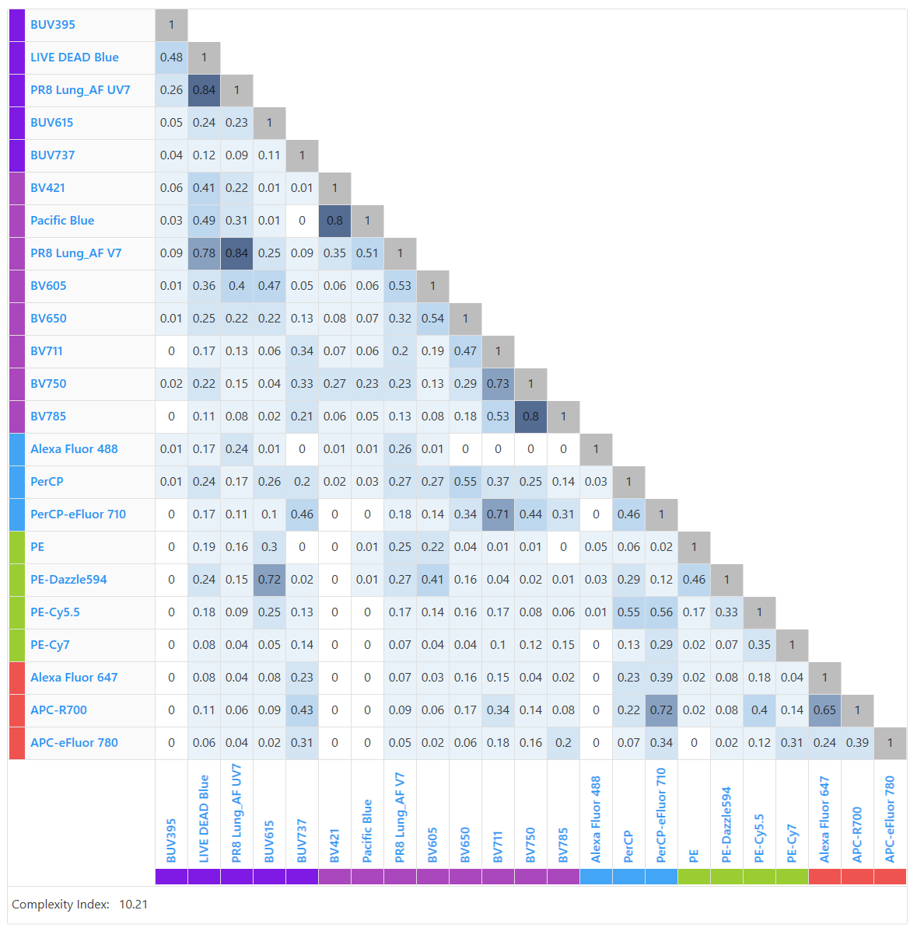
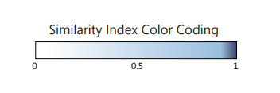
Multi-Compartmental Analysis of the Murine Pulmonary Immune Response by Spectral Flow Cytometry
Chang M.Y., Brune J.E., Black M., Altemeier W.A., and Frevert C.W.
American Journal of Physiology Lung Cellular and Molecular Physiology
Complexity Index 10.21
Supplemental Figure S1. Similarity™ and Complexity™ Matrix. The Similarity™ Index is a measure of fluorophore dye pair uniqueness on a scale from 0 to 1. Values close to 0 indicate that the full spectrum signatures of the 2 dyes are very different from each other, and values close to 1 indicate that the signatures are very similar to each other. The Complexity™ Index is an overall measure of uniqueness of all dyes in a full spectrum cytometry panel. The lower the value, the easier it will be to work with the dyes in the panel as the overall spread in the panel will be low; the higher the value, the more challenging it will be to work with the dyes in the panel as the overall spread is higher. Well-designed small panels (e.g. 10 dyes or fewer) will have complexity indices around 2 to 3. Well-designed large panels (e.g. 35 to 40 colors) will have complexity indices around 40 to 50. This panel including 20 fluorophore-antibody conjugates, Live/Dead Blue viability dye and two AF signatures, has low similarity and complexity. Compatibility of the two lung AF signatures from lungs of PR9-infected mice with all other fluorophores in this panel are shown in the red boxes.

