Slide 1
Choices
Session 4 For SCS Program

Slide 2
Choices definition
An act or instance of choosing; selection
The right, power, or opportunity to choose; option
The person or thing chosen or eligible to be chosen
An alternative
An abundance or variety from which to choose

Slide 3
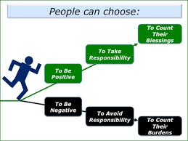

Slide 4
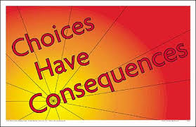

Slide 5
Conditioned response
http://www.youtube.com/watch?v=H6LEcM0E0io

Slide 6
Making choices under high stress
Stop and take a few minutes to breathe deeply
Then think about the question that was asked or the situation that has happened
Then ask yourself:
  Does this benefit me?
  Do I have time?
  What are the consequences?
When you are calm then make the choice otherwise wait to make a decision

Slide 7
How the brain makes choices
http://www.youtube.com/watch?v=sy0P5AYwFao

Slide 8
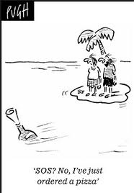
What Choices benefit you and society?

Slide 9
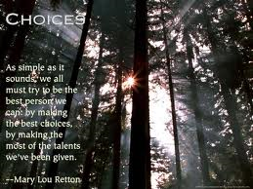
Choices that benefit you and society
Volunteering
Helping someone if it is safe
Picking garbage up off the ground
Recycling
Being kind to all people
Having a positive attitude

Slide 10
How to deal with mistakes when bad choices are made
Step1: What was the mistake?
Step 2: How could you make a better choice next time?
Step 3: What were the triggers?
Step4: What were the red flags?
Step 5: Guilt is good but do not put yourself down or continuously cycle through the mistake
Step 6: Forgive yourself and move forward
Step 7: Make better choice next time the situation arises

Slide 11
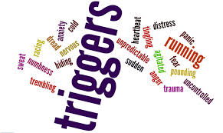
Defining triggers
A trigger is a thought about a situation that leads to an inappropriate response to that situation
It is not the situation or the feeling that’s the problem; it’s how the individual thinks about these things and what they say to themselves that causes problems
Read more: http://www.empoweringparents.com/How-to-Find-the-Behavioral-Triggers-That-Set-Your-Kid-Off.php#ixzz2vhdpW9Es

Slide 12

Defining Red flags
Red Flags are Warning Signs
  Listen to what people are saying around you
  Observe peoples behavior
  Are you hearing things that could be harmful to you or someone else?
  Are you getting an uncomfortable feeling?
  Listen to your instincts

Slide 13
Choices that follow you for life
Having a baby
Getting an STI
Committing a crime
  Unable to leave country
  Unable to get a job
  Unable to get a house or apartment
Doing drugs and changing your brain chemistry or overdosing
Hurting someone else

