Slide 1
Shared Values
Catalysts for Inspiring and Implementing Change in Library Collections
VIVA Collections Forum | May 21, 2021
Denise Pan, University of Washington
Notes:
Abstract:
What do you value? How do your values impact your work and your professional priorities?
Institutional and organizational values provide a foundation for identifying actions with purpose, and the process of implementing a vision. Drawing from past, present, and future plans and examples, Denise will demonstrate how she generates, evokes and applies values in library collection management. Driven by shared values and collective vision, there are opportunities for better outcomes when we are negotiating big deals, cancelling subscriptions, and exploring control digital lending together. Join us to reflect on the possibility of a shared values-driven approach at your institution and in our collective work at scale.

Slide 2

The University of Washington acknowledges the Coast Salish peoples of this land, the land which touches the shared waters of all tribes and bands within the Suquamish, Tulalip and Muckleshoot nations.
Credit: University of Washington

Slide 3
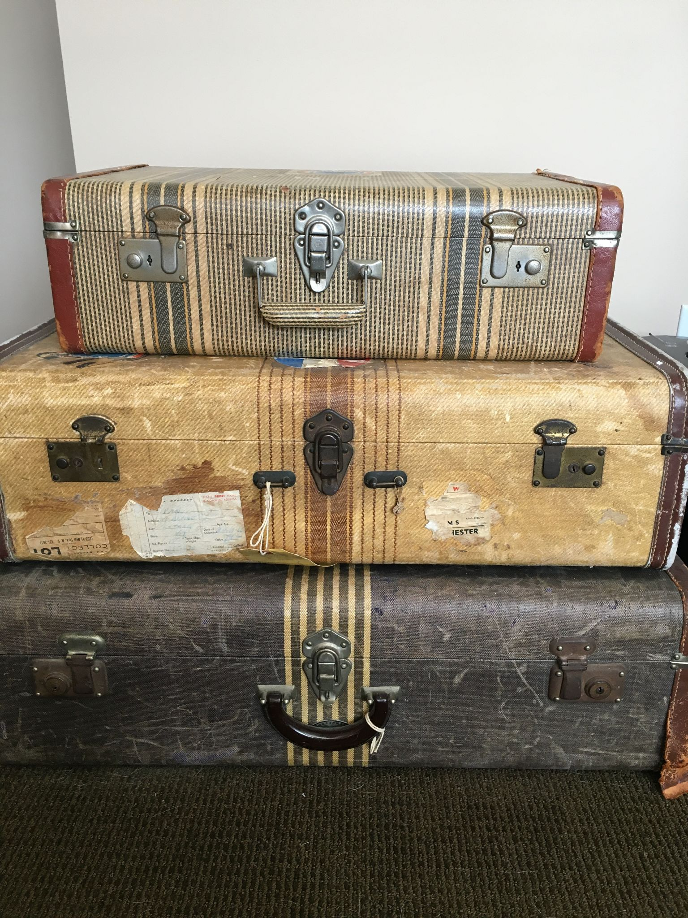
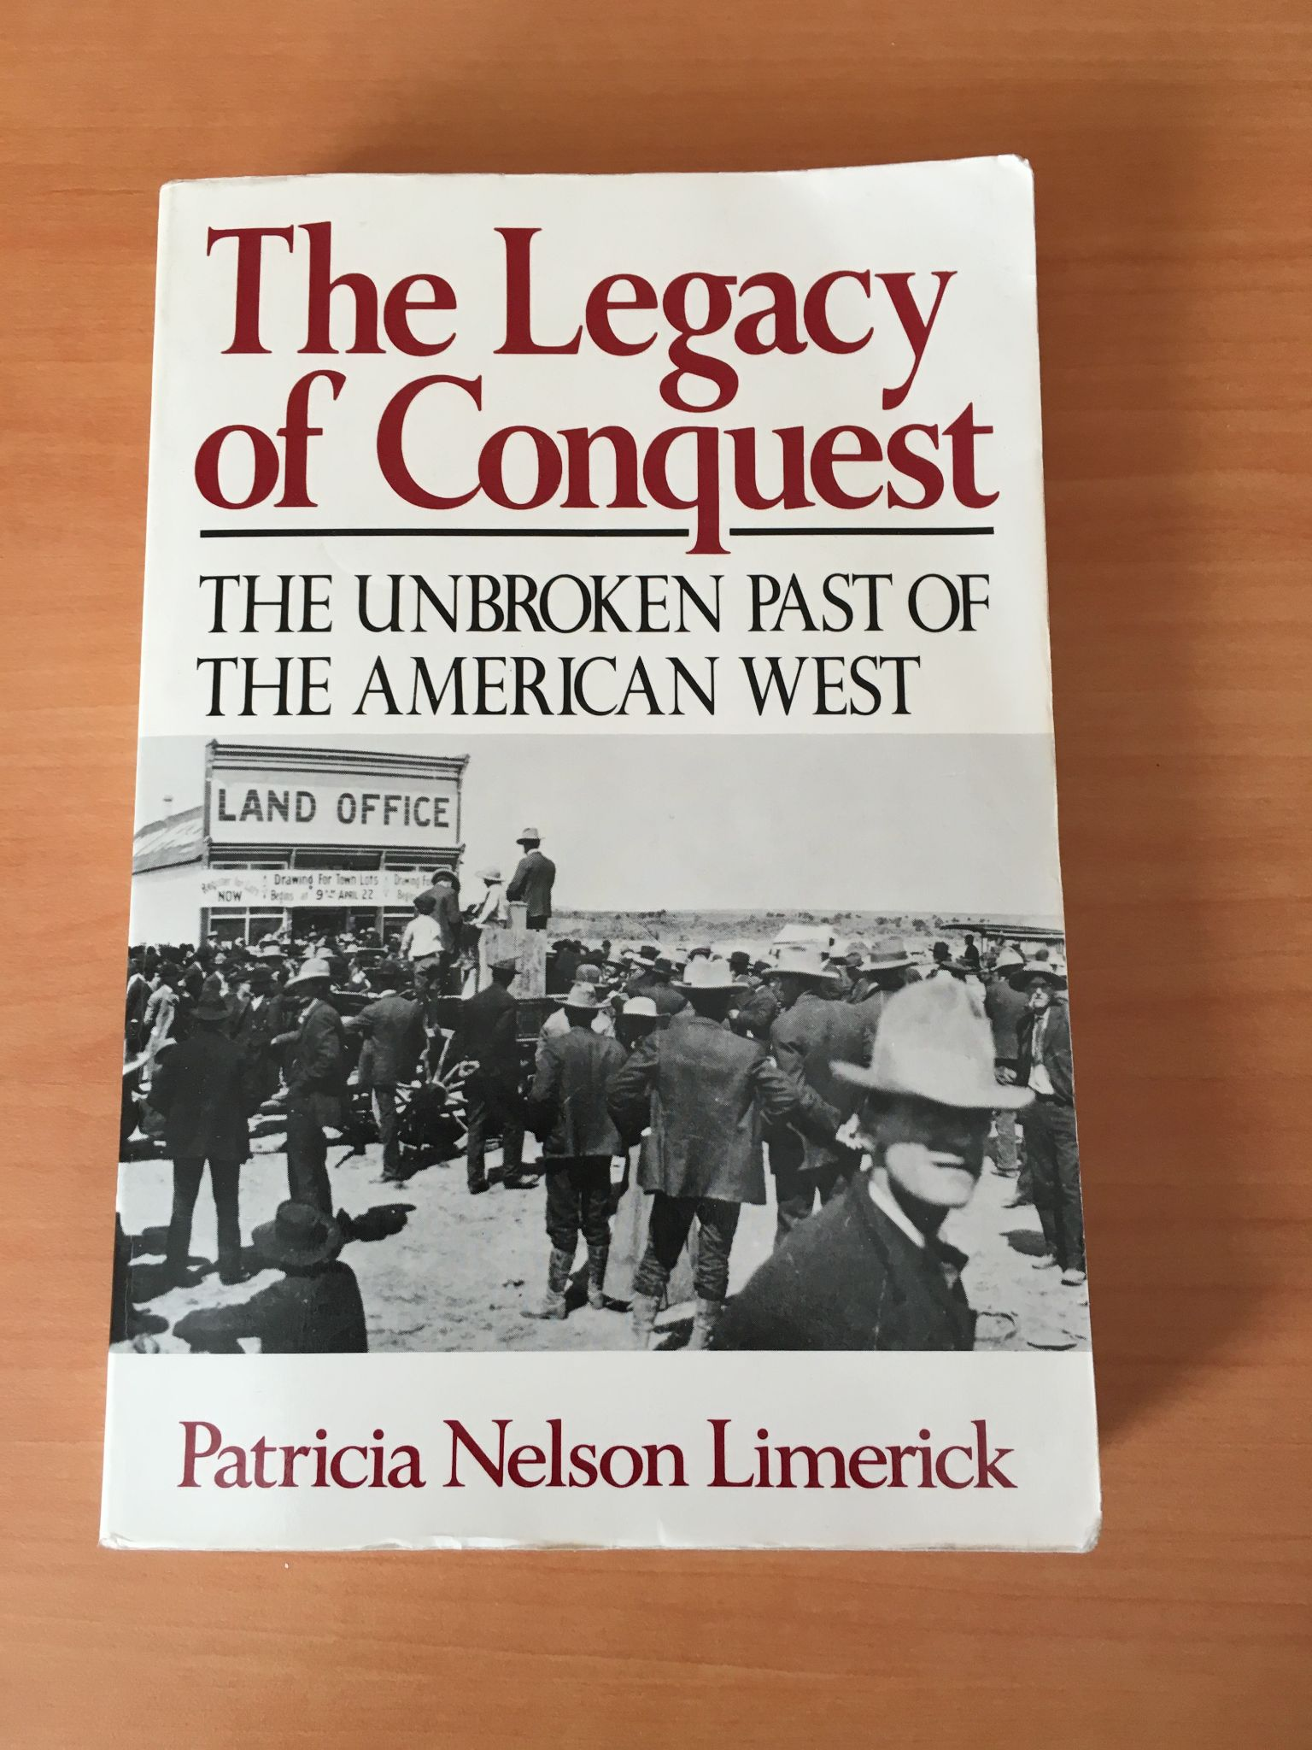
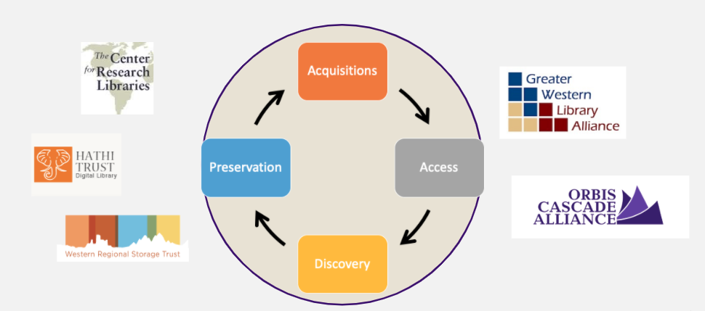
The Legacy of Community
The power of the future for Libraries
Consortia membership organizations
What do you value?
How do your values impact your work and your professional priorities?

Slide 4
University of Washington
MISSION
The University of Washington Libraries advances discovery and enriches the quality of life by connecting people with knowledge.
VISION
The University of Washington Libraries will accelerate inquiry, creativity, and learning for global impact and the public good. We will advance student success, catalyze world-class research, amplify the diverse voices of our communities, and empower faculty, staff and students to experiment fearlessly and create new knowledge.
VALUES
User Centered
Collaboration
Equity
Creativity
Sustainability

Slide 5
Case Studies
Themes
Transparency and clarity
with communication
Aligning values with actions
Focusing on values to build consensus and community
Past: the big deal
Present: cancellations
Future: controlled digital lending

Slide 6
The Big Deal: Context and Communications
Three journal packages ending December 31, 2019
Combined cost ~$4M nearly 25% of total publically-funded collections budget
  Springer and SAGE: negotiated via regional consortia, the Orbis Cascade Alliance (39 colleges and universities in Oregon, Washington, and Idaho)
  Elsevier: Negotiated directly
Public Announcements
March 7, 2019: Blog post
For the public good
May 16, 2019: Faculty Senate approved Class C Resolution
June 4, 2019: Convened Elsevier Negotiation Team
Oct 28, 2019: Convened Alternative Access Committee

Slide 7

There is a disconnect in the scholarly publishing ecosystem between the creators of scholarship and the ownership and distribution of scholarship…
...step back and reflect on our values as we think about this changing landscape of scholarly communication and our future negotiations with publishers. Among these values are a focus on sustainability, equity and user-centeredness.
UW research attains its
greatest impact on our most pressing global challenges when we advocate for open, public and emerging forms of scholarship.
https://sites.uw.edu/libstrat/2019/03/07/our-values-scholarly-communication/

Slide 8
Transparency
& Clarity
Cost Containment to provide collections for UW
Confidentiality to support research for the public good
Supporting UW Campus with
  Interlibrary Loan
  Accessibility
  Author Rights
  Early Termination Clause
  Open Access Workflows
  Privacy/Personal Data Processing
UW Sustainable Model: Elements

Slide 9
Libraries Dean Announces Elsevier Contract Finalized
January 3, 2020
I’m pleased to announce the Elsevier Negotiation Team, comprised of UW faculty and librarians, successfully negotiated a new journal subscription contract with Elsevier. The three-year agreement maintains access to publications that include more than 2,500 journal titles in the life, physical, medical, technical, and social sciences for the total cost of over $7.7M USD with an overall projected cost reduction of over $890K USD over the term of the contract. Pricing data and the full-text 2020-2022 license is available on the SPARC Big Deal Knowledge Base…
Sincerely,
Lizabeth (Betsy) Wilson
Vice Provost for Digital Initiatives and Dean of University Libraries

Slide 10
UW Elsevier Checklist
Bringing down subscription costs and increases to a sustainable level that will not imperil other collection and service needs See Schedule 1 “Subscribed Products/Access/Fees” Page 10
Ending NDAs to allow the Libraries to disclose their contractual terms and permit greater market transparency See 7.8 “Confidentiality” - “INTENTIONALLY DELETED” Page 8
Allowing interlibrary loan to facilitate resource sharing See 1.3 “Authorized Uses” Page 1-2
Protecting the rights of users to share articles with students and colleagues See 1.3 “Authorized Uses” Page 1-2 Pilot for International Interlibrary Loan (ILL) Page 2
Ensuring the privacy and data security of all users See 7.6 Page 10 and UW PDPA
Protecting the ability of students and researchers to continue to access journals and articles
See Schedule 1.1 “Post Termination Access to Subscribed Titles” Page 12
Supporting the University’s Open Access policies by allowing re-use and embargo-free deposit rights and protecting researchers’ copyright in their own research Letter of commitment for collaboration “to make sincere, good faith efforts to develop a practical, tangible Green OA pilot”
Enabling greater market flexibility and responsiveness by negotiating contracts on a 3-year basis
See “Schedule 1” Page 10
Providing equitable service and access to information for all our library users See 2.5 “Accessibility” Pages 6-7 (Agreed to “reasonable efforts”, Not to “shall comply”)

Slide 11
Quick Poll
Cost
Ending NDAs
ILL
International ILL
Privacy
Post termination access
Author rights for re-use
and embargo-free
deposit
Market flexibility
(shorter contract)
Accessibility
Top Three...
Which bargaining priorities are most important to you?
Which bargaining priorities are most important to your institution?
Up next...
Case Study | Present: cancellations

Slide 12
Announced FY21 cancellation target
of $125k
Announced FY22 cancellation target $1.5M in subscriptions
Posted initial list of proposed subscription cancellations
November
December
February
2021
March
April
Posted subscription review principles and timeline
Updated posting Principles and Rubrics for Subscription Review

Slide 13
Principles for Subscription Review
Goals
Greater transparency and clarity about our intentions
Create a framework for decision-making
Alignment with the Mission,
Vision, and Values
Details
To be posted on Libraries website
2-Part structure: 1) Preamble;
2) Actions aligned to values
Actions Aligned to Values
Sustainable
Equitable
Transparent
Collaborative

Slide 14
Principles & Rubric for Subscription Review
Principles | Rubric Elements and Assessment
To be sustainable… | Costs Current subscription price Subscription inflation rate over time
To be equitable… | Usage Cost per use (e.g. cost divided by the number of article downloads) Accessibility Compliance with UW Policy Library E-Resource Accessibility Testing Results Available to users across the three campuses (e.g. print library-use only subscriptions) Support underrepresented voices Representation of historically marginalized groups Uniqueness of subject matter Addressing needs of smaller programs (e.g. fine arts, language, etc.) Preserves and increases access to culturally-relevant information resources
To be collaborative and transparent… | Consultation Subject librarians consult with faculty, students, and staff in academic departments and programs. Subject librarians consult with librarian colleagues on all three campuses. Subject librarians consider comments and feedback when making cancellation decisions.

Slide 15
Quick Poll
Yes, no, maybe...
Do principles & rubric for subscription review resonate with you?
Would they resonate at your institution?
Up next...
Case Study | Future: controlled digital lending

Slide 16
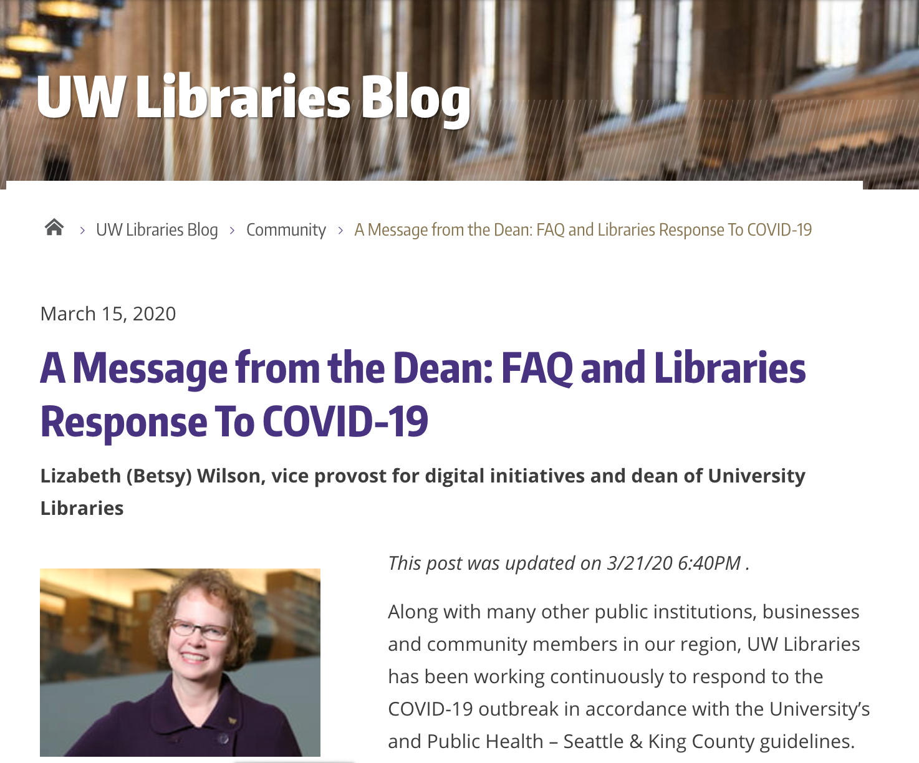

Notes:
https://sites.uw.edu/libstrat/2020/03/15/a-message-from-the-dean-libraries-response-to-covid-19/
https://sites.uw.edu/libstrat/2020/04/06/hathitrust-expands-access-to-materials-for-uw-libraries/
T

Slide 17
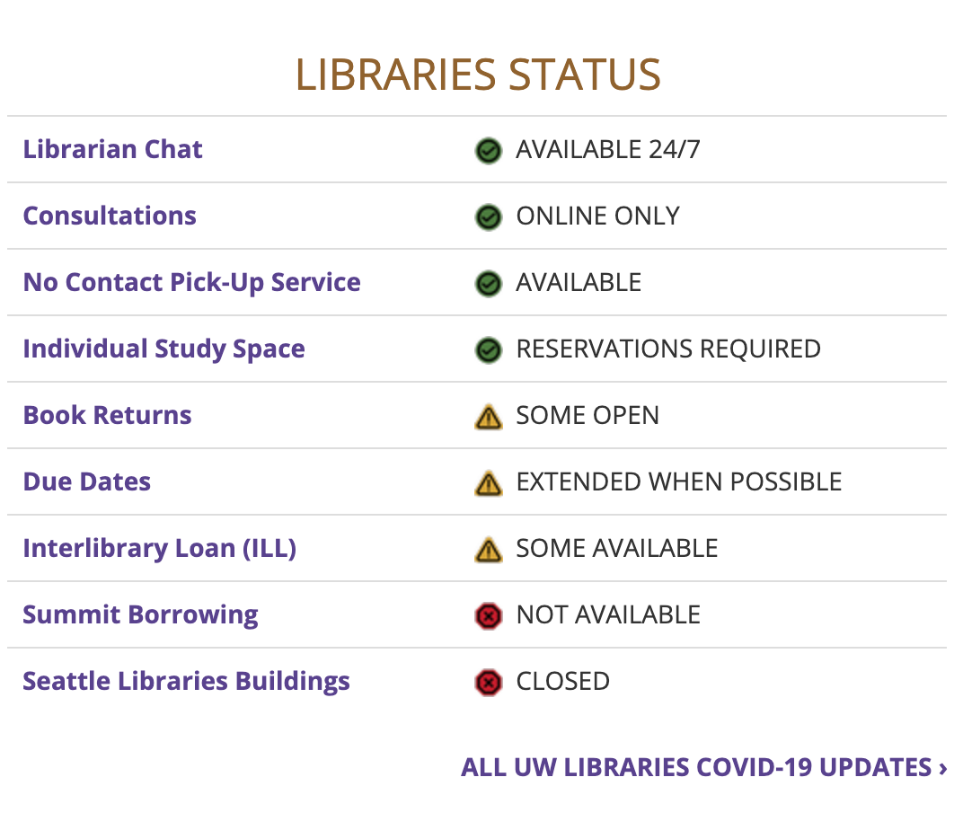
When will Libraries open again?
Suzzallo, Allen, and the 12 branch Libraries on UW Seattle campus are not currently planned for physical reopening during spring and summer quarter.
Maintaining HathiTrust Emergency Temporary Access Service is a critical factor in the Libraries’ reopening strategy. At this time, Libraries must prioritize spaces that do not conflict with the HathiTrust partnership that provides access to over 1 million electronic resources critical for current hybrid learning.
Our current planning approach prioritizes the safe and successful transition to expanded Libraries access in fall quarter: maximizing in-person study areas, access to physical materials and a return to more routine operations, pending current public health status and state/UW guidelines.

Slide 18
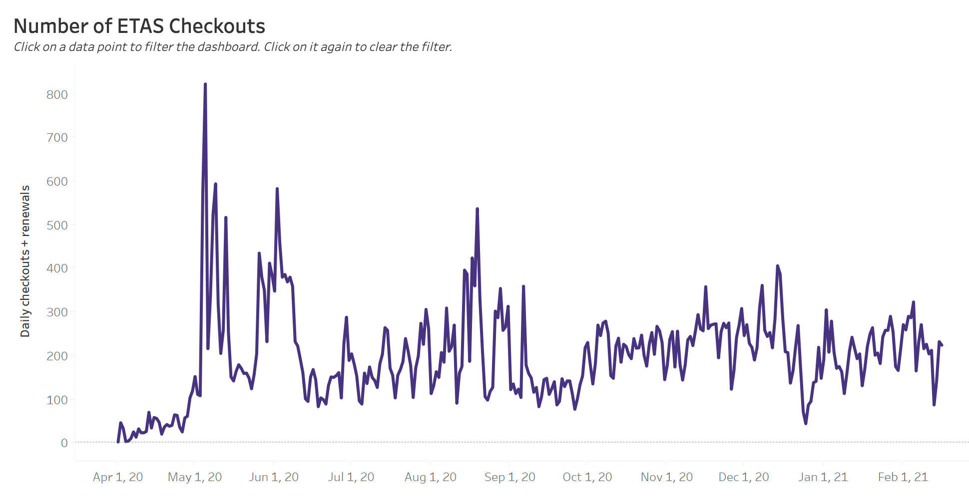
UW Libraries HathiTrust Total Usage 4/1/2020 to 2/16/2021
@UW Libraries Search
1.7 million books from UW Libraries
(Emergency Temporary Access)
3.7 million books in public domain
(Ongoing Access)
5.4 million total

Slide 19
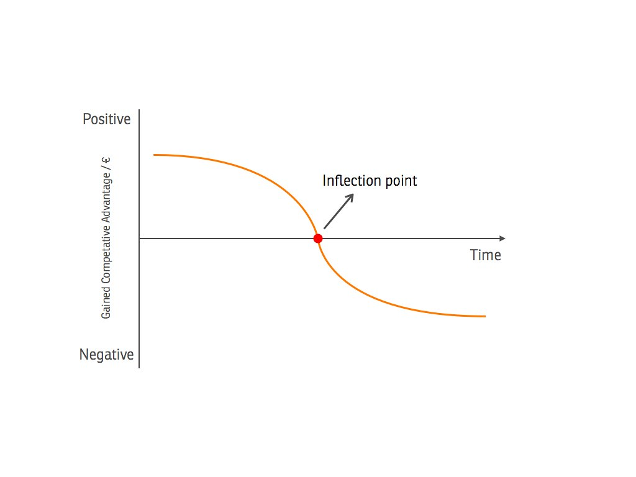
Inflection point…
Paradigm shift
or something else?
Credit: marcfonteijn

Slide 20


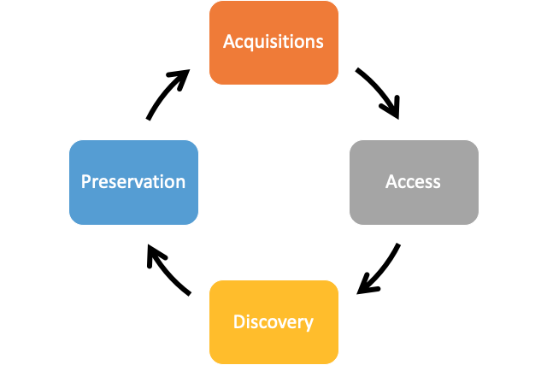



Shared values, community, and workflow

Slide 21
Opportunities to reflect and reiterate
Shared Challenges
  Flat or decreased budgets
  Limited staffing
Shared Opportunities
  Build on success with
  Collection Development and Resource Sharing
Shared Solutions
  Identify strategies, best practices and workflows across the consortium’s membership
Sustainable Cost Share Model for CDL
Example: Transparency and Tiers: Restructuring a Publisher Deal with a
Modified Decision Matrix
Methodology for complex problems requiring systematic consideration of multiple criteria and various stakeholders
Strategy ensures better decision making and timely implementation by using decision matrices, to explore options, make choices, and communicate decisions to stakeholders.

Slide 22
Opportunity to align and assess values (VIVA mission & vision)*
Values | Potential Assessment
Cost-effective* | Costs* Demonstrated value and return on investment Save institutional money and staff time by avoiding duplication
Equity* | Usage* Virginia's nonprofit academic libraries and their students Covering all subject areas Anti-racism (excerpts from Statement) Incorporate a focus on minority-owned and led publishers in the upcoming Small Publisher Task Force work. Collect and further promote member institutions’ resources related to anti-racism.
Cooperative* | Communication & consultation (from Joint CDL Task Force) Recommendations for Steering Committee Appointed by the Chairs of the Collections and Resource Sharing Committees Share best practices and workflows back out to VIVA institutions

Slide 23
Quick Poll
Cost
Usage
Anti-racism
Communication and
Consultation
Which assessment criteria will be an opportunity?
Which assessment criteria will be a challenge?

Slide 24

Final thoughts
Appreciation | Gratitude | Privilege
Credit: University of Washington

Slide 25
Shared Leadership
Who’s at the table? Who is not and why?
What’s the process for decision making? With pathways for input?
What resources are available & needed? Unintended consequences?

Slide 26
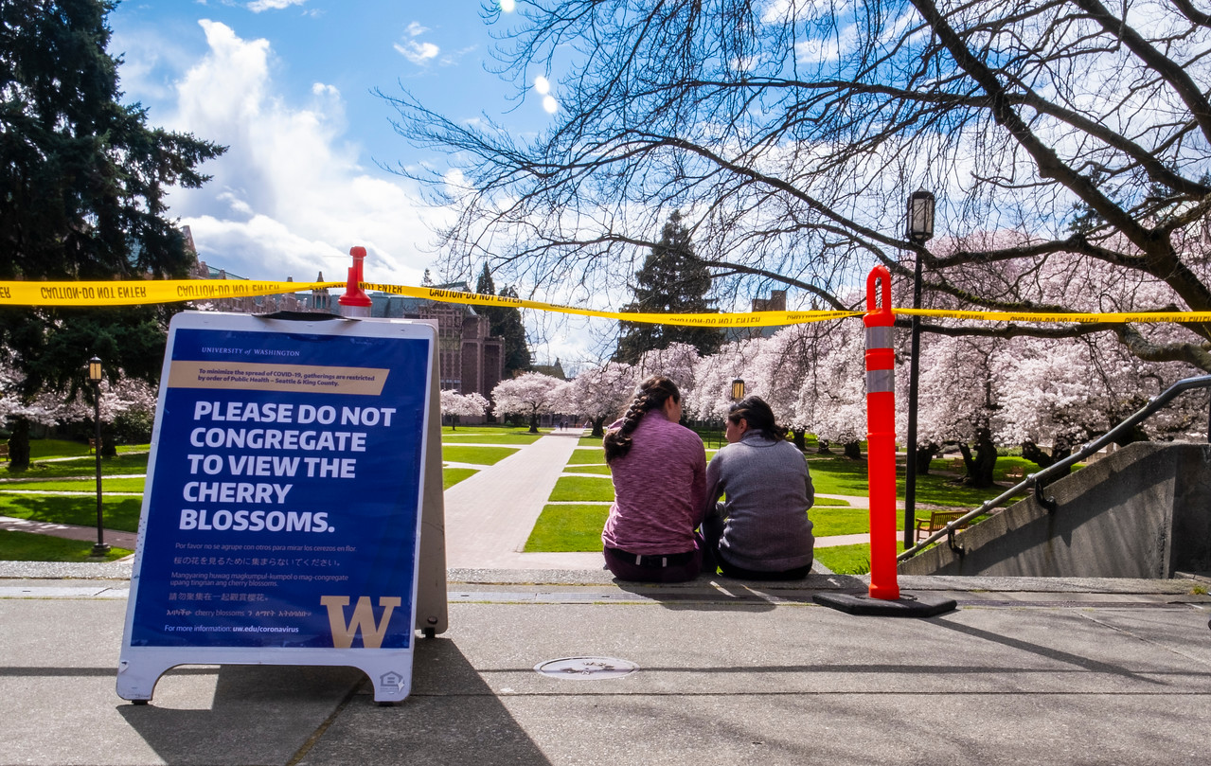
Thank you!
Questions?
Denise Pan
University of Washington Libraries
Box 352900
Seattle, WA 98195-2900
e. dpan@uw.edu
v. 206.543.4786 (Voice & Relay)
Credit: University of Washington

