Slide 1
The Moderating Effect of
Third-Party Assurance
Disclosed CSR Performance and Investor Judgments
on the Relationship Between
Leila “Emily” Hickman, PhD Student
Washington State University
Professor Bernie Wong-On-Wing
Washington State University

Slide 2
Growth of the CSR Movement
Lifestyles Of Health & Sustainability consumers: 19% of the U.S. market
Socially responsible mutual funds: $12 billion in 1995 to nearly $600 billion in 2014
Companies reporting in the Carbon Disclosure Project 1,449 in 2005 → 4,112 in 2012 (23% annual growth)
  Carbon disclosure is required in the UK and France, proposal under consideration by the European Union
GRI reports: 44 companies worldwide in 2000 → 3,653 companies worldwide by 2012
Notes:
Environmental and social dimensions of corporate performance are playing a growing role in investment and consumer decision making

Slide 3
Importance of CSR to Firms
Employees
  CSR themes such as “save the world” and “social responsibility” attract top MBA talent (McKinsey & Co. and Net Impact)
  CSR-conscious firms can attract better talent and motivate employees to improve productivity (Waddock and Graves 1997; Roberts and Dowling 2002; Edmans 2011)
  Greater employee satisfaction is likely to translate into better future financial performance (Banker and Mashruwala 2007)
Customers
  CSR impacts consumers’ assessment of a firm’s products (Brown and Dacin 1997) and has been linked to increased sales (Lev et al. 2010)
  Half of the 14,000 U.S. respondents polled in The Harris Interactive 2013 Reputation Quotient Survey said they “decided not to do business with a company because of something (…) learned about how the company conducts itself”
Regulators
  Superior CSR performance can result in “favorable treatment by regulators and policy makers” (Dhaliwal et al, 2012 citing Brown et al. 2006)
Capital Markets
  Institutional investor signatories to the CDP: 655 signatories in 2012, managing over $78 trillion
  A majority of shareholders’ association members in the US (60%), UK (50%), and Australia (68%) favor mandatory environmental disclosure
  Lower cost of equity capital for firms initiating CSR disclosure with positive CSR performance (Dhaliwal et al. 2011) and better financing terms offered by banks (Goss & Roberts 2009)
Notes:
appearance of “green products”
Wal-Mart → McKinsey & Co. report which indicated that “2% to 8% of the company's customers have stopped shopping” at Wal-Mart because of negative press regarding the company’s poor labor and environmental reputation

Slide 4
CSR and the Accounting Profession
G250: 52% issued CSR reports in 2005 → 92% in 2013
  30% were assured in 2005 → 59% in 2013 (KPMG 2013)
Robert Elliot (1997): ‘‘The audit tradition is a professional asset of incalculable value. It derives from the marketplace need for high-quality, decision-making information.”
The Sustainability Accounting Standards Board (www.sasb.org)
All of the Big 4 accounting firms provide assurance and consulting services related to sustainability Deloitte is providing certified GRI training seminars
The Accounting Review: “A Forum on Corporate Social Responsibility Research in Accounting”
Notes:
G250 = the largest 250 companies in the world
Big 4 - as featured on their websites.
In the first quarter of 2015, Deloitte listed three GRI training seminars scheduled around the U.S., each lasting two days (Deloitte 2015)

Slide 5
Potential “Greenwashing” in CSR Disclosures
“…management’s performance explanations tend to be self-serving” (Barton and Mercer 2005)
King (1998) claims that companies reporting inaccurate information trade at a lower price-to-earnings ratio than their peers, in what is termed as a “liar’s discount”
Holders-Webb et al. (2009) “document a generally self-laudatory tone in the content of CSR disclosures for sample firms”
Notes:
managerial decisions to ignore poor CSR performance in their disclosures
Empirical evidence uncovers a tendency of management to disclose only favorable voluntary information
If investors perceive CSR reports that are not assured and which contain only positive performance information as disingenuous (“greenwashing”), their negative impressions could have significant implications the firm’s reputation and its attractiveness as a potential investment

Slide 6
The Role of Assurance
Assured information is more credible (Pflugrath et al 2011; Libby 1979; Pany &Smith 1982; Johnson et al. 1983; Hodge 2001)
Approx. 59% of stand-alone CSR reports are independently assured (KPMG 2013)
“Attribution theory suggests that financial report users will discount self-serving statements when they are recognized as such” (Corman et al 2009, citing Koonce and Mercer 2005)
Notes:
Information that is assured is typically perceived to be far more credible than information that is not assured
“Attribution theory suggests that financial report users will discount self-serving statements when they are recognized as such, thereby resulting in a differential value being placed on the provision of assurance services (Koonce and Mercer 2005)” – Coram et al 2009
CSR reports will not be discounted as self-serving disclosures when third-party assurance exists

Slide 7
H1: Unassured Disclosure of CSR Performance
H1: In the absence of third-party assurance, investors’ assessments of a firm’s reputation will be lower when the firm’s disclosed CSR performance is all positive than when it is mixed.

Slide 8
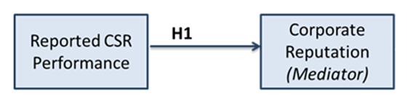
H1: Unassured Disclosure of CSR Performance

Slide 9
H2: Interaction of Disclosed CSR Performance and Third-Party Assurance
H2: The positive effect of third-party assurance on investors’ assessment of corporate reputation will be larger when the CSR performance disclosure is all positive than when the CSR performance disclosure is mixed.

Slide 10
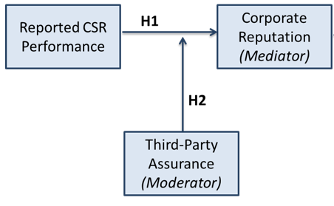
H2: Interaction of Disclosed CSR Performance and Third-Party Assurance

Slide 11
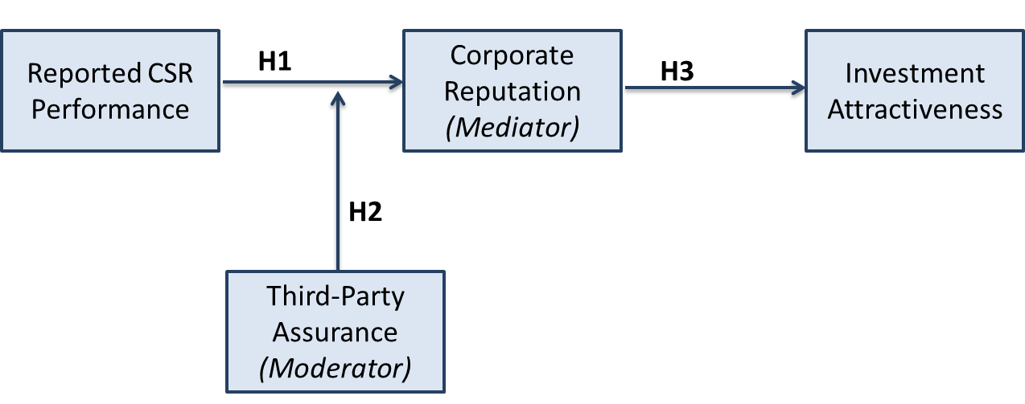
H3: Corporate Reputation as the Mediating Link to Evaluations of Investment Attractiveness
H3: Perceived corporate reputation will mediate the joint effect of CSR performance disclosure and assurance on investors’ perceived attractiveness of the firm as an investment.

Slide 12
Online Survey
Background on a fictitious firm in the soda industry
Financial information designed to make the firm a desirable investment
CSR report modeled after Starbucks’ and Coca-Cola’s
  Performance is manipulated
  Assurance is manipulated
Notes:
, with abbreviated financial statements modelled after an actual firm receiving favorable “buy”

Slide 13
Experimental Design
2 X 2 between-subjects design

Slide 14
Dependent Variables
Investment Attractiveness Assessment
  “How would rate the attractiveness of this firm’s stock as an investment?”
    11-point Likert scale: “Extremely Unattractive” to “Extremely Attractive”
Corporate Reputation Assessment
  RepTrakTM Pulse measure
    developed by Ponzi, Fombrun, and Gardberg (2011)
  4 questions: Cronbach’s Alpha 0.85
    7-point Likert scales: “Strongly Disagree” to “Strongly Agree”

Slide 15
Mediator DV
Corporate Reputation Assessment
  RepTrakTM Pulse from Ponzi et al 2011
Rate the extent… (“Strongly disagree” to “Strongly Agree”)
  …is a company have a good feeling about;
  …is a company that I trust;
  …is a company that I admire and respect;
  …has a good overall reputation

Slide 16
Online Survey – Additional Questions
Management Reputation Assessment Questions
Rate the extent… (“Strongly disagree” to “Strongly Agree”)
  …management has been honest in its reporting;
  …management is competent

Slide 17
Manipulation Check Questions
  Disclosed CSR Performance: All-Positive or Mixed?
  Assurance: Assured or Unassured?
  78 of 114 (approx. 68%) correctly answered both questions
Notes:
The data used to test the hypotheses exclude participants who failed one or both manipulation checks.

Slide 18
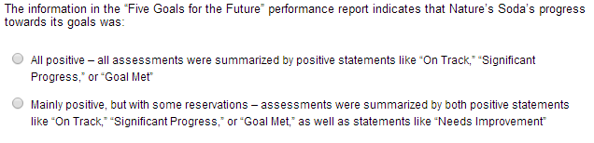
Manipulation Check Questions
  Disclosed CSR Performance: Positive or Mixed

Slide 19
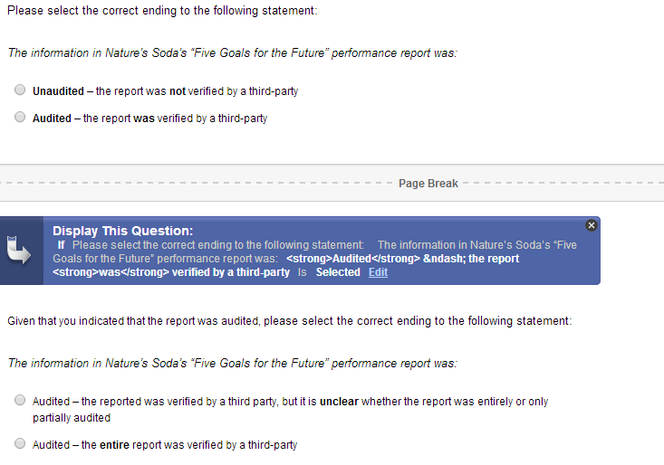
Manipulation Check Questions
  Assurance: Assured or Un-Assured

Slide 20
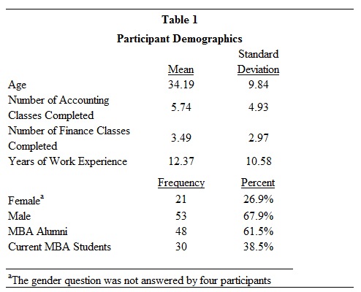
Table 1: Participant Demographics

Slide 21
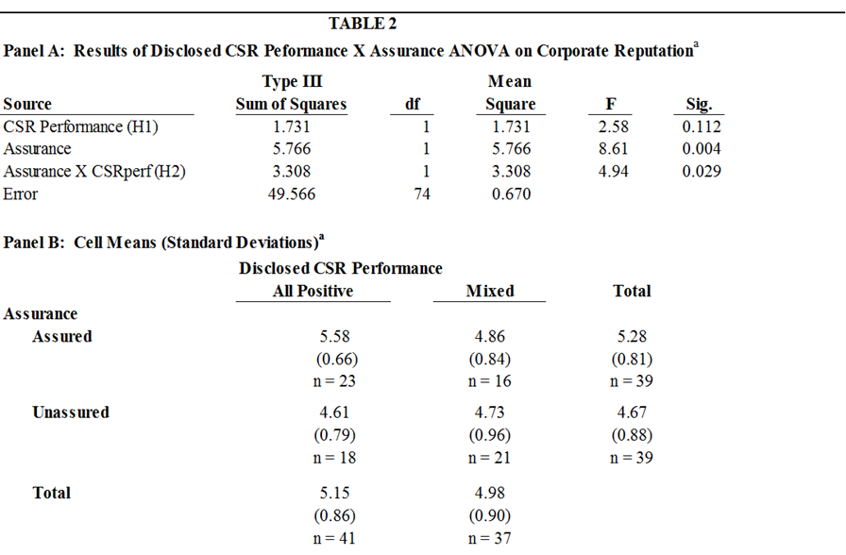
Table 2: Panel A & B
Notes:
H1: predicts that when the CSR report is not assured by a third-party, investors will discount the report disclosing all-positive CSR performance (“CSRperf”), leading to lower assessments of the firm’s corporate reputation (“CORP Reputation”) in the all-positive condition than in the mixed CSR performance condition.
As shown in Table 2 (Panel B), while the means were in the direction predicted (4.61 in the unassured all-positive CSRperf cell vs 4.73 in the unassured mixed CSRperf cell),
the difference is not significant (t = -0.409; p = 0.685).
Thus, H1 is not supported.
This result suggests that investors may discount unassured CSR reports that disclose only positive performance, but do not discount them to such an extent that the all-positive CSR performance reporting firm’s reputation is assessed significantly lower than a firm reporting mixed CSR performance.
H2: The second hypothesis predicts that third-party assurance will have a greater positive effect on investors’ assessment of corporate reputation when CSRperf is all positive than when CSRperf is mixed.
Consistent with this prediction, the analysis of variance in Table 2 (Panel A) reveals that the interaction between disclosed CSR Performance and Assurance is a significant predictor of corporate reputation assessments (p = 0.029).

Slide 22
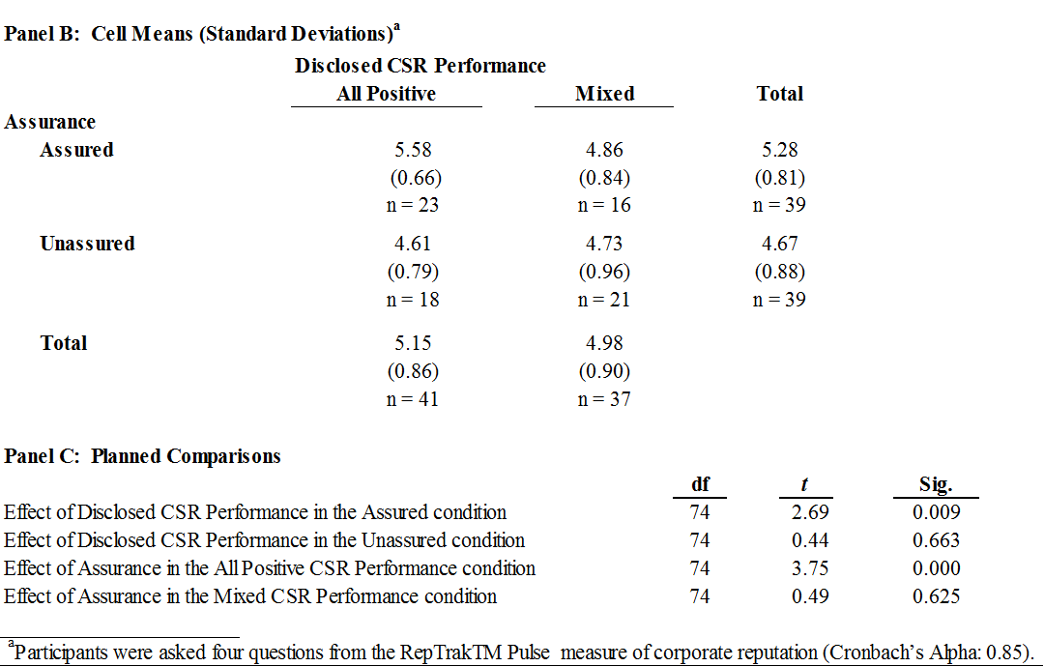
Table 2: Panel B & C
Notes:
To examine whether the nature of the interaction effect is as hypothesized, we perform planned comparisons.
As shown in Panel C of Table 2,
Assurance does not significantly change assessments of corporate reputation when the disclosed CSR performance is mixed (t=0.49, p=0.625),
but Assurance significantly increases corporate reputation assessments when the disclosed CSR performance is solely positive (t=3.75, p<0.001). This pattern of results supports H2.
Although not specifically predicted, it is interesting to note that the order of the four cell means (see Panel B of Table 2) from lowest to highest, is as would be expected: unassured/all-positive, unassured/mixed, assured/mixed and assured/all positive.
More importantly, post hoc tests (untabulated) show that CSRperf is significantly higher in the assured/all positive condition than in the other three conditions (all p-values <0.01).

Slide 23
Hayes’ Process Model 7 Output
Notes:
H3: predicts that the relationship between CSR performance and assurance on one hand and evaluations of the firm as an attractive investment on the other will be mediated by investors’ evaluations of firm reputation.
Consistent with our moderated mediation model shown in Figure 1, Hayes’ (2013) Model 7 was estimated using Preacher and Hayes (2004) - also Preacher, Rucker and Hayes (2007) - bootstrap test to examine the indirect effect proposed in the model (see Figure 1).
The results support the hypothesized moderated mediation.
Specifically, the indirect effect of CSRperf was stronger and significant in the assured condition (conditional indirect effect=-0.585, SE=0.242, 95% confidence interval of -1.19 to -0.206), but weaker and not significant in the unassured condition (conditional indirect=0.094, SE=0.233, 95% confidence interval of -0.313 to 0.619). This pattern of moderated mediation supports H3. Overall, the results indicate that investors’ evaluation of a firm’s attractiveness as an investment is significantly dependent on their assessments of the firm’s reputation, which is itself significantly affected by the nature of disclosed CSR performance and whether it is assured.

Slide 24
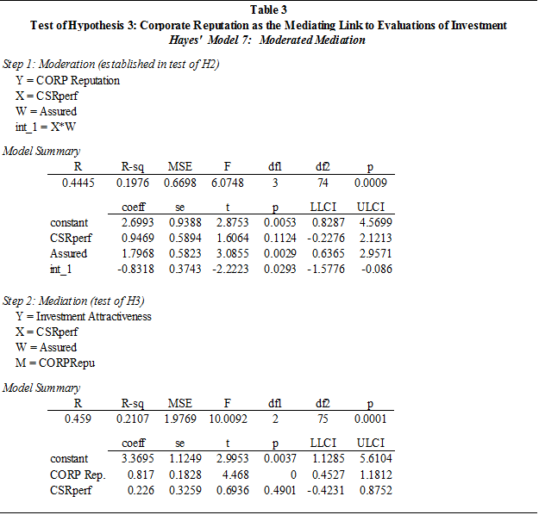
Table 3: Test of H3

Slide 25
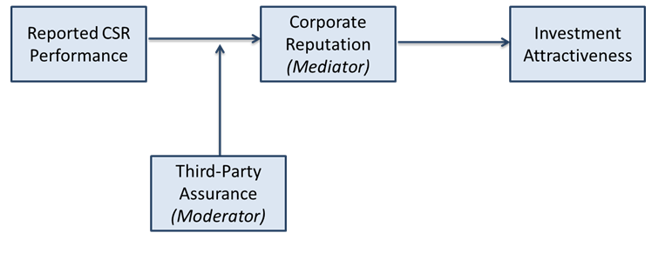
Summary of Results
The effect of disclosed CSR performance is moderated by whether the CSR report is assured
This interaction, in turn, effects investors’ assessments of corporate reputation
The assessment of corporate reputation predicts the investors’ evaluation of the firm as an attractive investment

Slide 26
Conclusions
CSR disclosures can positively influence investors’ assessments of corporate reputation, which in turn leads to greater investment attractiveness, if the disclosed CSR information is assured
  The lowest assessment of corporate reputation was in the All-Positive Unassured CSR disclosure condition
  The highest assessment is in the All-Positive Assured CSR disclosure condition
Managers of firms with superior CSR performance should strongly consider having their CSR disclosures assured
Opportunity for the accounting profession
Notes:
managers to strongly consider having their CSR disclosures assured
Almost half of stand-alone CSR disclosures are not being independently assured (KPMG 2013 and Simnett et al. 2009)

Slide 27
Thank you
Questions are welcomed!

Slide 28
Additional Analysis: Partial Assurance
Almost half of the firms issuing CSR disclosures only have partial assurance for their reports
(Center for Corporate Citizenship and Ernst & Young LP, 2013)
Will providing a vague statement regarding third-party assurance – as is often the case – mislead some investors?
Subjects who correctly indicated that the CSR disclosure was assured by a third-party in the manipulation check answered a subsequent question asking whether the disclosure was assured in full or if it was unclear how much of the disclosure was verified

Slide 29
Manipulation Check Questions
  Assurance: Assured or Un-Assured

Slide 30
Additional Analysis
Of the thirty-nine subjects who viewed assured CSR disclosures and correctly passed the manipulation check, twenty-eight (71.8%) correctly indicated that the level of assurance was unclear
Encouraging result!
May direct firms toward more comprehensive levels of assurance if they strive to project CSR authenticity and derive the maximum benefit to their reputations
Notes:
Indicates that respondents were paying attention to the information provided in the survey and did not jump to the conclusion that the entire report had been assured

Slide 31
Opportunity for Accounting Profession
Almost half of stand-alone CSR disclosures are not being independently assured (KPMG 2013)
Assurance providers are “fairly evenly distributed between members of the accounting profession (almost exclusively from the Big 4 accounting firms) and experts from outside the profession” (Plugrath et. al. 2011)
CSR disclosure assurance presents a considerable opportunity for accounting professionals, and this study can serve as evidence for auditors seeking to market the value of the assurance they can provide

