Slide 1
Role of Technology Selection in Supporting Collaboration and Communication in Globally Distributed Virtual teams
Presented by: Nishant Bordia
Committee: Dr. Carrie Sturts Dossick
Dr. Yong-Woo Kim

Slide 2

Agenda
Literature Review
Research Question
Methodology
Data Analysis
Conclusions and Future Research

Slide 3
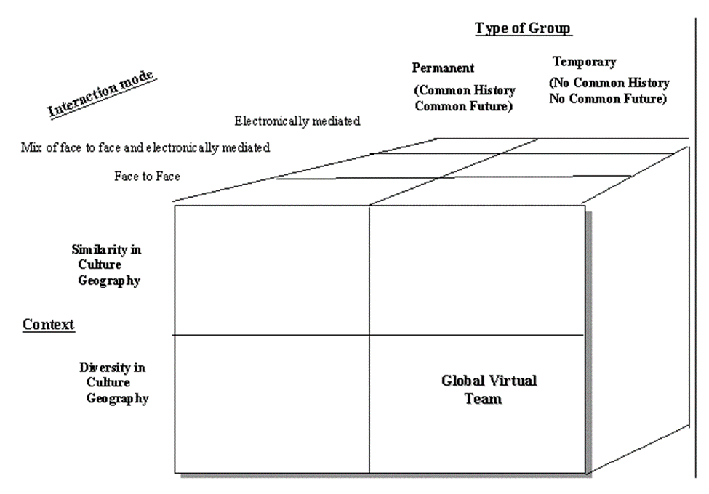
Defining Global Virtual Teams
“Groups of geographically and/or organizationally dispersed coworkers that are assembled using a combination of telecommunications and information technologies to accomplish an organizational task”, (Townsend et al. 1998)
Temporary, culturally diverse, geographically dispersed, electronically communicating work group (Kristof et al. 1995)
Source: Advances in Interdisciplinary Studies of Work Teams: Knowledge Work in Teams (Kristof et al. 1995)

Slide 4
Functionality of Virtual Teams
Socio-emotional processes
*Relationship building
*Cohesion
*Trust
Inputs
*Design
*Culture
*Technical
*Training
Outputs
*Performance
*Satisfaction
Parameters governing the functionality of Virtual Teams.
Influence of technology and leadership in establishing these parameters.
Task Processes
*Communication
*Coordination
*Task-Technology-Structure fit
Source: Life Cycle model of Virtual Teams (Powell, Piccoli and Ives, 2004, p.8)

Slide 5
Influence of Technology and Leadership
Technology and Leadership
Trust
Relationship building
Cultural differences
Distance and time difference
Training

Slide 6

Information and Communication Technologies (ICT)
ICTs are based on collaboration and contribute to competitive advantage, innovation, and economic growth as they enable global access to individual capabilities, best skills, and core competencies.
They allow individuals to communicate and share information and data regardless of their location in time and space, and are the primary means by which the members of virtual teams interact.

Slide 7
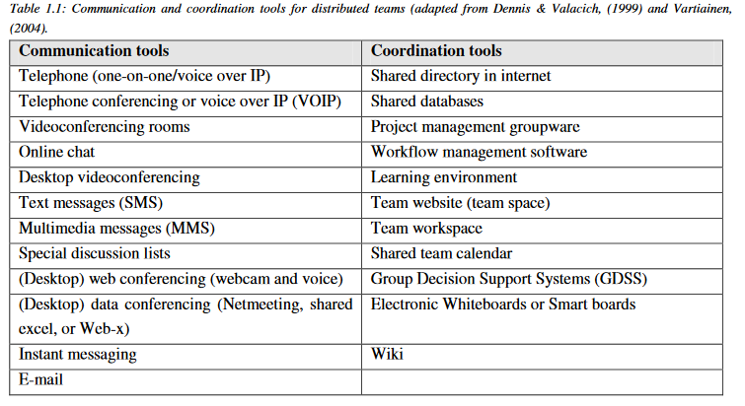
Communication and Coordination Tools
Communication and coordination tools for distributed teams (Dennis & Valacich, 1999 and Vartiainen, 2004)

Slide 8
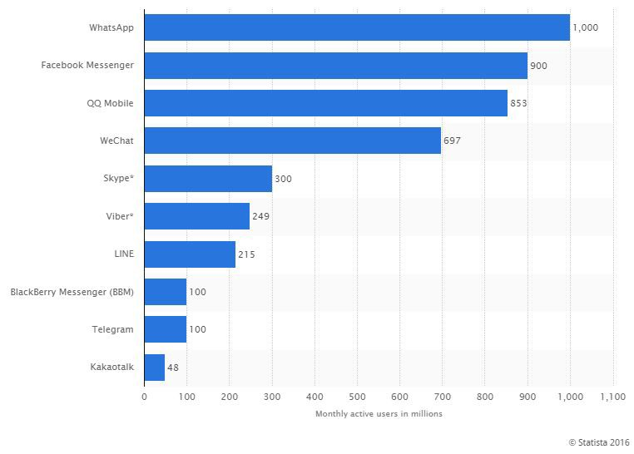
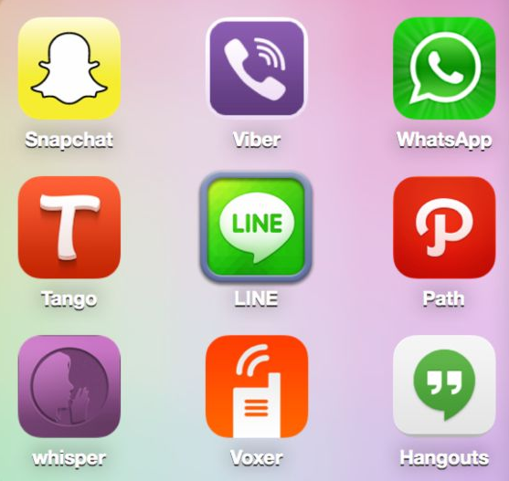
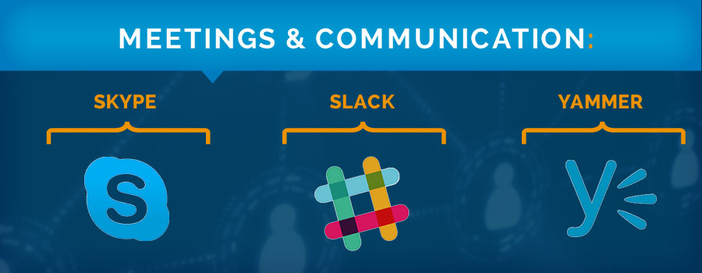


Current technology in use

Slide 9

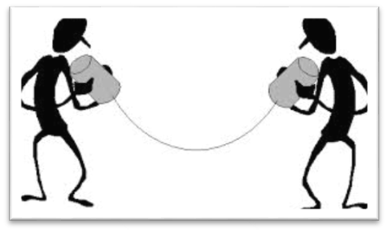

Leadership Practices of Effective Leaders of Virtual Teams
Establish and maintain trust using communication technology
Ensure that distributed diversity is understood and appreciated
Manage virtual work life cycle (meetings)
Monitor team progress using technology
Enhance visibility of virtual members
Enable individual members of the virtual team to benefit from the team

Slide 10
Categories of Leadership
E-Leadership
A social influence process mediated by advanced information technology (AIT) to produce a change in attitudes, feelings, thinking, behavior, and/or performance with individuals, groups, and/or organizations.
Transactional Leadership
Task-related exchange of actions and rewards between follower and leader.
Contingent reward, management by exception active, management by exception passive.
Transformational Leadership
Managing interpersonal relationships between team members and the leader.
Idealized influence (charisma), inspirational motivation, intellectual stimulation, and individualized consideration behaviors.
Technological Leadership
Need for leaders to identify or make available to the virtual team members the newest and the most appropriate communication and collaboration tools to maintain effective workflow and information exchange.

Slide 11
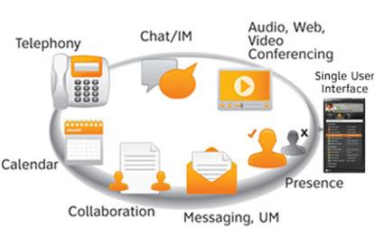

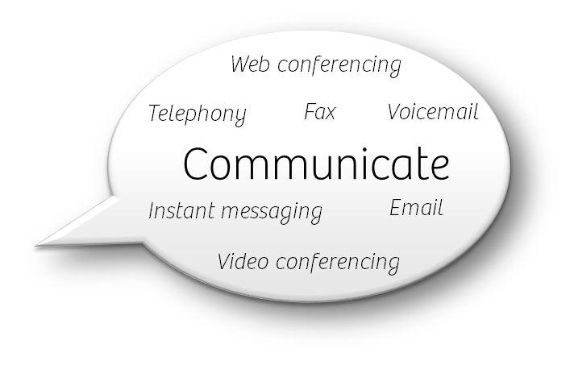
Concept of Technological Leadership

Slide 12


Research Question?
How does technology selection support collaboration and communication in globally distributed virtual teams?

Slide 13
Methodology
UW IITM Collab Project
Two Projects
Virtual Lab
Post-project Surveys
For last 6 years, Dr. Dossick research work
Student participation
Used Sococo as a 2D virtual collaboration platform
Project I: Three room addition to a residential house
Project II: Multi story residential building
Basis of Analysis
Also looked into other submittals and reflections by students
Innovative Project Management Concepts (CM515)

Slide 14


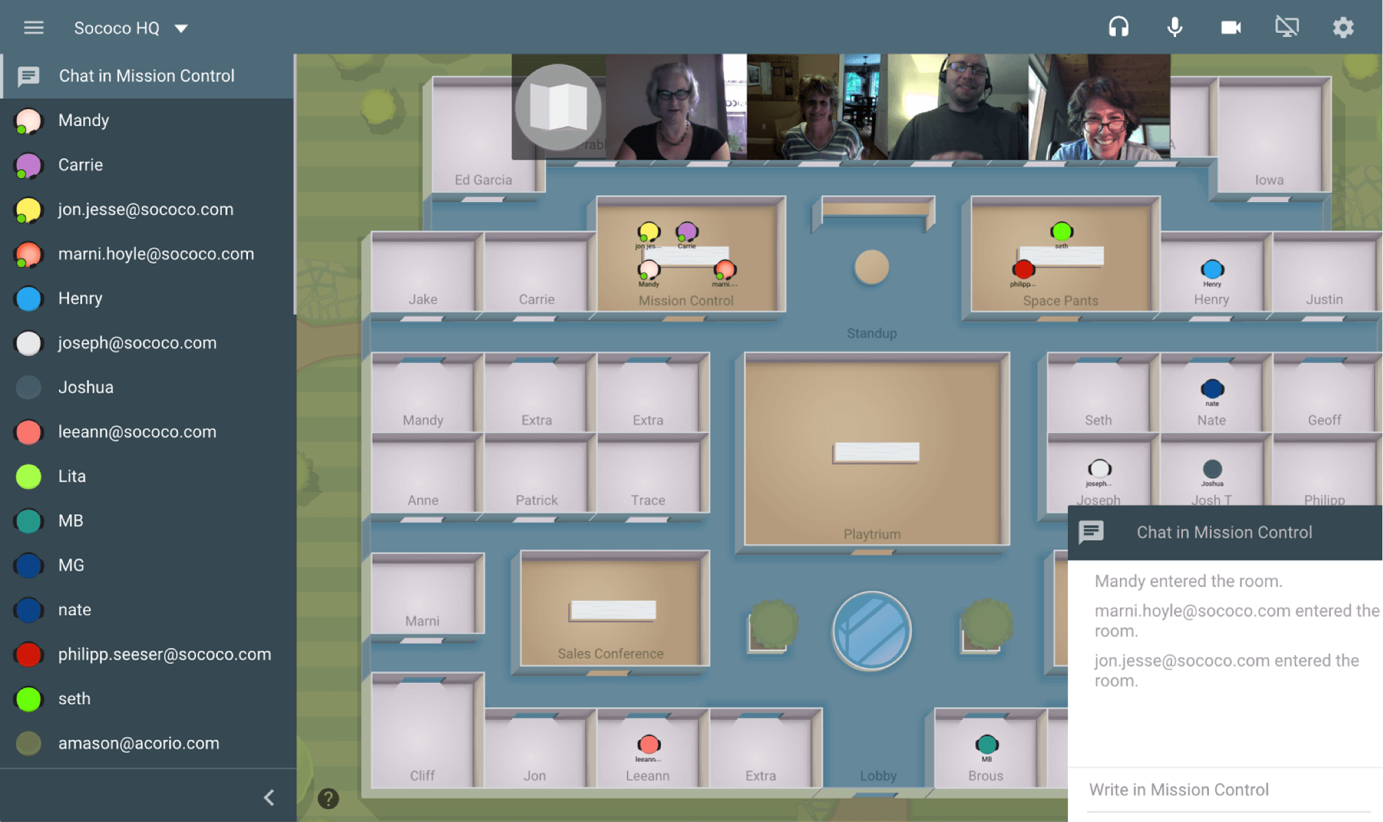
Collaboration Project

Slide 15
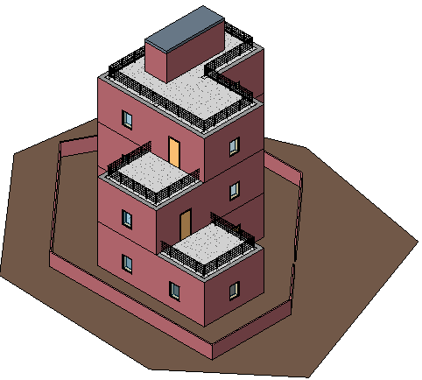
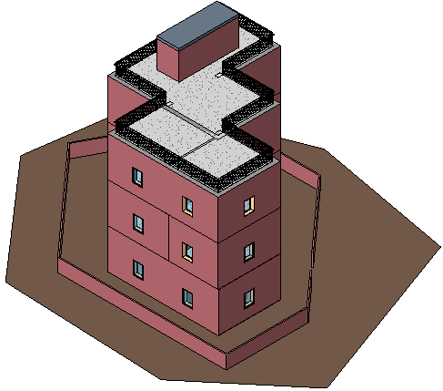
Project I
Original Model
Modified Model
Three Room Addition in a Residential House

Slide 16
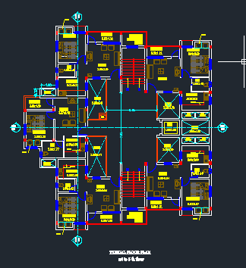
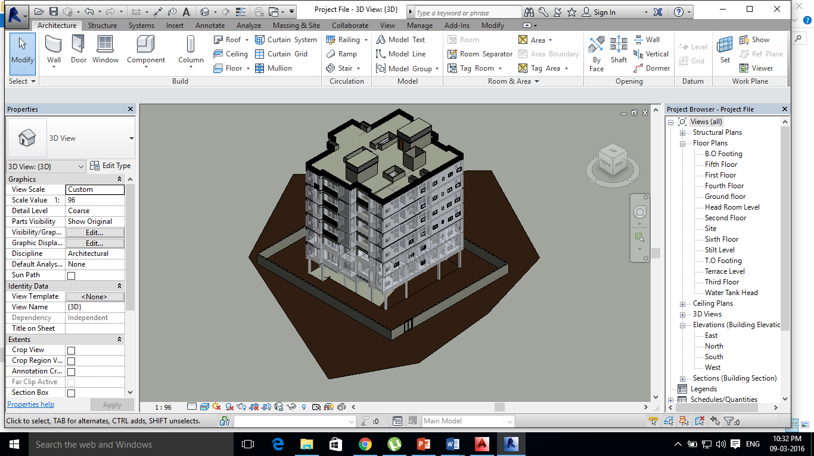
Project II
2D Plan
3D model
Multi Story Residential Building

Slide 17


Scope of Work
Task | Deliverables
First Virtual Team Meeting 3D Model (3 room addition) Construction Schedule | 3D model (revit) Construction Schedule (excel, MSProject, or P6)
4D Model Project I Debrief Meeting | 4D Model (NWD + .AVI) Debrief Memo
Project I
Task | Deliverables
Project II Kick-off | Draft BIM Execution Plan
3D Model Construction Schedule | 3D model (Revit) Construction Schedule (excel, MSProject, or P6)
4D Model | 4D Model (NWD+.AVI) Debrief Memo
Presentation Prep | Final Presentation
Presentation to Part II Teams | Recording of Presentation
Communicate and Collaborate
Project II

Slide 18
Participating Teams
Participating student teams | Number of UW students on each team
Team 3 | 2
Team 6 | 3
Team 7 | 3
Team 8 | 3
Team 9 | 2
Team 10 | 3
Team 13 | 3
Team 14 | 3
Team 15 | 3
Total teams: 9 | Total UW students: 25

Slide 19
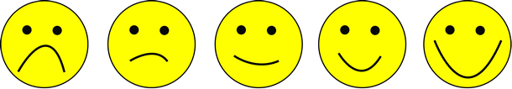
Data Analysis
3 – Low 4 – Neutral 5 – High 6 – Very High 7 – Extremely
High
Using Likert Scale (rating 1 to 7) to measure the level of collaboration satisfaction. Observing the transition from Project I to Project II.
Comparing level of collaboration to the use of newer technology for overcoming communication and collaboration issues.

Slide 20
Overall Level of Satisfaction
Level of satisfaction of most of the student virtual teams was high to very high (5-6 on a 7-point Likert scale).
Overall satisfaction level went from 76% (with rating 5 or higher) to 64% (with rating 5 or higher) from project I to project II.

Slide 21

Reasons for this Shift
Time constraints
Tight schedules
Limited knowledge of modeling tools
Unnecessary delays
Last moment meeting schedule changes
Time zone difference
Sococo connectivity issues

Slide 22

Sococo – Connectivity Issues
Bandwidth/internet issues on the IIT side.
Screen sharing feature was not utilized at its maximum efficiency.
A few teams didn’t even conduct one meeting on Sococo or used only the chat box feature to communicate.
This acted as a trigger for team members to find Sococo alternatives to communicate and collaborate more efficiently.

Slide 23
Use of Sococo Alternatives
Project II
Project I

Slide 24
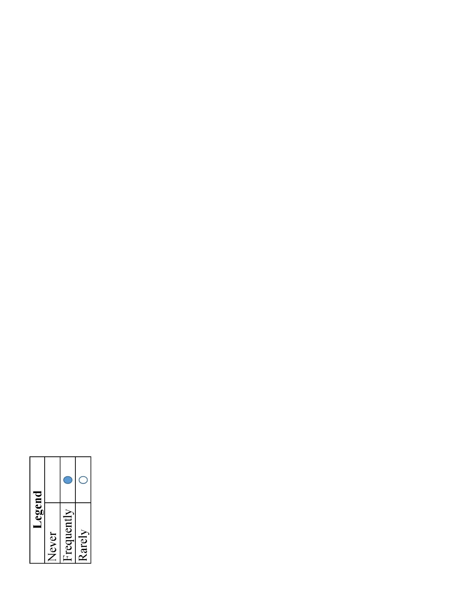
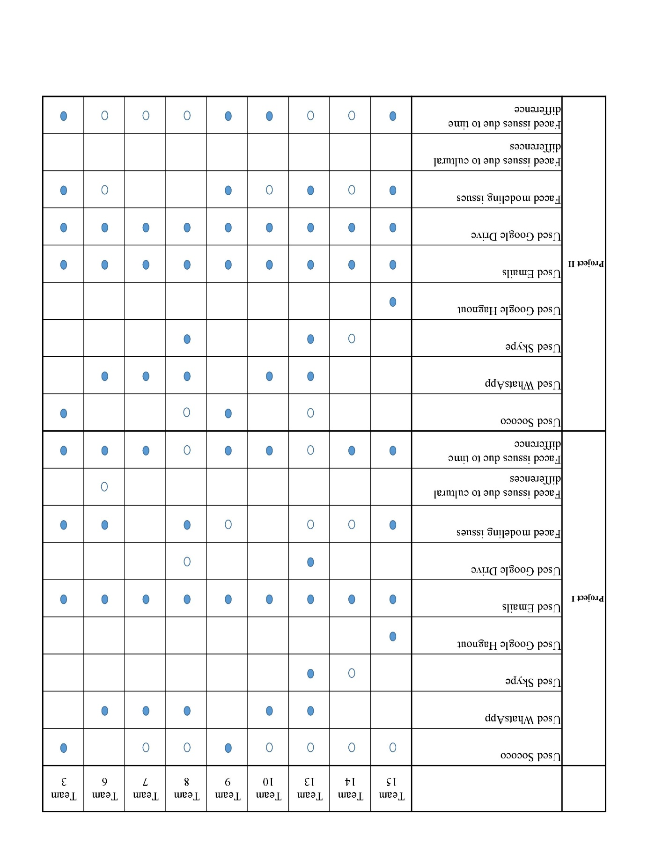
Truth Table Analysis

Slide 25
Team Specific Analysis - I
“WhatsApp will be quick and easy to communicate along with the voice recording tool. Internet is slow in IIT so using Sococo might bring up some communication issues”.
“Communication was observed to be better than project I, the communication is more efficient this time. Collaboration is very interesting and applying the theory into practice is very exciting”.

Slide 26
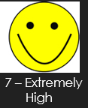
Team Specific Analysis - II
Team 13: Project I
Team 13: Project II
“Various collaboration tools were used in conjunction with each other, which increased the efficiency of communications. I liked the way web-based collaboration tools facilitated project communications”.
“Don't limit yourself to one collaboration tool. Start using multiple tools in the beginning of project itself”.
“IIT faced connectivity issues during the night (during the daytime the network quality was satisfactory), which caused some of the meetings to be unsuccessful and as a result be postponed. Understanding this limitation at the beginning of the project helped our team to plan the meetings accordingly and avoid the time lost at initial stages of the project due to problem in connection quality”.
“Besides Sococo, our team used email, skype and WhatsApp. WhatsApp is the most frequently used communication tool in Project I because we can almost get direct response from each other”.
“We managed the communication tool issues by using Sococo, Skype, email and WhatsApp in combination. When it comes to arranging meeting, we would use WhatsApp first because in this way we could get responses more quickly”.

Slide 27

Conclusions
As mentioned by Iorio and Taylor (2015), in addition to engagement in transactional and transformational interactions, effective leaders must also engage in technological interactions. This notion was very well supported by the data analysis of the post-project survey data (Section 4).
Due to existing issues in technology, team members start to feel the need of trying/using a newer technology to provide a better communication and collaboration platform to the team. Few of them come up as technological leaders who suggest the ideas of using advanced communication and collaboration technologies to maintain unrestricted workflow and rich information exchange.
Technology selection plays a very vital role in supporting collaboration and communication in globally distributed virtual teams. It reduces the communication and coordination issues within the team by providing better means of communication and collaboration. It provides a platform to the team members to stay connected and be on the same page. It further supports the idea of strengthening parameters like relationship building, trust, training, etc. that govern the functionality of virtual teams.

Slide 28

Future Research
How can technology selection deal with issues like time constraints, tight schedules, limited knowledge of modeling tools and unnecessary delays?

Slide 29
Thank you!
Questions?

