Slide 1
EVALUATION OF BIM-COBie DATA FOR FACILITY MANAGEMENT
[
]
PROF. CARRIE DOSSICK
PROF. KEN YU LIN
LOKESH MASANIA

Slide 2
OUTLINE
Literature Review
Qualitative Process
Quantitative Process
Conclusion

Slide 3
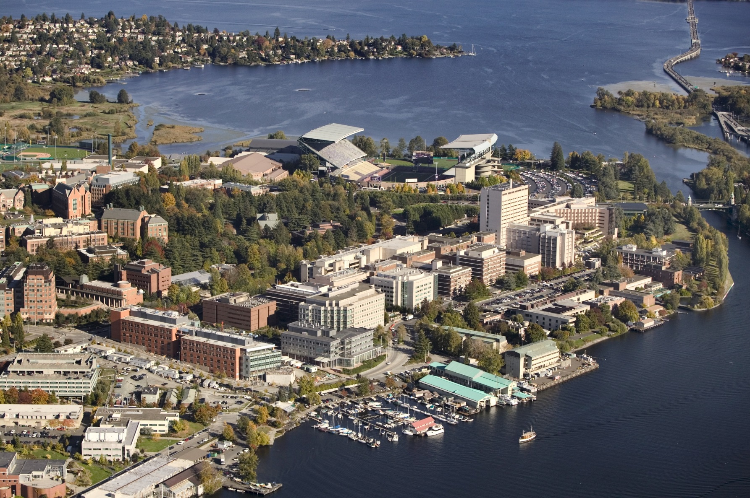

BACKGROUND
Pilot III Project
Research Work
UW spends 60% to 70% of budget on operation & Maintenance
3 Campuses
500 Building
20 Million Gross Foot

Slide 4

RESEARCH GOAL
2D
Vs
3D
TYPE OF DATA
EFFICIENT
What kind of geometry is important for improving the efficiency of data management for the operations and maintenance?
How much time impact can be brought in the current format if the data is presented and prepared in a different way?

Slide 5
BUILDING INFORMATION MANAGEMENT
BIM
[BIM] is an intelligent model-based correlative process that provides understanding to help in planning, designing, construction, and managing buildings & infrastructure.
OWNER
CONTRACTOR
ARCHITECT
INTERIOR DESIGNER
BIM
MECH.
ENGINEER
CIVIL ENGINEER
ELECT.
ENGINEER
CONST.
MANAGER

Slide 6
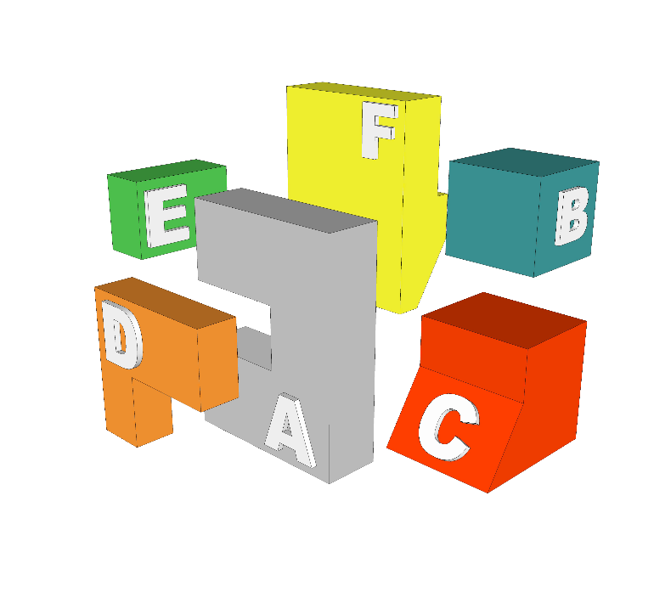
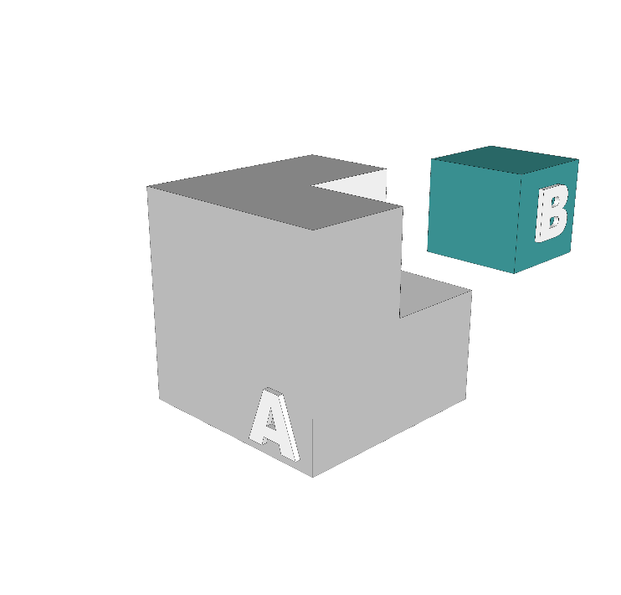
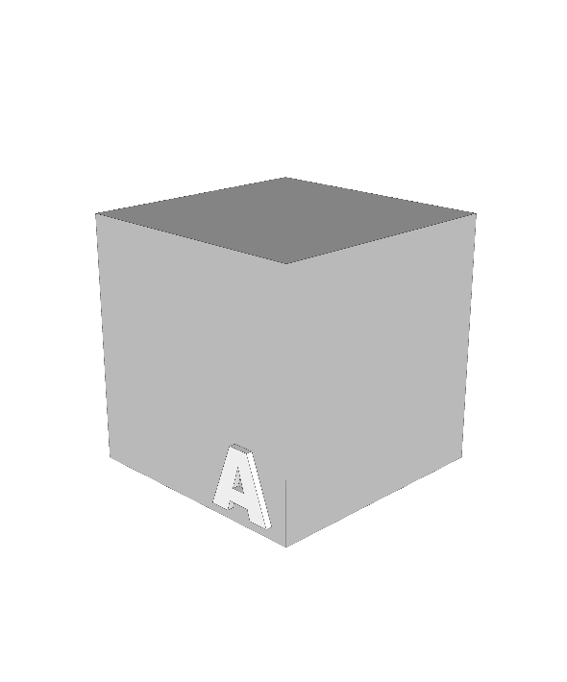
BIM PROCESS
DESIGN
[D]
Requirements & specification from manufacturer and owner
[D]
CONSTRUCTION
[C]
Requirements & specification from manufacturer and owner.
[D]+[C] & [D]+[C]
OPERATIONS
[O]
Requirements & specification from manufacturer and owner
[C]+[O] & [O]+[C]

Slide 7


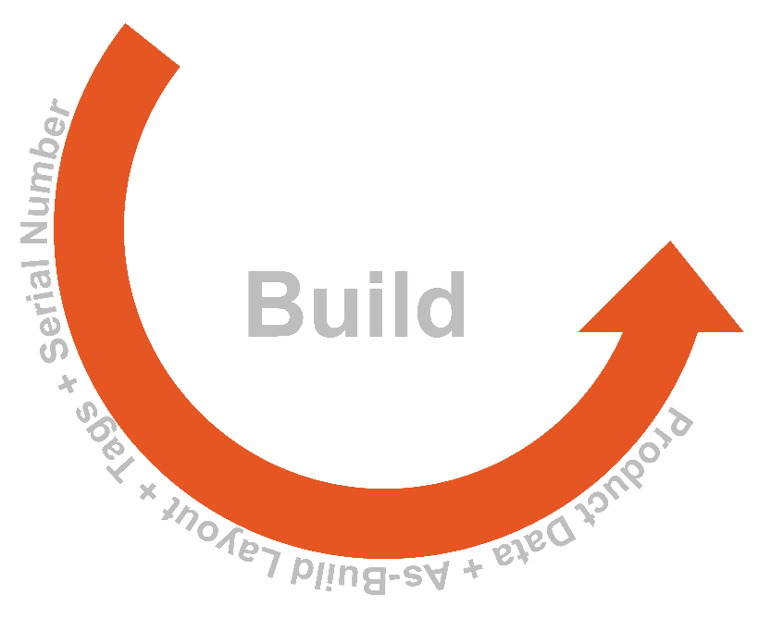
CONSTRUCTION OPERATION BUILDING INFORMATION EXCHANGE
COBie
[COBie] is a data exchange standardized process for recording the subsets of building model information focused on delivering building information not geometric modeling.
Operation

Slide 8

COBie PROCESS
DESIGN
[D]
Requirements & specification from manufacturer and owner
[D]
CONSTRUCTION
[C]
Requirements & specification from manufacturer and owner.
[D]+[C] & [D]+[C]
OPERATIONS
[O]
Requirements & specification from manufacturer and owner
[C]+[O] & [O]+[C]

Slide 9
CASE STUDY
TEXAS A&M
HEALTH SCIENCE CENTER
The team from Broaddus was looking into the aspect of use of COBie in facility management by implementing the WO process with CMMS to start up.
What is the time impact, if the data is digitalized.
TEXAS A&M, HEALTH SCIENCE CENTER
PROCESS
RESULT
QUESTIONS
They estimated former WO cycle times by interviewing with experienced Facility Managers at each campus by comparison to established flowcharts.
8.7%
Times the efficiencies can be
improved with the availability of digital data.
What kind of information is required for improving the efficiency?
And how much time does it saves?

Slide 10
METHODOLOGY
QUALITATIVE
QUANTITATIVE
INTERVIEW SURVEY
EXPERIMENT PROCESS

Slide 11
PROCESS
QUALITATIVE
Rating
Field
Knowledge
2D vs 3D
Awareness
Relevancy
Age
BACKGROUND
ASSET
MANAGEMENT
LOD
Needs
Experience
LOD Level
Use of LOD
Time Spent
Accuracy

Slide 12




PERSONAL
INFORMATION
AGE
BACKGROUND INFORMATION
PROFESSIONAL EXPERIENCE
50%
31%
42%
Participants were 41 years or older.
Only 17% were of age between 31-40 year.
And 33% were of age between 20 to 30 years.
Each of the Participants were Mechanical or Civil Engineers.
Only 15% each were either from Architecture background or others.
Only 8% were from Electrical background
Had 20 years or more experience.
Whereas 33 per cent had the experience of 1 - 5 year
17 percent each with 11 - 15 years of experience.

Slide 13








ASSET
INFORMATION
AWARENESS
RELEVANCE
ALTERATION
TIME
FUTURE
SUGGESTIONS
56%
25%
50%
Only 33% of the participants were aware about the UW asset information.
23% had some idea but were not sure.
At the same time 33 % were not aware.
Whereas about 11% were clueless.
Time Spent
Awareness
70%
34%
Relevancy
Suggestion

Slide 14





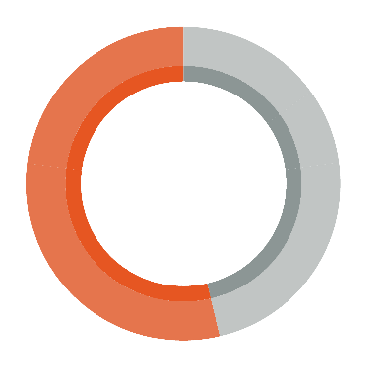
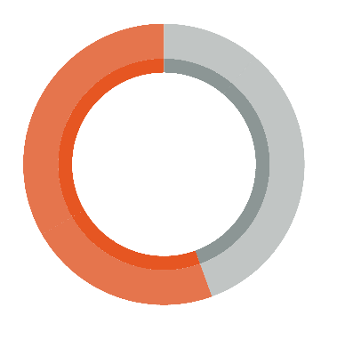
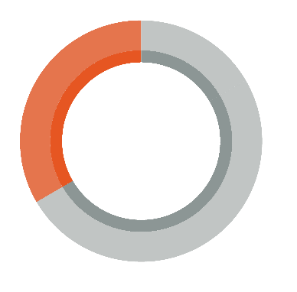

LOD
INFORMATION
2D OVER 3D
ACCURACY
3D FUTURE
BIM FUTURE
KNOWLEDGE
RELEVANCY
IMPORTANCE
TYPE OF LOD
41%
56%
66%
Had no clue about the LOD Data.
At the same time 25 % of the participant had some knowledge about it.
Participant agreed that they might use the data but they trust on their sources more.
42 per cent were really excited to use the information followed by about
About 66 per cent were very positive about the proposed LOD Document.
But still 34 per cent were not complete convinced.
34%
33%
55%
54%
2D Over 3D
Accuracy of 3D
3D As Future
BIM in Future
100
17%
200
00%
300
08%
400
33%
500
42%

Slide 15
PROCESS
QUANTITATIVE
6 PHASES
[RE-BASELINE]
TUTORIAL NOTES FOR THE EXPERIMENT
PERFORMING EXEPERIMENT
EXECUTION
PLAN
DATA ANALYSIS AND
COMPARISON
DATA COLLECTION FROM THE PARTICIPANTS
COMPLETING
THE
GIVEN TASK
TIME CHECK

Slide 16
RE-BASELINE
PROCESS
DOCUMENTATION
DATA GENERATION
LOD DOCUMENT
Phase 01
Data
Collection
Phase 02
Modeling
Phase 03
Data
integration
Phase 04
Reviewing
Phase 06
Testing
Phase 5
Data
Extraction

Slide 17
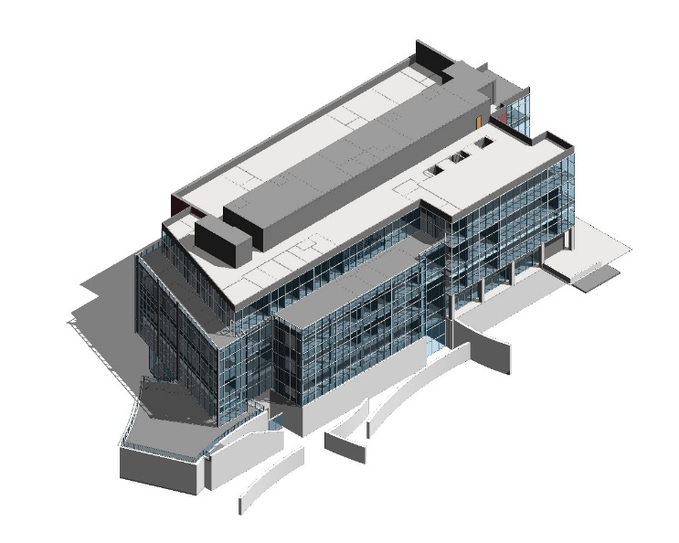
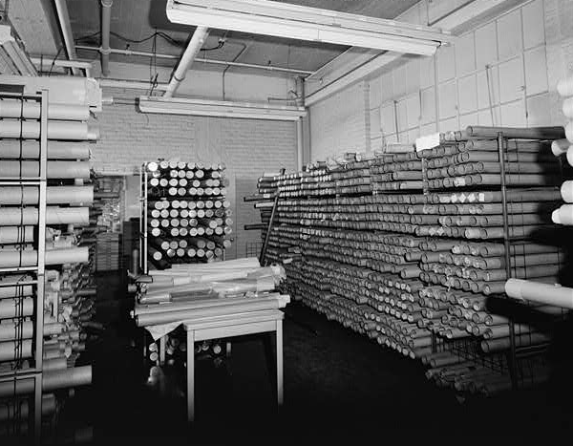
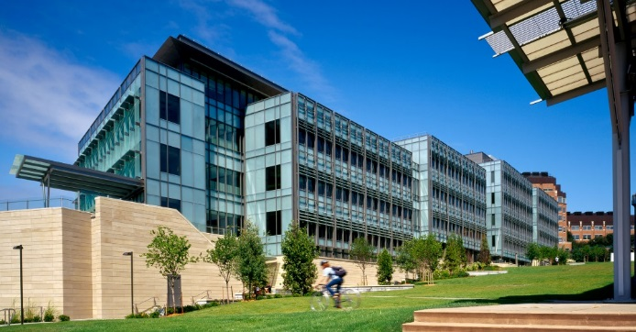
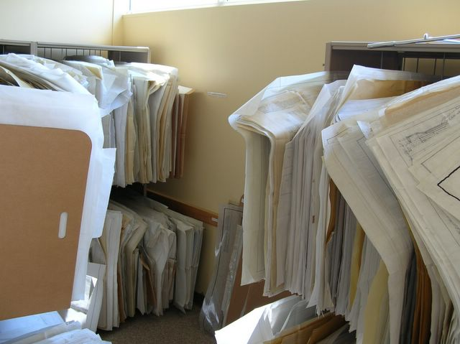
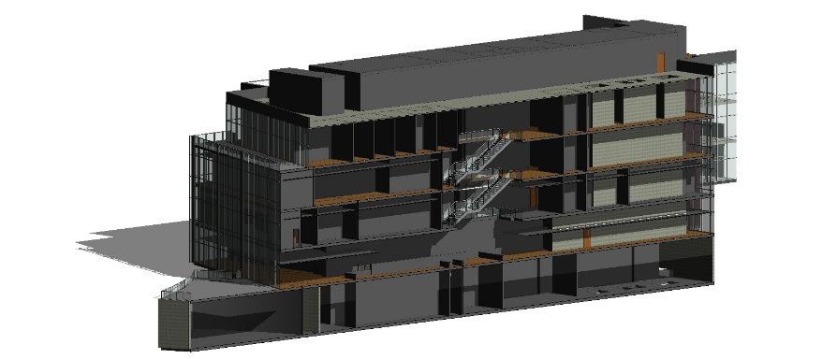
RE-BASELINE
PROCESS
DOCUMENTATION
DATA GENERATION
LOD DOCUMENT
WILLIAM H FOEGE
GENOME SCIENCE BUILDING
EXISTING DOCUMENTS WERE COLLECTED FROM THE UW RECORDS DEPARMENT
BIM MODEL OF THE EXISTING BUILDING WAS GENERATED ALONG WITH THE COBIE DATA

Slide 18
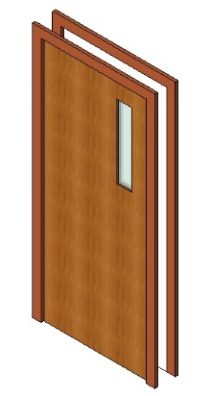
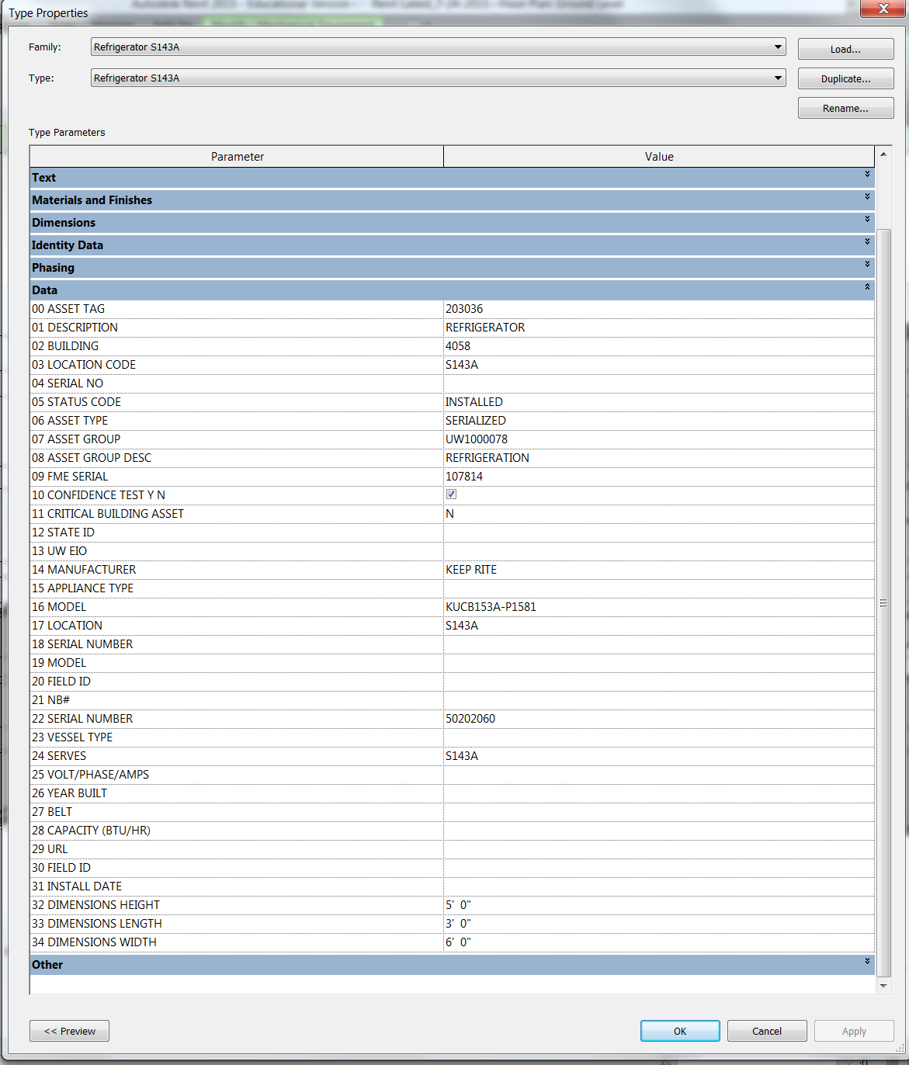
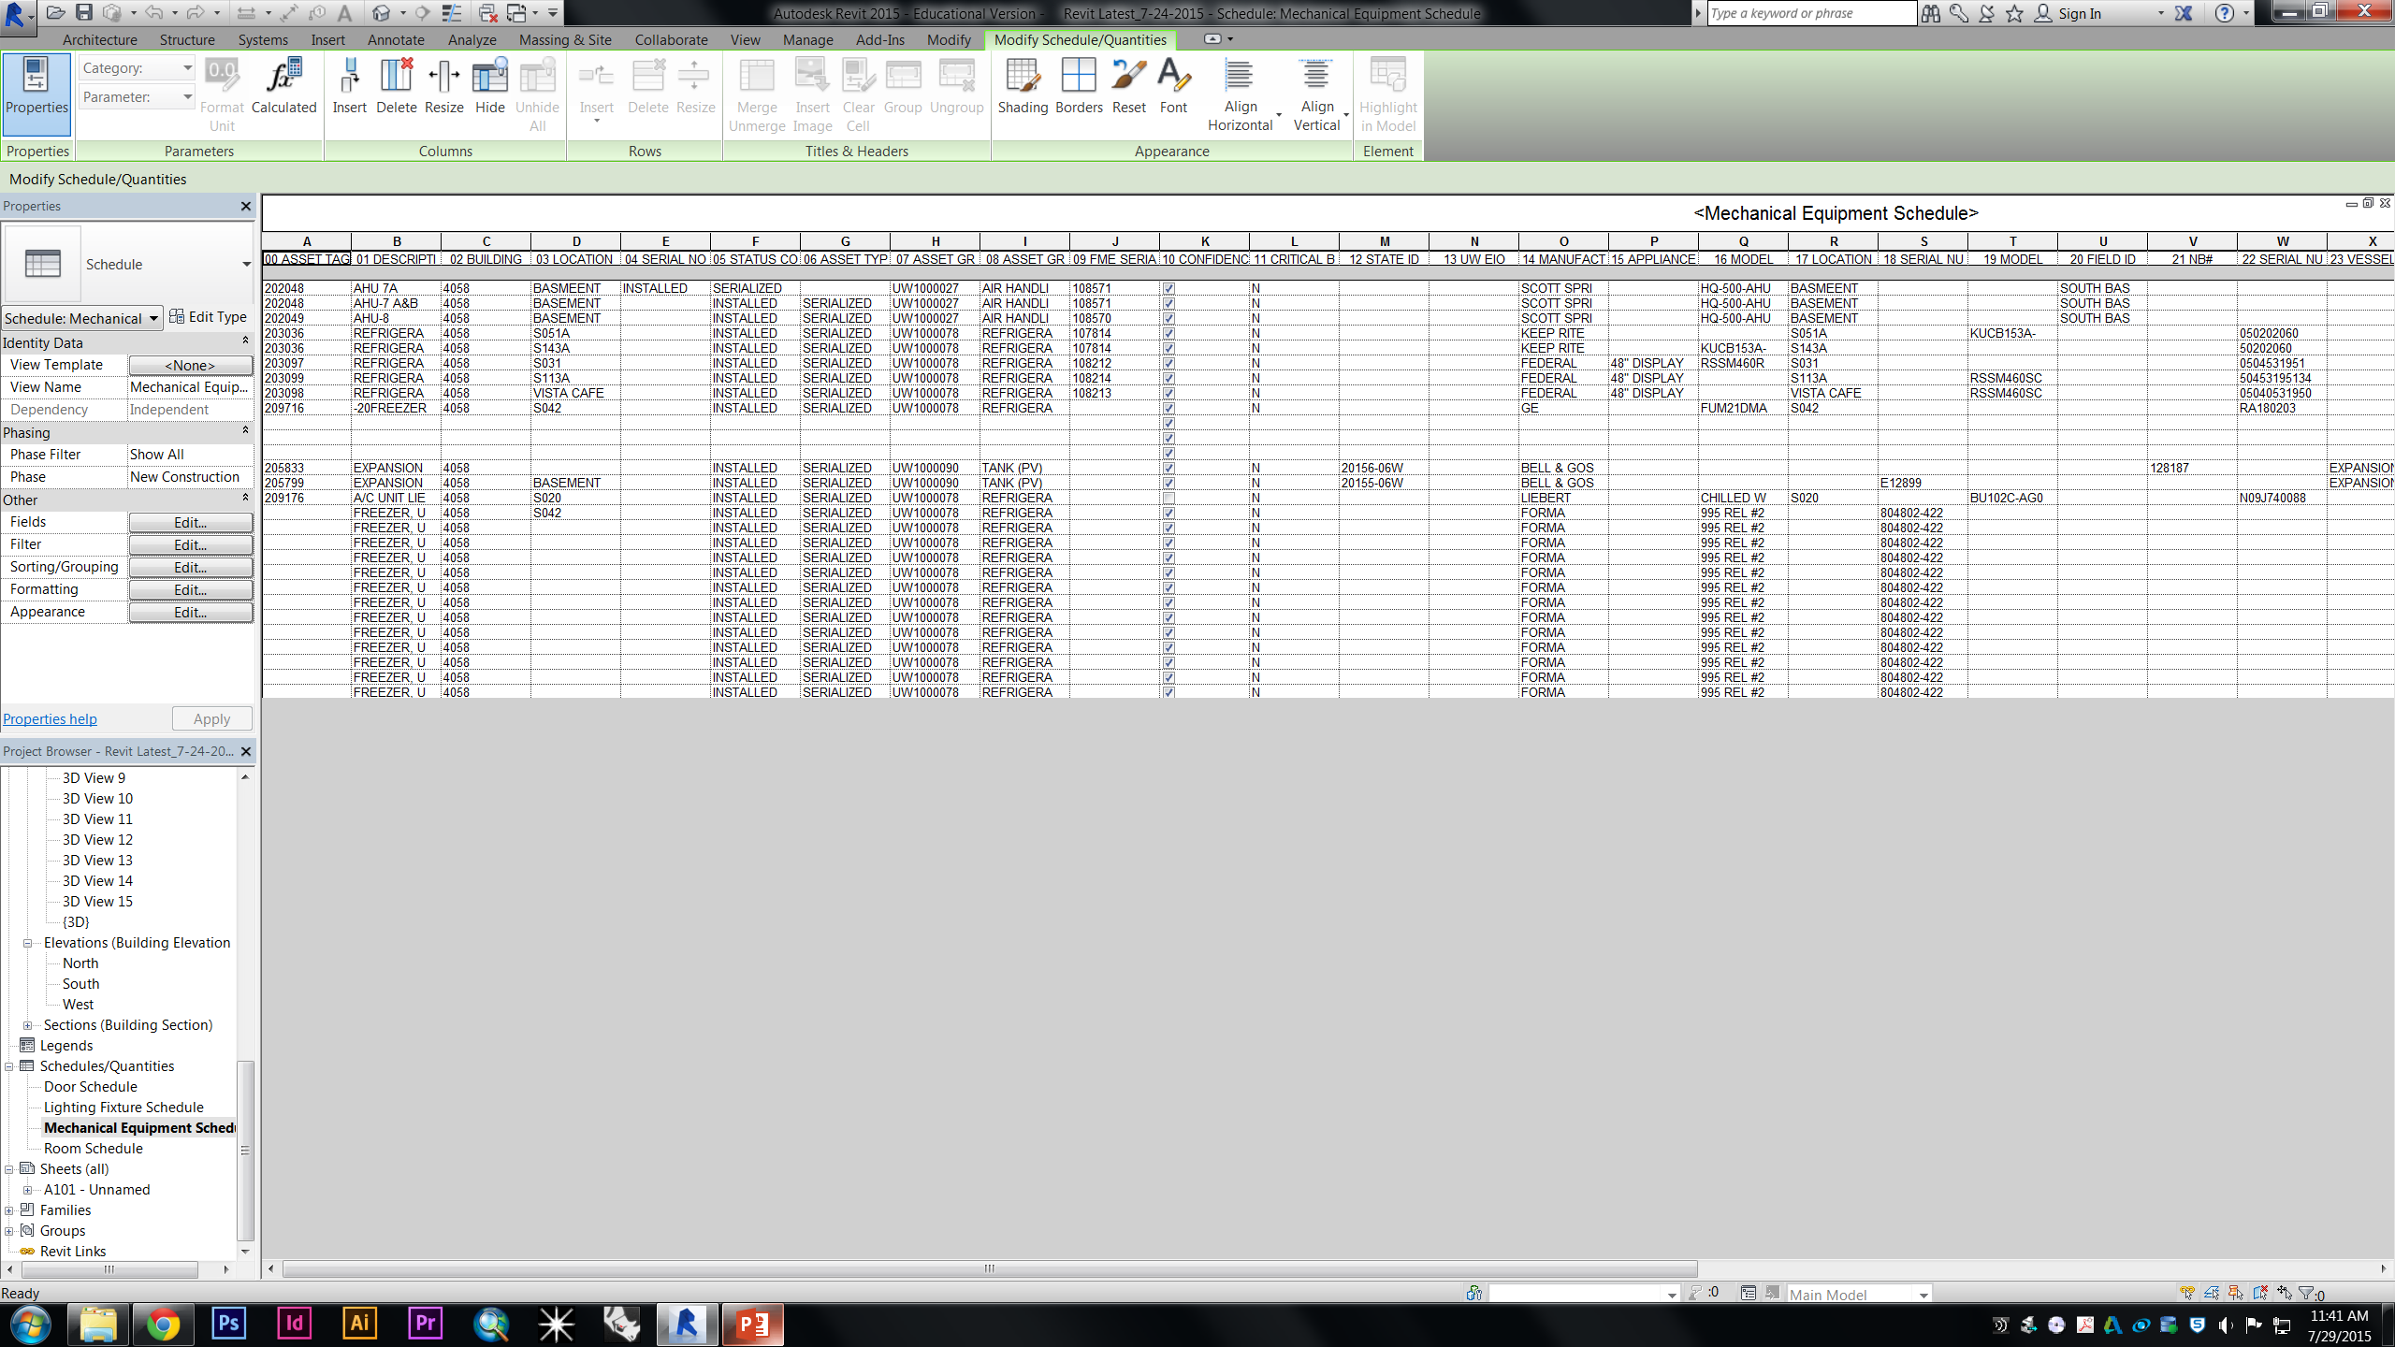
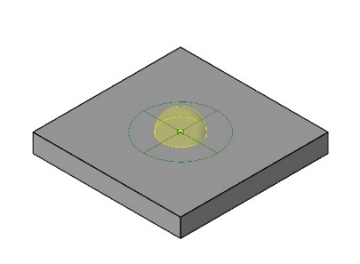
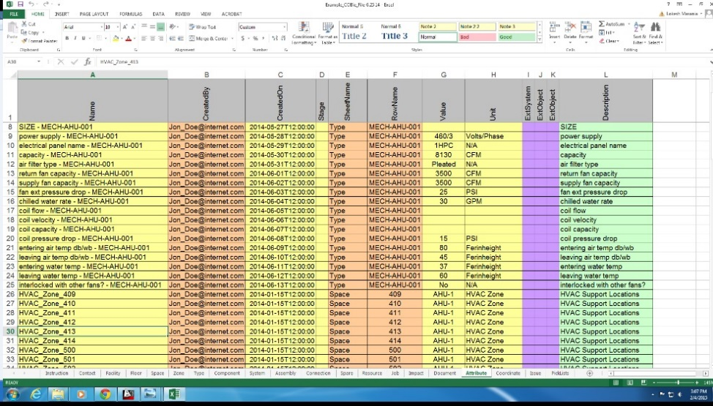
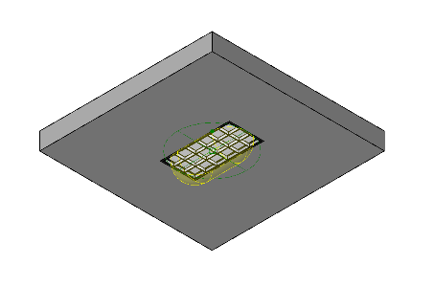
RE-BASELINE
PROCESS
DOCUMENTATION
DATA GENERATION
LOD DOCUMENT
ASSET INFORMATION TRANSFERRED TO EXCEL WHICH WILL BE EXPORTED TO AiM.
BIM MODEL OF THE EXISTING BUILDING WAS GENERATED ALONG WITH THE COBIE DATA

Slide 19
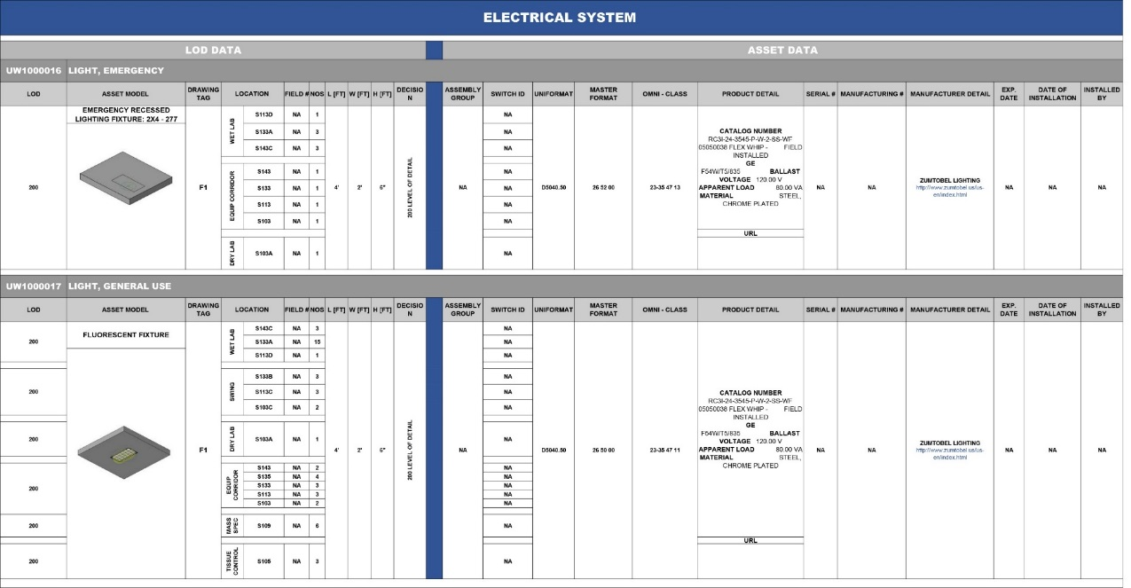
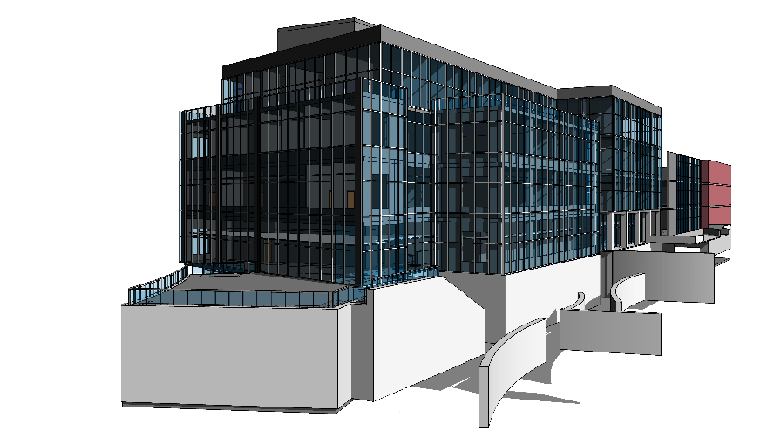
RE-BASELINE
PROCESS
DOCUMENTATION
DATA GENERATION
LOD DOCUMENT
ASSET INFORMATION TRANSFERRED TO EXCEL WHICH WILL BE EXPORTED TO AiM.
EFFICENT DATA
NO DUPLICATION
EASY TO LOCATE
USER FRIENDLY
UPDATED DATA

Slide 20
PROCESS
QUANTITATIVE
6 PHASES
[RE-BASELINE]
TUTORIAL NOTES FOR THE EXPERIMENT
PERFORMING EXEPERIMENT
EXECUTION
PLAN
DATA ANALYSIS AND
COMPARISON
DATA COLLECTION FROM THE PARTICIPANTS
COMPLETING
THE
GIVEN TASK
TIME CHECK

Slide 21
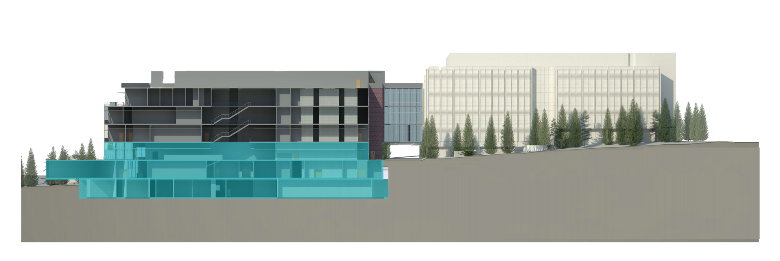
AREA OF INTEREST
WORK ORDER DATA
ASSET INFORMATION
EXPERIMENT
YEAR 2009 - 2013
29,198 HOURS OF WORK ORDERS
6,995 HOURS OF WORK ORDERS
FIRST FLOOR
GROUND FLOOR
MECHANICAL BASEMENT

Slide 22


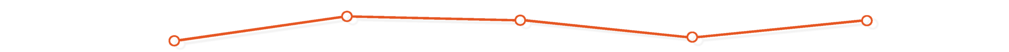
AREA OF INTEREST
WORK ORDER DATA
ASSET INFORMATION
EXPERIMENT
8000
7809
7534
7000
6692
6000
5299
5000
HOURS
4000
2585
3000
1143
1089
1042
2000
888
767
1000
2009
2010
2011
2012
2013
YEARS
Total number of Hours Spent During the Work Order for William Foege - Genome Science Building, University of Washington from the Year 2009 - 2013
Total number of Hours Spent During the Work Order for William Foege - Genome Science Building, University of Washington from the Year 2009 - 2013 for only Mechanical Basement, Ground Floor and First Floor

Slide 23


AREA OF INTEREST
WORK ORDER DATA
ASSET INFORMATION
EXPERIMENT
In the whole process of experiment,
we covered the following data:
ASSIST - 70 Work Orders
CALL-OUT - 70 Work Orders
CORRECTIVE - 40 Work Orders
EVENT - 2 Work Orders
PLANNED - 18 Work Orders
PREVENTIVE - 20 Work Orders
ROUTINE - 20 Work Orders
Experiment consisted of 10 -15 tasks of WO
[Starting from getting the compliant to ending with assigning someone for the task]
16
Nos
Of Participants did the Experiment which included FS Staffs and CM students
According to the Different Facility Staff Members, a Work Order Task
Takes Approximately 16 Minutes on an Average.
16:00 Min
According to the Experiments Conducted with the Facility Staff and Students, 1:40 Minutes Per Work Order Task was Calculated.
1:40
Min

Slide 24
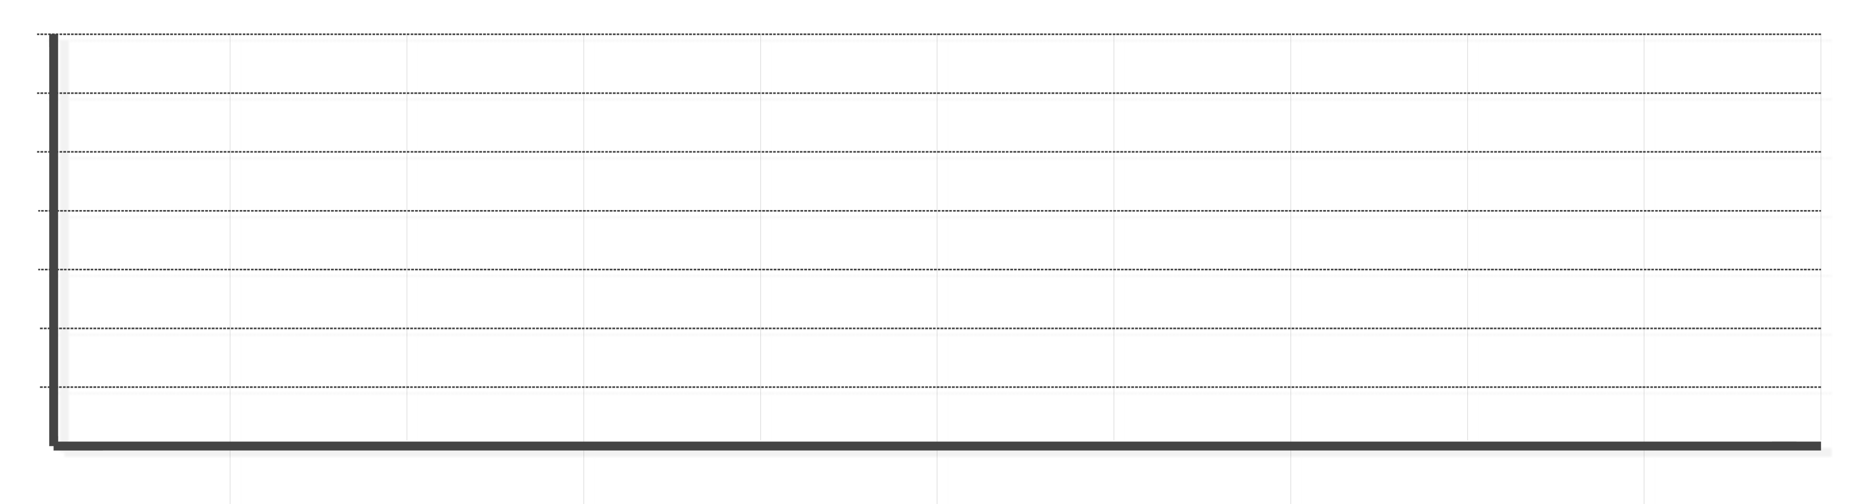


AREA OF INTEREST
WORK ORDER DATA
ASSET INFORMATION
EXPERIMENT
46.01
33.67
33.67
30.30
HOURS
11.23
Times
15.07
3.78
3.40
5.16
3.78
1.09
2009
2010
2011
2012
2013
YEARS
Total number of Hours Spent on the Work Order for William Foege - Genome Science Building, University of Washington from the Year 2009 - 2013 As Per Facility Staff.
Total number of Hours Spent on the Work Order for William Foege - Genome Science Building, University of Washington from the Year 2009 - 2013 As Per Experiment Conducted.

Slide 25
CONCLUSION
Adding a new dimension to the data curtailing makes the data 11.23 time more efficient.
Rather than having experience of working with 2D data till now, most of the people are open to adding a new dimension in the data
100 level of Geometry and 500 level of Data

Slide 26
FUTURE
How COBie Standards can be implemented in the contracts on the building?
How can we move one step ahead and build a real time data integration system for facility management?

Slide 27
QUESTIONS?
THANK YOU
[
]

