Slide 1
Accessibility during a pandemic
E-resources accessibility keyboard testing project at University of Washington
June 19, 2020
Notes:
Hi, I’m Denise Pan, Associate Dean for Collections & Content at the University of Washington Libraries. My pronouns are she/her.
Located in Seattle Washington, the University of Washington acknowledges the Coast Salish peoples of this land, the land which touches the shared waters of all tribes and bands within the Suquamish, Tulalip and Muckleshoot nations.
Joining me is our Collection Assessment Librarian, Hana Levay. Today we are presenting on the UW Libraries e-resources accessibility keyboard testing project during a pandemic.

Slide 2
Contents
Operationalizing Accessibility
Accessibility Plan
E-resources Keyboard Testing Project: Resources & Results
Next steps & future
sources accessibility keyboard testing project E-resources accessibility keyboard testing project
Notes:
I am going to start the presentation by providing some context on how we were able to operationalize accessibility. Hana is going to talk about our accessibility plan, the keyboard project, and next steps.

Slide 3
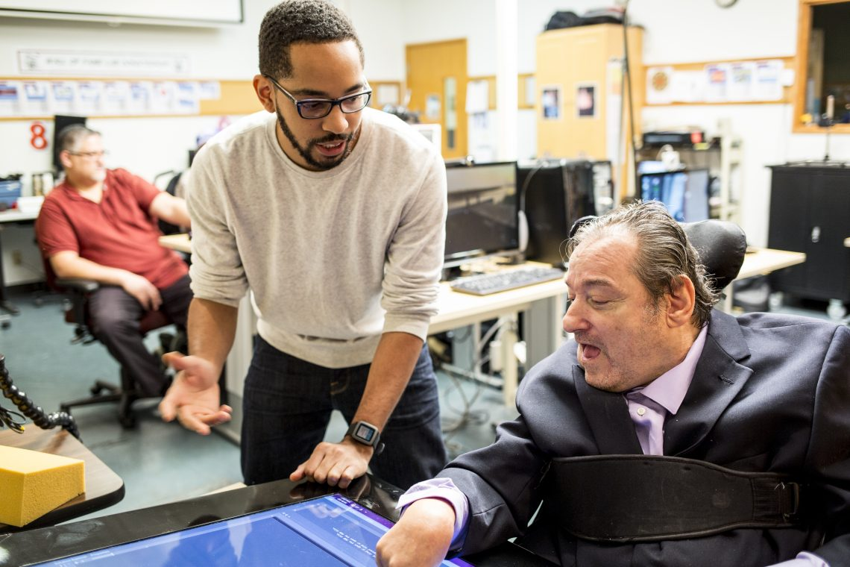
Commitment to Accessibility
Washington State
Policy #188 – Accessibility
University of Washington
Executive Order 31 Nondiscrimination and Affirmative Action
UW Administrative Policy Statement 2.3 Information Technology, Telecommunications and Networking Projects and Acquisitions.
UW News May 28, 2020 Announcing UW CREATE the new Center for Research and Education on Accessible Technology and Experiences with
$2.5 million investment from Microsoft
Photo description: Martez Mott works on Smart Touch with Provail participant
Ken Frye
Photo: Dennis Wise/University of Washington
Notes:
We are fortunate because there’s a strong commitment to Accessibility in the State of Washington and the University of Washington. Policies and an executive order elevate the significance of this work.
So much so, that at the end of May the University and Microsoft announced a $2.5 million investment to launch UW CREATE a new Center for Research and Education on Accessible Technology and Experiences.

Slide 4
Accessibility imbedded in Libraries Values
User Centered We do this by:
Applying user-centered and universal design principles to our services, spaces, and resources
Creating systems, procedures, and policies that are intuitive and accessible to all
Equity We do this by:
Providing equitable services and resources to all people
Continuously engaging in addressing our personal and organizational biases in order to transform our practices and achieve systemic change.
Notes:
For the Libraries specifically, accessibility in described in our values -- user centered and equity.

Slide 5
Strategic Directions & Goals 2018-2023 Plan
Enhance Equitable Environments for Research, Learning, and Working
Improve access for diverse user communities to physical and digital resources through universal design and accessibility compliance.
Grow as a Learning Organization
Improve communication to foster effective and equitable ways of working.
Transform our working practices to enable effective collaboration, efficient use of resources and a holistic perspective on individual work.
Notes:
Accessibility is also called out specific in two strategic directions and three goals in our 2018-2023 strategic plan.

Slide 6
Portfolio & Position Description
Collections & Content portfolio is responsible for identifying, acquiring, cataloging and preparing resources for patron use.
Departments:
Acquisitions & Rapid Cataloging Services
Cataloging & Metadata Services
Collection Analysis & Strategy
Preservation Services
Collection Assessment Librarian
Specific Responsibilities and Duties
Work with vendors, librarians and Libraries staff to manage and customize platform interfaces to meet user needs
Take a leadership role in the Libraries for accessibility of our licensed vendor platforms
Notes:
Working with the Director of Collection Analysis & Strategy, Corey Murata, we decided that accessibility is important and should be operationalized in the job description for the Collection Assessment Librarian.
Hana was hired into this permanent position in September 2018.
I’ll hand over to Hana to talk about what she’s been able to do.

Slide 7
Accessibility of electronic resources
Goal:
Improve the accessibility of subscribed third-party library resources
Problem:
VPATS unreliable [2]
Libraries have no control of third-party resources.
Libraries subscribe to many resources.
Plan:
First, determine which electronic resources are currently not accessible.
Then, negotiate with the vendors of inaccessible products
Notes:
When I was hired in this position, one of my tasks was to assess the accessibility of our subscribed third-party resources. Since it was a new position, there was not yet much direction in how to do this.
We started by looking at VPATs (Voluntary Product Accessibility Template). I quickly decided that would not be enough to ensure accessibility. A 2015 study by Laura DeLancey of Western Kentucky University suggested that VPATs have a 20% rate of errors or inaccurate information. My own experience also showed that even very inaccessible resources may offer a VPAT, so simply collecting VPATs would not help. We do still collect them during the licensing process for documentation purposes.
We also decided that simply assessing for accessibility was not enough; we want to improve the accessibility of our collection. Of course, we don’t have any control over the development of the resources we subscribe to. So, we needed to find out which resources were not accessible and then work with the vendors to improve those resources. To do this, we would need to manually test each resource.

Slide 8
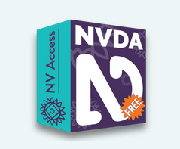
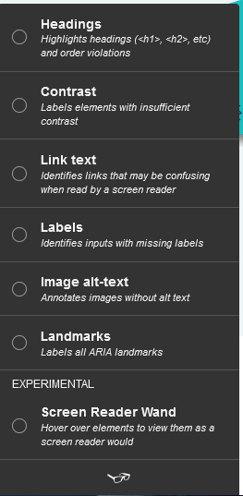
Testing Considerations
•How much staff time do we have?
•Testing with tools and assistive technology
•Specialized training
•Difficulty of use
•Retention of training
Tota11y browser plugin
Notes:
At this point, I realized we had a lot of work to do. First of all, a thorough accessibility review is a lot of work. There is a huge range of issues to check for: from headings and page structure, color contrast, image descriptions, to keyboard support and usability. We had to consider how much staff time we had available for training and testing. We also had to consider the fact that we have 650 resources to test.
To do the testing, we had a wide range of tools to choose from, like different browser addons that inspect HTML code, or screen readers or other assistive technology. These tools can be very difficult to become fluent in and if you don’t use them daily, you can quickly lose what you learned. In the end, we decided to do a very basic functional accessibility test using keyboard navigation.

Slide 9

Keyboard Navigation Testing
•Easy to learn, easy to use
•No software to download
•Generally speaking, if a website is accessible using keyboard navigation, it will also work with various assistive technologies.
“An accessible website does not rely on the mouse; it makes all functionality available from a keyboard. Then people with disabilities can use assistive technologies that mimic the keyboard, such as speech input.” [6]
Logo for #nomouse challenge
Notes:
Keyboard navigation is easy to learn and easy to use. It does not require any special software or HTML coding knowledge. Best of all, generally speaking, if a website is accessible using keyboard navigation, it will also work with various assistive technologies.
The disadvantage of using only keyboard testing is that it leaves out a lot of elements that may be inaccessible. But given our limitations, it seemed the best way to quickly find the worst offenders. If the resource can’t be used with only keyboard navigation, then it certainly cannot be used with assistive technology and would be nearly useless for users with disabilities.

Slide 10

2019 Pilot Project
Started testing January 2019, one year
One student and one staff, limited hours
Photo courtesy of University of Washington
Notes:
In January 2019, I began a pilot project to use keyboard navigation to test resources to see if this would be a reasonable project to pursue in full. I began doing keyboard navigation testing and trained one student employee to help. We both still had our full range of regular tasks to do, so this was done in any extra time we had. By the end of the year, we had tested just 101 resources, about 16% of our total. I concluded that this process was taking too much time. Time is our enemy here; interfaces can change over time, rendering our tests obsolete. Our resource list can change over time as we cancel or subscribe to different resources. We would need to either hire additional workers to do the testing or change our focus to collaboration, such as working with the Big10 Accessibility Project or forming smaller regional groups to work together on testing a shared collection. Then, our campus was shut down in response to the Coronavirus pandemic.

Slide 11

2020 Pandemic Project
“Stay Home Stay Safe” closed all library buildings March 12, 2020
Sudden surplus of student employees with nothing to do
Swiftly created training and workflow starting March 25, 2020
Testing began April 2, 2020
Photo courtesy of University of Washington
Notes:
Suddenly, we had dozens of employees and student workers who could no longer perform the tasks they were hired to do. The whole library scrambled to establish projects that could be done remotely so everyone could continue working. I realized this could be the perfect opportunity to get the staffing to finish the keyboard navigation testing project. I worked with supervisors of student employees in the Preservation department to develop a training procedure so student employees could learn how to do the testing.

Slide 12
Training and workflow
Needs:
Avoid 1-1 training
One shared location for posting results
Assign multiple people to subsets of resources
Created:
Web page with workflow documentation
Video presentation about the pilot project for background
Google sheet with all resources and URLs listed from A-Z list
  columns for date, initials, results
Notes:
We needed the training to be remote and asynchronous since we would not be able to do in person, one on one training for each student. We also needed a way to manage the assignments and results.
So we created a training guide. It included: a webpage with a step by step guide to getting started and the testing procedure and a link to a video I had created to give background and motivation for the project. We also created a Google sheet with a list of the resources to test. The Google sheet contained the resource name and URL as well as columns for the testing date, initials of the tester, and results. After a few days of testing, I spot-checked each tester’s results and found them to be the same as I would have found. I determined that the students had quickly learned how to do the testing and were doing an excellent job.

Slide 13
Results
Staffing
9 students from Preservation, 187 hours
3 additional students from 3 departments
Tested from April 2, 2020 to May 26, 2020 - nine weeks
Tested 555 of 650 interfaces, 86% of total
Deferred 94 (14%)
Deferred due to connection problems, language barriers, or other issues not noted
490 passed (88%)
66 failed (12%)
Notes:
I am amazed to report that after just nine weeks, we have tested 555 of the 650 resources, 86% of the total. We deferred testing on 94 resources and will be re-evaluating those resources over the summer if can. Deferrals were because of some kind of connection problem or the database being temporarily down, which seemed to happen more than usual in the early days of the pandemic. Or, there were language barriers or some kind of barrier to testing, like having to create a separate account.
Surprisingly, 88% of the resources passed our keyboard navigation testing.
So, 66 failed our keyboard navigation testing. This means, 66 resources are basically unusable for people with disabilities. These are the resources we will be prioritizing for improvement.

Slide 14
Next Steps
Three-Phase Plan
Phase One - Keyboard testing sets a minimum baseline
  Other issues probably exist
  Finds worst offenders - unusable resources
  Phase One helps prioritize
  List on UW Libraries website
Phase Two - Document and Communicate
  Create report of issues for resources that failed Phase One
  Share the report with the provider/vendor to establish working relationship
  Negotiation point during renewal process
Phase Three - Repair Issues
  If provider/vendor is receptive, work together to create timeline for repairs
  More comprehensive testing to find and improve as much as possible
Notes:
The keyboard testing was the first phase of what will be a three-phase plan. We intend to create a link on our University of Washington Libraries accessibility page outlining our findings.
Now, we will enter phase two. We will create a report for each resource that briefly describes the issues we found. We will share our report with the provider or vendor and ask them to work with us to improve the accessibility of their product. We can mention our findings during the renewal process and ask about adding an accessibility improvements timeline or language to the license.
The third phase will proceed if the provider vendor is receptive to us. Not all providers will have the development resources to improve their products. On the other hand, some other vendors may simply be unaware of the issues and will be eager to improve their product. Not every company has accessibility experts on their staff. We can help them by pointing out what isn’t working and what we need. Ideally we can work together on a timeline for improvements. At that time, depending on staffing and interest from the vendor, we can do a more comprehensive analysis of all accessibility issues that we can find beyond the basic keyboard accessibility. Building good working relationships is essential for this phase.

Slide 15
Conclusions
This takes a long time, and interfaces change over time
No one library can do this alone; we *need* to collaborate
Common databases by larger vendors tend to be more accessible (Ebsco, ProQuest, Elsevier)
We should focus local testing on smaller unique products
We can influence vendors to improve accessibility
Notes:
Accessibility testing takes a long time. We had the exceptional circumstances of a pandemic to get us through phase one quickly, and obviously we can’t predict when we will have similar circumstances in the future. Phases two and three will be more complicated and will need to be done by trained staff, not student employees, interacting with vendors. So, it is very important to collaborate with other libraries. We all subscribe to many of the same resources; we shouldn’t have to each test every one of them.
Big10 is doing great work and has a lengthy list of resources they have tested. Individual libraries should probably then focus on smaller, more unique products. Finally, we can influence vendors to improve accessibility. Early in this project, I reached out to a vendor who had a major accessibility problem. They did not know about the problem, thanked me for letting them know, and they fixed it. I am optimistic that other vendors will react similarly, and realistic enough to know it won’t always go smoothly.
But even without doing your own testing, you can work to improve accessibility. Ask vendors to give you an accessibility demo at conferences. Ask for accessibility language in your licenses. Bring up accessibility during the procurement process. The more we all talk about it, the more visibility and attention is brought to this issue, and the more motivation vendors will have to change.

Slide 16
Citations and Resources - Definition
Web Accessibility
“Web accessibility means that people with disabilities can equally perceive, understand, navigate, and interact with websites and tools. It also means that they can contribute equally without barriers.”
W3C page on accessibility, usability and inclusion
(accessed 6/9/20)
Notes:
The next several slides are here to provide some resources in case you would like more specific details on the tools and methodology considered for this project. In the interest of time, I didn’t do a deep dive into the details but I have included them here. I’ve also included a link to a template you can use if you want to replicate this project. You should have access to these slides after the presentation.

Slide 17
Citations and Resources -
Testing Tools
•Accessibility Bookmarklets
•Landmarks, Headings, Lists, Images, Forms
•Tota11y (Firefox)
•Headings, Contrast, Link text, Labels, Image alt-text, Landmarks
•Screen readers such as NVDA
•Keyboard testing
•Others (speech to text, word prediction, sip-and-puff, etc)
Notes:
move to end

Slide 18
Citations and Resources -
Testing Procedure
Go to resource
Determine main functions
Use keyboard navigation to perform main functions
If all main functions can be achieved, the resource is considered to be technically accessible

Slide 19
Citations and Resources -
Determine Main Functions
Electronic Journal Databases
search
retrieve result
use result (open, turn pages)
Streaming Media
search
retrieve result
play and control result (i.e. pause, adjust volume, rewind)
Specialty Databases
Work with subject specialist to determine main functions
Notes:
Consider flipping the script; start with spoiler? How can you do this work at your institution

Slide 20
Citations and Resources-
Keyboard Testing: common keys
•Tab – move to the next link, form element or button.
•Shift+Tab – move to the previous link, form element, or button.
•Enter – activate the current link or button.
•Space – check or uncheck a checkbox form element. Will also activate a button that currently has focus.
•Up/Down arrow keys – move between radio buttons or, in some cases, menu links.
•Right/Left arrow keys – in some cases, move between menu links or adjust sliders in audio and video plugins.
•Escape – Close the current modal dialog or dropdown menu and return focus to the element that spawned it.[9]
Notes:
move to end

Slide 21

Citations and Resources-
Testing Templates
Keyboard navigation testing tracking document - template
Photo courtesy of University of Washington

Slide 22
Citations and Resources - Documentation
Articles:
[1] Kirsten Ostergaard (2015) Accessibility from Scratch: One Library’s Journey to Prioritize the Accessibility of Electronic Information Resources, The Serials Librarian, 69:2,155-168, DOI: 10.1080/0361526X.2015.1069777 Permanent link to this document: https://doi.org/10.1080/0361526X.2015.1069777
[2] Laura DeLancey, (2015) "Assessing the accuracy of vendor-supplied accessibility documentation", Library Hi Tech, Vol. 33 Issue: 1, pp.103-113, https://doi.org/10.1108/LHT-08-2014-0077 Permanent link to this document: https://doi.org/10.1108/LHT-08-2014-0077
[3] Heidi M. Schroeder, (2018) "Implementing accessibility initiatives at the Michigan State University Libraries", Reference Services Review, Vol. 46 Issue: 3, pp.399-413, https://doi.org/10.1108/RSR-04-2018-0043 Permanent link to this document: https://doi.org/10.1108/RSR-04-2018-0043
Web pages:
[4] Making Electronic Resources Accessible in Libraries
[5] Big 10 Library E-Resource Accessibility – Testing
[6] W3C page on accessibility
[7] Accessible University 3.0
[8] UW IT Accessibility Checklist & Tutorial
[9] Designing for Keyboard Accessibility
[10] ADA.gov

Slide 23
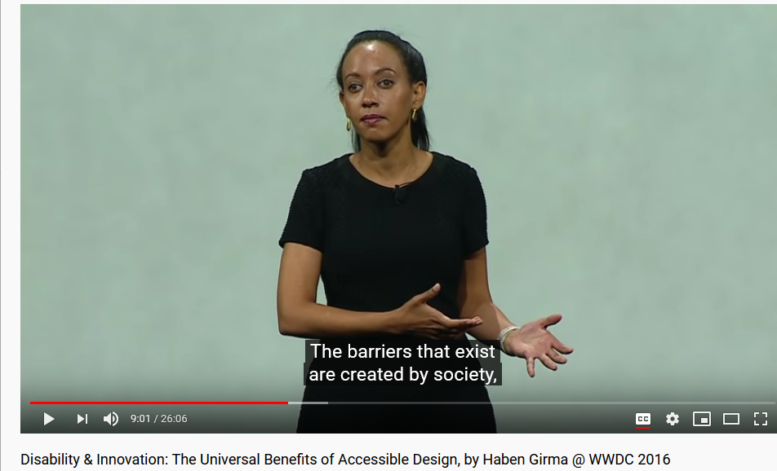
Why should we strive for accessibility?
“Disability never holds anyone back. Disability is not something that people need to overcome. The barriers that exist are created by society, and it’s up to every single one of us to work together to remove those barriers. Helen [Keller] was successful because she was part of communities that chose to practice inclusion.”
-- Haben Girma
WWDC 2016 “Disability & Innovation”
Quote begins at (8:52)
Screenshot from YouTube https://www.youtube.com/watch?v=_bC7Mvy7Vn4&feature=youtu.be
Notes:
I’d like to leave you with a quote. It’s important whenever doing diversity work to listen to the people most affected by these issues. This is an image of Haben Girma. She is the first deaf blind person to graduate from Harvard Law School and is now an Accessibility and Inclusion Advocate. In her speech at WWDC 2016, she said, “Disability never holds anyone back. Disability is not something that people need to overcome. The barriers that exist are created by society, and it’s up to every single one of us to work together to remove those barriers. Helen [Keller] was successful because she was part of communities that chose to practice inclusion.” By doing this accessibility work, we have the opportunity to reduce the barriers at our institutions and allow everyone to be successful.

Slide 24
Thank you!
Hana Levay | levay@uw.edu
Denise Pan | dpan@uw.edu

