Slide 1

A Framework for Mass-Market Inductive Program Synthesis
Alex Polozov
polozov@cs.washington.edu
Supervisory Committee
Sumit Gulwani (co-advisor)
Zoran Popović (co-advisor)
Rastislav Bodik
Gary Hsieh (GSR)
Emina Torlak
University of Washington
Paul G. Allen School of
Computer Science & Engineering
PhD Final Exam

Slide 2
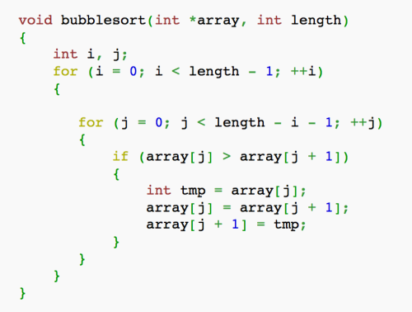

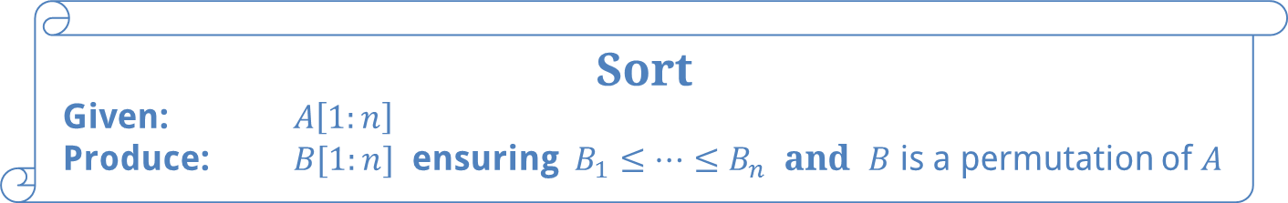
Program Synthesis: “The Golden Dream of CS”
(circa 1950-1960)
Sort
Given: $A\left[1:n\right]$
Produce: $B[1:n]$ ensuring $B_{1}≤…≤B_{n}$ and $B$ is a permutation of $A$
Notes:
All of this work revolves around the idea of program synthesis, the so-called "Golden Dream of CS".
It's an old idea, dates back to the early days of AI in 1950-60s.
Back then it was formulated as:
given a problem spec, for example, for an array sorting function
the computer processes this spec
and automatically generates a snippet of code that implements it.
As many ideas in the early age of AI, it was more ambitious than the computers' capabilities.

Slide 3
Modern Program Synthesis
User Intent
Program Space
Search Algorithm
Program
[Gulwani: PPDP 2010]

Slide 4
Modern Program Synthesis
User Intent
Program Space
Search Algorithm
Executable Model
[Gulwani: PPDP 2010]
Notes:
Nevertheless, we have achieved a lot in program synthesis over the years, but now it looks a bit different.
It is a combination of
a well-defined program space (such as a DSL),
a multi-modal specification of user intent,
and some kind of search algorithm.
Moreover, the resulting program can be any executable model in that chosen domain. Here are some examples.

Slide 5
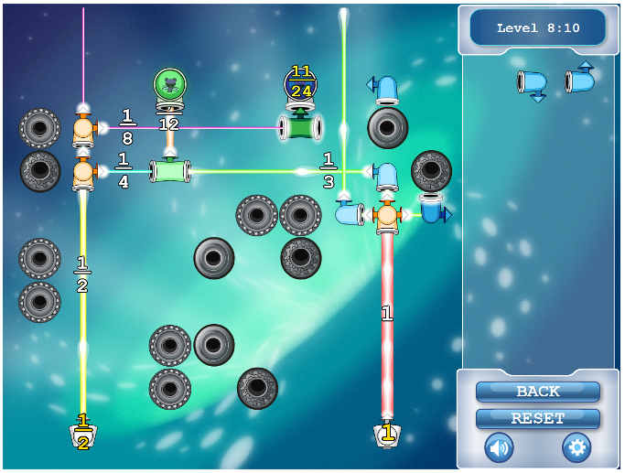
Applications: Educational Games
User Intent
Program Space
Pedagogical and spatial constraints
Game level descriptions
Search Algorithm
[Butler et al.: FDG 2013]

Slide 6
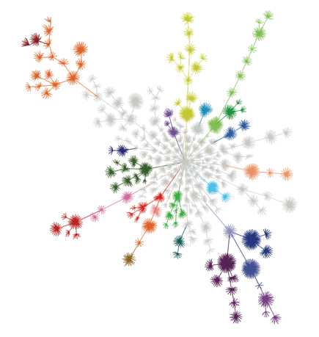
Applications: Biology
User Intent
Program Space
A dataset from the lab experiments
Protein interaction networks
Search Algorithm
[Koksal et al.: POPL 2013]
© 20n Labs

Slide 7
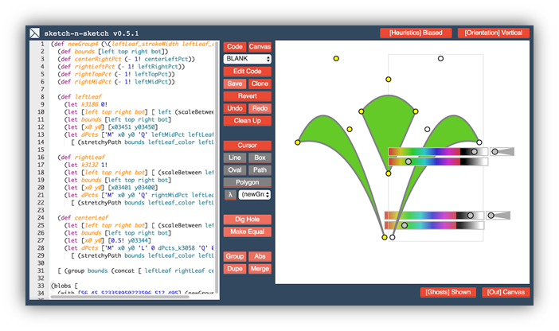
Applications: Live Programming
User Intent
Program Space
Change of the output value
Expressions that produce the current element
Search Algorithm
[Chugh et al.: PLDI 2016]

Slide 8
But what about mass-market deployments?

Slide 9



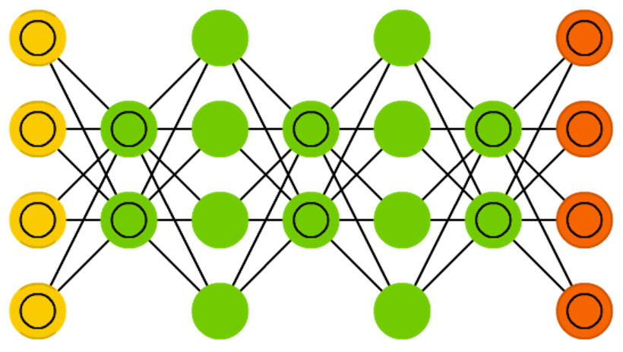

Outline
Program Synthesis: Intro
PROSE Framework
Mass-Market Deployments & Challenges
Future Work: Synthesis $⊂$ ML $⊂$ AI

Slide 10
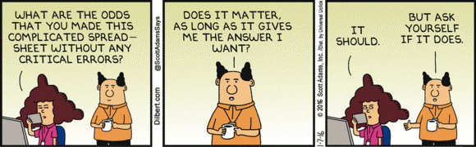
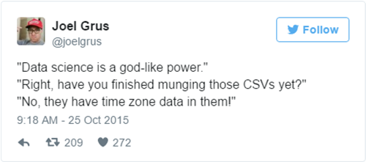
Original Motivation: Data Wrangling
99% of spreadsheet users
do not know programming
Data scientists spend 80% time extracting & cleaning data
Notes:
The original motivation for this line of work was two-fold.
First, we have spreadsheets, the most widespread programming language on Earth, and 99% of its users don't know how to program even in cases where it would probably help.
Second, even if you do know how to program, you're still in bad luck.
As it turns out, if you're a data scientist, 80% of your time you spend not developing intelligent ML algorithms, but instead parsing your datasets, cleaning them, transforming into a nice structured CSV so that you can apply your intelligent algorithms at all.
This problem is called data wrangling, and it is a massive issue for the entire field of data science.

Slide 11


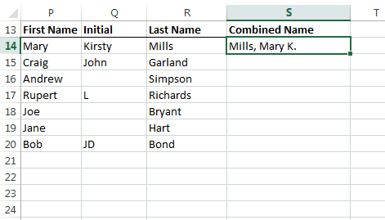
Flash Fill
[Gulwani: POPL 2011]
Concat(input[2], Const(“, ”), input[0], Const(“ ”),
let v = input[1] in Substring(v, AbsPos(v, 0), RegexPos(v, UpperCase, ε, -1)),
Const(“.”))
from the beginning till the last uppercase character

Slide 12
Flash Fill
[Gulwani: POPL 2011]
if (input[1] == ε) then Concat(input[2], Const(“, ”), input[0], Const(“.”)) else
Concat(input[2], Const(“, ”), input[0], Const(“ ”),
let v = input[1] in Substring(v, AbsPos(v, 0), RegexPos(v, UpperCase, ε, -1)),
Const(“.”))
from the beginning till the last uppercase character

Slide 13
Flash Fill
[Gulwani: POPL 2011]
Inductive Program Synthesis a.k.a.
Programming by Examples (PBE)
if (input[1] == ε) then Concat(input[2], Const(“, ”), input[0], Const(“.”)) else
Concat(input[2], Const(“, ”), input[0], Const(“ ”),
let v = input[1] in Substring(v, AbsPos(v, 0), RegexPos(v, UpperCase, ε, -1)),
Const(“.”))
from the beginning till the last uppercase character

Slide 14


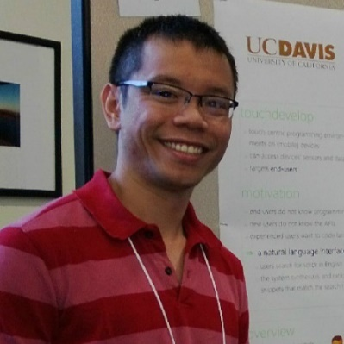




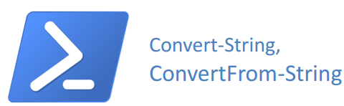

PBE Timeline
FlashFill
(text transformations)
FlashExtract
(text extraction)
FlashRelate
(table transformations)
…
  2010-2012
  [POPL 11]
  2012-2014
  [PLDI 14]
  2012-2015
  [PLDI 15]

Slide 15
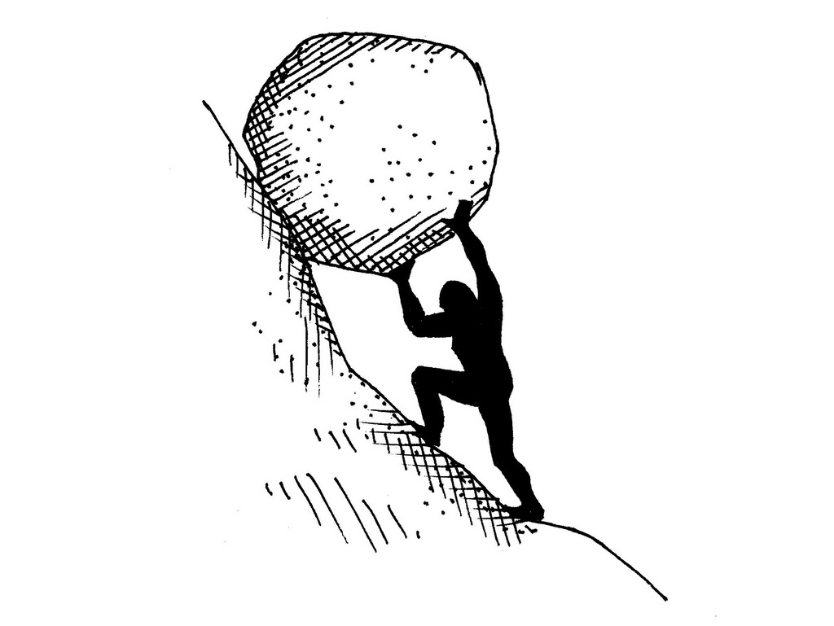


Why the Complexity?
Real-time program synthesis needs domain-specific logic.
  Complex data types + search heuristics + ranking
Prototypes are monolithic.
  Intertwined search and domain-specific insights
Not modular, extensible, or reusable.
$$⇓$$
$$⇓$$

Slide 16
PBE Timeline
FlashFill
(text transformations)
FlashExtract
(text extraction)
FlashRelate
(table transformations)
FlashMeta
(PBE framework)
PROSE
SDK
…
  2010-2012
  [POPL 11]
  2012-2014
  [PLDI 14]
  2012-2015
  [PLDI 15]
  2014-2015
  [OOPSLA 15]
  2015-present

Slide 17




PROSE
I/O Examples
Program Synthesis Framework
Input
Synthesis
Strategies
PROSE
App
Programs
Synthesizer
DSL
Definition
Output

Slide 18



PROSE
I/O Examples
Program Synthesis Framework
Input
Synthesis
Strategies
PROSE
App
Programs
Synthesizer
DSL
Definition
Output
Development time: $10$ months $→$ $10$ weeks!
Notes:
The main achievement that made the whole deployment story possible is that we separated these two personas. Previously, they were the same person, and this whole block was one big entanglement of synthesis and domain logic.

Slide 19




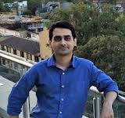

PROgram Synthesis using Examples
https://microsoft.github.io/prose
Sumit Gulwani
Prateek Jain
Ranvijay Kumar
Vu Le
Daniel Perelman
Mark Plesko
Alex Polozov
Mohammad Raza
Danny Simmons
Abhishek
Udupa

Slide 20
Thesis Statement
Interactive example-driven program synthesis for any data-centric domain can be expressed as one common domain-agnostic
top-down search algorithm parameterized by concise
domain-specific deduction procedures.
Such a decomposition makes program synthesizers scale
to real-life application domains, enables domain-agnostic
intent disambiguation techniques, incremental synthesis sessions,
and mass-market deployment of the derived technologies.

Slide 21


Outline
Program Synthesis: Intro
PROSE Framework
Mass-Market Deployments & Challenges
Future Work: Synthesis $⊂$ ML $⊂$ AI

Slide 22

Key Idea
DSL synthesizer
Notes:
Consider a domain-specific synthesizer, one big black box of code.

Slide 23

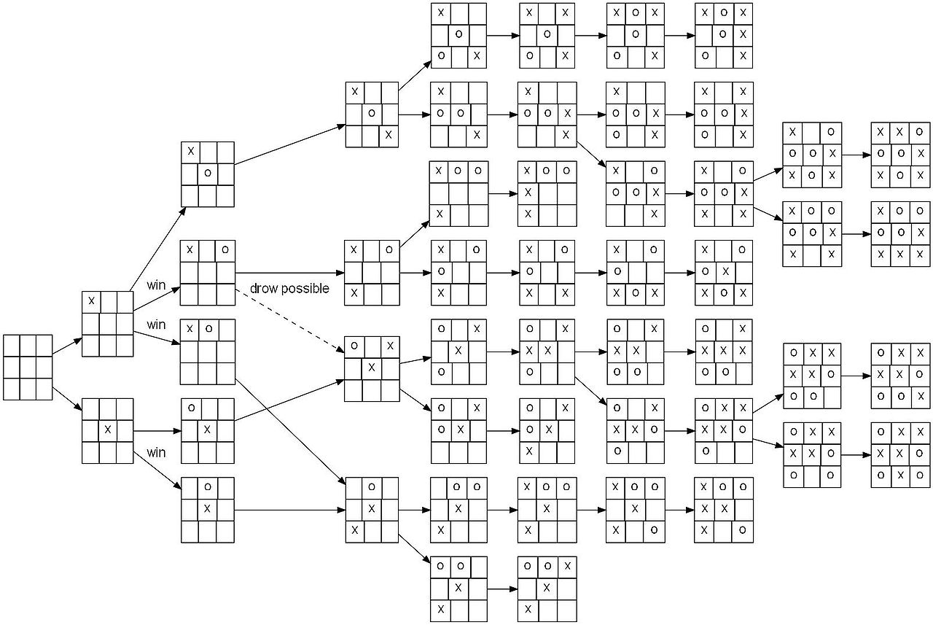

Key Idea
Depend only on the properties of DSL operators
$$⇓$$
✔ Modular
✔ Accessible
to non-experts
in synthesis
Generic divide-&-conquer
search strategy
Domain-specific insights
Notes:
What we realized is that every such synthesizer can be refactored into:
a generic divide-and-conquer search strategy, that is
parameterized by smaller black boxes -- the domain-specific insights.
These insights depend only on the meaning of individual operators in the DSL, and NOT on the whole search process pipeline.
That brings two benefits.
First, they are modular: you can mix-and-match common operators like Map and Filter in any DSLs, and synthesis will just work.
And second, you don't have to be an expert in program synthesis or formal logic to write those. You only need domain expertise. We have engineers on the team writing these without effort.
The technique that enables such separation of concerns and keeps synthesis fast we call witness function.
The name is not accidental: it is similar in spirit and in many ways to its sibling in the ML world.

Slide 24
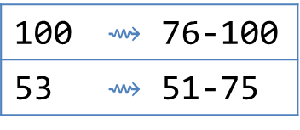





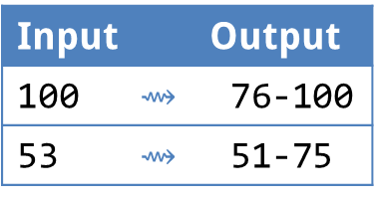
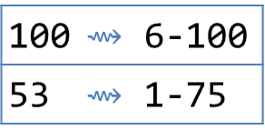



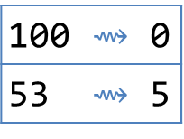



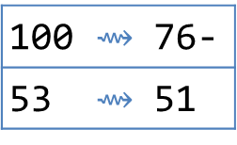


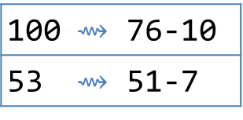

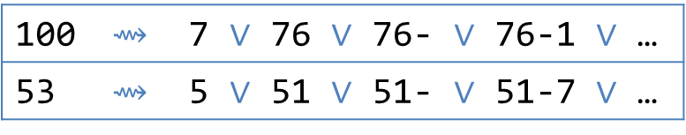



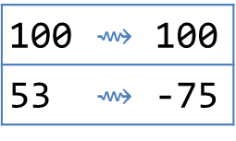


Witness function, a.k.a. Inverse Semantics
Witness function
Input | Output
100 $⇝$ | 76-100
53 $⇝$ | 51-75
Goal: find $s$ and $t$ s.t. $\text{Concat}(s,t)$ satisfies the examples
Method: invert the semantics of $\text{Concat}$
100 | $⇝$ 76-100
53 | $⇝$ 51-75
$$⟹$$
100 | $⇝$ 7 $∨$ 76 $∨$ 76- $∨$ 76-1 $∨$ …
53 | $⇝$ 5 $∨$ 51 $∨$ 51- $∨$ 51-7 $∨$ …
$$\text{Concat}\left(s,t\right)⊢$$
$$s⊢$$
$$𝒮$$
$$⋃$$
$$𝒮_{1}$$
100 $⇝$ | 7
53 $⇝$ | 5
$$𝒮_{10}$$
100 $⇝$ | 76-
53 $⇝$ | 51
$$𝒮_{20}$$
100 | $⇝$ 76-10
53 | $⇝$ 51-7
…
…
…
…
…
$$𝒯_{1}$$
$$𝒯_{10}$$
$$𝒯_{20}$$
100 | $⇝$ 6-100
53 | $⇝$ 1-75
100 | $⇝$ 100
53 | $⇝$ -75
100 | $⇝$ 0
53 | $⇝$ 5
$$t⊢$$
$$t⊢$$
$$t⊢$$
$$⋈$$
$$⋈$$
$$⋈$$

Slide 25
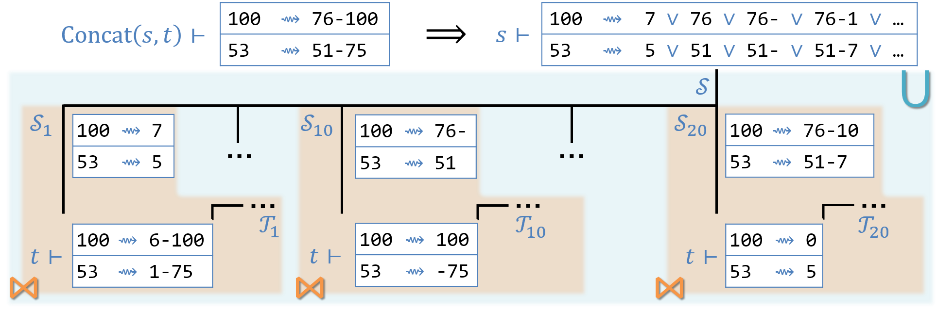
Witness function, a.k.a. Inverse Semantics
Witness function
Input | Output
100 $⇝$ | 76-100
53 $⇝$ | 51-75
Goal: find $s$ and $t$ s.t. $\text{Concat}(s,t)$ satisfies the examples
Method: invert the semantics of $\text{Concat}$
Conditional witness function

Slide 26

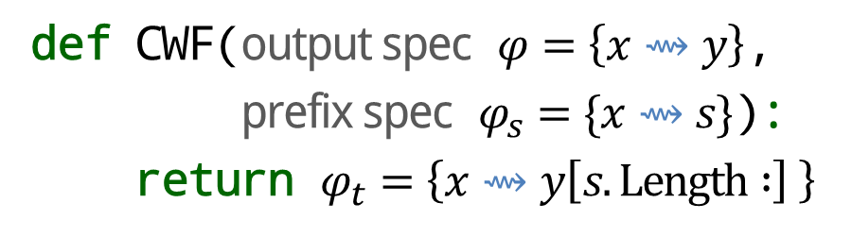
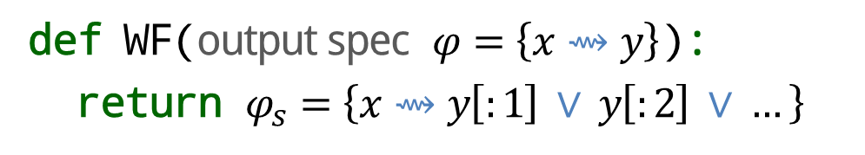
Witness function, a.k.a. Inverse Semantics
Witness function
Conditional witness function
def WF(output spec $φ=\left\{x⇝y\right\}$):
return $φ_{s}=\left\{x⇝y\left[:1\right] ∨ y\left[:2\right] ∨ \text{…} \right\}$
def CWF(output spec $φ=\left\{x⇝y\right\}$,
prefix spec $φ_{s}=\{x⇝s\}$):
return $φ_{t}=\left\{x⇝y\left[s.Length :\right] \right\}$
Example insight (search tactic): breaking numbers is unlikely
Ex. BK: breaking numbers is unlikely

Slide 27
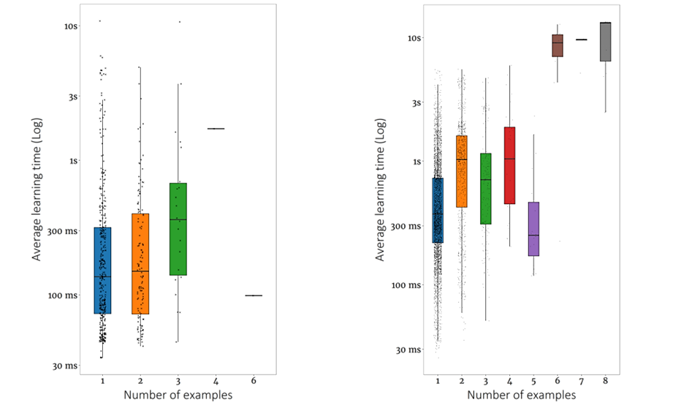



Performance & Number of Examples
PROSE Fill
PROSE Extract
$$≅$$
Learning time within $0.5$-$3$x of the original.
Slower because of the abstraction layer.
Faster because many optimizations are now free.
Notes:
On the left we have about 400 FlashFill scenarios, and on the right about 7000 FlashExtract scenarios. All real-world, taken from the web or from our partners or from customer data.
As you can see, our response time is almost always within 3 seconds.
In the cases where it exceeds this bar, we are dealing with highly ambiguous problems, where there's too many plausible hypotheses and we need more examples to nail down the right one.
I'll show in the second part of the talk how exactly such ambiguity complicates things.

Slide 28
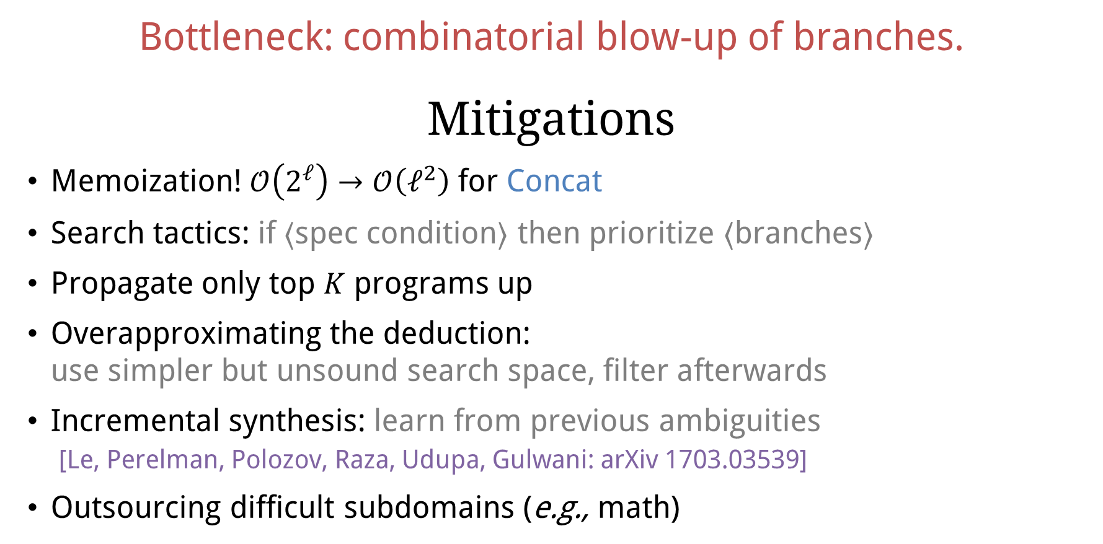
Limitation: Disjunctions
Bottleneck: combinatorial blow-up of branches.
Mitigations
Memoization! $𝒪\left(2^{ℓ}\right)→𝒪\left(ℓ^{2}\right)$ for Concat
Search tactics: if $⟨$spec condition$⟩$ then prioritize $⟨$branches$⟩$
Propagate only top $K$ programs up
Overapproximating the deduction:
use simpler but unsound search space, filter afterwards
Incremental synthesis: learn from previous ambiguities
[Le, Perelman, Polozov, Raza, Udupa, Gulwani: arXiv 1703.03539]
Outsourcing difficult subdomains (e.g., math)

Slide 29

Outline
Program Synthesis: Intro
PROSE Framework
Mass-Market Deployments & Challenges
Future Work: Synthesis $⊂$ ML $⊂$ AI

Slide 30







PROSE team
established

Slide 31

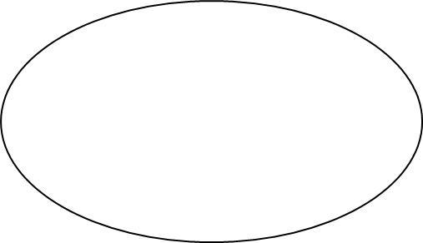
PROSE team
established

Slide 32
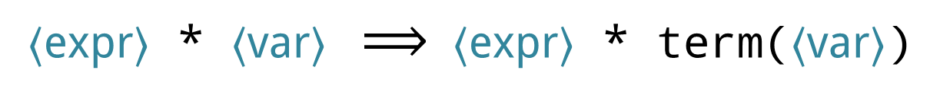
Refazer: Code Refactoring by Examples
def product(n, term):
total, k = 1, 1
while k <= n:
- total = total * k
+ total = total * term(k)
k = k + 1
return total
def product(n, term):
if n==1:
return 1
- return product(n-1, term) * n
+ return product(n-1, term) * term(n)
Refazer
(on top of PROSE)
〈expr〉 * 〈var〉 $⟹$ 〈expr〉 * term(〈var〉)
[Rolim, Soares, D’Antoni, Polozov, Gulwani, Gheyi, Suzuki, Hartmann: ICSE 2017]

Slide 33
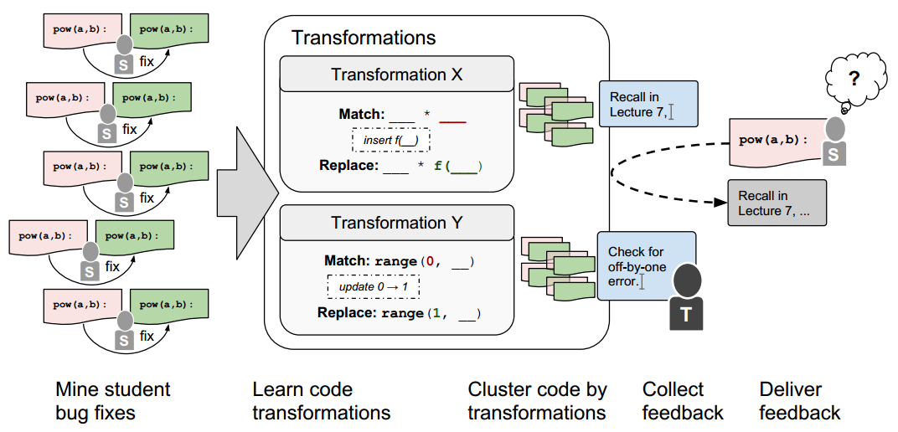
Refazer: Code Refactoring by Examples
Automated feedback in programming MOOCs
[Head, Glassman, Soares, Suzuki, Figueredo, D’Antoni, Hartmann: L@S 2017]

Slide 34
PROSE
I/O Examples
Program Synthesis Framework
Input
Synthesis
Strategies
PROSE
App
Programs
Synthesizer
DSL
Definition
Output

Slide 35


PROSE
I/O Examples
Program Synthesis Framework
Input
Synthesis
Strategies
PROSE
App
Programs
Synthesizer
DSL
Definition
Output

Slide 36

Examples are a terrible specification.
Notes:
Let's start with the elephant in the room.

Slide 37
Challenge №1: Intent Ambiguity
P₃ = Concat(“I”, first letter of last word)
P₆ = Concat(first uppercase letter, Substring(from: last uppercase letter followed by lowercase word, to: +1))
P₅ = Concat(first uppercase letter, Substring(from: second uppercase letter, to: last lowercase letter))
P₁ = Concat(first uppercase letter, second uppercase letter)
P₄ = Concat(first uppercase letter, “A”)
P₂ = Concat(first uppercase letter, first letter of last word)
Input
P₁
P₂
P₃
P₄
P₅
P₆
Isaac Asimov
IA
IA
IA
IA
IA
IA
Kyokutei
Bakin
KB
KB
IB
KA
KB
KB
Howard Roger
Garis
HR
HG
IG
HA
HRoger
G
HG
Enid Blyton
EB
EB
IB
EA
EB
EB
Edwy
S. Brooks
ES
EB
IB
EA
ES. B
EB
Barbara Cartland
BC
BC
IC
BA
BC
BC
Margaret Atwood
MA
MA
IA
MA
MA
MA
Iain M. Banks
IM
IB
IB
IA
IM. B
IB
John Smith III
JS
JI
II
JA
JS
JS

Slide 38
Challenge №1: Intent Ambiguity
I/O Examples
App
User
Synthesizer
Programs

Slide 39
Challenge №1: Intent Ambiguity
Refined examples
I/O Examples
Desired program
App
User (Debugging)
Synthesizer
Programs
Test Inputs
Notes:
This is called "intent disambiguation".
That's a serious issue in PBE because our workflow chart from before doesn't actually match the reality.

Slide 40

Anecdotes
Flash Fill was not accepted to Excel until it solved the most common scenarios from one example
  Some users do not know you can give two!
Adam Smith | Adam
Alice Williams | Alic

Slide 41

Ambiguity Resolution
Option 1: machine-learned robustness-based ranking
[Singh & Gulwani: CAV 2015]
Notes:
The most common one is to define a ranking function on your programs that somehow captures the notion of generality or robustness. Turns out you can even machine-learn such a function if you have a dataset of real-life scenarios.
Rishabh did an excellent job doing this for FlashFill, and we are now building a general pipeline for machine-learning ranking in PROSE itself, for any domain.

Slide 42
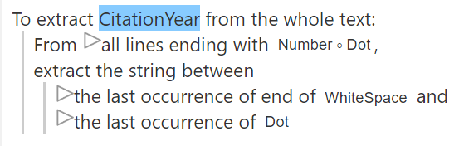
Ambiguity Resolution
Option 1: machine-learned robustness-based ranking
[Singh & Gulwani: CAV 2015]
Option 2: display the program (paraphrased in English)
[Mayer et al.: UIST 2015]
Notes:
However, when the ranking fails, to the user debugging this situation still feels like a black magic.
So how can we help them? One natural idea is to show the program to them, maybe paraphrased in English. The user can now read the program and decide whether it's the right one. We can even show some alternatives to pick from.

Slide 43
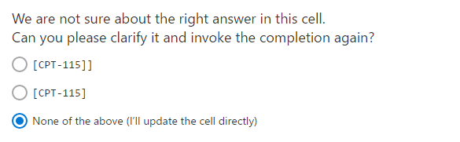
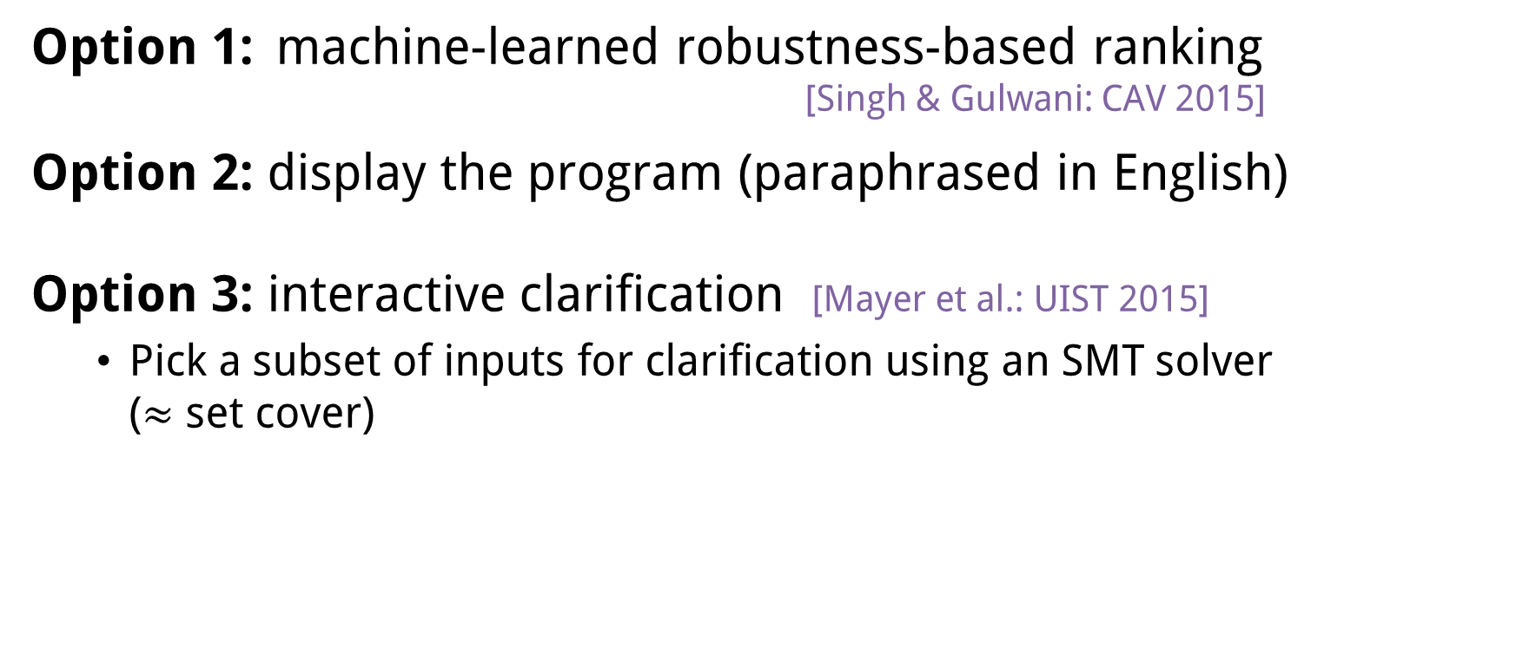
Ambiguity Resolution
Option 1: machine-learned robustness-based ranking
[Singh & Gulwani: CAV 2015]
Option 2: display the program (paraphrased in English)
Option 3: interactive clarification [Mayer et al.: UIST 2015]
  Pick a subset of inputs for clarification using an SMT solver
  ($≈$ set cover)
[Mayer et al.: UIST 2015]
Notes:
Turns out, this is not the best approach to interaction.
The best one is this: find an input where your alternative programs disagree, and ask a question about it.
"We have two programs that fit your examples, but one outputs this string on row 37, and another output this string. Which one do you want?"
The nice part about it is that we can pick these distinguishing inputs to optimize the convergence speed, and we can even offload this problem to an SMT solver.

Slide 44
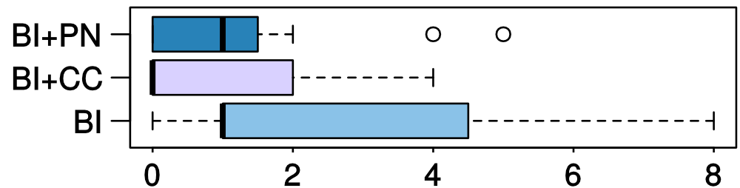


Comparing interaction models
Examples + Program
Any interaction leads to fewer errors in the task
Examples + Questions
($W=78.5, p<0.05$)
Questions tend to increase confidence in the system
Examples only
($W=181.5, p=0.07$)
Errors
[Mayer, Soares, Grechkin, Le, Marron, Polozov, Singh, Zorn, Gulwani: UIST 2015]

Slide 45
Interactive Program Synthesis
Refined examples
I/O Examples
Desired program
App
User (Debugging)
Synthesizer
Programs
Test Inputs

Slide 46


Interactive Program Synthesis
Refined examples
I/O Examples
Desired program
App
User (Debugging)
Synthesizer
Programs
Test Inputs
Notes:
Therefore, we treat program synthesis as an interactive process first-class, as it actually is in real life.
At each iteration, we ask the user these clarifying questions, and use the answers to refine the intent automatically and launch the new iteration of synthesis.

Slide 47


Interactive Program Synthesis
Outer loop:
Disambiguation
Refined examples
I/O Examples
Desired program
App
User (Debugging)
Synthesizer
Programs
Test Inputs

Slide 48


Interactive Program Synthesis
Inner loop:
Incrementality
Outer loop:
Disambiguation
Refined examples
I/O Examples
Desired program
App
User (Debugging)
Synthesizer
Programs
Test Inputs

Slide 49
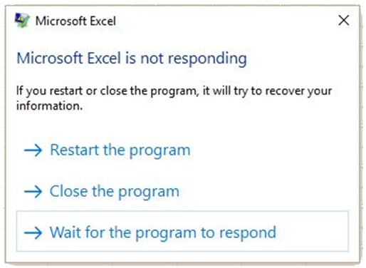
Challenge №2: Incremental Synthesis

Slide 50
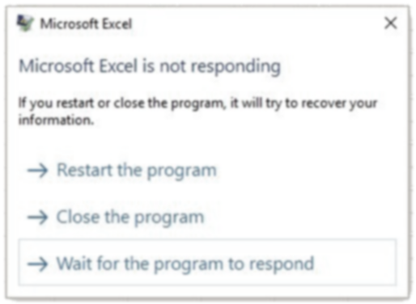
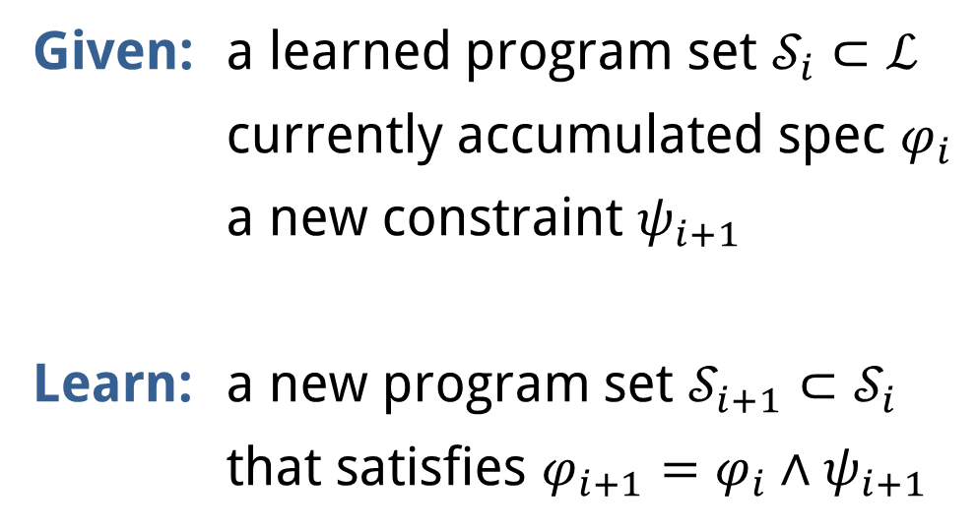
Challenge №2: Incremental Synthesis
Given: a learned program set $𝒮_{i}⊂ℒ$
currently accumulated spec $φ_{i}$
a new constraint $ψ_{i+1}$
Learn: a new program set $𝒮_{i+1}⊂𝒮_{i}$
that satisfies $φ_{i+1}=φ_{i}∧ψ_{i+1}$

Slide 51
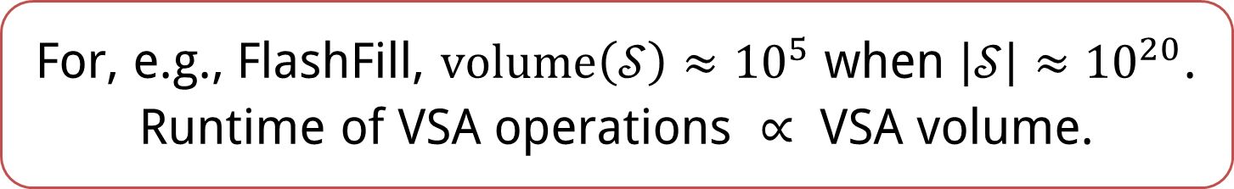
Background: Version Space Algebra
For, e.g., FlashFill, $\text{volume}\left(𝒮\right)≈{10}^{5}$ when $\left|𝒮\right|≈{10}^{20}$.
Runtime of VSA operations $∝$ VSA volume.
int positionIn[string s] := AbsPos(s, k)
| RegPos(s, std.Pair(r, r), k);
Sharing #1:
cross-product representation
Sharing #2:
equal sets are shared as the same DAG node
Sharing #2:
equal sets are shared as the same DAG node

Slide 52
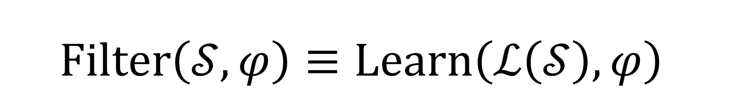
VSAs and CFGs are two isomorphic representations for a language
$$\text{Filter}\left(𝒮, φ\right)≡\text{Learn}\left(ℒ\left(𝒮\right), φ\right)$$

Slide 53
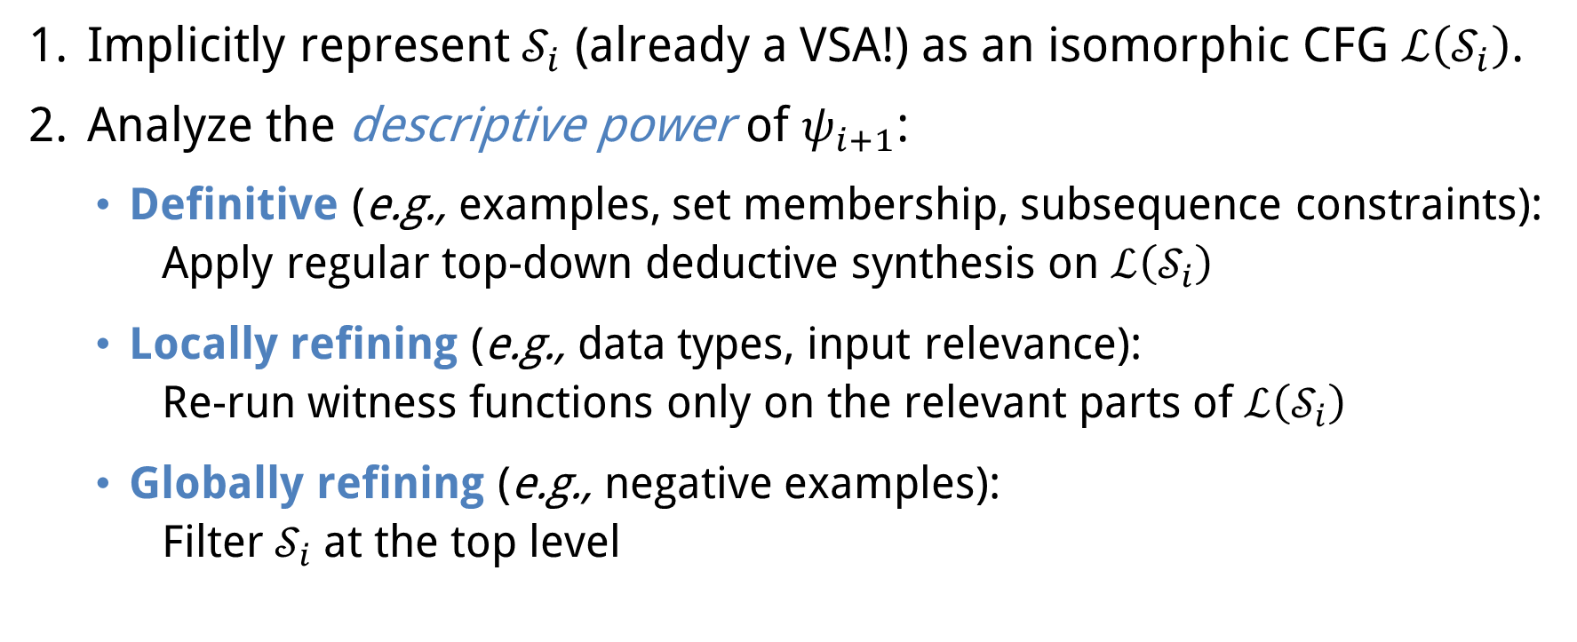
Incremental Inductive Synthesis
Implicitly represent $𝒮_{i}$ (already a VSA!) as an isomorphic CFG $ℒ\left(𝒮_{i}\right)$.
Analyze the descriptive power of $ψ_{i+1}$:
  Definitive (e.g., examples, set membership, subsequence constraints):
  Apply regular top-down deductive synthesis on $ℒ\left(𝒮_{i}\right)$
  Locally refining (e.g., data types, input relevance):
  Re-run witness functions only on the relevant parts of $ℒ\left(𝒮_{i}\right)$
  Globally refining (e.g., negative examples):
  Filter $𝒮_{i}$ at the top level

Slide 54
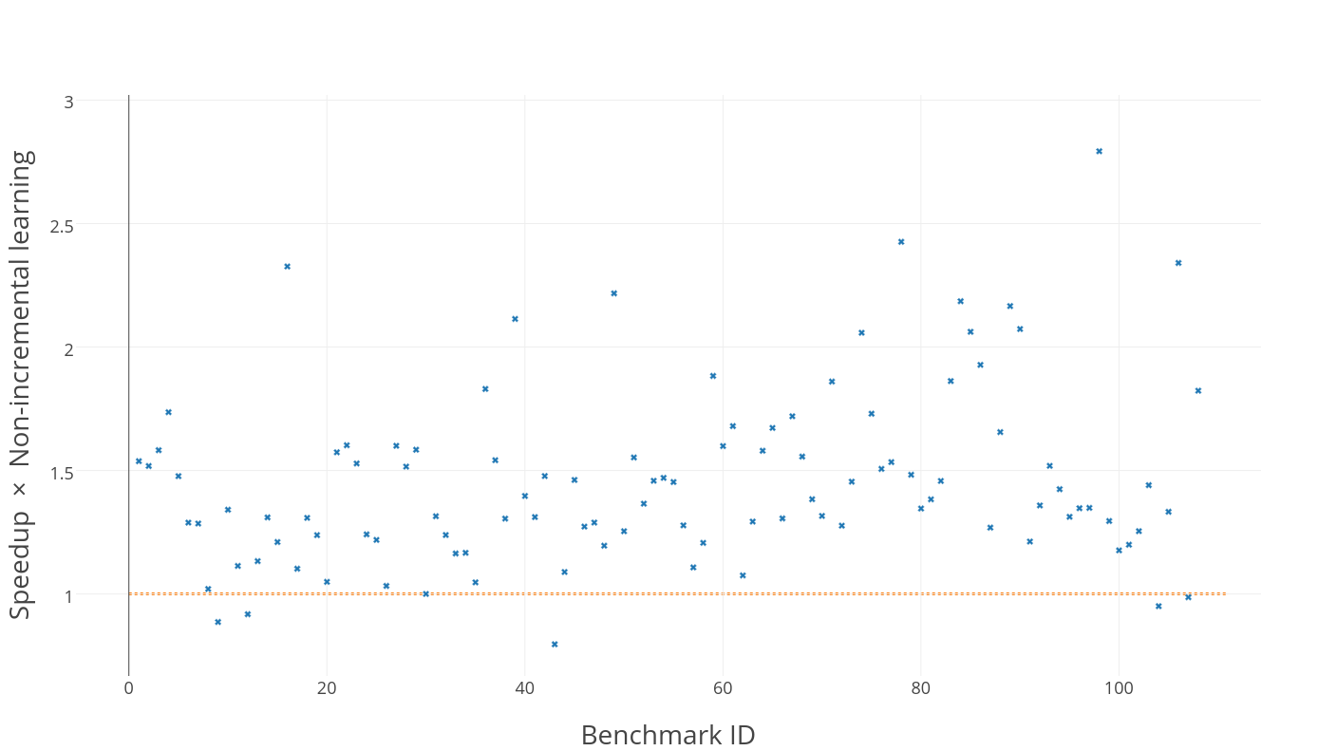
Speedup example: FlashFill

Slide 55
Outline
Program Synthesis: Intro
PROSE Framework
Mass-Market Deployments & Challenges
Future Work: Synthesis $⊂$ ML $⊂$ AI

Slide 56
Program Synthesis $⊂$ Machine Learning $⊂$ AI
 | INDUCTIVE PROGRAM SYNTHESIS | STATISTICAL MACHINE LEARNING
Representation | Declarative program with abstractions & recursion | High-dimensional numerical model with implicit abstractions
Learning | Logical reasoning, deduction | Stochastic gradient descent
Prior Knowledge | Re-uses | Infers
Dataset | Small “hard” spec, precise Optional “soft” spec: ranking | Large, may be noisy No hard/soft separation
Interpretable | Yes | Only locally; globally opaque
Notes:
From the perspective of general ML or AI, I see this whole line of work as complementary to statistical techniques that are common nowadays in ML.
Program synthesis operates in the logical world, learns declarative programs with lots of abstraction, effectively leverages domain-specific knowledge, can learn from very little data, and explicitly distinguishes hard precise constraints and soft noisy/optimization constraints.
Statistical ML operates in the probabilistic world, learn complex non-linear imperative models that are usually pretty opaque, usually has to infer any domain-specific knowledge, and requires large datasets, although they can be arbitrarily noisy.
So, both fields have their strengths and weaknesses, and they can and should help each other.

Slide 57
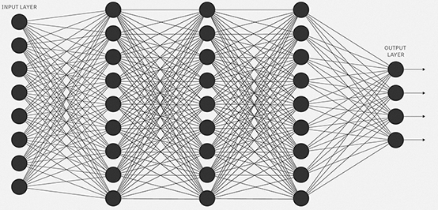




ML 👉 PS: Adaptive synthesis
Learning grammar weights speeds up enumerative program synthesis.
[Balog et al.: ICLR 2017] [Menon et al.: ICML 2013]
Extension to deductive synthesis $⟹$ learning search tactics.
$$w_{1}$$
$$w_{10}$$
$$w_{20}$$
Notes:
Marc has done great work by establishing that machine-learning grammar weights can tremendously help enumerative synthesis.
Now, that result was achieved for a quite simple synthesis algorithm -- syntactic enumeration. In a more complex system like PROSE we can learn _search tactics_ from data, and let ML guide the search process on a higher level of abstraction. We have all the infrastructure and data available, we just need to try it.

Slide 58
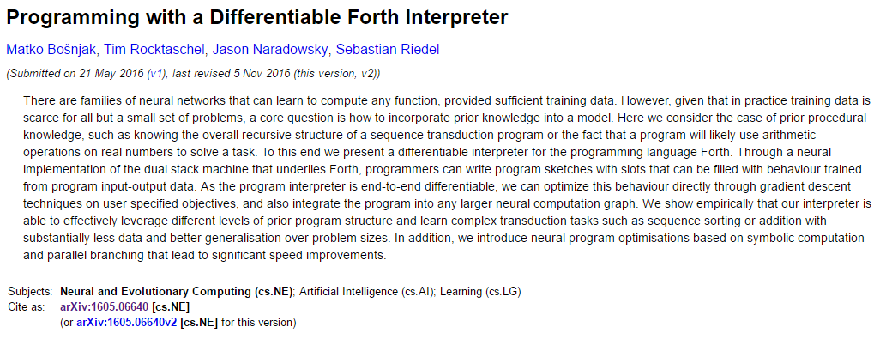
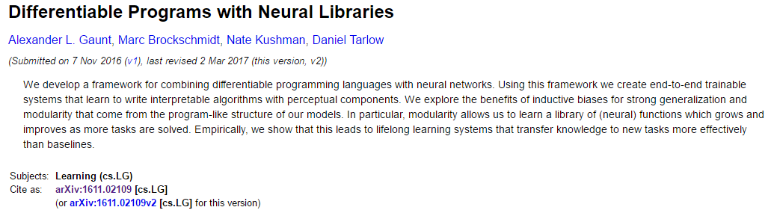
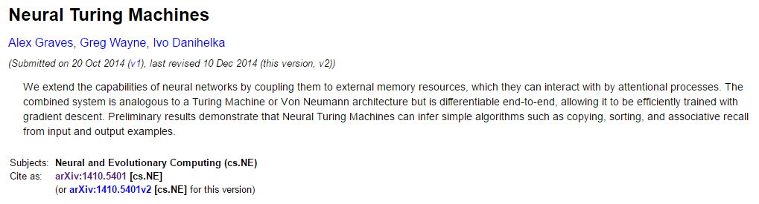
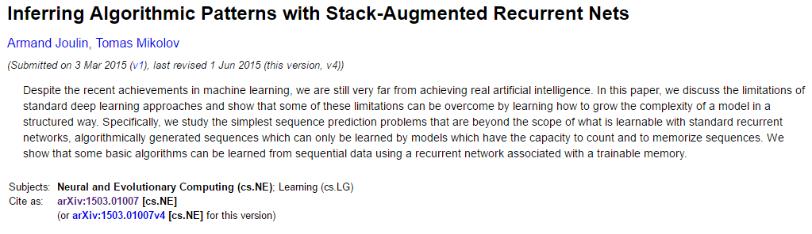
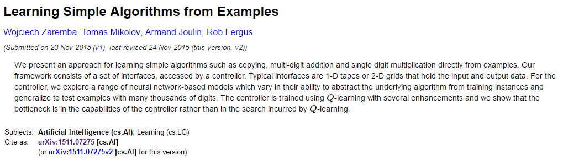



ML 👈 PS: Programming
Notes:
There’s been considerable interest in applying DL methods to programming/program synthesis in the last ~2 years. However, almost all of them define a notion of a “differentiable interpreter”, which aims to synthesize the entire program end-to-end from a spec (natural language or examples). And these interpreters are incredibly difficult to train. Non-surprisingly. Because humans don’t program end to end!

Slide 59




ML 👈 PS: Programming
Humans do not program end-to-end!
Infer the high-level structure/sketch of the solution.
Deduce the specification on the missing parts.
Fill in the implementation details to match the spec.
[Zoph & Le: ICLR 2017]
$$∀∃$$
[Schkufza et al.: CACM 2/16]
$$∀∃$$
[Bosnjak et al.: arXiv 1605.06640]
$$∀∃$$
[Solar-Lezama 2008]

Slide 60
Summary
PROSE: Decomposition of Inductive Program Synthesis algorithms into
a domain-agnostic meta-algorithm + domain-specific knowledge
Modular, accessible for software engineers, deployed Microsoft-wide & beyond
Deductive search parameterized by the domain ensures real-time response
Key challenge: intent ambiguity resolution and transparent interaction
Interactive clarification is the most effective disambiguation model
Future: ML 🤝 PS collaboration in practical AI

Slide 61


















Thank you!

Slide 62
Summary
PROSE: Decomposition of Inductive Program Synthesis algorithms into
a domain-agnostic meta-algorithm + domain-specific knowledge
Modular, accessible for software engineers, deployed Microsoft-wide & beyond
Deductive search parameterized by the domain ensures real-time response
Key challenge: intent ambiguity resolution and transparent interaction
Interactive clarification is the most effective disambiguation model
Future: ML 🤝 PS collaboration in practical AI
Thank you!
https://microsoft.github.io/prose

