Slide 1
Myanmar DIL WORKSHOP SERIES
Unit 4: Working Online and Using Information
MBAPF
May 2015

Slide 2
Module 4 Overview
Topics Covered:
Privacy and security measures,
online etiquette,
referencing online sources, and
working in collaborative online environments.
Questions You Will Be Able to Answer:
How do I protect my privacy online?
What some rules and guidelines for online behavior?
How do I use and reference online sources?
How do I work online with others?

Slide 3
Information Literacy – For You and Your Community
In the 21st century, literacy is not enough for success
Means computer literacy and using many kinds of IT (phones, scanners, cameras, etc.)
Also means that you learn to analyze the quality and validity of what you find online
With information literacy, people keep up to date
It is the basis for lifelong learning
Is a practical and an academic skill
Notes:
Will come back to this but …

Slide 4
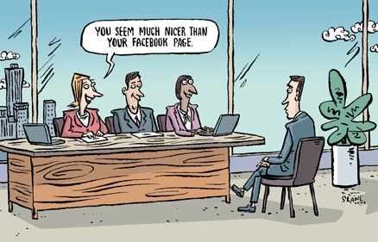
Privacy, Why Bother?
Notes:
Similar to the physical environment, where we must take certain precautions to ensure privacy and security for ourselves and others, the online environment has its own particular set of precautions that are important to be aware of. Why would we want to protect our privacy?[Take a few answers.]

Slide 5
Internet Ethics, Online Security
Internet Ethics, including plagiarism and cyberbullying; and Online Security. The acceptable behavior while using the Internet; being honest and respecting the rights of others on the Internet.
Online security – is protecting students from inappropriate material online and protecting students and teachers from threats from outsiders and each other.

Slide 6
What is Plagiarism?
According to the Merriam-Webster Dictionary:
  To steal and pass off (the ideas or words of another) as one’s own
  To use (another person’s work) without honoring/crediting/citing/crediting the source
  To commit literary theft
  To present as new an original an idea or product from another source

Slide 7
Examples
Turning in someone else’s work as your own
Copying words or ideas from someone else without giving credit
Failing to put a quotation in quotation marks
Giving incorrect information about the sources of a quotation
Copying so many words that it is the majority of your work

Slide 8
How to Avoid Plagiarism
Plan your paper with your own thoughts first
Keep good notes about your sources
Cite/reference your sources
Don’t use someone else’s work as your own
If you are working in a group, make sure that your co-workers don’t plagiarize

Slide 9
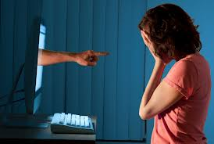
Cyberbullying
Cyberbullying is the use of the Internet and related technologies to harm other people, in a deliberate, repeated, and hostile manner.
Notes:
www.stopcyberbullying.org
Stop, block and tell
Thinkb4uclick
Respect (use good netiquette and respect the feelings and bandwidth of others)
Keep personal information private
Google yourself
Take 5

Slide 10
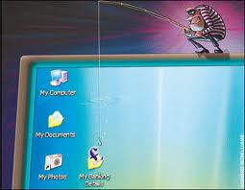
Phishing
Phishing is the illegal attempt to acquire sensitive information such as usernames, passwords, and credit card details (and sometimes, indirectly, money), often for malicious reasons, by masquerading as a trustworthy entity in an electronic communication.

Slide 11
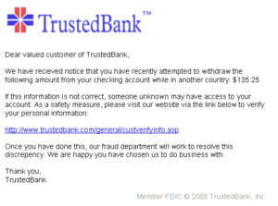
Fake Bank

Slide 12
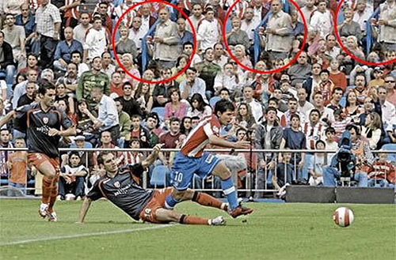
Fake Photo

Slide 13
Hackers
The term "white hat" in Internet slang refers to an ethical computer hacker, or a computer security expert, who specializes in penetration testing and in other testing methodologies to ensure the security of an organization's information systems.[
A "black hat" hacker is a hacker who "violates computer security for little reason beyond maliciousness or for personal gain“
A grey hat hacker is a combination of a Black Hat and a White Hat Hacker. A Grey Hat Hacker may surf the internet and hack into a computer system for the sole purpose of notifying the administrator that their system has been hacked, for example. Then they may offer to repair their system for a small fee.

Slide 14
4 Types of Privacy Harms
We’ll look more closely at 4 categories of privacy harms:
  Intrusions
  Information collection
  Information processing
  Information dissemination

Slide 15
Intrusions
“ They” come into “your” space and contact you or tell you what to do
Examples:
  Unwanted email (spam)
  Unwanted phone calls
  Parents entering a teen’s room without knocking
  Government saying what you can or can’t do with your own body or property

Slide 16
Information Collection
“ They” watch what you are doing, more than they should
Surveillance & Interrogation
  Visual, such as peeping Toms
  Communications, such as wiretapping your phone or email
  Government, employers, or parents ask you “private” information
Example of protections: with a warrant, the government can wiretap or search your house. Having to get a warrant is a protection, though, against too much information collection.

Slide 17
Information Processing
“ They” have a lot of data, and do things with it
  Identification: they learn about your “anonymous” actions
  Data mining: they learn patterns, to decide if you are a good customer or a suspected terrorist
  Exclusion: they decide you are not a good potential employee or customer, or go on the no-fly list at the airport
  Secondary use: they collect the data for one reason, but use it for others
Note: Information processing can be helpful, when it “personalizes” and gives you better service. But it can invade your privacy when it goes too far or is used in ways that break the rules.

Slide 18
Information Dissemination
“ They” disclose data, perhaps more than “you” think they should
  Breach of confidentiality: a doctor or lawyer discloses more than you wish
  Transfer to third parties: a company or government shares data about you to persons you don’t expect
  Public disclosure of private facts: an intimate photo of you, or disclosure of intimate facts
  Disclosure of untrue facts: you are put in a false light
  Appropriation: they use your name or picture without your permission

Slide 19
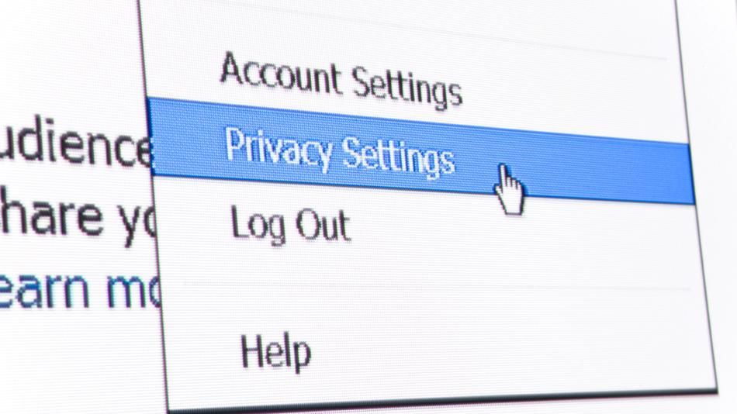
Privacy and Security

Slide 20
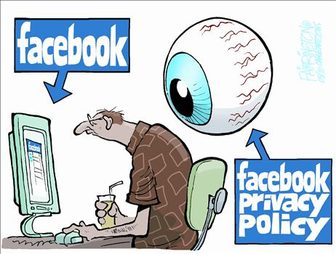
Facebook Privacy Policy

Slide 21
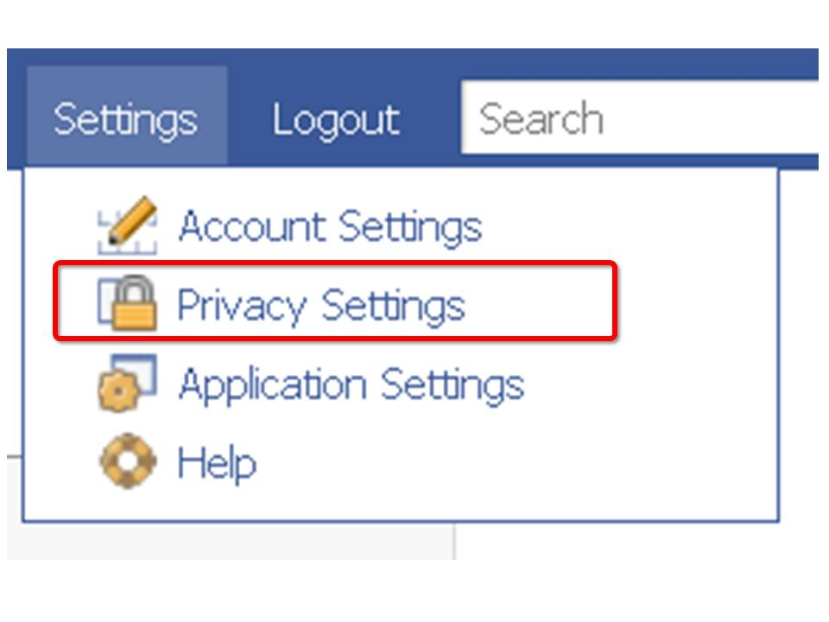
Privacy

Slide 22
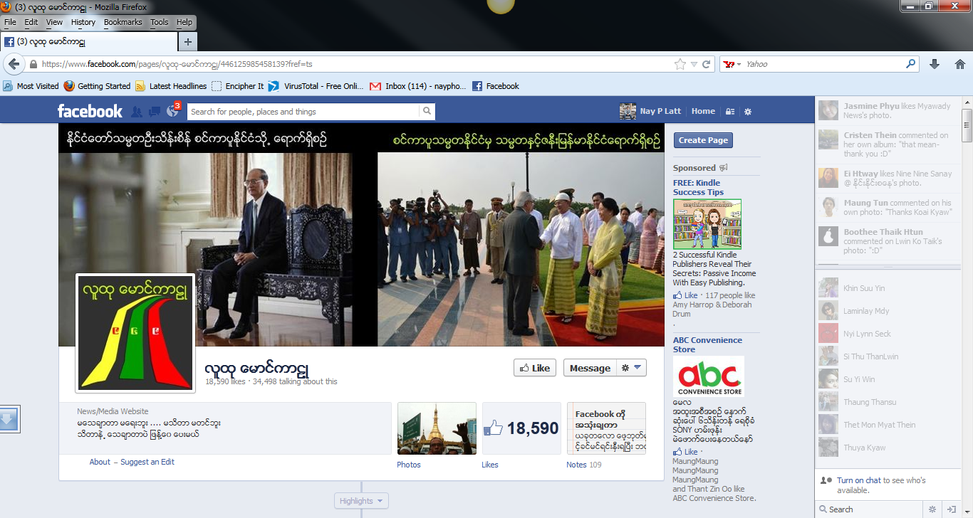
Hate Speech

Slide 23
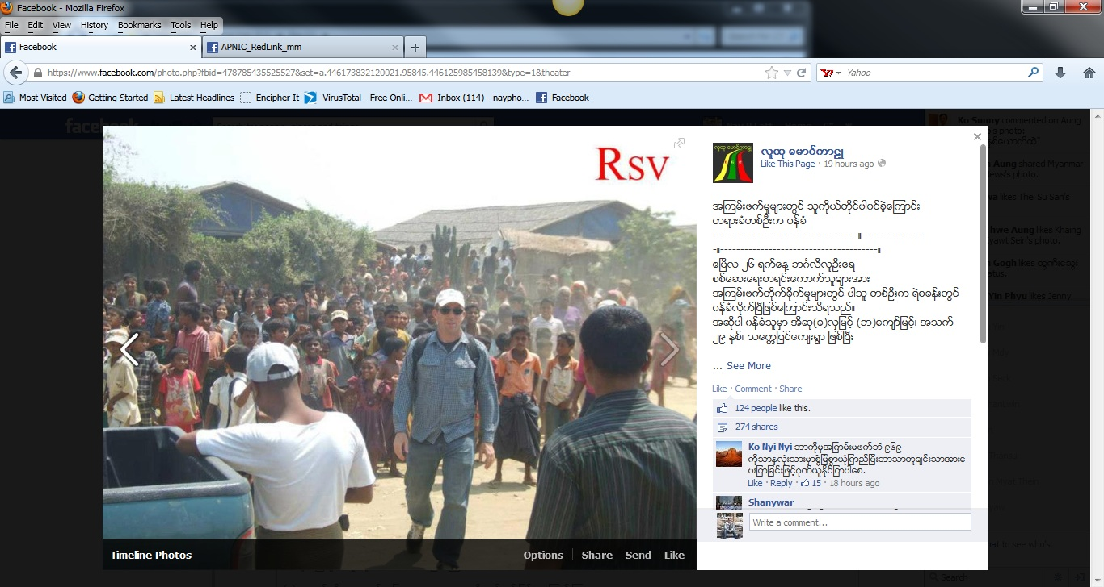
Defamation

Slide 24
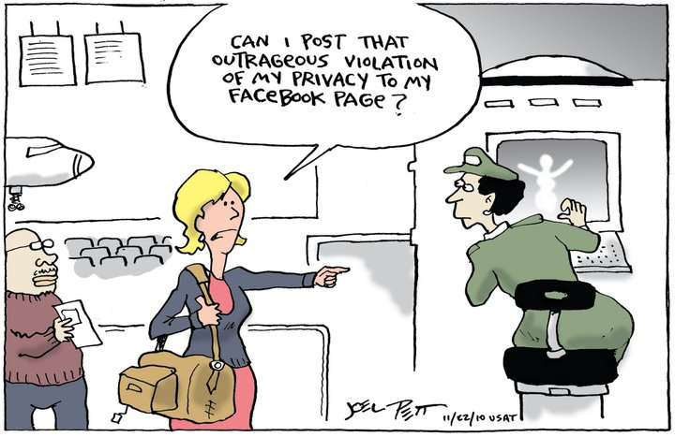
Who is Responsible for Privacy and Security?

Slide 25
အျခားသူမ်ားရဲ႕အခြင့္အေရးကုိ ကာကြယ္ျခင္း www.facebook.com/policies
Facebook ေပၚတြင္ သင္ဟာ -
တစ္ပါးသူတုိ႔ရဲ႕ အခြင့္အေရးကုိ ခ်ဳိးေဖာက္ေသာ၊တရားဥပေဒကုိျငိစြန္း
ေနေသာ အေၾကာင္းအရာမ်ားကုိ တင္ခြင့္မရွိပါ။
ဤေၾကျငာခ်က္ႏွင့္ ေပၚလစီမ်ားကုိ ခ်ဳိးေဖာက္သည္ဟု ယုံၾကည္ပါက
ထုိတင္ထားေသာ အခ်က္အလက္၊ အေၾကာင္းအရာမ်ားကုိ ဖယ္ရွားပစ္ပါမည္။

Slide 26
အျခားသူမ်ားရဲ႕အခြင့္အေရးကုိ ကာကြယ္ျခင္း www.facebook.com/policies
အျခားသူတုိ႔၏မူပုိင္ခြင့္ဆုိင္ရာအခ်က္အလက္မ်ားအား အၾကိမ္ၾကိမ္
ခ်ဳိးေဖာက္လာလွ်င္ သင္၏အေကာင့္အား အသုံးျပဳခြင့္မေပးေတာ့ပါ။
မူရင္းပုိင္ရွင္မ်ားထံသုိ႔ “ ဘယ္လုိအခ်က္အလက္ကုိယူပါသည္၊ ဘယ္လုိအသုံးျပဳပါမည္ ” ဆုိသည့္အေၾကာင္းကုိ ရွင္းျပေပးရမည္။

Slide 27
www.facebook.com/policies
(ကာယကံရွင္၏ခြင့္ျပဳခ်က္မရွိပဲ)အျခားသူမ်ားရဲ႕ကုိယ္ေရးအခ်က္အလက္မ်ားကုိ တင္ခြင့္မရွိပါ။
အျခားသူမ်ားရဲ႕ ခြင့္ျပဳခ်က္မရွိပဲ ပုံမ်ား၊ Note မ်ားတြင္ Tagging
( တြယ္ခ်ိတ္ေပးျခင္း) ၊ ဖိတ္ေခၚသည့္Email မ်ားေပးပုိ႔ျခင္း မျပဳရပါ။

Slide 28

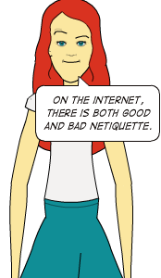
Notes:
Internet Etiquette
Fake photo
Hate speech, incitement
Defamation

Slide 29
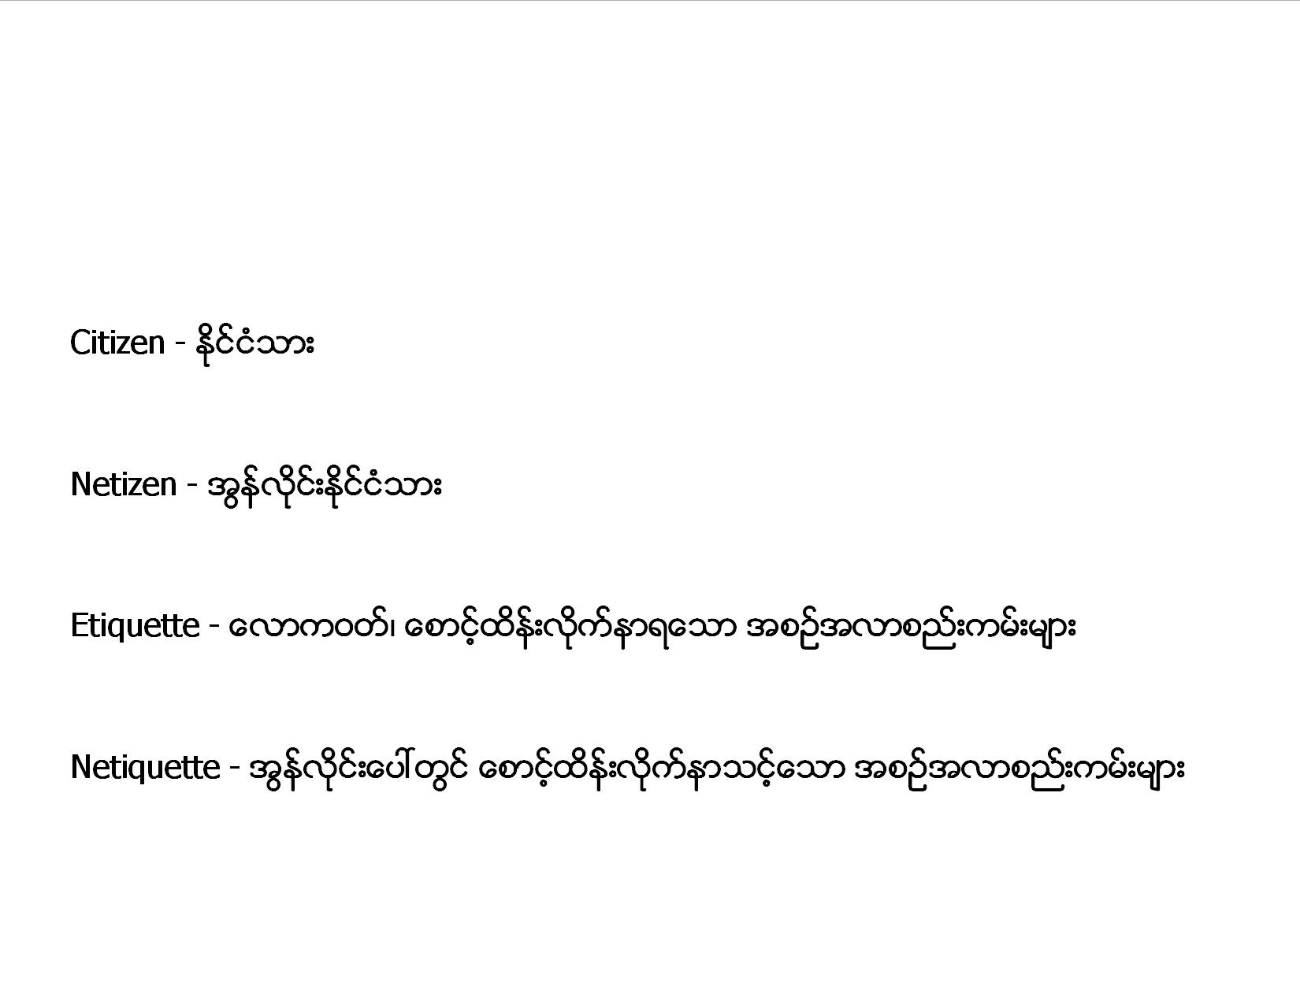
Citizen - ႏုိင္ငံသား
Netizen - အြန္လိုင္းႏုိင္ငံသား
Etiquette - ေလာကဝတ္၊ ေစာင့္ထိန္းလိုက္နာရေသာ အစဥ္အလာစည္းကမ္းမ်ား
Netiquette - အြန္လုိင္းေပၚတြင္ ေစာင့္ထိန္းလိုက္နာသင့္ေသာ အစဥ္အလာစည္းကမ္းမ်ား

Slide 30
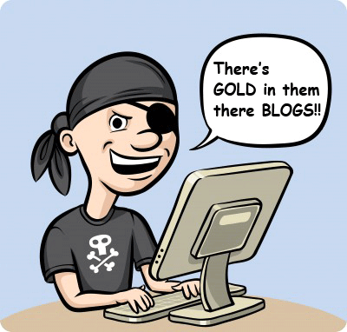
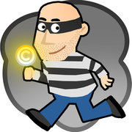
Credit, Credibility, and Copyright

Slide 31
Credits and Credibility
Author and credentials. Has he/she written other articles considered to be credible? Are the author and his/her credentials considered respectable and authoritative on the subject matter?
Type of organization. Is the organization considered to be reputable and a credible source for information? What type of information do they provide?
Content. Does the information appear to be accurate?

Slide 32
Credits and Credibility
Writing style. Is the information written in a manner that is appropriate as a credible information source?
References. Do other reputable sources reference this work? Does this work reference reputable sources?
Date. Is the information current?
Retrieval. How did you find this resource? Was it found through a reputable channel, for example through a knowledge database or peer-reviewed resource?

Slide 33
Copyright
Copyright is automatic, no need to register or do anything
It lasts for many decades
Author is the copyright holder
Employer can sometimes be the copyright holder

Slide 34
Exceptions to Copyright
Fair Use for Educational Purposes
Use of material to format and make available to persons with disabilities such as blind people (Marrakesh Agreement)
Things in the public domain, usually after the author has been dead for a long time

Slide 35
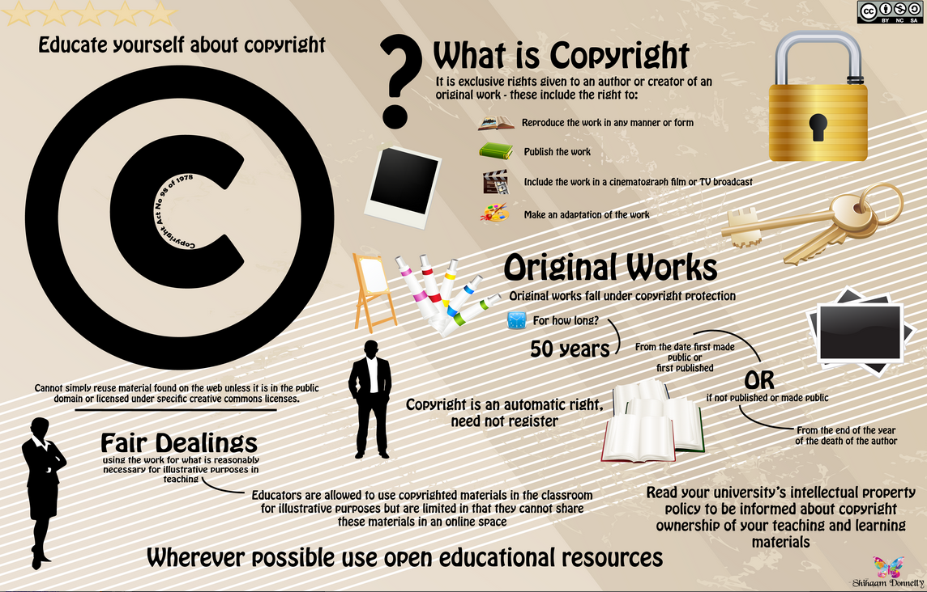

Slide 36
Turnitin/URKUND
A Service that helps to prevent plagiarism
Students submit papers/assignments in electronic form
The paper is checked against thousands of existing papers/articles in a database and documents on the internet
Possible matches or similarities are shown to the professor

Slide 37
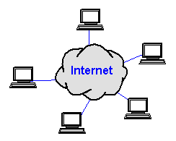
Today's Cloud
Quite often, the cloud is the Internet, and cloud computing on the Internet has several advantages for developers, content publishers and users.
More functionality than just the network of networks
Whereas users relied on their devices to manipulate and store information, cloud service providers enable users to manage, store, and manipulate data over the internet.

Slide 38

Activity 4.1: Basic Protection Measures

Slide 39
Identify security settings
Device
  Password, lock, location settings, remote lock/find/erase, etc.
  Frequently used apps, especially social media and messaging apps
  Browser apps (Do not track, clear data/history/cookies, etc.)
  Secure Accounts
    Social media
    Emails, etc.

Slide 40
Discussion
What security options did you find?
Which did you think were important to set? Why?
How might these security options be important for your organization or personally?

Slide 41
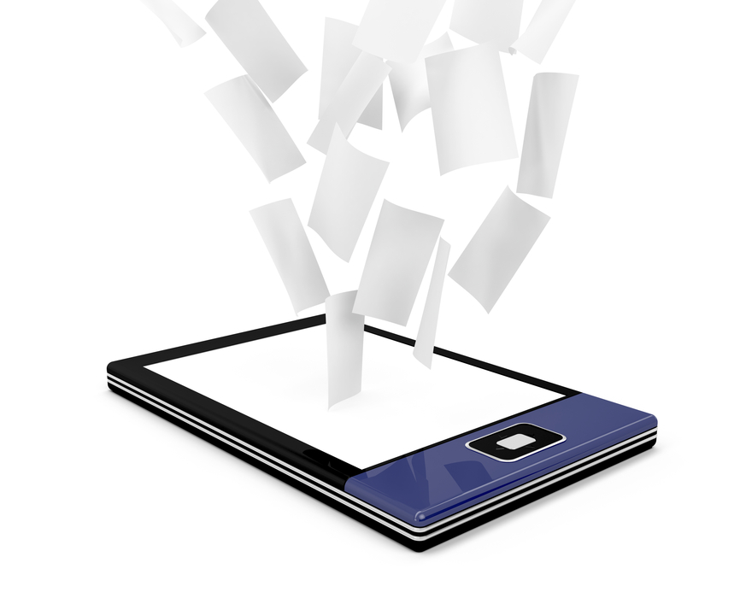
Activity 4.2: Using Online Content

Slide 42
Do You Need Permission?
most online content is protected by copyright
always assume that online content is protected unless you know otherwise
if you use unauthorized content, don’t be surprised if you get an email from the content owner
Digital or electronic content, such as e-books, photographs on Web sites and electronic databases are subject to the same protections under the Copyright Act as non-digital, traditional or analog works.

Slide 43
Fair use
Copyright law protects almost all content on the Web or in any other digital or electronic form.
Therefore, permission is most likely required to use that work beyond fair use.

Slide 44
Unique Uses
The electronic environment features methods of reusing
copyright-protected materials. These methods include:
Scanning
Using Content from a Web Site
Posting Content to a Web Site
Forwarding E-Mail
Linking to a Web Site
Electronic Discussion Lists,
Bulletin Boards and Newsgroups

Slide 45

Activity 4.3: Facebook Groups

Slide 46
Facebook Group
Create a Facebook Group
Limit membership
Pls. add me to your facebook group
Interact and explore in the group space
  Posts vs. messages
  Attaching photos and videos
  Tagging photos
  Creating and managing albums
  Attaching files
  Editing posts
  Deleting posts
  Sharing website links

Slide 47

Activity 4.4: Intro to Google Docs

Slide 48
Creating Google Docs

Slide 49
To create a new file
Google Document
Locate and select the New button
Choose the type of file you want to create
Select Google Docs to create a new document

Slide 50
New file, New Tab
Locate and select Untitled document in the upper left corner
Rename dialog box will appear
Type a name for your file, then click OK

Slide 51
Renamed
Your file will be renamed
You can access the file anytime from your Google Drive, where it will be saved automatically.
Simply double click to open the file again

Slide 52
Automatically saved
You may notice that there is no save button for your files.
This is because Google Drive uses which automatically and immediately save your files as you edit them

Slide 53
Review
Topics Covered:
Privacy and security measures, online etiquette, referencing online sources, and working in collaborative online environments.
Concepts Learned:
How do I protect my privacy online?
What some rules and guidelines for online behavior?
How do I use and reference online sources?
How do I work online with others?

Slide 54

End Unit 4
Congratulations!!! You have completed the Myanmar Digital Information Literacy (DIL) Workshop Module Unit 4: Working Online and Using Information.

