Slide 1
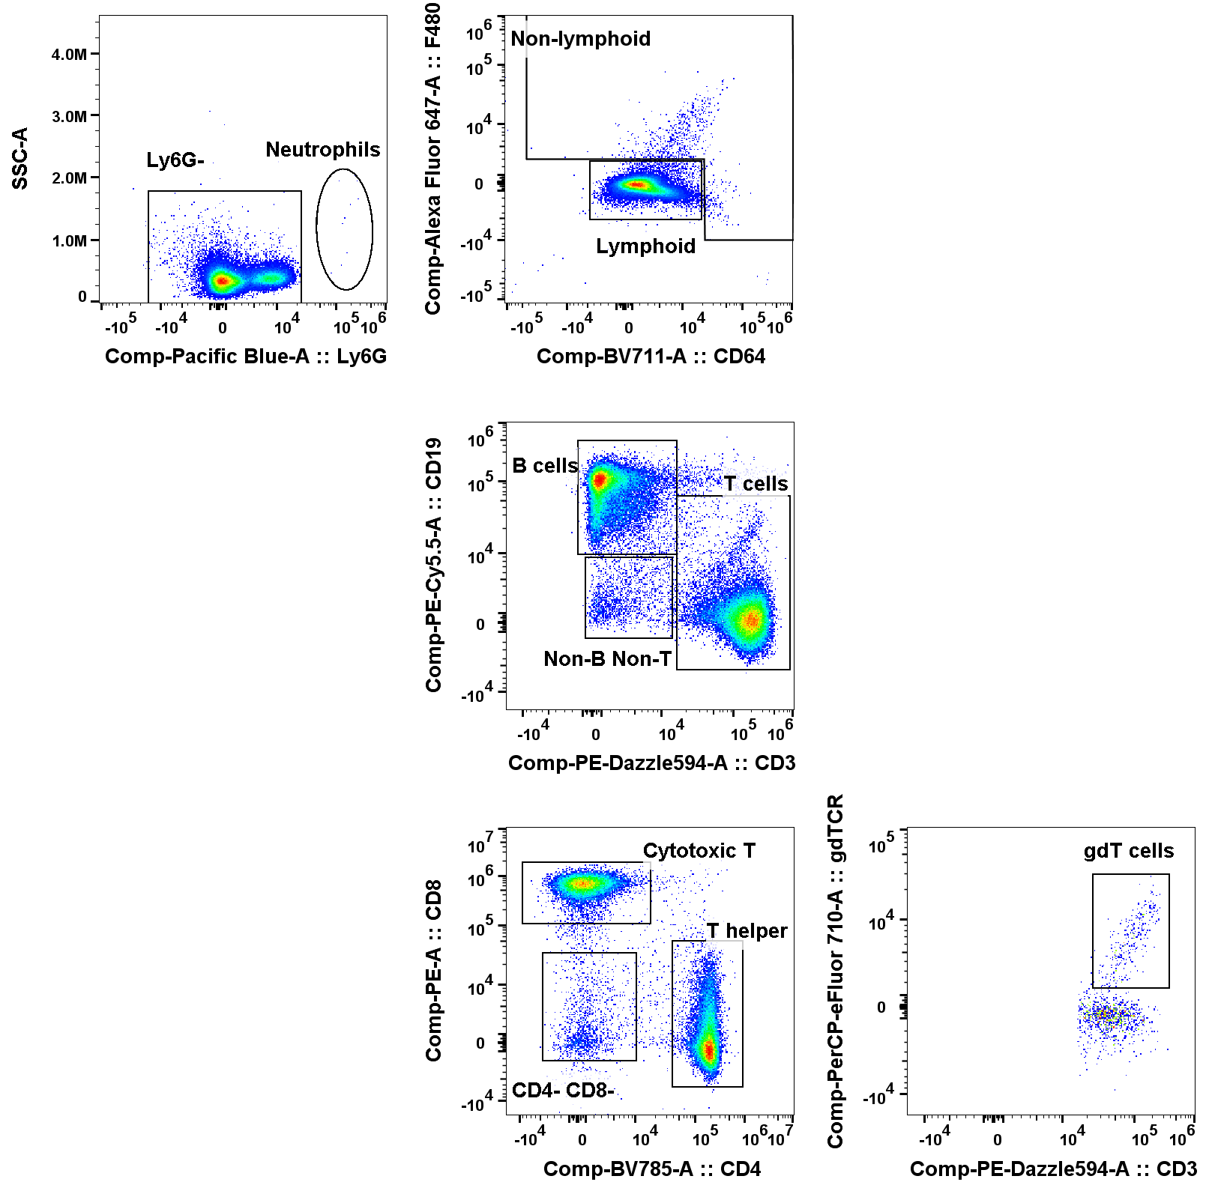
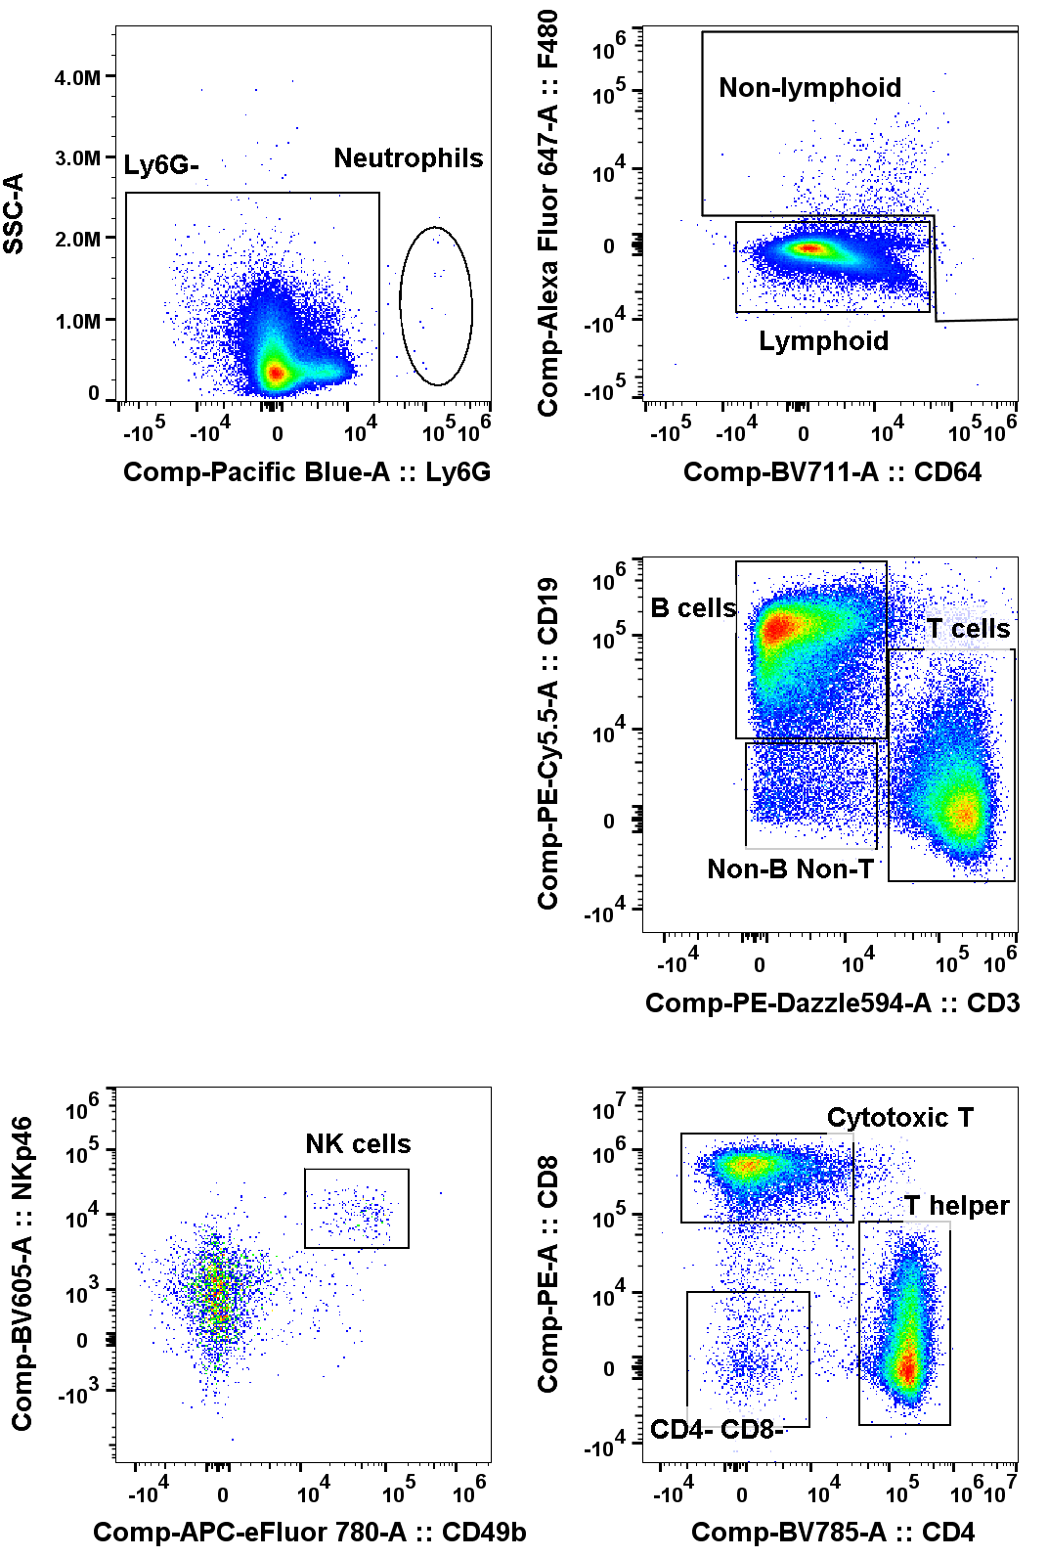
Multi-Compartmental Analysis of the Murine Pulmonary Immune Response by Spectral Flow Cytometry
Chang M.Y., Brune J.E., Black M., Altemeier W.A., and Frevert C.W.
American Journal of Physiology Lung Cellular and Molecular Physiology
A. PBS 9dpi LN
B. PR8 9dpi LN
Supplemental Figure 5. Gating Tree on Lymph Node Leukocytes. The supervised gating strategy was applied to single live CD45+ cells from the lymph nodes of (A) a control male mouse, and (B) a 9 dpi PR8-infected male mouse. Populations representing <2% of the parent gate were not further characterized. See text for full description of gating strategy.

