Slide 1
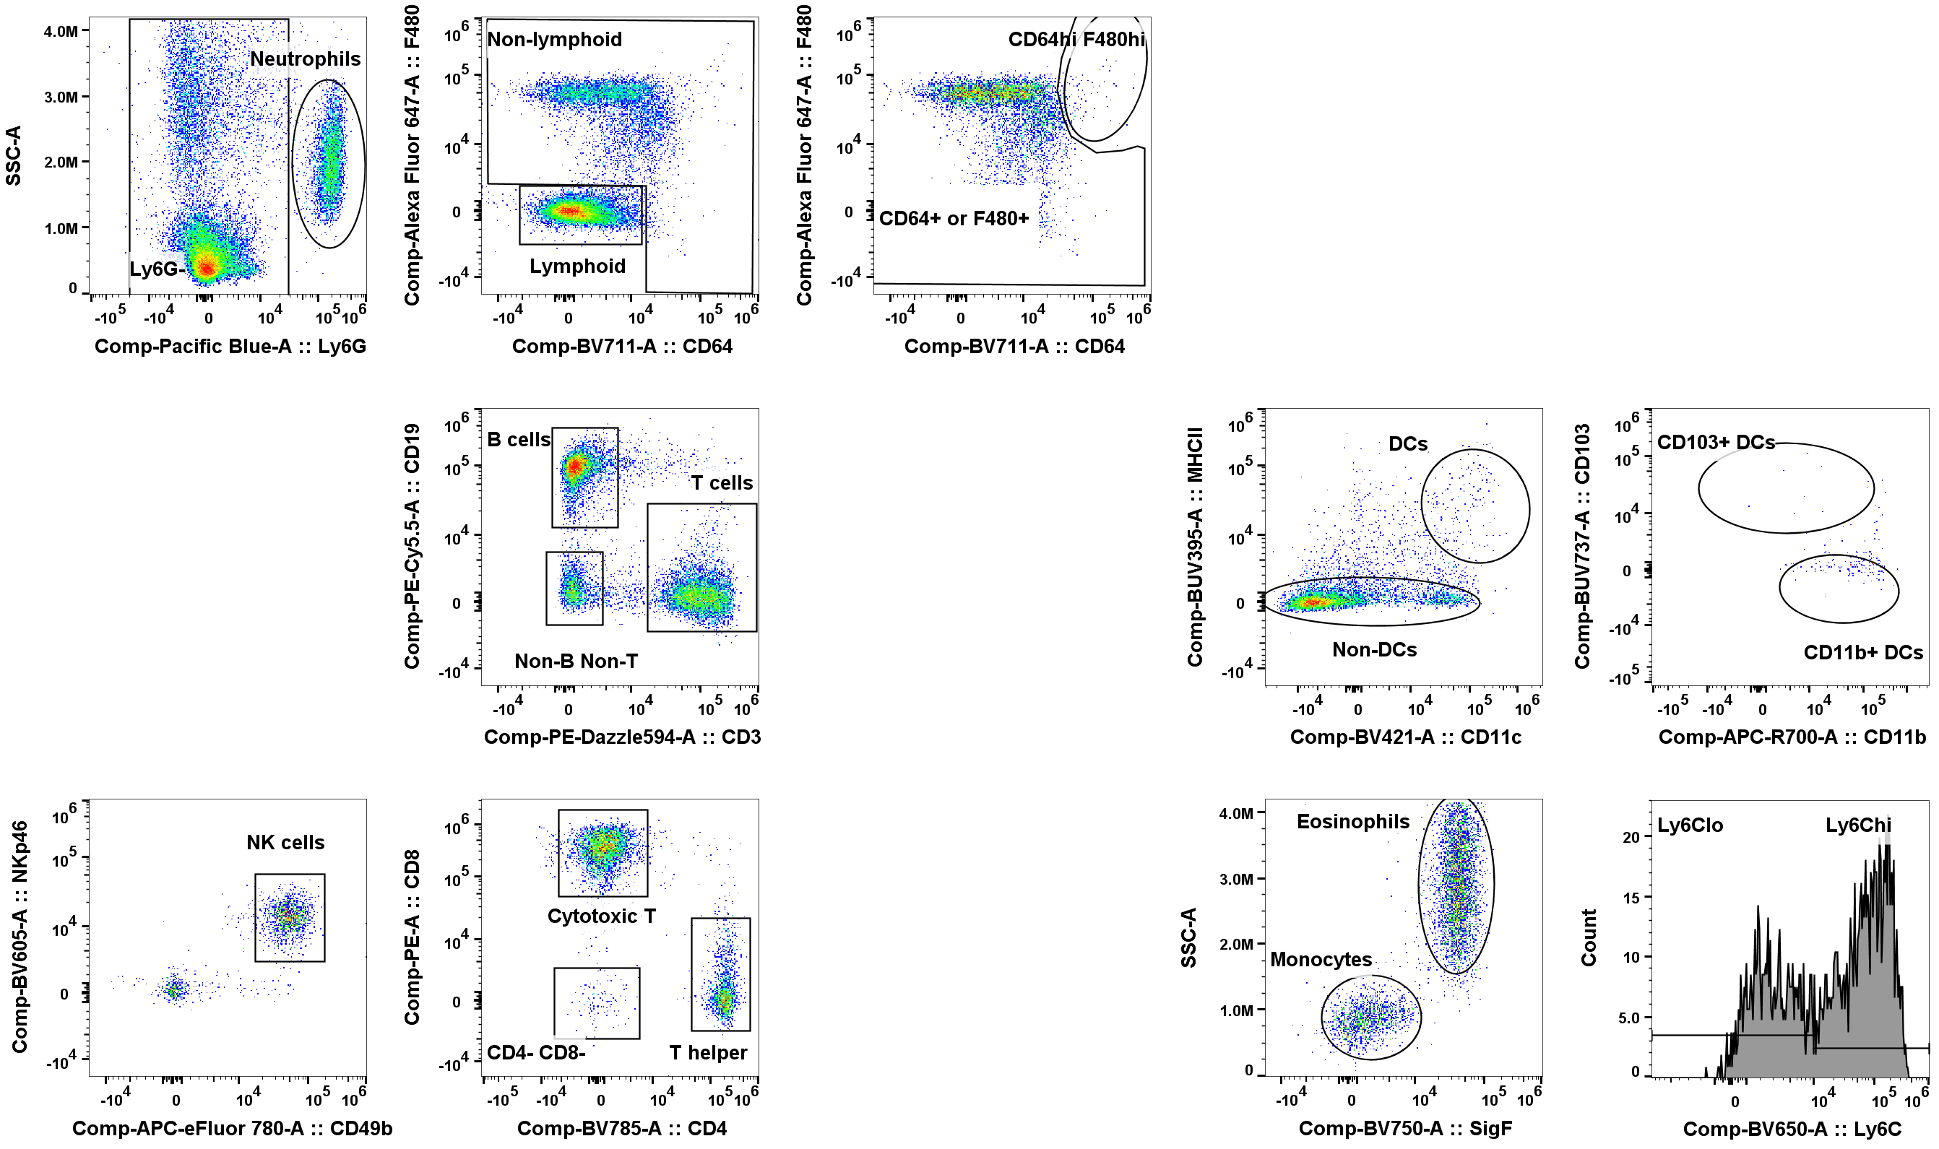
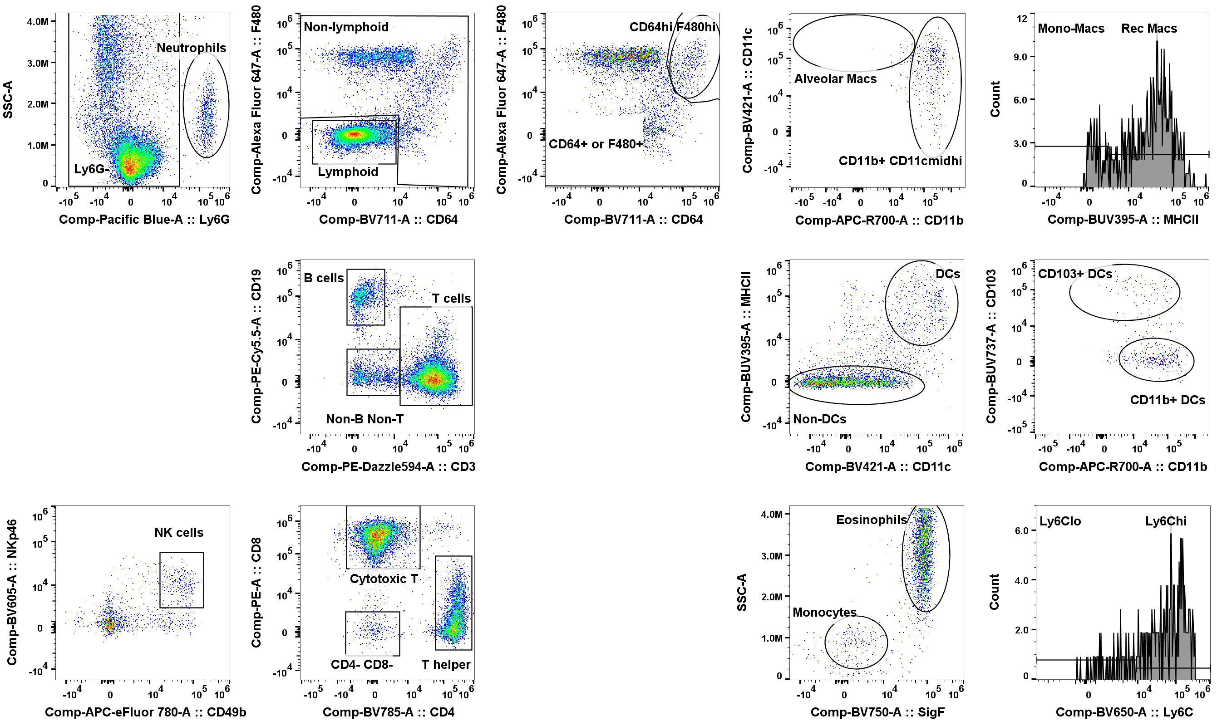
Multi-Compartmental Analysis of the Murine Pulmonary Immune Response by Spectral Flow Cytometry
Chang M.Y., Brune J.E., Black M., Altemeier W.A., and Frevert C.W.
American Journal of Physiology Lung Cellular and Molecular Physiology
A. PR8 9dpi Marginated Vasculature
B. PR8 9dpi Lung Interstitium

Slide 2
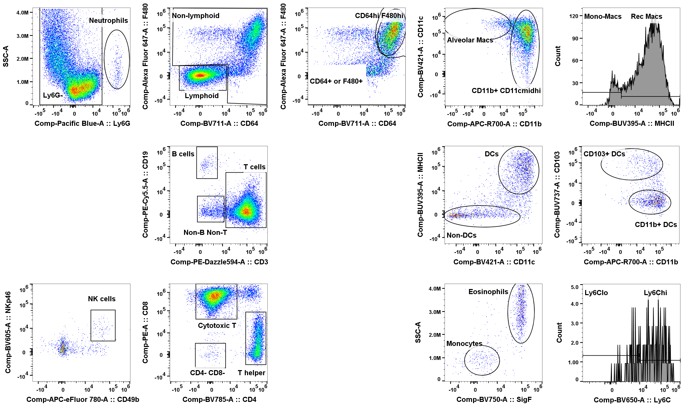
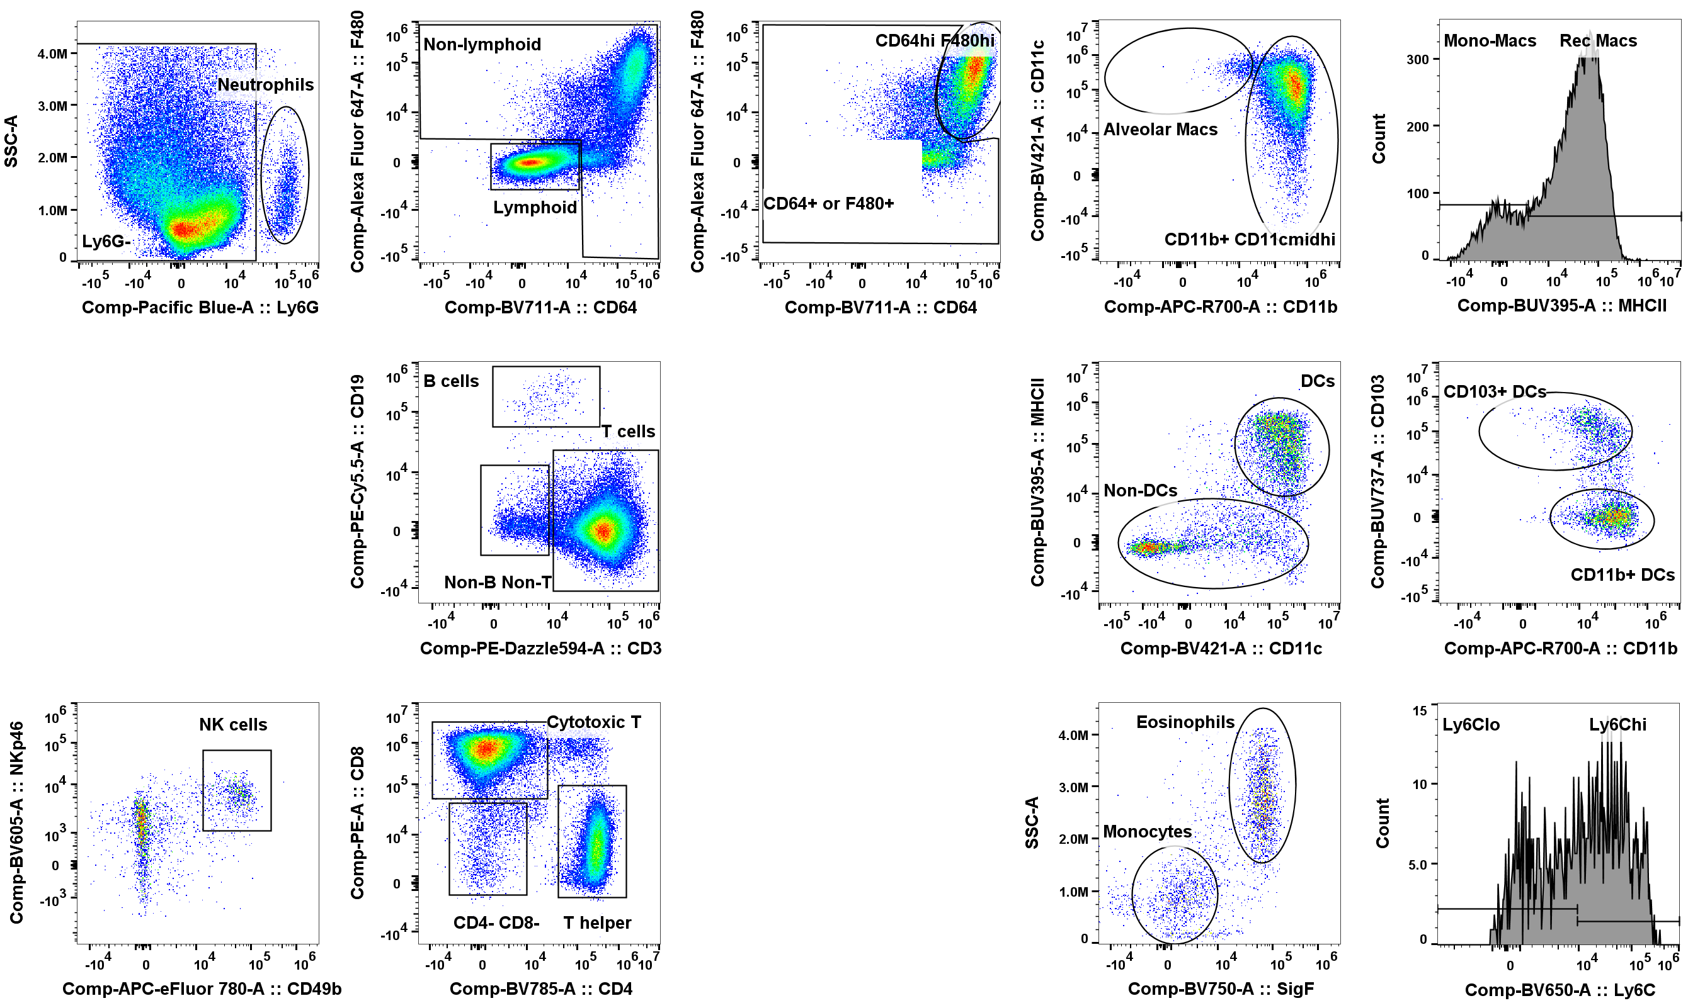
C. PR8 9dpi Non-Lavageable Airway
D. PR8 9dpi Lavageable Airway
Supplemental Figure 4. Gating Tree on PR8 9dpi Lung and BAL Leukocytes. The supervised gating strategy was applied to single live CD45+ cells from a PR8-infected male mouse. Representative gating trees are shown for leukocytes in the (A) marginated vasculature; (B) lung interstitium; (C) non-lavageable airway; and (D) lavageable airway. Populations representing <2% of the parent gate were not further characterized. See text for full description of gating strategy.

