Slide 1
Best Practices for Teachers and Providers: A Cross Systems Training to Support Gender-Variant Youth
Kathyrn Chociej, University of Washington – Tacoma, School of Social Work
MSW Candidate, Class of 2013

Slide 2
Module III
Mental Health Providers Training Module

Slide 3
Mental health providers will gain an understanding of gender identity and expression, better understand barriers gender-variant youth face when accessing mental health services, be better prepared to support gender-variant youth; and recommend other affirmative therapies and gatekeeping practices which positively advocates for potential medical interventions.

Slide 4
Introductions and check-in
What do you hope to learn and/or gain from this workshop?
  What part of the state do you work in?
  What age youth do you typically work with?
  Have you attended similar trainings to this one?

Slide 5
Group norms and creating a safe training space
No interrupting
No side conversations – cross talk
Give the benefit of the doubt – look for learning
No judgment – we are all in different places
Commitment to the process- stay through the hard stuff
Own your stuff – apologize
“I” statements
Stay humble
Focus is: to explore, to encourage a deeper understanding of complex topics
To engage in an analysis of the topic

Slide 6
When are we first gendered?
Notes:
Challenges We Face
From the moment of our birth we are identified by others. They define our sex identity by looking at our genitals when we are born. Our parent(s) choose our name and dream of how we will "turn out." The record of our birth is the binding legal statement that says who we are.
We are socialized immediately, and later taught "proper" behavior. We learn to recognize our parent(s) and siblings, and learn how to eat, speak, walk, and move our bladder and bowels, all within the first three years of life! We learn what is important. We learn that we are part of a family. We learn loyalty to the family culture, including the family’s race and ethnicity. We also learn about our family secrets and learn to keep them secret. We are praised for doing "good," and punished for being "bad." In general, "socialization" efforts by those around us are very intensive, especially between birth and age five. And when we are not being actively taught, we watch and listen, and integrate everything we see and hear within the very core of ourselves, so that we can know just how to "be." Like everyone else, we desperately want to please and receive praise.
Then, there comes this feeling, this desire to be the other sex. This frightens us and challenges everything that we have learned. We worry about ourselves. We fear others might find out. Prayers do not help. We become angry with ourselves in having these thoughts and desires. Yet, we must press on hoping it will go away. But it doesn’t go away. It just gets "worse." We wonder, ‘Am I crazy?’ ‘Am I gay or lesbian?’ ‘Why do I enjoy "dressing up?" (Source: http://community.pflag.org/page.aspx?pid=702 )

Slide 7
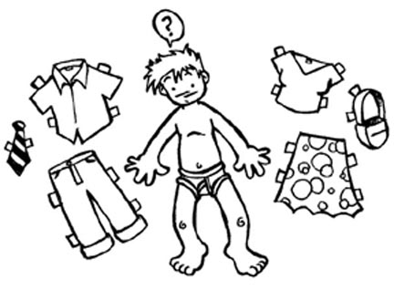
TRANSGENDER
  A person whose internal sense of gender doesn’t match the gender identity that society expects of them based on their anatomy
GENDER IDENTITY
  A person’s internal, deeply-felt sense of being either male, female, something other, or in between

Slide 8


GENDER EXPRESSION
  An individual’s characteristics and behaviors such as appearance, dress, mannerisms, speech patterns, and social interactions that are perceived as masculine or feminine, or neither.
Affirmed male or affirmed female
  Someone who transitions from one gender to another
    Change in style of dress
    New name and new pronouns
    May or may not include hormone therapy, counseling, and/or surgery
    MTF (male to female)
    FTM (female to male)

Slide 9
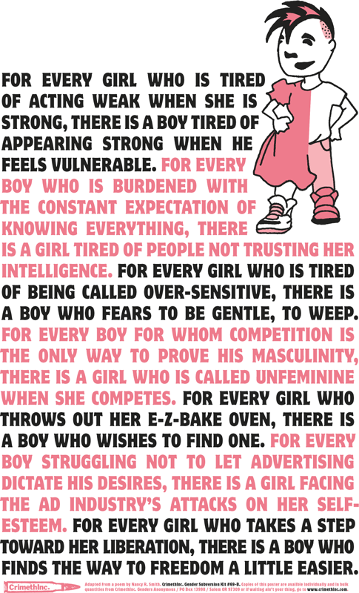
GENDER NON-CONFORMING
  A person who is or is perceived to have gender characteristics and/or behaviors that do not conform to traditional or societal expectations.
    “The discrimination in society toward children who do not behave or look the way we expect them to look and behave according to their gender can be even more extreme than anti-gay discrimination” (Baker, 2002).

Slide 10
GENDER QUEER
  People who do not identify as, or who do not express themselves as completely male or female. Gender Queer people may or may not identify as transgender
SEXUAL ORIENTATION
  A person’s emotional and sexual attraction to other people based on the gender of the other person.
    “GID can be conceptualized as an end-point of a continuum of cross-gender identification and it is conceivable that there are now more individuals who identify within this broader spectrum of cross-gender identity” (Zucker & Lawrence, 2009).

Slide 11
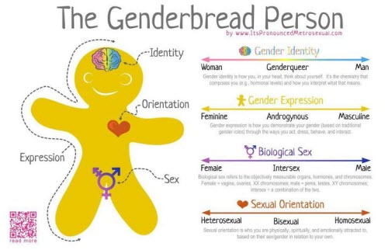
      “Rather than a binary concept, gender identity includes gradations of masculinity to femininity and maleness to femaleness, as well as identification as neither essentially male nor female” (Haas, Eliason, Mays, Mathy, Cochran, D’Augelli, Silverman & Clayton, 2011).
http://jessthanthree.site11.com/genderbread.html
Notes:
How is this different than sexual orientation?
How is gender identity different from gender expression?
Terminology - Differences between youth and adults
Pronoun preference

Slide 12
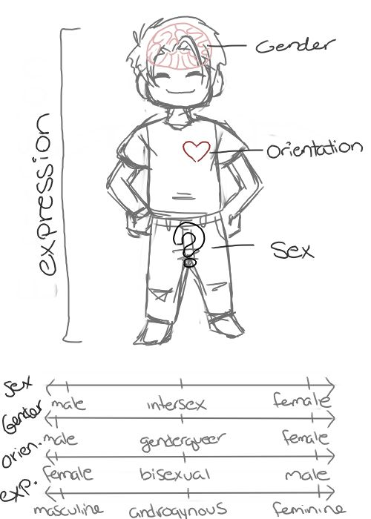
Notes:
“In post-modern Western culture, it has been claimed that more and more individuals are rejecting the traditional binary of male versus female, suggestive of greater evidence of normative gender fluidity” (Singh, Peterson-Badali, Johnson, Bradley, Kibblewhite, Owen-Anderson, Deogracias & Zucker, 2010).

Slide 13
Statistics – they aren’t just numbers!
Gender non-conformity is attributed to decreased coping and resilience and social rejection, which places youth at a higher risk for suicidal symptoms.
  While adolescents in general are a high-risk group for suicidal ideation and self-harm, with suicide being the third cause of death for young adults ages 15-24, there is increasing evidence that transgender youth are at increased risk for low self-esteem, depression, suicide, substance abuse, school problems, family rejection and discord running away, homelessness, and prostitution.

Slide 14
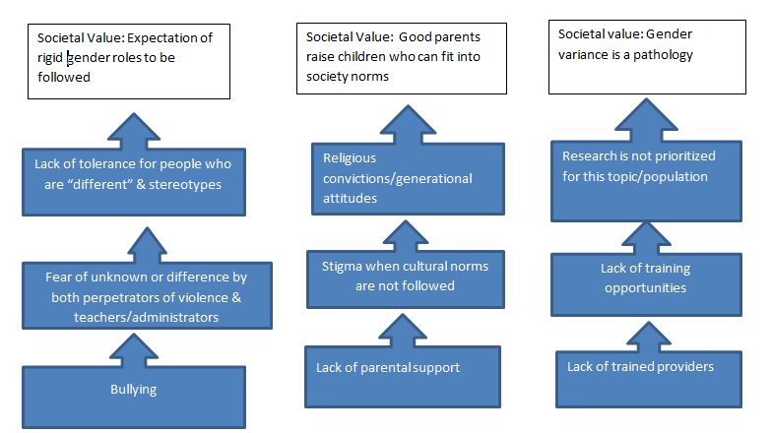

Slide 15
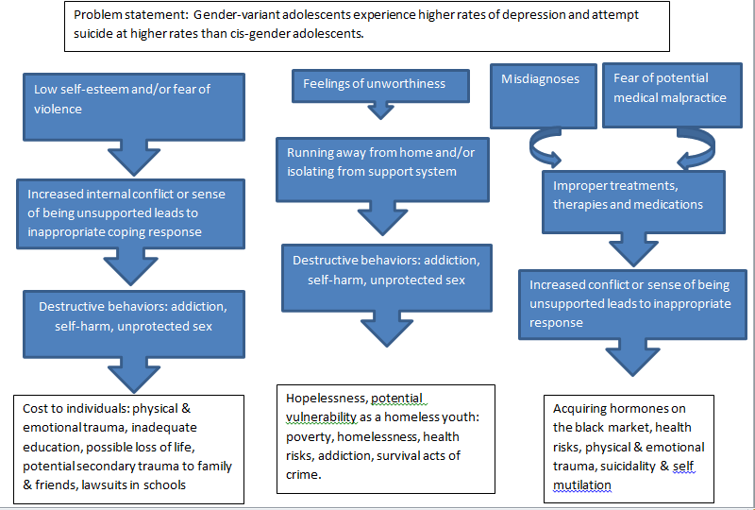

Slide 16
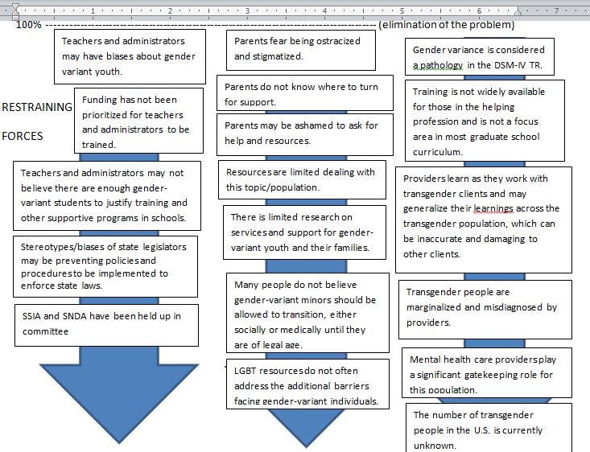
Restraining Forces

Slide 17
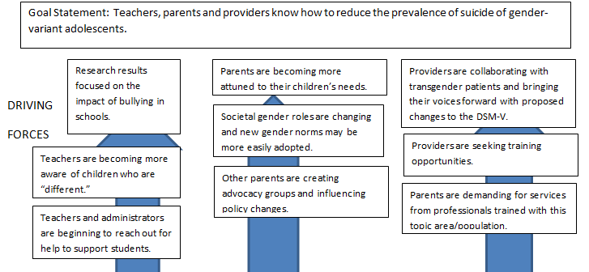
Driving Forces

Slide 18
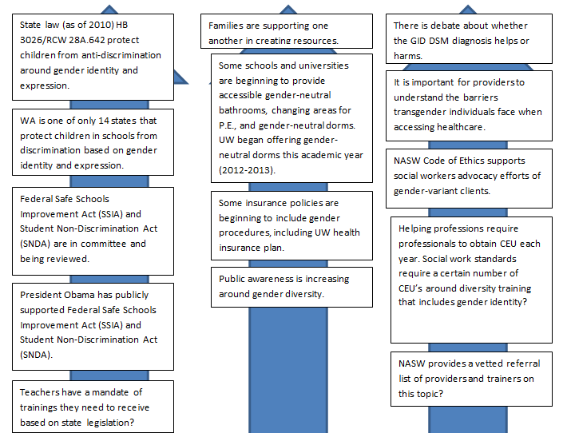

Slide 19
Statistics – they aren’t just numbers!
Gender non-conformity is attributed to decreased coping and resilience and social rejection, which places youth at a higher risk for suicidal symptoms.
  While adolescents in general are a high-risk group for suicidal ideation and self-harm, with suicide being the third cause of death for young adults ages 15-24, there is increasing evidence that transgender youth are at increased risk for low self-esteem, depression, suicide, substance abuse, school problems, family rejection and discord running away, homelessness, and prostitution.

Slide 20
Risk factors
    “Young people who do not conform to heteronormative societal values are at risk for victimization during adolescence” (Russell, Ryan, Toomey, Diaz & Sanchez, 2011).
    “The more young people present as gender non-conforming, the more likely they will be victimized or abused at school” (Russell, Ryan, Toomey, Diaz & Sanchez, 2011).
Gender-nonconforming youth are at elevated risk levels for experiencing victimization and negative psychosocial adjustment.
The shame felt by gender-nonconforming adolescents may be compounded by the reactions from their peers and family.
Peer reactions to gender nonconforming behavior are often negative, ranging from verbal questioning of another’s biological sex to physical abuse.

Slide 21
Risk factors
    Emotional distress, isolation, internalized homophobia/transphobia, depression, substance abuse, suicide, violence/victimization, family conflict, school performance, sexually transmitted diseases and/or pregnancy or other health risk behaviors (Elze, 2007; Kitts, 2010).
    “Teenagers who believe they alone are responsible for family conflicts may feel overwhelmed by the constant stress and may perceive suicide as the best solution for everyone” (Kanel, 2012, p. 85)
    There is an increased risk of suicidal thinking and attempts during the coming-out process (Kanel, 2012).
    Additional risk factors are attributed to lack of training among service providers.

Slide 22

STUDY: INJUSTICE AT EVERY TURN
Notes:
Transgender is an umbrella term that can be used in its broadest definition to describe anyone who transgresses usual gender roles. But there is little research that can provide solid numbers as to the population of the trans community as a whole. Even if the census were to include a gender variant option, many people self-identifying as gender variant would likely not self-disclose, for fear of how the information collected may be used. So, we are using the information gathered from the most comprehensive survey of trans individuals we have been able to find – Injustice at every Turn, published earlier this year (2011) by the National Center for Transgender Equality and the National Gay & Lesbian Task Force.

Slide 23
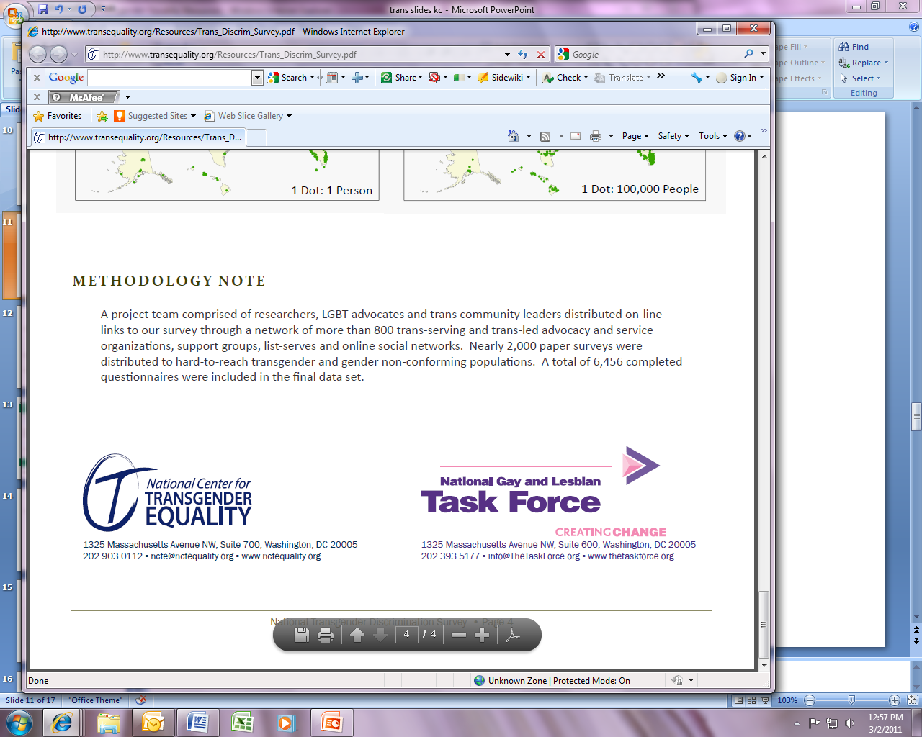
FINDING FROM STUDY OF 6,450
Discrimination was pervasive throughout the entire sample, yet the combination of anti-transgender bias and persistent, structural racism was especially devastating
Respondents live in extreme poverty
Forty-one percent of respondents reported attempting suicide

Slide 24


FORMS OF DISCRIMINATION IDENTIFIED
Harassment and discrimination in education
Employment discrimination and economic insecurity
Housing discrimination and homelessness
Discrimination in public accommodations
Barriers to receiving updated ID documents
Abuse by police and in prison
Discrimination in health care and poor health outcomes
Cumulative discrimination

Slide 25
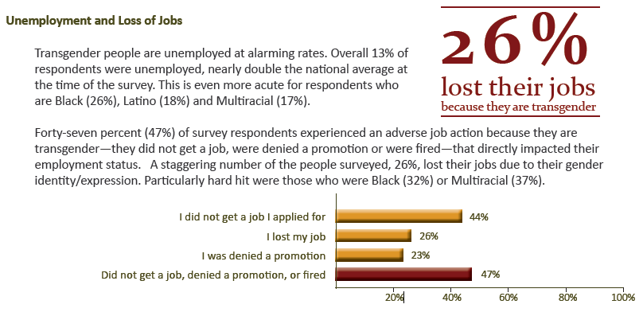
UNEMPLOYMENT AND LOSS OF JOBS

Slide 26
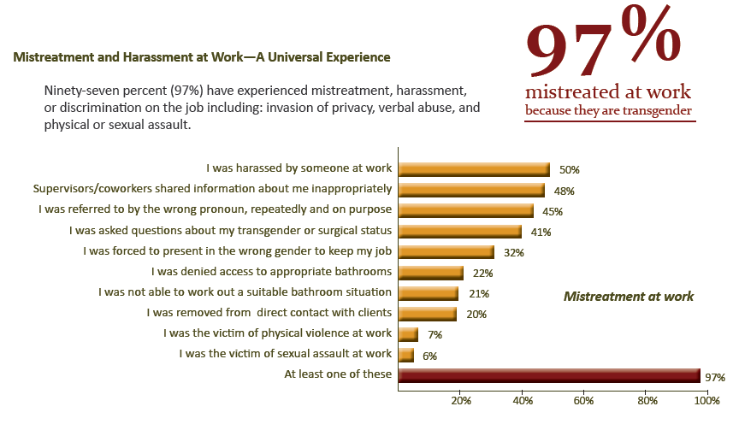
MISTREATMENT

Slide 27
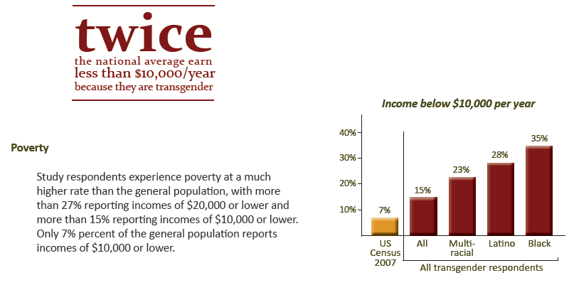
POVERTY

Slide 28
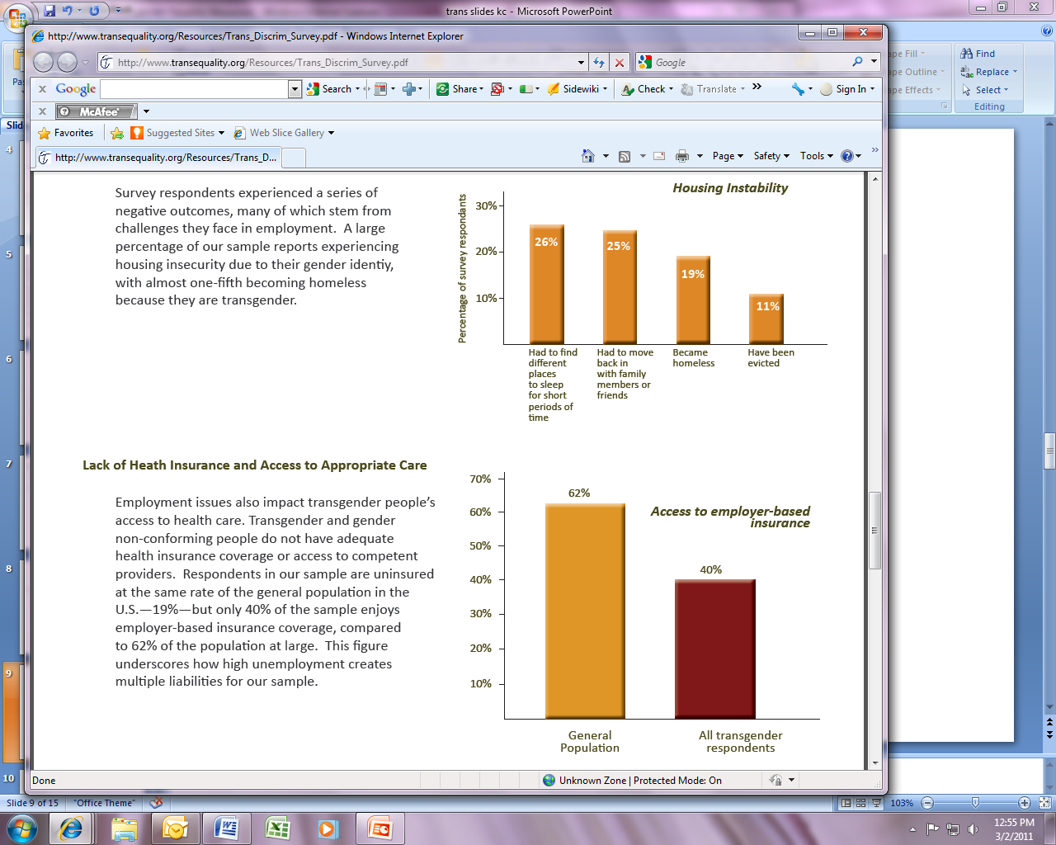
HOUSING

Slide 29
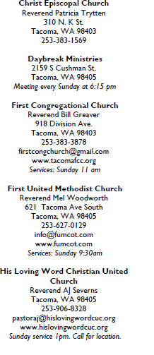




RELIGION

Slide 30

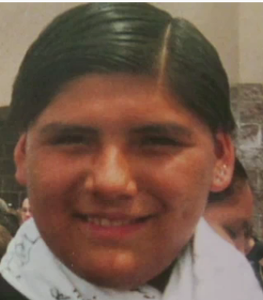

TWO SPIRIT
Exists in many native societies
Individuals are greatly respected in native community as healers and for their energy/originality
Berdache vs. Two Spirit (1990)
Freddy Martinez -2001
  www.twospirits.org

Slide 31
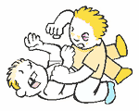


EDUCATION
In grades K-12: 78% report harassment, 35% report physical assault, and 12% report sexual violence.
6% were expelled from school for gender identity/expression
19% in higher education were denied access to gender-appropriate housing, 5% were denied housing altogether
11% report losing or not receiving financial aid because of their gender identity/expression.

Slide 32
EFFECTS OF MISTREATMENT IN SCHOOL
32% physically assaulted at school were reported doing sex work or other work in the underground economy (drug sales, etc.)
22% of those physically assaulted and 24 % of those sexually assaulted were incarcerated at some point in their lives.
38% of those physically assaulted reported homelessness at some point, for those whom left school because of harassment, 48% are currently or were homeless at one time.
35% of those verbally, sexually, or physically harassed reported using drugs and/or alcohol
Those who left school due to harassment were HIV + at a rate of 5.14%, eight times higher than the rate of the general population.
51% of those who were verbally, physically, and/or sexually harassed reported attempting suicide.
Suicide attempts rose greatly when it was teachers who were the perpetrators.

Slide 33
HEALTHCARE

Slide 34


HEALTHCARE
Cigna medical coverage policy: gender reassignment surgery:
  Age 18 or older
  Diagnosed with gender identity disorder (GID)
    Desire to live and be accepted as a member of the other sex
    Express desire to make their body congruent as possible with preferred sex
    Transsexual identity has been present for two or more years
  Active participant in a gender identity treatment program
VA Services
  Endocrinology

Slide 35
Cis-gender privilege checklist
  On a daily basis, a cis-gender person:
  Strangers don’t assume they can ask me what my genitals look like and how I have sex.
  I am not expected to constantly defend my medical decisions.
  Strangers do not ask me what my “real name” {birth name} is and assume then they have the right to call me by that name.
  If I end up in an emergency room, I do not have to worry that my gender will keep me from receiving appropriate treatment, nor will all my medical issues be seen as a product of my gender (cis-gender privilege checklist, 2007).
Notes:
Cisgender is a term that refers to people whose birth sex is consistent with the gender identity and expression considered appropriate by society, in contrast to transgender (Israel, 2011).
Peggy McIntosh's White Privilege: Unpacking the Invisible Knapsack , refer to Cisgender privilege checklist
(http://www.t-vox.org/index.php?title=Cisgender_privilege#Cisgender_privilege_checklist)

Slide 36
Protective factors include:
    Unconditional support of a child’s identity
    Access to safe health care
    Ensuring that the child’s school is safe and welcoming
    Ensuring service providers are well trained and sensitive to transgender issues
    Ensuring that service agencies implement explicit policies that prohibit all forms of discrimination; and
    Supporting a child’s transition at a younger age at home and at school.
      For adolescents, this could include pubertal suspension, to be discussed more later in the presentation
Notes:
Suspension of the youth’s biological puberty reduces their preoccupation with it, and affords the adolescent greater opportunity to explore their longer-term gender identity options in a more reflective and less pressured way (Zucker, Bradley, Anderson, Blanchard & Bain, 2011).

Slide 37
Protective factors
    Resilience, positive and supportive family relationships, stable intellectual functioning, self-confidence, high self-esteem, a socially appealing disposition/personality and social competence, a supportive and validating faith, special talent (e.g., athletic or musical skills) and/or educational achievement, sustainable hope, and supportive school and other peer relationships.
    Family support is associated with greater self-acceptance, which contributes to fewer mental health problems (Elze, 2007).
    Youth Empowerment programs and events
      Provides a sense of community to fight against isolation
    It is important to identify and use these protective factors as client strengths in social work practice with LGBTQIS2-S youth (Zubernis, Snyder & McCoy, 2011).

Slide 38
Entering the Discomfort Zone
Why this is so much harder for adults than children?
How do I help others understand?
Why are pronouns so hard to switch?
Cultural/ethnic differences and their impact on potential child acceptance
Understanding the daily implications of having an atypical gender presentation
How homophobia and ridid gender role norms affect the acceptance of trans kids

Slide 39
Confronting Biases
  Does a five-year-old know their gender?
  Is this a phase?
  Aren’t they too young to understand?
  Are they confused?
  Maybe this child is “just gay”
  http://www.oprah.com/own-our-america-lisa-ling/Transgender-Child-A-Parents-Difficult-Choice

Slide 40
Confronting Biases
Age we have a sense of our gender identity
  Age we have a sense of our sexual orientation is different!
  Gender does not equal sexual orientation!

Slide 41
Know your resources
      Gender Diversity trainings in schools for both students and educators and administrators www.genderdiversity.org
      Trans Youth & Family Allies trainings for educators and administrators http://www.imatyfa.org/
      Welcoming Schools trainings in schools for both students and educators http://www.welcomingschools.org/
      Safe Schools Coalition http://www.safeschoolscoalition.org/
      Gay Lesbian Straight Educators Network (GLSEN) http://www.glsen.org/cgi-bin/iowa/all/home/index.html

Slide 42
Developmental stages
    The two age groups that are associated with the most self-harm, distress and suicidality are five to seven year-olds who are being forced to fit into social gender roles that aren’t true to who they are, and self-harm and suicidality for kids entering puberty, whose bodies are betraying them.
    The internalization of homophobic and heterosexist messages begins very early—often before transgender youth fully realize their gender identity.
    Transgender youth who disclose their gender identity to their parents are at risk for parental rejection, withdrawal of financial support, authoritative restrictions of their social lives, forced counseling, and even violence and removal from the home.
Notes:
How a child is supported at home and at school may impact how successful they are in meeting this developmental milestone.
Children diagnosed with GID may have a developmental delay in establishing gender constancy. Researchers speculate that this delay may occur because of a parent who does not help the child label gender correctly or correct “inappropriate” behaviors. Or, these children may have achieved an understanding of gender as flexible. Much of the attention to GID children comes from parents intolerant of gender variance, not from the children themselves, as is the case with most childhood psychological problems. It has been noted repeatedly in the literature that almost all referrals of GID youth to gender treatment centers come from parents and other adults, such as teachers, who are not comfortable with their gender expressive behaviors.

Slide 43
    “The passage through puberty, peer group acceptance, and the establishment of a personal identity are all developmental tasks of the adolescent years. For the youth who is lesbian, gay, bisexual, or transgender, self-acceptance and identity formation in the face of a heterosexist society are difficult tasks associated with many risks to physical, emotional, and social health” (Kreiss & Patterson, 1997).

Slide 44
Interventions

Slide 45
World Professional Association for Transgender Health

Slide 46
    WPATH Standards of Care
    Version 7
      The World Professional Association for Transgender Health (WPATH) is an international, multidisciplinary, professional association whose mission is to promote evidence-based care, education, research, advocacy, public policy, and respect for transgender health.
      The vision of WPATH is to bring together diverse professionals dedicated to developing best practices and supportive policies worldwide that promote health, research, education, respect, dignity, and equality for transsexual, transgender, and gender nonconforming people in all cultural settings.
      One of the main functions of WPATH is to promote the highest standards of health care for individuals through the articulation of Standards of Care (SOC) for the Health of Transsexual, Transgender, and Gender Nonconforming People.

Slide 47
Goal of Standards of Care
      The overall goal of the SOC is to provide clinical guidance for health professionals to assist transsexual, transgender, and gender nonconforming people with safe and effective pathways to achieving lasting personal comfort with their gendered selves, in order to maximize their overall health, psychological well-being, and self-fulfillment. This assistance may include primary care, gynecologic and urologic care, reproductive options, voice and communication therapy, mental health services (e.g., assessment, counseling, psychotherapy), and hormonal and surgical treatments.
      The SOC are intended to be flexible in order to meet the diverse health care needs of transsexual, transgender, and gender nonconforming people. While flexible, they offer standards for promoting optimal health care and guiding the treatment of people experiencing gender dysphoria – broadly defined as discomfort or distress that is caused by a discrepancy between a person’s gender identity and that person’s sex assigned at birth.

Slide 48
Diagnostic and Statistical Manual of Mental Disorders, 4th Edition

Slide 49
    DSM – Sexual and Identity Disorder (APA, 2000)
    There are two components of Gender Identity Disorder (GID) which both must be present to make a diagnosis.
      There must be evidence of a strong and persistent cross-gender identification, which is the desire to be, or the insistence that one is, of the other sex.
        This cross-gender identification must not merely be a desire for any perceived cultural advantages of being the other sex. There must also be evidence of persistent discomfort about one’s assigned sex or a sense of inappropriateness in the gender role of that sex.
        The diagnosis is not made if the individual has a concurrent physical intersex condition.
        To make the diagnosis, there must be evidence of clinically significant distress or impairment in social, occupational, or other important areas of functioning.

Slide 50
      Distress in individuals with GID is manifested differently across the life cycle.
        In young children, distress is manifested by the stated unhappiness about their assigned sex. Preoccupation with cross-gender wishes often interferes with ordinary activities.
          Children with GID may manifest coexisting Separation Anxiety Disorder, Generalized Anxiety Disorder, and symptoms of depression.
          For clinically referred children, onset of cross-gender interests and activities is usually between ages 2 and 4 years. Typically children are referred around the time of school entry because of parental concern that what they regarded as a phase does not appear to be passing.
        In older children, failure to develop age-appropriate same-sex peer relationships and skills often leads to isolation and distress, and some children may refuse to attend school because of teasing or pressure to dress in attire stereotypical of their assigned sex.

Slide 51
Adolescents diagnosed with GID
        In adolescents and adults, preoccupation with cross-gender wishes often interferes with ordinary activities. Relationship difficulties are common, and functioning at school or at work may be impaired.
          Adolescents are particularly at risk for depression and suicidal ideation and suicide attempts.

Slide 52
      Diagnostic criteria code is based on age
        302.6 Gender Identity Disorder in Children
        302.85 Gender Identity Disorder in Adolescents or Adults
        Regarding the criteria for GID for adolescents and adults, the current criteria do not capture the whole spectrum of gender variant phenomena (Narrow & Cohen-Kettenis, 2010).

Slide 53
DSM and insurance coverage
      The GID diagnosis is, to date, required for insurance coverage of hormonal therapy and sex reassignment procedures for transitioning individuals. Those who seek treatment often view it as a trade-off between stigma and insurance reimbursement. Because most insurance companies require DSM diagnoses for treatment coverage in general, the diagnoses of GID facilitates payment and thus access to basic care for gender-variant individuals. While many view GID diagnoses as a societal prejudice rather than a mental disorder, there has been concern that without a specific disorder label to categorize behaviors, treatment-seeking individuals would be turned away. (Kamens, 2011).
      Utilization of health care services is reduced in this population, with received barriers, including cost, fear of services in general, and fear of mental health stigma (Colton, Fitzgerald, Pardo & Babcock, 2011).
      Puberty blockers are both medically necessary and expensive.

Slide 54
Dutch Protocol
      Since the mid-1990s, one model of therapeutic care, developed by Dutch clinicians and researchers, has been to initiate the biomedical aspects of sex reassignment in early – to mid-adolescence, rather than wait for the legal age of adulthood. After careful psychological evaluation, adolescents deemed appropriate for such treatment are prescribed hormonal medication to delay or suppress somatic puberty. If the gender dysphoria persists, then cross-sex hormonal therapy is offered at the age of 16, and if the adolescent desires, surgical sex change procedures are then offered (Zucker, Breadley, Owen-Anderson, Singh, Blanchard & Bain, 2011).

Slide 55
Rationale
        There is the assumption that for some adolescents with GID there is little systematic empirical evidence that psychological interventions can resolve the gender dysphoria
        The use of hormonal blockers can be helpful to the adolescent because it reduces the incongruence between the development of natal sex secondary physical characteristics (male: facial hair growth, hair growth on other parts of body, deepening of voice; female: breast development, menstruation) and the felt psychologic gender, thereby reducing stress
        Reduction of incongruence makes it easier for adolescents to present socially in the cross-gender identity/role, which is also helpful in reducing stress during the gender transition process

Slide 56
      “A study in the Netherlands at a gender clinic found adolescents to be faring better than adults in measures of psychological health, largely attributed to the youth receiving gender role assistance by way of puberty suspension or hormone therapy, and implications the adolescents felt more supported and experienced less harm through stigmatization than adults” (Herbert, 2011).

Slide 57
Stages of treatment for adolescents
      Stage 1: therapeutic exploration
      Stage 2: For adolescents whose GID persists and becomes more distressing during adolescent development, stage two may be considered following careful assessment. This involves the use of hypothalamic blockers which suppresses the production of estrogen or testosterone and produces a state of biological neutrality. This intervention is reversible. A controversy exists about the timing of this intervention during pubertal development.
      Stage 3: includes partially reversible interventions such as hormonal treatment which masculinizes or feminizes the body. Current guidelines allow this intervention after the age of 16
      Stage 4: after the age of 18, stage four includes irreversible interventions, such as surgical procedures” (Ceglie, 2008).

Slide 58
Misdiagnosis
        On quantitative gender assessment scales, children with GID are at risk for misdiagnosis.
        Professional services for GID children are provided primarily by pediatric endocrinologists and urologists, and very few centers have staff experienced with treating gender identity variants in children (Meyer-Bahlburg, 2009).
        Inexperienced clinicians may mistake indications of gender dysphoria for delusions. The vast majority of children and adolescents with gender dysphoria are not suffering from underlying severe psychiatric illness such as psychotic disorders (WPATH, 7th version)

Slide 59
Misdiagnosis
        It is more common for adolescents with gender dysphoria to have co-existing internalizing disorders such as anxiety and depression, and/or externalizing disorders such as oppositional defiant disorder (WPATH, 7th version)
        There seems to be a higher prevalence of autistic spectrum disorders in clinically referred, gender dysphoric adolescents than in the general adolescent population (WPATH, 7th version).
        Regarding children and adolescents who are gender variant, there is a greater risk for misdiagnosis of Oppositional Defiant Disorder, Attention Deficit Disorder, and Asperger’s, as reported anecdotally by families attending support groups.
        Youth may be exhibiting symptoms that are similar to these disorders as a result of high anxiety levels and fixation of interests or hobbies as a way to cope (Bradley & Zucker, 1997).
        Adolescents referred for gender identity concerns also displayed significant behavioral difficulties such as anger, aggression, isolation, and depression, as reported by their mothers (Bradley & Zucker, 1997).
        In one parent support group, a parent shared recent research about complex brain trauma. She explained that on-going stress and anxiety from living in the wrong gender can lead to complex brain trauma.
        Once gender issues are addressed, many parents shared that other symptoms go away.

Slide 60
Misdiagnosis
        Inexperienced clinicians may mistake indications of gender dysphoria for delusions. The vast majority of children and adolescents with gender dysphoria are not suffering from underlying severe psychiatric illness such as psychotic disorders (WPATH, 7th version)
        It is more common for adolescents with gender dysphoria to have co-existing internalizing disorders such as anxiety and depression, and/or externalizing disorders such as oppositional defiant disorder (WPATH, 7th version)
        There seems to be a higher prevalence of autistic spectrum disorders in clinically referred, gender dysphoric adolescents than in the general adolescent population (WPATH, 7th version).
        Regarding children and adolescents who are gender variant, there is a greater risk for misdiagnosis of Oppositional Defiant Disorder, Attention Deficit Disorder, and Asperger’s, as reported anecdotally by families attending support groups.
        Youth may be exhibiting symptoms that are similar to these disorders as a result of high anxiety levels and fixation of interests or hobbies as a way to cope (Bradley & Zucker, 1997).
        Adolescents referred for gender identity concerns also displayed significant behavioral difficulties such as anger, aggression, isolation, and depression, as reported by their mothers (Bradley & Zucker, 1997).

Slide 61
Cortisol and stress
        In one parent support group, a parent shared recent research about complex brain trauma. She explained that on-going stress and anxiety from living in the wrong gender can lead to complex brain trauma.
        Once gender issues are addressed, many parents shared that other symptoms go away.
        Some parents hypothesized that when the cortisol goes away, it gives the brain an opportunity to heal itself and other symptoms then retreat as well.
        These parents’ insights are consistent with research published by Child Welfare Information Gateway (2009), which states that if a child lives in a threatening, chaotic world, the child’s brain may be hyperalert for danger because their survival may depend on it.
        When children are exposed to chronic, traumatic stress, their brains sensitize the pathways for the fear response, resulting in a number of biological reactions, including a persistent state of fear.
        Gender-variant children and adolescents receive perpetual messages in society that there is something wrong with them, and they live with a constant fear of people finding out their secret.
        For adolescents with symptoms of chronic stress, which may include changes in attention, impulse control, sleep, and fine motor control, it is understandable how they may be misdiagnosed as ODD or ADD.
        The research further explains that chronic activation of certain parts of the brain involved in the fear response can “wear out” other parts of the brain such as the hippocampus, which is involved in cognition and memory. This may causes excess production of cortisol—a hormone that may damage or destroy neurons in critical brain areas.

Slide 62
Psychosocial interventions
        Psychosocial assessment should include evaluation of the transgender adolescent’s home life, education/employment, eating, activities, drugs, sexuality, suicide/depression, and safety.
        When discussing sexuality, clinicians should engage in frank and explicit discussion about the actual practices an adolescent is engaged in, rather than making assumptions about the gender of partner(s) or sexual activities. The transgender adolescent should be asked about preferred terms for genitals to ensure that sexual health discussion is respectful of self-defined gender identity.
        For adolescents with intense frustration or distress about body image, in addition to a general screening tool for eating disorders, it may be appropriate to inquire about excessively tight breast binding, wrapping of the penis/testicles, and compulsive or excessive exercise. Intervention may explore transgender identity, transgender community involvement, and peer support.
        For adolescents undergoing gender transition, psychosocial issues that tend to be impacted over the course of gender transition or to change as part of general adolescent development (such as relationships, sexuality, infertility, disclosure of transgender identity and body image) need to be revisited periodically.
        Sexual health education should be offered as part of treatment.
        Family therapists or family counselors should try to help parents determine realistic demands and to work on the development of healthy boundaries and limits. In some cases, it may be appropriate to involve a second clinician in work with parents to avoid compromising the therapeutic alliance with the adolescent.

Slide 63
Safe spaces
    Research suggests that the presence of a GSA in middle school and high school can serve as a protective factor for LGBTQ adolescents. The presence of a GSA is associated with reduced suicide risk for sexual minority youths.
      Creating a safe zone is a means of support for students who are LGBTQ. This can consist of a teacher or counselor with training concerning issues related to these students. Teacher preparation programs and in-service training should emphasize the importance of avoiding anti-biased language, particularly concerning students who are LGBTQ. Using a curricular focus, schools can assist children in becoming more comfortable with diversity in all its human forms. GLSEN proposes the use of early intervention to facilitate acceptance of sexual diversity by targeting elementary school students.
        Gender neutral bathrooms are another visual cue for transgender youth that this is a safe zone
        Support students in dressing and expressing consistent with their internalized identity

Slide 64
Supporting families in supporting their child
      Promoting family involvement can be affected by a few different factors, including emotional responses as they learn to adjust and accept their child’s status (Spencer, 2005):
        Stage 1: shocked and dejected, may experience grief and fear
        Stage 2: confused, feny their child’s status, reject their child, or avoid dealing with the issue by looking for other explanations
        Stage 3: anger, self-pity, disappointment, guilt and a sense of powerlessness that may be expressed as rage or withdrawal
        Stage 4: begin to understand and accept their child’s status and impact on the family
        Stage 5: families may accept, love, and appreciate their child unconditionally
        Stage 6: families may begin to focus on living on the benefits accrued, on the future, and on working with others to teach and provide support services for their child

Slide 65
Support Through a Gender Transition
  Create opportunities for child to see that they are not alone
  Creating a network of support
  Identify current and former trans/gnc role models/examples and give their journey some historical context
  Dealing with uncontrollable variables, delays and other factors
  Role-play how to address questions, slips, and other potentially awkward gender moments
  Need for celebration
  Allowing for non-binary gender exploration – what is that?

Slide 66
Supporting a Child in Distress
  Switching schools, homeschooling, or on-line programs
  Create/find alternative community
  Find peers/mentors for your child
  Therapists, school counselors, religious leaders, support groups, etc.
  Fast-tracking a transition?

Slide 67
Cultural competence
    Transgender patients may present with gender dysphoria. For transgender care, humaneness and technical competence are particularly important. Transgender patients are among the most socially stigmatized of sexual minorities, facing discrimination in health care coverage and insensitivity from ill-informed health providers. (Bockting, Robinson, Benner & Scheltema, 2004).
    (http://community.pflag.org/page.aspx?pid=702) As counselors/therapists: Be open to learning the truth about transgender—that it is not a psychiatric disorder, but a physical issue that has not been understood until research, reported in recent years, identified the site of sex identity—which is the brain. This means that you will need to unlearn your own personal and professional socialization, which told you that the genitals define sex identity. They do not.
    Become aware of your own comfort levels. Some helpers just are not appropriate to work with the transgender community, just as some cannot work with excessively dependent people or with spousal abusers.
    Become aware of the WPATH Standards of Care established by the Harry Benjamin International Gender Dysphoria Association, Inc.
    Become aware of the transgender community and of the resources available in that community.
    Be prepared to provide supportive counseling to transgender persons, both individually and in transgender groups. You may also need to be ready to do family work, to be an advocate (job, school, community), and be able to work with medical persons and others.

Slide 68
Clinical competence
        Clinicians who diagnose and treat transgender and gender variant adolescents should have training in adolescent psychiatry and/or clinical psychology and/or clinical social work and experience in diagnosing and treating typical issues related to adolescents, as well as specific expertise relating to transgender and gender variant identity development and gender identity concerns
        Therapists working with transgender adolescents must be accustomed to working with adolescents and be able to practice in a trans-affirming manner that includes the ability to discuss sensitive topics, including sexuality
        Regardless of the presenting issues, the clinician should be able to evaluate the impact of trans-specific issues on the adolescent’s overall health and well-being, and incorporate this into the overall care plan
        Clinicians should be aware of the gender diversity among the local transgender/gender variant adolescent population as part of the general sensitivity and awareness needed for any work with the transgender communities

Slide 69
    “There is no compelling reason to withhold treatment as the youth and their families are very troubled, and the prognosis of any treatment is extremely guarded after puberty. So, for those interested in converting the gender-variant child back to a traditionally gendered child, the current wisdom states that the earlier the diagnosis, the better the prognosis” (Hill, Rozanski, Carfagnini & Willoughby, 2006).

Slide 70
What you can do to affirm a gender-variant youth in your practice
  What you can do today to affirm gender variant youth in your practice (HRSA Care, 2011) http://hab.hrsa.gov/newspublications/careactionnewsletter/hab_transgender_dec_careaction_pdf.pdf
    Post trans-friendly materials in waiting rooms
    Offer single-occupancy or gender-neutral bathrooms
    A best practice would be to include preferred name in a medical chart alongside legal name, which is a trigger to other staff in your clinic so they know what name to call the patient and helps avoid creating billing issues.
    To demonstrate that a clinic is transgender friendly, it is important to have materials in the waiting room that are spe­cific to this population.

Slide 71
    Have visual cues – such as posters
      http://www.safeschoolscoalition.org/SafeZone_SafeSchoolsCoalition.pdf
    Clinics should also post antidiscrimina­tion policies and provide written hiring policies indicating the organization’s desire to employ qualified, diverse candidates.
    Do research and find out which insurance codes your clinic can bill services through

Slide 72
Confidentiality concerns
      Mitigate patient worries around the confidentiality of client-level data and assure patients that any patient-specific information disclosed among medical staff is restricted to appropriately addressing their health needs.
      Providers should also create a nonjudgmental environment where patients feel comfortable discussing any risk-taking behaviors.

Slide 73
Using the correct pronoun
      Clinics should respect what gender a client says he or she is. If providers are in doubt, they should ask the patient politely and discreetly what his or her preference is. Use of gender-neutral language ensures inclusion of all transpersons and avoids inadvertently “outing” someone in public.
      Patients may wish to be labeled male or female according to their gender identity and expression, their legal status, or according to the way they are registered with their insur­ance carrier.
      Patients may wish to be referred to as female in one situation (e.g., in their record with the physician’s office and in personal interactions with the physician and staff), but male in other situations (e.g., on forms related to their insurance coverage, lab work, etc.).
      This application of ter­minology could change at any time as individuals come to understand or evaluate their gender.

Slide 74
Resources
  Resources
    AMA Policy
    WPATH Standards of Care
    WPATH Clarification on Medical Necessity
    Injustice at Every Turn Executive Summary
    Sample doctor’s letters
    Cis-gender privilege checklist
    LGBTQ Worksheet
    Safe Zone poster
    Book reference list for adults
    Book reference list for children
    List of LGBTQ youth organizations, conferences, support groups
    List of gender therapists in Washington state
    Gender Alliance of the South Sound Resource Guide
    Provider tool kit for adolescents

Slide 75
Resources
    Dear Colleague Letter (October 26, 2010) - Harassment and Bullying (U.S. Department of Education): http://www2.ed.gov/about/offices/list/ocr/letters/colleague-201010.html
    Cis-gender privilege checklist
    List of LGBTQ youth centers
    List of transgender books www.glsen.org/booklink
    Support groups and advocacy organizations
    Safe Schools Coalition www.safeschoolscoalition.org
    www.glsen.org/educator
    Jump-start guide for GSAs www.glsen.org/jumpstart
    Educators Allies Network http://edallies.ning.com
    WPATH Standards of Care

Slide 76
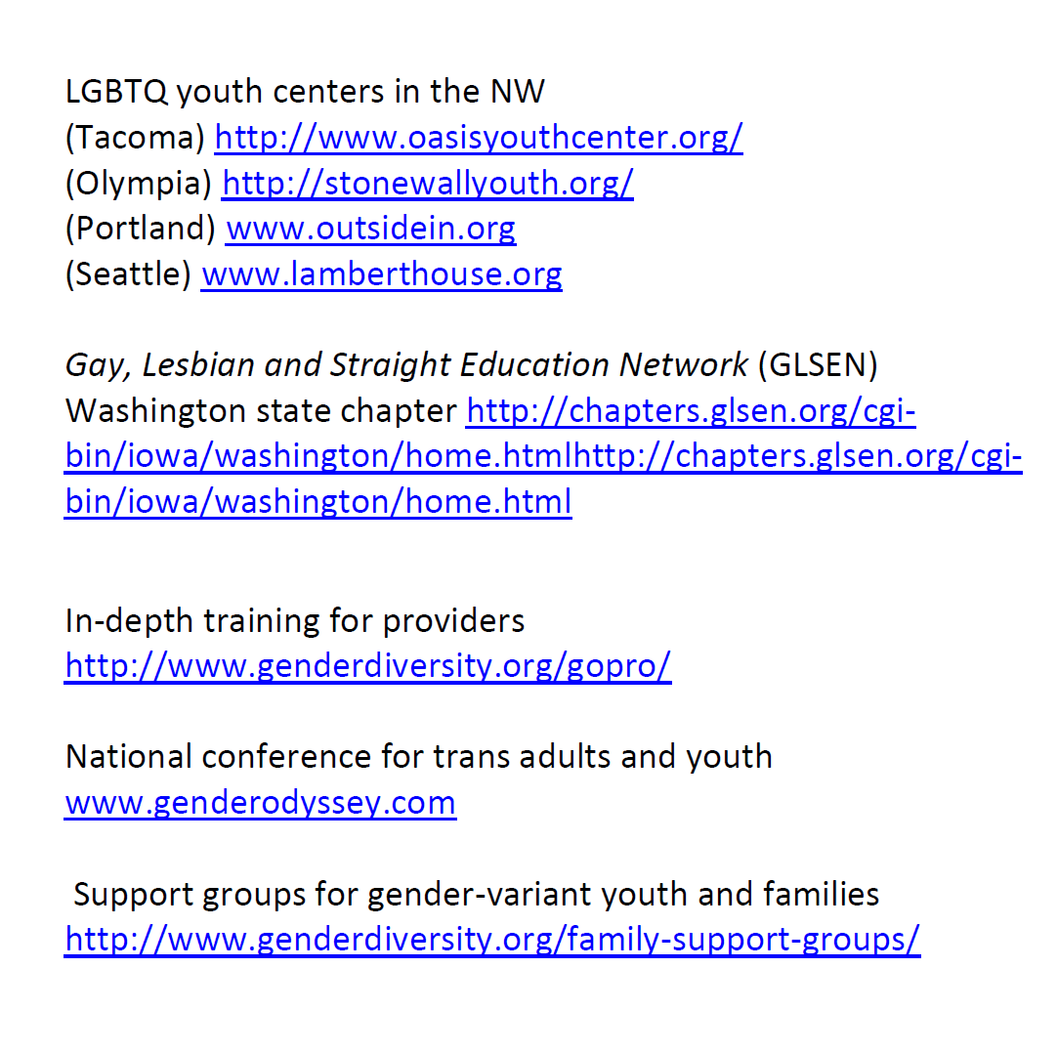

Slide 77


Slide 79
Thank you!
Any questions or comments?

Slide 80
Complete Survey

Slide 81
      Subscribe to the Gender Odyssey mailing list to learn about training events, such as professional Day: https://app.e2ma.net/app2/audience/signup/28753/17074/?v=a
      Register for more in-depth training at Gender Odyssey’s annual Professional Day: http://www.genderdiversity.org/event-registration/?ee=2

