Slide 1
Best Practices for Teachers and Providers: A Cross Systems Training to Support Gender-Variant Youth
Kathyrn Chociej, University of Washington – Tacoma, School of Social Work
MSW Candidate, Class of 2013

Slide 2
Module II
Medical Providers Training Module

Slide 3
Introductions and check-in
What do you hope to learn and/or gain from this workshop?
  What part of the state do you work in?
  What age youth do you typically work with?
  Have you attended similar trainings to this one?

Slide 4
Medical providers will gain an understanding of gender identity and expression, better understand barriers gender-variant youth face when accessing healthcare services; and will be able to offer prescriptive options for gender-variant youth and reduce common misdiagnoses.

Slide 5
Group norms and creating a safe training space
No interrupting
No side conversations – cross talk
Give the benefit of the doubt – look for learning
No judgment – we are all in different places
Commitment to the process- stay through the hard stuff
Own your stuff – apologize
“I” statements
Stay humble
Focus is: to explore, to encourage a deeper understanding of complex topics
To engage in an analysis of the topic

Slide 6
When are we first gendered?
Notes:
Challenges We Face
From the moment of our birth we are identified by others. They define our sex identity by looking at our genitals when we are born. Our parent(s) choose our name and dream of how we will "turn out." The record of our birth is the binding legal statement that says who we are.
We are socialized immediately, and later taught "proper" behavior. We learn to recognize our parent(s) and siblings, and learn how to eat, speak, walk, and move our bladder and bowels, all within the first three years of life! We learn what is important. We learn that we are part of a family. We learn loyalty to the family culture, including the family’s race and ethnicity. We also learn about our family secrets and learn to keep them secret. We are praised for doing "good," and punished for being "bad." In general, "socialization" efforts by those around us are very intensive, especially between birth and age five. And when we are not being actively taught, we watch and listen, and integrate everything we see and hear within the very core of ourselves, so that we can know just how to "be." Like everyone else, we desperately want to please and receive praise.
Then, there comes this feeling, this desire to be the other sex. This frightens us and challenges everything that we have learned. We worry about ourselves. We fear others might find out. Prayers do not help. We become angry with ourselves in having these thoughts and desires. Yet, we must press on hoping it will go away. But it doesn’t go away. It just gets "worse." We wonder, ‘Am I crazy?’ ‘Am I gay or lesbian?’ ‘Why do I enjoy "dressing up?" (Source: http://community.pflag.org/page.aspx?pid=702 )

Slide 7
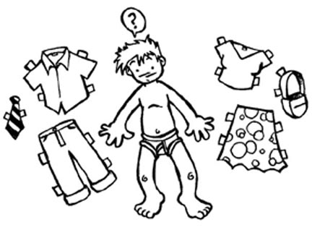
TRANSGENDER
  A person whose internal sense of gender doesn’t match the gender identity that society expects of them based on their anatomy
GENDER IDENTITY
  A person’s internal, deeply-felt sense of being either male, female, something other, or in between

Slide 8


GENDER EXPRESSION
  An individual’s characteristics and behaviors such as appearance, dress, mannerisms, speech patterns, and social interactions that are perceived as masculine or feminine, or neither.
Affirmed male or affirmed female
  Someone who transitions from one gender to another
    Change in style of dress
    New name and new pronouns
    May or may not include hormone therapy, counseling, and/or surgery
    MTF (male to female)
    FTM (female to male)

Slide 9
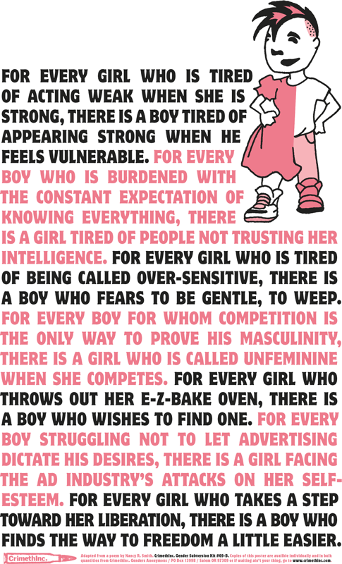
GENDER NON-CONFORMING
  A person who is or is perceived to have gender characteristics and/or behaviors that do not conform to traditional or societal expectations.
    “The discrimination in society toward children who do not behave or look the way we expect them to look and behave according to their gender can be even more extreme than anti-gay discrimination” (Baker, 2002).

Slide 10
GENDER QUEER
  People who do not identify as, or who do not express themselves as completely male or female. Gender Queer people may or may not identify as transgender
SEXUAL ORIENTATION
  A person’s emotional and sexual attraction to other people based on the gender of the other person.
    “GID can be conceptualized as an end-point of a continuum of cross-gender identification and it is conceivable that there are now more individuals who identify within this broader spectrum of cross-gender identity” (Zucker & Lawrence, 2009).

Slide 11
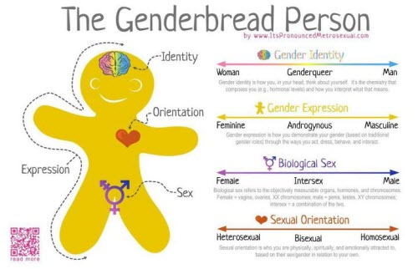
http://jessthanthree.site11.com/genderbread.html
Notes:
How is this different than sexual orientation?
How is gender identity different from gender expression?
Terminology - Differences between youth and adults
Pronoun preference

Slide 12
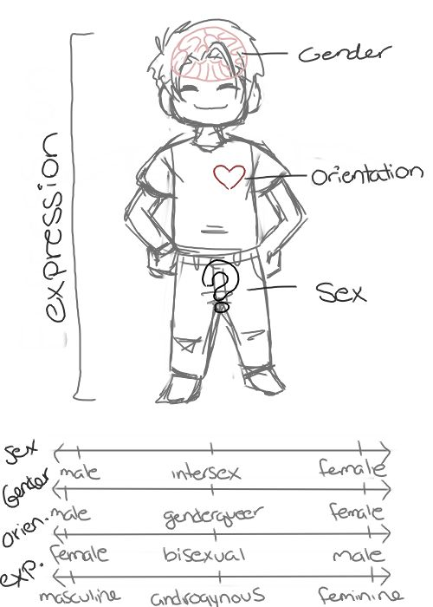
Notes:
“In post-modern Western culture, it has been claimed that more and more individuals are rejecting the traditional binary of male versus female, suggestive of greater evidence of normative gender fluidity” (Singh, Peterson-Badali, Johnson, Bradley, Kibblewhite, Owen-Anderson, Deogracias & Zucker, 2010).

Slide 13
Statistics – they aren’t just numbers!
Gender non-conformity is attributed to decreased coping and resilience and social rejection, which places youth at a higher risk for suicidal symptoms.
  While adolescents in general are a high-risk group for suicidal ideation and self-harm, with suicide being the third cause of death for young adults ages 15-24, there is increasing evidence that transgender youth are at increased risk for low self-esteem, depression, suicide, substance abuse, school problems, family rejection and discord running away, homelessness, and prostitution.

Slide 14
Risk factors
    “Young people who do not conform to heteronormative societal values are at risk for victimization during adolescence” (Russell, Ryan, Toomey, Diaz & Sanchez, 2011).
    “The more young people present as gender non-conforming, the more likely they will be victimized or abused at school” (Russell, Ryan, Toomey, Diaz & Sanchez, 2011).
Gender-nonconforming youth are at elevated risk levels for experiencing victimization and negative psychosocial adjustment.
The shame felt by gender-nonconforming adolescents may be compounded by the reactions from their peers and family.
Peer reactions to gender nonconforming behavior are often negative, ranging from verbal questioning of another’s biological sex to physical abuse.

Slide 15
Risk factors
    Emotional distress, isolation, internalized homophobia/transphobia, depression, substance abuse, suicide, violence/victimization, family conflict, school performance, sexually transmitted diseases and/or pregnancy or other health risk behaviors (Elze, 2007; Kitts, 2010).
    “Teenagers who believe they alone are responsible for family conflicts may feel overwhelmed by the constant stress and may perceive suicide as the best solution for everyone” (Kanel, 2012, p. 85)
    There is an increased risk of suicidal thinking and attempts during the coming-out process (Kanel, 2012).
    Additional risk factors are attributed to lack of training among service providers.

Slide 16
Protective factors include:
    Unconditional support of a child’s identity
    Access to safe health care
    Ensuring that the child’s school is safe and welcoming
    Ensuring service providers are well trained and sensitive to transgender issues
    Ensuring that service agencies implement explicit policies that prohibit all forms of discrimination; and
    Supporting a child’s transition at a younger age at home and at school.
      For adolescents, this could include pubertal suspension, to be discussed more later in the presentation
Notes:
Suspension of the youth’s biological puberty reduces their preoccupation with it, and affords the adolescent greater opportunity to explore their longer-term gender identity options in a more reflective and less pressured way (Zucker, Bradley, Anderson, Blanchard & Bain, 2011).

Slide 17
Protective factors
    Resilience, positive and supportive family relationships, stable intellectual functioning, self-confidence, high self-esteem, a socially appealing disposition/personality and social competence, a supportive and validating faith, special talent (e.g., athletic or musical skills) and/or educational achievement, sustainable hope, and supportive school and other peer relationships.
    Family support is associated with greater self-acceptance, which contributes to fewer mental health problems (Elze, 2007).
    Youth Empowerment programs and events
      Provides a sense of community to fight against isolation
    It is important to identify and use these protective factors as client strengths in social work practice with LGBTQIS2-S youth (Zubernis, Snyder & McCoy, 2011).

Slide 18
Supporting families in supporting their child
      Promoting family involvement can be affected by a few different factors, including emotional responses as they learn to adjust and accept their child’s status (Spencer, 2005):
        Stage 1: shocked and dejected, may experience grief and fear
        Stage 2: confused, feny their child’s status, reject their child, or avoid dealing with the issue by looking for other explanations
        Stage 3: anger, self-pity, disappointment, guilt and a sense of powerlessness that may be expressed as rage or withdrawal
        Stage 4: begin to understand and accept their child’s status and impact on the family
        Stage 5: families may accept, love, and appreciate their child unconditionally
        Stage 6: families may begin to focus on living on the benefits accrued, on the future, and on working with others to teach and provide support services for their child

Slide 19
    “Most social service providers, schools, and families are ill-equipped to help transgender youth and many remain hidden to be accepted” (Grossman, D’Augelli, Howell & Hubbard, 2005).

Slide 20
Entering the Discomfort Zone
Why this is so much harder for adults than children?
How do I help others understand?
Why are pronouns so hard to switch?
Cultural/ethnic differences and their impact on potential child acceptance
Understanding the daily implications of having an atypical gender presentation
How homophobia and ridid gender role norms affect the acceptance of trans kids

Slide 21
Confronting Biases
  Does a five-year-old know their gender?
  Is this a phase?
  Aren’t they too young to understand?
  Are they confused?
  Maybe this child is “just gay”
  http://www.oprah.com/own-our-america-lisa-ling/Transgender-Child-A-Parents-Difficult-Choice

Slide 22
Confronting Biases
Age we have a sense of our gender identity
  Age we have a sense of our sexual orientation is different!
  Gender does not equal sexual orientation!

Slide 23
Know your resources
      Gender Diversity trainings in schools for both students and educators and administrators www.genderdiversity.org
      Trans Youth & Family Allies trainings for educators and administrators http://www.imatyfa.org/
      Welcoming Schools trainings in schools for both students and educators http://www.welcomingschools.org/
      Safe Schools Coalition http://www.safeschoolscoalition.org/
      Gay Lesbian Straight Educators Network (GLSEN) http://www.glsen.org/cgi-bin/iowa/all/home/index.html

Slide 24
Developmental stages
    The two age groups that are associated with the most self-harm, distress and suicidality are five to seven year-olds who are being forced to fit into social gender roles that aren’t true to who they are, and self-harm and suicidality for kids entering puberty, whose bodies are betraying them.
    The internalization of homophobic and heterosexist messages begins very early—often before transgender youth fully realize their gender identity.
    Transgender youth who disclose their gender identity to their parents are at risk for parental rejection, withdrawal of financial support, authoritative restrictions of their social lives, forced counseling, and even violence and removal from the home.
Notes:
How a child is supported at home and at school may impact how successful they are in meeting this developmental milestone.
Children diagnosed with GID may have a developmental delay in establishing gender constancy. Researchers speculate that this delay may occur because of a parent who does not help the child label gender correctly or correct “inappropriate” behaviors. Or, these children may have achieved an understanding of gender as flexible. Much of the attention to GID children comes from parents intolerant of gender variance, not from the children themselves, as is the case with most childhood psychological problems. It has been noted repeatedly in the literature that almost all referrals of GID youth to gender treatment centers come from parents and other adults, such as teachers, who are not comfortable with their gender expressive behaviors.

Slide 25
    “The passage through puberty, peer group acceptance, and the establishment of a personal identity are all developmental tasks of the adolescent years. For the youth who is lesbian, gay, bisexual, or transgender, self-acceptance and identity formation in the face of a heterosexist society are difficult tasks associated with many risks to physical, emotional, and social health” (Kreiss & Patterson, 1997).

Slide 26
Interventions

Slide 27
AMA Policy
      In 2007, the Board of Trustees of the American Medical association (AMA) amended its policies to include language that would prohibit discrimination against and ensure “protection and equality relating to gender identity issues.”
      The AMA’s policy states “Physicians cannot refuse to care for patients based on gender identity.”
      The AMA also opposes the denial of health insurance on the basis of sexual orientation or gender identity.
      Doctors who do not comply can be admonished, censured, or even lose their licenses.

Slide 28
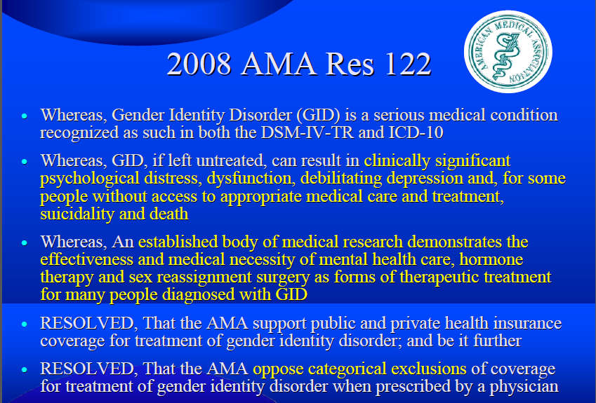

Slide 29
World Professional Association for Transgender Health

Slide 30
  WPATH Standards of Care
  Version 7
      The World Professional Association for Transgender Health (WPATH) is an international, multidisciplinary, professional association whose mission is to promote evidence-based care, education, research, advocacy, public policy, and respect for transgender health.
      The vision of WPATH is to bring together diverse professionals dedicated to developing best practices and supportive policies worldwide that promote health, research, education, respect, dignity, and equality for transsexual, transgender, and gender nonconforming people in all cultural settings.
      One of the main functions of WPATH is to promote the highest standards of health care for individuals through the articulation of Standards of Care (SOC) for the Health of Transsexual, Transgender, and Gender Nonconforming People.

Slide 31
Goal of Standards of Care
      The overall goal of the SOC is to provide clinical guidance for health professionals to assist transsexual, transgender, and gender nonconforming people with safe and effective pathways to achieving lasting personal comfort with their gendered selves, in order to maximize their overall health, psychological well-being, and self-fulfillment. This assistance may include primary care, gynecologic and urologic care, reproductive options, voice and communication therapy, mental health services (e.g., assessment, counseling, psychotherapy), and hormonal and surgical treatments.
      The SOC are intended to be flexible in order to meet the diverse health care needs of transsexual, transgender, and gender nonconforming people. While flexible, they offer standards for promoting optimal health care and guiding the treatment of people experiencing gender dysphoria – broadly defined as discomfort or distress that is caused by a discrepancy between a person’s gender identity and that person’s sex assigned at birth.

Slide 32
Diagnostic and Statistical Manual of Mental Disorders, 4th Edition

Slide 33
  DSM – Sexual and Identity Disorder (APA, 2000)
  There are two components of Gender Identity Disorder (GID) which both must be present to make a diagnosis.
      There must be evidence of a strong and persistent cross-gender identification, which is the desire to be, or the insistence that one is, of the other sex.
        This cross-gender identification must not merely be a desire for any perceived cultural advantages of being the other sex. There must also be evidence of persistent discomfort about one’s assigned sex or a sense of inappropriateness in the gender role of that sex.
        The diagnosis is not made if the individual has a concurrent physical intersex condition.
        To make the diagnosis, there must be evidence of clinically significant distress or impairment in social, occupational, or other important areas of functioning.

Slide 34
      Distress in individuals with GID is manifested differently across the life cycle.
        In young children, distress is manifested by the stated unhappiness about their assigned sex. Preoccupation with cross-gender wishes often interferes with ordinary activities.
          Children with GID may manifest coexisting Separation Anxiety Disorder, Generalized Anxiety Disorder, and symptoms of depression.
          For clinically referred children, onset of cross-gender interests and activities is usually between ages 2 and 4 years. Typically children are referred around the time of school entry because of parental concern that what they regarded as a phase does not appear to be passing.
        In older children, failure to develop age-appropriate same-sex peer relationships and skills often leads to isolation and distress, and some children may refuse to attend school because of teasing or pressure to dress in attire stereotypical of their assigned sex.

Slide 35
Adolescents diagnosed with GID
        In adolescents and adults, preoccupation with cross-gender wishes often interferes with ordinary activities. Relationship difficulties are common, and functioning at school or at work may be impaired.
          Adolescents are particularly at risk for depression and suicidal ideation and suicide attempts.

Slide 36
      Diagnostic criteria code is based on age
        302.6 Gender Identity Disorder in Children
        302.85 Gender Identity Disorder in Adolescents or Adults
        Regarding the criteria for GID for adolescents and adults, the current criteria do not capture the whole spectrum of gender variant phenomena (Narrow & Cohen-Kettenis, 2010).

Slide 37
Dutch Protocol
      Since the mid-1990s, one model of therapeutic care, developed by Dutch clinicians and researchers, has been to initiate the biomedical aspects of sex reassignment in early – to mid-adolescence, rather than wait for the legal age of adulthood. After careful psychological evaluation, adolescents deemed appropriate for such treatment are prescribed hormonal medication to delay or suppress somatic puberty. If the gender dysphoria persists, then cross-sex hormonal therapy is offered at the age of 16, and if the adolescent desires, surgical sex change procedures are then offered (Zucker, Breadley, Owen-Anderson, Singh, Blanchard & Bain, 2011).

Slide 38
Rationale
        There is the assumption that for some adolescents with GID there is little systematic empirical evidence that psychological interventions can resolve the gender dysphoria
        The use of hormonal blockers can be helpful to the adolescent because it reduces the incongruence between the development of natal sex secondary physical characteristics (male: facial hair growth, hair growth on other parts of body, deepening of voice; female: breast development, menstruation) and the felt psychologic gender, thereby reducing stress
        Reduction of incongruence makes it easier for adolescents to present socially in the cross-gender identity/role, which is also helpful in reducing stress during the gender transition process

Slide 39
      “A study in the Netherlands at a gender clinic found adolescents to be faring better than adults in measures of psychological health, largely attributed to the youth receiving gender role assistance by way of puberty suspension or hormone therapy, and implications the adolescents felt more supported and experienced less harm through stigmatization than adults” (Herbert, 2011).

Slide 40
Misdiagnosis
        On quantitative gender assessment scales, children with GID are at risk for misdiagnosis.
        Professional services for GID children are provided primarily by pediatric endocrinologists and urologists, and very few centers have staff experienced with treating gender identity variants in children (Meyer-Bahlburg, 2009).
        Inexperienced clinicians may mistake indications of gender dysphoria for delusions. The vast majority of children and adolescents with gender dysphoria are not suffering from underlying severe psychiatric illness such as psychotic disorders (WPATH, 7th version)

Slide 41
        It is more common for adolescents with gender dysphoria to have co-existing internalizing disorders such as anxiety and depression, and/or externalizing disorders such as oppositional defiant disorder (WPATH, 7th version)
        There seems to be a higher prevalence of autistic spectrum disorders in clinically referred, gender dysphoric adolescents than in the general adolescent population (WPATH, 7th version).
        Regarding children and adolescents who are gender variant, there is a greater risk for misdiagnosis of Oppositional Defiant Disorder, Attention Deficit Disorder, and Asperger’s, as reported anecdotally by families attending support groups.
        Youth may be exhibiting symptoms that are similar to these disorders as a result of high anxiety levels and fixation of interests or hobbies as a way to cope (Bradley & Zucker, 1997).
        Adolescents referred for gender identity concerns also displayed significant behavioral difficulties such as anger, aggression, isolation, and depression, as reported by their mothers (Bradley & Zucker, 1997).
        In one parent support group, a parent shared recent research about complex brain trauma. She explained that on-going stress and anxiety from living in the wrong gender can lead to complex brain trauma.
        Once gender issues are addressed, many parents shared that other symptoms go away.

Slide 42
Tanner stages
        When the brain determines that it is time to start puberty, usually around age 11 in male bodied persons and 10 in female bodied persons, the pituitary gland releases 2 hormones called LH (leutinizing hormone) and FSH(follicle stimulating hormone).
        With a rise in these two hormones, they both then affect the sex gland at hand by producing sex hormones: testes produce testosterone, and ovaries produce estrogen.
        It is these sex hormones that cause the typical changes we see with puberty and they occur in a series of steps called Tanner Stages 1-5. Tanner Stage 1 is, generally speaking, the time from birth to the onset of puberty, at which point the child enters Tanner Stage 2.

Slide 43
In male-bodied persons
          First, the LH and FSH cause increase in testicular size;
          Which then results in an increase in testosterone production;
          Testosterone causes increase in pubic hair and phallic size;
          There is more acne;
          They get axillary (armpit) hair and facial hair;
          Eventually they get a growth spurt and their voice changes;
          When they are around 18 years of age, puberty is complete and growth stops

Slide 44
In female-bodied persons
          Estrogen causes breast development first;
          This progresses and the person then gets more curves, and fat deposits in the typical adult female places;
          About 2 years after the start of breast development, menstrual periods start;
          A female-bodied person does get pubic hair, axillary (armpit) hair and acne, but not from estrogen. These changes come from hormones that are produced from the adrenal glands, and happen independently of LH, FSH and estrogen.

Slide 45
Puberty delay
      (Dr. Karin Selva, TransActive, 2012) http://transactiveonline.org/community_education/TransActive%20OHSC%20Testimony.pdf

Slide 46
      What are puberty blockers and how do they work?
          These are agents (or medicines) that block (or as we say suppress) the release of LH and FSH from the pituitary gland.
          This then stops testosterone from being released from the testes, and estrogen from being released from the ovaries.
          Thus, they SUPPRESS PUBERTY.
          Without exposure to the sex hormones, the body does not undergo the changes associated with them.
        These agents (medicines) come in 2 forms:
          Leuprolide or Depot Lupron: This form of the medicine is an injectible that is given on either a monthly or every 3 month basis. It is injected into the muscle. Often the patient or family members are taught how to administer this shot at home.
          Suprellin or Histrelin: This form is an implant. A very small device is implanted under the skin of one’s upper arm, and it slowly releases the agent (medicine) over a period of one year. The unit must be replaced on a yearly basis by a surgeon, but this can be done under local anesthesia.

Slide 47
      Why are they used and when are they prescribed?
          These agents (medicines) are used for many different reasons. In children they are used to treat precocious puberty, when puberty happens too early. They are given to a child until the child is older and mature enough to enter into puberty, and once these agents are stopped, puberty will start on its own.
          These agents are also used to suppress endogenous sex hormone production in an adult individual who is undergoing cross-gender transition. By suppressing the individual’s production of sex hormones, administering cross hormone therapy for transition is more effective.
          In transgender youth, puberty blockers are used to suppress the endogenous pubertal changes that quite often worsen the individual’s gender dysphoria. In addition, by not being exposed to one’s own sex hormones, cross hormone therapy is even more effective at achieving the desired physical appearance in gender transition.

Slide 48
      Endocrine Society recommendations www.endo-society.org
        We recommend that adolescents who fulfill eligibility and readiness criteria for gender reassignment initially undergo treatment to suppress pubertal development.
        We recommend that suppression of pubertal hormones start when girls and boys first exhibit physical changes of puberty (confirmed by pubertal levels of estradiol and testosterone, respectively), but no earlier than Tanner stages 2–3.
        We recommend that GnRH analogues be used to achieve suppression of pubertal hormones.

Slide 49
    Cost considerations and insurance coverage
      The GID diagnosis is, to date, required for insurance coverage of hormonal therapy and sex reassignment procedures for transitioning individuals. Those who seek treatment often view it as a trade-off between stigma and insurance reimbursement. Because most insurance companies require DSM diagnoses for treatment coverage in general, the diagnoses of GID facilitates payment and thus access to basic care for gender-variant individuals. While many view GID diagnoses as a societal prejudice rather than a mental disorder, there has been concern that without a specific disorder label to categorize behaviors, treatment-seeking individuals would be turned away. (Kamens, 2011).
      Utilization of health care services is reduced in this population, with received barriers, including cost, fear of services in general, and fear of mental health stigma (Colton, Fitzgerald, Pardo & Babcock, 2011).

Slide 50
    Puberty blockers are both medically necessary and expensive.
        Typically, Depot-Lupron costs range from around $700 (online) to $800 (Portland area) to $1,500 dollars a month elsewhere for the monthly preparation. The 3 month preparation is equivalent in price.
        The Histrelin implant is approximately $15,000 total for the device and the cost of surgically implanting it.
        Also, labs need to be monitored while on these agents. A pre-treatment LH, FSH and testosterone or estradiol level is checked, as well as a post treatment level to assess the level of suppression.
        Some health insurance will cover them partially in cross-gender treatment, and some won’t. As a result, the out of pocket cost of these agents can be quite substantial and out of reach for most youth and their families.
Notes:
Peggy Cohen-Kettenis of the Free University of Amsterdam Medical Center said: "People are always afraid that if will be harmful for the children. But what they never take into account is that it is also harmful to not give them this treatment."

Slide 51
Other considerations
          While a child is being treated with GnRH inhibitors, they will not experience the cognitive development that comes naturally with the increase of hormonal activity in the body, which is simply a delay and not a permanent impact on development.
          If a child is not treated with puberty blockers, the likelihood for future surgical interventions will increase.

Slide 52
      ICD-9-CM Code for billing insurance for puberty blockers
        259.1 Sexual development and puberty, precocious
        259.8 is a billable medical code that can be used to specify a diagnosis on a reimbursement claim.
        Providers may also use non­specific diagnostic and procedural codes to work around the issue related to hormonal imbalances or unwanted puberty changes.

Slide 53
Cross hormones
      Hormonal interventions are an often-sought option for transgender individuals seeking to medically transition to an authentic gender (Colton, Fitzgerald, Pardo & Babcock, 2011).
      Due to lack of insurance coverage, hormone replacement therapy (HRT) is more commonly accessed than surgery. Most individuals who desire to make a gender transition select hormonal regimens solely or as an initial step.
      The aim for HRT for transgender individuals is to diminish the secondary sex characteristics of the original sex (such as fat distribution) and to engender and/or enhance the secondary sex characteristics (hair growth, muscle), of the sex with which the individual identifies (Colton, Fitzgerald, Pardo & Babcock, 2011).

Slide 54
Fertility considerations
      It should be noted that suppression of the natal sex hormones combined with cross-hormone therapy will alter reproductive capacity in patients, so sperm storage for genetic males and cryopreservation of eggs for genetic females might be presented as an option to maintain the possibility of having their own biologic offspring later in life.
      Prepubertal or pubertal adolescents may not develop reproductive function in their natal sex due to blockers or cross gender hormones. There is currently no technique for preserving function from the gonads of these individuals (WPATH, 7th version).

Slide 55
Health care consent for minors
      The Sylvia Rivera Law Project (www.srlp.org) states: “A parent, guardian, or the state can consent to health care for people under 18. Health care providers may treat young people for gender identity issues – including with hormones – if a parent, guardian, or foster care agency agrees.”
      Feminizing/masculinizing hormone therapy may lead to irreversible physical changes. Providers should document in the medical record that comprehensive information has been provided and understood about all relevant aspects of hormone therapy, including both possible benefits and risks and the impact on reproductive capacity. (WPATH, 7th version)

Slide 56
Surgeries
      Individuals with gender dysphoria may need sex reassignment services in order to alleviate their distress and find comfort with their identity and role (Bockting, 2009).
      Gender affirmation treatment (GAT) are medical affirmation treatments that align physical sex with the transgender individuals’ identity and can take the form of surgical interventions and/or hormonal regimens (Colton, Fitzgerald, Pardo & Babcock, 2011).

Slide 57
A staged approach to management
    The approach involves four stages:
      Stage 1: therapeutic exploration
      Stage 2: For adolescents whose GID persists and becomes more distressing during adolescent development, stage two may be considered following careful assessment. This involves the use of hypothalamic blockers which suppresses the production of estrogen or testosterone and produces a state of biological neutrality. This intervention is reversible. A controversy exists about the timing of this intervention during pubertal development.
      Stage 3: includes partially reversible interventions such as hormonal treatment which masculinizes or feminizes the body. Current guidelines allow this intervention after the age of 16
      Stage 4: after the age of 18, stage four includes irreversible interventions, such as surgical procedures” (Ceglie, 2008).
Notes:
“Adolescents who have a persistent experience of incongruity between mind and body find puberty painful and unbearable. They are often at high risk of suicide attempts. A staged approach to management has been devised and this provides a containing framework for these unbearable states of mind.

Slide 58
  What you can do today to affirm gender variant youth in your practice (HRSA Care, 2011) http://hab.hrsa.gov/newspublications/careactionnewsletter/hab_transgender_dec_careaction_pdf.pdf
    Steps like posting trans-friendly materials in provider waiting rooms and having single-occupancy bathrooms go a long way in making transpeople feel welcomed and comfortable in your clinic space.
    Electronic medical records (EMRs) sometimes do not have transgender-specific options. Some EMR systems may permit a change but retain a record of the change that can be seen without the need for the physician or patient to provide permission. Such systems leave transpa­tients vulnerable to exposure and discrimination.
    A best practice would be to include preferred name in a chart alongside legal name, which is a trigger to other pro­viders so they know what name to call the patient and helps avoid creating billing issues.
    To demonstrate that a clinic is transgender friendly, it is important to have materials in the waiting room that are spe­cific to this population.

Slide 59
Visual cues
    Have visual cues – such as posters
      http://www.safeschoolscoalition.org/SafeZone_SafeSchoolsCoalition.pdf
    Clinics should also post antidiscrimina­tion policies and provide written hiring policies indicating the organization’s desire to employ qualified, diverse candidates.
    Do research and find out which insurance codes your clinic can bill services through

Slide 60
    Confidentiality concerns
      Mitigate patient worries around the confidentiality of client-level data and assure patients that any patient-specific information disclosed among medical staff is restricted to appropriately addressing their health needs.
      Providers should also create a nonjudgmental environment where patients feel comfortable discussing any risk-taking behaviors.

Slide 61
    Using the correct pronoun
      Clinics should respect what gender a client says he or she is. If providers are in doubt, they should ask the patient politely and discreetly what his or her preference is. Use of gender-neutral language ensures inclusion of all transpersons and avoids inadvertently “outing” someone in public.
      Patients may wish to be labeled male or female according to their gender identity and expression, their legal status, or according to the way they are registered with their insur­ance carrier.
      Patients may wish to be referred to as female in one situation (e.g., in their record with the physician’s office and in personal interactions with the physician and staff), but male in other situations (e.g., on forms related to their insurance coverage, lab work, etc.).
      This application of ter­minology could change at any time as individuals come to understand or evaluate their gender.

Slide 62
Resources
  Resources
    AMA Policy
    WPATH Standards of Care
    WPATH Clarification on Medical Necessity
    Injustice at Every Turn Executive Summary
    Sample doctor’s letters
    Cis-gender privilege checklist
    LGBTQ Worksheet
    Safe Zone poster
    Book reference list for adults
    Book reference list for children
    List of LGBTQ youth organizations, conferences, support groups
    List of gender therapists in Washington state
    Gender Alliance of the South Sound Resource Guide
    Provider tool kit for adolescents

Slide 63
Resources
    Cis-gender privilege checklist
    List of LGBTQ youth centers
    List of transgender books www.glsen.org/booklink
    Support groups and advocacy organizations
    WPATH Standards of Care

Slide 64
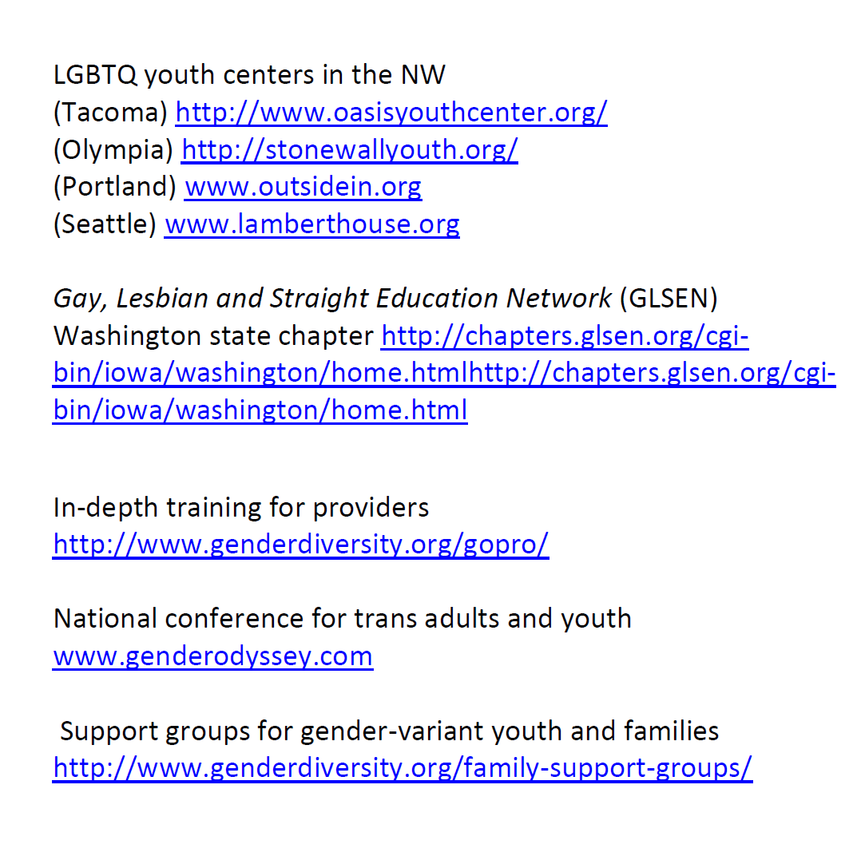

Slide 65


Slide 66
Thank you!
Any questions or comments?

Slide 67
Complete Survey

Slide 68
      Subscribe to the Gender Odyssey mailing list to learn about training events, such as professional Day: https://app.e2ma.net/app2/audience/signup/28753/17074/?v=a
      Register for more in-depth training at Gender Odyssey’s annual Professional Day: http://www.genderdiversity.org/event-registration/?ee=2

