Slide 1
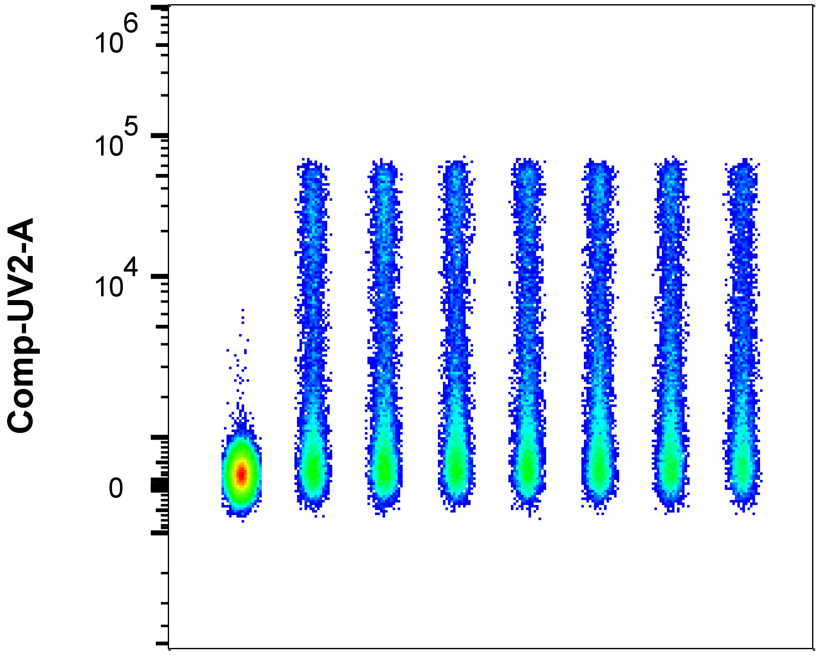
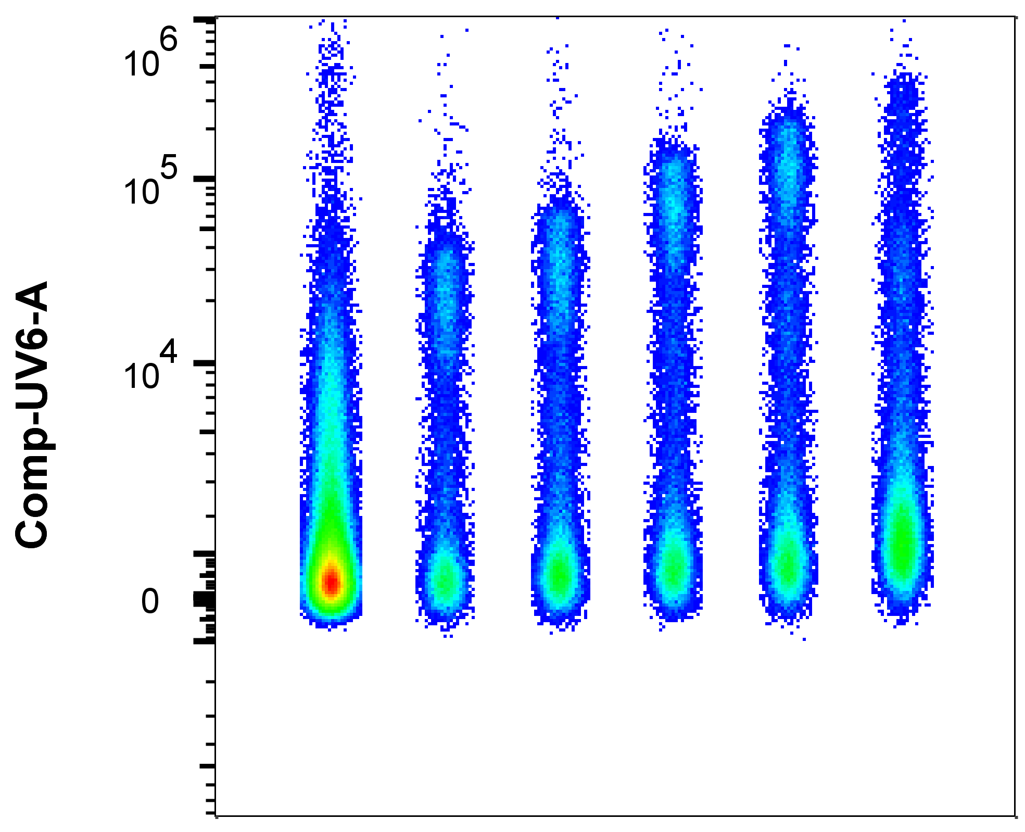
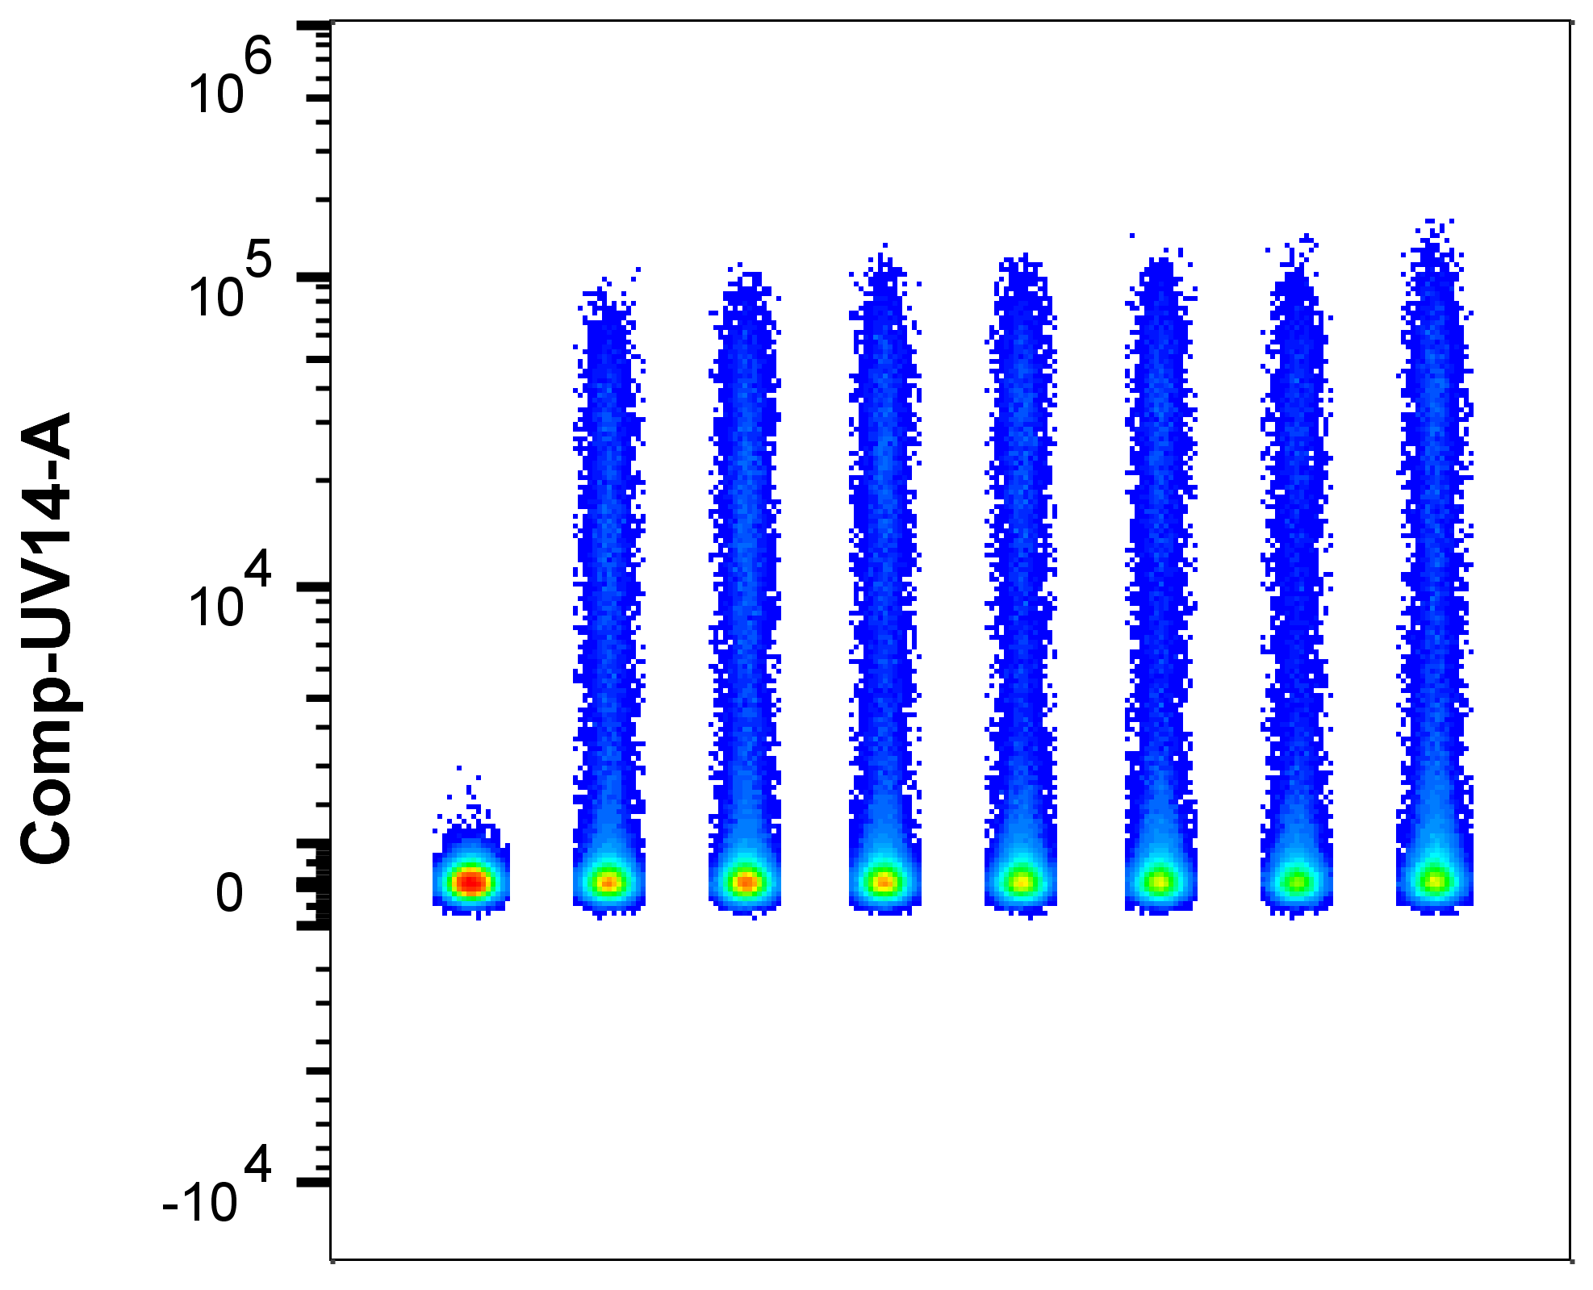
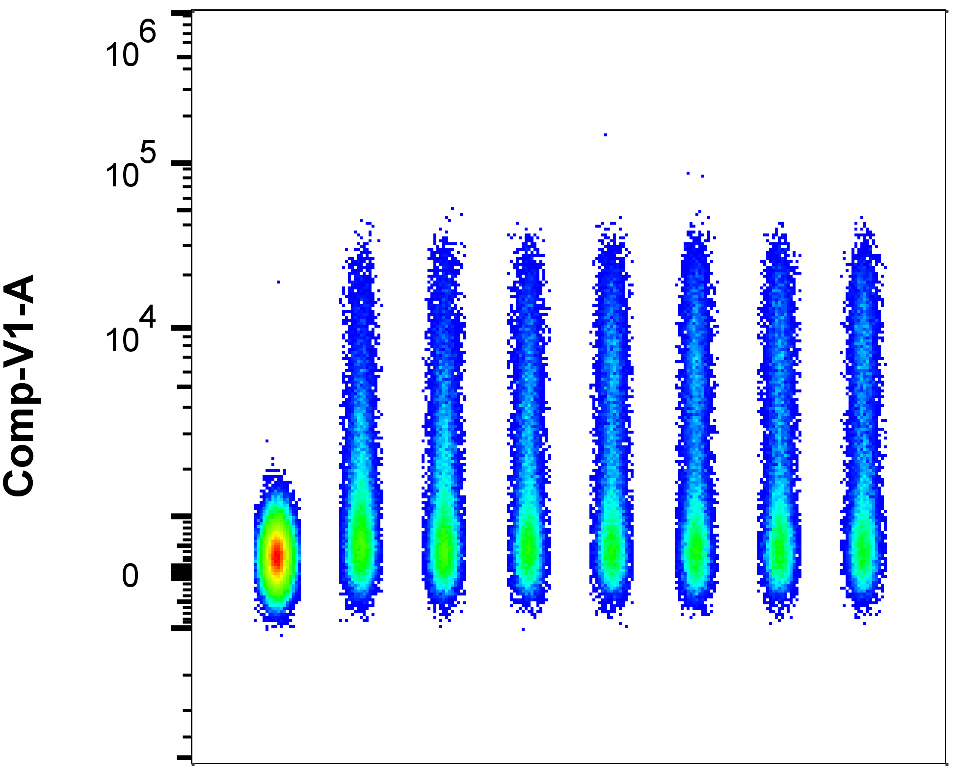
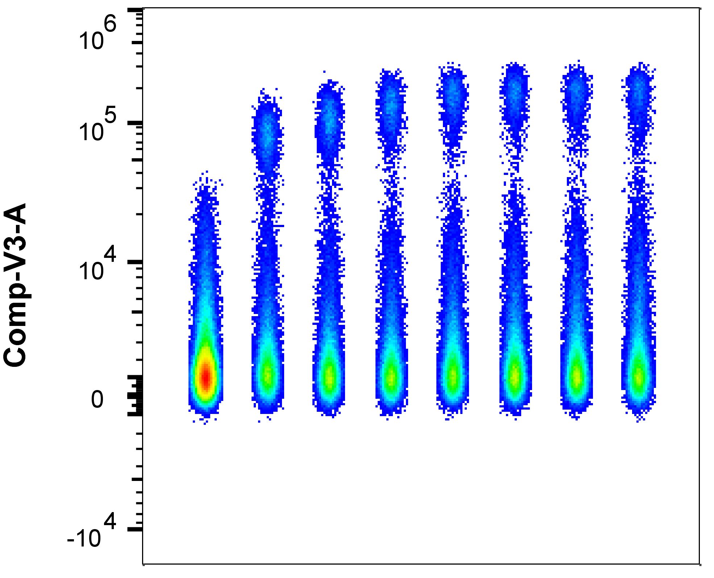
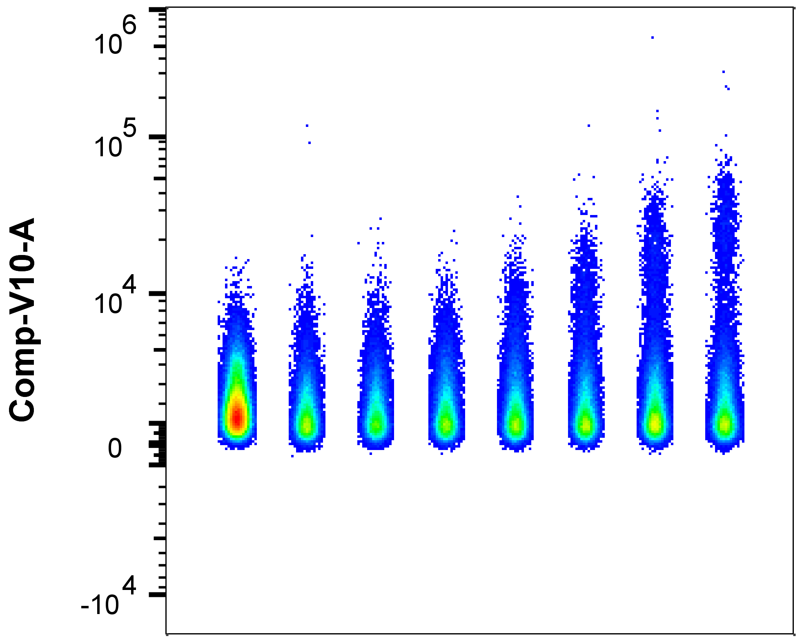
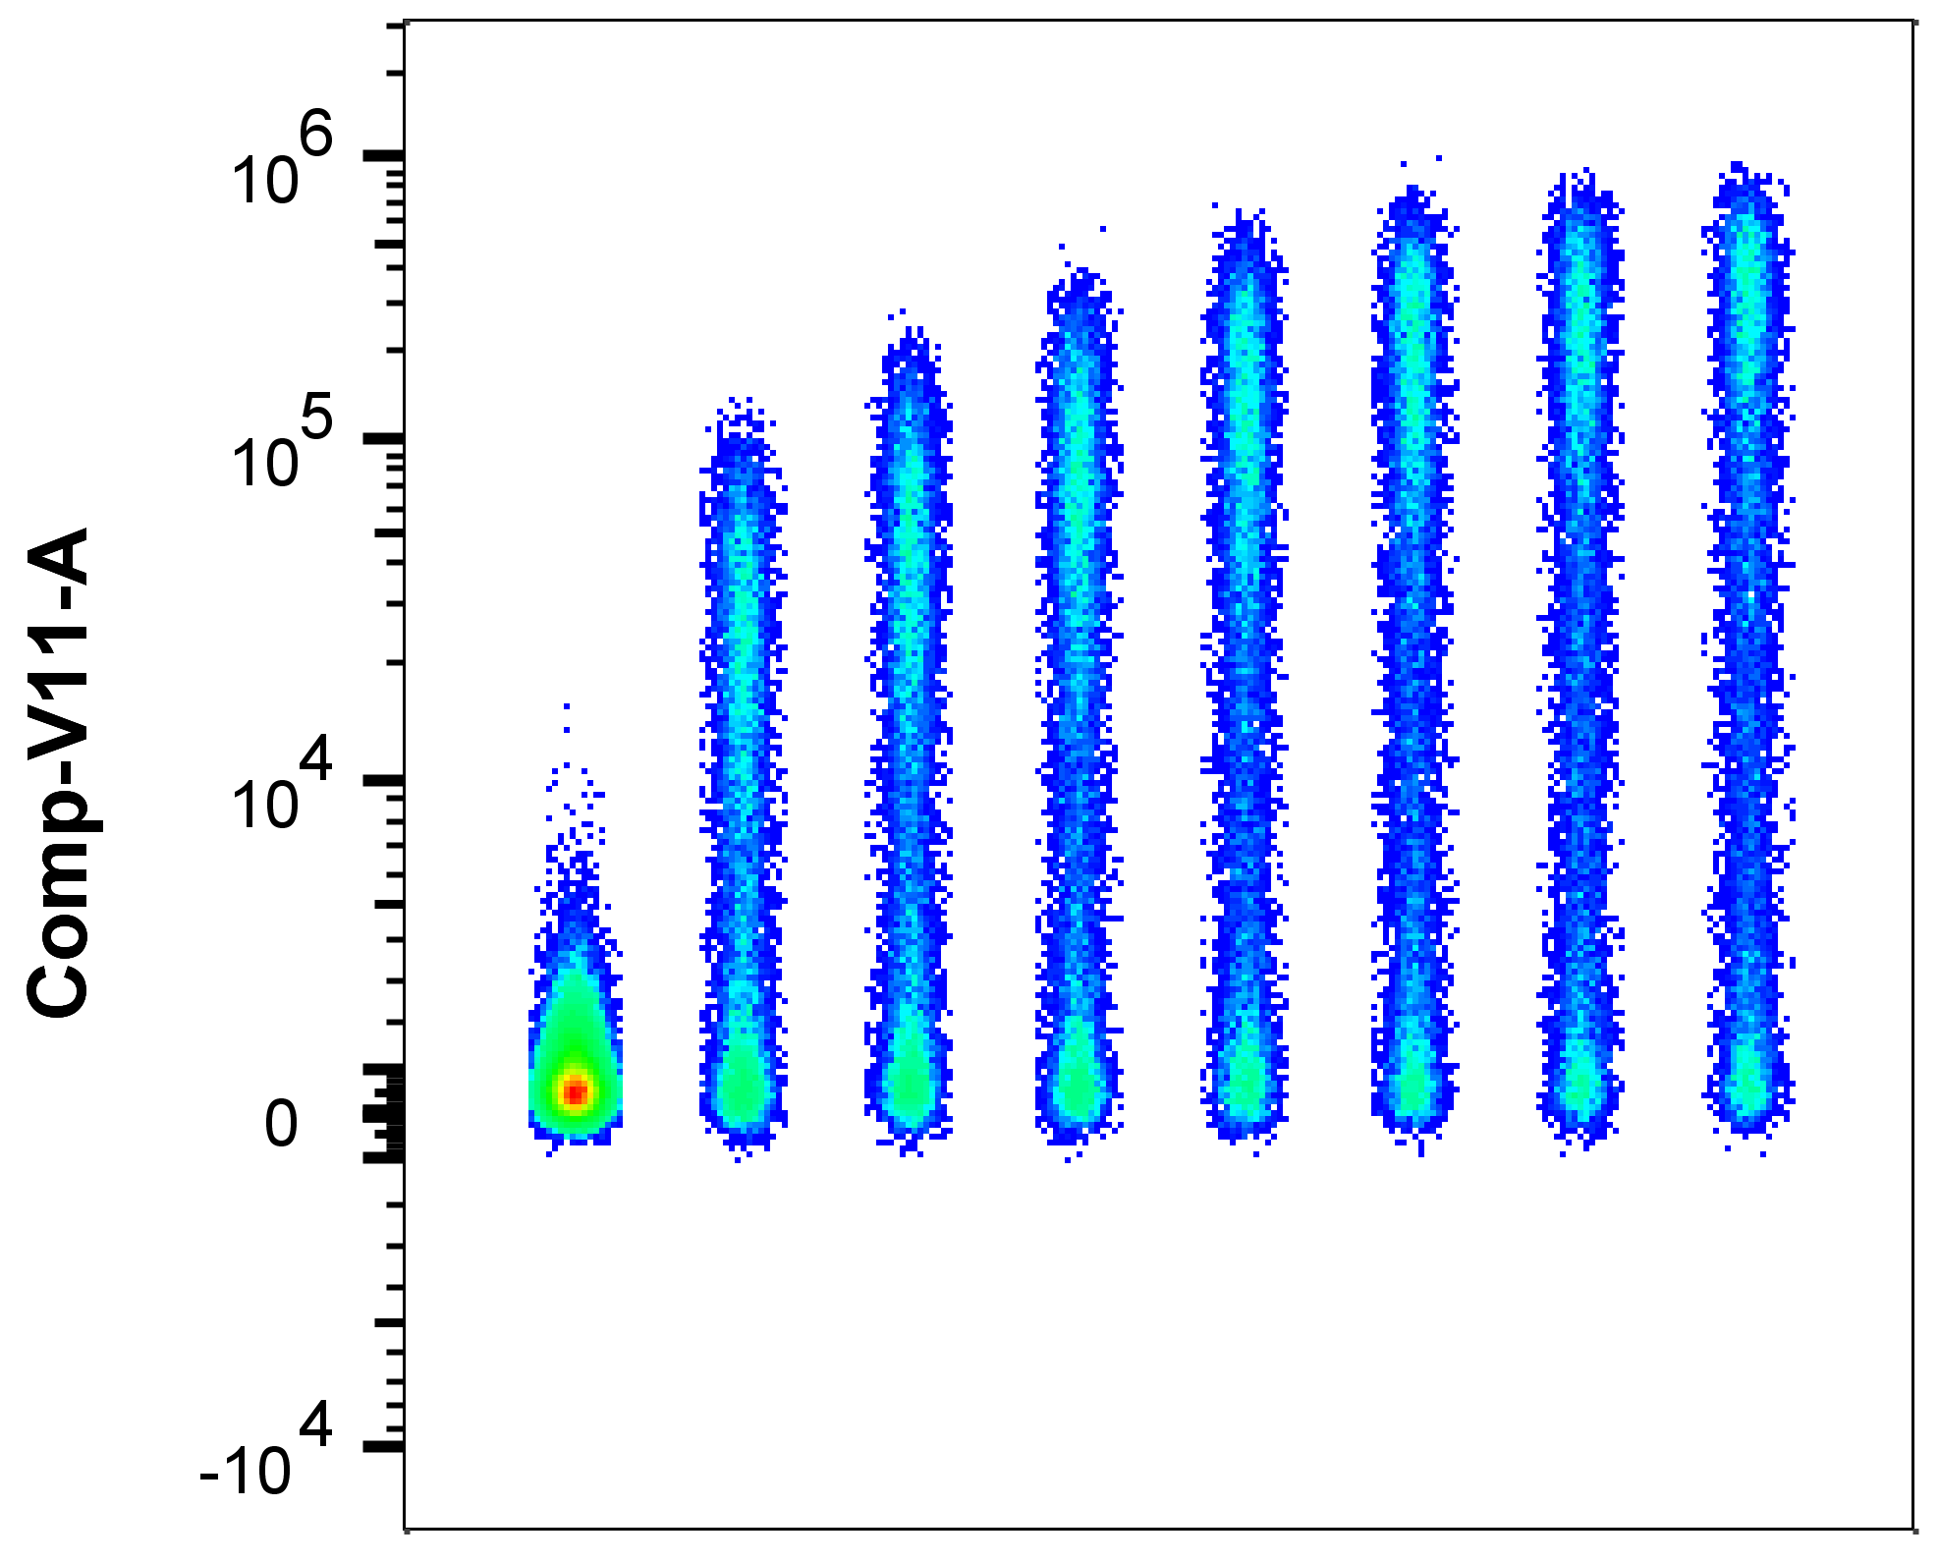
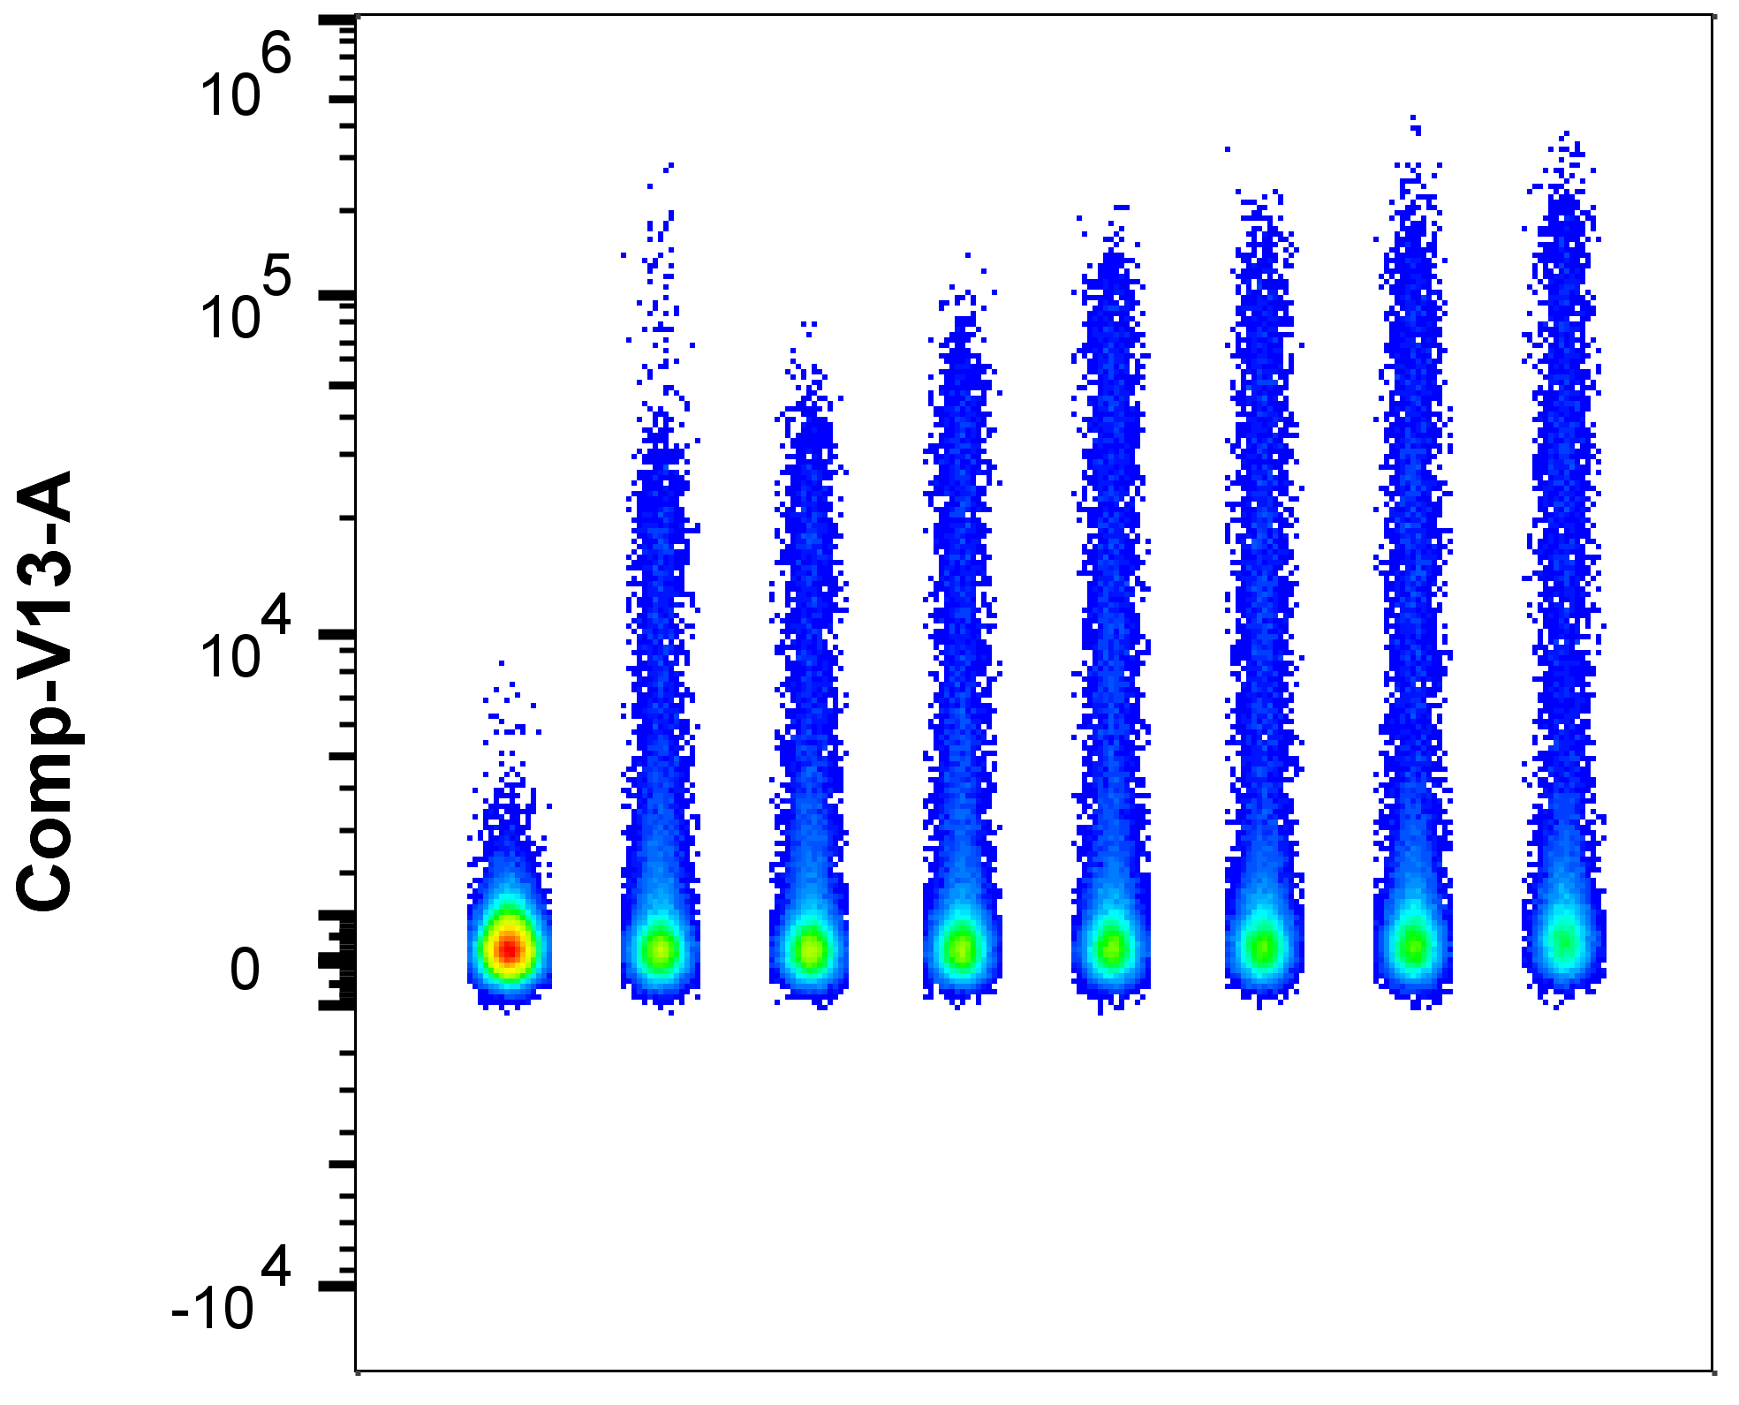
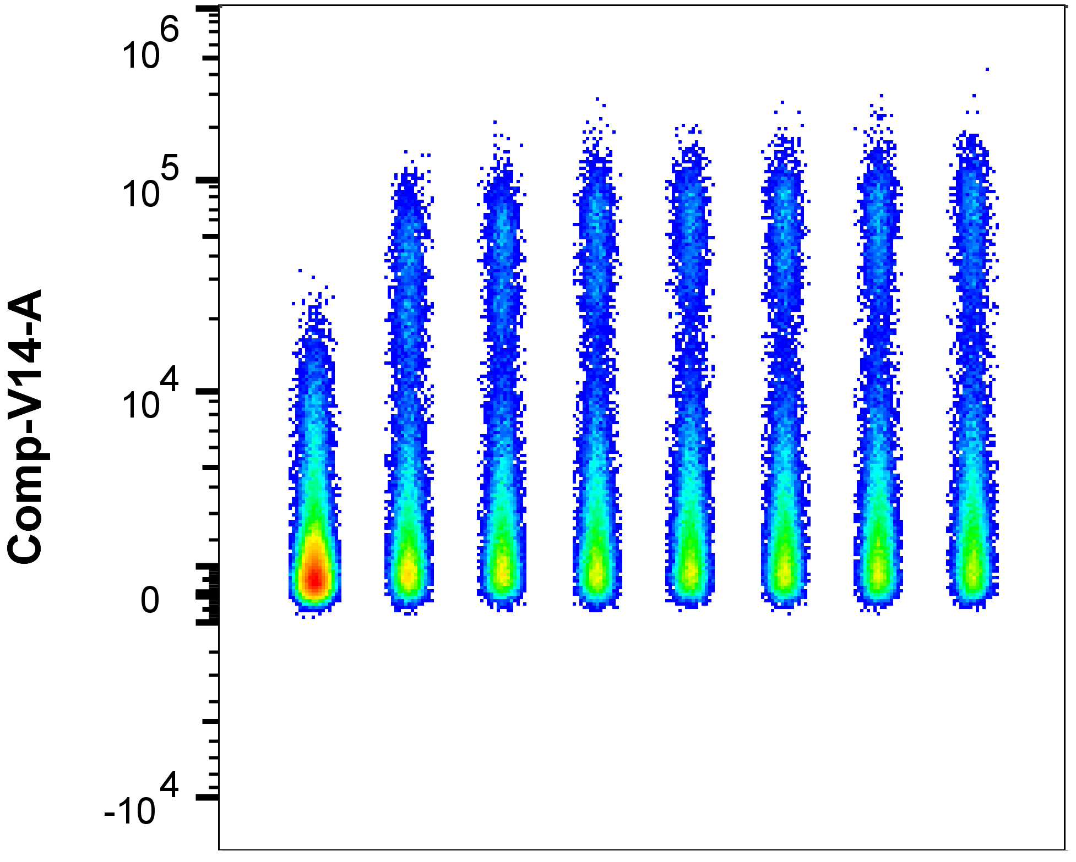
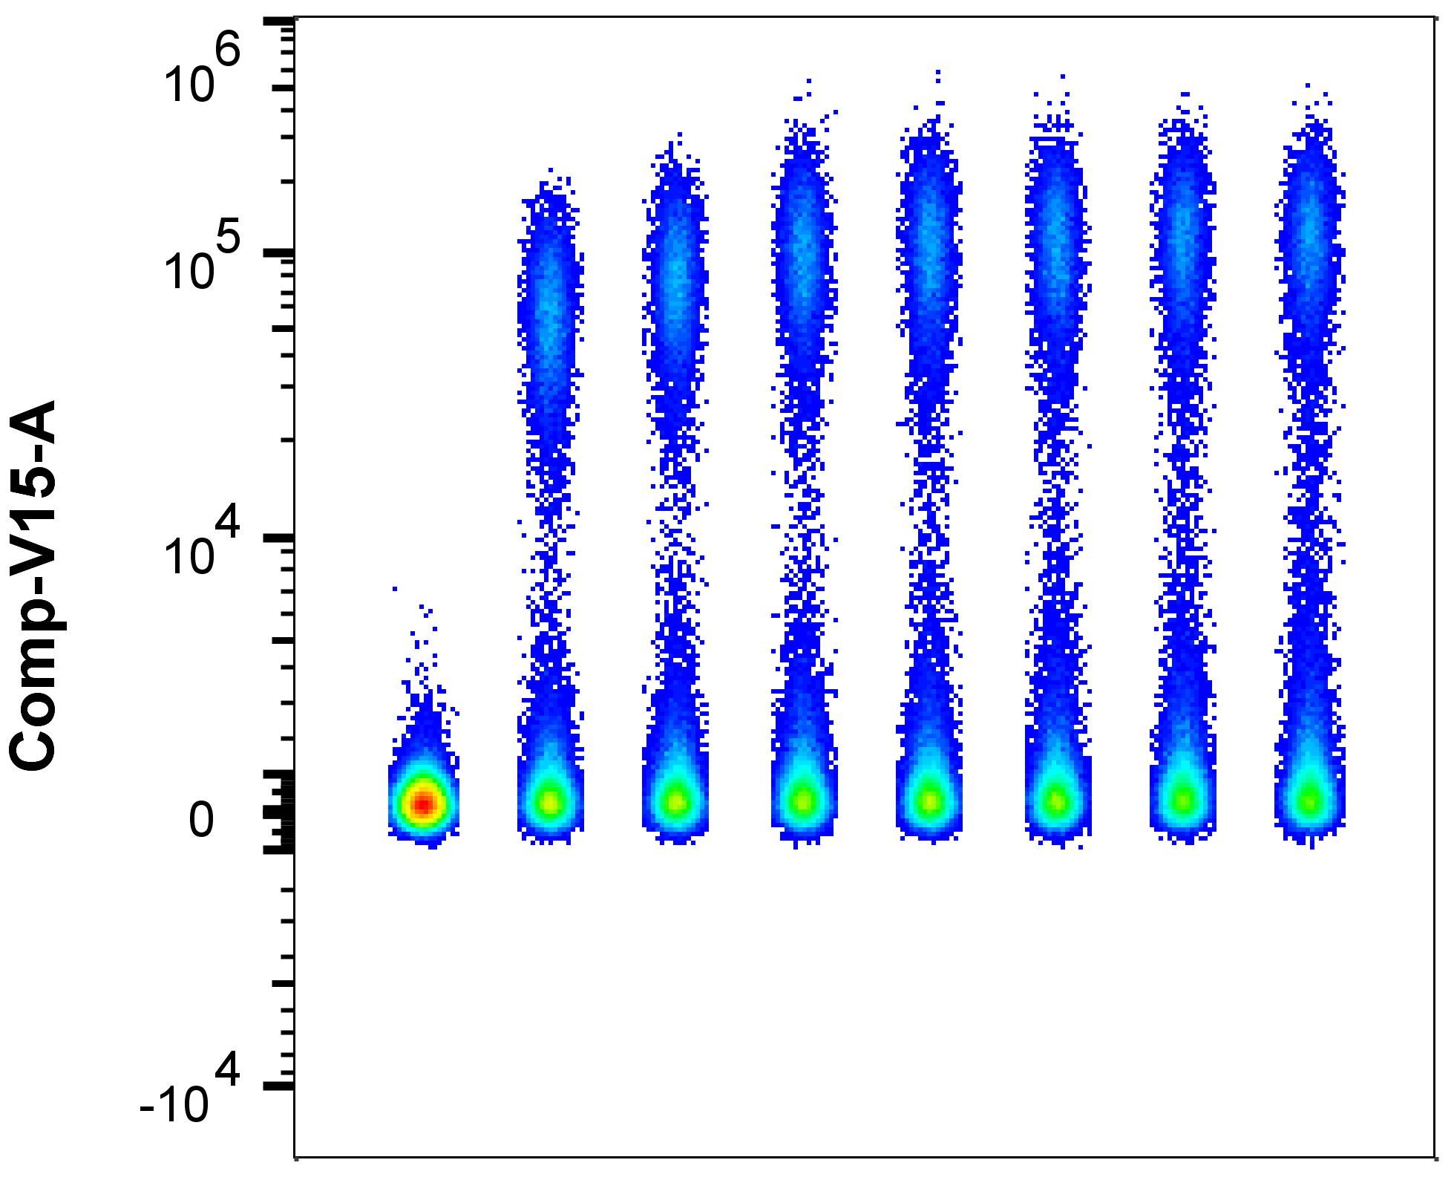
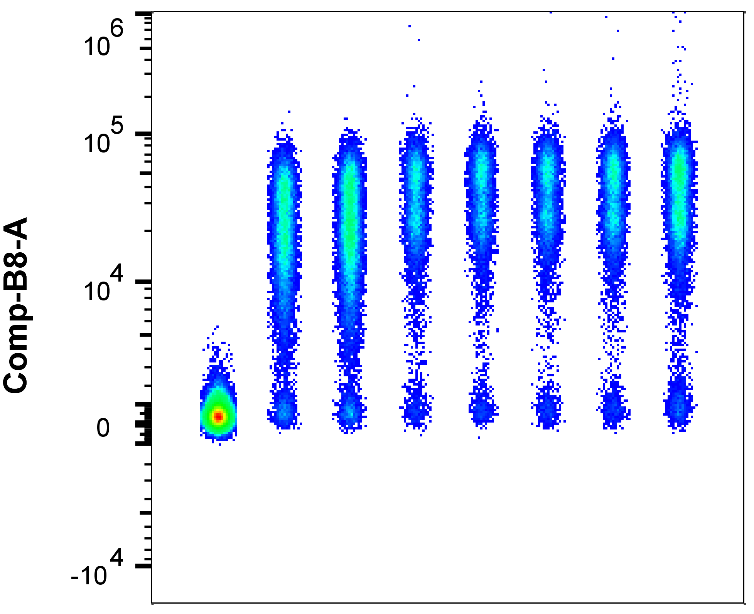
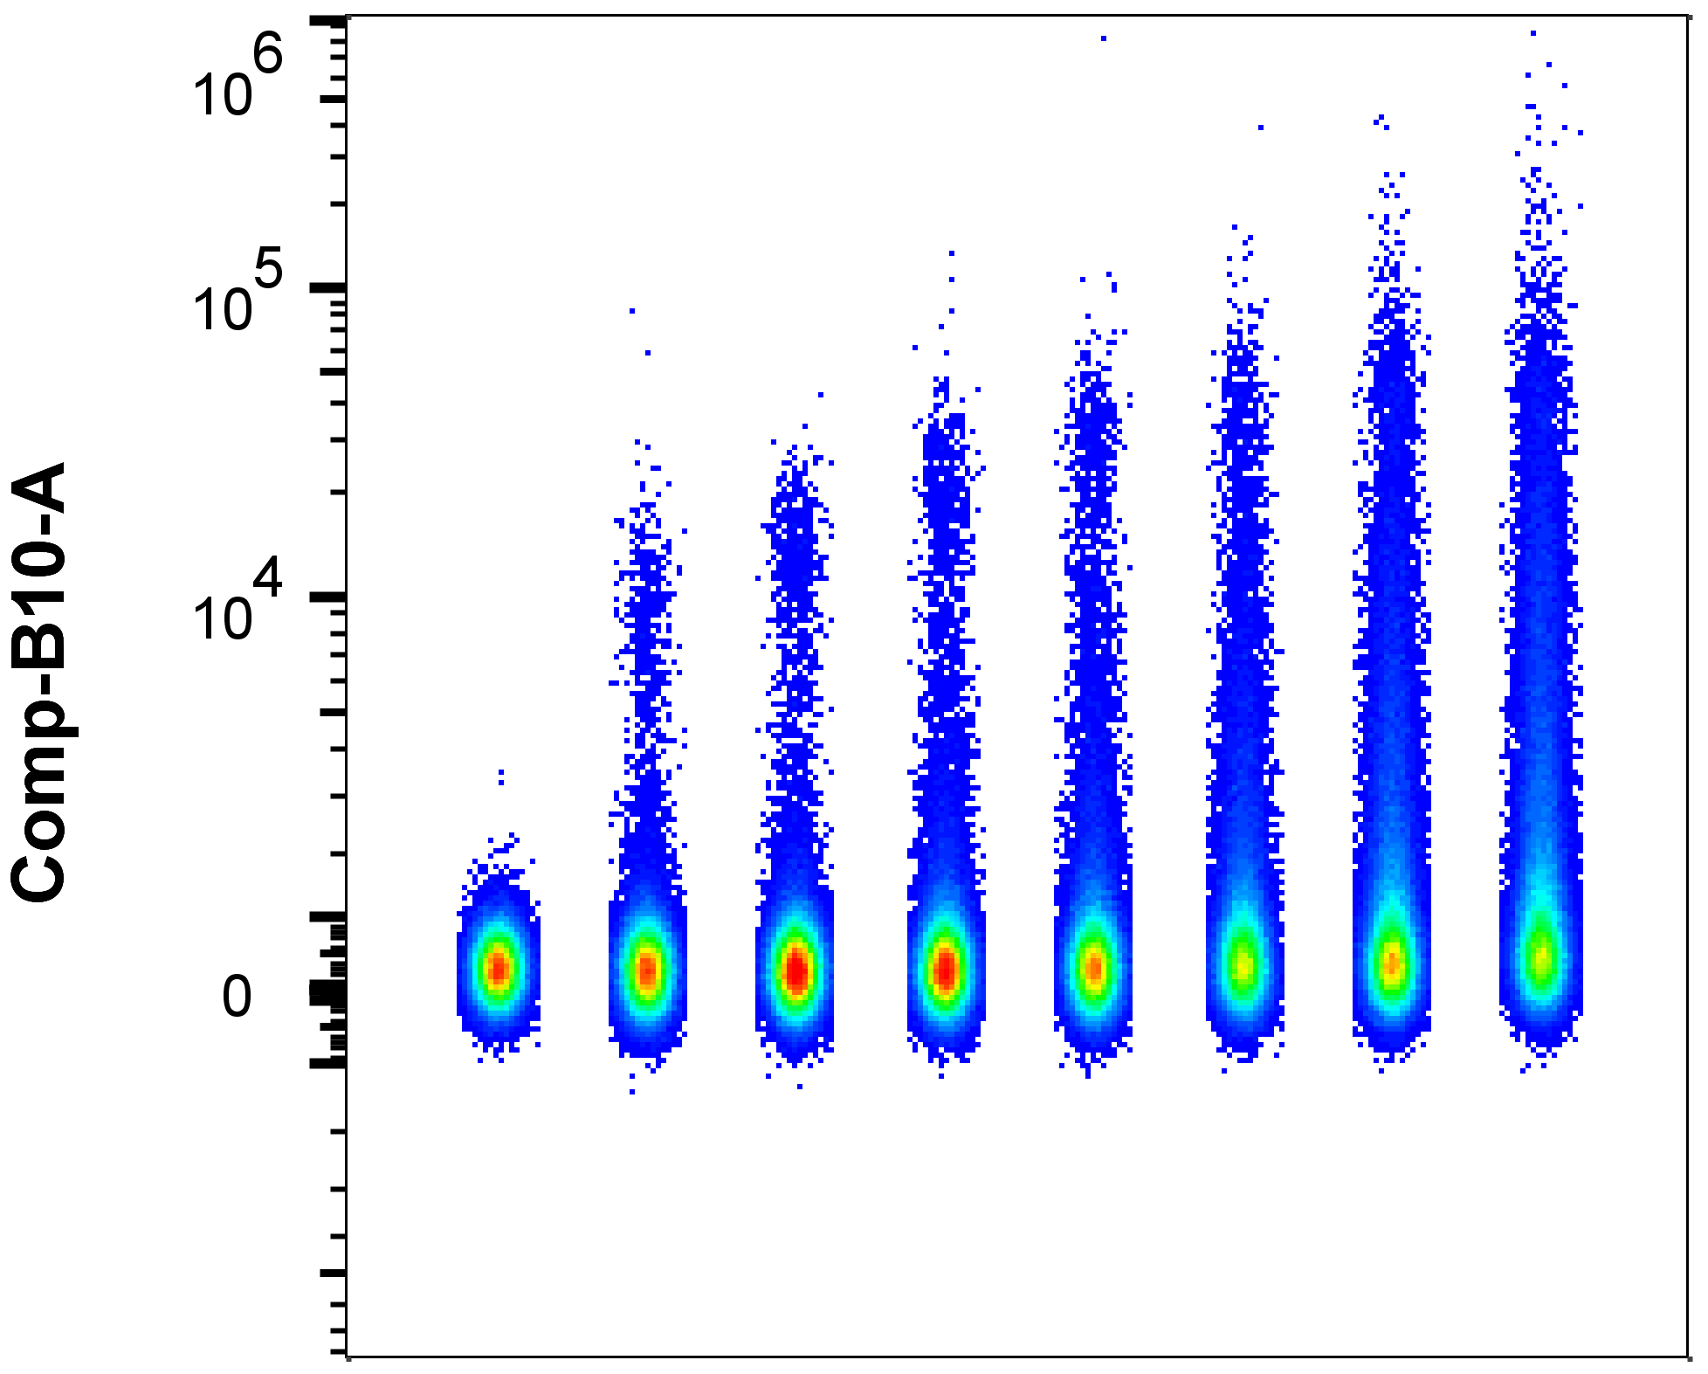
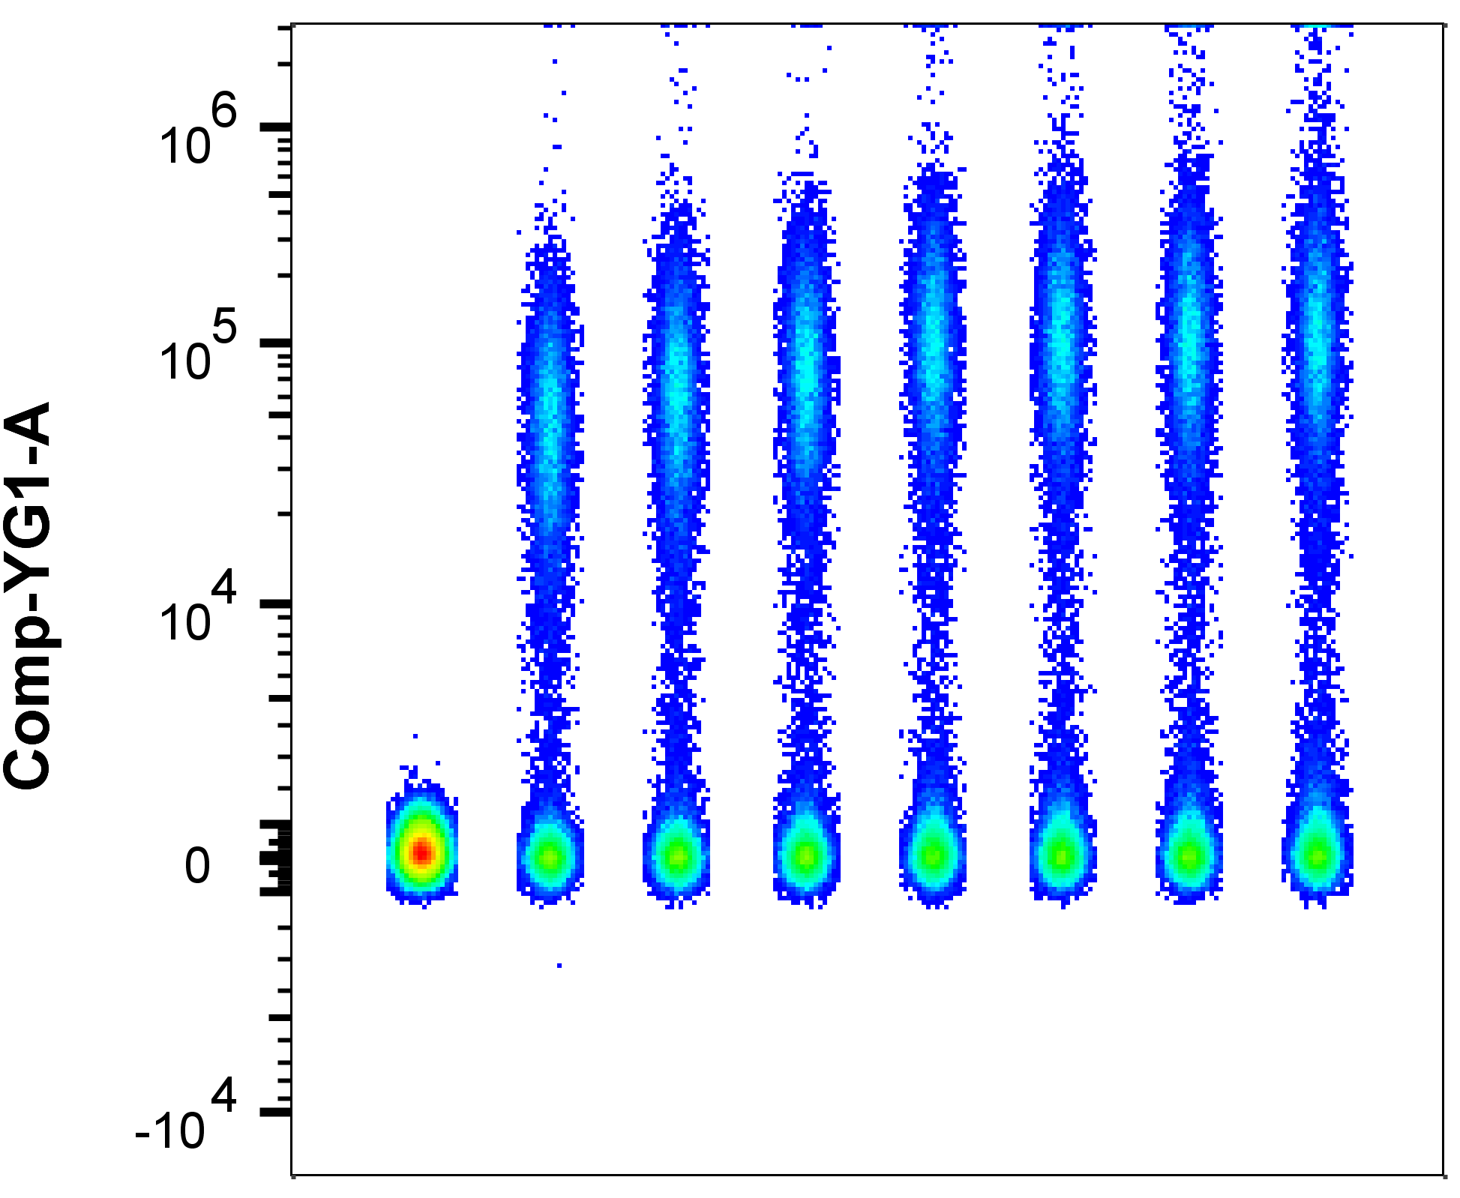
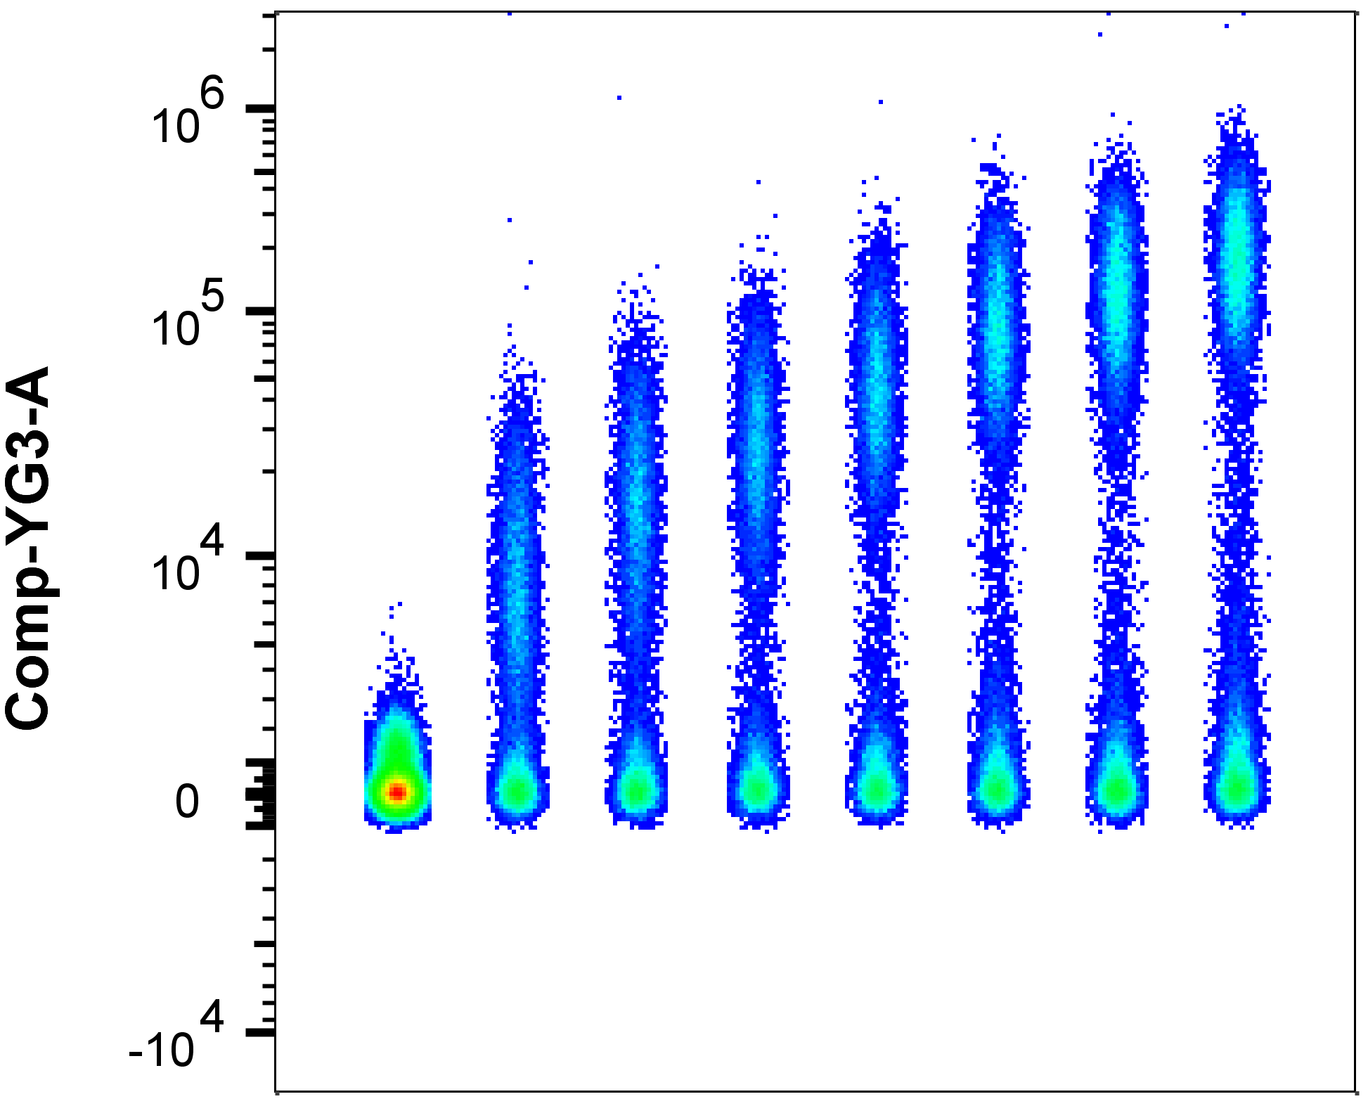
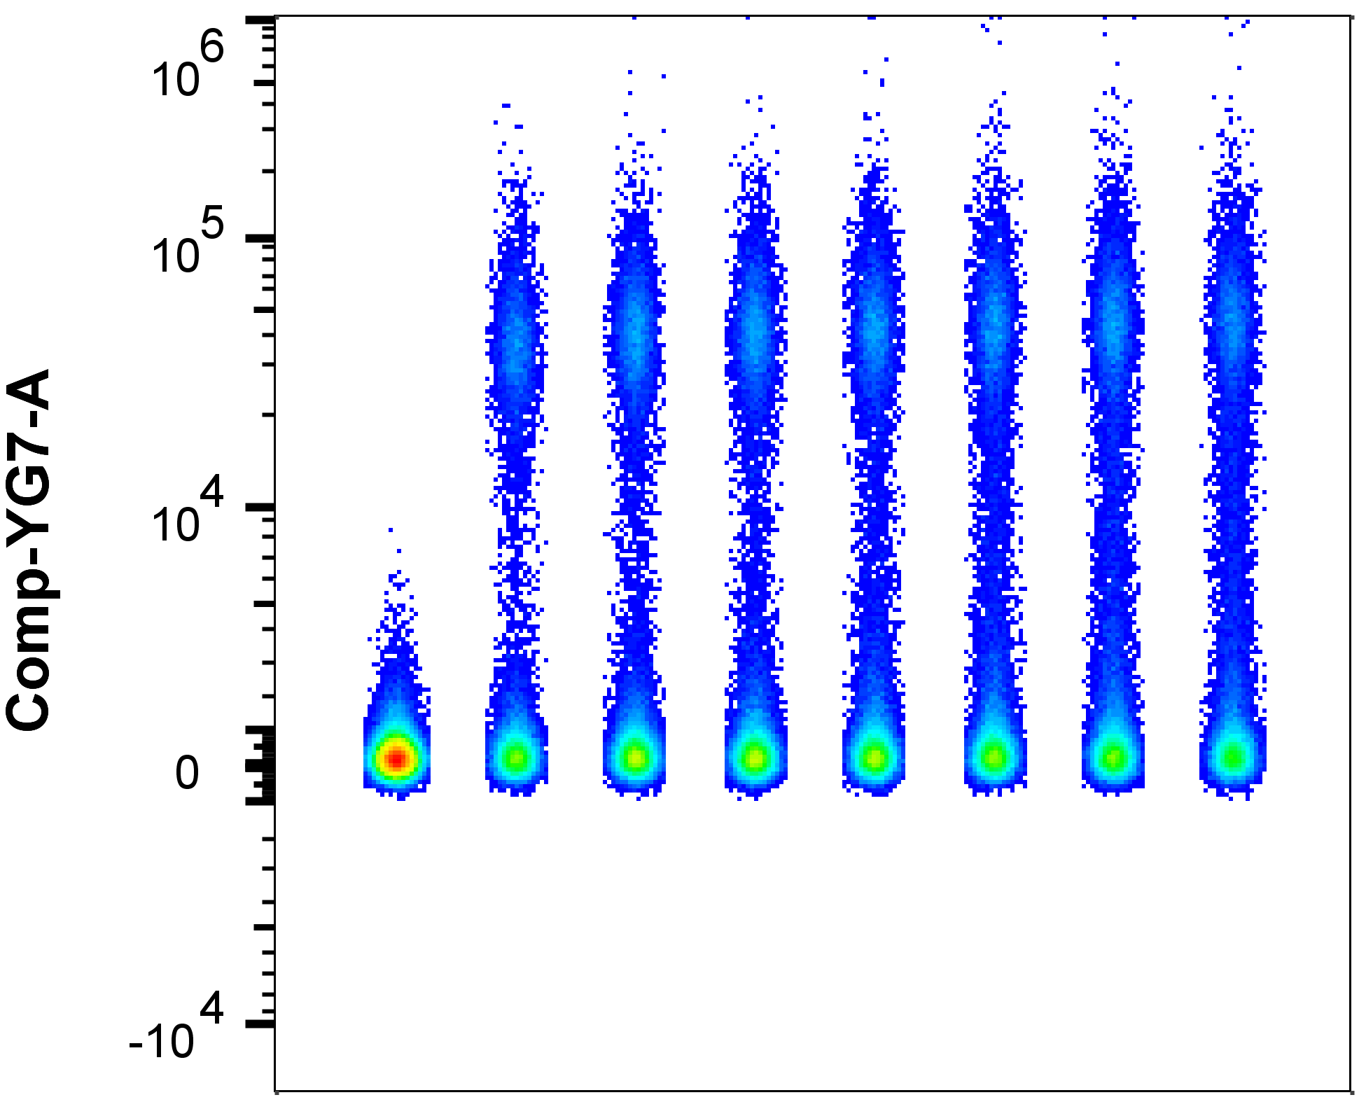
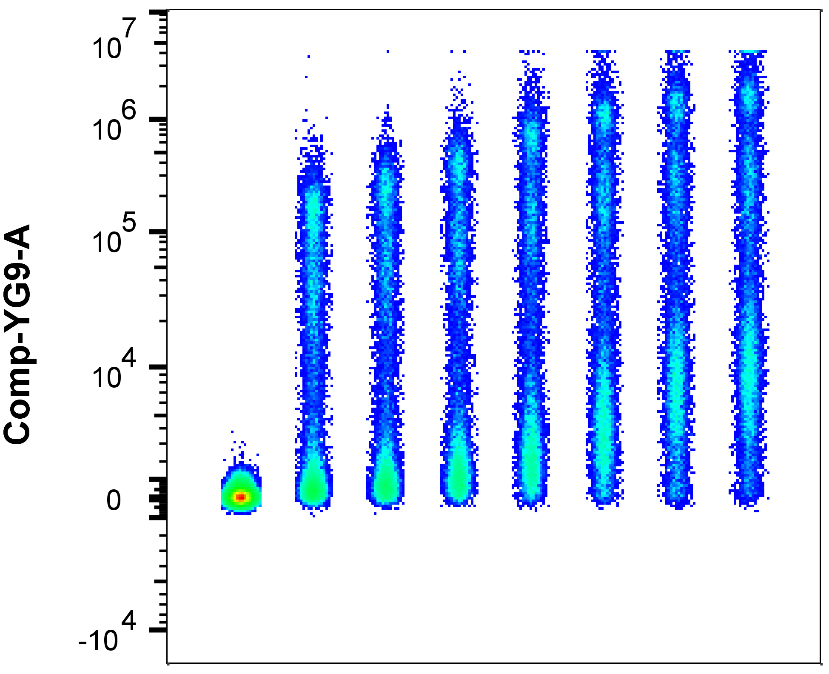
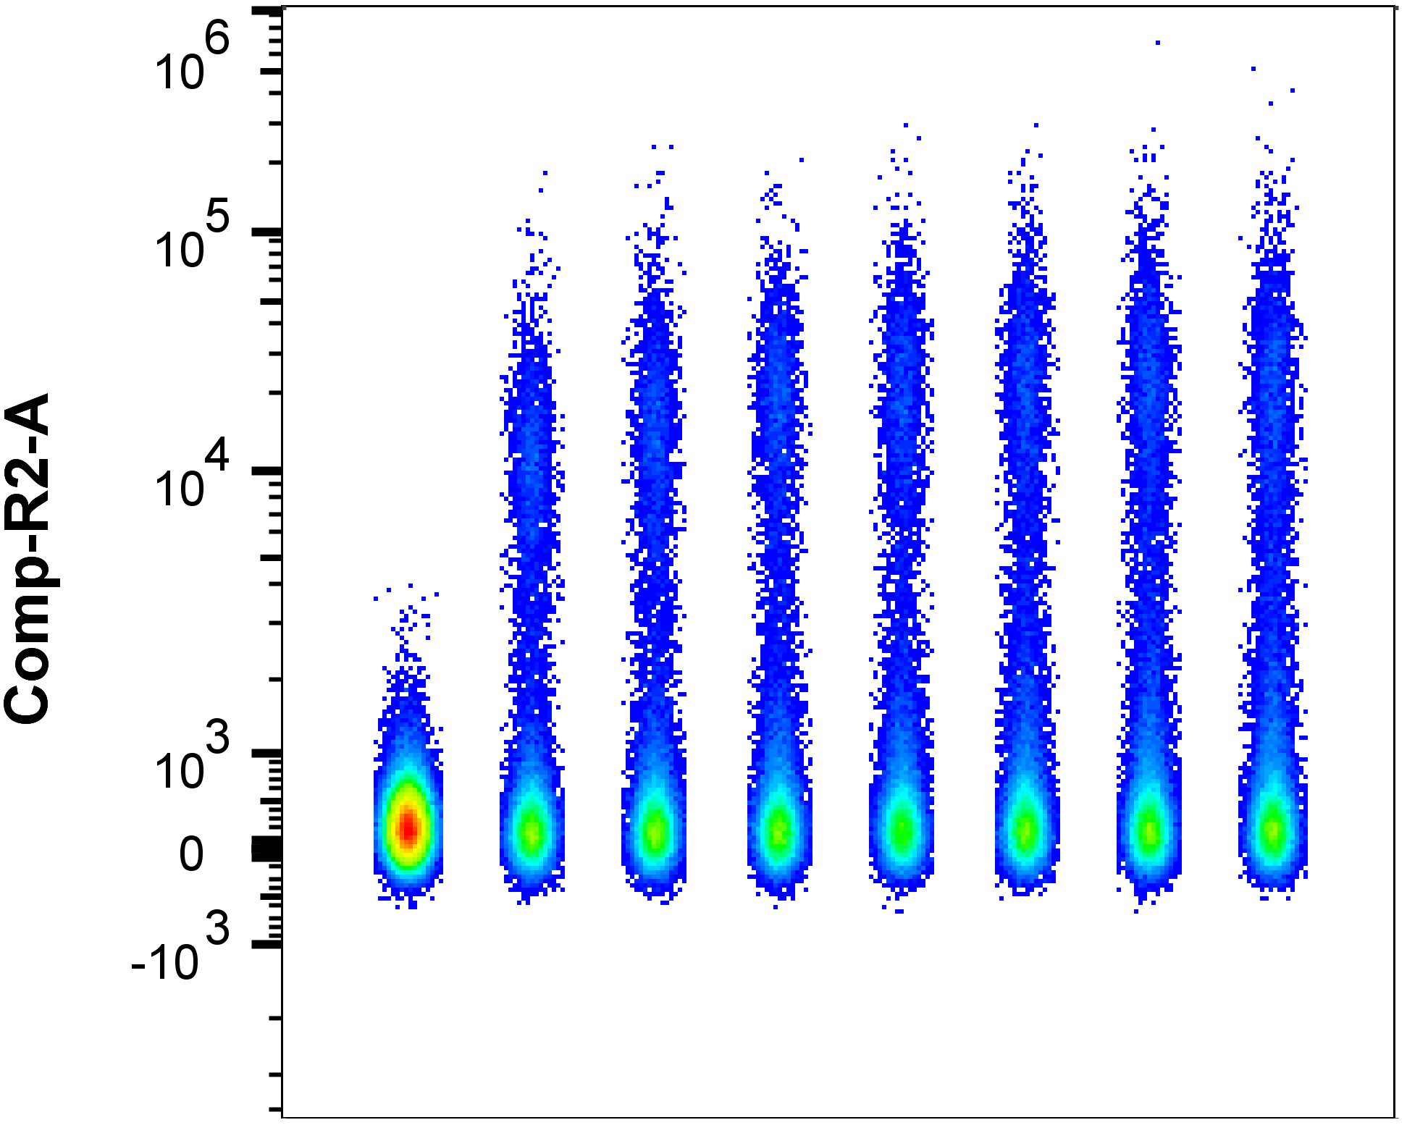
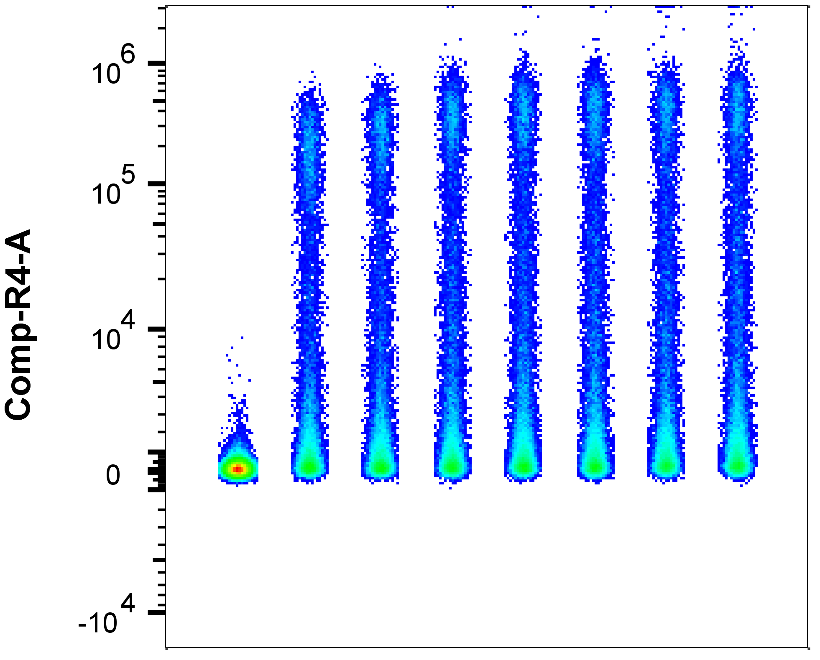
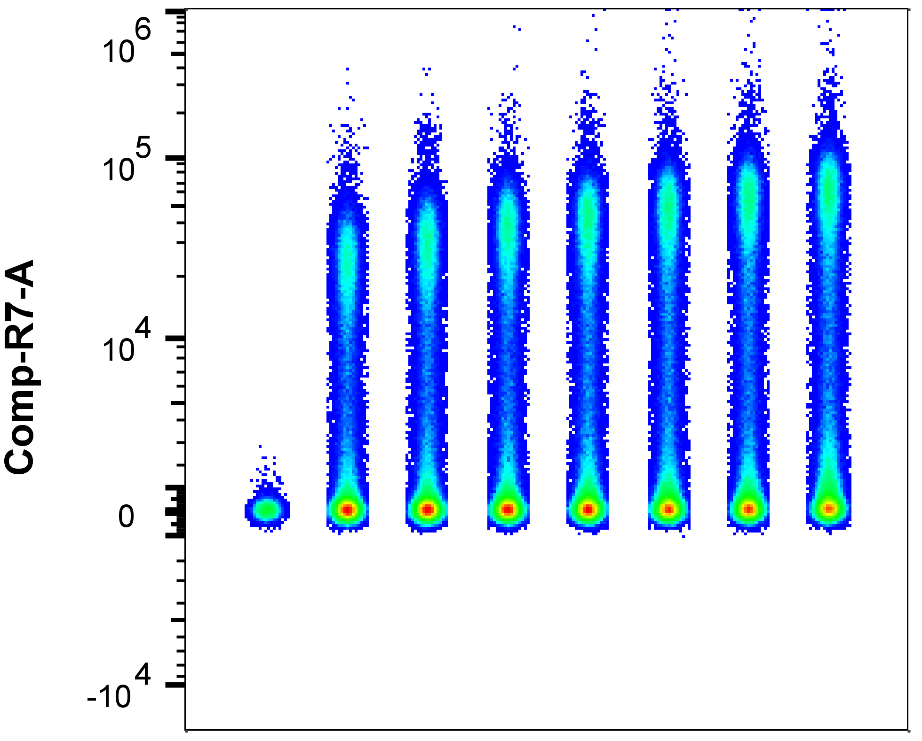
Multi-Compartmental Analysis of the Murine Pulmonary Immune Response by Spectral Flow Cytometry
Chang M.Y., Brune J.E., Black M., Altemeier W.A., and Frevert C.W.
American Journal of Physiology Lung Cellular and Molecular Physiology
MHCII BUV395
Live/Dead Blue
CD103 BUV737
UV Laser
MFI
0 2 4 8 16 31 63 125
MFI
0 5 10 20 40 80
0 16 31 63 125 250 500 1000
ng/test
ul @ 1:320 dilution/test
CD11c BV421
Ly6G PacBlue
NKp46 BV605
Ly6C BV650
Violet Laser
0 16 31 63 125 250 500 1000
0 16 31 63 125 250 500 1000
0 16 31 63 125 250 500 1000
0 2 4 8 16 31 63 125
CD64 BV711
SiglecF BV750
CD4 BV785
0 16 31 63 125 250 500 1000
0 4 8 16 31 63 125 250
0 8 16 31 63 125 250 500
CD45 PerCP
γδTCR PerCP-eFluor710
Blue Laser
0 16 31 63 125 250 500 1000
0 8 16 31 63 125 250 500
CD8 PE
CD3 PEDazzle594
CD19 PECy5.5
CD24 PECy7
Yellow/Green Laser
0 8 16 31 63 125 250 500
0 16 31 63 125 250 500 1000
0 16 31 63 125 250 500 1000
0 4 8 16 31 63 125 250
F4/80 AlexaFluor647
CD11b APC-R700
CD49b APC-eFluor780
Red Laser
0 16 31 63 125 250 500 1000
0 4 8 16 31 63 125 250
0 31 63 125 250 500 1000 2000
Supplemental Figure 2. Antibody Titrations. Two-fold dilutions were tested for all fluorophores. The y-axis reflects mean fluorescence intensity (MFI); the x-axis reflects ng/test for conjugates or ul/test for Live/Dead Blue. Files were concatenated and staining indices determined with FlowJo 10.8.1. For each conjugate, the optimal amount selected for inclusion in the full-stained master mix is indicated by the red box.

