Slide 1
Figure S3.2 - Trend in average of length, weight and daily growth rate measured over time in female and male offspring for each family. Individual measures are depicted by open circular dots. Means are represented by black circular dots, and standard deviations are depicted by black bars. The following graphs illustrate individual trait changes for either female or male progeny in each family:
Figure S3.2.a - Length for female offspring in Family_1
Figure S3.2.b - Weight for female offspring in Family_1
Figure S3.2.c - Daily growth rate for female offspring in Family_1
Figure S3.2.d - Length male offspring in Family_1
Figure S3.2.e - Weight for male offspring in Family_1
Figure S3.2.f - Daily growth rate for male offspring in Family_1
Figure S3.2.g - Length female offspring in Family_2
Figure S3.2.h - Weight for female offspring in Family_2
Figure S3.2.i - Daily growth rate for female offspring in Family_2
Figure S3.2.j - Length male offspring in Family_2
Figure S3.2.k - Weight for male offspring in Family_2
Figure S3.2.l - Daily growth rate for male offspring in Family_2
Figure S3.2.m - Length female offspring in Family_3
Figure S3.2.n - Weight for female offspring in Family_3
Figure S3.2.o - Daily growth rate for female offspring in Family_3
Figure S3.2.p - Length male offspring in Family_3
Figure S3.2.q - Weight for male offspring in Family_3
Figure S3.2.r - Daily growth rate for male offspring in Family_3
Figure S3.2.s - Length female offspring in Family_4
Figure S3.2.t - Weight for female offspring in Family_4
Figure S3.2.u - Daily growth rate Female offspring in Family_4
Figure S3.2.v - Length male offspring in Family_4
Figure S3.2.w - Weight for male offspring in Family_4
Figure S3.2.x - Daily growth rate for male offspring in Family_4

Slide 2
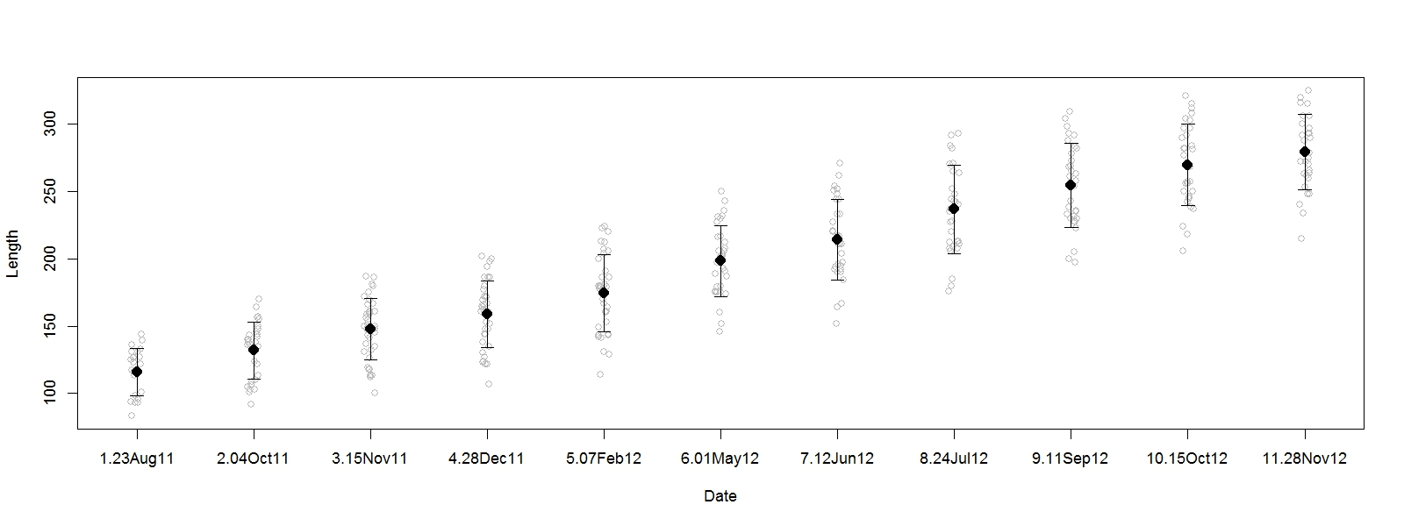
Figure S3.2.a - Length for female offspring in Family_1

Slide 3
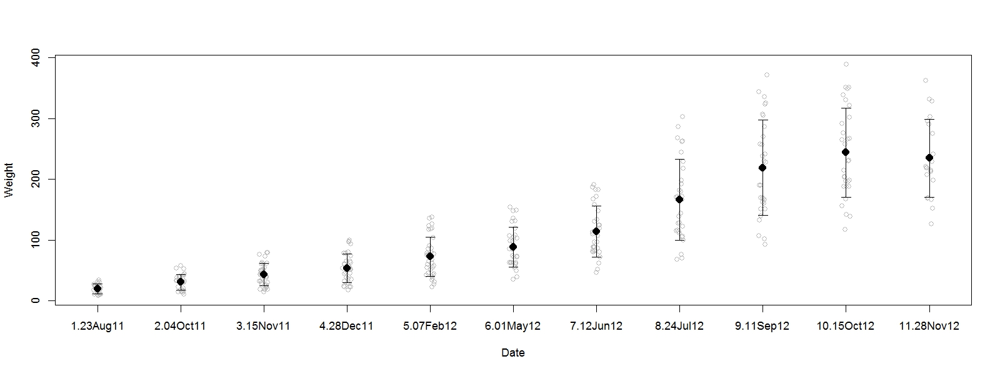
Figure S3.2.b - Weight for female offspring in Family_1

Slide 4
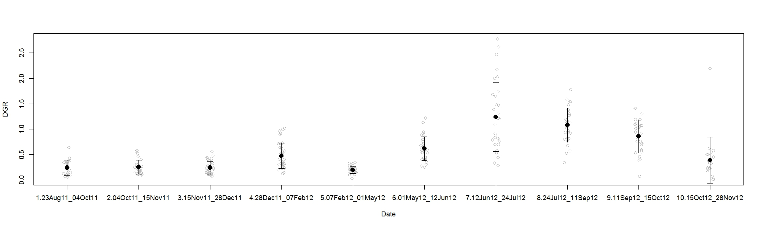
Figure S3.2.c - Daily growth rate for female offspring in Family_1

Slide 5
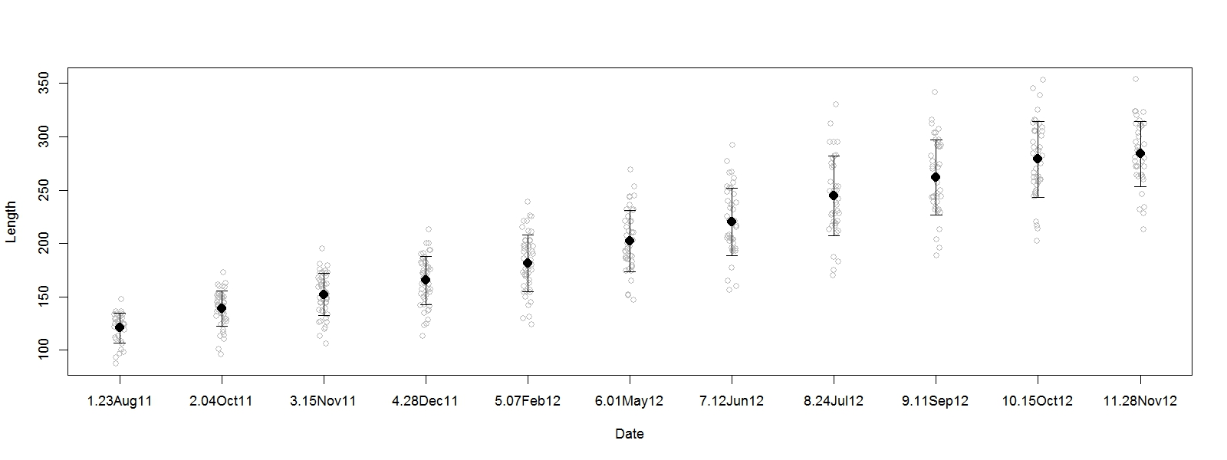
Figure S3.2.d - Length male offspring in Family_1

Slide 6
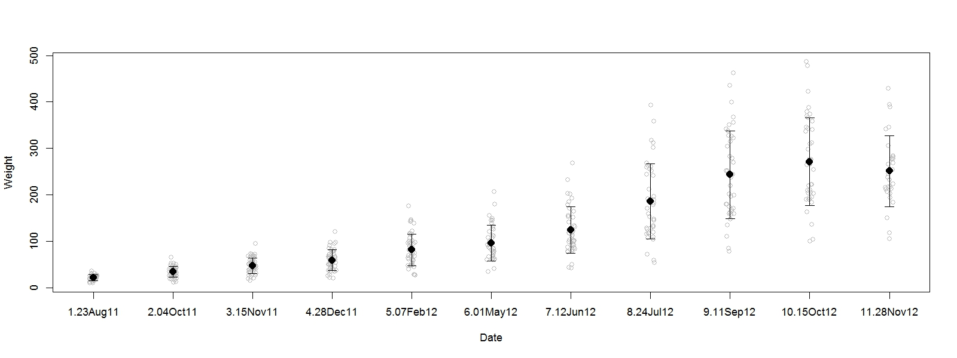
Figure S3.2.e - Weight for male offspring in Family_1

Slide 7
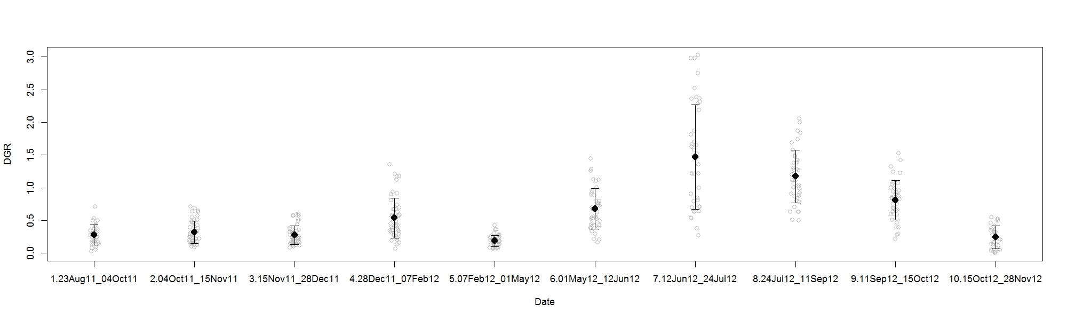
Figure S3.2.f - Daily growth rate for male offspring in Family_1

Slide 8
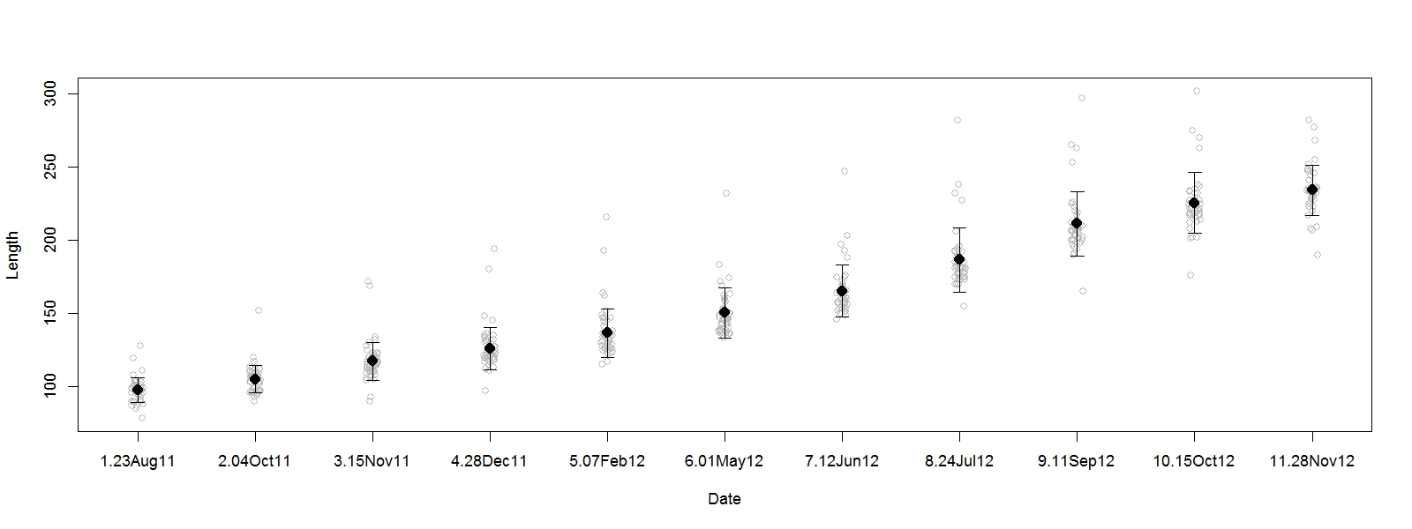
Figure S3.2.g - Length female offspring in Family_2

Slide 9
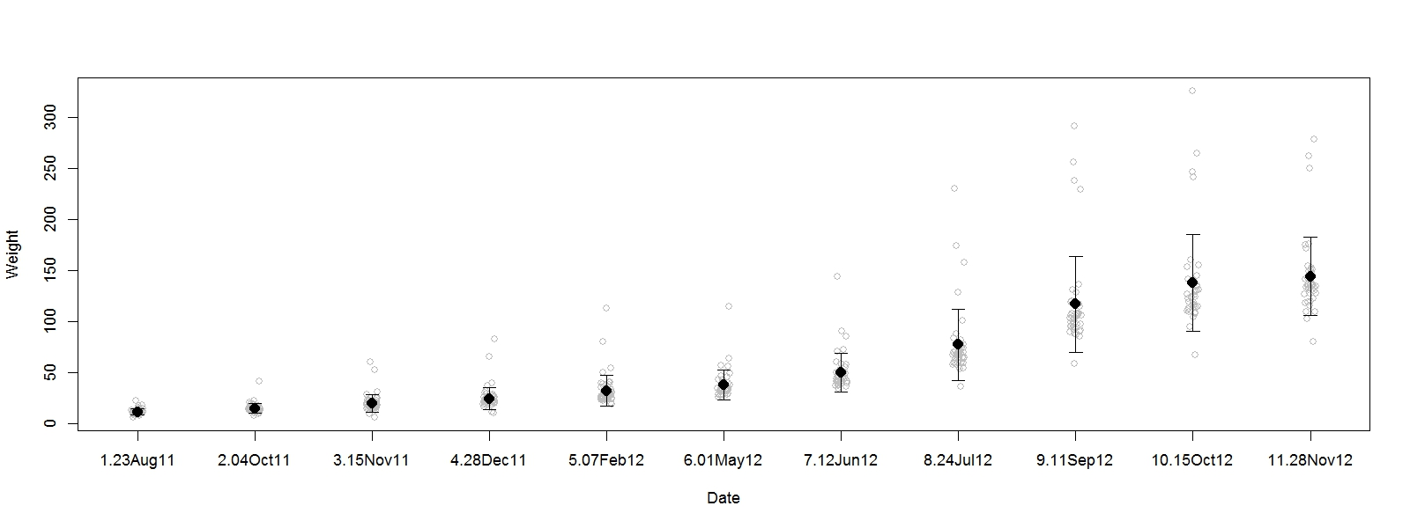
Figure S3.2.h - Weight for female offspring in Family_2

Slide 10
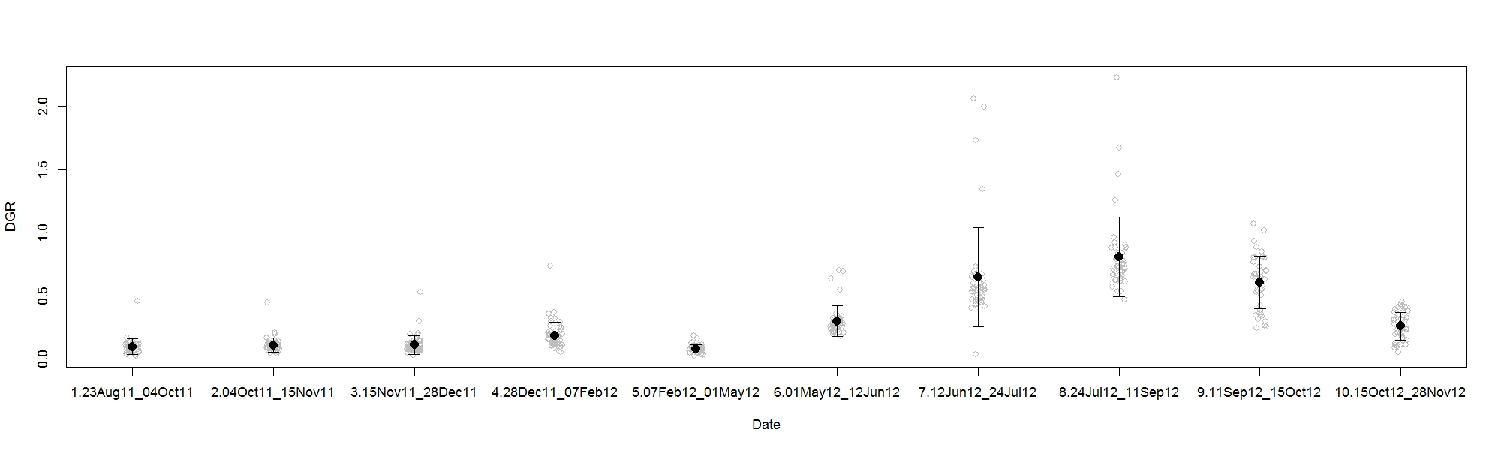
Figure S3.2.i - Daily growth rate for female offspring in Family_2

Slide 11

Figure S3.2.j - Length male offspring in Family_2

Slide 12
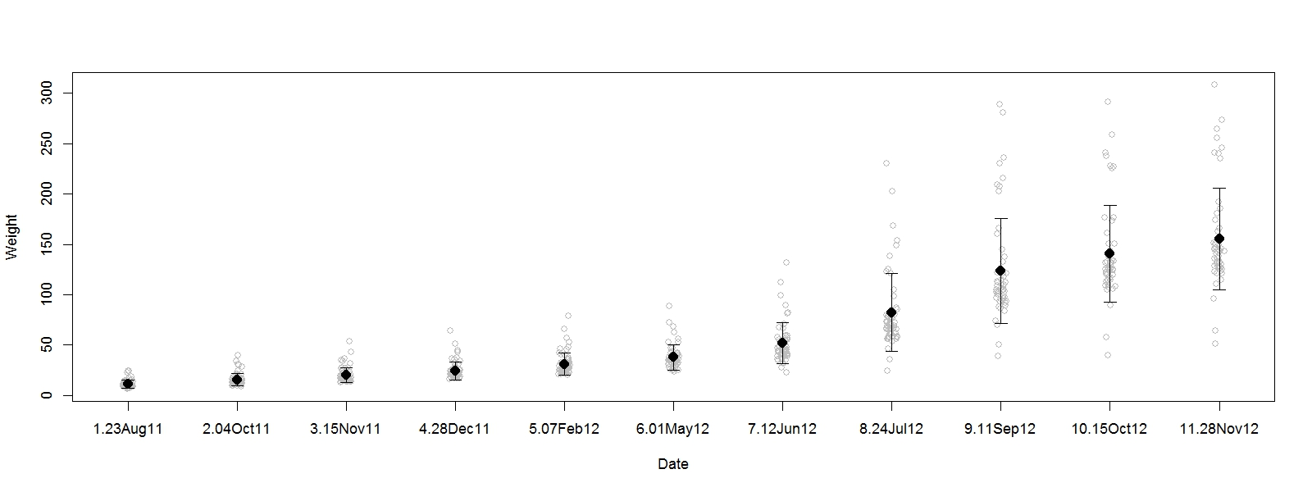
Figure S3.2.k - Weight for male offspring in Family_2

Slide 13
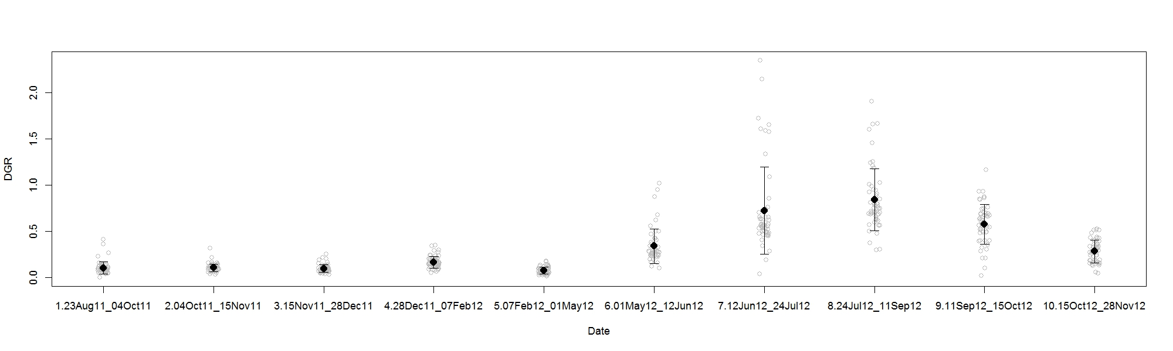
Figure S3.2.l - Daily growth rate for male offspring in Family_2

Slide 14
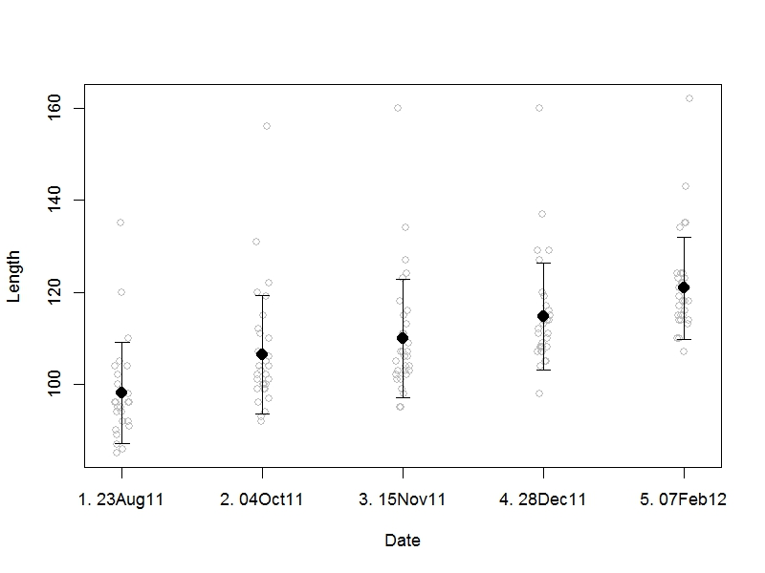
Figure S3.2.m - Length female offspring in Family_3

Slide 15
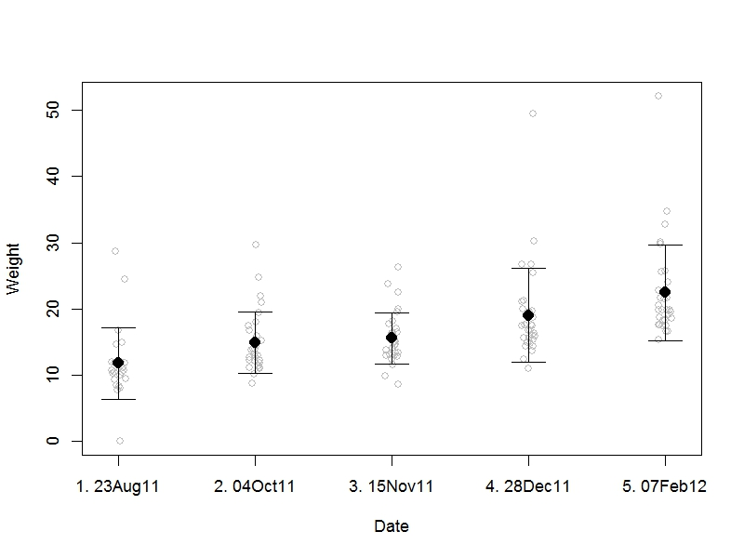
Figure S3.2.n - Weight for female offspring in Family_3

Slide 16
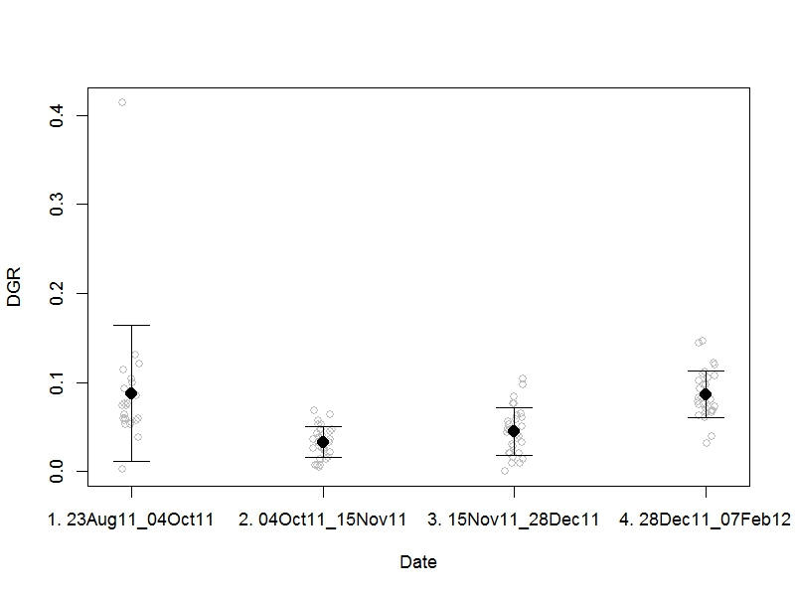
Figure S3.2.o - Daily growth rate for female offspring in Family_3

Slide 17
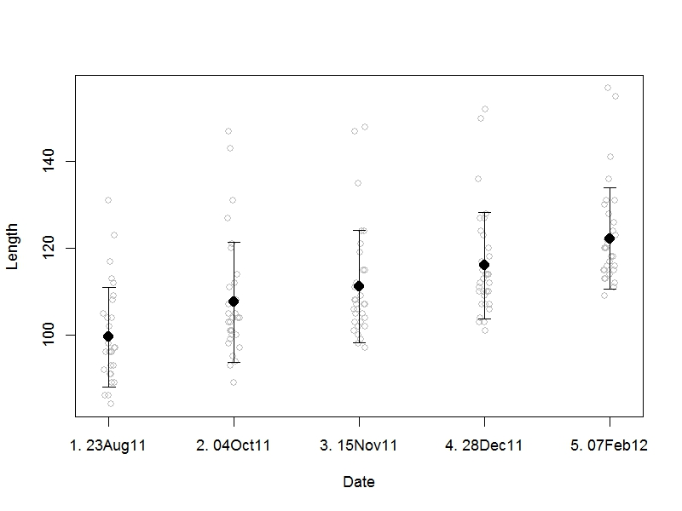
Figure S3.2.p - Length male offspring in Family_3

Slide 18
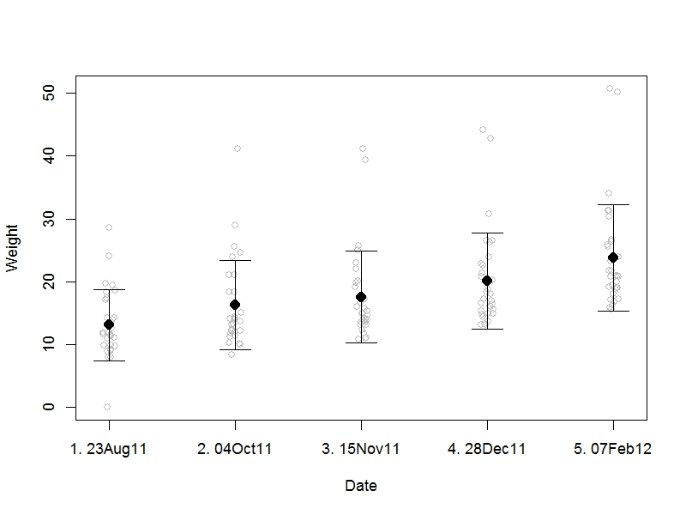
Figure S3.2.q - Weight for male offspring in Family_3

Slide 19
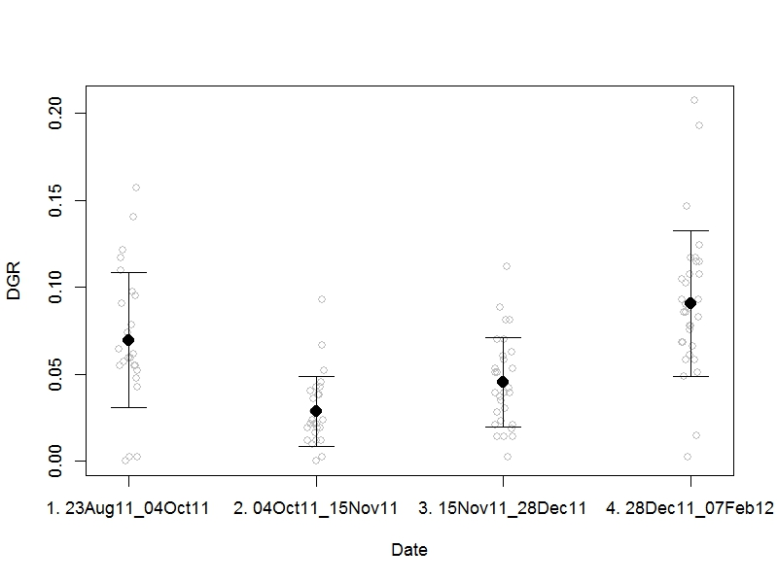
Figure S3.2.r - Daily growth rate for male offspring in Family_3

Slide 20
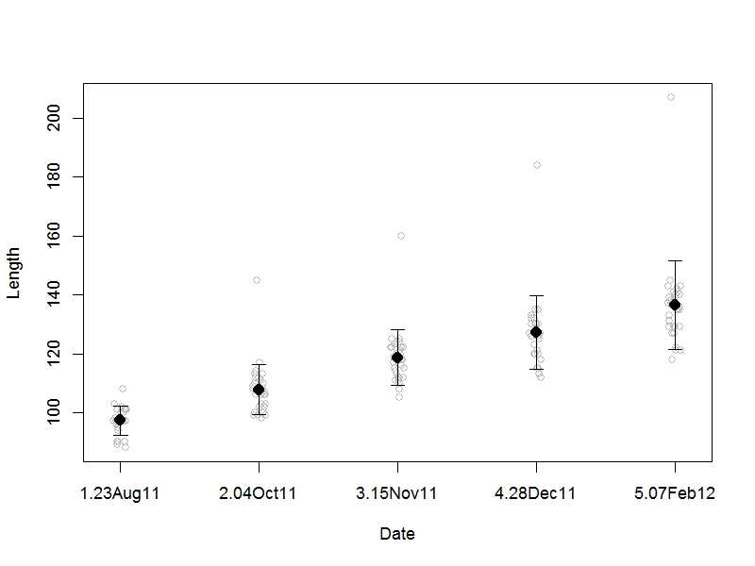
Figure S3.2.s - Length female offspring in Family_4

Slide 21
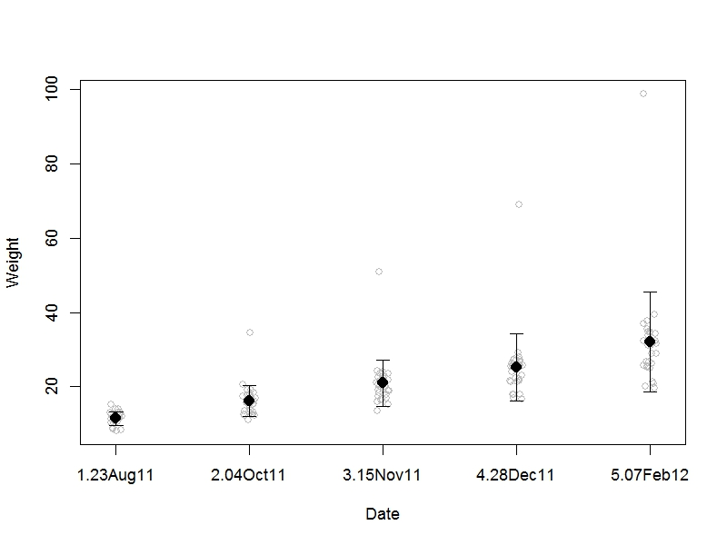
Figure S3.2.t - Weight for female offspring in Family_4

Slide 22
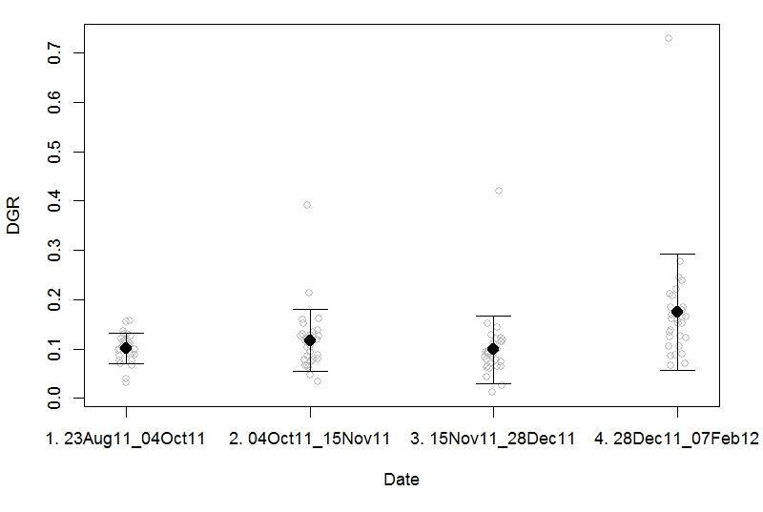
Figure S3.2.u - Daily growth rate Female offspring in Family_4

Slide 23
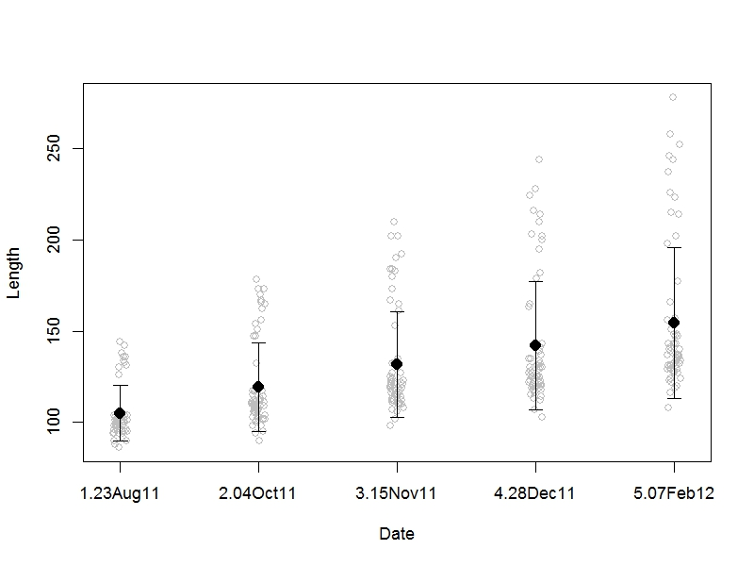
Figure S3.2.v - Length male offspring in Family_4

Slide 24
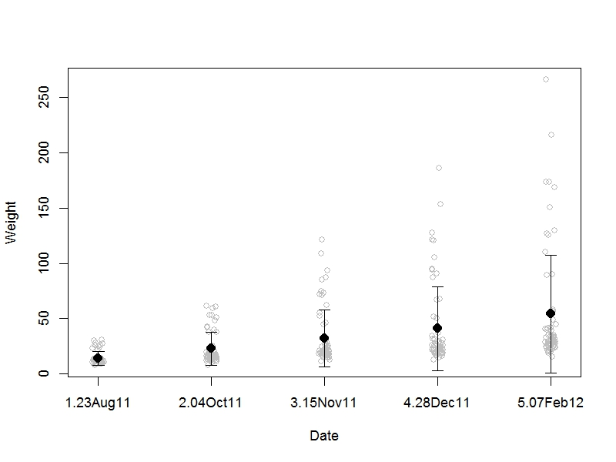
Figure S3.2.w - Weight for male offspring in Family_4

Slide 25
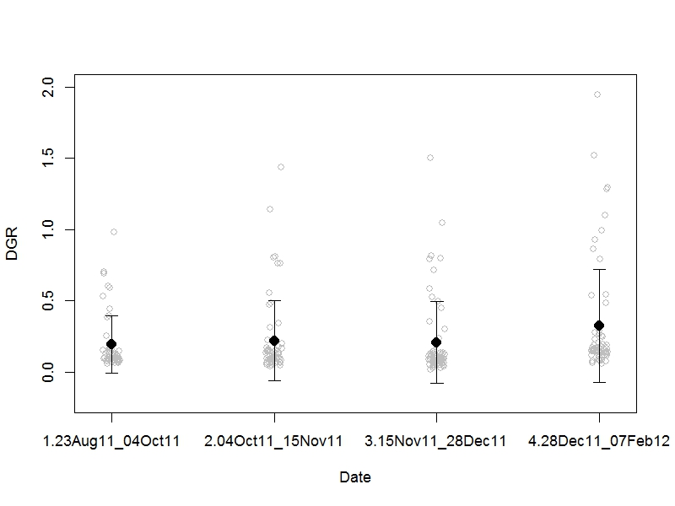
Figure S3.2.x - Daily growth rate for male offspring in Family_4

