Slide 1


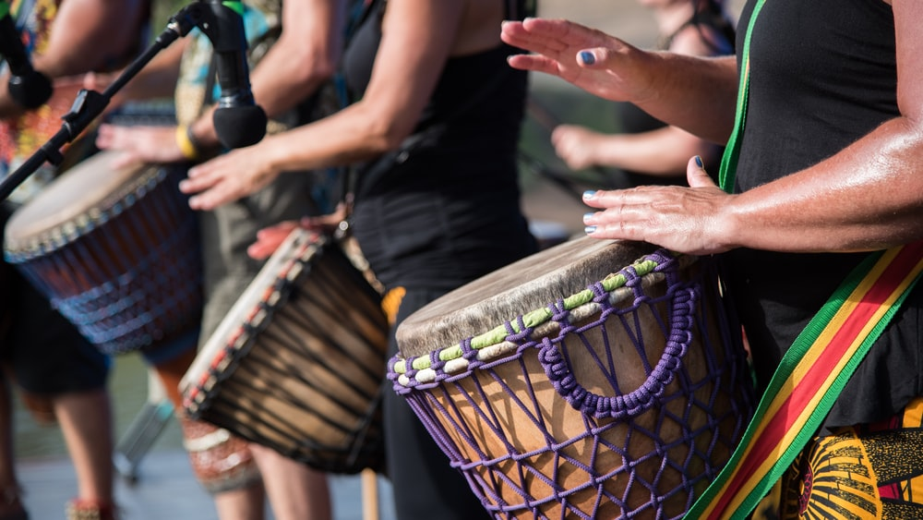
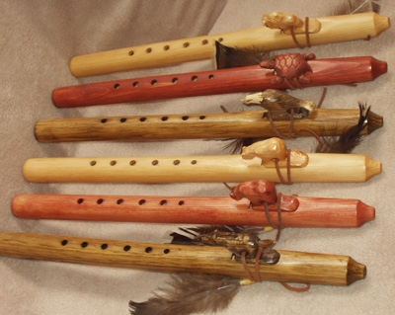
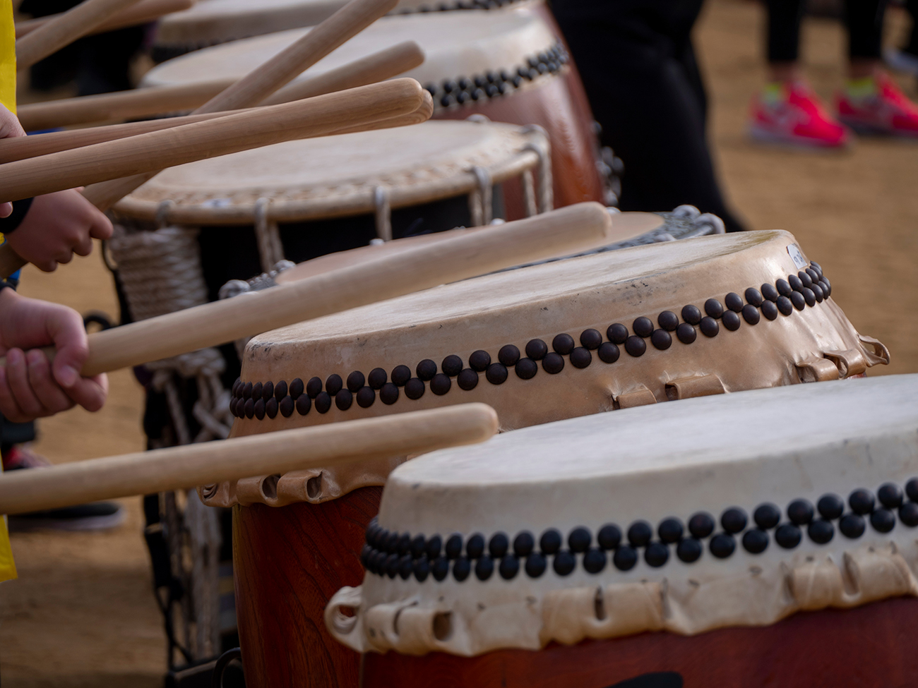

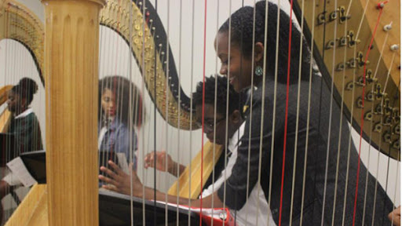
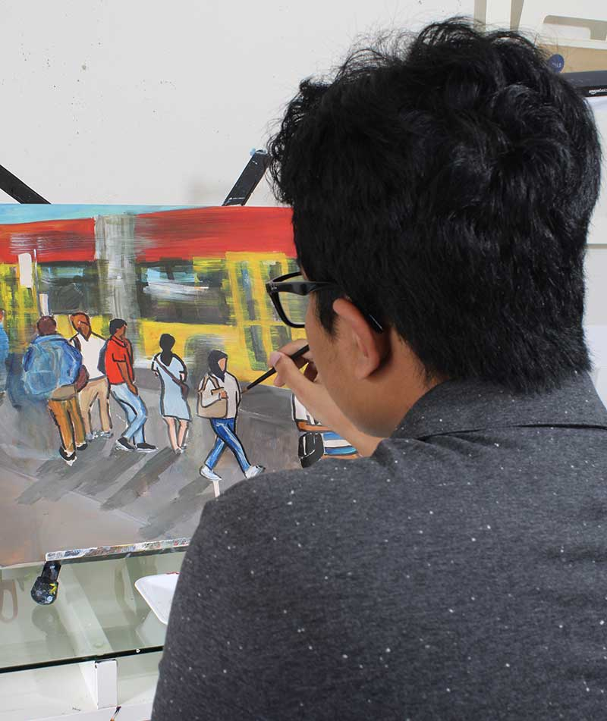
Square Pegs Community Arts on Campus
Needs Statement:
Neurodivergent Black, Indigenous, other university and college students of color, and all neurodivergent students, need social opportunities on campus to connect with each other and to feel included through creating art together.
Significance & Relevance:
Research shows that neurodivergent students want to belong, most notably during the current COVID-19 pandemic . The exclusion and isolation faced by Black, Indigenous, other neurodivergent students of color, and all neurodivergent students have resulted in loneliness, anxiety, depression, and suicidal ideation.
Intervention:
Step 1: University of Washington Tacoma students gather in virtual space through Zoom on Square Pegs Community Arts on Campus Meetup.
Step 2: The community facilitator starts with a check-in and an ice-breaker question, such as: what is your favorite sound on a summer evening? Then, the group facilitator begins with a welcome rhythm or a welcome song, and students may join in if they so choose.
Step 3: The group facilitator opens the main discussion by asking each member to share out about their favorite music and how it is meaningful for them. Then, an activity is introduced such as drum circle improvisation or sharing a favorite musical instrument.
Step 4: The group facilitator ends with a goodbye rhythm or song and invites everyone to sing along or add their own rhythm to the goodbye rhythm.
Goal Statement:
Neurodivergent university and college students will have a safe, judgement-free, sensory-friendly community space to socialize through music and other arts-based activities.
Objectives
Outcome 1: A comfortable, casual sensory-friendly space will exist for neurodivergent students on the UW Tacoma campus and remotely through Zoom on Meetup.
Indicator 1a:
DRS can book rooms for student events, students can book rooms, and Square Pegs Community Arts on Campus will be launched on the Meetup platform for online Zoom gatherings.
Indicator 1b:
UW Tacoma neurodivergent students approve of sensory-friendly accommodations.
Outcome 2: BIPOC neurodivergent students, including white neurodivergent students, at UWT will feel included, safe, and supported by each other and confident in expressing themselves and connecting socially through music and other arts-based activities.
Indicator 2a:
Positive feedback from UW Tacoma neurodivergent students through surveys or interviews.
Indicator 2b:
Interviews or surveys indicating student satisfaction before and after the intervention.
Gabrielle Marina Miller 2022 MSW Candidate University of Washington Tacoma gab2000@uw.edu

