Slide 1
Stress Management
Session One For SCS Program

Slide 2

What is Stress?

Slide 3
What is Stress?
Emotional, mental, and physical strain or tension.
A physical or psychological stimulus that can produce mental tension or physiological reactions that may lead to illness.
A physiologic reaction by an organism to an uncomfortable or unfamiliar physical or psychological stimulus. Biological changes result from stimulation of the sympathetic nervous system, including a heightened state of alertness, anxiety, increased heart rate, and sweating.
To suffer annoyance; to experience stress.

Slide 4
How stress can effect the brain
http://www.youtube.com/watch?v=OHl7BewJ0yU

Slide 5
How stress can effect the body
http://www.youtube.com/watch?v=iplbkK5hH_k

Slide 6
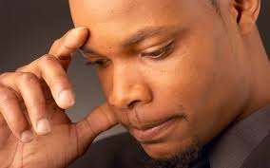
When do you know you are stressed?

Slide 7
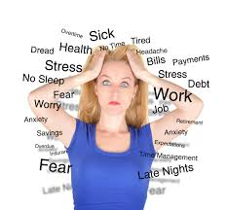

Slide 8
How do you know your emotions?

Slide 9
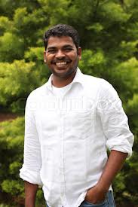
How is he feeling?

Slide 10
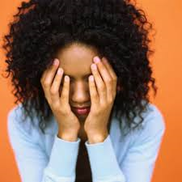
How does she feel?

Slide 11
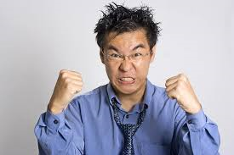
How is he feeling?

Slide 12

How is she feeling?

Slide 13
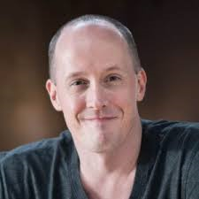
How is he feeling?

Slide 14
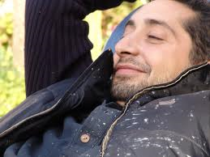
What is content?
Satisfied with what one is or has; not wanting more or anything else.

Slide 15
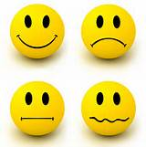
Know Your Emotions

Slide 16
How do you negatively deal with stress?

Slide 17
Negative Ways to Cope with Stress
Negative self talk
Putting self down
Isolation for long periods of time
Hitting self
Cutting self
Anorexia
Bulimia
Bullying
Name calling
Fighting
Doing Drugs
  Alcohol
  Cigarettes
  Marijuana
  Other illicit drugs
Sexual promiscuity
Expecting people to make you feel better
Emotional outburst of yelling, screaming, or physical violence

Slide 18
How do you positively cope with stress?

Slide 19
Positive Ways to Cope with Stress
Exercise
Journaling
Watch a funny movie
Organize your room
Play with your dog
Talk to a friend that you trust
Talk to a counselor
Talk to an adult you trust
Know that the situation is temporary
Focus on solution
Tell yourself 7 positive things that are going on in your life
Write a story and/or poem
Go out into nature
Deep breathing
Meditation
Go into natural setting
Listen to calming music
Go for a bike ride
Go swimming or boating

Slide 20
What does it mean to dwell on a situation?

Slide 21
Dwell Definition
to live or stay as a permanent resident; reside.
to live or continue in a given condition or state: to dwell in happiness.
to linger over, emphasize, or ponder in thought, speech, or writing (often followed by on or upon ): to dwell on a particular point in an argument.
(of a moving tool or machine part) to be motionless for a certain interval during operation.
Do you want to Dwell in negative stress?

Slide 22
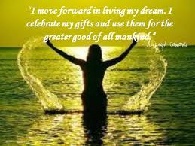

Slide 23
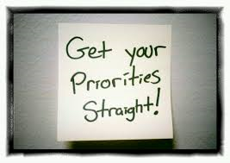
How to set priorities

Slide 24
Setting priorities
Step 1: Write down the list of things that you need to accomplish
Step 2: Ask yourself:
  What will benefit my life and situation
  What time constraints do you have
  Note: Sometime depending on time, harder priorities a nice to get done first
Step 3: Number your list- 1 being most important
Step 4: Reward yourself for your accomplishments

Slide 25
But how can stress be important…

Slide 26
Importance of Stress
http://www.youtube.com/watch?v=MXHQAqUJC6c

