Slide 1
Key components of Collaboration in Higher Education Buildings: a case study of Stakeholder Engagement at the University of Washington
Presented by: Committee:
Achaiah Ramesh Malachira Dr. Carrie Sturts Dossick
Dr. William Bender

Slide 2

Agenda
Literature Review
Research Question
Methodology
Data Analysis
Summary and Future research

Slide 3
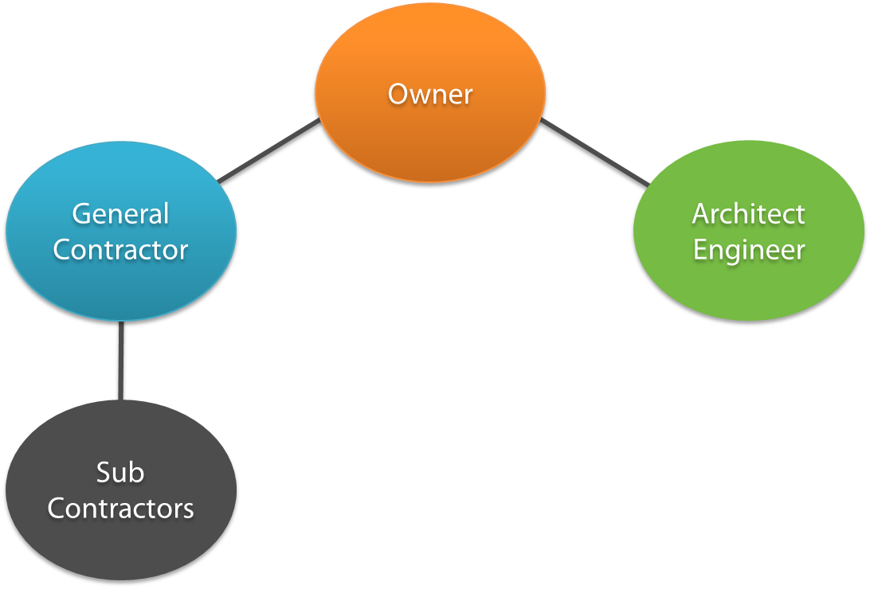
Project Delivery Methods
Design-Bid-Build
Traditional, hard bids
Lowest bidder wins the tender
No scope for fast-tracking and value engineering
Design-Build
Single contract between owner and Design-Builder
Fast tracking is a characteristic feature
There is scope for value engineering
General Contractor/Construction Manager (GC/CM)
Selected on the basis of qualifications, experience or best value
GC brought on early in design to provide constructability review
There is scope for value engineering

Slide 4
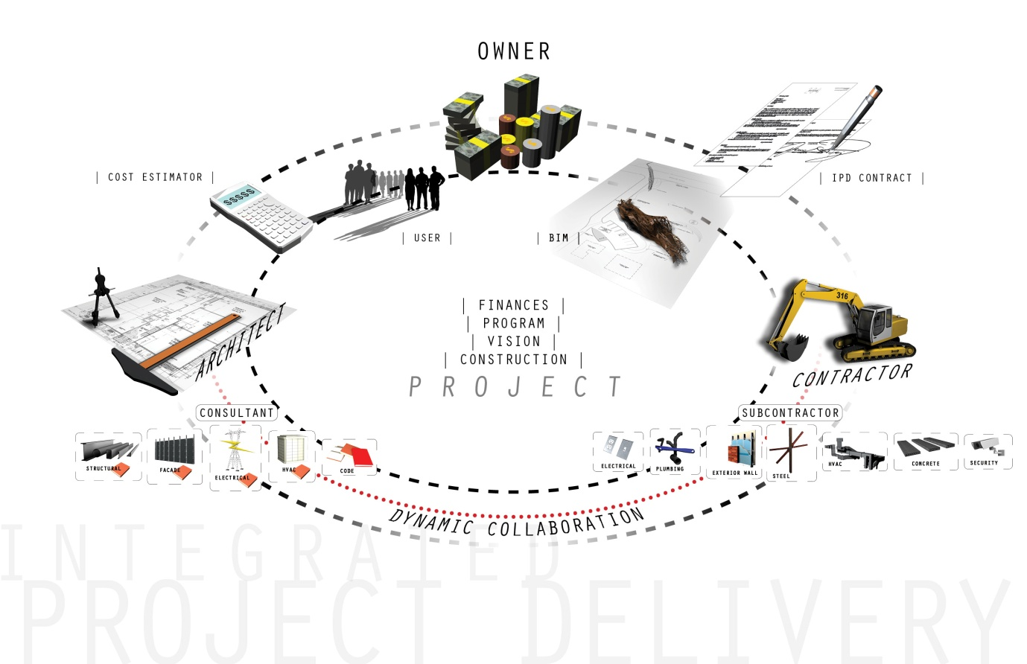
Integrated Project Delivery
One Integrated Agreement
Shared Risk and Reward
Dispute and Liability avoidance
Joint Decision making
Collaboration
Stakeholder Engagement!!!
Figure 1: Pictorial representation of Integrated Project Delivery (http://www.archdaily.com/153953/integrated-project-delivery-methodology#_=_ /Accessed 1/16/2017 at 2:46 pm)

Slide 5
Stakeholder Engagement
Key Components of Stakeholder Engagement
Stakeholder Identification & Analysis
Stakeholder Consultation
Information Disclosure
Stakeholder Involvement in Project Monitoring
Grievance Management
Stakeholder Reporting
Figure 2: Key components of Stakeholder Engagement (Stakeholder Engagement, IFC Handbook 2007)

Slide 6
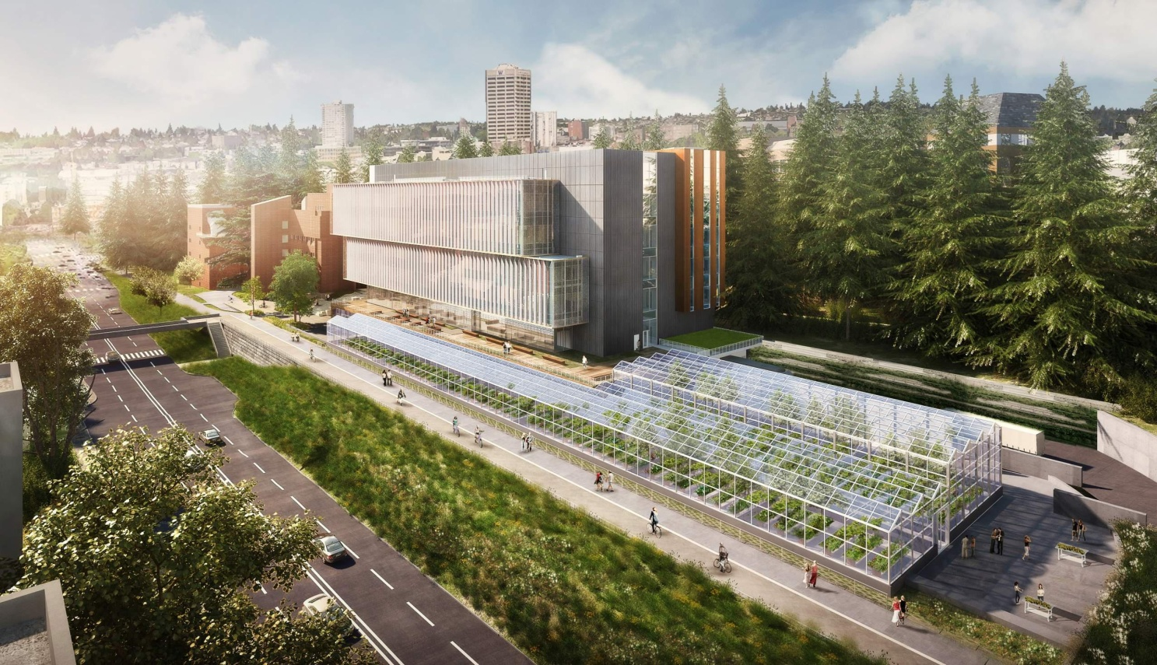
Project Overview
Life Sciences Building (LSB)
Research & Institutional space for the Department of Biology
G+5 structure plus Mechanical Penthouse &two stories below grade (B1 & B2)
B1 & B2 house growth chambers and other research facilities
167,700 gsf LSB with 20,000 gsf Greenhouse
GC/CM type project delivery method implemented
Figure 3: Final rendering of the Life Sciences Building Project currently being constructed on the University of Washington, Seattle campus

Slide 7

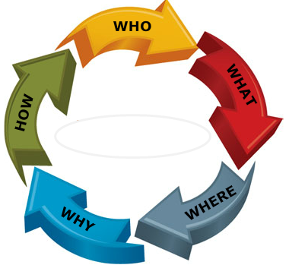
Research Question?
How do the key components of Stakeholder Engagement play out and aid collaboration in Higher Education Buildings?

Slide 8

Methodology

Slide 9

Data Sources
UW/WSU Capital Cost Initiative Conference notes
Joint initiative by the University of Washington & Washington State University
Held on 24th October, 2016
Construction industry’s best minds were part of the speakers that attended
Main topic was centered around University buildings construction
Core themes included :
  What we build : Programming, Planning & Design
  How we Build : Teaming
  How we Build : Fostering Innovation

Slide 10
Data Sources
Personal Interviews
The Stakeholders that were interviewed are:
SUMMARY OF INTERVIEWEES
Construction Manager (CPD) | 1
General Contractor | 1
Designer | 1
Building End User Representative | 1
Commissioning Agent | 1
Building Envelope Consultant | 1
Total Interviewees | 6

Slide 11
Data Collection Tool
Interview Questionnaire

Slide 12
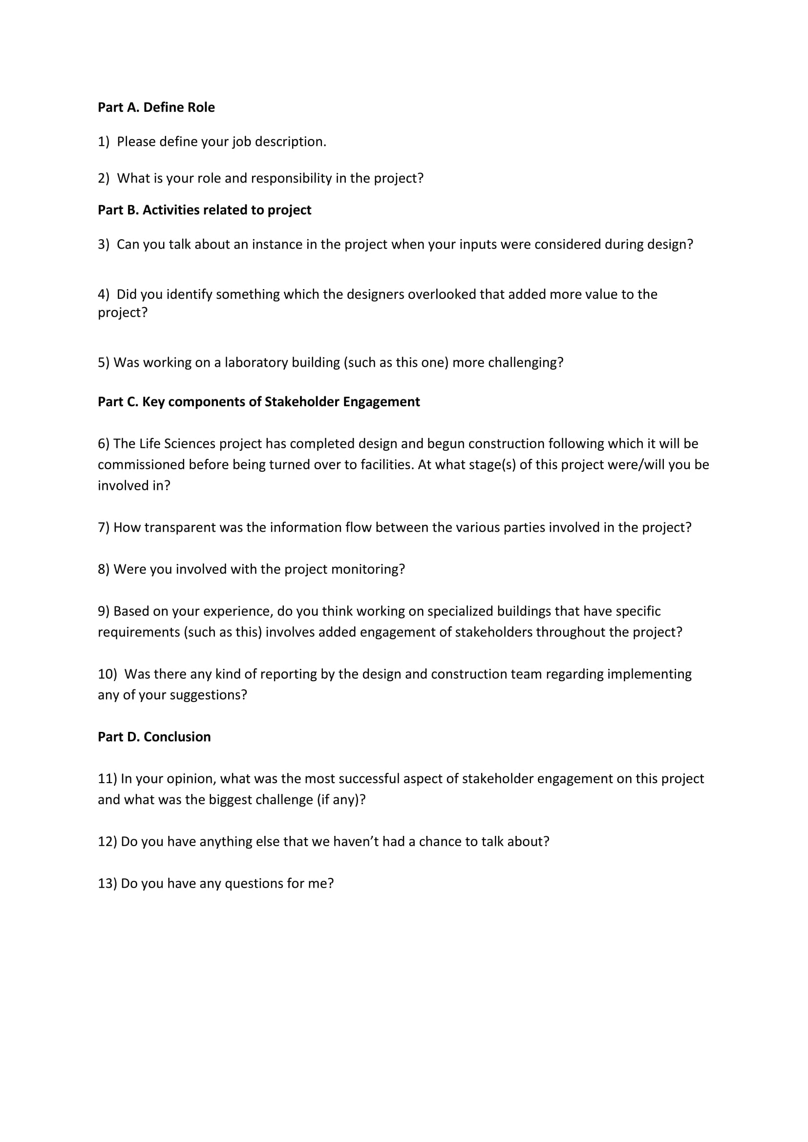
Figure 6: Interview questionnaire used for the research

Slide 13

Data Analysis

Slide 14
Data Analysis (Conference notes)
Notes were taken down as the various speakers voiced their opinions
The Conference notes were analyzed to determine if there was a similarity with the LSB project
Notes from 5 different note takers were analyzed
A truth table was prepared to identify the important criteria for collaboration as far as university buildings construction was concerned
Green dot indicates high popularity & importance of that criteria
Red dot indicates no importance according to the various conference speakers

Slide 15
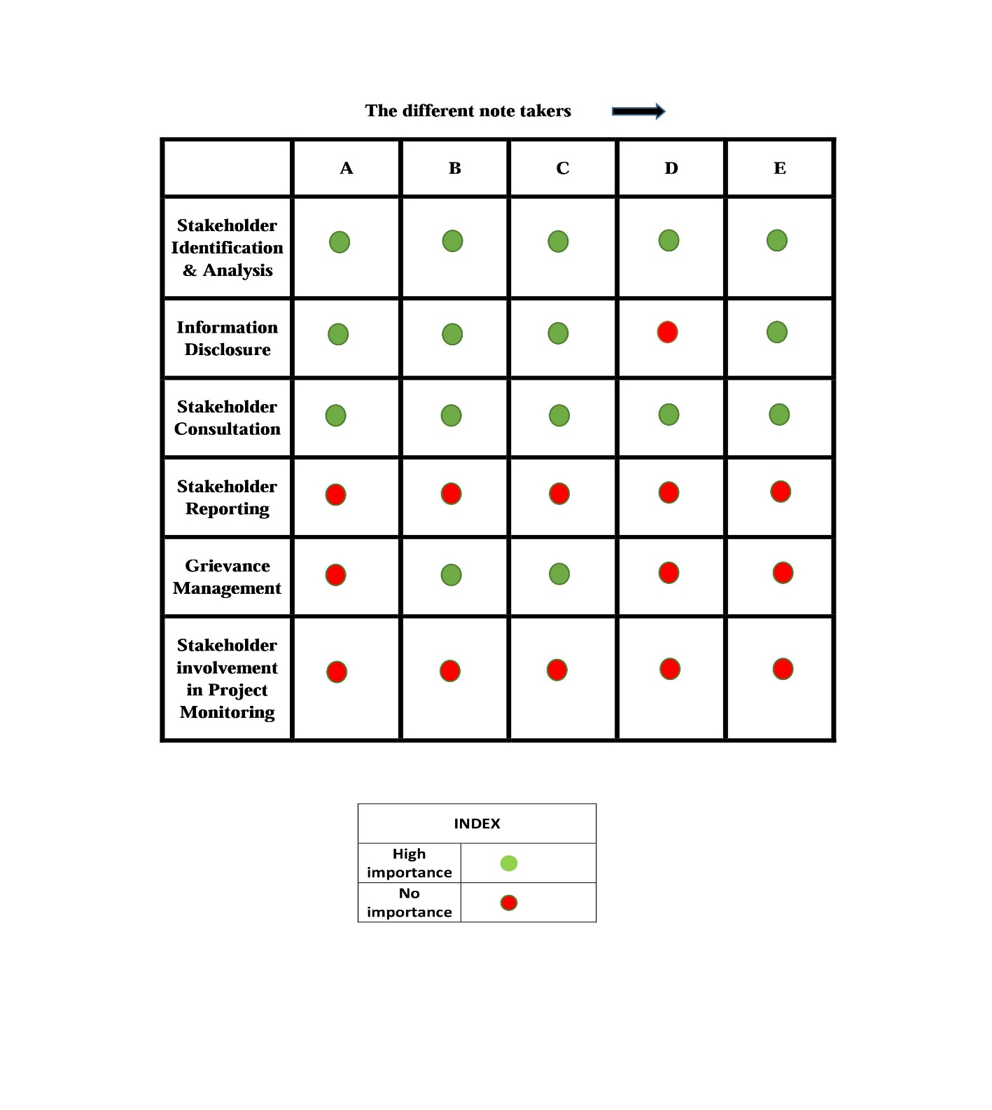
Truth table indicating important criteria as far as the University buildings construction was concerned

Slide 16

Data Analysis (Personal Interviews)
Key stakeholders on the LSB project were identified and contacted
A consent form was signed prior to interviews as part of the protocol
The interviews were mostly conducted on the UW campus
Key components used as critical identifiers on LSB project
Recordings were transcribed & analyzed
Components were scored on a scale from 0 to 5
Data was depicted graphically to get a clear picture
Truth table prepared to reinforce graphical findings

Slide 17
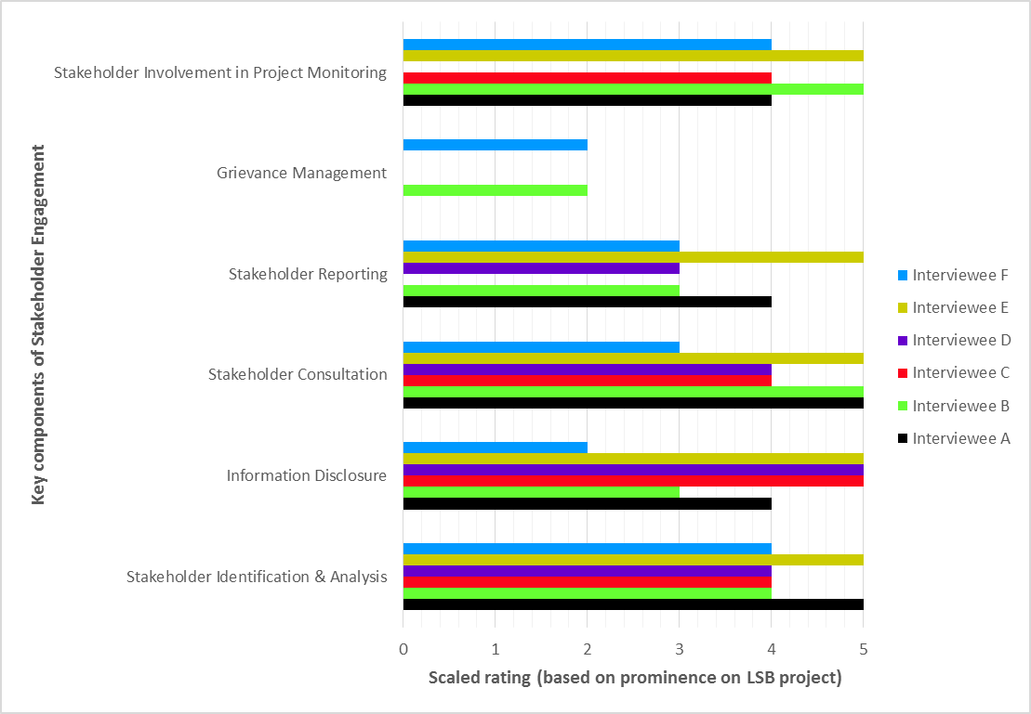
Figure 7: Graphical representation of interview data

Slide 18
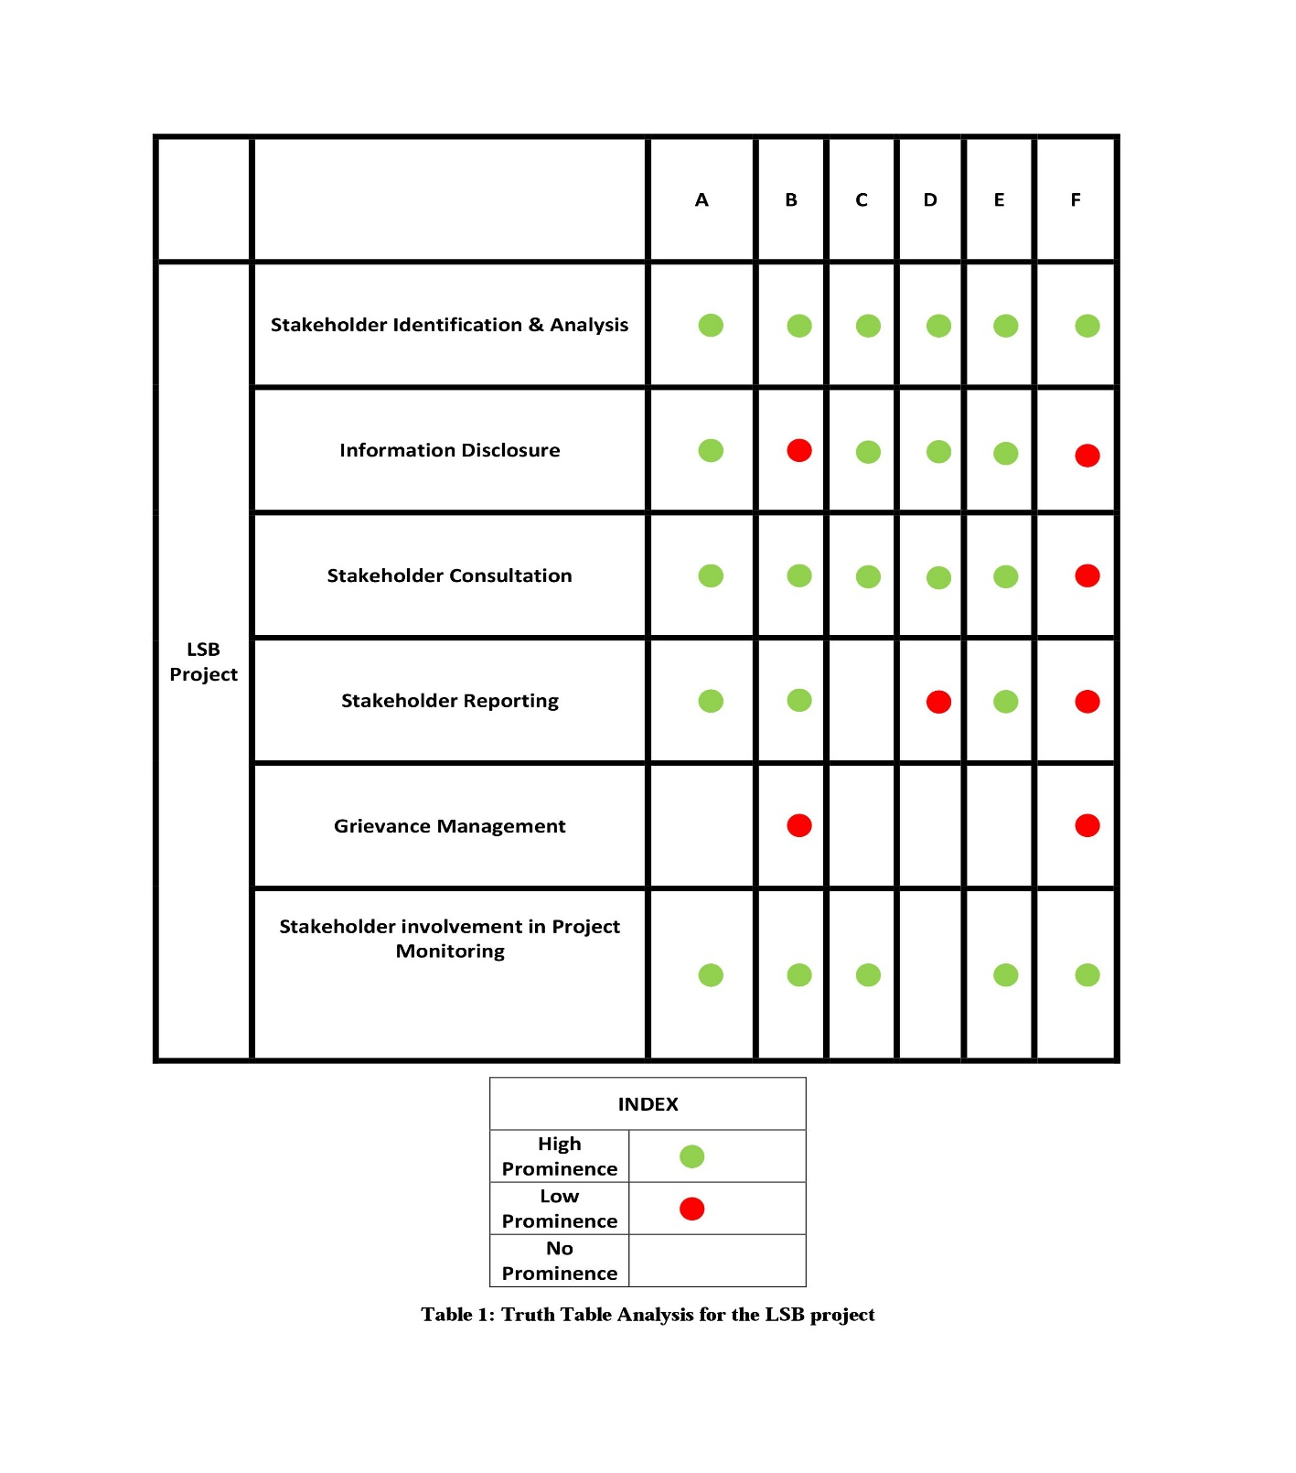
Truth table indicating prominence of each component as per Stakeholders on the LSB project

Slide 19
Similarities?
Capital Cost Initiative Conference notes
Stakeholder Identification & Analysis
Stakeholder Consultation
Information Disclosure/ Transparency
Grievance Management
Stakeholder Involvement in Project Monitoring
Personal Interviews on Life Sciences Building project
Stakeholder Identification & Analysis
Stakeholder Consultation
Information Disclosure/ Transparency
Grievance Management
Stakeholder Involvement in Project Monitoring
Reporting to Stakeholders

Slide 20
Quotes
“I’d say this was a very successful project and it was clear from the beginning that there was one point of contact from the University who was from the user’s side. Everything funneled through him and he managed all activities and from our side it helped a lot because we could just feed things to him and he was that funnel.”
“The GC came on board during SD phase, the mechanical and electrical sub came on during the late DD phase or early CD phase which proved to be invaluable. I’ve never worked on a project where you get your primary subs involved, helping make decisions and actually a lot of the drawings which involved a lot of detailing on the mechanical side was done by them which was incredible and that was a new setup for me.”
“Trying to incorporate all of those infra into those tiny spaces was very challenging and by the mechanical sub’s drawing and involvement early, we were able to do the co-ordination without much hassle. We still do the co-ordination with our BIM model and run clash detections to see in anyone’s scope interfere with each other and sort it out accordingly. That alone has saved us tons of RFIs.”

Slide 21
Quotes
“The most successful part was the AE team puts together their program in the early stages of design so they usually meet with the major stakeholders to get a general sense of what this building is going to be and that is supposed to translate into this Basis of Design document we spoke about earlier.”
“Information was not provided as clearly or as thoroughly and time to consider and weigh the pros and cons clearly as we moved forward wasn’t considered.”
“I would say not quite as transparent as some of the other projects I have been involved in here at the UW. I’ve been involved in projects where I have been asked to be in quite a few meetings but other projects such as this it is more of design-assist sort of a role I have. But that being said, it is a pretty open group and most of the UW projects are pretty transparent by nature.”
“We meet weekly, we call it our OAC meeting and then we report out of that. So we provide a schedule update of direct activities. Early on we did a lot of pull planning with the design team to determine where we needed to have certain design complete so that we can have permit drawings to go into the city.”

Slide 22
Conclusion & Future Scope
Implementation & strict adherence of some of the key components of Stakeholder Engagement has contributed to project success so far
Early engagement of peripheral stakeholders has made working on a complex project involving multiple stakeholders relatively smoother
Data from interviewing the stakeholders suggest that implementing these components has contributed to significant reduction in RFIs, increased team bond and added value to the project
Advantages of implementing the various components of Stakeholder Engagement cannot be justified through a single project and a limited sample space of interviewees
A more thorough comparative analysis involving multiple projects would provide the platform for validating the hypothesis

Slide 23

Thank You

