Slide 1
Self-Confidence
Session 7 For SCS Program

Slide 2
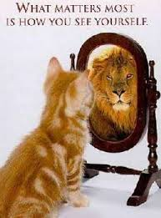
What is self-confidence
realistic confidence in one's own judgment, ability, power.
assurance, self-possession, self-respect, and self-esteem

Slide 3
Understanding the self
Who knows themselves?
What do you know about yourself?
What makes you upset?
What makes you happy?
What makes you cry?
What makes you have inspiration?
What are your strengths?
What do you need to work on?
Do you know?

Slide 4
Teen advice on building self-confidence
http://www.youtube.com/watch?v=Xno6m8H-sMQ

Slide 5
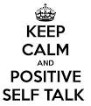
How to reflect positively toward self
First remember: Everyone has strengths and weaknesses
Be your unique self
Find out what you are good at and need to work harder at
Forgiveness is important but boundaries are too!
Mistakes are apart of life but some mistakes can follow you for life
If you make a mistake take that time to find the lesson and how you can improve

Slide 6
How to create a good habit
http://www.youtube.com/watch?v=OAFpEfexkZw
Step 1: Make a decision
Step 2: never allow an exception
Step 3: tell others
Step 4: visualize the new habit
Step 5: create affirmation
Step 6: resolve to persist to the behavior
Step 7: reward yourself for new behavior

Slide 7

Affirmations
Step 1: know what you want to believe or improve on
Step 2: grab post-its
Step 3: write simple note Ex: “I am… beautiful, loving, kind” (write one on each post-it note)
Step 4: place note somewhere you will see everyday (mirror in bathroom, on bedroom door, in locker)
Step 5: say out loud what the post-it says and say with belief

Slide 8
Inspiring story
http://www.youtube.com/watch?v=Gc4HGQHgeFE

Slide 9
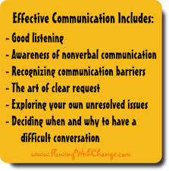
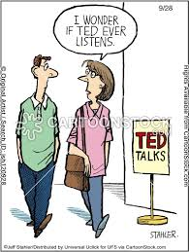
Effective communication
Make sure when communicating, you repeat back information to make sure you heard them correctly to avoid misunderstanding

Slide 10
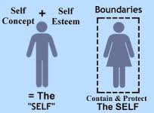
Boundaries
Boundaries are set in order to help yourself not become effected by others negative thoughts, attitudes, or behaviors
At times, we have to even set boundaries with our families and friends when they behave in a way that is harmful to your development
Be patient and do not try to control others and their decisions but control yourself, your behaviors, and your reactions

Slide 11
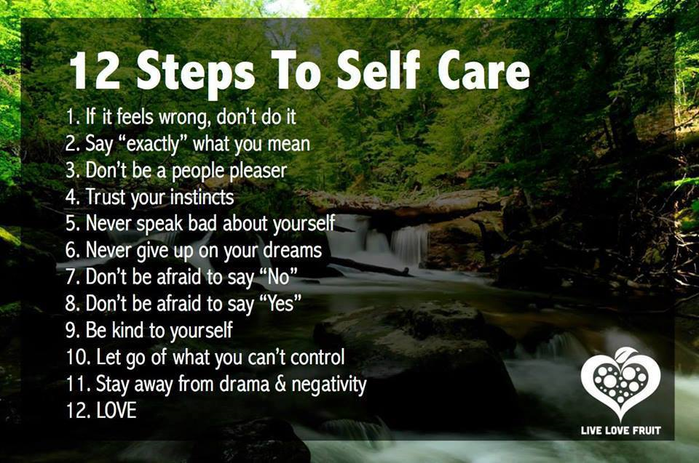
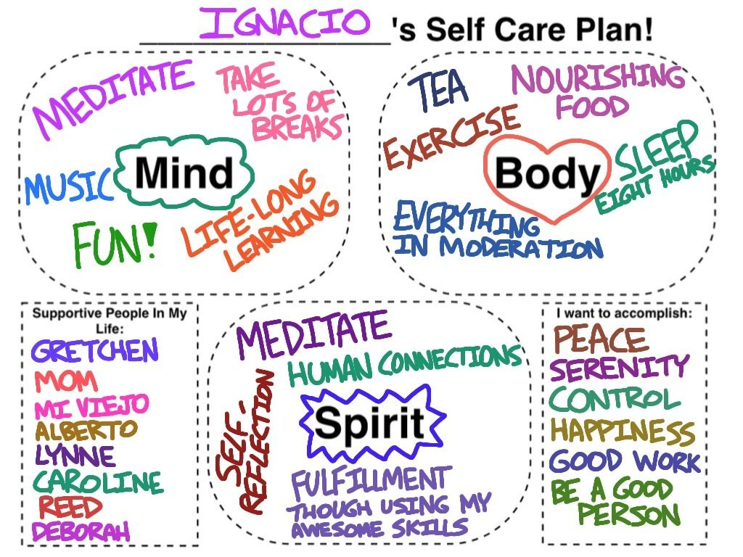
Self care
Self care is a way to balance responsibilities and leisure time

