Slide 1

Open Data Challenges in the Public Library Domain
Bree Norlander | norlab@uw.edu
Chris Jowaisas | chrisjow@uw.edu

Slide 2


Who we are and how we got here
Funded by a grant from the Institute of Museum and Library Services LG-246255-OLS-20
Using Open Data to Inform Public Library Branch Services
Karalyn Rose Ostler, Bree Norlander, Nic Weber
https://doi.org/10.1080/01616846.2020.1798206
Open data is data that can be freely used, re-used and redistributed by anyone - subject only, at most, to the requirement to attribute and sharealike.
http://opendatahandbook.org/guide/en/what-is-open-data/

Slide 3
Community
Beardsley Library volunteer, Remy, is preparing a deery bag.
Audience question:
When you hear the word community, what picture do you draw in your mind? Do you think of a physical space, a group of people, or some other feature to define it?

Slide 4
Community
“...what I'm going to tell the City Council who provides the bulk of our funding is different than what I'm going to tell the County Commissioners.” - Workshop Participant

Slide 5
Community
Beardsley Library volunteer, Remy, is preparing a deery bag.
CHALLENGES
Lots of component parts
Doesn’t necessarily align with legal definition
OPPORTUNITIES
Location data in the PLS
  Flexibility (to some degree)
https://www.imls.gov/research-evaluation/data-collection/public-libraries-survey

Slide 6
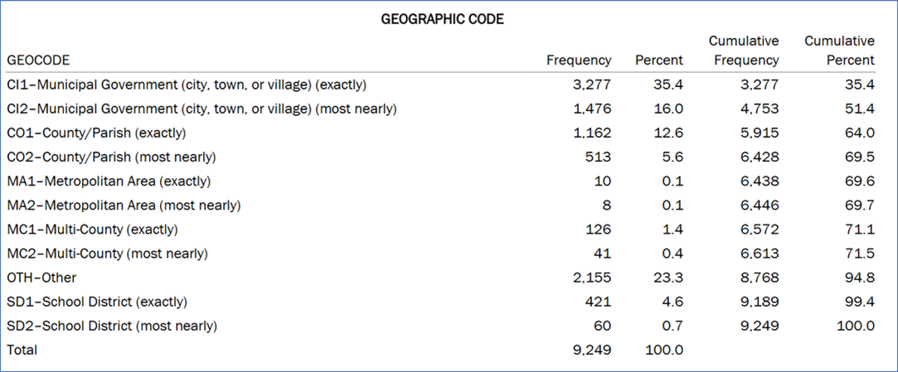
Community
Beardsley Library volunteer, Remy, is preparing a deery bag.

Slide 7
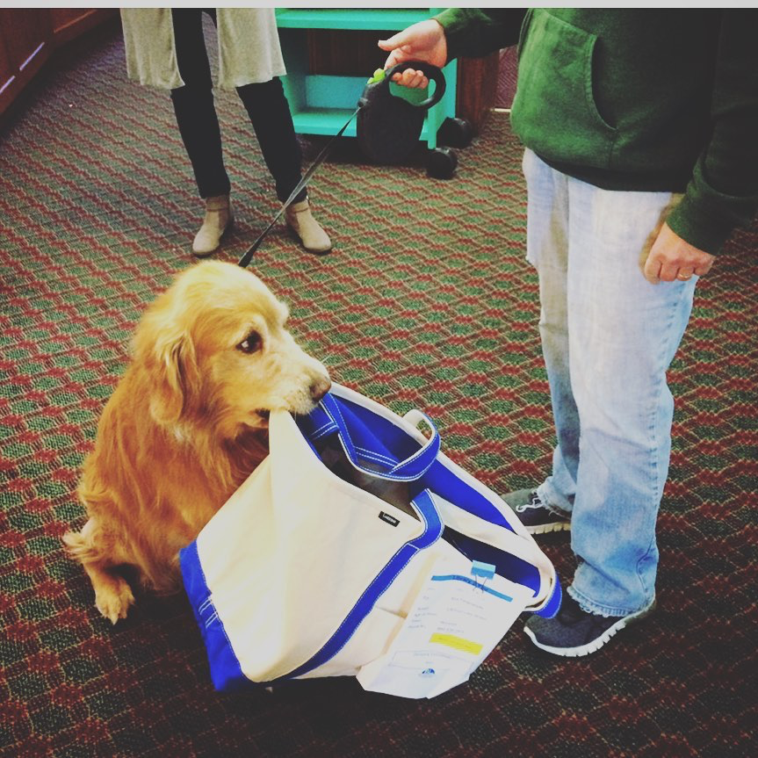
Peers
Beardsley Library volunteer, Remy, is preparing a delivery bag.
What would make another library branch a peer?

Slide 8
Peers
Library
(e.g . IMLS PLS)
Community
(e.g . census)
Square footage
Population
Patrons
Operating Budget
Demographics
Programs/Services
Staffing
Assets

Slide 9
Peers
How many full time librarians do peer libraries employ?
What are the most popular children’s programs at a peer library?
What MakerSpace assets are most useful in a town like mine?
What library programming has helped residents access healthcare in similar cities?
Is my circulation decreasing at the same rate as similar community libraries?
In other communities do the libraries offer social worker services?
Are similar libraries as busy at 5pm on Friday as mine?

Slide 10
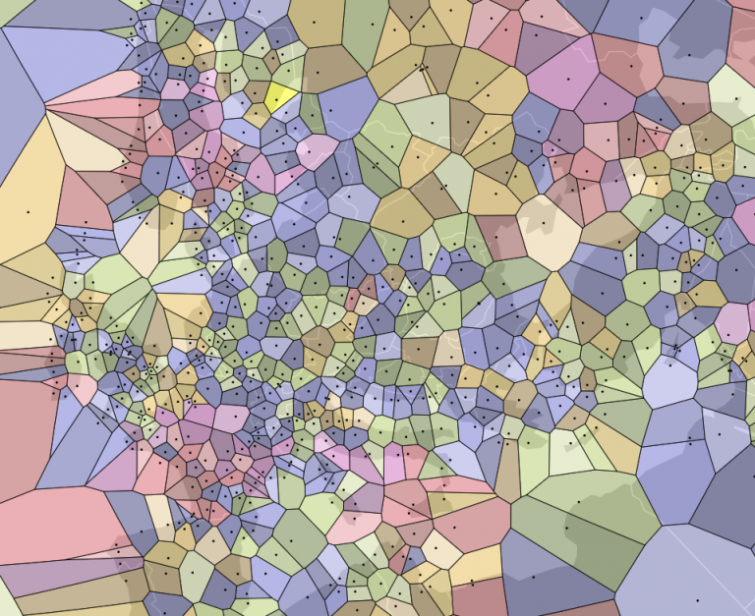
Peers
Image credit: https://ubique.americangeo.org/map-of-the-week/map-of-the-week-voronoi-diagrams-in-geography/

Slide 11
Peers
CHALLENGES
Will a combination of library data and community data build the best peer groups?
What are the geographical boundaries of a library community?
OPPORTUNITIES
Test iterations of peer groups in collaboration with libraries
Build comparison tools

Slide 12
Open Data
Question for the audience:
What is your rank in using open data to answer questions about your community? Choose from the following ranks:
Newbie
Semi-experienced
Experienced
Expert
Open data is data that can be freely used, re-used and redistributed by anyone - subject only, at most, to the requirement to attribute and sharealike.
http://opendatahandbook.org/guide/en/what-is-open-data/

Slide 13
Answering questions with
Open Data
Employment
How many people in the community are underemployed and unemployed vs employed?
What types of employment exist in the community?
What workforce development resources/organizations are available in the community?
What do people identify as personal barriers to employment?
What shifts are people working? (When do people have free time?)
What new industries are coming into the community and/or growing?
What languages should programs/services be offered in?
Are we (the library) reaching the people in most need of employment resources and services?
Children/Youth & Education
What capacity level do parents have to engage in their children’s education?
How many students are bilingual? What bilingual education environments exist?
What is the status of digital access for children, especially when faced with the challenge of switching to a virtual learning environment?
How did the lack of access to school lunches affect children (during the pandemic)?
How many children are unhoused?
How many children serve as language interpreters for their families?
What opportunities exist for youth - volunteer, service learning, place-based learning?
What after-school or out-of-school time programs exist in the area?
Health
What is the health profile of the community and are we providing programs that fit that need?
Who does not have health insurance?
Are there healthcare deserts in my service area where it is difficult to access health services?
Is local healthcare affordable?
How many community members are homebound?
How many community members need mental health care and are they being supported and given the resources they need?
Are the health needs of those experiencing homelessness being met?
What are the changes in number of people needing mental or emotional care?

Slide 14
Open Data
CHALLENGES
Finding it
Different scales of data
Uneven coverage
Currency
Accuracy
OPPORTUNITIES
Improving Findability
Data Pre-Processing
Storytelling
Finding Outliers

Slide 15
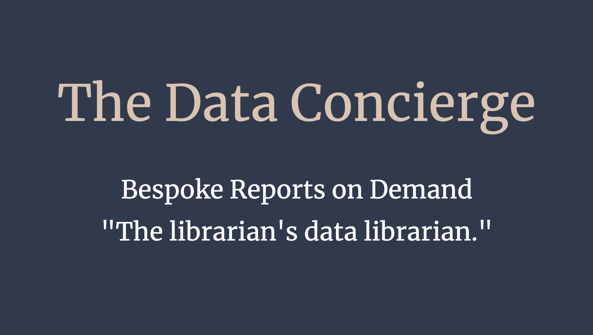

Conclusion
What we heard:
Flexibility in Defining Community
Information/Data: Easy to Use

Slide 16

Questions/Thoughts?
How do you see any work that you have done intersecting with this work?
Have the observations we have shared about this work generated any thoughts on your side about your research, classes, or work in a library?
Bree Norlander | norlab@uw.edu
Chris Jowaisas | chrisjow@uw.edu

