Slide 1

Using GIS to Support Reentry Planning for Youth Exiting the Juvenile Justice System
Ellie Albertson, MPHc
Department of Health Services
UW School of Public Health
May 2018

Slide 2
“We’re gonna tell you a bunch of stories about young people who are not innocent, and yet depending on their ZIP Code, or skin color, or just plain luck they face very different consequences for their guilt.”
- Caught, a podcast from WNYC Studios

Slide 3
Overview of Presentation
Background
Juvenile Justice System
Youth Reentry
Methods
Study Questions
GIS Data and Methods
Findings
Maps of Results
Policy Implications

Slide 4
Background
Juvenile Justice System
Courts
Jails and Prisons
Parole Services
Education and Training
Health Care
Social Services

Slide 5
Background
Number of youth incarcerated on any given day
48,000 nationally
1,000 in Washington State (all facilities)
500 in Washington State Juvenile Rehabilitation facilities (DSHS)

Slide 6
Background

Slide 7
Background
Reentry Services
Incarceration
Transition Back Into Community
Life In Community

Slide 8
Background
Successful Youth Reentry
Access to Services
Staff Support
Youth Buy-In
Social and Family Support

Slide 9
Background
Access to Services
Financial Access
Provider Capacity
Geographic Proximity
Legal Access (Felonies)
Socio-Cultural Fit

Slide 10
Methods
Study questions
1. Where are youth with behavioral health conditions reentering after incarceration?
2. Where do youth have most and least geographic access to behavioral health facilities after reentry?

Slide 11
Methods
Data sources
Youth location: Home ZIP Code from administrative records for youth released in 2016 and 2017
Facility location: Address from Washington State DSHS Directory of Certified Behavioral Health Services
Other: Boundary shapefiles including ZIP Code Tabulation Areas (ZCTAs) from U.S. Census and WA OFM

Slide 12
Methods
Descriptive Choropleth Maps
Number of Youth by ZCTA
Number of Facilities by ZCTA
Geographic Proximity Analysis
Youth Geocoded to Geographic ZCTA Center
Youth Geocoded to Population-Weighted ZCTA Center

Slide 13
Methods
Descriptive Choropleth Maps
Number of Youth by ZCTA
Number of Facilities by ZCTA
Geographic Proximity Analysis
Youth Geocoded to Geographic ZCTA Center
Youth Geocoded to Population-Weighted ZCTA Center

Slide 14
Findings*
Overview of key findings
1. Youth proximity to behavioral health services after reentry varies across the state
2. Descriptive maps are an effective tool for identifying potential priority areas for investing in behavioral health services for this population
*Findings are preliminary and will be finalized by June 1, 2018.

Slide 15
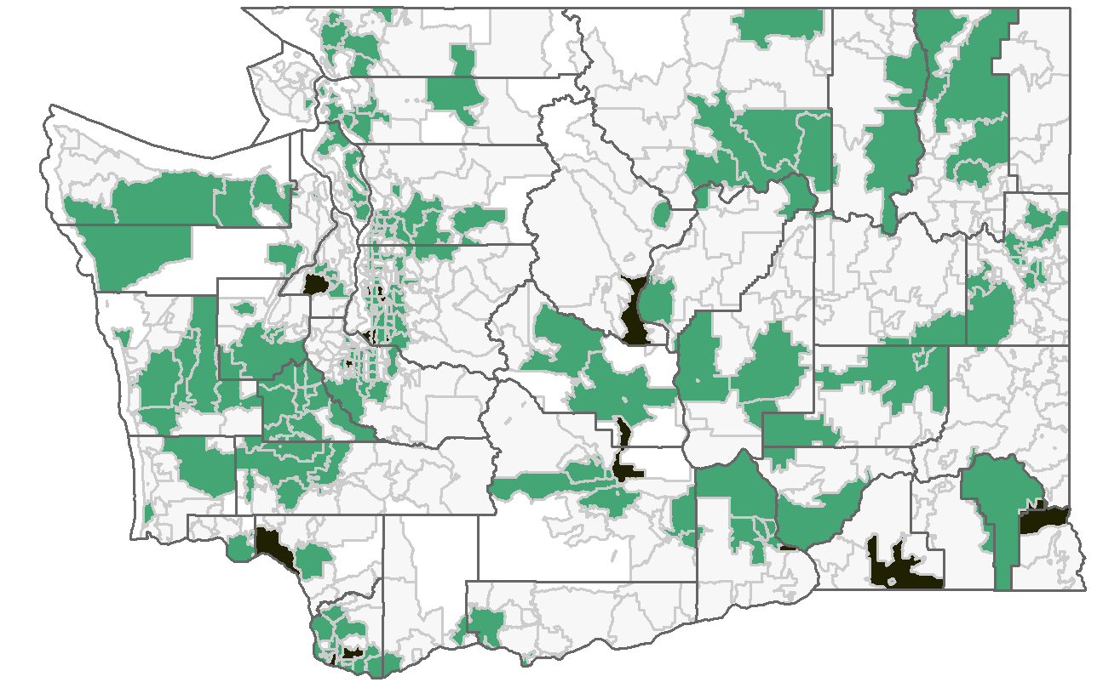
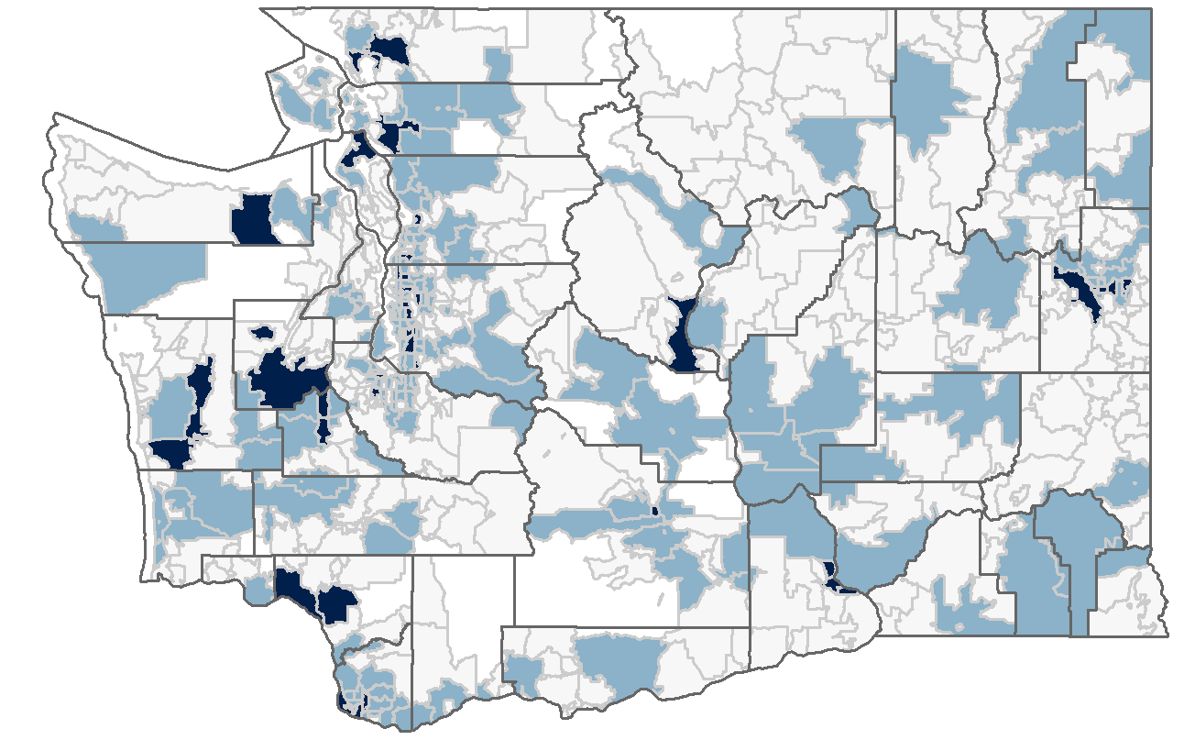
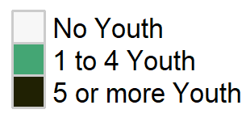
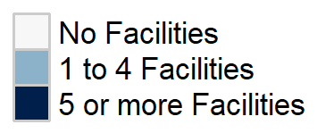
Findings*
Mental Health
Number of Youth with History of Diagnosis | Number of State-Registered Facilities Providing Services
*Findings are preliminary and will be finalized by June 1, 2018.

Slide 16
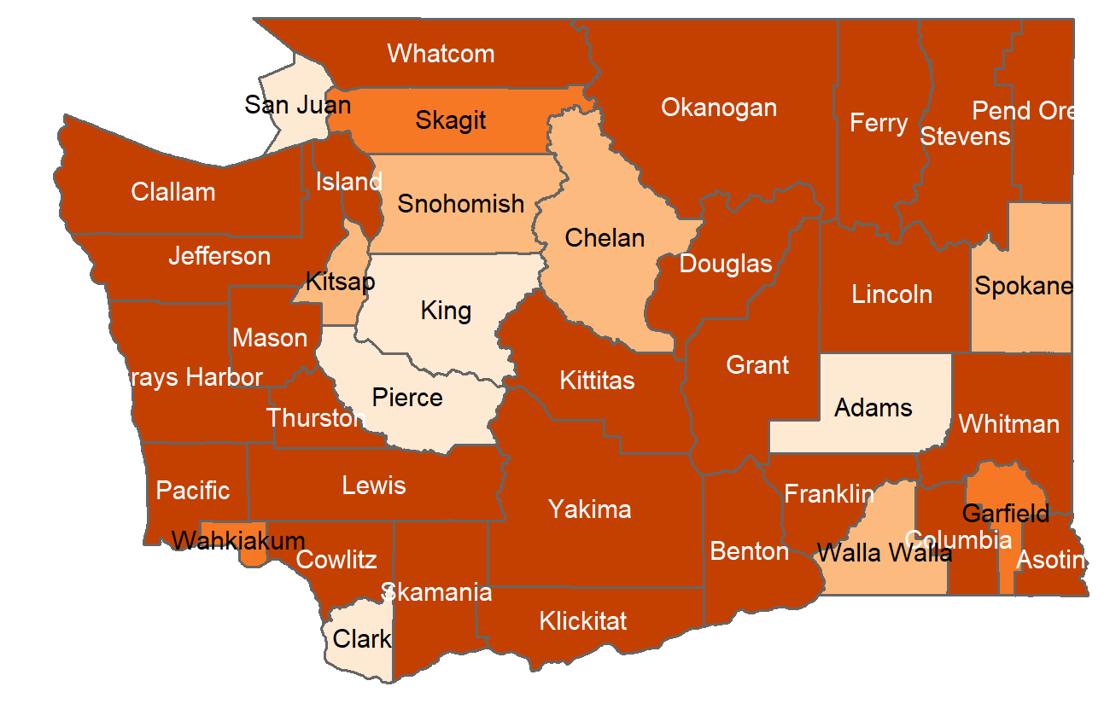
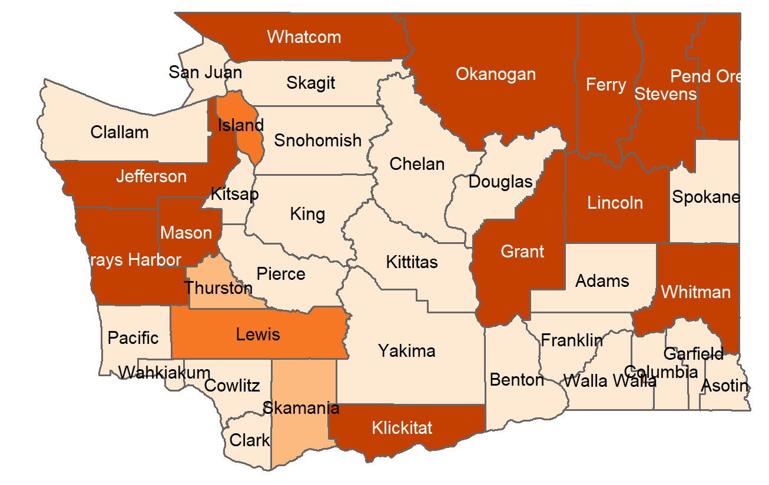
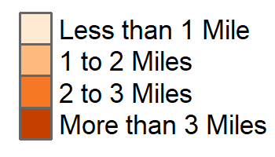
Findings*
Mean Youth Distance to Mental Health Facility
Youth Geocoded to ZCTA Geographic Center | Youth Geocoded to ZCTA Population-Weighted Center
*Findings are preliminary and will be finalized by June 1, 2018.

Slide 17

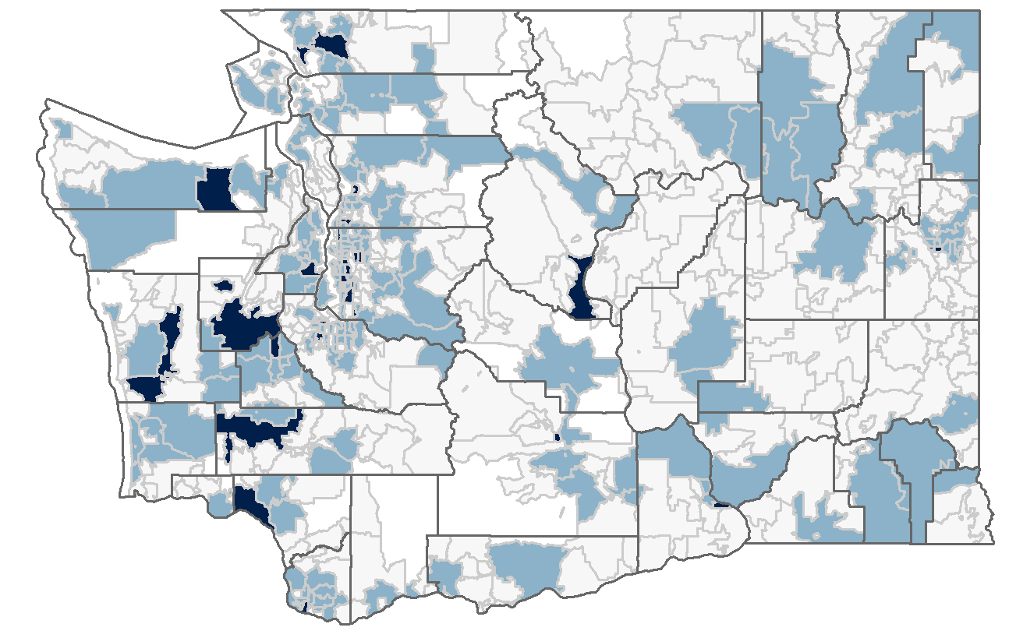
Findings*
Substance Use
Number of Youth with History of Diagnosis | Number of State-Registered Facilities Providing Services
*Findings are preliminary and will be finalized by June 1, 2018.

Slide 18
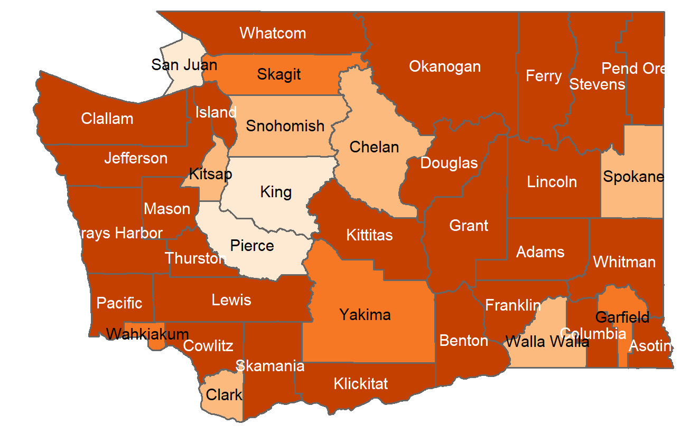
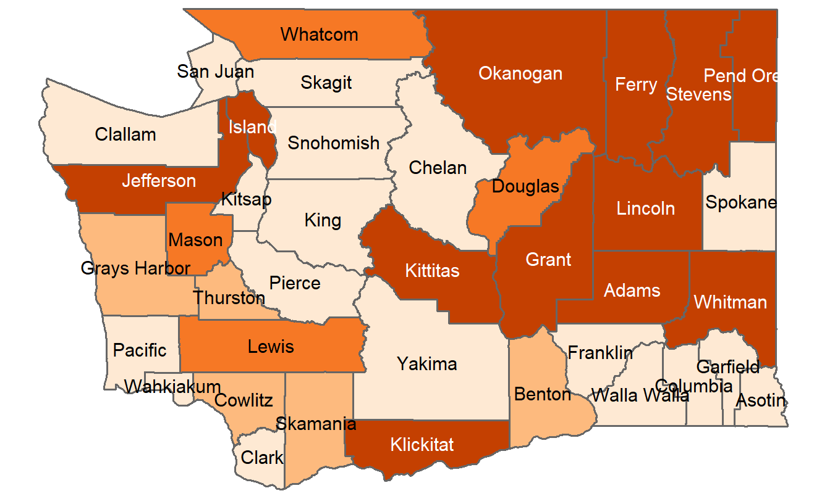
Findings*
Mean Youth Distance to Substance Use Facility
Youth Geocoded to Geographic Center of ZCTA | Youth Geocoded to Population-Weighted Center of ZCTA
*Findings are preliminary and will be finalized by June 1, 2018.

Slide 19
Findings*
Policy implications
Dissemination: Findings will be shared with agency representatives in 2018
Future analysis: Resources should be invested to conduct more sophisticated and real-time GIS analyses within the juvenile justice system
Investment in services: Maps generated for this project indicate regions where investment in behavioral health services for this population could be fruitful
*Findings are preliminary and will be finalized by June 1, 2018.

Slide 20
Findings*
Policy implications
Dissemination: Findings will be shared with agency representatives in 2018
Future analysis: Resources should be invested to conduct more sophisticated and real-time GIS analyses within the juvenile justice system
Investment in services: Maps generated for this project indicate regions where investment in behavioral health services for this population could be fruitful
*Findings are preliminary and will be finalized by June 1, 2018.

Slide 21

Time’s Up!
About your speaker:
  Name: Ellie (Elaine) Albertson
  Company: UW School of Public Health
  Email: emalb@uw.edu
  LinkedIn: https://www.linkedin.com/in/albertsonem/
  Quick bio: I’m a health policy researcher with expertise in the evaluation of cross-sector collaborations in health care and social services.
  Acknowledgements: This work is supported by a Field Placement and Collaborative Project grant from the Northwest Center for Public Health Practice; Sarah Veele, PhD, Senior Research Manager, Washington State DSHS; and Professor Clarence Spigner, Department of Health Services, University of Washington.

Slide 22
References and Notes
Apparicio, P., Abdelmajid, M., Riva, M., & Shearmur, R. (2008). Comparing alternative approaches to measuring the geographical accessibility of urban health services: Distance types and aggregation-error issues. International Journal of Health Geographics, 7(1), 7.
Sickmund, M., Sladky, T.J., Kang, W., & Puzzanchera, C. (2017). Easy access to the Census of Juveniles in Residential Placement. Retreived from http://www.ojjdp.gov/ojstatbb/ezacjrp/
Washington State Juvenile Rehabilitation Administration. (2016). Demographics/characteristics of population. Retrieved from https://www.dshs.wa.gov/sites/default/files/JJRA/jr/documents/Reports/2016DemographicsOn1-11-16.pdf
All analyses conducted in RStudio version 1.0.136 and R version 3.4.3.
Shortest distance calculated using gDistance() from the rgeos package.

Slide 23
Suitability Map: Safe Consumption Site in Seattle
Hanna Peterson
R E 370: Data Modeling
Final Project

Slide 24
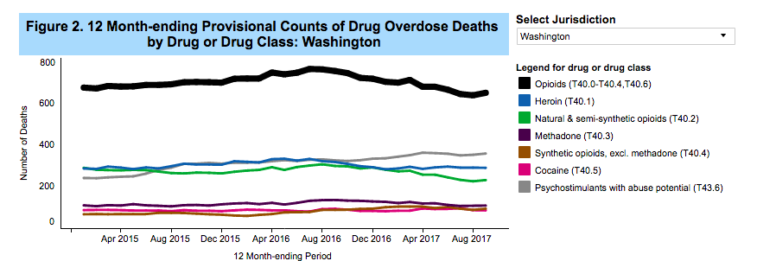
Background
Source: https://www.cdc.gov/nchs/nvss/vsrr/drug-overdose-data.htm

Slide 25
Background
Source: https://www.cdc.gov/nchs/nvss/vsrr/drug-overdose-data.htm

Slide 26
Layers Used
Daytime Population
Lack of Health Insurance
Poverty Rates

Slide 27
Layers Used
4. Poor Mental Health
5. Transportation Patterns
6. Drug Overdoses

Slide 28
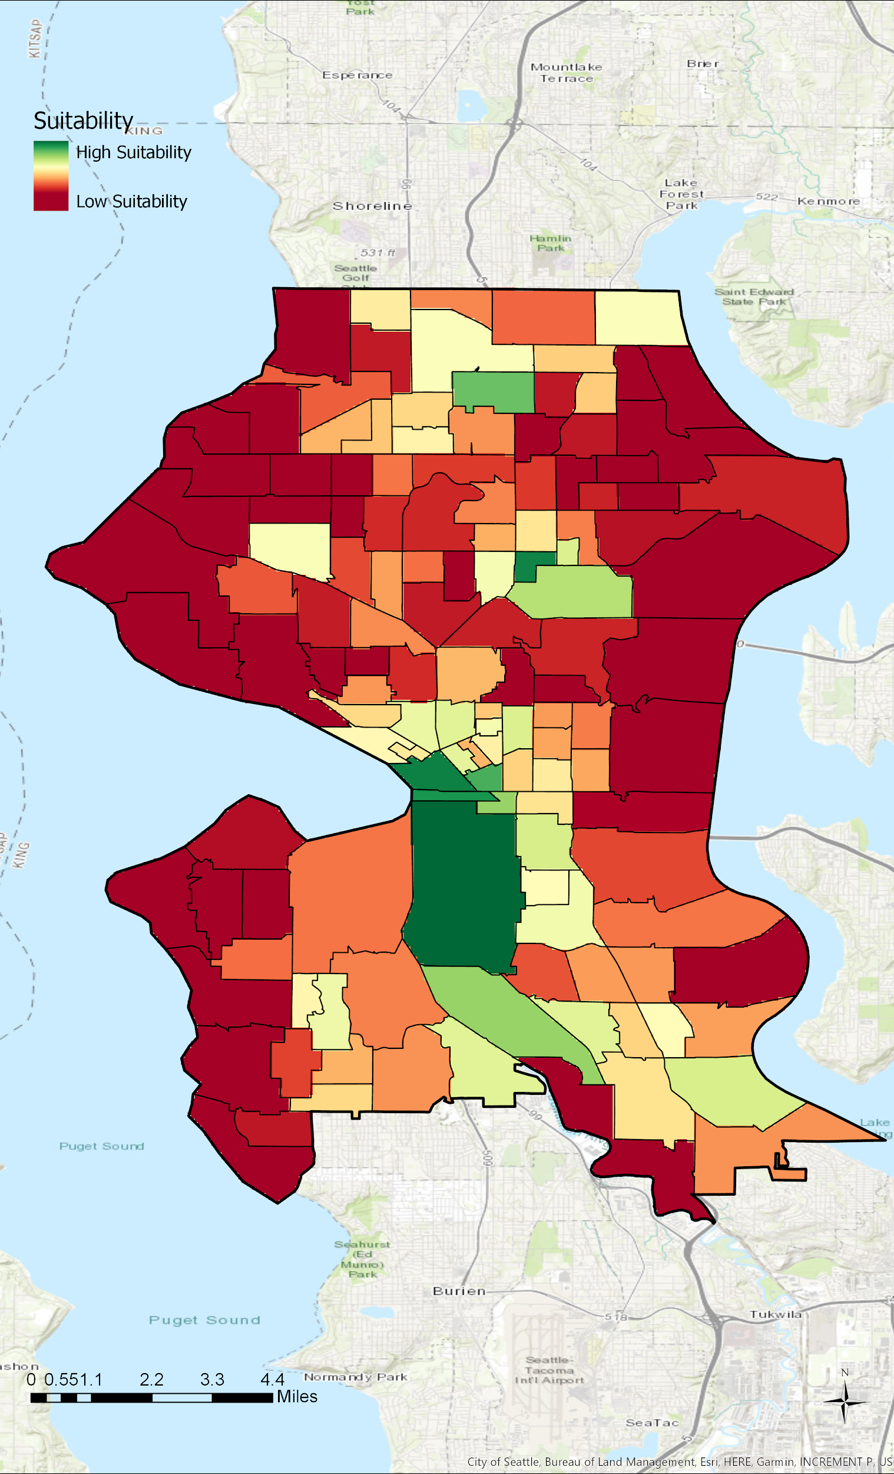
Methods
Pull data from various sources
Map to census tract
Convert polygon layers to raster images
Convert to common scale: MS Large
Weighted Sum: Weighed Drug Overdose Layer Heaviest, Followed by Poverty and Daytime Population

Slide 29
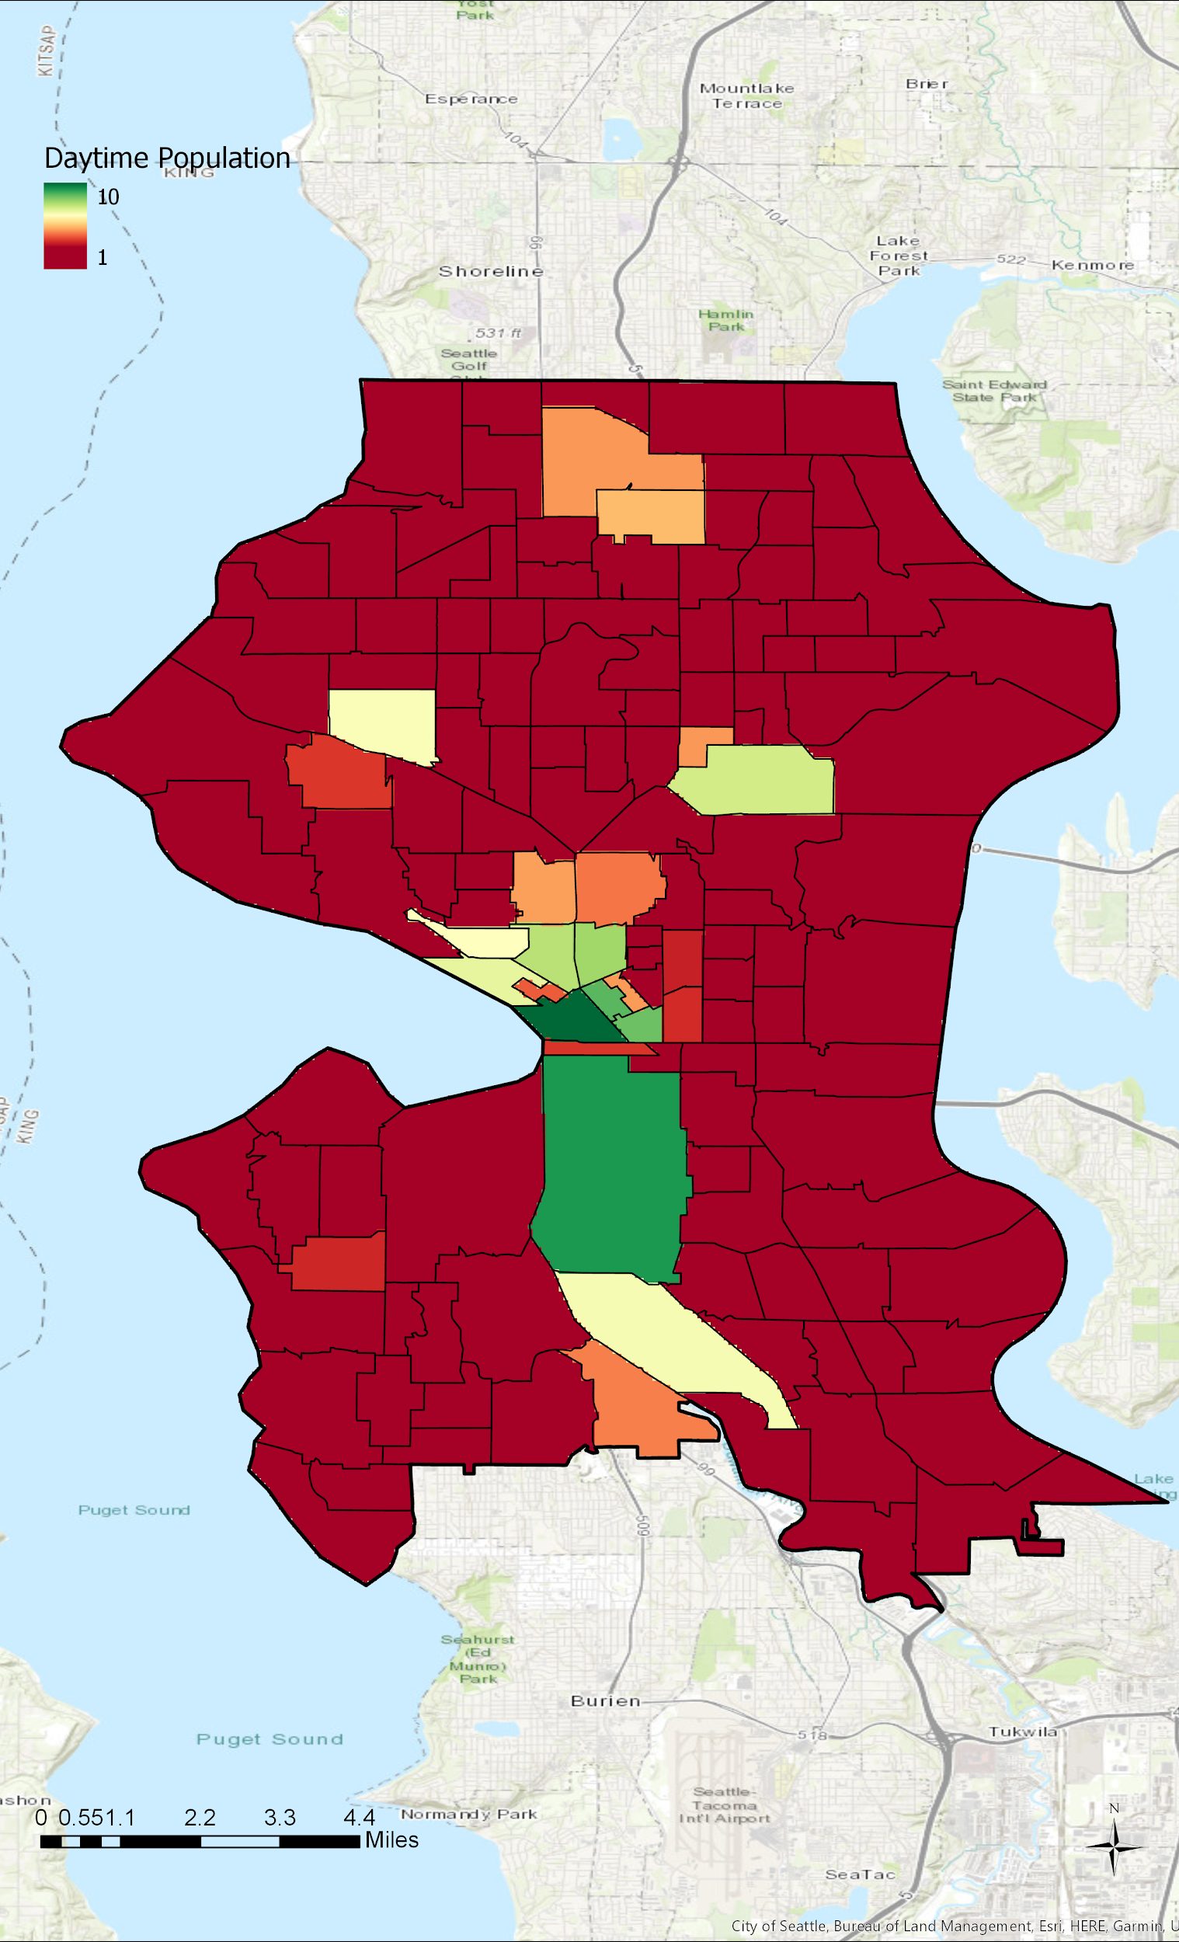
Daytime Population

Slide 30
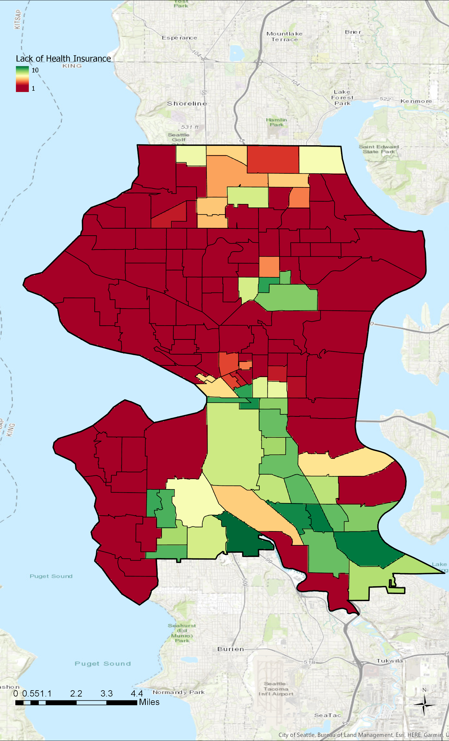
Lack of Health Insurance

Slide 31
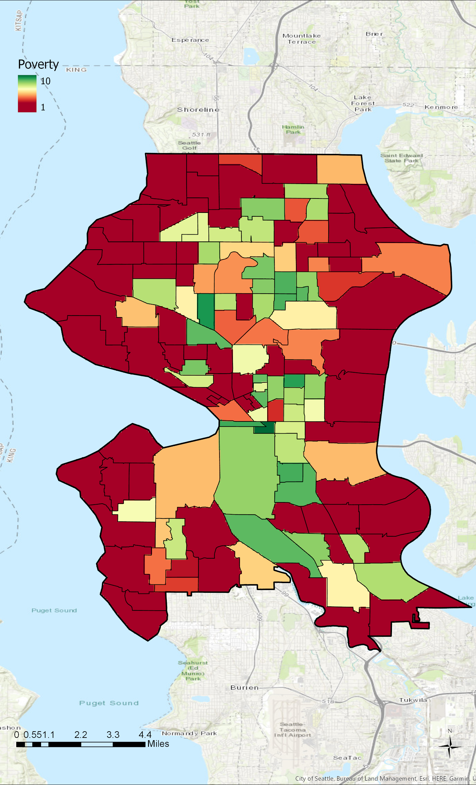
Poverty Rates

Slide 32
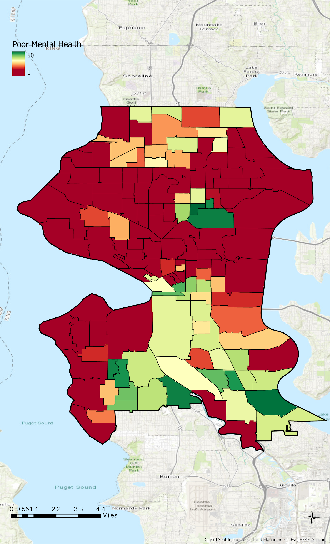
Mental Health

Slide 33

Transportation Patterns

Slide 34
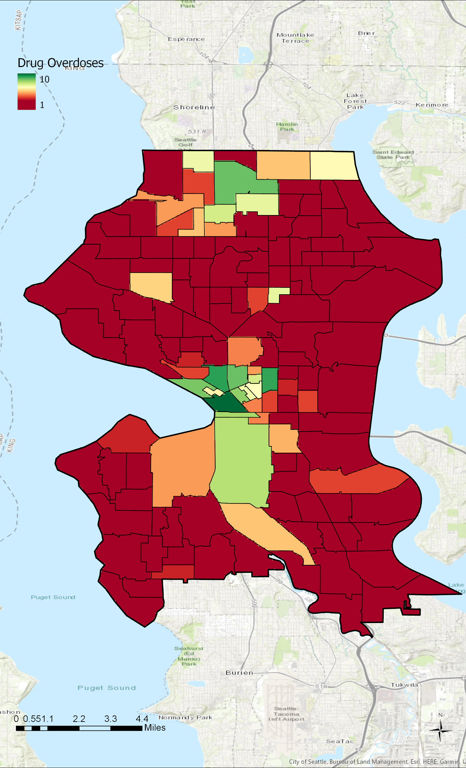
Overdose Rates

Slide 35
Overdose Rates

Slide 36
Final Suitability Map

Slide 37
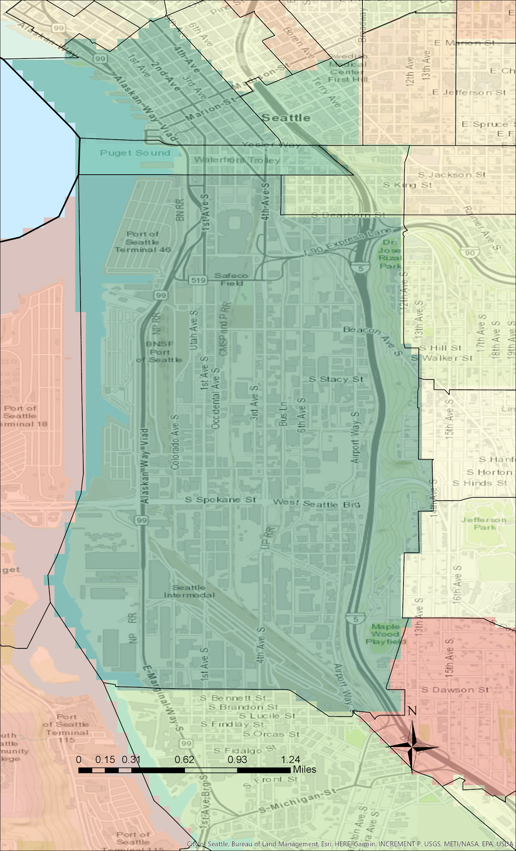
Findings
Most Suitable Site:
Census Tract 93: Sodo

Slide 38
Findings
Most Suitable Site:
Census Tract 93: Sodo

Slide 39
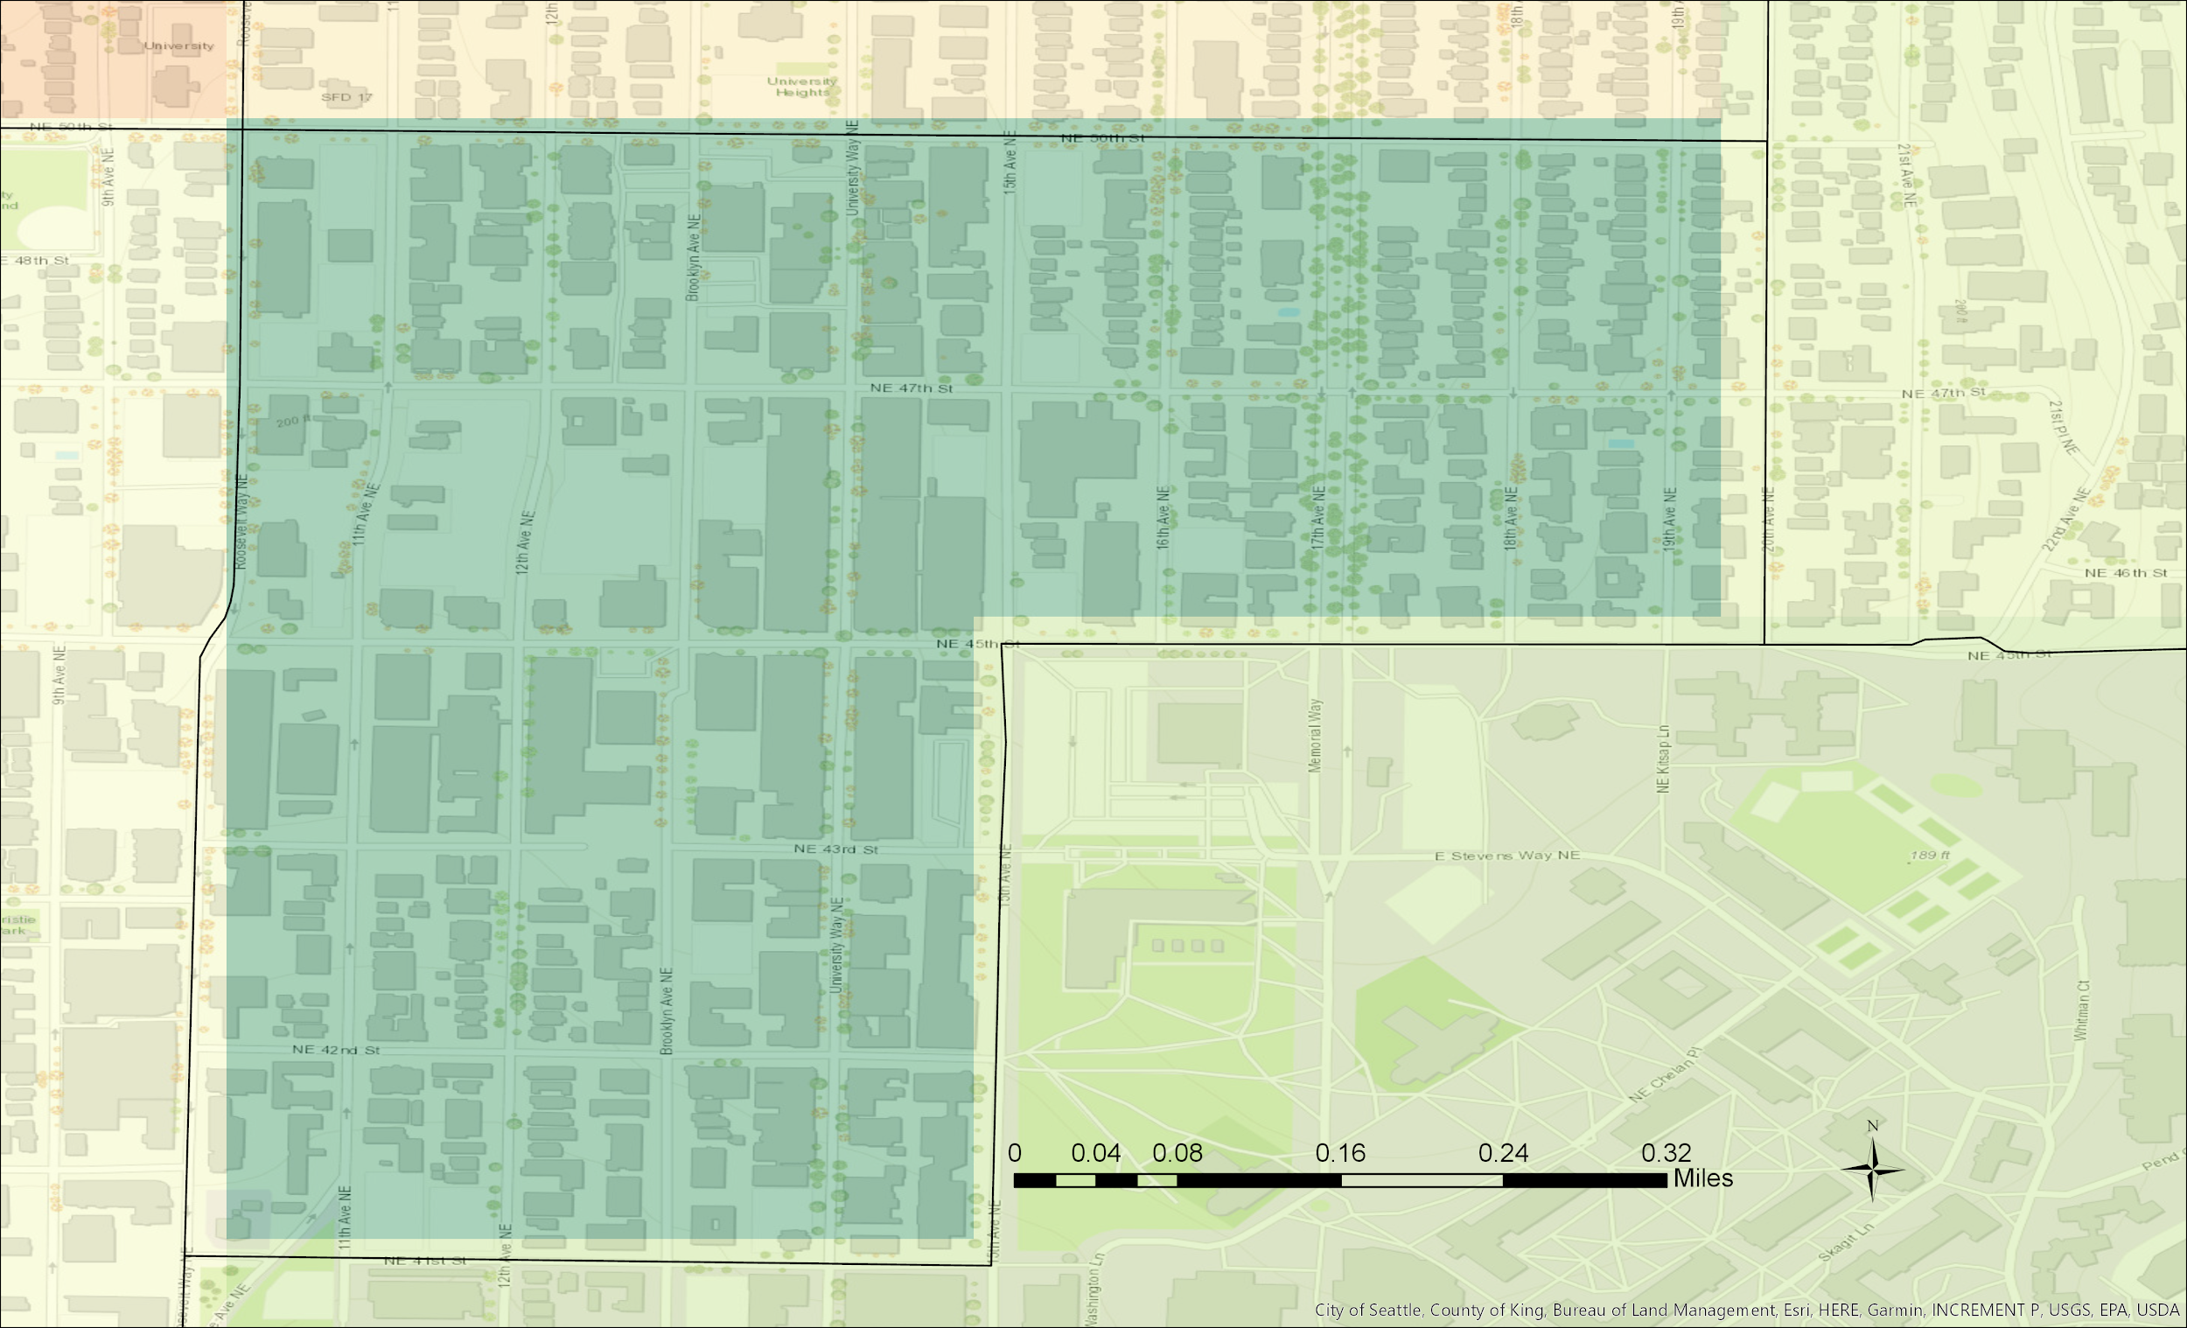
Findings
Second Most Suitable Site:
Census Tract 53: University District

Slide 40
Findings
Second Most Suitable Site:
Census Tract 53: University District

Slide 41
Limitations and Concerns
Self-Reporting of Mental Health
Overdose rates reliability

Slide 42
Future of Project
Build into senior project next year
Use additional GIS layers, other mediums

Slide 43

Time’s Up!
About your speaker:
  Name: Hanna Peterson
  Company: CEP
  Tel: (425) 530 6194
  Email: hannanp@uw.edu
  Social Media: Call/Email
  Quick bio: Hanna Peterson is a junior in the Community, Environment and Planning major at the University of Washington. She hopes to pursue a career in public policy and/or human services.

Slide 44
Mapping Our Realities in the Pacific Northwest Natives Geodatabase
Victoria Buschman

Slide 45
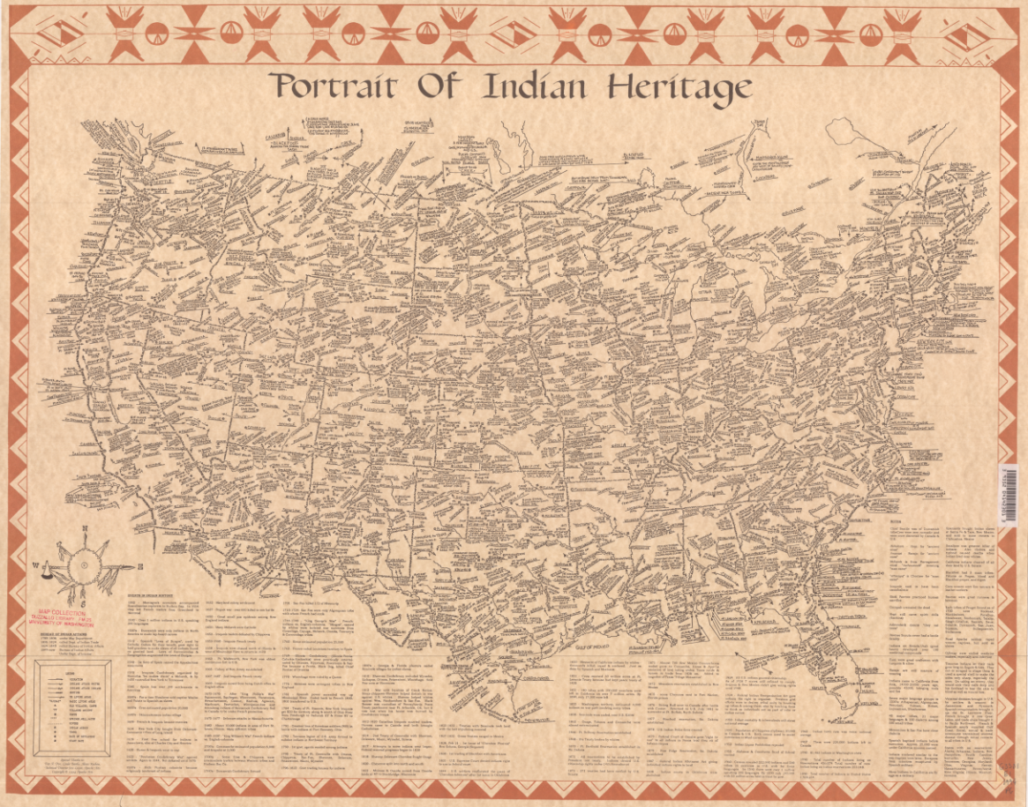

Notes:
People have tried mapping complex Indigenous realities for a long time. Physical maps draw by Indigenous scholars to address some of this complexity and robustness of information are available, but they are often criticized for their cartographic choices as being overwhelming or unconventional.
Introduction to the topic. What are our realities, what are our histories, how can we make this information relevant to our communities, both of Natives and to academics. How do we decolonize information and make it available to people who would benefit most from this information. Is an institution the place to host this information. How do we use geospatial information to tell the stories of our people.

Slide 46
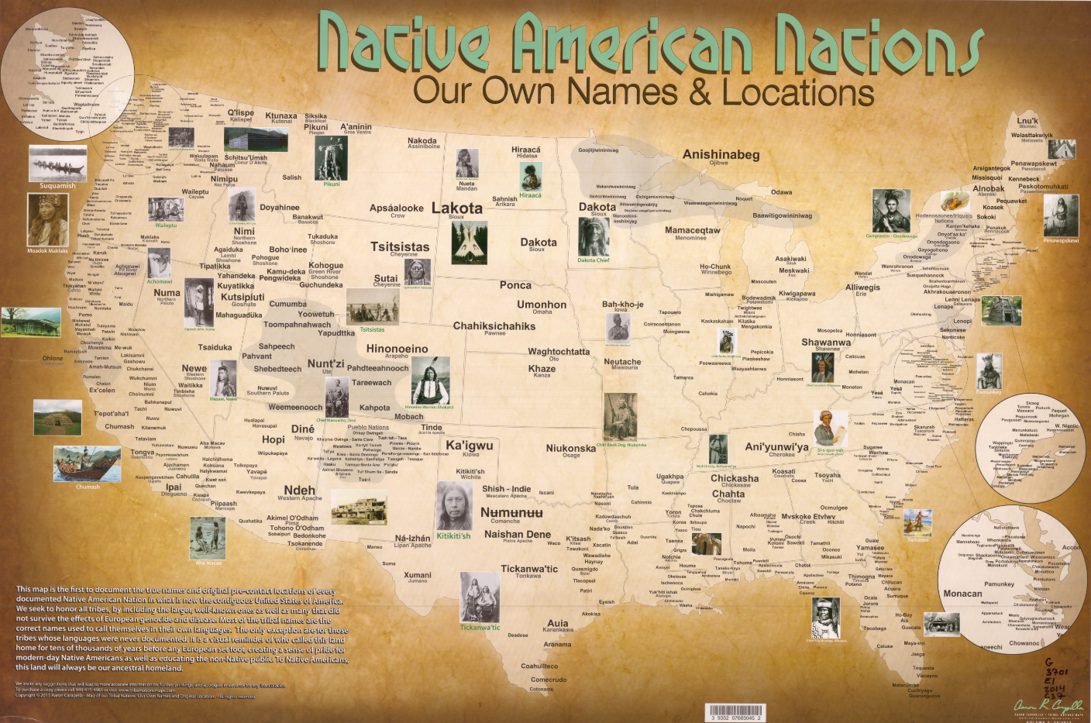
Notes:
Why we chose the scale – something more continuous
We have a lot of publically available data, but there isn’t any kind of centralized place for this data to live. That’s why I came up with the idea for the PNW Natives Geodatabase, a publically facing data portal for use by Native communities, Indigenous scholars, and academic researchers.

Slide 47
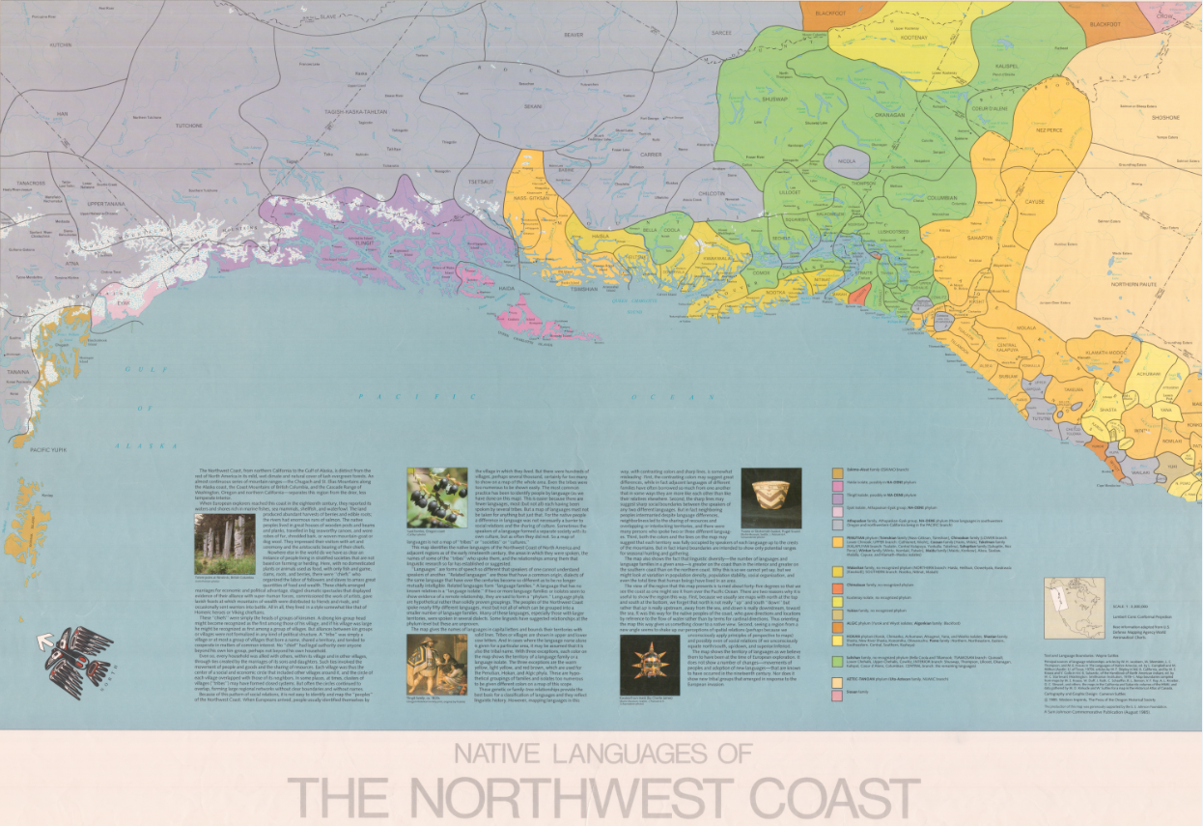
Notes:
Professional geospatial technologies are often out of reach for tribal organizations and governments, often relying on the BIA to provide relevant information.

Slide 48
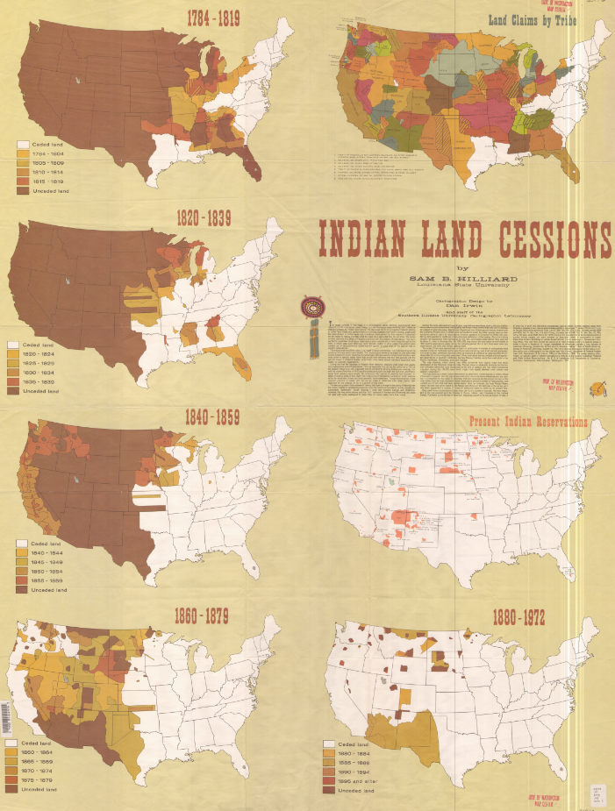
Transformative data from physical maps
US federal and state public data
Canadian federal and provincial data
From Where?
Notes:
Show emblems of the different data places.
Where does the data come from?
End: Forewarning, I am not a cartographer and the rest of the images are more for previewing the available data rather than making it easily consumable.

Slide 49
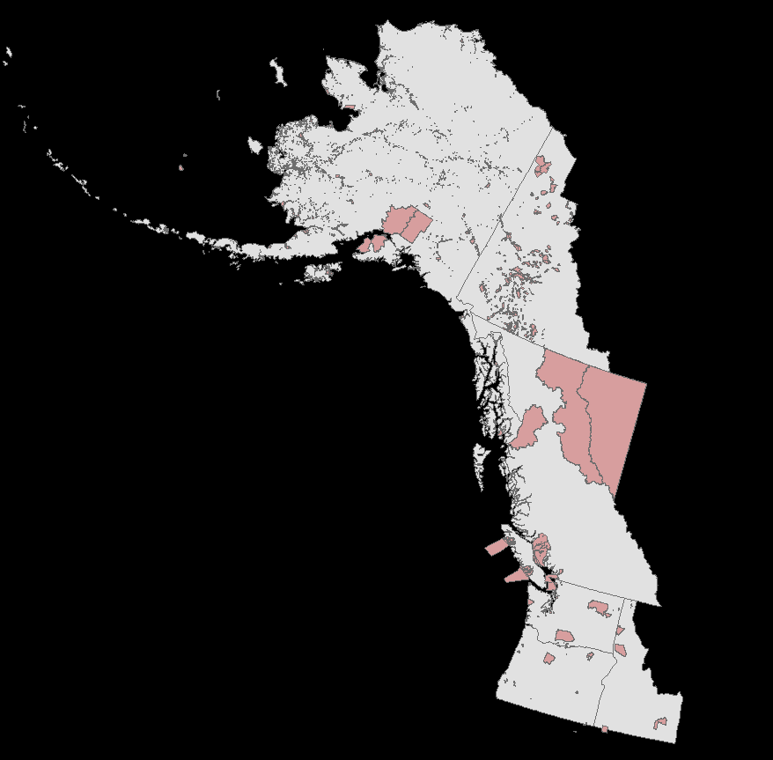
Native-Owned Lands
Notes:
So what is the data? Mixture of georeferenced paper maps and vector data.

Slide 50
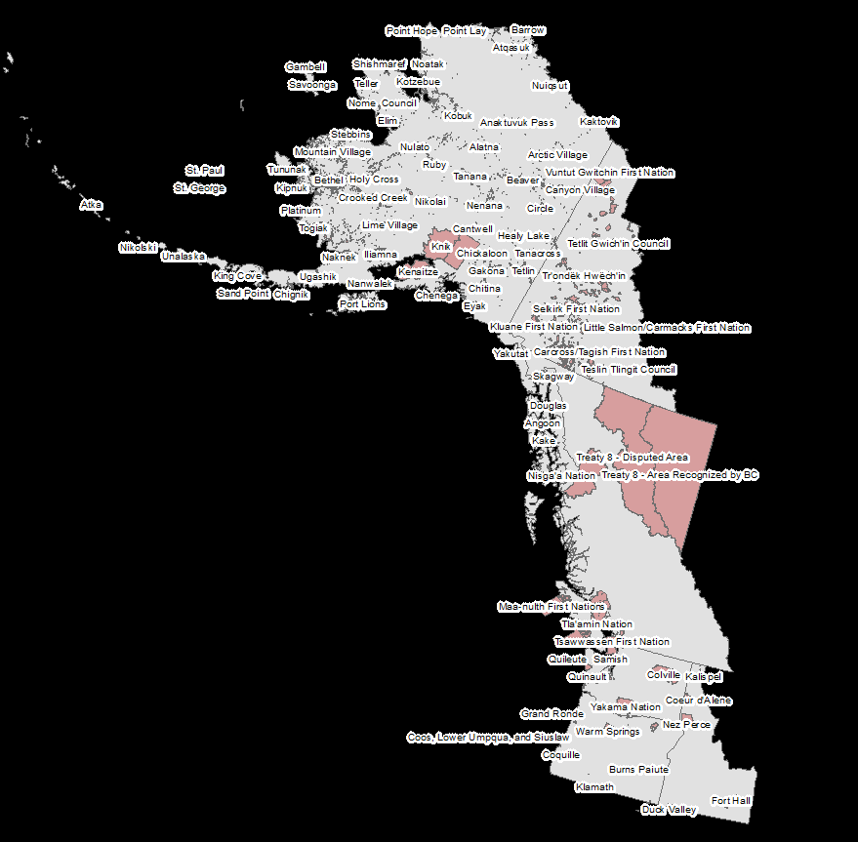
Native-Owned Lands

Slide 51
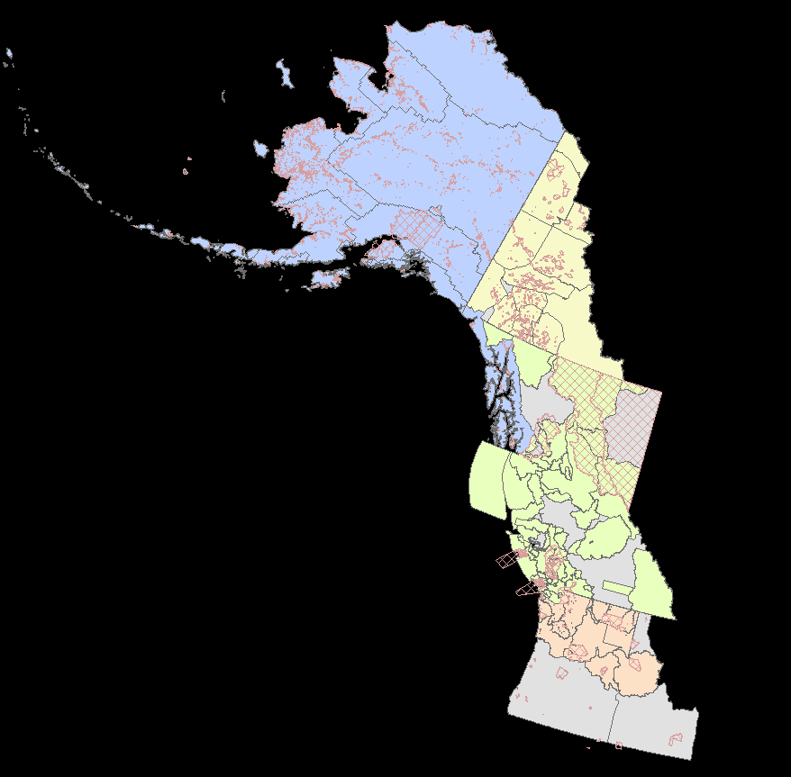
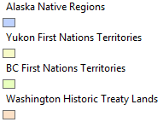
Current and Historic Territories
Notes:
We should maybe be asking questions like, why is the Colville Nation one quarter the size it was when the first treaty was signed. What is being done to all of those lands. Why was the new treaty signed just one year after the publication of a map surveying precious metals in the Colville area. I have a lot of theories and conspiracies.

Slide 52
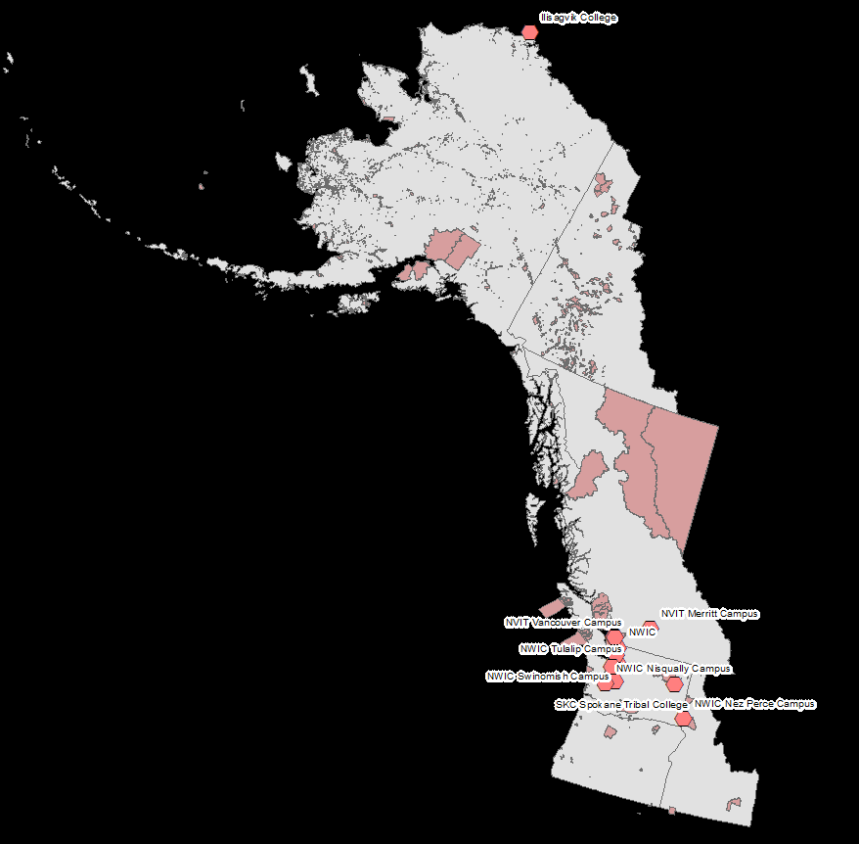
Native Community Resources

Slide 53
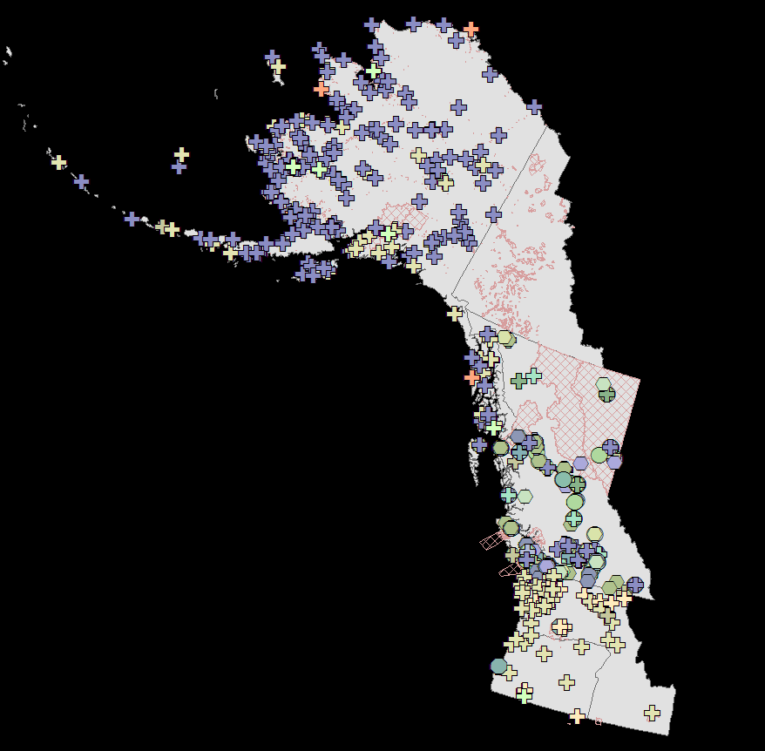
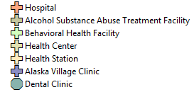
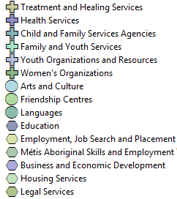
Native Community Resources

Slide 54
Native Community Resources

Slide 55
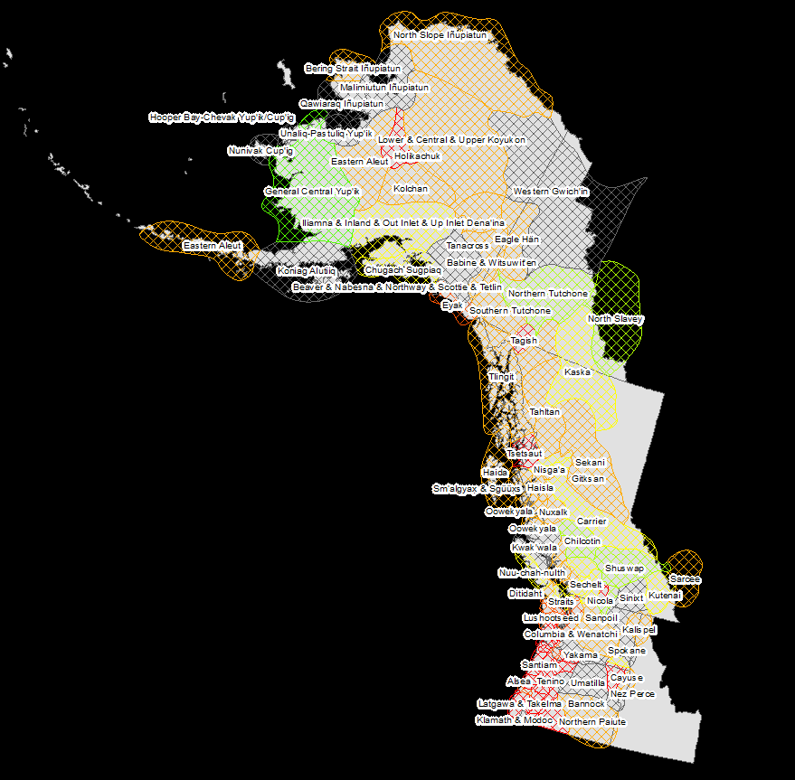
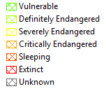
Native Languages

Slide 56
Native Languages

Slide 57
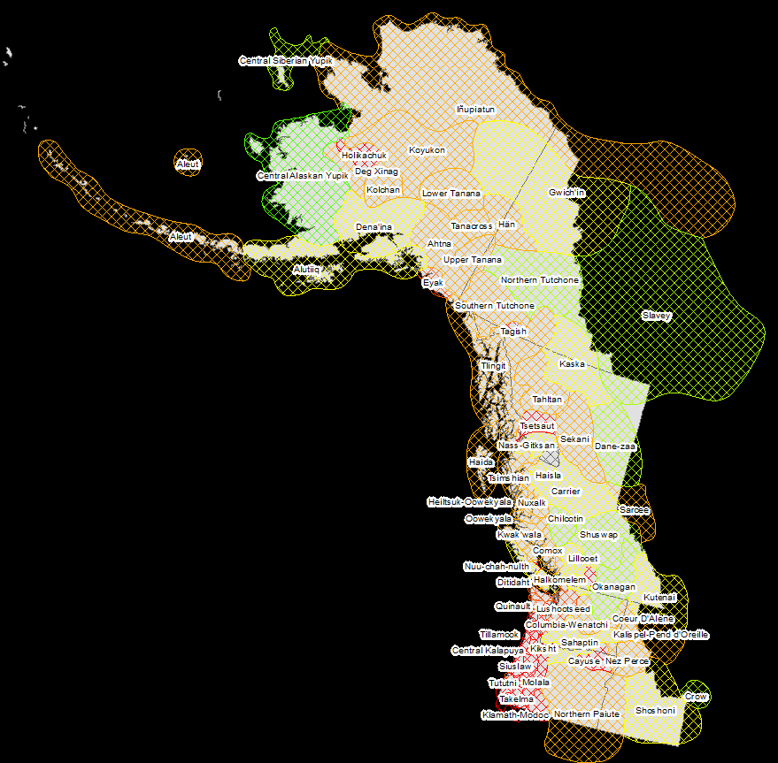
Native Languages

Slide 58
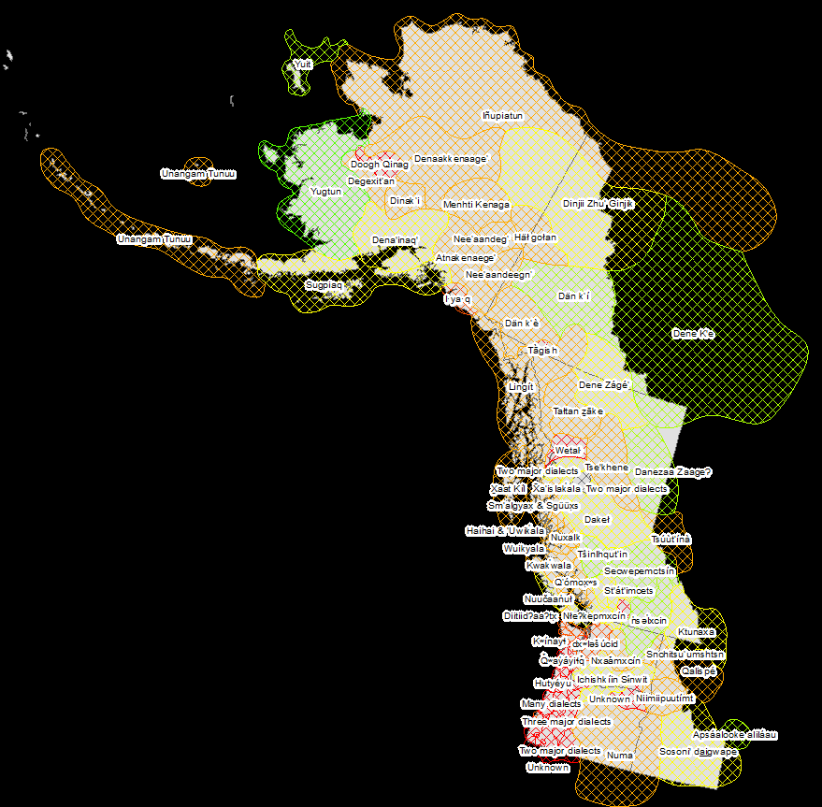
Native Languages

Slide 59
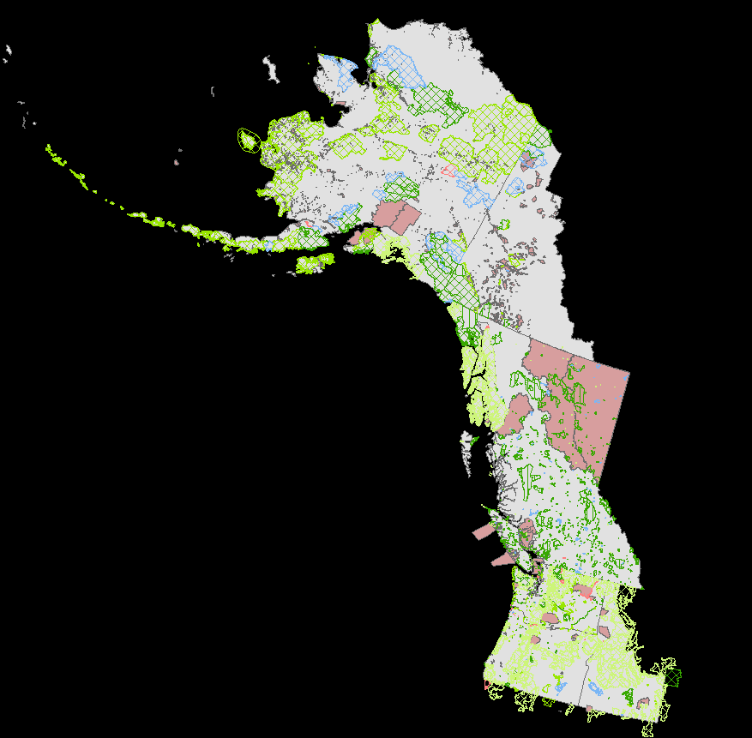


Public Lands
Notes:
I’ve also collected data related to environmental concerns.

Slide 60
Public Lands
Notes:
I’ve also collected data related to environmental concerns.

Slide 61
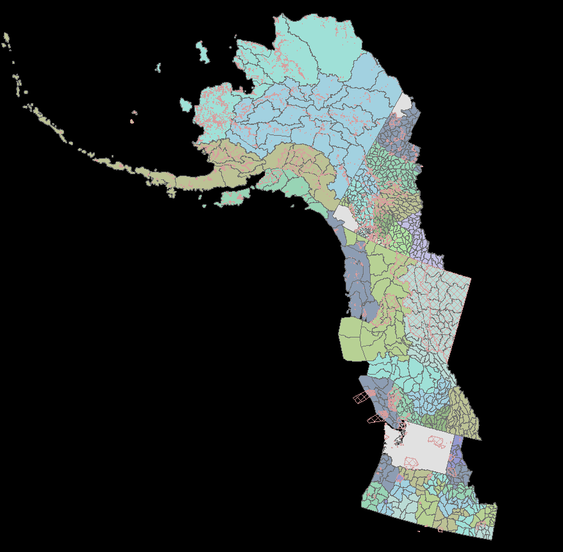
Natural Resource Management

Slide 62
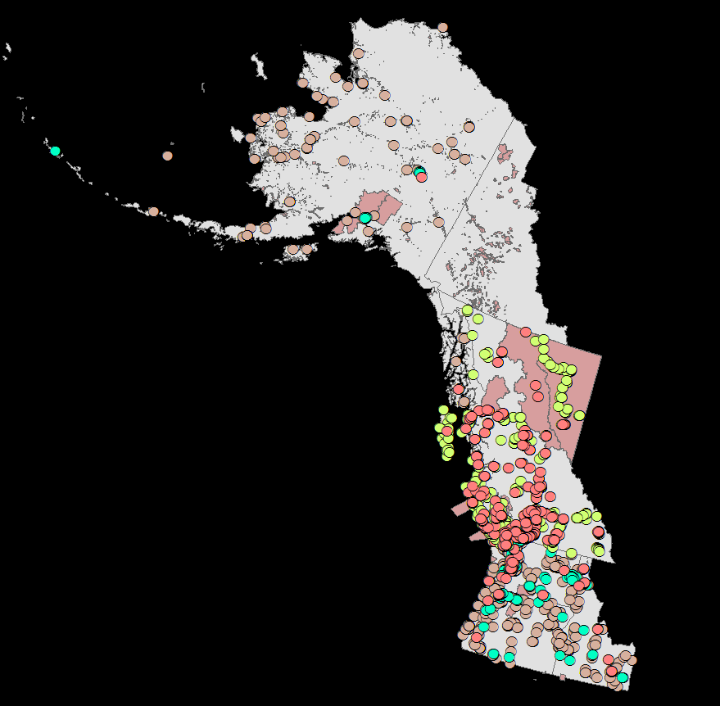
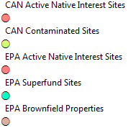
Environmental Concerns

Slide 63
Environmental Concerns

Slide 64
Time’s Up!
About your speaker:
Victoria Buschman
School of Environmental and Forest Sciences vbuschmn@uw.edu
Victoria is Alaska Native, a PhD Students at the University of Washington, and a Fulbright-NSF Scholar to Iceland. She studies food security and conservation planning in the Arctic.

Slide 65
Cool Projects at UW’s
Polar Science Center
And a job opportunity!

Slide 66


Kristin Laidre

Slide 67
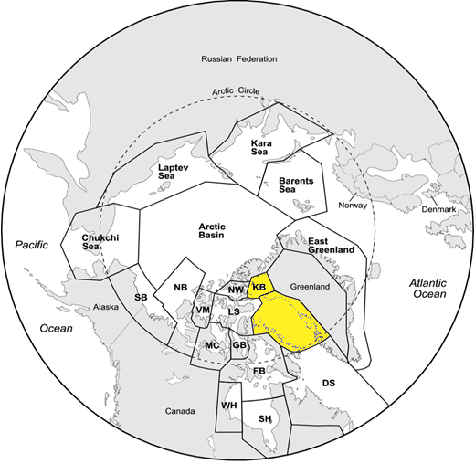


Slide 68
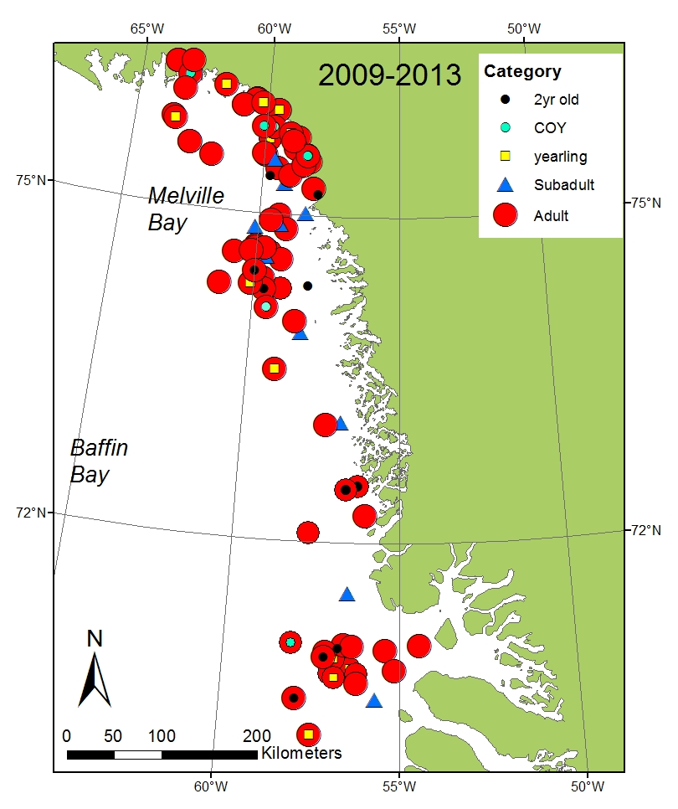
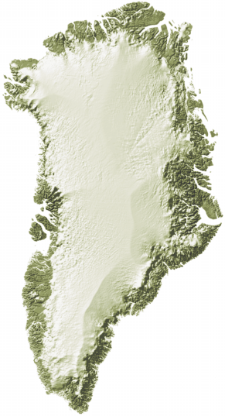
2009-2013
satellite tagging sites
139 bears

Slide 69
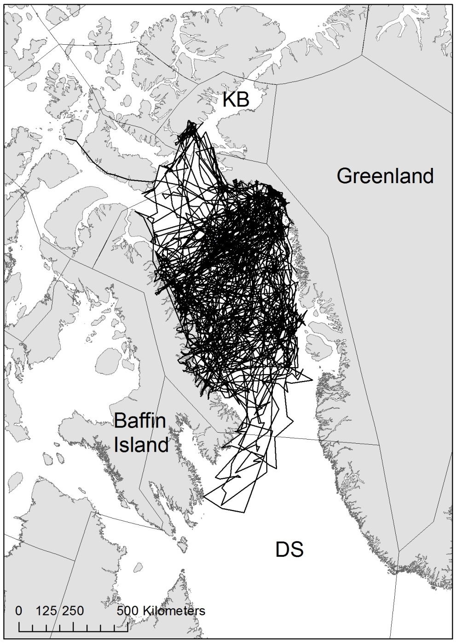
2009-2013
Tracks of 38
adult female bears

Slide 70
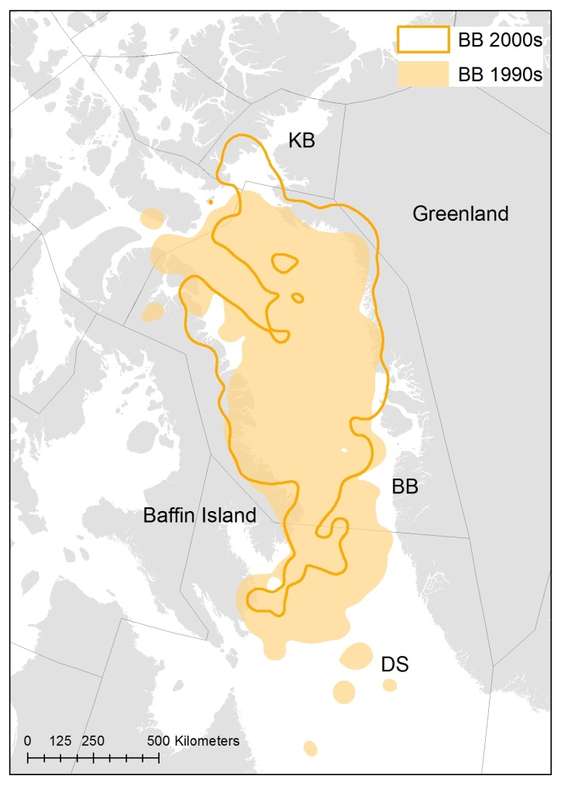
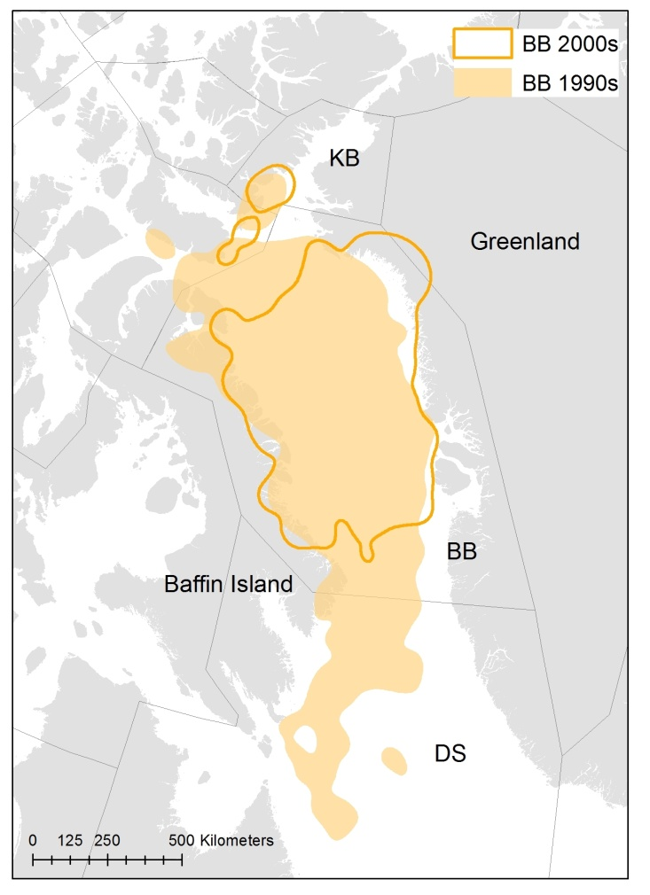
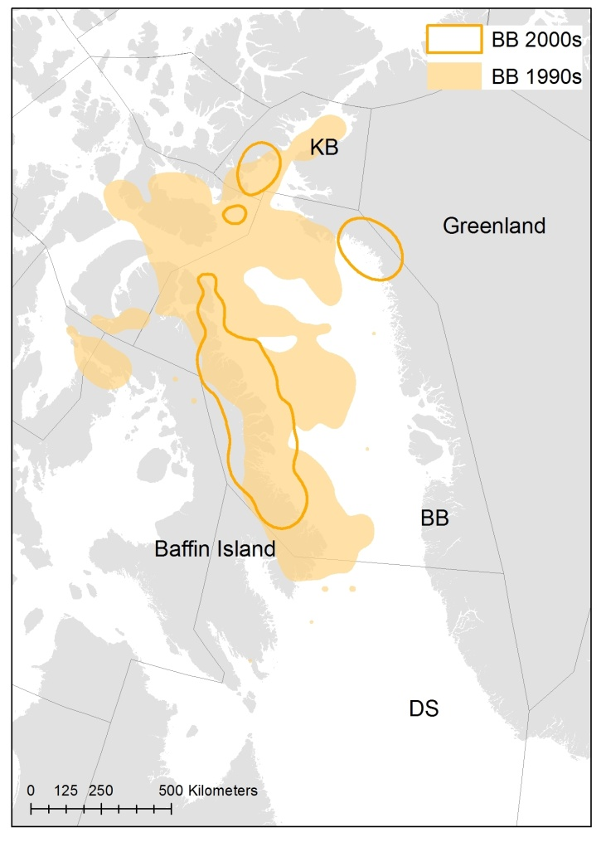
Seasonal Range
Winter (Nov-Feb)
Spring (March-July)
Summer (Aug-Oct)
13% reduction
30% reduction
70% reduction

Slide 71
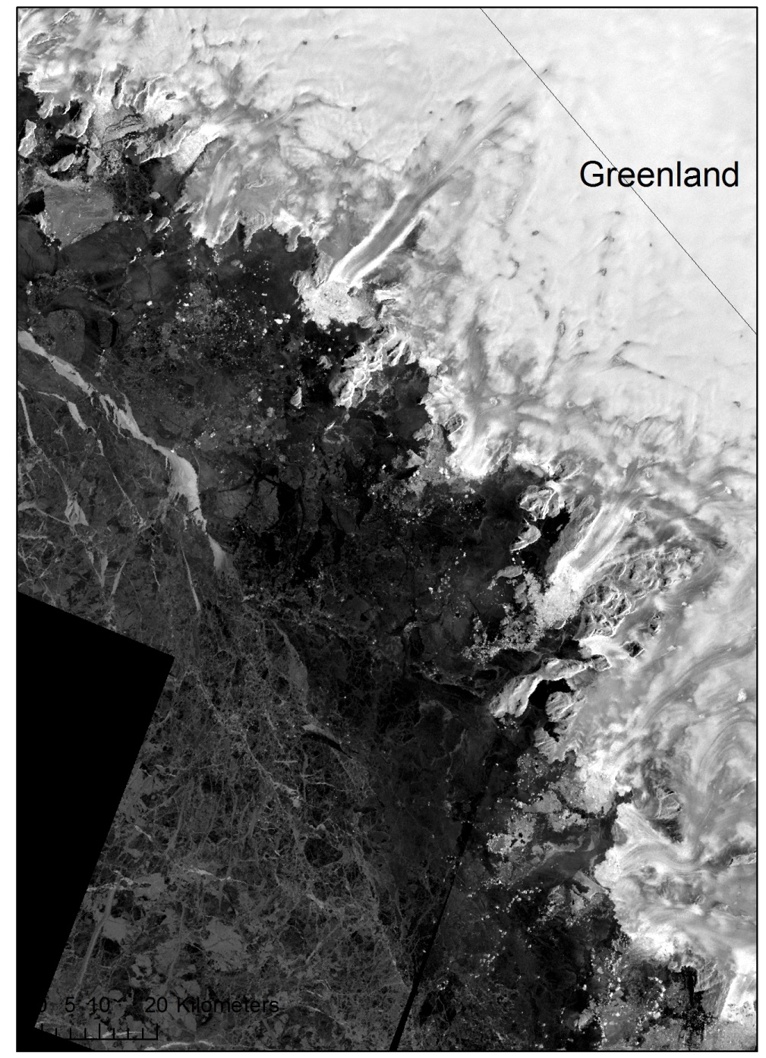

Melville Bay

Slide 72
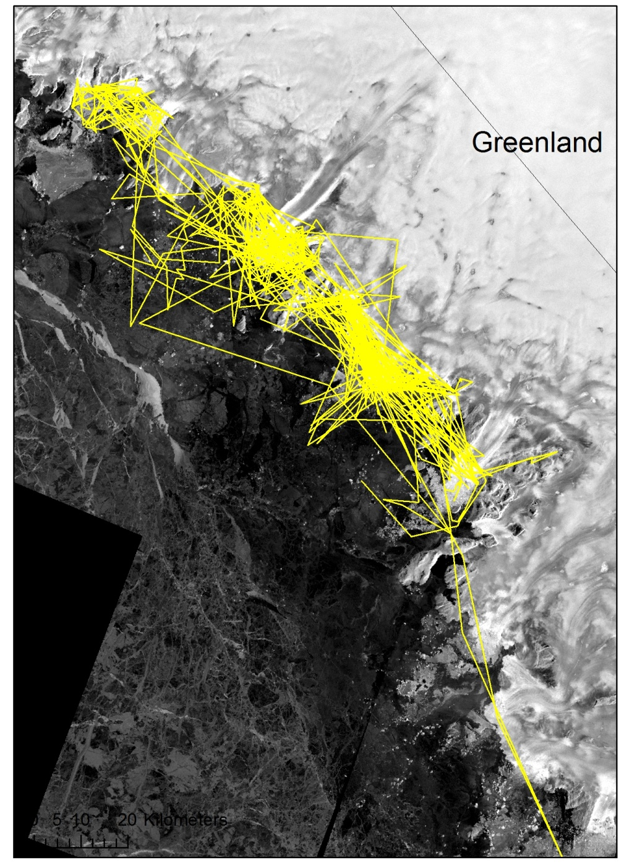

Melville Bay

Slide 73


Slide 74

Harry Stern

Slide 75
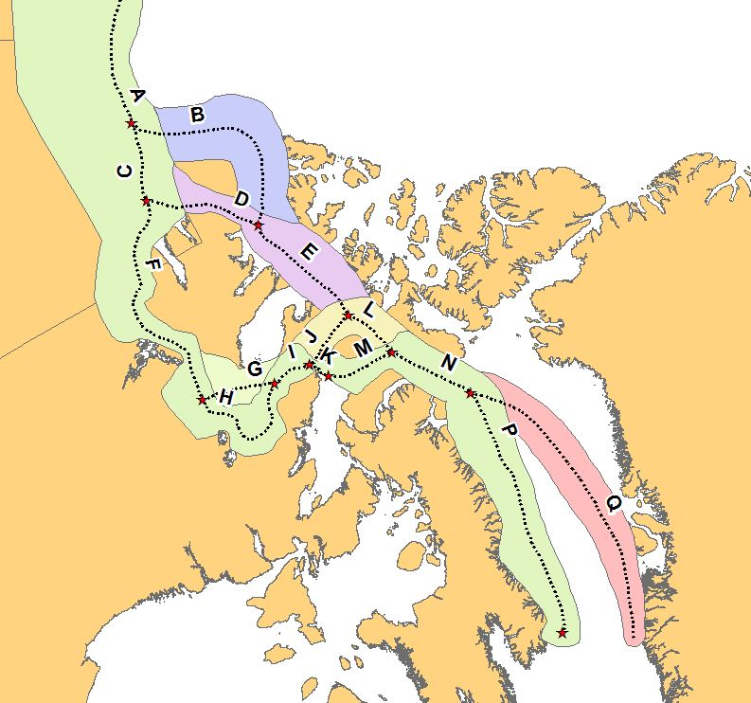
Routes of the Northwest Passage
Greenland
Canada

Slide 76
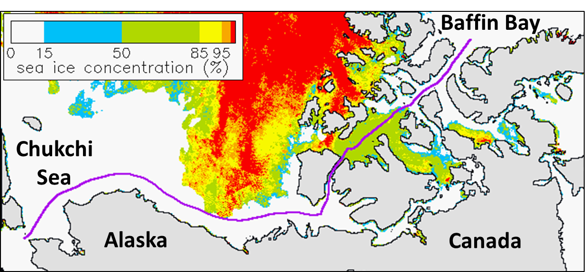

Slide 77

Percent of route open
June
July
Aug
Sept
Oct

Slide 78


Slide 79



Greenland
Greenland
Bowhead whale
Beluga
Alaska
Canada
Alaska
Canada
Greenland
Narwhal
“Vulnerability of Arctic marine mammals to vessel traffic in the increasingly ice-free Northwest Passage and Northern Sea Route”
submitted to PNAS

Slide 80



Slide 81

Job Opportunity
Data Analyst
with GIS experience
50% time
with benefits

Slide 82
Bachelor’s degree
ArcGIS
Python, R
Excel, Word, PPT

Slide 83
Flexible work schedule

Slide 84
Great work environment

Slide 85
Time’s Up!
About your speaker:
  Name: Kristin Laidre
  Company: Polar Science Center, UW
  Tel: 206-616-9030
  Email: klaidre@uw.edu
  Social Media: Twitter – @KristinLaidre
  Quick bio: Marine biologist https://staff.washington.edu/klaidre/

Slide 86
Disrupting Gentrification:
Tacoma Community Land Trust
Michael Monroe
RE: 370 Data Modeling
Final Project

Slide 87

Community Land Trusts
Nonprofit community organization
Homeownership opportunities for low-income people
Homes stay affordable in perpetuity

Slide 88
Community Land Trusts
Nonprofit community organization
Homeownership opportunities for low-income people
Homes stay affordable in perpetuity

Slide 89
Community Land Trusts
Nonprofit community organization
Homeownership opportunities for low-income people
Homes stay affordable in perpetuity

Slide 90

City of Tacoma
Population: 211,277
Median Income: $53,553
Racial Demographics:
  African American: 10.1%
  Asian: 9.1%
  Hispanic or Latino: 11.3%
  White: 59.7%
Avg. Commute: 27 mins
Source: Census.gov Quick Facts

Slide 91

Layers
Proximity to Superfund sites
Median Home Value
Crime Index

Slide 92

Layers
Educational Attainment
Percentage Renter Occupied

Slide 93

Methods
Data at Block Group
Layer for each dataset
Layers converted to raster images
Raster layers transformed to common scale (1 – 10)
Rasters combined with equal weight
  (Weighted Sum)

Slide 94
Methods
Data at Block Group
Layer for each dataset
Layers converted to raster images
Raster layers transformed to common scale (1 – 10)
Rasters combined with equal weight
  (Weighted Sum)

Slide 95
Proximity to Superfund Sites
Dark green furthest from superfund sites
Low scoring areas in Port of Tacoma and heavy industrial sectors

Slide 96

Median Home Value
High values near water
Limited variance in value in central areas

Slide 97

Crime Index
Lowest crime in dark green
National average crime index is 100
Some areas score 400+ or 3 times as much crime as the national average

Slide 98
Educational Attainment
Education operationalized as percentage of population with Bachelors degree or higher
Highest scores in wealthiest areas

Slide 99

Percentage Renter Occupied
Lowest percentage of renters near water
Higher percentage of renters near TCC / UPS and Hilltop neighborhood

Slide 100

Suitability Model

Slide 101
Suitability Model

Slide 102

Site 1: North Central

Slide 103

Site 2: Southeast

Slide 104

Site 3: North

Slide 105
Future Improvements
Access to Healthy Foods
Exclude Upper Threshold of Home Values
Interview more community stakeholders

Slide 106
Time’s Up!
About your speaker:
  Name: Michael Monroe
  Company: Bromik Design & Build
  Tel: (206) 795-8686
  Email: mmonro@uw.edu
  Social Media: Call / Email
  Quick bio: Michael is a Junior in the Community Environment & Planning Major and is also the Director of Operations for Bromik Design & Build in Kirkland. After he graduates Michael aims to help create an affordable housing nonprofit in Tacoma.

Slide 107
Two Geospatial Data Resources @ Your Library that You Need to Know
With
Matt and Kian

Slide 108



Notes:
Demographic data is core to a lot of GIS research projects. But working with the US Census Bureau often leads one to experience levels of frustration and despair. Trying to understand what variables are included in which Census tool (Decennial OR American Community Survey) can make you to wish that you had a direct line to a Census master like Gov Docs Librarian, Cass Hartnett. On top of that you still have to get the TIGER/Line files and join the two pieces together.
There’s got to be a better way?!?

Slide 109



Notes:
You’re in luck!
“SimplyAnalytics is a web-based mapping, analytics, and data visualization application that makes it easy for anyone to create interactive maps, charts, and reports using 100,000+ data variables. …related to demographics, employment, housing, market segments, businesses, consumer spending, brand preferences, public health, and more from industry-leading data vendors.”--http://simplyanalytics.com/
Primarily comes from 2 vendors: EASI and Simmons
EASI (Easy Analytic Software Inc.) Data:
Using input data from the Census Bureau, Bureau of Labor Statistics, and Mediamark, EASI develops model-based indicators of the demographic characteristics, consumer spending, and behavior patterns
range of geographic areas—State, counties, census tracts, and block groups.

Slide 110



Notes:
Once inside, the first thing you want to do is choose your data variable. You don’t need to know if it is part of the Decennial Census or ACS. They’ve categorized everything into topics that make it easy to browse. Here we’re selecting Population Density per sq mile.
Once you’ve selected your variable, the next thing you need to do is select your location of interest. You can choose from National down to City level geographies. As you type, an auto-generated list of options will appear. Here we are choosing to map the City of Seattle.
Of course, SimplyAnalytics does include metadata, so if you wanted to know if this is a Census or ACS variable, you can find out. It also contains info on what the variable is, so that you can be confident you are mapping the right thing in order to tell your story.

Slide 111

Notes:
Once your variable and location are selected, SimplyAnalytics creates an interactive map like this one. Here you can edit the legend, color scheme, classification method, etc. You can also change the level of Census geography depicted from State down to Block Group.

Slide 112


Notes:
You can also create a custom layout of your map after you are done with your editing. Options for exporting the layout include jpg, pdf, and other formats.

Slide 113



Notes:
But the neat thing about SimplyAnalytics is that you also have to option of exporting the map data out as a shapefile. With a few clicks of the mouse, you can tell SimplyAnalytics to package up the Census attribute data with the Census geography. Once the backend processing is complete, you get an email with a link to download the zipped shapefile.

Slide 114

Notes:
After you download and extract the zipped file, you can add it to your ArcMap project just like any other shapefile.

Slide 115


Notes:
But wait, there’s more. Remember the other vendor supplying data to SimplyAnalytics, Simmons?
Simmons Local Consumer Insight (SimmonsLOCAL) Data includes:
information on lifestyles, attitudes, purchase behaviors, and media usage
analysis down to the zip code level
For all of America’s 210 media markets.
So if you want to map the percent of the population classified as “Kids and Cabernet” in your zip code, you can!

Slide 116




Notes:
So, how do you get to SimplyAnalytics? It’s simple: either via the UW Libraries’ Articles & Research Databases link and search for “SimplyAnalytics.”
Or by linking to it from the Libraries Geospatial Data Resources Guide’s page on “Other Mapping Tools.”

Slide 117


washington.policymap.com

Slide 118

Census Geography Boundaries
washington.policymap.com

Slide 119


Map Features
Flood Risk Areas, US Gulf Coast
Flood Risk Areas, King County
washington.policymap.com

Slide 120


Custom Geographies & Reports
washington.policymap.com

Slide 121
New Proprietary Data
Boxwood Means Inc.
  Census Block level data for:
    # of home sales
    Median sale price
    Loan-to-value ratios
GreatSchools
  District level data for:
    Student test scores
washington.policymap.com

Slide 122
New Proprietary Data
Valassis Lists
  Census block group level data for:
    Quarterly vacancy rates
New Localism Advisors
  Census tract level data for:
    Qualified Opportunity Zones, Social Needs Index
Urban Mapping Inc.
  Census tract level data for:
    Sum of public transit stops within a census tract
    Shortest distance to a public transit rail stop
washington.policymap.com

Slide 123

3-Layer Maps
washington.policymap.com

Slide 124

3-Layer Maps
washington.policymap.com

Slide 125


Data Loader
washington.policymap.com

Slide 126
Data Loader
washington.policymap.com

Slide 127
Time’s Up!
About the speakers:
  Name: Matthew Parsons and Kian Flynn
  parsonsm@uw.edu and Flynnk7@uw.edu
  University of Washington Libraries
    Matt is the Geospatial Data and Maps Librarian
    Kian is the Geography and Global Studies Librarian

Slide 128
Spatial literacy in Ocean Science and Technology
Miles Logsdon
School of Oceanography
ONLY 3 WORD SLIDE !!!

Slide 129


Goodchild, M.F., 1992. Geographical information science. International Journal of Geographical Information Science, 6(1), pp.31-45. Available at: http://www.tandfonline.com/doi/abs/10.1080/02693799208901893.
Goodchild, M.F., 2010. Twenty years of progress: GIScience in 2010. Journal of Spatial Information Science, 1(1), pp.3-20. Available at: http://josis.org/index.php/josis/article/view/32 [Accessed July 25, 2011].
Newcombe, N. S. (2013). Seeing Relationships: Using Spatial Thinking to Teach Science, Mathematics, and Social Studies. American Educator, 37(1), 26-31 and 40.
Werner Kuhn (2012) Core concepts of spatial information for transdisciplinary research, International Journal of Geographical Information Science, 26:12, 2267-2276, DOI: 10.1080/13658816.2012.722637

Slide 130

Spatial structures – object, field, surface, networks, regions, area, zone, cell, etc.
Spatial properties – composition, size, shape texture, boundary, center, etc.
Space-time context – location, local, global, site, environment, etc.
Position – distance, direction, orientation
Spatial dynamics - motion, dispersion, diffusion, expand, merge, split, route, convection, etc.
Spatial relations – adjacency, proximity, centrality, distribution, density, pattern, gradient, etc.
Spatial interaction – connection, link, system, ecosystem, etc.
Spatial transformations – scale, rotation, projection interpolation
Representation – map, diagram, overlay, grid, point, line, polygon, etc.
Spatial principles – autocorrelation, heterogeneity, association distance decay, isotropy, congruence.

Slide 131






Slide 132





Slide 133




Slide 134




Slide 135


Slide 136





Slide 137


Slide 138


Slide 139


Slide 140






Slide 141





Slide 142





Slide 143







Slide 144






Slide 145




Slide 146




Slide 147




Slide 148
Time’s Up!
About your speaker:
  Name: Miles Logsdon
  Company: University of Washington
  Email: mlog@uw.edu

Slide 149

Determining Park
Level of Service in the
City of Lake Forest Park
Collene Gaolach

Slide 150



PROST
Fun Fact: the word “prost” translates as “Cheers”!

Slide 151


Level of Service (LOS)
A measurement of how well parks and recreational needs of the community are being met
1/2 mile (YELLOW)
1/4 mile (PURPLE)

Slide 152

About 1.75 miles W to E
About 3 miles N to S

Slide 153

PROST used % of city area to quantify park LOS
67% ½ mile
34% ¼ mile

Slide 154
PROST used % of city area to quantify park LOS
67% ½ mile
34% ¼ mile

Slide 155

King County GIS
Address Point Data
Notes:
A comprehensive address file containing a point for every addressable site within King County. It is derived from the E 9-1-1 address layer which was created with the intention of assisting emergency responders locate 9-1-1 wireless callers more efficiently. Address points with the site type: ED (Dry Hydrant), EH (Hydrant), ET(Public Telephone) are not included. The layer is overlayed with the Washington County polygon layer and the King County parcel layer. The layer is joined with KCZipcode table to bring in the USPS Zip+4 data fields. The layer is joined with King County Assessor tables to identify primary addresses for each parcel.

Slide 156


Slide 158

Percentage of LFP Address Locations within Park Service Area

Slide 159



Problem: We don’t fly

Slide 160





Slide 162


Slide 164

Percentage of LFP Address Locations within Park Service Area

Slide 165


Slide 167

Percentage of LFP Address Locations within Park Service Area

Slide 168


GIS Takeaway:
Know Your Subject!

Slide 169
Time’s Up!
About your speaker:
  Name: Collene Gaolach
  Email: rasmuscj@uw.edu
  Social Media: www.linkedin.com/in/collenegaolach
  Quick bio: Collene has been doing GIS since the dawn of time. She’s worked in governmental, non-profit, and environmental consulting organizations. She keeps thinking one day she’ll have this GIS thing figured out. But that day never comes, thank goodness.

