Slide 1
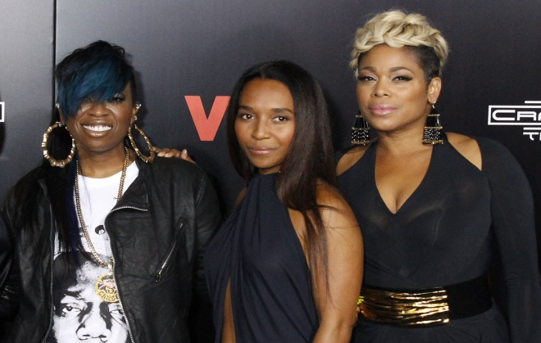
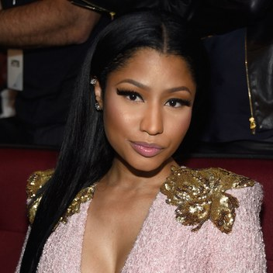
Interview with Nicki Minaj:
Q: What would you say to women who are thinking about getting into this line of work?
A: My advice to women in general: Even if you’re doing a nine-to-five job, treat yourself like a boss. Not arrogant, but be sure of what you want – and don’t allow people to run anything for you without your knowledge. I can rap in a London accent, make weird faces, wear spandex, wigs, and black lipstick. I can be more creative than the average male rapper
Q: What do you think about the societal standards for women?
A: When you’re a girl, you have to be everything, You have to be dope at what you do, but you have to be super sweet, and you have to be sexy, and you have to be this and you have to be that and you have to be nice, and you have to – it’s like, I can’t be all of those things at once. I’m a human being
Q: What would you say to the people who criticize you?
A: I don’t agree that everyone should agree with everyone’s lifestyle. I think that some people aren’t going to agree, but I think that when you’re mean and when you ridicule people it’s a sign of your own insecurities. You wanna know what scares people? Success. When you don’t make moves and when you don’t climb up the ladder, everybody loves you because you’re not competition. I’m tired of hiding my motherf*cking cellulite.
Answers quoted from thoughtcatalog.com
Feminists Take on Hip-Hop
Who’s For us Ladies?
I didn’t take his life Instead I tied him up and made him watch me rape his wife (Big L)
Positive Rap and Hip-Hop lyrics for women are hard to find, but they do exist, so lets look at some of them shall we?
Tupac: “I wonder why we take from our women Why we rape our women, do we hate our women? I think it's time to kill for our women Time to heal our women, be real to our women”- Keep Ya Head Up
Shad: “There's no girls rapping so we're only hearing half the truth What we have to lose? Too much”- Keep Shining
Queen Latifah: “Everytime I hear a brother call a girl a bitch or a ho Trying to make a sister feel low You know all of that gots to go” – U.N.I.T.Y
And if you got a daughter older then 15, I’mma rape her Take her on the living room floor, right there in front of you (DMX)
When we see some of the popular lyrics that are in these Hip-Hop songs, we can get very dismayed. But alas, there is a glimmer of hope when we look at the lyrics above. There are more of the like, and hopefully they will become more frequent. As a society of people, everyone needs to be more uplifting to the women in our lives. When all we hear is that we should slip something in our dates drink and have our way with her, that is unacceptable. Around the pages you can see the rape lyrics that are common and popular among Hip-Hop songs, while these type of lyrics have been disapproved, and apologized for, we need more positive images portrayed in a genre of music that about 70% of music listeners questioned listen to, according to the Pacific Institute for Research and Evaluation.
Mentioned on mtv.com
Tired of my face Telling lies gettin’ niggas wives tied up and raped (Rick Ross)
New!
The Personal Is Political
Missy Elliot, TLC, created a top charting song for women, The Personal Is Political hit number one, a week after release.
On the Sunny Side
I got niggas that rob you and rape yo bitch if they in the mood (Freddie Gibbs)
We have been seeing a decrease in derogatory names for women being used in hip-hop, at least in the top charting hip-hop songs. From a lengthy history of very degrading music, this is a positive trend. Finally. When it comes to Hip-Hop, it is notorious for its more scandalous lyrics, and charged up sense about it. Unfortunately, women have had to bear the brunt of the degradation. According to Jay Shah, a Hip-Hop aficionado, and longtime listener, the songs hanging around at the top have used less negativity towards women, and added some more emotions, not historically accepted in Hip-Hop. Shah admits that this straight data really doesn’t answer the hard hitting questions, but it does make us think about the whole genre.
Cited from jayshah.me
see whore, you’re the kind of girl that I’d assault And rape then figure why not try not to make your pussy wider (Eminem)

Slide 2
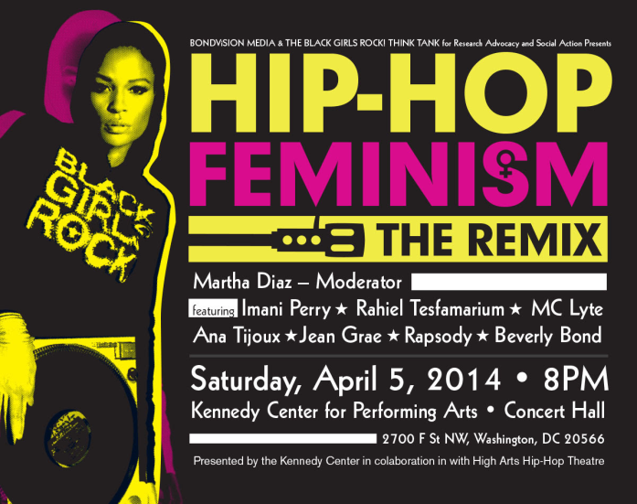
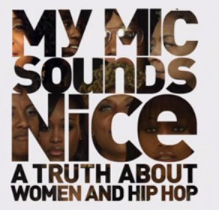
Feminists Take on Hip-Hop
Have my nigga snatch yo bitch and rape yo honey (Meek Mill)
Apologies or Appearances?
When we look at the lyrics scattered throughout the pages, we see some pretty disgusting lyrics right? Well what if I told you that the artist who spoke these words, had apologized? Does that make it better? Maybe, but let’s also examine what was at stake that lead to the apologies, and then we will take a vote if it was an apology, or if it was an appearance.
We first come to Rick Ross. He made lyrics that say “Put molly all in her champagne/ She ain't even know it / I took her home and I enjoyed that/ She ain't even know it”. After Reebok dropped him and he came under fire by the public he released an apology stating “Most recently, my choice of words was not only offensive, it does not reflect my true heart”. Since he was losing sponsors and fans before realizing the lyrics were not really from his heart, we vote that this apology was for appearances.
Verdict: APPEARANCES.
Cited from rollingstone.com
The Next artist we look at is, the young Rich Homie Quan. Only we are looking at TWO different songs and TWO different apologies. The first time he was “under fire” was with a supposedly leaked song with the lyrics “just want that cookie from her/ She tried to resist so I took it from her/ How are you gonna tell me no?” He said this song was not completed it was taken the wrong way, and it was leaked, so therefore forgive him because he didn’t mean to. Maybe, but then we see the SECOND round from him. This song’s lyrics under fire are “Chances ain’t shit if you don’t take one / Mansion full of bitches, about to rape one”. These ones were just because he was young with no mentor, and after all as he says he is too little to rape someone. Let’s vote, apology or appearance? Well with two on the record, we vote appearances.
Verdict: APPEARANCES.
Cited from Vibe.com
You call this shit kids, well I call these kids cum And you call this shit rape but I think that rape’s fun (Tyler the Creator)
Voices For Women In Hip-Hop
In a world full of the negative and the patriarchal roles, we have to recognize who is for us ladies. When analyzing who is there and who is actually using their positions to help women out, the list isn’t as long as we would like, but we will recognize a few of the ladies here now. The famous hip-hop group TLC has long since had songs that promote the independence of women. When looking at their most famous and recognizable songs, the first that comes to mind is “No Scrubs”. This song was catchy, and talked about how ladies don’t need to stele for a man, and that sometimes women are just powerful on their own. Another artist that comes up as being for us ladies is Missy Elliot. She has many songs that were subtle in her feminism, but none the less they brought out the truth. She reclaimed the slur “bitch”, she brought other women into her fame and helped them succeed (as shown by the collaborations), she talked about women in the work place being independent, and she talked about defying the beauty standards placed on women in this society. She was a more unsung hero for women in hip-hop.
These two need to be recognized when women in hip-hop are either the artists, or the girls in videos. These two are telling us through their music that women are more than just the video girls and subject’s men rap about.
( information from blog.izzyandliv.com)
get your ass beat the fuck up by Cindy
Obie don’t temp me, or I’ll rape this bitch and use no fuckin’ jimmy (Bizarre)
This is how she wants to be laced, I’m raping it
Anywhere, I’m taking it (Masta Killa)
Looking through her window, now my body is warm She’s naked, and I’m a peeping tom Her body’s
beautiful, so I’m thinking rape Shouldn’t have had her curtains open, so that’s her fate (Geto Boys)
We be, thuggers, stunners, hustlers Kidnap mothers, rape with no rubbers (Lil Wayne)
Hip-Hop Feminism and My Mic Sounds Nice
A show is coming near you! In collaboration with My Mic Sounds Nice, Hip-Hop Feminism is holding a show promoting the lovely ladies in Hip-Hop. This show is being held to promote strong women influences in a male dominated field. We are pleased to be able to show you some new talents, as well as cross the race lines and promote women of all colors. Admission is donation based, and all profits will be used to support ladies who are standing strong and fighting for women across the country. Come and support our women, and join in in the festivities. Booths for local and national women’s movements will be there to answer any and all questions!
2017
I had to rape his b*tch cause the hoe was stacked
I f*cked her from the back, with my gun to her back (three 6 mafia)
Images pulled from google

