Slide 1
Disability Resources for Students (DRS) Services Utilization Among School of Public Health Students
Chandra Wajdik, MPH & MSW student
Committee: Clarence Spigner (chair), Anjulie Ganti (advisor), Chelsea Elkins (member)
MPH Thesis presented on July 15, 2025
Notes:
Welcome everyone! Thank you for coming to my MPH Thesis presentation. My name is Chandra Wajdik and I will be presenting today.
DRS is the UW office that approves and manages disability accommodations for students.
This project is personal to me because I am a person who lives with disabilities. I chose studying DRS impacts on SPH students because of the barriers AND facilitators I noticed regarding DRS for disabled public health students like me.
Person-first language and identity-first language are two different ways of referring to people with disabilities. Person-first language emphasizes the individual before the disability (e.g., "person with a disability"), while identity-first language emphasizes the disability as an integral part of the person's identity (e.g., "disabled person"). There's no universally agreed-upon preference, and individuals may have strong preferences for one over the other. You will hear me use both forms.
Sample sizes are written in terms of number of responses because for several questions participants were allowed to make multiple responses for single survey questions.

Slide 2
Disability Services at Universities
Specific Aim: assess quality of DRS services at UW
Local context: anecdotal reports that UW DRS processes for obtaining and maintaining accommodations are overly burdensome, is this true?
National context: At four year vs. two-year universities, disclosure rates are lower, fewer accommodations are utilized, and staff to student ratios are higher, (Wells, 2025).
National context: Increased access to postsecondary education has resulted in positive outcomes for students with disabilities, but disability services have yet to be widely validated, (Shaw & Dukes, 2005).
Notes:
Specific aim: assess quality, won’t validate, need outside group to conduct that study
Local context: students talk about DRS processes as burdensome but is that really true?
National (light green): 4-year universities do a poorer job of creating a conducive environment for students with disabilities than 2-year universities.
National: increased availability of college and disability services have benefitted disabled students, but we don’t know if offices like DRS actually have the effects they intend to (not validated).
AND…from the literature it seems like college is good for people with disabilities, just not too much college. ☹

Slide 3
Methods
Survey was distributed to SPH student community and was created by a Public Health-Global Health Capstone mixed graduate/undergraduate course
n = 82 participants
Due to single survey questions being allowed multiple responses; analysis utilizes a mix of descriptive and inferential statistics
Notes:
This survey was distributed to SPH community and was created by a public health-global health capstone course.

Slide 4
Are you a current undergraduate or graduate student in the school of public health?
One-Sample Proportions Test
Graduate proportion = 38% Undergraduate proportion = 44%
Z = .663, p = .51, n = 82 responses
Conclusion: There is no significant difference between the proportion of graduate and undergraduate students among public health classes like these (p > .05).
Notes:
No difference between proportion of undergraduates and graduate students in samples like these.

Slide 5
What gender(s) do you best identify with? (Select all that apply)
n = 80 responses
Notes:
Female cisgender is the most popular sex/gender combination in the sample.

Slide 6
n = 82 responses
Notes:
Similar to other UW samples, White is the most common racial/ethnic identity, followed by Asian identities.

Slide 7
How would you rate your familiarity with DRS services and processes?
Notes:
Biased towards negative end—more responses in poor, fair, good categories. Relatively uniform until “good” then drops off.

Slide 8
Do you identify as someone who has a disability?
n = 82 responses
According to the Americans with Disabilities Act, someone with a disability is "a person who has a physical or mental impairment that substantially limits one or more major life activities, a person who has a history or record of such an impairment, or a person who is perceived by others as having such an impairment,” (ada.gov, n.d.)
Notes:
With 82 total responses, a slight majority at 43 are the no’s (indicating not disabled), and a slim minority with 37 are the yes’s (indicating disabled status).
The quote below the pie chart is the ADA definition of a disability that we used in this study and provided to participants.

Slide 9

Have you ever received DRS accommodations provided by UW?
n=80 responses
Notes:
I hypothesized 10% of SPH students have DRS accommodations, where the empirical estimated value in this survey is 30%.

Slide 10
n = 94 not disabled responses
n = 57 disabled responses
Notes:
The disabled and not disabled graphs are similar. Regardless of disability status, learning about the types of accommodations available is the most frequently endorsed response that students want to learn more about.

Slide 11
N = 101.2 responses
Notes:
The majority of students get information on disability and accommodations from:
--UW DRS website (29%) [orange]
--My instructors (21.3%) [dark green]
--My classmates (25.2%) [purple]

Slide 12
N = 192 responses
Notes:
Whether one is disabled or not disabled, the most important disability related resource provided to public health students is the types of accommodations available. This is generally not publicly available information at UW DRS.

Slide 13


Classes, accommodations, and student disability needs
Percent of classes that had active accommodations (Winter 2025, quarter survey was conducted) = 92%, n = 28 responses
Percent of classes with active accommodations that students felt met their needs = 98.7%, n = 31 responses
Notes:
Both the percentage of classes that have accommodations, and those whose accommodations met their needs are very high.

Slide 14
N = 31 responses
Notes:
1/3 of students rate it neutral or difficult to get DRS accommodations, certainly not okay.
Interestingly, 2/3 of students rate it easy to get DRS accommodations.
Future questions:
how to best support students, like how to best communicate the types of accommodations available.
what will make them eligible?
The 1/3 that reported difficulty obtaining accommodations were largely students identified as having a LTD. WHY?
→perhaps due to having good relationships with DRS advisors/counselors
→program level administrators (faculty directors and staff advisors) who have familiarity with the student, and can anticipate accommodation needs
E.g, at student's request, program level administrators could liaise with faculty teaching upcoming courses

Slide 15

How do we improve DRS at UW?
ADA.gov
US Department of Justice
Civil Rights Division
Main finding: 1/3 of SPH students reported having a difficult experience with DRS, 2/3 had a not difficult time getting accommodations; recommend facilitating good relations between DRS Access Coordinators, Program Level Admin (directors & staff advisors), and faculty.
UW DRS's processes for establishing accommodations are well-defined and rely on documentation from healthcare providers, verifying the student's disability and its impact. This aligns with standard practices for disability services in higher education.
UW DRS's practices and policies are likely influenced by and aim to comply with federal laws such as the Americans with Disabilities Act (ADA) and Section 504 of the Rehabilitation Act of 1973, which mandate reasonable accommodations for students with disabilities in higher education.
However, formal external validation or accreditation of DRS as a whole by a specific independent body focused on disability services in higher education has yet to be completed.
Notes:
UW DRS uses standard practices for disability services in higher education in determining student eligibility and establishing accommodations.
UW DRS aims to comply with ADA and the Rehabilitation Act of 1973.
An independent body focused on disability services has never validated UW DRS.
No studies or reports have been made evaluating the effectiveness of DRS accommodations in improving student outcomes.
UW DRS could go through an independent, external validation process (do they do what they say they do? Do they have the intended effects?) to improve their services.
With that, I will take any questions or comments you may have.

Slide 16
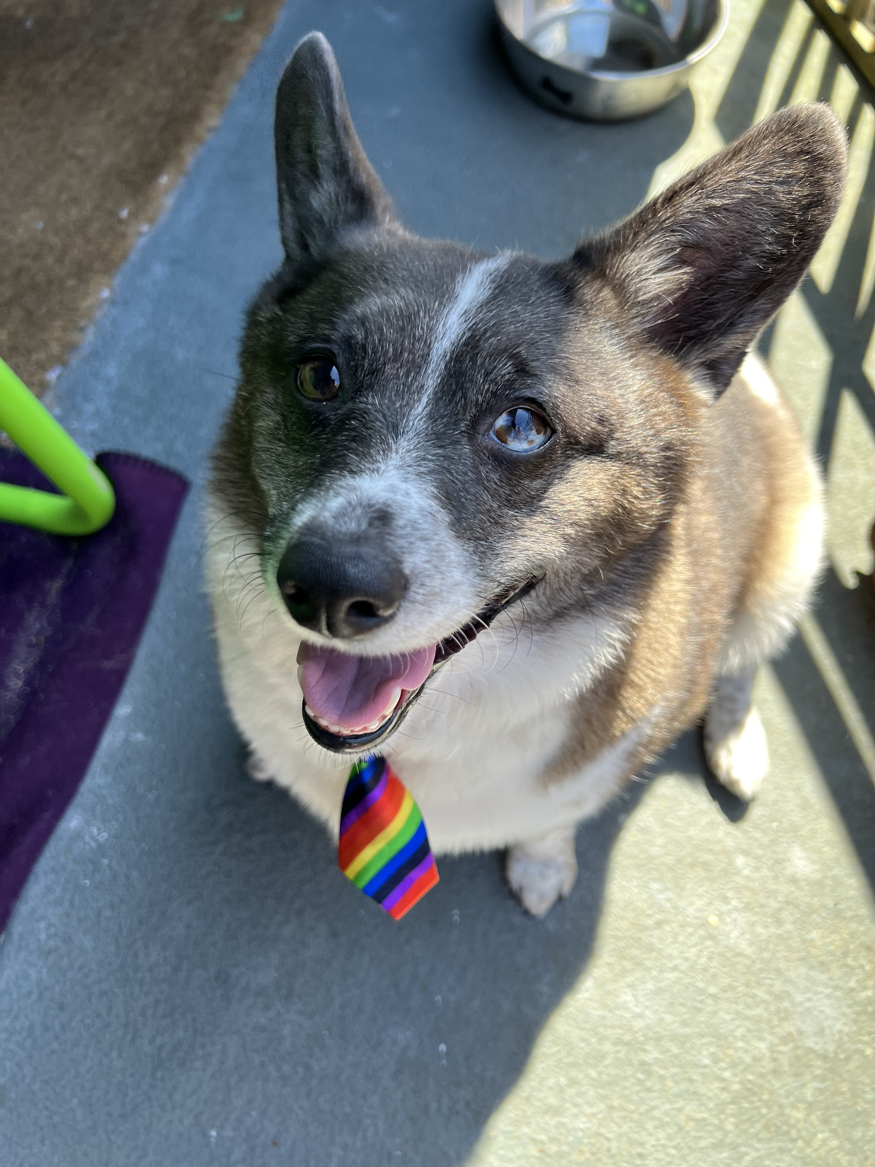
Thank you!
Dog: Dawn (Chandra’s corgi/blue heeler)
Notes:
This is my ESA, Dawn. She smiles all the time.
I’d like to introduce my committee, they are full of patience, intelligence, and humor. Chair Clarence Spigner, with the most reasoned arguments, Advisor, Anjulie Ganti, with the most original ideas, and committee member Chelsea Elkins, forever keeping me organized and making every effort to keep me on time. Thank you for all you have taught me.
I’d also like to thank DRS and the University of Washington for being the data source for this project.
Thank you everyone for attending my virtual thesis presentation!

Slide 17
References
ADA.gov. (n.d.) The Americans with Disabilities Act (ADA) protects people with disabilities from discrimination. US Department of Justice, Civil Rights Division. https://www.ada.gov/
Disability Resources for Students. (2024). Frequently Asked Questions. https://depts.washington.edu/uwdrs/faculty/faqs/
Shaw, S. F., & Dukes, L. (2005). Performance indicators for postsecondary disability services. Default journal. https://login.ezproxy.lib.usf.edu/login?url=http://search.ebscohost.com/login.aspx?direct=true&db=ofm&AN=507849656&site=ehost-live
Wells, M. (2025). Disability services in higher education: Statistical disparities and the potential role of AI in bridging institutional gaps. PLOS One, 20(5), 1–7. https://doi.org/10.1371/journal.pone.0322728

