Slide 1

Connecting People for Development: Why Public Access ICTs Matter
Findings of the Global Impact Study of Public Access to Information and Communication Technologies (ICTs)

Slide 2

Contents
Background
About the study
Findings
Recommendations
More information & other resources

Slide 3
Background
The history of public access to ICTs
Public access ICT research to date
Major critiques of public access venues

Slide 4

A Brief History of Public Access to ICTs
Possibly most visible ICT for development (ICTD) initiative during 1990s-2000s
Huge resource investments by governments and development agencies
Parallel emergence of profit-oriented public access enterprises
Primary aim of non-profit public access programs
  Close digital divides
  Enhance access to information for social and economic development
Theory of change
  Access to computers and the internet = access to information = improved health, education levels, employment opportunities, incomes, etc.
High expectations about impact of public access venues on development

Slide 5
Research on Public Access ICT Impacts
Hype of public access venues spurred much research
Public access was the top ICTD research area in the 2000s, but:
  Scattered, isolated studies
  Highly localized studies
  Mostly anecdotal impact evidence
  Inconclusive impact evidence
  No studies on indirect impacts or impacts on non-users
  Indications that “disadvantaged” populations not being reached – users mostly middle class, young, males.
  Conflicting claims about impacts of public access ICTs; uncertainty about return on investment

Slide 6
Main Critiques of Public Access ICTs
4 main critiques:
  Public access ICTs are failures because they are financially unsustainable
  Public access ICTs are only used for frivolous activities, such as playing games
  Public access ICTs are no longer needed because mobile phones have replaced them
  Public access ICTs are irrelevant as ICTs are now mainstreamed into other areas (health, agriculture, etc.)
The Global Impact Study was initiated to address these critiques and much more

Slide 7

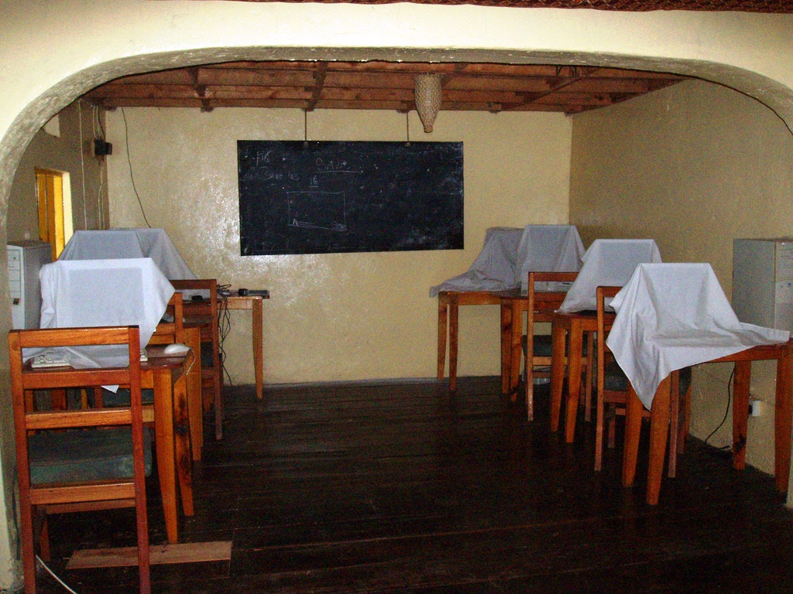
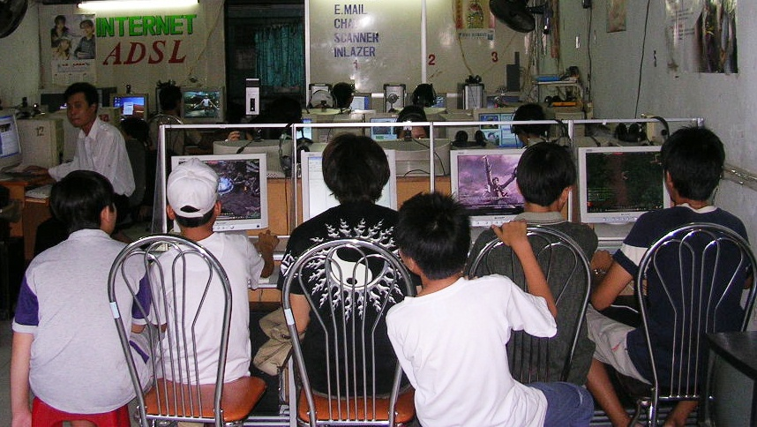
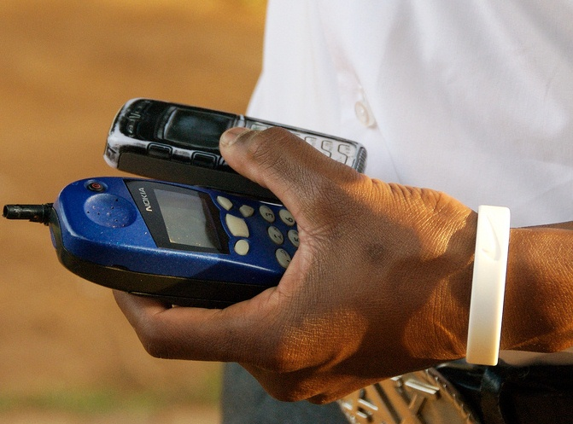
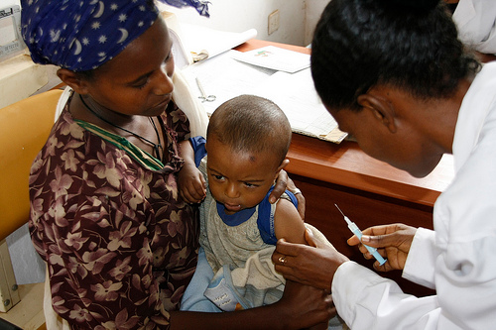
Are Public Access ICT Venues…
failures?
frivolous?
© make_change
© mikekogh
needed?
irrelevant?
© digital.democracy
© DFID

Slide 8
The Global Impact Study
About the study
Research design
Research methods:
  Inventory of public access venues
  Surveys of venues, users, and non-users
  In-depth studies

Slide 9
The Global Impact Study
Goal: To answer the question: do public access ICTs impact people’s lives?
  Generate evidence
  Produce policy and program recommendations
  Advance open research
Global five-year $5 million research project
Funding support from the International Development Research Centre (IDRC) and a grant to IDRC from the Bill & Melinda Gates Foundation
Led by the Technology & Social Change Group with over 30 research partners around the world

Slide 10
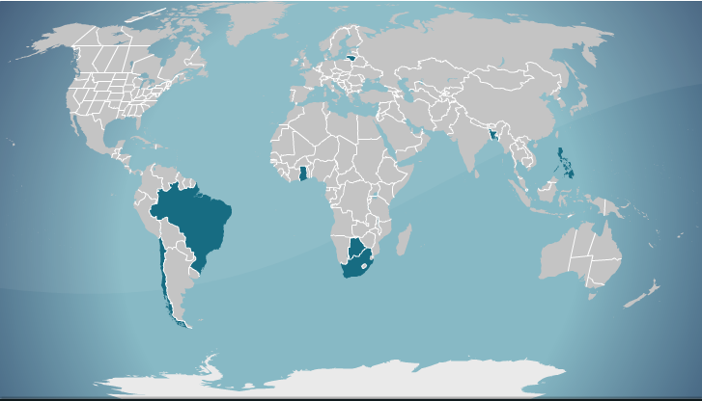
The Largest Study of Its Kind
Lithuania
Bangladesh
Ghana
Philippines
this is a blank slide for photos or graphics
Brazil
Botswana
Chile
South Africa

Slide 11
Range of Countries
8 countries: Bangladesh, Botswana, Brazil, Chile, Ghana, Lithuania, Philippines, South Africa
  Geographic and socio-economic diversity
  Low and middle income status
Rationale:
  To explore conditions that may facilitate impacts, not to compare one country to another
  To identify potential universally relevant findings

Slide 12
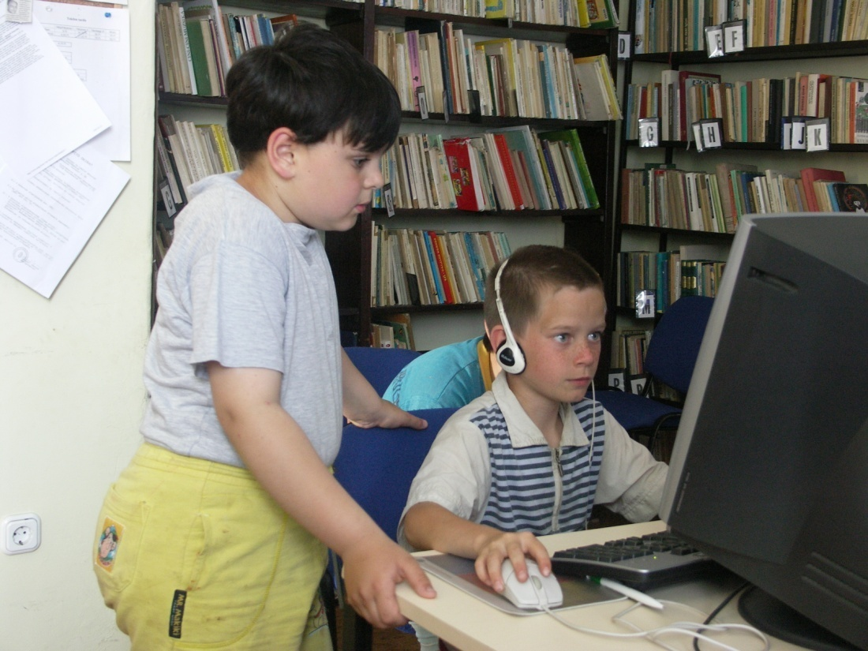
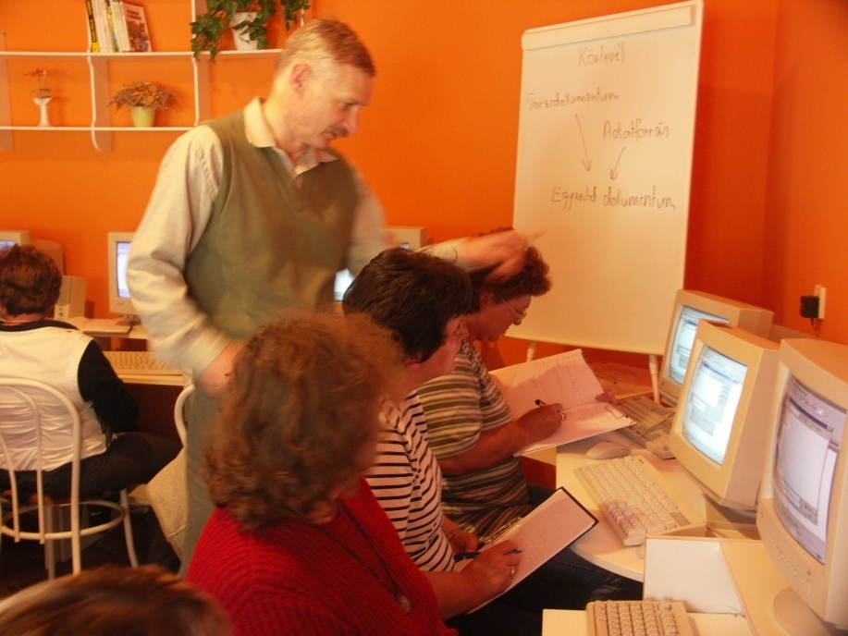
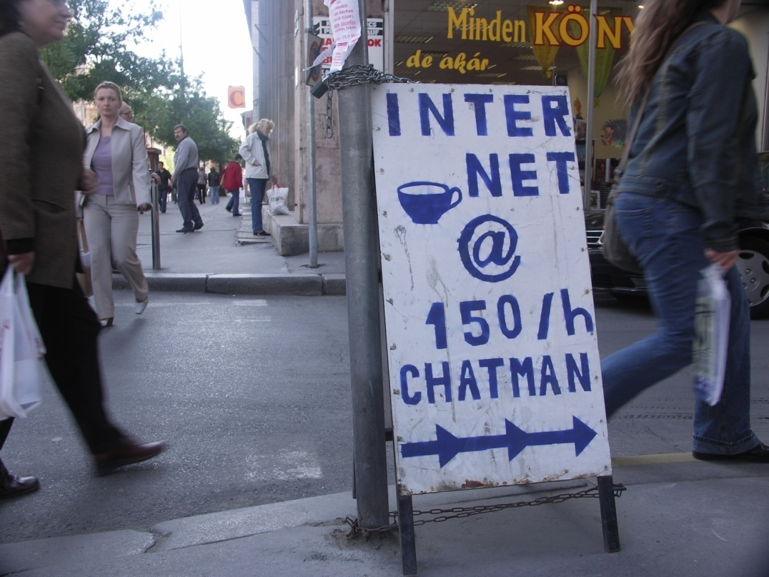
Explores Different Models of Public Access
libraries
telecenters
cybercafés

Slide 13
Different Models of Access
3 main types of public access venues explored:
  Public libraries
  Telecenters
  Cybercafés
Defined public access as any venue open to the public; does not have to be publicly funded
Cybercafés dominate the public access landscape in most countries

Slide 14
Definitions
ICTs: information and communication technologies - computers only, OR computers and internet; mobile phones were not included
Impacts: impacts of public access phenomenon, not evaluation of specific public access ICT programs

Slide 15
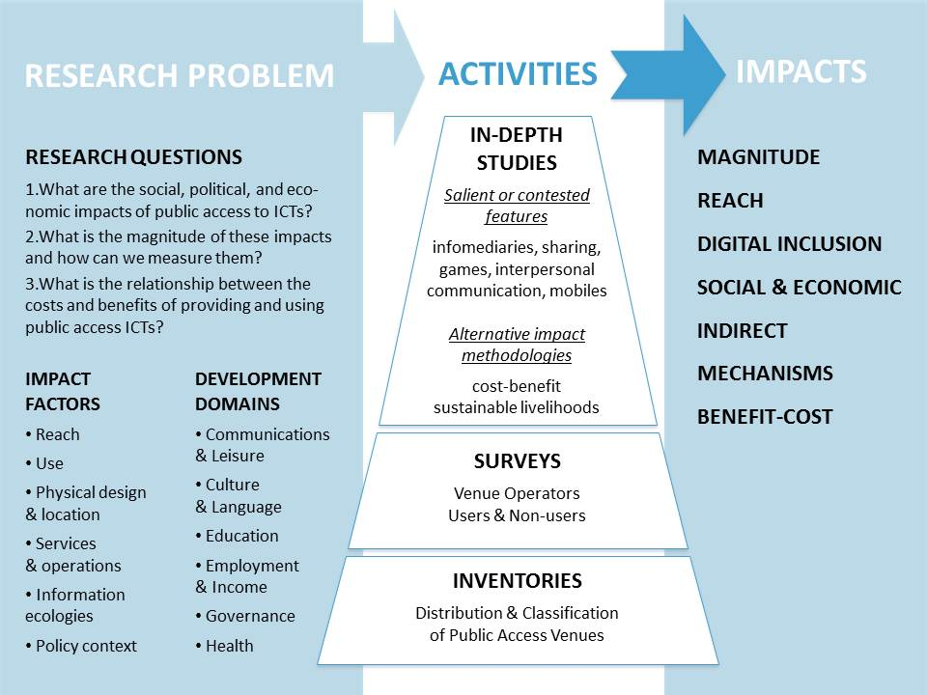
Research Design

Slide 16
Research Questions
The study explored 3 central research questions:
  1. What are the social and economic impacts of public access to ICTs?
  2. What is the magnitude of these impacts and how can we measure them?
  3. What is the relationship between the costs and benefits of providing and using public access ICTs?

Slide 17
Impact Factors & Development Domains
Impact Factors | Impact Domains
Reach | Communications & Leisure
Use | Culture & Language
Physical design & location | Education
Services & operations | Employment & Income
Information ecologies | Governance
Policy context | Health

Slide 18
Research Method #1: Inventory
The study began with an inventory to count and categorize all public access venues in selected countries
The inventory used existing administrative information sources
Helped to quantify the magnitude of the public access ICT phenomenon
Served as a sampling frame for surveys
Facilitated analysis by type of establishment, geographical location and other characteristics
6 countries: Bangladesh, Brazil, Chile, Ghana, Lithuania, Philippines
All of the inventory data is included in a web database

Slide 19
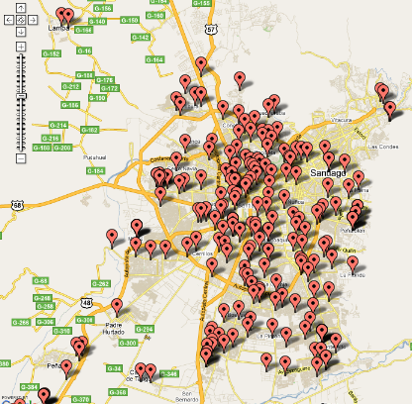
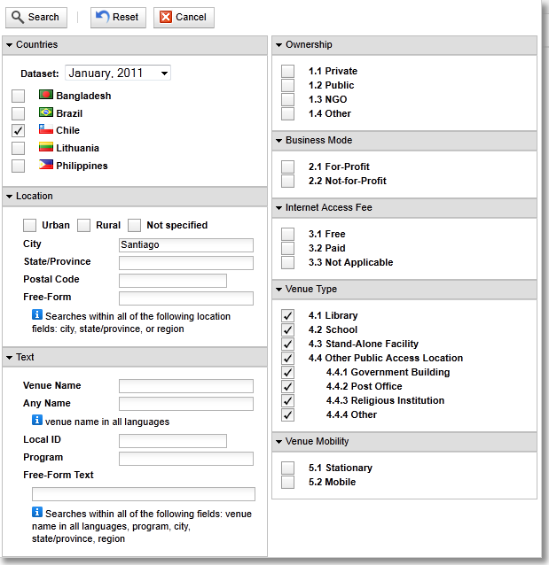
Inventory Web Database
Available at: http://database.globalimpactstudy.org/

Slide 20
Research Method #2: Surveys
5 Countries: Bangladesh, Brazil, Chile, Ghana, and Philippines
Venue Operator Survey
Identify venue design
Operational characteristics
Perceptions of impact
User Survey
Identify user characteristics
Usage patterns
Perceptions of impact
Non-user Survey
Identify non-user characteristics
Potential indirect impacts

Slide 21
Survey Sample
Venue Survey: 1,247 total (~250 in each country)
User Survey: 5,010 total (~1,000 in each country)
Non-User Survey: 2,000 total (~400 in each country)
Venue breakdown by country
 | Libraries | Cybercafés | Telecenters | Other | Total
Bangladesh | 4 | 99 | 148 | 0 | 251
Brazil | 6 | 192 | 39 | 5 | 242
Chile | 71 | 109 | 22 | 41 | 243
Ghana | 4 | 220 | 14 | 12 | 250
Philippines | 18 | 229 | 13 | 1 | 261
Total | 103 | 849 | 236 | 59 | 1,247

Slide 22
Research Method #3: In-depth studies
7 targeted topics were investigated to take a closer look at salient & contested issues surrounding public access ICTs
In-depth Study | Country Sites | Research Methods
Infomediaries & infomediation | Bangladesh, Chile, Lithuania | Ethnographies, focus groups, interviews, panels, field visits
Shared use & knowledge sharing | Ghana | User surveys, designing content sharing system, developing user behavior application
Gaming & non-instrumental uses | Brazil | User interviews, computer-based exercises
Mobile internet | South Africa | Operator interviews, user interviews, user surveys
Interpersonal communications | Philippines | User surveys, parent focus groups, operator interviews
Benefit-Cost | Chile | User surveys, non-user surveys, general population survey
Livelihoods | Botswana | User surveys, interviews, focus groups

Slide 23
In-depth study #1: Infomediaries
Purpose: To investigate the role of infomediaries and the process of infomediation in shaping outcomes for users at public access venues. An infomediary is defined as a person working in a public access venue who combines coaching and technological resources to serve users’ needs.
Countries: Bangladesh, Chile, Lithuania
Principal Investigators:
Ricardo Ramirez (University of Guelph)
Balaji Parthasarathy (International Institute of Information Technology, Bangalore)
Andrew Gordon (University of Washington)
Research methods:
Ethnographies
Focus groups
Infomediary interviews
Panels
Field visits

Slide 24
In-depth study #2: Collaborative Knowledge Sharing
Purpose: To explore why people share computers at public access venues and how people interact, share knowledge, and work together at cybercafés
Country: Ghana
Principal Investigator: Michael Best (Georgia Institute of Technology)
Research methods:
Cybercafé user surveys
Designing & deploying BusyBoard, an online content sharing system and display at a cybercafé
Developing & piloting a computer application to analyze video recordings of user behavior

Slide 25
In-depth study #3: Non-instrumental Uses
Purpose: To explore the value of non-instrumental uses (gaming, chatting, social networking) of public access ICTs and identify if computer skills are gained through non-instrumental uses, and if so, if these skills are transferrable to “productive” tasks
Country: Brazil
Principal Investigator: Beth Kolko (University of Washington)
Research methods:
Interviews with users
Administering computer-based exercises (CBEs) to users

Slide 26
In-depth study #4: Mobile internet
Purpose: To explore the interplay between public access venues and mobile phones and the advantages and disadvantages of different use models
Country: South Africa
Principal Investigators:
Marion Walton (University of Cape Town)
Jonathan Donner (Microsoft Research India)
Research methods:
Venue operator interviews
Interviews and task analyses with teenage venue users
User questionnaires

Slide 27
In-depth study #5: Interpersonal Communication
Purpose: To examine the role public access venues play in facilitating connectedness of families separated by overseas work
Country: Philippines
Principal Investigator: Erwin Alampay (University of the Philippines)
Research methods:
Surveys of children of overseas workers
Focus groups with parents who lived abroad
Interviews with cybercafé managers

Slide 28
In-depth study #6: Benefit-Cost Analysis
Purpose: To explore the costs and benefits of providing and using public access ICTs
Country: Mainly Chile, with user & non-user survey data from all survey countries (Bangladesh, Brazil, Chile, Ghana, Philippines)
Principal Investigator: Tyler Blake Davis (University of Washington)
Research methods:
Contingent valuation survey (by phone)
Non-user surveys
User surveys

Slide 29
In-depth study #7: Sustainable Livelihoods
Purpose: To explore the impact of public access venues on education, income generation, and employment opportunities for users
Country: Botswana
Principal Investigators:
Angelina Totolo (University of Botswana)
Jacobus Christiaan Renken (University of Botswana)
Research methods:
User surveys
Interviews
Focus groups

Slide 30
Findings
User snapshot
Digital inclusion
Social & economic impacts
Communications & leisure activities
Value of public access
Mobile phones

Slide 31
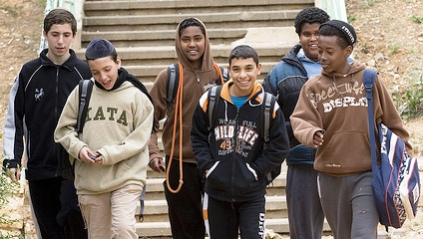
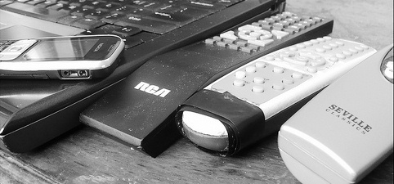
User snapshot
Majority of users are:
  Young (68% under 25 years old)
  Male (65%)
  Educated (82% high school +)
  Students (44%)
  Employed (39%)
  Proficient in English (74%)
Majority of users:
  Have +3 years computer & internet experience (60%)
  Have medium or high computer skills (80%)
  Have medium or high internet skills (69%)
  Own ICTs:
    Computers (56%)
    Internet access (28%)
    TV (95%)
    Radio (83%)
    Mobile phones (96%)
© Jewish Agency
© Corycam
31

Slide 32

Digital Inclusion
A major contribution of public access is digital inclusion (technology access, information access, and ICT skills)
Digital inclusion is necessary before people can realize social and economic benefits
© Dorian V.

Slide 33
The Critical First Touch
For more than half of the user survey respondents, a public access venue provided them with their:
  first ever contact with computers (50%)
  first ever contact with the internet (62%)
In countries with lower socio-economic standing (Bangladesh & Ghana), public access provided almost 80% of users with their first contact

Slide 34
Only Option for Access
Public access venues were the only source of access to the internet for at least a third (33%) of survey respondents
The majority of respondents (over 55%) would see a decrease in their use of ICT if public access venues were no longer available

Slide 35
Access to Information of All Kinds
Users see public access venues as places where a broad range of information needs can be met
Almost half of users (47%) had come to the public access venue on the day of the survey to look for specific information

Slide 36
Digital Literacy – ICT Skills
Users identified public access venues as the most important place at which they developed their computer (40%) and internet (50%) skills – more than home or school

Slide 37

Venue Staff Support Digital Inclusion for Novice Users
7% of all users use public access mainly to get help from venue staff
© quinn.anya
22% of users in Bangladesh use public access mainly to get help from venue staff
Users in Bangladesh have lower computer/internet skills and experience
Staff empathy is more important than ICT skills for novice users
While ICT skills are more important for advanced users, they too welcome empathy in a different form (e.g. being left to work without interruption)

Slide 38
Digital Inclusion – Non-Users Benefit Too
  18% of non-users surveyed were former public access users
  30% of ex-users first used a computer at a public access venue
  35% of ex-users first used the internet at a public access venue
  40% of former users developed their computer & internet skills at a public access venue

Slide 39

Social & Economic Impacts
The positive impacts of public access venues are most experienced in the two areas of universal relevance to users – communication and education
In other areas, positive impacts are experienced by users when the area is more relevant and higher priority
Particular impacts do not have to be experienced by a majority of users in order to be considered important

Slide 40
Impacts Vary Across Categories
Highest proportions of perceived positive impacts in social, leisure, & education
Lowest proportions of perceived positive impacts in many of the priority domains
High proportions of no perceived impact in many categories
Highest perceived negative impacts in financial savings and time savings

Slide 41
Domain Use Levels Can Explain Perceived Impacts

Slide 42
Perceived Positive Impacts Increase
with Use Frequency
For each domain, positive impacts were most likely to be perceived by people who had used that domain in the last 12 months
All domains showed a dramatic increase in perceived positive impact perceptions for the users who more frequently used a venue for that domain

Slide 43
User Needs Drive Use
The number one reason people don’t use public access for particular domains is because they didn’t have the need

Slide 44
Goal Achievement
Did you search for a job? (57%)
Did you find information to apply? (89%)
Did you apply? (91%)
When users do use public access for specific reasons, they are successful in doing so and in following though
Across all tasks in all domains, approximately 90% of users took action based on the information they found
Public access is useful when people have an information need
Employment & Income
Did you search for info on how to use government services? (64%)
Did you find information you were looking for? (94%)
Do you feel more knowledgeable on how to use? (95%)
Governance

Slide 45
Indirect Impacts
  Non-users also benefit from public access ICTs
  Indirect impacts of public access venues ripple out into communities
  60% of non-users have family or friends who use public access
  Up to 63% of non-users perceive positive impacts from family/friend’s use of pubic access

Slide 46
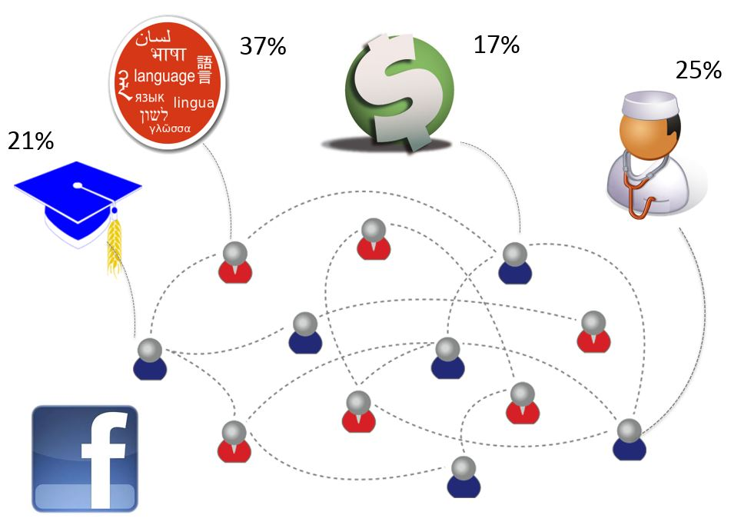
Communications & Social Networks
Communications and leisure activities at public access venues can contribute to development goals
Large percentages of users (12-37%) said that email or social networking was the most important resource for achieving goals in various domains
Using public access ICTs for communicating with friends and family can lead to other impacts and support development aims

Slide 47


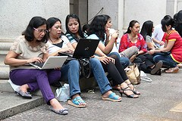
More than Fun & Games
Non-instrumental uses (gaming, social) can lead to instrumental (employability) skills
Public access can help keep families connected when separated by migrant work
© KC Wong

Slide 48
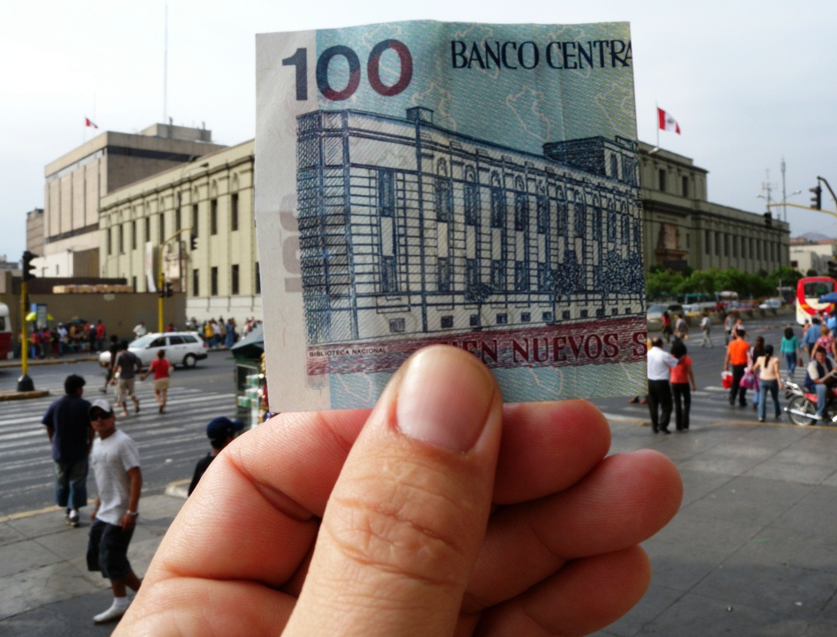
The Value of Public Access
© Ryan McFarland
(National Library in Peru)

Slide 49
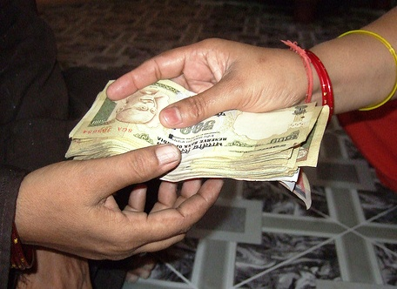
People Value Public Access:
Willingness to Pay
People want access, regardless of where it is: Where users don’t have a variety of venue options, they are prepared to pay to get to whatever venue is available
Non-users value public access: Non-users are willing to pay for other people to have public access
© IMTFI

Slide 50
Libraries are Highly Valued…
Where they Exist
Where people do have a choice of venues, public libraries are highly valued where they exist

Slide 51
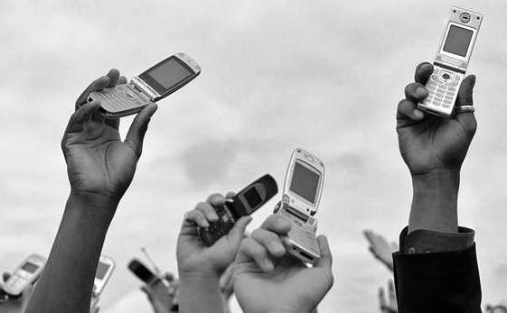
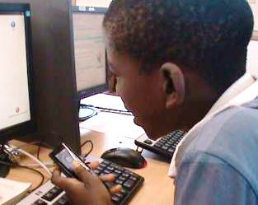
Mobile Phones are Not a Substitute
Almost all users surveyed have a mobile phone (96%)
85% of users have never used mobile internet
The majority (88%) of public access users use a mobile phone daily or almost daily
Only 4% of non-users don’t use public access venues because of mobile phones
© ICT4Gov.net
Researchers in South Africa found that mobile phones complement, rather than replace, public access venues
Teens have developed practices to maximize use of both mobile phones and public access computers & internet
© Marion Walton

Slide 52
Public Access Moving Forward
Is public access still relevant?
Recommendations
  For governments & donor organizations
  For practitioners
  For researchers
Open data
More information & resources

Slide 53
Is Public Access Still Relevant?
YES, public access is still relevant!
Public access…
  Plays a critical role in extending the benefits of ICTs to many
  Constitutes the only option for access for many
  Has not been replaced by mobile phones for ICT access
  Is part of an ecology of information and communication resources including mobile phones, TV, radio etc., all of which have a role in meeting people's information needs
  Can play an important role in all countries, regardless of the level of connectivity or socioeconomic factors

Slide 54
Recommendations: Government & Donor Organizations
1. Provide strategic support for public access venues: Based on ICT access levels and needs of particular communities
2. Use existing infrastructure: Consider leveraging public library and cybercafé facilities where they exist
3. Provide and publicize specific information and services through public access venues: For example: government, educational, or health information
4. Embrace communications and non-instrumental uses: Restrictions on uses such as gaming, chatting, and social networking eliminate alternative pathways to building ICT and workplace skills
5. Assess performance against realistic measures: Public access venues may foster internet access and the development of basic digital skills, but cannot guarantee other outcomes such as increased income

Slide 55
Recommendations: Practitioners
1. Adopt a flexible approach to rules: Some restrictions can inhibit behaviors that have the potential to lead to development outcomes. Make adjustments to policy while being sensitive to the needs of users, societal trends, and new knowledge.
2. Embrace mobile phone services: Venues may be able to enhance their services by introducing mobile-based services such as Wi-Fi access for mobile phone users or computer reservations through SMS
3. Do not rule out fees too quickly: Users have demonstrated willingness to pay for public access ICT facilities. Venues facing sustainability challenges could consider charging fees, taking into account socioeconomic status of priority groups and potential users.
4. Design venue environment to facilitate infomediation: Venue configuration can be adjusted to meet the collaboration needs of users and to enable venue staff to spot which users need assistance and which do not
5. Make users aware of content availability in priority domains: Actively publicize available resources relevant to areas of priority concern

Slide 56
Recommendations: Researchers
1. Build on methodological lessons: Much work remains to be done to develop and strengthen methodologies for conceptualizing, identifying, and measuring public access impacts
2. Explore open inventory and survey data: Conduct deeper analysis; for example, exploring specific user populations, past impacts and indirect impacts of public access using the study’s openly available datasets

Slide 57
Open Research, Open Data
The Global Impact Study embraced an open research approach by making publicly available all of the datasets, research tools and instruments, methodology, and more
All resources are freely available to the public for access, use, and adaptation under a Creative Commons Attribution Share-Alike license
To access the inventory data, visit: http://database.globalimpactstudy.org/
To access the survey datasets and instruments, visit: http://www.globalimpactstudy.org/resources/resources-surveys/
To view a subset of the data and create data visualizations, visit: http://spark.rstudio.com/tascha/globalimpactstudy/
All other Global Impact Study resources can be found at: http://tascha.uw.edu/projects/global-impact-study/publications/

Slide 58
More Information
More information about the Global Impact Study of Public Access to ICTs can be found here: http://tascha.uw.edu/projects/global-impact-study/
The material presented in these slides is based on the final report of the Global Impact Study, Connecting people for development: Why public access ICTs matter – available here: http://tascha.uw.edu/publications/connecting-people-for-development
For questions, please contact tascha@uw.edu

Slide 59
Thank You
Technology & Social Change Group
tascha.uw.edu | @taschagroup

