Slide 1
Kenyan public librarians’ role in mobile-centric information access
Stacey Wedlake & Karah Lothian
May 2018
Notes:
Hello, I’m Stacey Wedlake, and I work with the Technology and Social Change Group or TASCHA. TASCHA is an applied research center located within the Information School. I’m interested in what technology skills and access people need to accomplish their goals and how systems can support people reaching their goals. I have my MPA and MLIS from UW, and before entering the research world I taught digital literacy classes for adults here in Seattle and while a Peace Corps Volunteer in Mongolia. My co-presenter today is my colleague Karah. Could you introduce yourself?
My name is Karah Lothian. I am a research assistant at TASCHA. Currently, I am a graduate student in the Learning Sciences and Human Development Program in the College of Education at UW. My research interests include cognition & communication, learning across settings, and teacher inquiry through technology-based supports. I support the research team with an educational perspective, which was put into practice over the previous ten years, as a teacher for students with communication differences.

Slide 2

Outline
Identifying a need for Mobile Information Literacy
Implementation in Myanmar
Implementation in Kenya
Exploring Kenyan public librarians’ information access via information worlds
Notes:
In our talk today, we’ll cover a few different topics,
first, I’ll talk how we identified a need for Mobile Information Literacy including the project’s history in Myanmar. Next, I’ll talk about the current implementation in Kenya. Finally, we’ll talk some inprogress research from the MIL implementation in Kenya. Informed by the theory of information worlds, we’ve started to explore Kenyan public librarians’ information access and their influence on their communities information access.

Slide 3
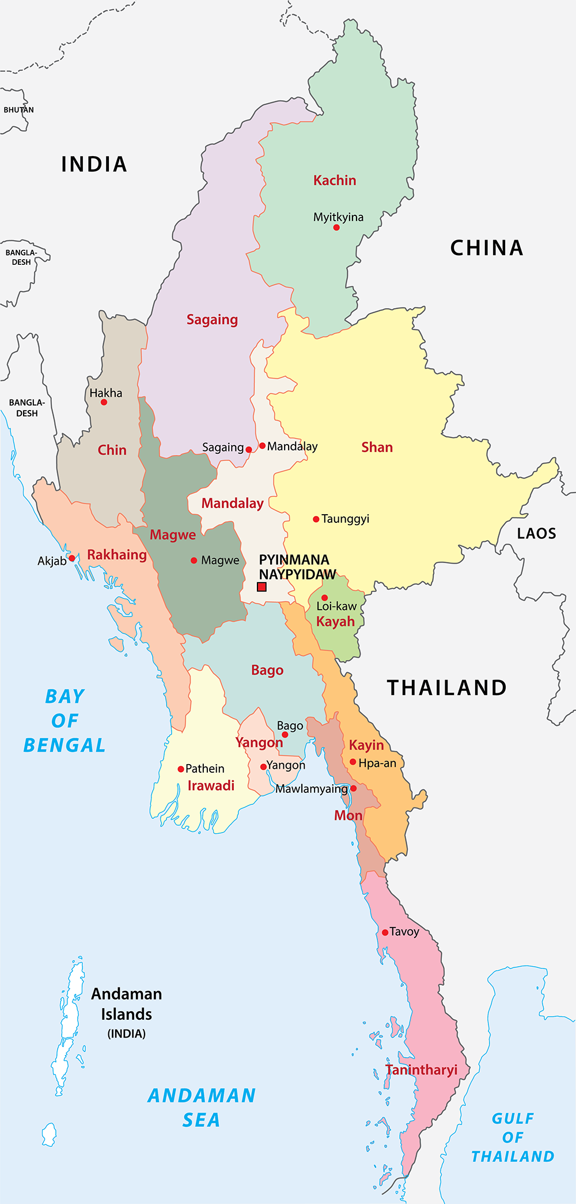
It all began with Myanmar
Mobile subscription rate:
  2011 2.4% (World Bank)
  2016 92.7% (ITU)
2016 54.5% (ITU) active mobile-broadband subscription
5,000 Libraries in Myanmar
Notes:
Before we get to Kenya, I’m going to talk about how TASCHA started working on Mobile Information Literacy.
In 2014, as part of a project with the Jackson School of International Studies working with Myanmar libraries and other civil society organizations.
After decades of military rule, Myanmar that faced unprecedented leapfrog into the internet and specifically the mobile Internet. Before market liberalization in 2013/2014, you had to enter a lottery to get a mobile sim card and then sim cards cost upwards of $2,000. In 2011, the mobile penetration rate was 2.4% and was 92.7% in 2016.
TASCHA sought a digital and information literacy curriculum that librarians could use to address the digital and information literacy needs of the Burmese library communities. However, at the time, the digital literacy curriculums were still primarily focused on PC skills and and mobile-specific skills that Burmese require.
92.7% mobile subscribtion
54.5% active mobile-broadband subscritopion
Myanmar citizens lacked foundational knowledge needed to manage the recent unprecedented access to information and ICTs.
So back in 2014, for the project “Information Strategies for Societies in Transition” which was a TASCHA/Jackson School of International Studies collaboration. This program was developed to address the challenges Myanmar faces as it seeks to “catch-up” in the world’s most economically competitive region.
The larger project has four major components: (1) building organizational capacity in civil society, political parties, the media, government ministries, and think tanks to design and implement effective and transparent information solutions; (2) developing and implementing mobile information literacy curricula; (3) growing the capacity of libraries to serve as trustworthy information hubs; and (4) piloting new platforms that tackle digital and information challenges in Myanmar. The program is supported by United States Agency for International Development (USAID), Microsoft, the Bill & Melinda Gates Foundation, and the Tableau Foundation. The program is housed in the University of Washington's Henry M. Jackson School of International Studies and is run in collaboration with the Technology & Social Change Group (TASCHA) in the University of Washington’s Information School, and two partner organizations in Myanmar: the Myanmar Book Aid Preservation Foundation (MBAPF) and Enlightened Myanmar Research Foundation (EMReF).
Talk briefly how
For this mobile-centric country, needed to create information and digital literacy curriculum
Information Literacy Curricula
Digital Literacy Curricula
Mobile curricula
https://www.itu.int/en/ITU-D/Statistics/Documents/publications/misr2017/MISR2017_Volume2.pdf

Slide 4
Created own approach
Information Literacy
Frameworks
Digital Literacy
Framework
SCONUL
Identify
Scope
Plan
Gather
Evaluate
Manage
Present
Empowering 8
Identify
Investigate
Choose
Set
Make
Attend
Assess
Apply
EU DIGCOMP
Information
Communication
Content-creation
Safety
Problem-solving
Notes:
And I think most of us here would agree that using the Internet on a smartphone is not the same experience as using the Internet on a PC. So, TASCHA created our own approach.
We did a comprehensive literature review on different information literacy and digital literacy frameworks. If you’re not familiar, American Library Association defines information literate as a person that can recognize when information is needed and have the ability to locate, evaluate and use effectively the needed information" [When I say we, I’m using the royal we. I wasn’t apart of TASCHA during this first phase]
As part of the literature review, three frameworks guided our development:
two information literacy frameworks: one from the Society of College, National and University Libraries (SCONUL) represents all university libraries in the UK and Ireland
and the other called Empowering Eight (E8), an Information Literacy Model was developed at this workshop organized jointly by IFLA -ALP and the National Institute of Library & Information Sciences (NILIS) of Sri Lanka. There were participants representing ten South and Southeast Asian countries.
EU Digcomp framework - 5 main competency areas; comprehensive digital literacy framework. It’s been updated since we developed the framework. Now it’s incredibly robust with sub-competencies and then 8 profency levels within each sub-compentecy. However, it is through an European lens and still mainly PC-based.

Slide 5
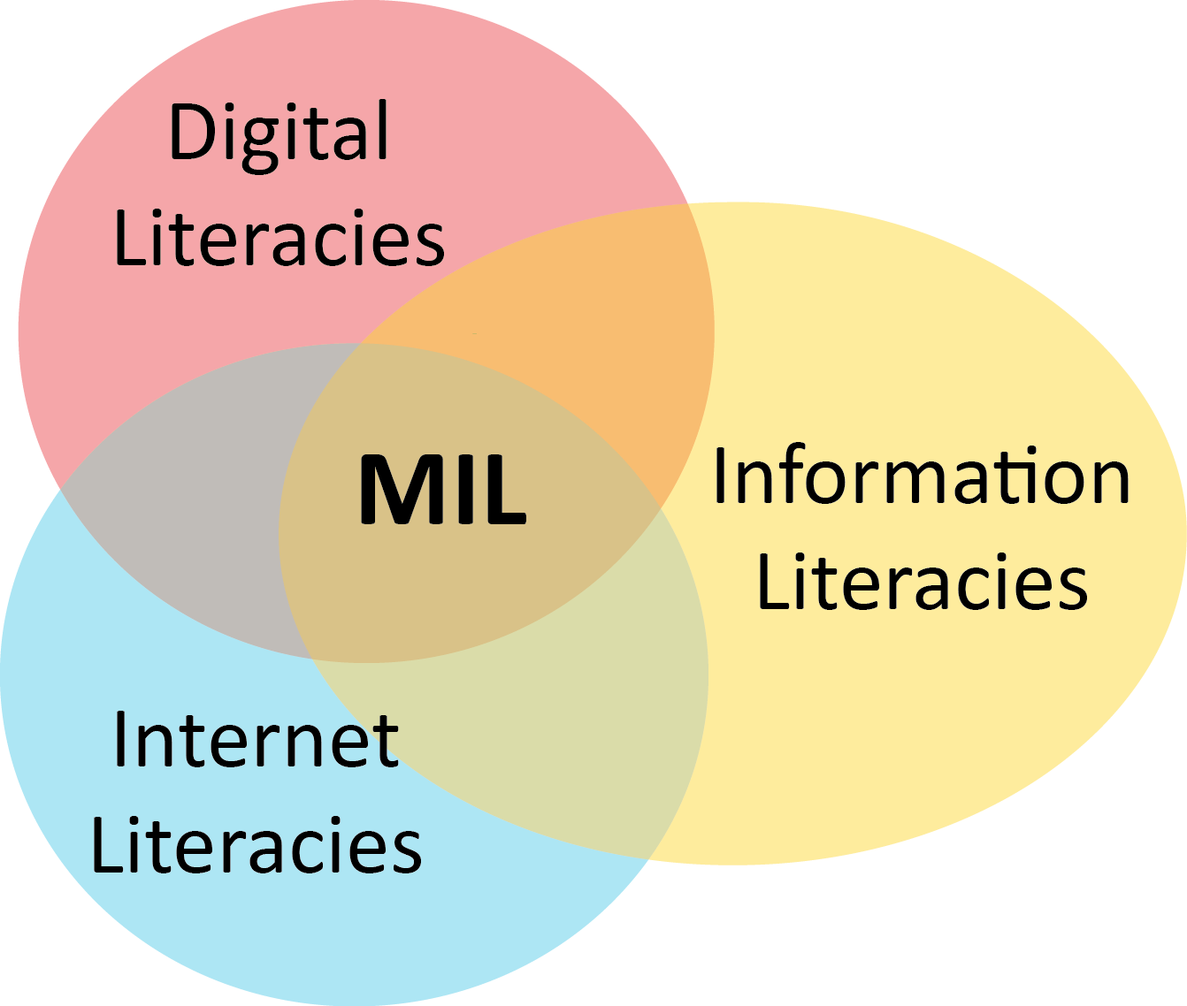
Mobile Information Literacy (MIL)
Notes:
The outcome was this was mobile information literacy. We define mobile information literacy as the combination of digital, internet, and information literacies needed for smartphone-centric populations. We argue that it’s important to think about MIL separately from traditional, PC-based digital literacy. Influenced by Jonahtahn Donner’s After Access lens, We believe the different affordances and limitations of different devices shape how people interact with information, and even one’s conceptualization of the Internet itself. We think that using a smartphone doesn’t just require different operational skills but distinct informational skills as well.
Additionally, this work is Informed by constructivism and social/cultural educational theories
Emphasizes social learning (i.e peer-to-peer, project-based)
Brings technology learning into social spaces (such as libraries) where people can develop both ICT-related skills and also collaboration, group design thinking and others.

Slide 6
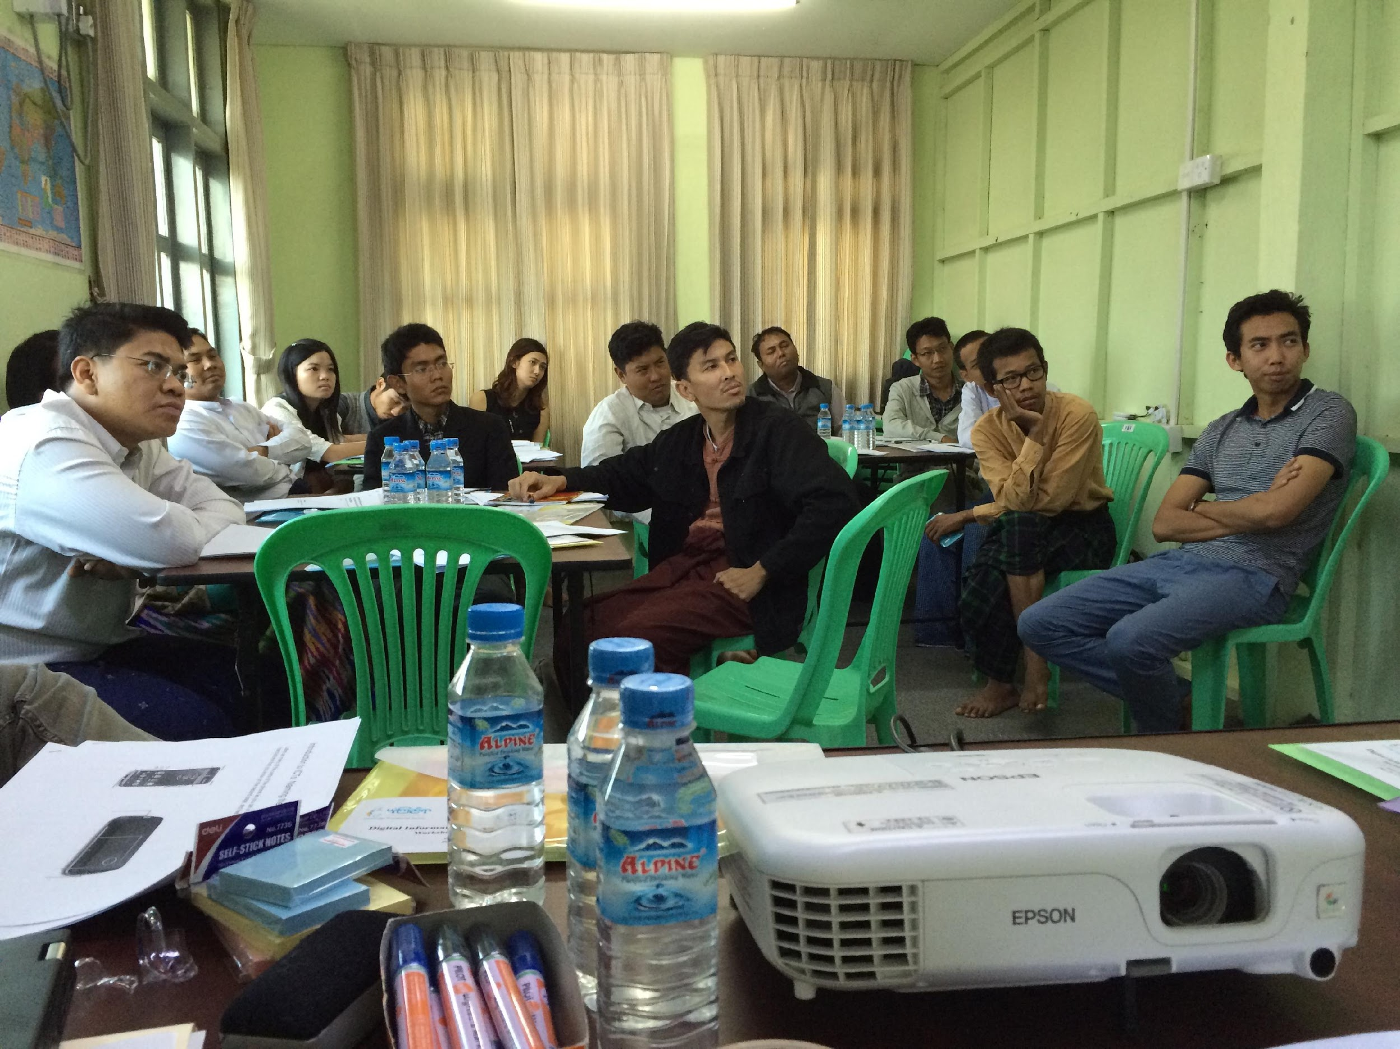
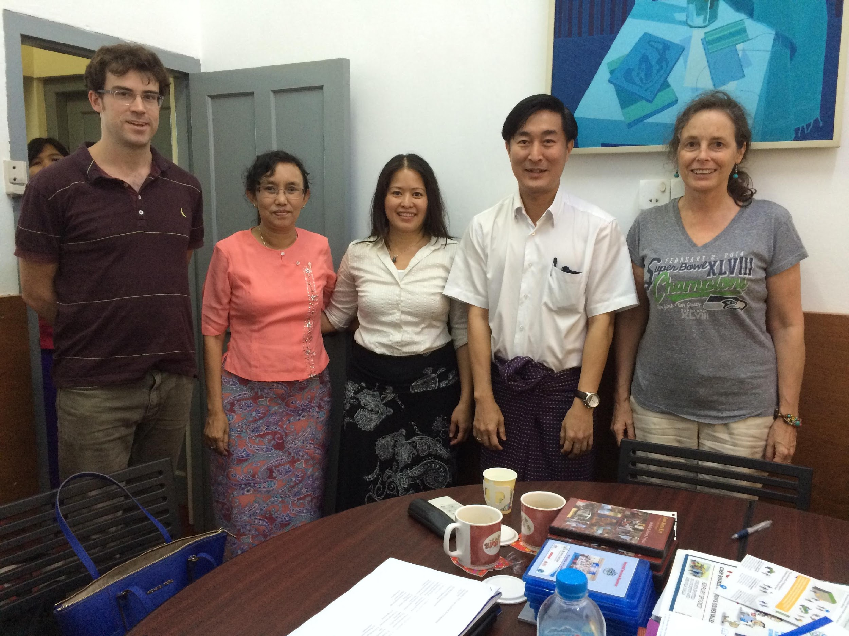
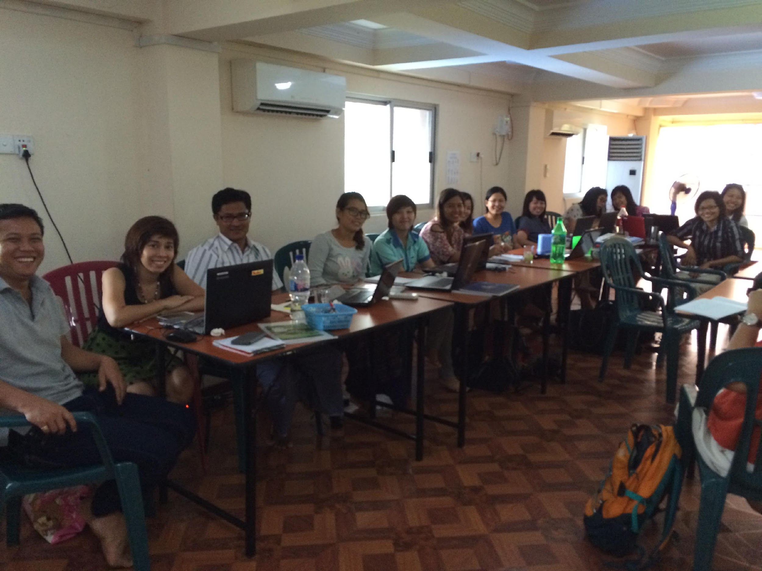
MIL in Myanmar
Pilot
Feedback 2
Implementation
Jan. 2015
Feb. 2015
April 2015
Module 1 | Intro to Mobile Information and Communication Technologies (ICTs)
Module 2 | A Mobile Lens on the Internet
Module 3 | Basic Web Searching via Mobile Devices
Module 4 | Working Online and Using Information via Mobile Devices
Module 5 | Putting It All Together
Module 6 | Module 5 Project Presentations
Notes:
The Myanmar Curriculum implementation was developed over the course of 2015.
Curriculum + Training Guide + Sample Slide Deck
Customizable, modular format
Active Learning Pedagogy
Student-centered approach
Project-based learning
Mistakes as learning
Creative Commons License

Slide 7
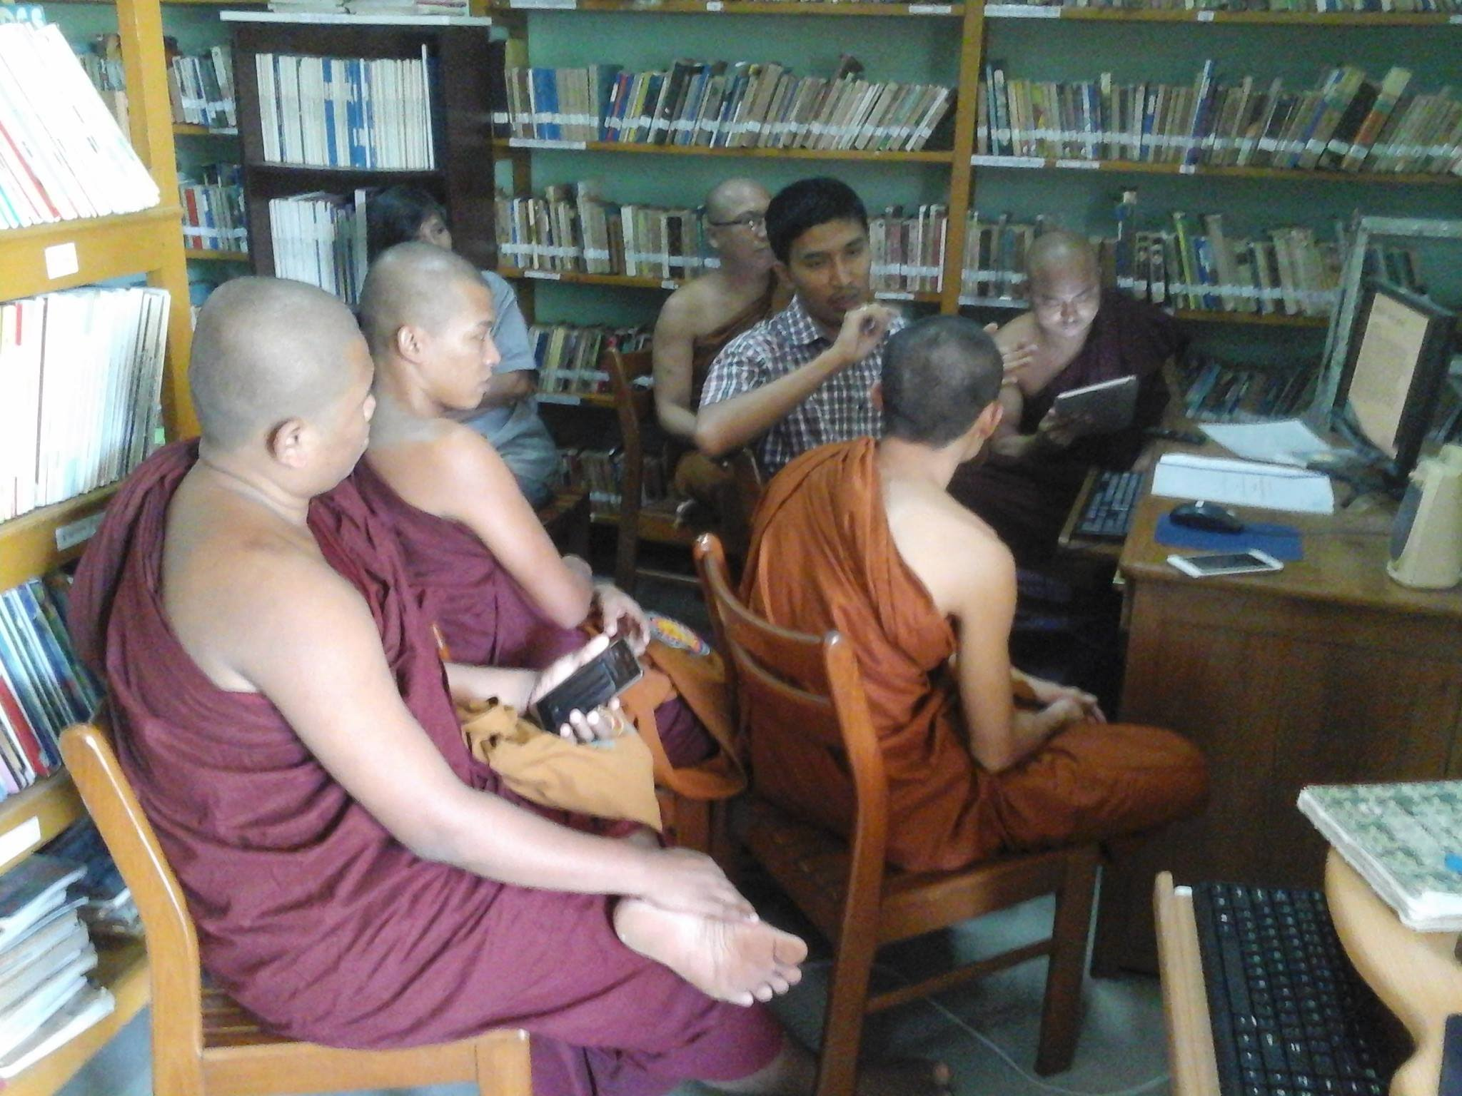
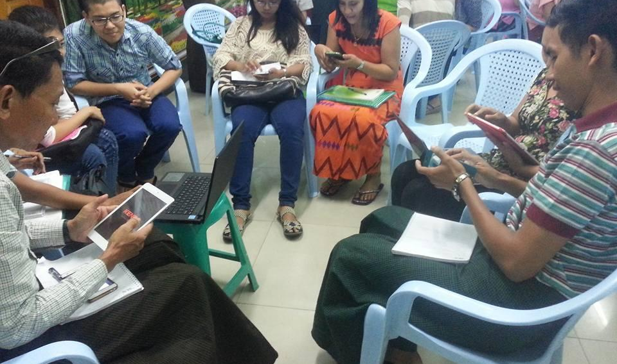
Continuing Demand for MIL
MIL, Mettananda Library
January 4, 2016
MIL, Sun Institute
“Working Online” Module
April 30, 2016
https://www.facebook.com/photo.php?fbid=923764287719400&set=pcb.534049610095328&type=3&theater
https://www.facebook.com/photo.php?fbid=10210120113229164&set=pcb.580958992071056&type=3&theater
Notes:
Myanmar Book Aid Preservation Foundation has continued the trainings in Myanmar and currently can’t keep up with demand. Estimates 10,000 have been trained.
. Union Civil Service Board- adopted the curriculum
2. Ministry of Education- Library and Information Study course
- Universities students
3. Ministry of Information Staffs
4. MBA course
5. Community Librarians and their cascade training
6. Agricultural extension workers from NGO and Ministry of Agriculture and university worked with UNESCO
7. Ministry of immigration
8. Tourism police

Slide 8

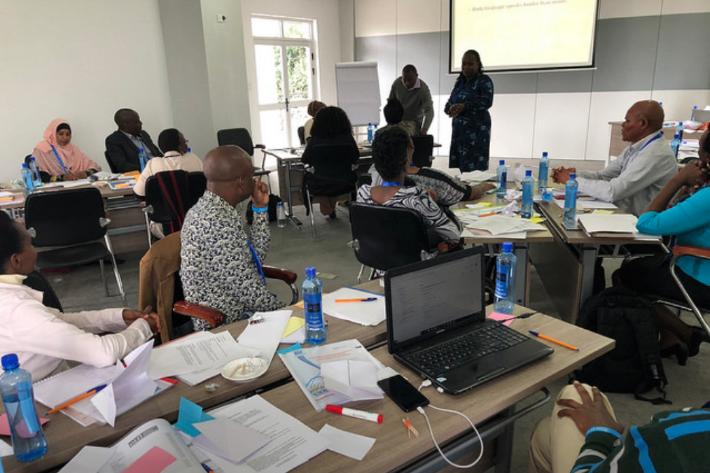

Mobile Information Literacy in Kenya
March 2018: Nakuru, Kenya
Cascade MIL and teaching training for Kenya National Library Service
Notes:
EIFL and KNLS were interested in adapting the curriculum for use in Kenya.
EIFL works with libraries to enable access to knowledge for education, learning, research and sustainable community development.
KNLS - 62 public libraries across the country
In 2018, EIFL and KNLS were partnering together on an 18 month program to strengthen the professional development training of public librarians. There would be different topic areas and then librarian would teach each other. The 32 selected trainers will attend six training-of-trainers workshops led by trainers drawn from the international library community. The newly-skilled trainers will train their colleagues according to the master plan for continued professional development of KNLS staff. In the case of MIL, it will cascade down to the public library community members.
Based on the existing curriculum, lessons were swapped out and overall training time shortened.
Mobile penetration at 81.3 (recent numbers closer to 90)
active mobile subscriptions 26.2%
mobile data numbers

Slide 9
About the participants
20 participants from the Kenya National Library Service (14 from public libraries)
Selected to participate in a year-long professional development program
All brought their own smartphones (some had multiple)
Educated (half have Masters’ degrees)

Slide 10
MIL Kenya
Mon & Tues | EIFL training skills curriculum
Wed | Introduction to Smartphones and Mobile Internet
 | Mobile Security and Information Searching
Thurs | Making mobile phones work for you (includes local apps)
 | Accessing library e-resources on smartphones
Friday | Practice teaching using mini-modules
Including 7 mini-modules (lessons lasting about 30 minutes long)
Notes:
Powerpoint, mini-modules
situated within EIFL’s train-the-trainer training
In response, we created a MIL curriculum.It was designed to support individuals in reaching their personal goals, whatever they may be, using mobile devices. We’re not arguing that smartphones are replacements for PCs - just that if that’s the device they have - what skills support their needs?
The curriculum covers how to minimize mobile data usage, how to safely search for apps and identify what permissions the apps request, mobile-specific search strategies - including how to fact-check images, staying safe from online scams, and using locally relevant apps. It’s structured to be done as part of a multi-day training but can be easily broken into smaller chunks. The curriculum is shared on our website - tascha.uw.edu - available for implementation and adaptation. (Although our latest adaptation isn’t up yet. It will be soon!) The approach emphasizes social learning (hands on, peer-to-peer, and is project based).
locally relevant content: Facebook was more of a focus in Myanmar. WhatsApp, Kenya specific applicaiton
focus on library resoruces
different types of content - full modules and mini-modules
focus on social learning, hands-on activities
Adapated exisiting MIL lessons but also borrowed Mozilla Digital Skills Observatory lessons and other Creative Commons licensed materials online.

Slide 11
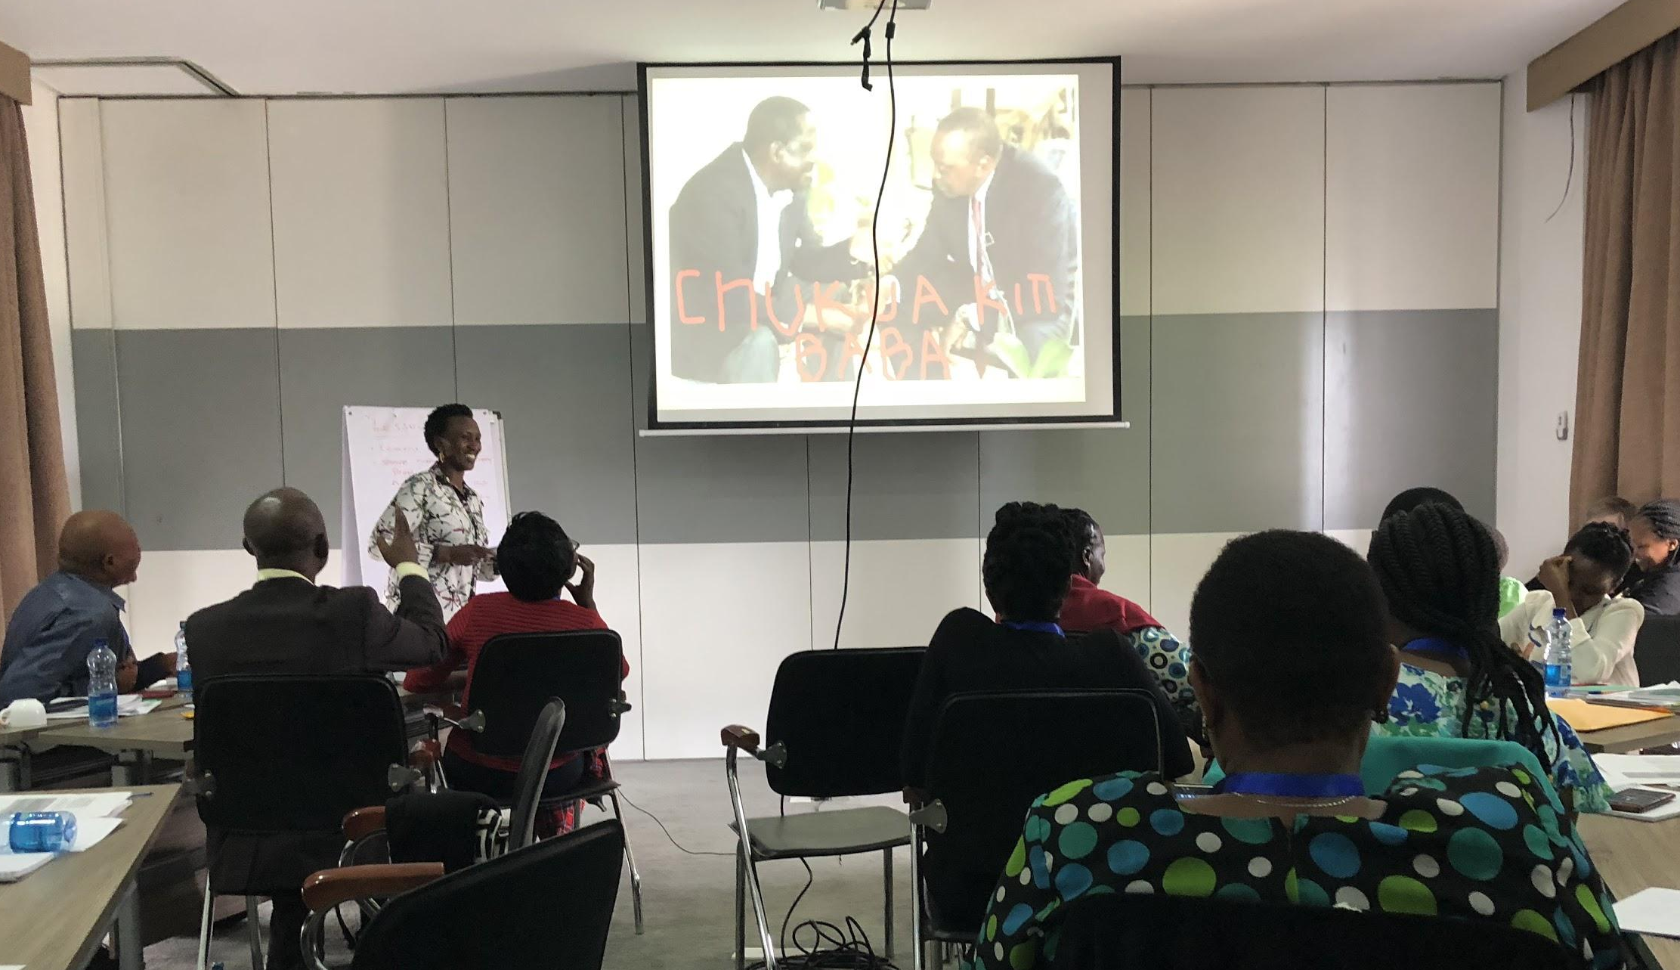
Friday: Practice teaching
Notes:
Thursday everyone was put into groups and given a mini-module to teach

Slide 12
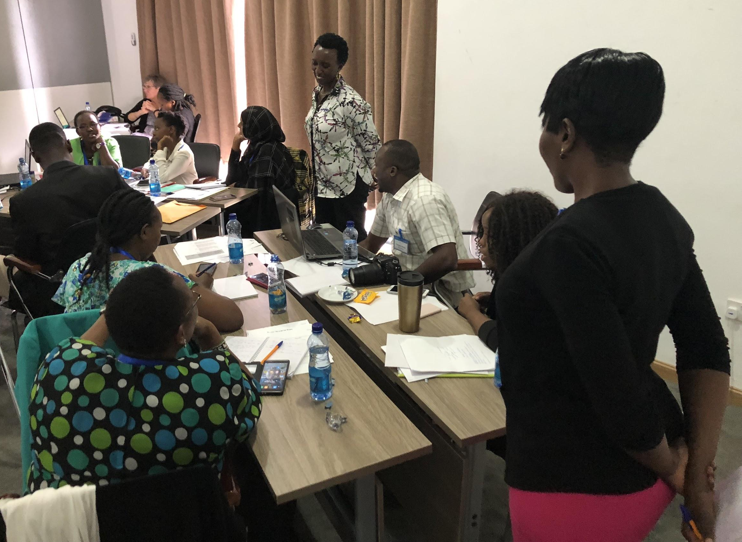
May 2018: Cascade training
May 2018: 3 of the original MIL trainees just delivered the first “cascade” training to the KNLS ICT Officers
Notes:
It worked pretty well except for the beginning with the definition of terms, the group really got into the weeds. They also incorporated a role play for opening the google account. Each group had to walk an user through the process, it was very dynamic.

Slide 13
Lessons learned
What worked:
Group activities and peer-to-peer learning
Peer help desk
In-training reflections
What would we do differently next time?
Training length
Clearer instructions

Slide 14
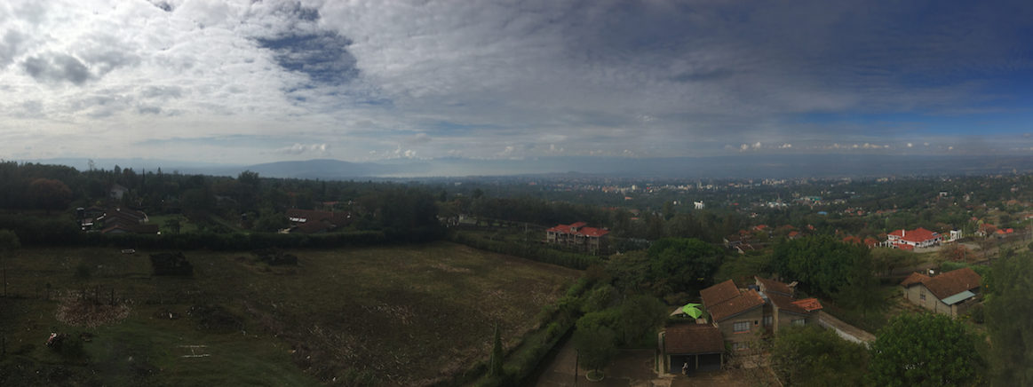
MIL Kenya:
Capturing Information Behavior
8 semi-structured Interviews
Pre/Post surveys
Classroom Observations
Module Artifacts
Notes:
In preparation for the training, we began to explore the assumptions embedded in our understanding of public librarians. The training provided the perfect opportunity to understand more about Kenyan librarian’s information behavior with smartphones, as well as how they perceive the needs of their communities. Although this was a limited group, we hoped to gain a window into the broader scope of how public librarians may be using mobile phones to support their communities. The principal research scientist, Maria Garrido, could not be here today, as she was invited to give a keynote speech in Greece. We wanted to be sure to mention her contributions, as Stacey, Maria, and I are collaborators on the project.
The training was held in this beautiful location in Kenya, shown above. Findings are preliminary; our March visit was a busy one. Over the course of the week, we gathered about 100 pages of transcripts, surveys, observational notes, and written artifacts.
The interview & surveys asked questions in the areas of mobile use, information behavior, benefits & challenges of the mobile internet, and community connections to the mobile internet. We began to analyze the interviews informed by Burnett & Jaegar’s Information Worlds Framework.

Slide 15
Information Worlds
Social Types
ACCESS
Physical
Intellectual
Social
Social Norms
Information Behavior
Boundaries
Information Value
Burnett & Jaeger
Notes:
Burnett & Jaeger created the information worlds framework to study individuals, social groups, and societies multiple interactions with information.
This theory builds upon the “small worlds” theory of Elfreda Chatman and the lifeworld theory of Jurgen Habermas. Each world contains the five social elements of: information behavior, information value, boundaries, social types, and social norms.
This theoretical lens accounts for how we interact with information in our immediate worlds of friends, family, church groups, and/or workplaces. As well as more expansive worlds, like political parties or UW affiliates who enjoy lunch and a presentation. Because of the great diversity of our interests and identities, we simultaneously exist in multiple worlds, each of which can overlap or bridge to one another. Ultimately, our participation in these worlds dictate how we access information.

Slide 16
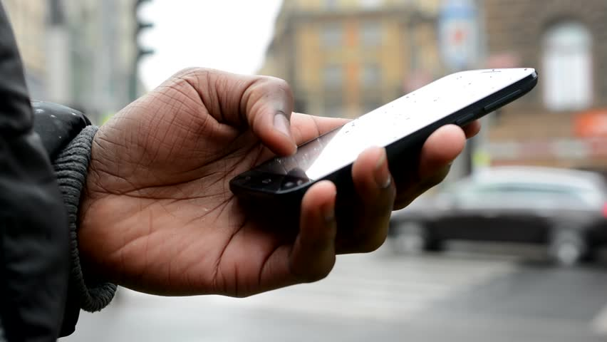
Physical Access
“...the document’s location and format and the conditions, technologies, or abilities required to reach that document. ”
(Burnett & Jaeger, 2008, p.57)
Photo: Shutterstock
Burnett & Jaeger
Notes:
The bulk of traditional work around access focuses almost entirely on physical access, accounting for the information, its format, & the devices used to retrieve it. Physical access, though necessary, is not a complete picture. Having access to a device does not equate success in navigating full access.

Slide 17
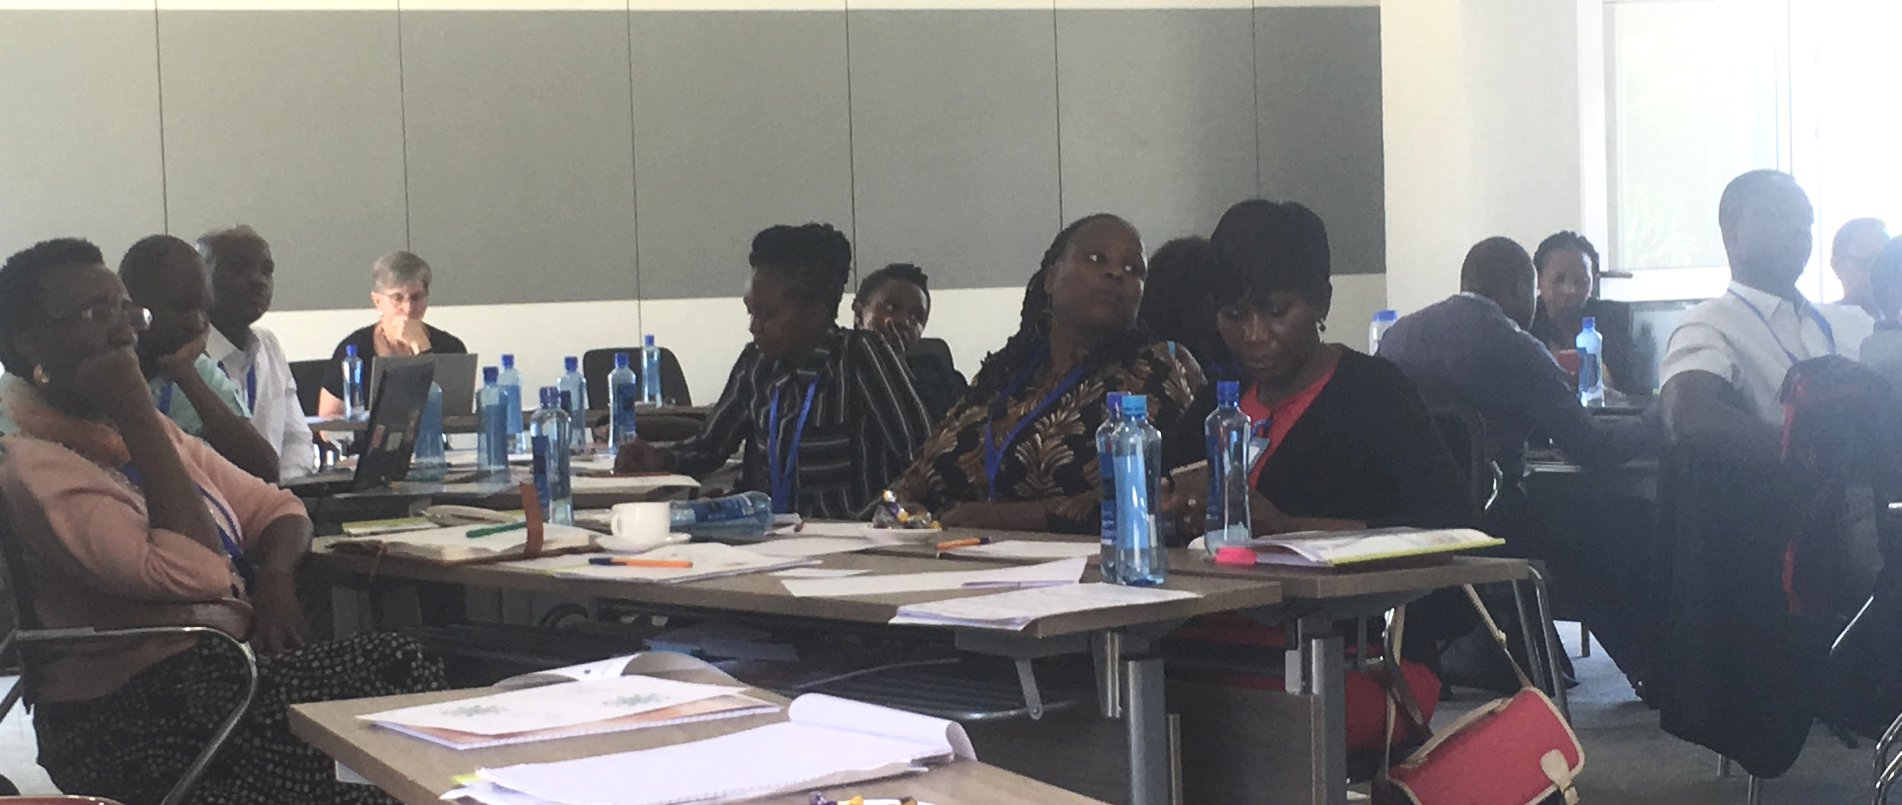
Intellectual Access
“the ability to understand how to get to… the information and understand [its meaning] once it has been physically obtained” (Burnett & Jaeger, 2008, p.58)
Burnett & Jaeger
Notes:
Intellectual access is described as “the ability to understand how to get to… the information and understand [its meaning] once it has been physically obtained” (Burnett & Jaeger, 2008, p.58). This can include how individuals come to information seeking behaviors, literacy- including technological, mobile information, & educational, and their own subjective views. At its most basic, it is the ability to understand information from a source. This is a photograph from the MIL training on how to reduce data usage.

Slide 18
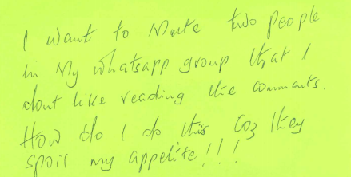
Social Access
“...constrains what small world members are interested in or willing to pay attention to...” (Burnett & Jaeger, 2008, p.58)
Burnett & Jaeger
Notes:
Finally, social access describes how the norms, attitudes, and relationships within information worlds define what information is valuable. Perceived value of information, ultimately shapes access & “constrains what small world members are interested in or willing to pay attention to.”
During this help desk session, one participant wrote “I want to mute two people in my Whatsapp group, that I don’t like reading my comments. How do I do this? Cus it’s likely to spoil my appetite!!!” This participant is attempting to shape their own social access, which appears to impact their eating behavior, and likely, also their information behavior.

Slide 19
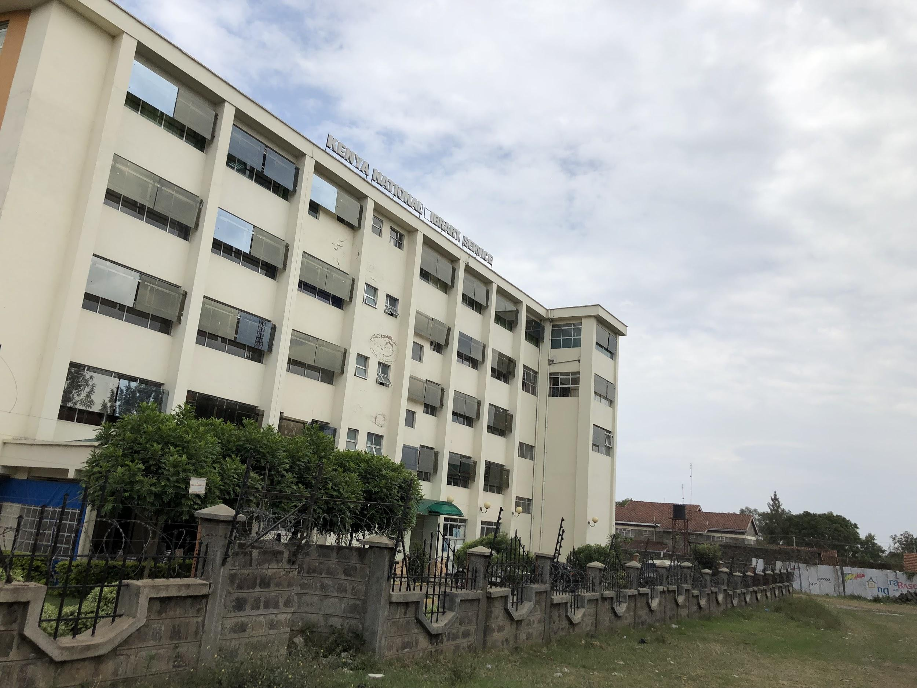
Librarians’ Information Access
Nakuru branch of the Kenya National Library Service
Notes:
Librarians’ personal information access and their social perceptions of information and technology impact their ability to provide access to their community members. We’re going to spend some time exploring librarians’ personal information access.

Slide 20
Librarians’ Information Access
Physical:
Almost all participants used or had used a cell phone, most for longer than 5 years.
Half of the participants had internet access at home.
Most participants accessed the internet at work.
Notes:
All of the professionals that participated in the training owned a smartphone with access to mobile data. They have additional access to the internet through WiFi and PCs at work. Some respondents also reported having their mobile data paid by their employer but this was not true of everyone. 60% were the sole user of their device. So for these librarians, mobile supplements PC internet access.
However, the interviewees also talked about how they used their personal devices for work related access.
Physical:
“sometimes even if I’m in the office, I’ll use my phone because we
have Wi-Fi. Mostly use the desktop. But I’m at home, if someone contacts me, I’ll use my
mobile and search for information instead of telling them I’m not in the office”
“Because of the users in the library. If we have connection problem in the library, instead of
chasing the user away, you can provide that information for them. If you can use your phone
for them, the better. That person is satisfied.”
Communicating in real time. I’m always able to assist whoever is contacting me immediately.
My communication improved. Now if you call or contact immediately, I can assist you. I’m
checking mail, WhatsApp, even if I’m office or at home or on leave. We have a WhatsApp
group for the office and can react on it in real time
Intellectual
“Not having phone changed things. I couldn’t share information. I had to go to the bank. Before
that, I don’t remember the last time I went to the bank. I go to the bank app.”
Social
“I am a mentor with AfLIA. So I access information about mentorship about AfLIA. On daily
basis, send information to innovators. Two different mentor WhatsApp groups.” [professional development group]
“I’m even trying youth in my
library, how to read books using mobile app instead of being Facebook.”

Slide 21
Librarians’ Information Access
Physical:
“sometimes even if I’m in the office, I’ll use my phone because we have Wi-Fi. Mostly use the desktop. But I’m at home, if someone contacts me, I’ll use my mobile and search for information instead of telling them I’m not in the office”
Notes:
So, for example,
“sometimes even if I’m in the office, I’ll use my phone because we have Wi-Fi. Mostly use the desktop. But I’m at home, if someone contacts me, I’ll use my
mobile and search for information instead of telling them I’m not in the office”
At work, they use their phones instead of PCs to look up information because of convenience. They also used their phones to respond to work matters when out of the library during the day or at home after hours.
Physical:
Communicating in real time. I’m always able to assist whoever is contacting me immediately.
My communication improved. Now if you call or contact immediately, I can assist you. I’m
checking mail, WhatsApp, even if I’m office or at home or on leave. We have a WhatsApp
group for the office and can react on it in real time
Intellectual
“Not having phone changed things. I couldn’t share information. I had to go to the bank. Before
that, I don’t remember the last time I went to the bank. I go to the bank app.”
Social
“I am a mentor with AfLIA. So I access information about mentorship about AfLIA. On daily
basis, send information to innovators. Two different mentor WhatsApp groups.” [professional development group]

Slide 22
Librarians’ Information Access
Intellectual:
“Not having [a] phone changed things. I couldn’t share information. I had to go to the bank. Before that, I don’t remember the last time I went to the bank. I go to the bank app.”
Notes:
Interviewees shared examples that demonstrated their intellectual access. In this case, an interviewee discusses what happened when their phone broke. “Not having [a] phone changed things. I couldn’t share information. I had to go to the bank. Before that, I don’t remember the last time I went to the bank. I go to the bank app.”
For their own intellectual access, the library professionals described having the ability to use a wide variety apps on their phone and perform simple information searches. They understood that different apps or websites are used for accessing different types of information. Additionally, some librarians demonstrated an awareness of community-specific mobile information, including apps specific to farming or health.
They could name a wide variety of apps, but big stumbling blocks for some basic tasks. (Trying to get to Google Play Store through Google etc)
big gaps in privacy & safety & being efficient with data use
intellectual in access in one information world doesn’t dictate intellectual access in another

Slide 23
Librarians’ Information Access
Social:
“I am a mentor with AfLIA. So I access information about mentorship in AfLIA. On a daily basis, [I] send information to innovators, [and] mentor two different WhatsApp groups.”
Notes:
In relation to social access, this participant said “I am a mentor with AfLIA. (which is a professional librarian group) So I access information about mentorship in AfLIA. On a daily basis, send information to innovators. Mentor two different WhatsApp groups.” It seemed to be an established social norm that librarians, as individuals, were trusted information sources or connectors. They were regularly in positions of power to introduce new information or mediate current understandings through information.
Librarians discussed their own social access when talking about how they use their smartphones to help their own professional development. People discussed how they communicate with others about work projects and share and ask questions from one another. They use WhatsApp to share their work accomplishments with colleagues and their supervisors.

Slide 24
Social perceptions
“I’m even trying with youth in my library. How to read books using mobile app instead of being Facebook.”
Notes:
Note - didn’t say that they wanted to read a book instead of FB - still using phone
Overall, the library professionals’ have a positive social perception of smartphones and internet use. They believe that increased access will have a positive impact on their communities. All interviewees see WhatsApp as an important resource and social communication tool, much more than a substitute for texting. However, perceptions of Facebook use is mixed. Some people recognize positive social purposes, like increasing the awareness of local business, but others discussed that people spend too much time using it. They felt that Facebook users should do more productive things, like reading, instead. People had some concerns about using the internet, including worries about becoming “addicted.” Some respondents purposely put limits on their own use. These shared perceptions of technology ultimately shape the way librarians provide information access to the communities their libraries serve.

Slide 25
Community access
“Because of the users in the library. If we have connection problem in the library, instead of
chasing the user away, you can provide that information for them. If you can use your phone
for them, the better. That person is satisfied.”
Notes:
We’ve also started to explore how library professionals’ own information access and behavior influence the community’s access to information.
Libraries provide physical access by providing the physical infrastructure: books, databases, computers, and wireless internet. Librarians supplement that physical access themselves by using their phones to search for information. Librarians discussed using their phones to look up information during library hours, because of convenience, or when the library’s internet fails. Some even mentioned that community members contact them directly on their phone with questions outside of work hours. They also provide intellectual access by offering technical and research assistance. Because of these interactions, the interviewees see a need in their communities for more mobile-specific information skills and literacy training.

Slide 26
Community access
“We have so many hopes because mobile connectivity is good but people don’t know how to use it. For example, my colleague has a good phone but he does not know how to use it. More people just use social networking or mobile money. If they knew there’s an app now to get information about cattle, they would use apps to better lives. Most importantly is digital literacy. They don’t maximize their phones.”
Notes:
It makes sense that those that attended this training see mobile digital literacy as important. Lots of talk about trying to help people “maximize their phones.” In other words, train people, show people all the things that a phone can be used for.
Not all rosy - expressed worries about addictions (mostly about their own use!), worries about cyberbullying with kids.

Slide 27
Community Access
“WhatsApp group ...for security issues – for what’s happening in the community where I work. Not where I live. Being the only library in the community, people created the group and three people approached and said that librarian should be part of the group.”
Notes:
So when we look at the bigger picture of our research, we see communities, the many small worlds they exist in and move between, and the boundaries where those worlds interact. In this example, a participants discusses an invitation to enter a whatsapp group: “WhatsApp group ...for security issues – for what’s happening in the community where I work. Not where I live. Being the only library in the community, people created the group and three people approached and said that a librarian should be part of the group.” We are only hearing from the librarian’s point of view, but they have made enough of a connection to the community to get invited into community-created groups.
Librarians, in many ways, form connections between these small worlds and actively engage their participants in information exchange. We see the librarian as a specific social type that shapes information behavior of others. Simultaneously, we see that librarian’s personal access greatly impacts how they are able make bridges between small worlds and ultimately the information behavior of their community members.

Slide 28
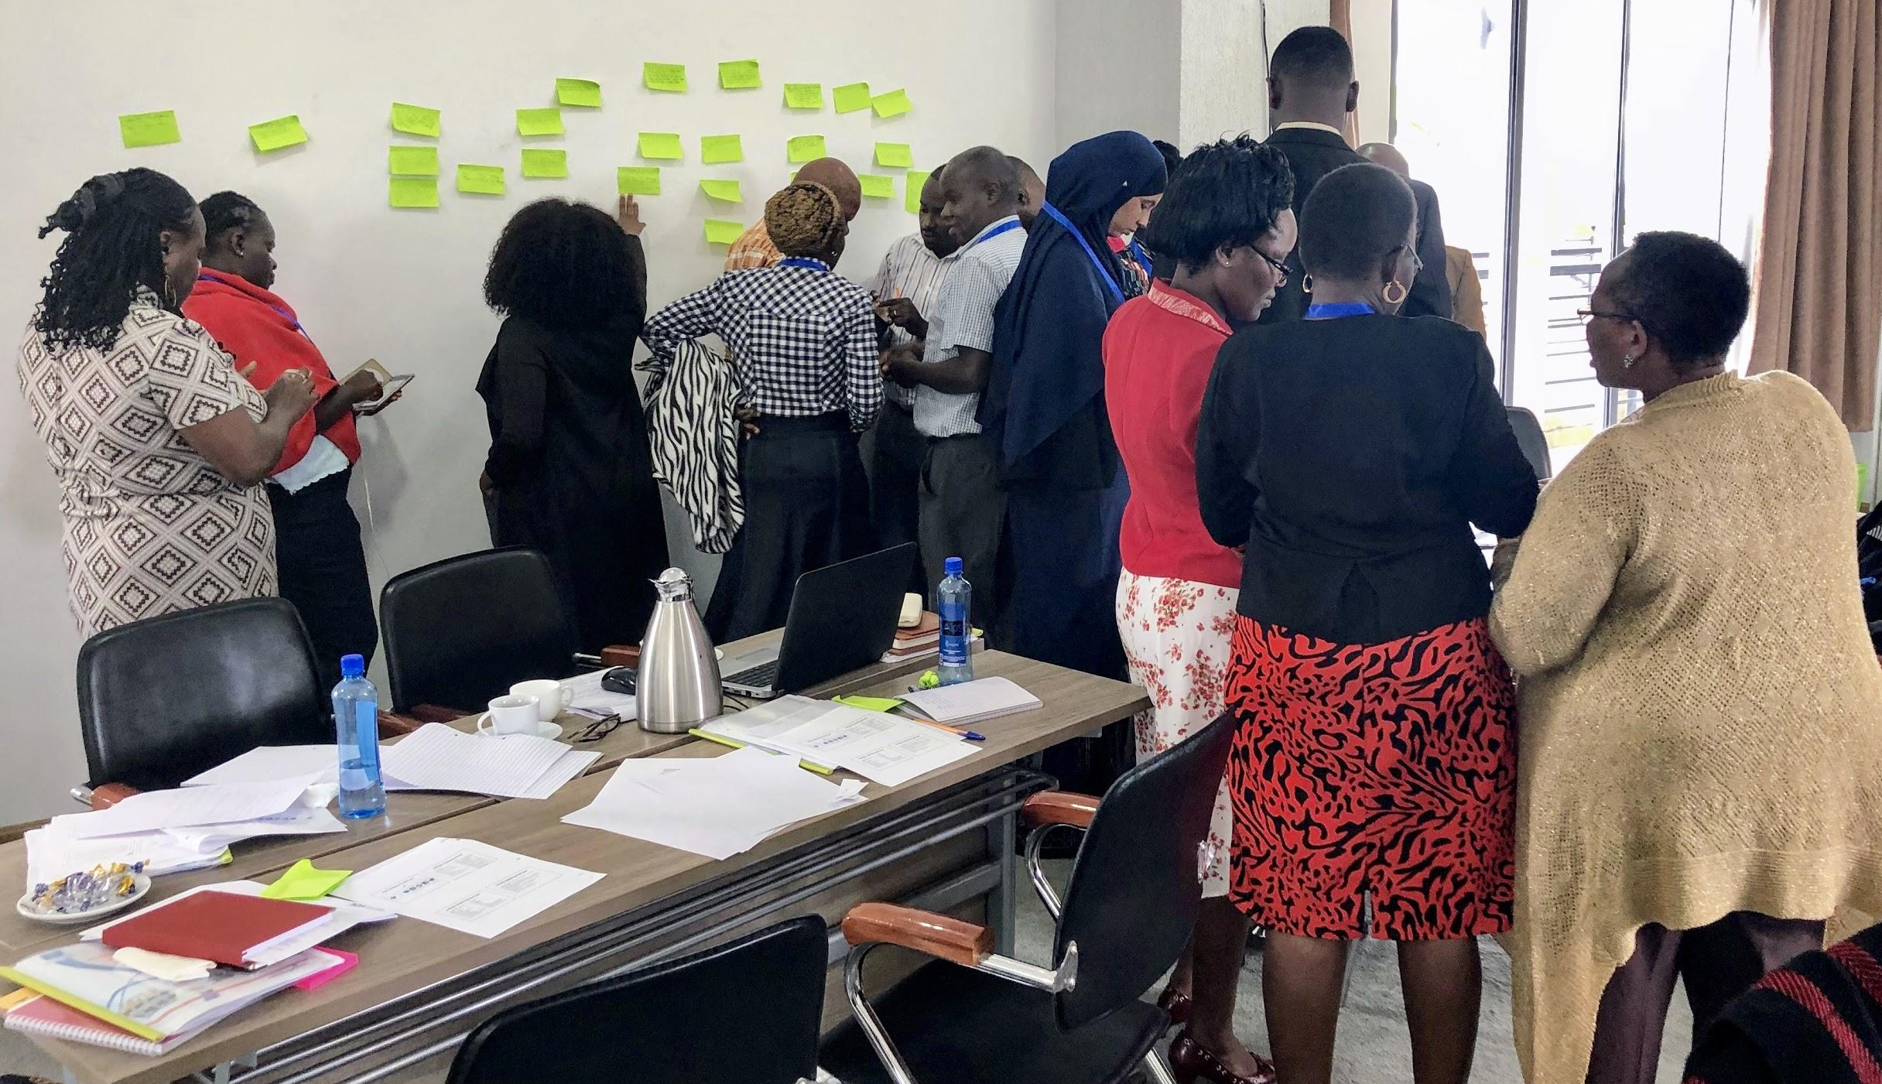
What’s next
Continue analysis
Feedback from Cascade training
Publish curriculum on Github

Slide 29
Thank You!
Stacey Wedlake
staceyaw@uw.edu
@staceyawe
Karah Lothian
klothian@uw.edu
Technology & Social Change Group
tascha.uw.edu
+1.206.616.9101
@TASCHAGroup
Email: tascha@uw.edu

