Slide 1
Vision Based Surgical Tool Tracking
with Robot Kinematics Prior
Yun-Hsuan Su
Committee: Blake Hannaford, Howard Chizeck
Date: July 31, 2017
Notes:
Research topic

Slide 2
Outline
Introduction
Overview (of the four stages)
Stage 1: Image segmentation
Stage 2: Depth mesh rendering
Conclusion
Future work
Notes:
This is the outline of sections we’re covering today

Slide 3
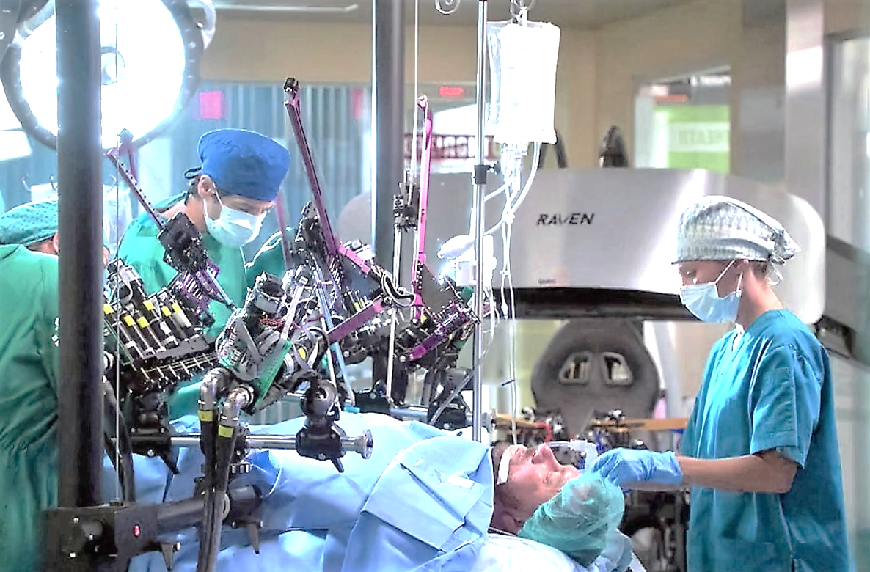
Introduction
Robot Assisted Minimally Invasive Surgery (MIS)
Collaboration between surgeons and machines.
Advantages:
- High precision beyond human dexterity.
- Remote surgical practices with teleoperation.
1
Notes:
Robot assisted minimally invasive surgery (MIS) combines the skill and techniques of highly-trained surgeons with the robustness and precision of machines.
achieved precision is beyond that of human dexterity alone
surgeons are able to operate remotely, i.e. agnostic

Slide 4
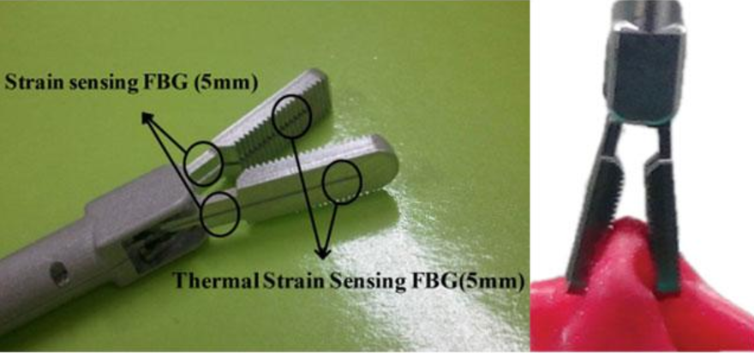
Introduction
Lack of force feedback is a major drawback.
Unintentional tissue damage.
Solution:
(1) Direct force sensing:
Force sensors¹ on the surgical tool
Difficulties during sterilization procedures.
1. Soo-Chul Lim; Hyung Lee; Joonah Park , 2014, p. 733 – 735, The Institution of Engineering and Technology,Grip force measurement of forceps with fibre Bragg grating sensors
2
Notes:
There is no force feedback in any current commercialized surgical robots.

Slide 5
Introduction
Lack of force feedback is a major drawback.
Unintentional tissue damage.
Solution:
(1) Direct force sensing:
Force sensors¹ on the surgical tool
Difficulties during sterilization procedures.
(2) Vision based force estimation:
Infer force from tissue deformation.
1. Soo-Chul Lim; Hyung Lee; Joonah Park , 2014, p. 733 – 735, The Institution of Engineering and Technology,Grip force measurement of forceps with fibre Bragg grating sensors
3
Notes:
Infer the applied force based on real-time analysis of tissue deformation.
This is what my research focuses on

Slide 6
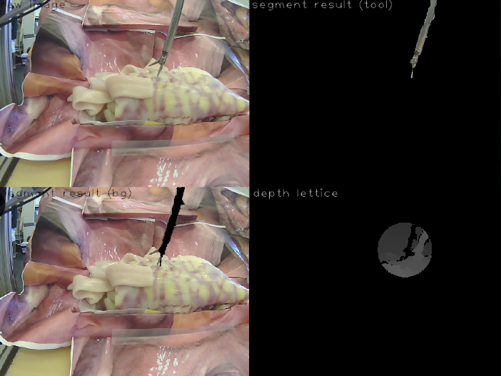
Overview
Stage 1:
Image segmentation
Stage 2:
Depth mesh rendering
Stage 3:
Force Estimation
Stage 4:
Haptic teleop.
tool
non-tool
raw image
4
Notes:
Given a surgical image
Know where the tool is

Slide 7
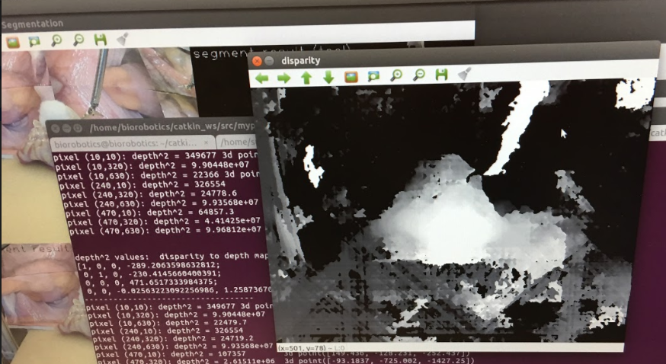
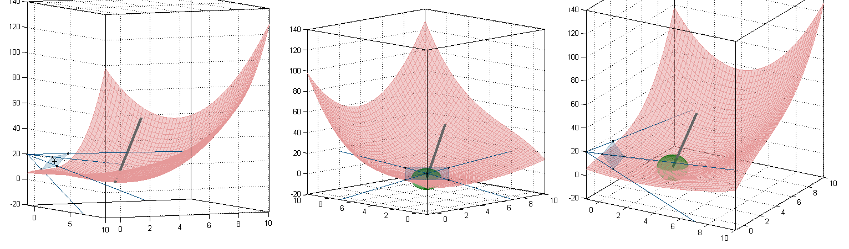
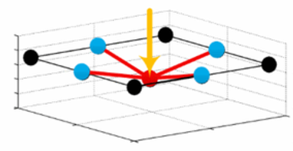
Overview
Stage 1:
Image segmentation
Stage 2:
Depth mesh rendering
Stage 3:
Force Estimation
Stage 4:
Haptic teleop.
tool
disparity map
non-tool
deformation
raw image
5

Slide 8
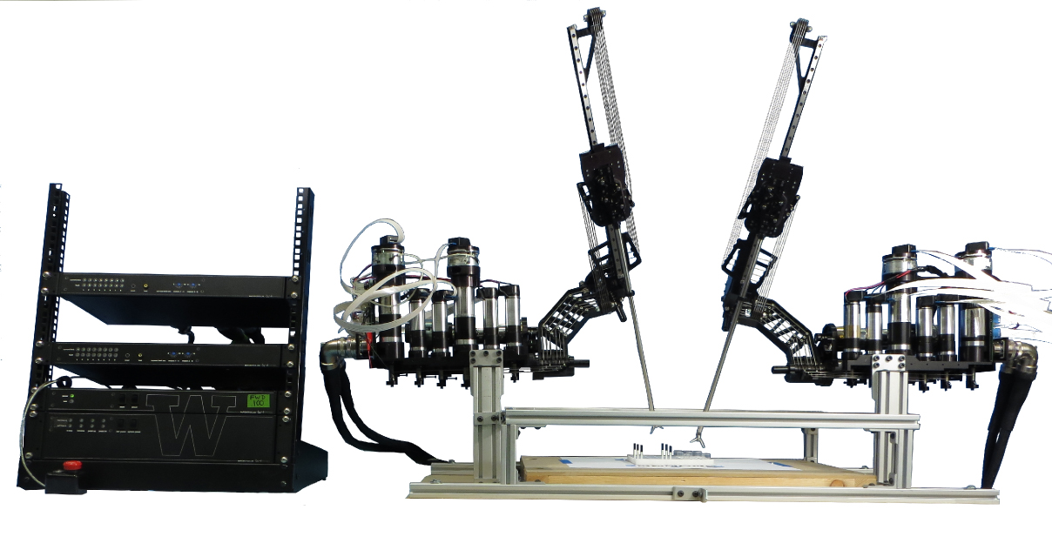
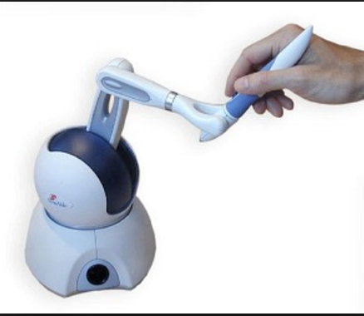
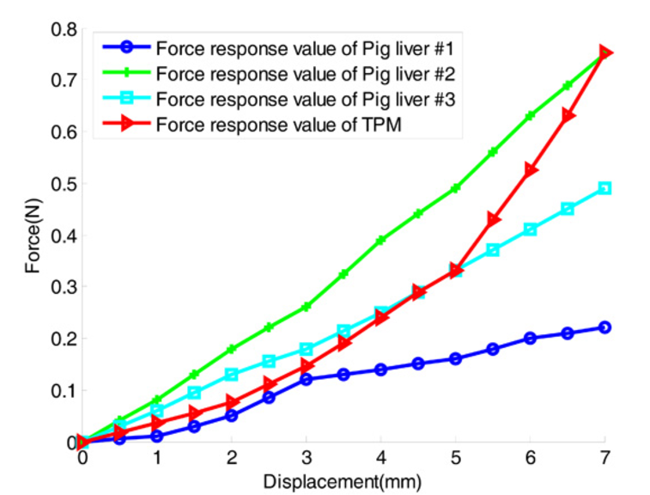
Overview
Stage 1:
Image segmentation
Stage 2:
Depth mesh rendering
Stage 3:
Force Estimation
Stage 4:
Haptic teleop.
tool
disparity map
motion
force
non-tool
deformation
haptic implementation
force
raw image
6

Slide 9
Overview
Stage 1:
Image segmentation
Stage 2:
Depth mesh rendering
Stage 3:
Force Estimation
Stage 4:
Haptic teleop.
Master thesis research.
Future work.
7
Notes:
Time contraints
After the overview, let jump into each stage

Slide 10
Stage 1:
Image segmentation
Stage 1: Image Segmentation
2D
Raw image
project
Step 1: Perspective N Points (PNP)
Step 2: Robot Kinematics
Step 3: Color filtering
Step 4: Shape matching with DFT
Step 5: Color mask
Result
Analysis
3D
Real-time
Robot
kinematics
Color filters
Adjust
prediction
Segmentation result
8
Notes:
Use this as a prior information
Different sections including steps, result, analysis

Slide 11
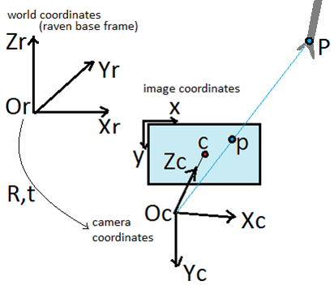
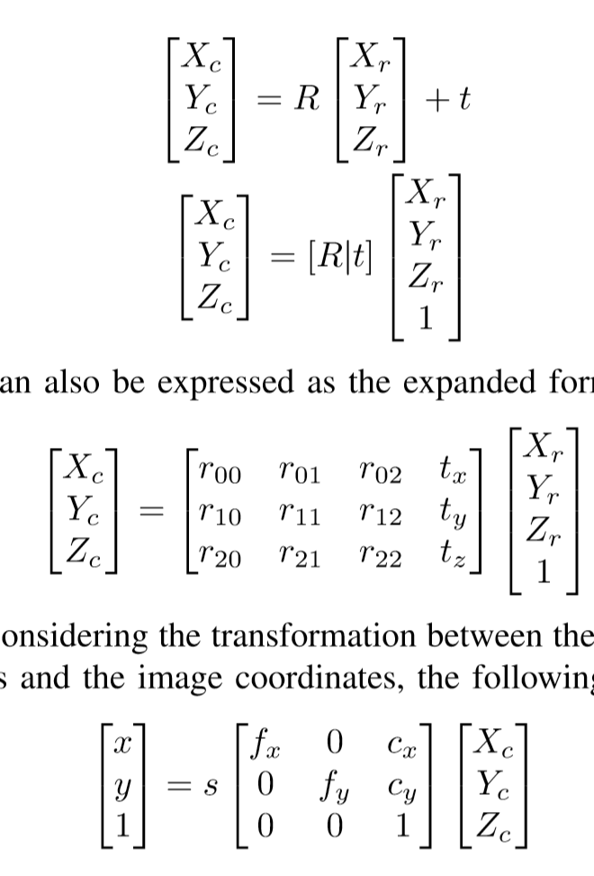
Stage 1:
Image segmentation
Step 1: Perspective n Points (PnP)
PnP is a method of finding camera extrinsic matrix.
Project surgical tool tip on image.
Trying to find.
9
Notes:
Suppose we have rotation R and translation t
We can transform the world frame to the camera frame
Compart form
9 eles, 3 eles

Slide 12
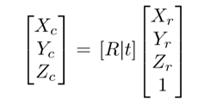
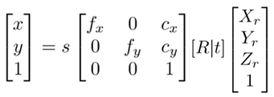
Stage 1:
Image segmentation
Step 1: Perspective N Points (PNP)
Unknown extrinsic matrix: ………………..…….(1)
Known intrinsic matrix: ……………..….(2)
Multiply (1) with
…………………..(3)
known
10

Slide 13
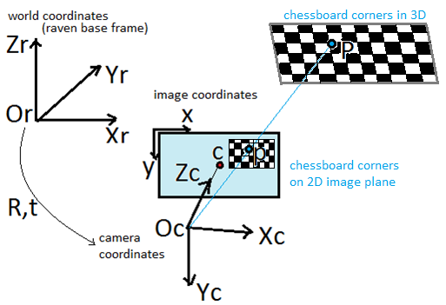
Stage 1:
Image segmentation
Step 1: Perspective N Points (PNP)
Input:
A set of 3D points and their 2D projections on image.
Output:
The extrinsic matrix
input
known
input
11
Notes:
workspace

Slide 14
Stage 1:
Image segmentation
Step 2: Robot Kinematics
Raven Surgical Robot System
Open architecture and open source
7 DOF cable-driven robot arm
12
Notes:
For laparoscopic research
Consists of two

Slide 15
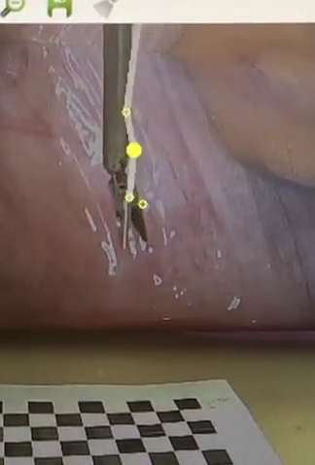
Stage 1:
Image segmentation
Step 2: Robot Kinematics
Stick figure from robot kinematics.
Stick figure
Robot kinematics
13
Notes:
Given the robot kinematics
Tool config → onto image
Static 3D offset

Slide 16
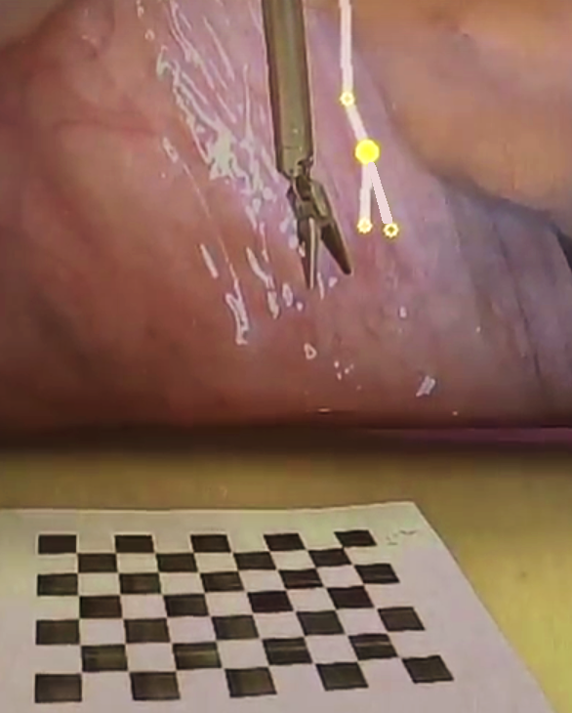
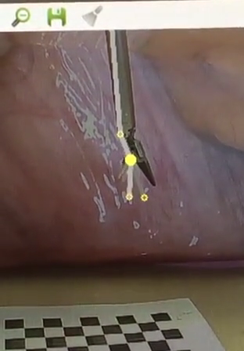
Stage 1:
Image segmentation
Step 2: Robot Kinematics
Stick figure from robot kinematics.
Apply 3D static offset.
Stick figure
Stick figure + offset
Static offset
13
Notes:
Given the robot kinematics
Tool config → onto image
Static 3D offset

Slide 17
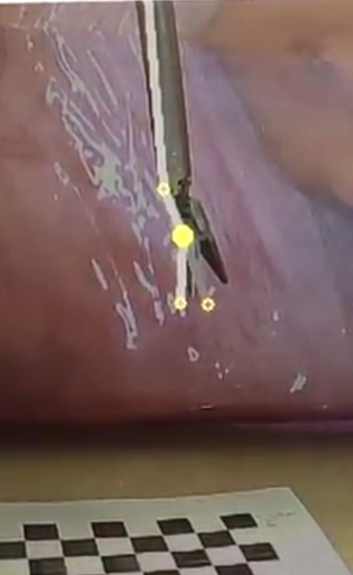
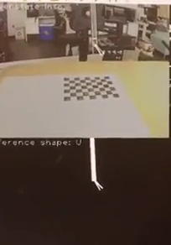
Stage 1:
Image segmentation
Step 2: Robot Kinematics
Include thickness (width):
Pixel width =
Focal length x Object thickness / Distance to camera.
Stick figure
Stick figure + offset
Include thickness
Add thickness
14
Notes:
Having stick figure is not enough
Can get a shape prior mask (bottom row)
Tool config + thickness/width

Slide 18
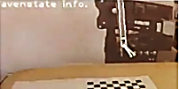
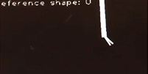
Stage 1:
Image segmentation
Step 2: Robot Kinematics
Include thickness (width):
Pixel width =
Focal length x Object thickness / Distance to camera.
Predicted projection
Shape prior U
14
Notes:
Having stick figure is not enough
Can get a shape prior mask (bottom row)

Slide 19

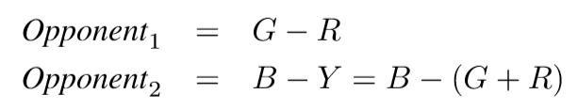
Stage 1:
Image segmentation
Step 3: Color filtering
Robot shape prior mask not perfectly aligned.
Use color filter to examine accuracy of shape prior.
Important color space components²:
Saturation, Hue, Opponent 1, and Opponent 2.
Raw image
Shape prior U
2. Vision-based and marker-less surgical tool detection and tracking: a review of the literature, David Bouget, Max Allan, Danail Stoyanov, Pierre Jannin, 2016 Elsevier B.V.
15
Notes:
to compensate for the error
Discriminative power

Slide 20
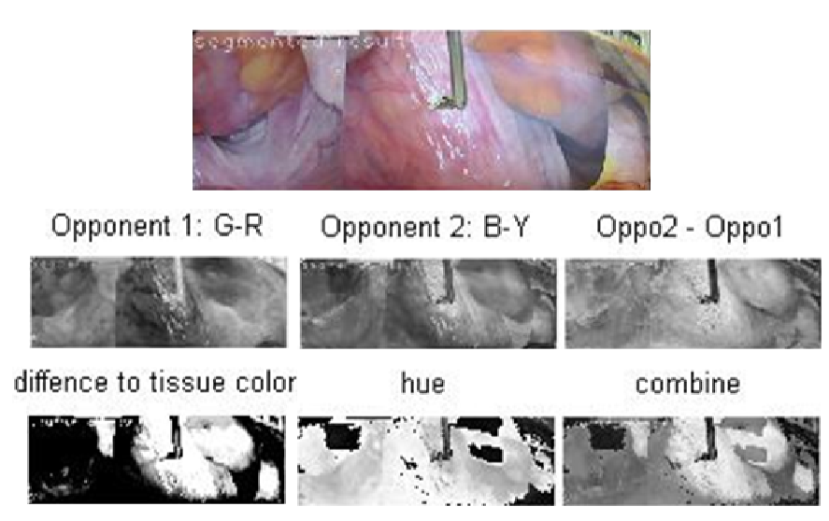
Stage 1:
Image segmentation
Step 3: Color filtering
Weighted sum of color space components
Goal: Darker regions --- surgical tool
Brighter regions --- tissue background
Likelihood Q
weighted sum
16
Notes:
Individual output
Combine everything by the weighted sum of the important components

Slide 21
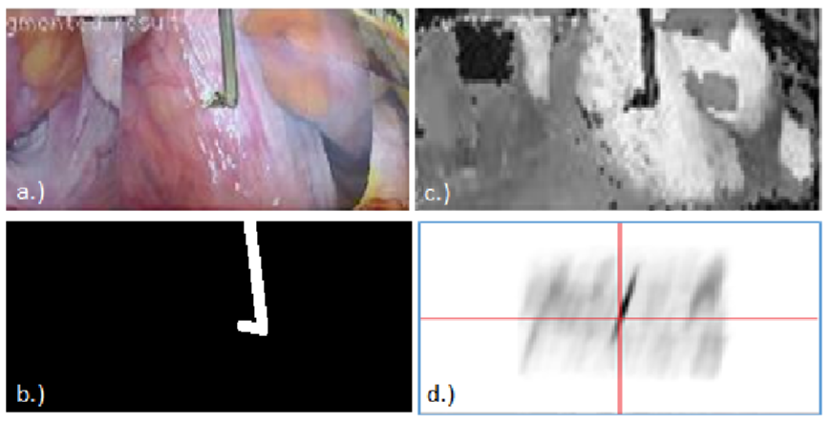
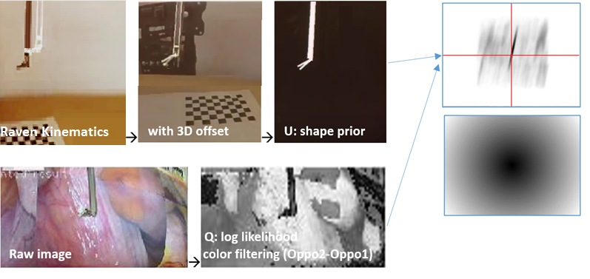
Stage 1:
Image segmentation
Step 4: Shape matching with DFT
Raw image
Likelihood: Q
Q and U may not
perfectly align.
Robot kinematics
Shape prior map: U
17
Notes:
U from robot kinematics
Q from color filtering
Shift U around so it matches the likelihood the best.
Cost function:
Sum of pixelwise multiplication
Want min(energy map)

Slide 22
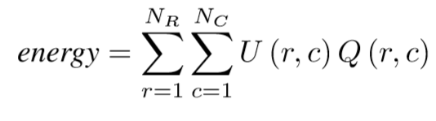
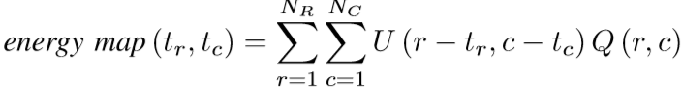
Stage 1:
Image segmentation
Step 4: Shape matching with DFT
Likelihood Q
Shape prior U
Likelihood map: Q
Shape prior map: U
May not perfectly align.
17
Notes:
U from robot kinematics
Q from color filtering
Shift U around so it matches the likelihood the best.
Cost function:
Sum of pixelwise multiplication
Want min(energy map)

Slide 23

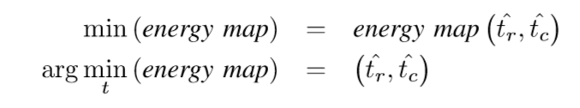
Stage 1:
Image segmentation
Step 4: Shape matching with DFT
Exhaustive search in spatial domain:
Multiplication in frequency domain analogous to convolution in spatial domain³.
Goal: find min value point on the energy map:
3. Image Segmentation with One Shape Prior – A Template-Based Formulation, Siqi Chena, Daniel Cremersb, Richard J. Radkea, submitted to Image and Vision Computing
18
Notes:
O of N to the 4
O of N square log N

Slide 24
Stage 1:
Image segmentation
Step 4: Shape matching with DFT
energy map
Low energy
(good match)
High energy
19
Notes:
The optimal translational offset is the pixel coordinates of the min value point

Slide 25
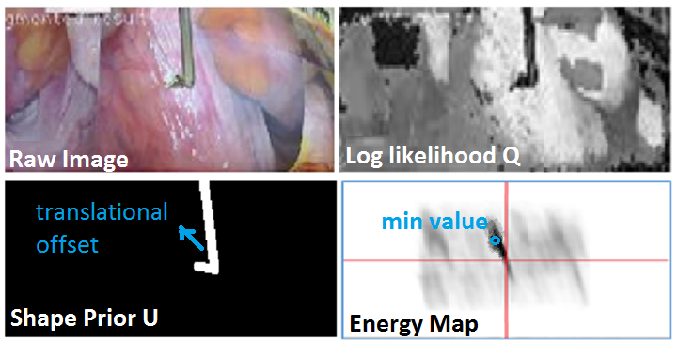
Stage 1:
Image segmentation
Step 4: Shape matching with DFT
Modify the shape prior U by optimal shifting offset.
20
Notes:
The vector from image center to the min value point
Is the translational offset

Slide 26
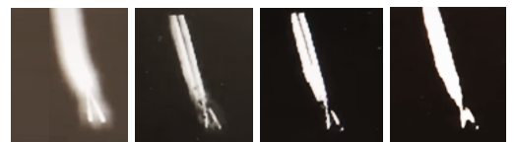
Stage 1:
Image segmentation
Step 5: Color mask
Q and U are nicely aligned.
Further improvement: pixel-wise classification
(1) Fine adjust the edges
(2) Deal with partial occlusion.
dilate, blur
21

Slide 27
Stage 1:
Image segmentation
Step 5: Color mask
Q and U are nicely aligned.
Further improvement: pixel-wise classification
(1) Fine adjust the edges
(2) Deal with partial occlusion.
multiply with color mask
22

Slide 28
Stage 1:
Image segmentation
Step 5: Color mask
Q and U are nicely aligned.
Further improvement: pixel-wise classification
(1) Fine adjust the edges
(2) Deal with partial occlusion.
binary thresholding
23

Slide 29
Stage 1:
Image segmentation
Step 5: Color mask
Q and U are nicely aligned.
Further improvement: pixel-wise classification
(1) Fine adjust the edges
(2) Deal with partial occlusion.
morphologyEX
24
Notes:
Get rid of black spots inside white region
Vice versa

Slide 30
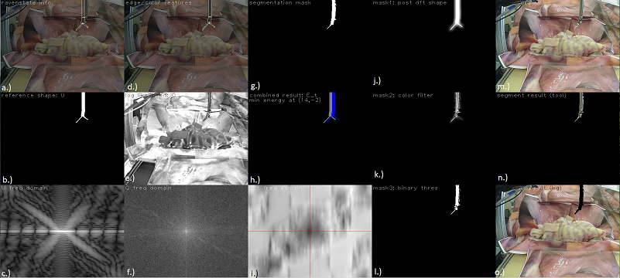
Stage 1:
Image segmentation
Result
Tool pose of U and modified U
4. Morphology
1. Dilate
Raw image
Shape prior U
2. Color filtering
Likelihood Q
U and modified U
Segmented tool
Fourier transform for U and Q
Energy map
3. Binary thres.
Segmented tissue
25
Notes:
A lot of information
Break it down a little bit

Slide 31
Stage 1:
Image segmentation
Result
Shape matching with DFT
Tool pose of U and modified U
Shape prior U
Likelihood Q
U and modified U
Fourier transform for U and Q
Energy map
25
Notes:
We’re going to talk about each of the figures

Slide 32
Stage 1:
Image segmentation
Result
Shape matching with DFT
Shape prior U
Likelihood Q
Fourier transform for U and Q
25

Slide 33
Stage 1:
Image segmentation
Result
Robot kinematics
Color filtering
Shape prior U
Likelihood Q
Shape matching with DFT
Fourier transform
Of Shape prior U
Fourier transform
Of Likelihood Q
Shape prior U
Likelihood Q
Fourier transform for U and Q
25
Notes:
4 figures on the bottom left

Slide 34
Stage 1:
Image segmentation
Result
Raw tool pose
Modified tool pose
Shape matching
with DFT
Shape matching with DFT
Robot kinematics
Tool pose of U and modified U
U and modified U
Energy map
U and modified U
Fourier transform of U
Fourier transform of Q
Energy map
25
Notes:
Shape matching
Multiplication of the two fourier transform result

Slide 35
Stage 1:
Image segmentation
Result
Color mask
4. Morphology
1. Dilate
2. Color filtering
3. Binary thres.
25

Slide 36
Stage 1:
Image segmentation
Result
Color mask
1. Dilate
2. Color filtering
3. Binary thres.
25

Slide 37
Stage 1:
Image segmentation
Result
1. Dilate and blur the edges
Color mask
1. Dilate
2. Multiplication with color filter
2. Color filtering
3. Binary thresholding
3. Binary thres.
25

Slide 38
Stage 1:
Image segmentation
Result
4. Morphology: eliminate black spots
Color mask
This is also the
surgical tool segmentation mask.
4. Morphology

Slide 39
Stage 1:
Image segmentation
Result
Segmentation result
Raw image
Segmented tool
Segmented tissue
25

Slide 40
Stage 1:
Image segmentation
Result
Segmentation result
Raw image
Segmented tool
Segmented tissue
25

Slide 41
Stage 1:
Image segmentation
Result
Raw image
Segmentation result
Raw image
(Foreground) (Background)
Segmented tool
Segmented tissue
Segmented tool
Segmented tissue
25
Notes:
This is the result!

Slide 42
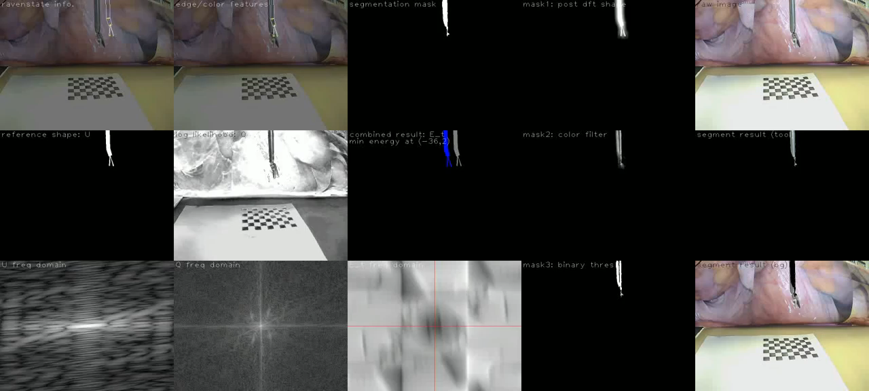
Stage 1:
Image segmentation
Result
Shape matching with DFT
Color mask
Segmentation result
Displayed speed: x5 times faster (30fps)
Original speed: ~ 6fps
26
Notes:
!!! Right most column Result!!!!
Prediction with offset
Aligned after DFT shape matching
Segmentation result decent.

Slide 43

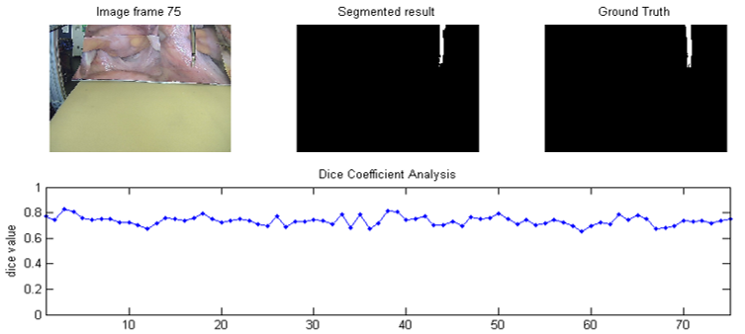
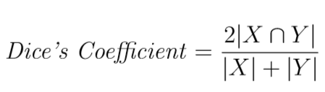
Stage 1:
Image segmentation
Analysis: Dice coefficient
Dice Coefficient
Quantify the performance of image segmentation.
The value ranges from 0 to 1
raw image
ground truth
segmentation result
27
Notes:
A statistic used for comparing the similarity of two samples.
Suppose |X| and |Y| are the cardinality of the two samples X and Y , the Dice Coeﬃcient is deﬁned as the following:

Slide 44
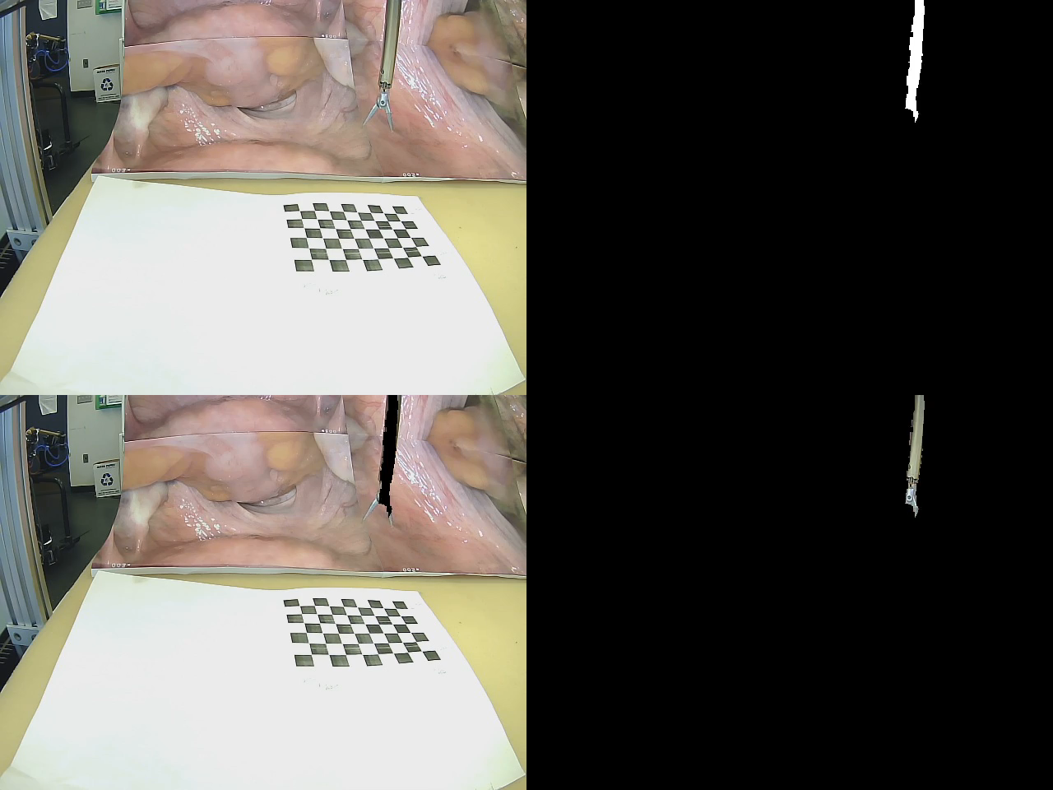
Stage 1:
Image segmentation
Analysis: Dice coefficient
Average Dice coefficient value = 0.75
raw image
segmentation mask
segmented background
segmented tool
Displayed speed: x5 times faster (30fps)
Original speed: ~ 6fps
28
Notes:
Average 0.75
Interested in knowing
if the dice’s coefficient is correlated to tool pose
Recorded a video

Slide 45
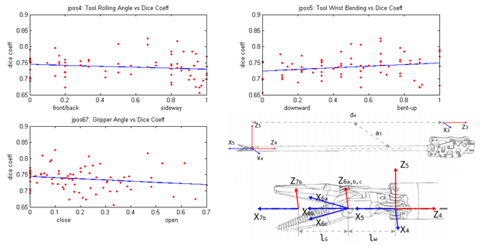
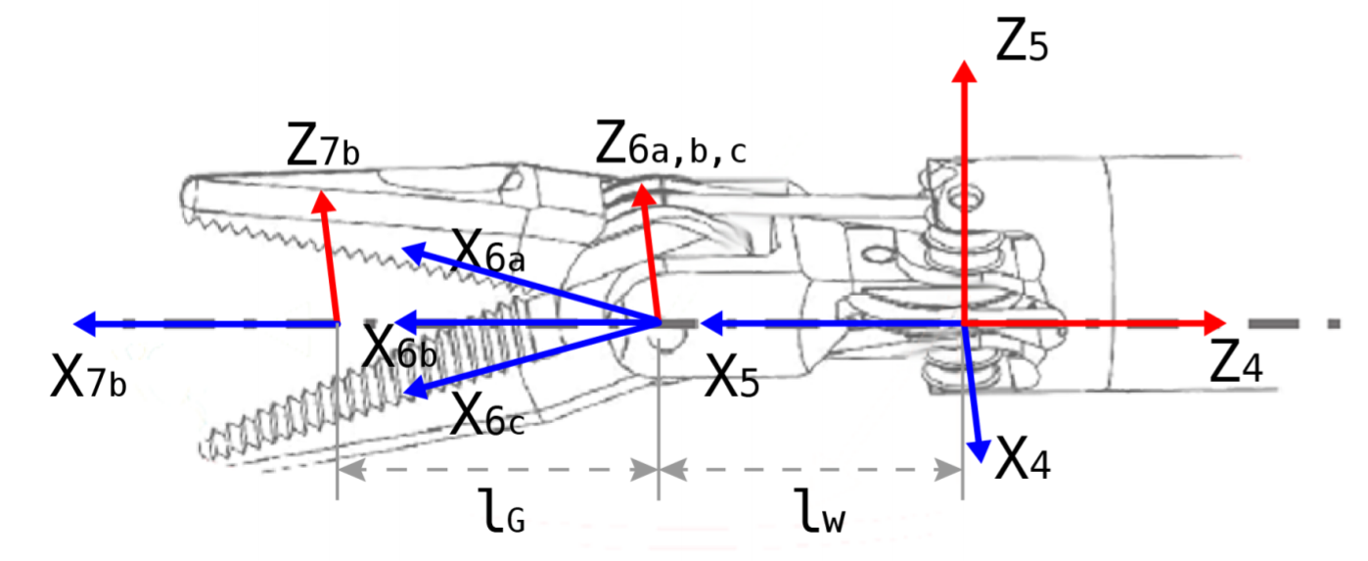
Stage 1:
Image segmentation
Analysis: Dice coefficient
Performance almost uncorrelated with tool pose.
Joint 4: tool roll
Joint 5: tool wrist
Dice value
Dice value
Front facing
Sideway
Bent up
Straight down
Joint 6,7: gripper
Dice value
closed
open
29
Notes:
Small correlation.
Good!
Performance independent of tool pose.

Slide 46
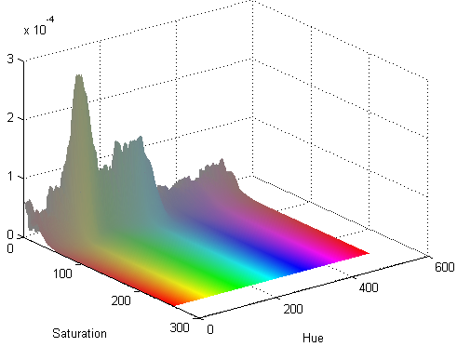
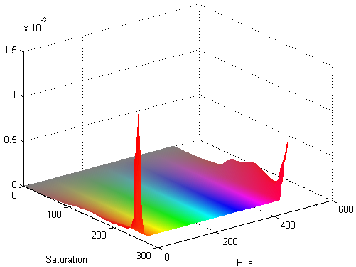
Stage 1:
Image segmentation
Analysis: Color Statistics
Probability of occurrence for each color in the color space being classified as a tool or non-tool pixel.
Potentially improve color filter.
Surgical tool pixels
Tissue pixels
30

Slide 47
Stage 2:
Depth mesh rendering
Stage 2: Depth Mesh Rendering
Stereo vision
Segmentation result
Disparity map
Step 1: Image rectification
Step 2: Disparity correction
Step 3: Disparity post filtering
Step 4: Disparity to depth
Result
Analysis
Sphere ROI
Depth map
deformation
31
Notes:
Again, on the right are sections including the steps result and analysis

Slide 48
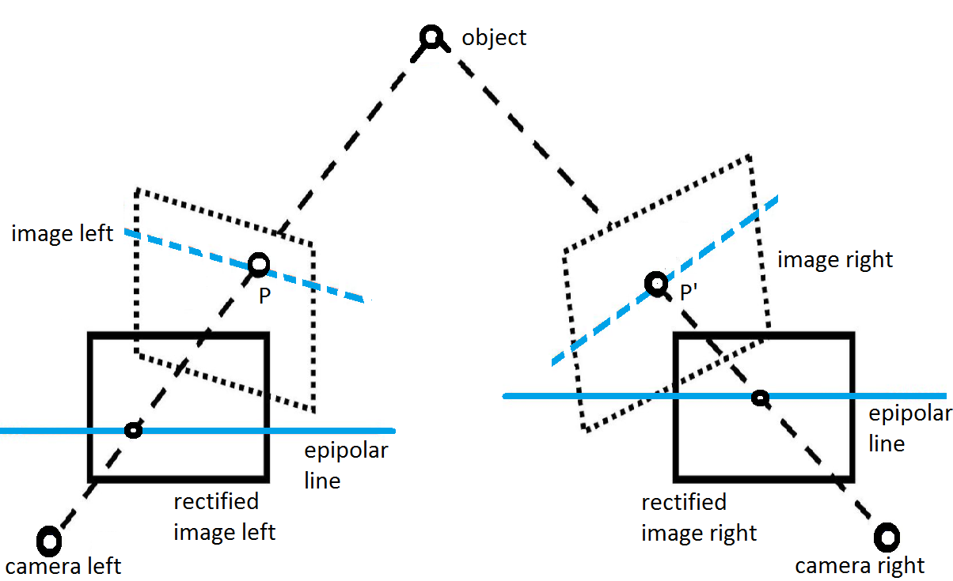
Stage 2:
Depth mesh rendering
Step 1: Image Rectification
Disparity: the apparent pixel diﬀerence or motion between a pair of stereo image.
Prerequisite:
make sure they share a common image plane.
32
Notes:
Left and right camera share a common image plane

Slide 49
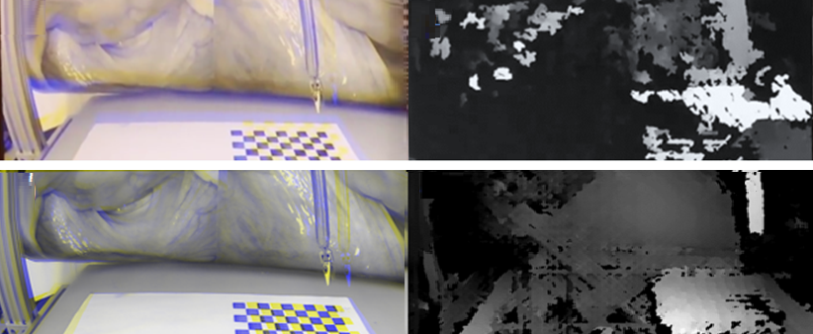
Stage 2:
Depth mesh rendering
Step 1: Image Rectification
Overlay the left and right images on different color channels.
Before Rectification
Disparity
After Rectification
Disparity After Rectification
33

Slide 50
Stage 2:
Depth mesh rendering
Step 1: Image Rectification
Well rectified image pairs should be row aligned.
Before Rectification
Disparity
After Rectification
Disparity After Rectification
34
Notes:
As you can see the disparity greatly improved

Slide 51
Stage 2:
Depth mesh rendering
Step 2: Disparity correction
Reasonable disparity ≠ Correct disparity
Causes:
(1) Error during camera calibration.
(2) Manufacturing imperfection with the camera.
Correct or not ?
35
Notes:
Closer brighter
Further darker
Not guanteeed to be correct

Slide 52
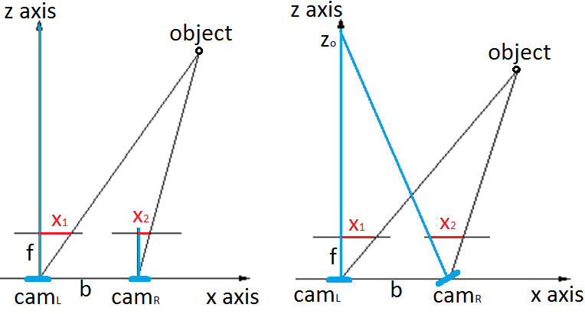
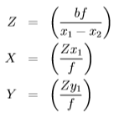
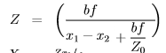
Stage 2:
Depth mesh rendering
Step 2: Disparity correction
Slight rotation around the y axis
True disparity = Perceived disparity + Shifting offset
Parallel case:
Rotated about y case:
36
Notes:
Closer brighter
Further darker
Not guanteeed to be correct
Re-projection equations

Slide 53
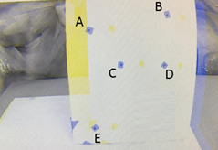
Stage 2:
Depth mesh rendering
Step 2: Disparity correction
Slight rotation around the y axis
True disparity = Perceived disparity + Shifting offset
Rotated about y case:
Shifting offset: 46 pixels
37
Notes:
Closer brighter
Further darker
Not guanteeed to be correct

Slide 54
Stage 2:
Depth mesh rendering
Step 3: Disparity post filtering
Broken points in disparity
Post filtering to reduce the number of broken points.
Raw image:
:Segmented Foreground
Segmented
Background:
:Disparity
Region of interest
38

Slide 55
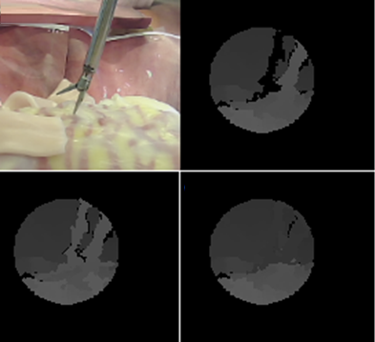
Stage 2:
Depth mesh rendering
Step 3: Disparity post filtering
Post filtering schemes:
(1) Max filtering
(2) Weighted least square (wls) filtering⁴
Raw image
Raw Disparity
(by left matching)
Filtered Disparity
(max filtering)
Filtered Disparity
(wls filtering)
4. Fast Global Image Smoothing Based on Weighted Least Squares, Dongbo Min, Member, IEEE, Sunghwan Choi, Student Member, IEEE, Jiangbo Lu, Member, IEEE, Bumsub Ham, Member, IEEE, Kwanghoon Sohn, Senior Member, IEEE, and Minh N. Do, Fellow, IEEE, 2013 IEEE
39

Slide 56
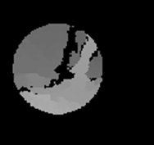


Stage 2:
Depth mesh rendering
Step 4: Disparity to depth
Re-project pixel points back into 3D
, where
$$\left[\begin{matrix}\begin{matrix}X_{w} \\ Y_{w}\end{matrix} \\ \begin{matrix}Z_{w} \\ W\end{matrix}\end{matrix}\right]=\left[\begin{matrix}\begin{matrix}1 & 0 \\ 0 & 1\end{matrix} & \begin{matrix}0 & −c_{x} \\ 0 & −c_{y}\end{matrix} \\ \begin{matrix}0 & 0 \\ 0 & 0\end{matrix} & \begin{matrix}0 & f \\ \frac{−1}{b} & \frac{c_{x}−c_{x}^{′}}{b}\end{matrix}\end{matrix}\right]\left[\begin{matrix}\begin{matrix}x \\ y\end{matrix} \\ \begin{matrix}disparity \\ 1\end{matrix}\end{matrix}\right]$$
$$\left[\begin{matrix}X \\ Y \\ Z\end{matrix}\right]=\left[\begin{matrix}X_{w} /W \\ Y_{w }/W \\ Z_{w} /W\end{matrix}\right]$$
disparity
Disparity
+ camera matrices
40
Notes:
Unnormalized 3d points

Slide 57
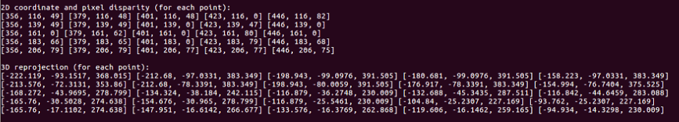

Stage 2:
Depth mesh rendering
Step 4: Disparity to depth
Re-project pixel points back into 3D
Around 1cm re-projection error for the tissue terrain.
2D Pixel points and 3D Re-projections
Raw image
Disparity
41
Notes:
Into the 3d space

Slide 58

Stage 2:
Depth mesh rendering
Result
Speed: x2.5 times
42
Notes:
A spherical region of interest centered at the tool tip, with 5 cm radius.

Slide 59
Conclusion
Vision based Surgical Tool Segmentation algorithm with robot kinematics prior.
Using stereo vision, a depth map is generated from the disparity near the tool-tissue interaction point.
Contribution:
  (1) Real time. (~5 fps, no GPU)
  (2) Average Dice coefficient of 0.75
  (3) Image segmentation done on Raven tool instead of Da Vinci tool.
  (4) Adaptable to partial occlusion.
43
Notes:
Raven robot system.
Robot kinematics, color filtering
Robust !

Slide 60
Future work
Stage 1:
Image segmentation
Stage 2:
Depth mesh rendering
Stage 3:
Force Estimation
Stage 4:
Haptic teleop.
Stage 1 : Image segmentation
Color statistics to improve the color filter.
Compare dice coefficient without robot kinematics or color filtering.
Stage 2 : Depth mesh rendering
Improve sensitivity down to mm scale.
(Can reduce the baseline of the stereo camera setup.)
Stage 3 : Force Estimation
Stage 4 : Haptic Teleoperation
Implement the next two stages.
44

Slide 61

Thank you.
Special thanks to committee members – Blake Hannaford, Howard Chizeck.
And to the wonderful people from the Biorobotics Lab.
45
Notes:
all the people I have a chance of meeting

Slide 62
Questions
Yun-Hsuan Su
Committee: Blake Hannaford, Howard Chizeck
Date: July 31, 2017
46

Slide 63
Backup slides
Read all
Yun-Hsuan Su
Committee: Blake Hannaford, Howard Chizeck
Date: July 31, 2017

Slide 64

Lit review
paper 1: feature classification for tracking articulated surgical tools
  (1) 1.2sec/frame
  GPU to enhance efficiency
  (2) CAD model
  (3) Randomized Trees (RT)
  (4) accuracy:
  tool within dashed line
  (93% accuracy)

Slide 65

Lit review
paper 2: Marker-less Articulated Surgical Tool Detection
  23sec/frame →3sec/frame using pyramid search
  CAD model (on GPU)
  Interesting ideas: vanishing point, tool end in edges
  87% correctness: “on correct tool tip in a visibly consistent joint configuration”

Slide 66

Lit review
Paper 3: Navigating inner space: 3D assistance for minimally invasive surgery
  30 fps (very fast)
  only tracking with a bounding box, no segmentation
  interesting idea: line recovery

Slide 67


Stage 1:
Image segmentation
Step 1: Perspective N Points (PNP)

Slide 68
Stage 1:
Image segmentation
Step 1: Perspective N Points (PNP)
How many points are necessary for pnp computation and why?
6 degrees of freedom, at least 3 points
But if we have more points
We can eliminate worse solutions, and find an optimal

Slide 69


Stage 1:
Image segmentation
Step 3: Color filtering
Notes:
By the weighted sum of the components

Slide 70


Stage 1:
Image segmentation
Step 4: Shape matching with DFT
For rotation and scaling.

Slide 71


Stage 1:
Image segmentation
Step 4: Shape matching with DFT
Proof of concept for shifting using DFT

Slide 72

Stage 1:
Image segmentation
Step 4: Shape matching with DFT
Proof of concept for rotation and scaling using DFT

Slide 73

Stage 1:
Image segmentation
Step 4: Shape matching with DFT
Proof of concept for shifting using DFT

Slide 74

Stage 1:
Image segmentation
Step 4: Shape matching with DFT
Exhaustive search in spatial domain:
Multiplication in frequency domain analogous to convolution in spatial domain³.
Energy map generation:
(1) Exhaustive search in spatial domain:
(2) DFT in frequency domain:
3. Image Segmentation with One Shape Prior – A Template-Based Formulation, Siqi Chena, Daniel Cremersb, Richard J. Radkea, submitted to Image and Vision Computing
18
Notes:
O of N to the 4
O of N square log N

Slide 75
Stage 1:
Image segmentation
Analysis: Dice coefficient

Slide 76

Stage 1:
Image segmentation
Analysis: Color Statistics

Slide 77


Stage 2:
Depth mesh rendering
Step 2: Disparity correction
Find out the disparity offset:

Slide 78



Stage 2:
Depth mesh rendering
Step 2: Disparity correction
Slight rotation around the x axis

Slide 79

Stage 2:
Depth mesh rendering
Step 2: Disparity correction
Derivation?

Slide 80

Stage 2:
Depth mesh rendering
Step 2: Disparity correction
Derivation?

Slide 81

Stage 2:
Depth mesh rendering
Step 3: Disparity post filtering
Broken points (holes) in disparity
(1) discontinuity in depth
(2) thin tool shaft

Slide 82
Stage 2:
Depth mesh rendering
Step 3: Disparity post filtering
How does weighted least square really works?
Disparity map filter based on Weighted Least Squares filter (in form of Fast Global Smoother that is a lot faster than traditional Weighted Least Squares filter implementations) and optional use of left-right-consistency-based confidence to refine the results in half-occlusions and uniform areas.
http://docs.opencv.org/trunk/d9/d51/classcv_1_1ximgproc_1_1DisparityWLSFilter.html#details

Slide 83

Stage 2:
Depth mesh rendering
Result

Slide 84
Future work
Improve stereo camera sensitivity down to mm scale.
(Can reduce the baseline.)
why?
if b is smaller, f is fixed.
Increasing the baseline will increase your depth resolution, but will also increase the minimum distance to the camera
Decreasing the baseline will decrease your depth resolution, but will also decrease the minimum distance to the camera
https://nerian.com/support/resources/calculator/
44

