Slide 1
The Effects of CSR Reporting Regimes and Financial Conditions on Managers’ Willingness to Invest in CSR
Yasheng Chen
Johnny Jermias
Jamal Nazari
Simon Fraser University
Presentation by Nazari , July 10, 2015

Slide 2
Outline
Definition and the statement of research objectives
Conceptual framework and research hypotheses
Research method and sample characteristics
Results and discussion
2
Notes:
2

Slide 3
Research Background
CSR reporting is now mainstream
In 2013, almost all of the Global Fortune 250 firms issued voluntary stand-alone CSR reports, compared to only 39% in 1999 (KPMG, 2013).
Previous studies on CSR have focused their investigations on the impacts of CSR disclosure on decision making of external users.
Despite a significant amount of research on CSR, we do not yet fully understand managers’ incentives or motivations to invest in CSR.
We argue that managers’ willingness to invest in CSR activities is influenced by the CSR disclosure regimes.
3
Notes:
3

Slide 4
Conceptual Framework - Legitimacy
In order to survive and succeed, the company’s operations should be perceived by society to be complying with the terms and requirement of the social contract.
Companies will take various actions to ensure that the society perceive that their operations are legitimate.
Adopt either a passive strategy to comply with external pressures or take a proactive strategy to engage in managing the external pressures.
Passive strategy: An organization might use disclosures to convince stakeholders that corporate change is occurring when in reality it is not
Proactive strategy: Strategy and planning process might be augmented based on the needs of its key stakeholder groups (Parker, 2005) and thus an organization’s reporting is a true reflection of its activities.
4
Notes:
4

Slide 5
Research Hypothesis- Stand Alone CSR Report
When managers prepare both annual financial statements (FS) and stand-alone CSR, the managers have the opportunity to mitigate the effect of the less profitable CSR project through the disclosure of these projects in the stand-alone CSR report.
H1: Managers’ willingness to invest in a CSR project will be higher under the CSR stand-alone reporting regime as compared to that in the FS reporting regime.
5
Notes:
5

Slide 6
Evolution of CSR Reporting
70s & 80s
Mid 90s
2000s
Report in annual report (what is available)
Report what stakeholders want (environment)
Incorporate social and economic verification.
Report in separate environmental report (what is available)
Reporting standards emerged
Integrated reporting of five capitals
Late 90s
2013
Early 90s

Slide 7
Integrated Reporting (IR) and IIRC
International Integrated Reporting Council (IIRC)
Joint effort of International Federation of Accountants (developed IFRS) and Global Reporting Initiative (GRI) and launched by Prince of Wales.
The guideline was released in December of 2013
Canadian Participants: Vancity, Teck Resources
U.S. Participants: Cliff’s Natural Resources, Edelman (media), Jones Lang LaSalle (real estate), Microsoft Corporation, Prudential Financial, Clorox, Coca-Cola
7
Notes:
7

Slide 8
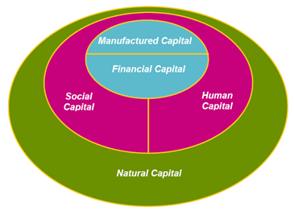
Integrated Reporting Framework
Business Model
EXTERNAL & INTERNAL CONTENT
Value
Short
Medium
Longterm

Slide 9
Research Hypothesis- Integrated Reporting
Despite its conceptual appealing, IR has not yet been well developed and rarely used in practice.
IR tends to be cumbersome and deviate significantly from the existing accounting frameworks.
According to a survey of CSR reporting practices by PWC (2013), while 499 of the S&P 500 companies provided sustainability disclosure, only seven used IR to report their CSR activities. IR framework is still far from a quality that can be adopted as a mainstream reporting system.
H2: There will be no difference in managers’ willingness to invest in a CSR project under IR reporting regime as compared to that under financial reporting regime.
9
Notes:
9

Slide 10
Research Theory & Hypothesis- Financial Conditions
While external factors and pressures play an initiating role in motivating corporate behavior toward social/environmental performance, internal resources are becoming increasingly important to maintain and expand these activities.
As per RBV &NRBV, companies with higher financial resources and superior financial performance are more likely to pursue proactive environmental strategies. In line with this theory, we propose the following hypothesis:
H3: Managers in profitable companies will be more willing to invest in a CSR project than those in unprofitable companies.
10
Notes:
10

Slide 11
Experimental Task And Procedure
Experimental case was developed based on a case study in a master thesis
We use a 3 (CSR reporting regimes) X 2 (financial condition) between subject design to test the hypotheses developed in the previous sections.
Participants acted as a CEO of a company operating in the upstream oil and gas production.
Participants chose either investing in a production expansion project with an IRR of 10 percent over the five years of the project or investing in a CSR project with an IRR of 6.15 percent and wrote a memo to stakeholders.
11
Notes:
11

Slide 12
Participants
Managers residing in the U.S.
Have supervised at least 10 subordinates
Have at least a bachelor degree
Have managerial experience for at least 3 years and work experience in accounting or finance.
A total of 6657 respondents started to participate in the survey. We obtain usable data from only 154 participants who passed all the qualifying questions and completed the survey.
The average age of the qualified participants was 44 years and 6 months (range 24-64 years old), and the average length of their full time work experience was 21 years and 3 months (range 4-41 years). 92 (60 percent) of the participants were male and 62 (40 percent) were female.
12
Notes:
12

Slide 13
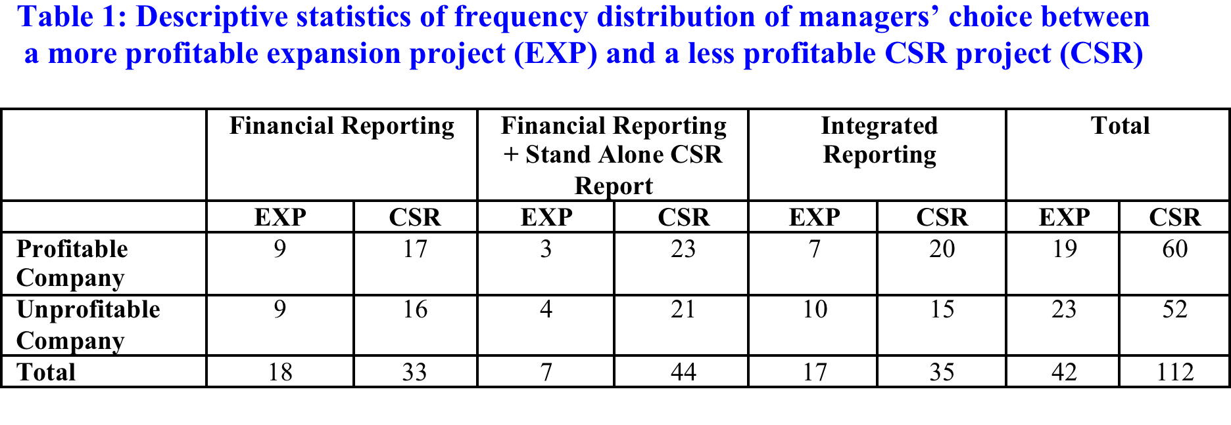

Slide 14
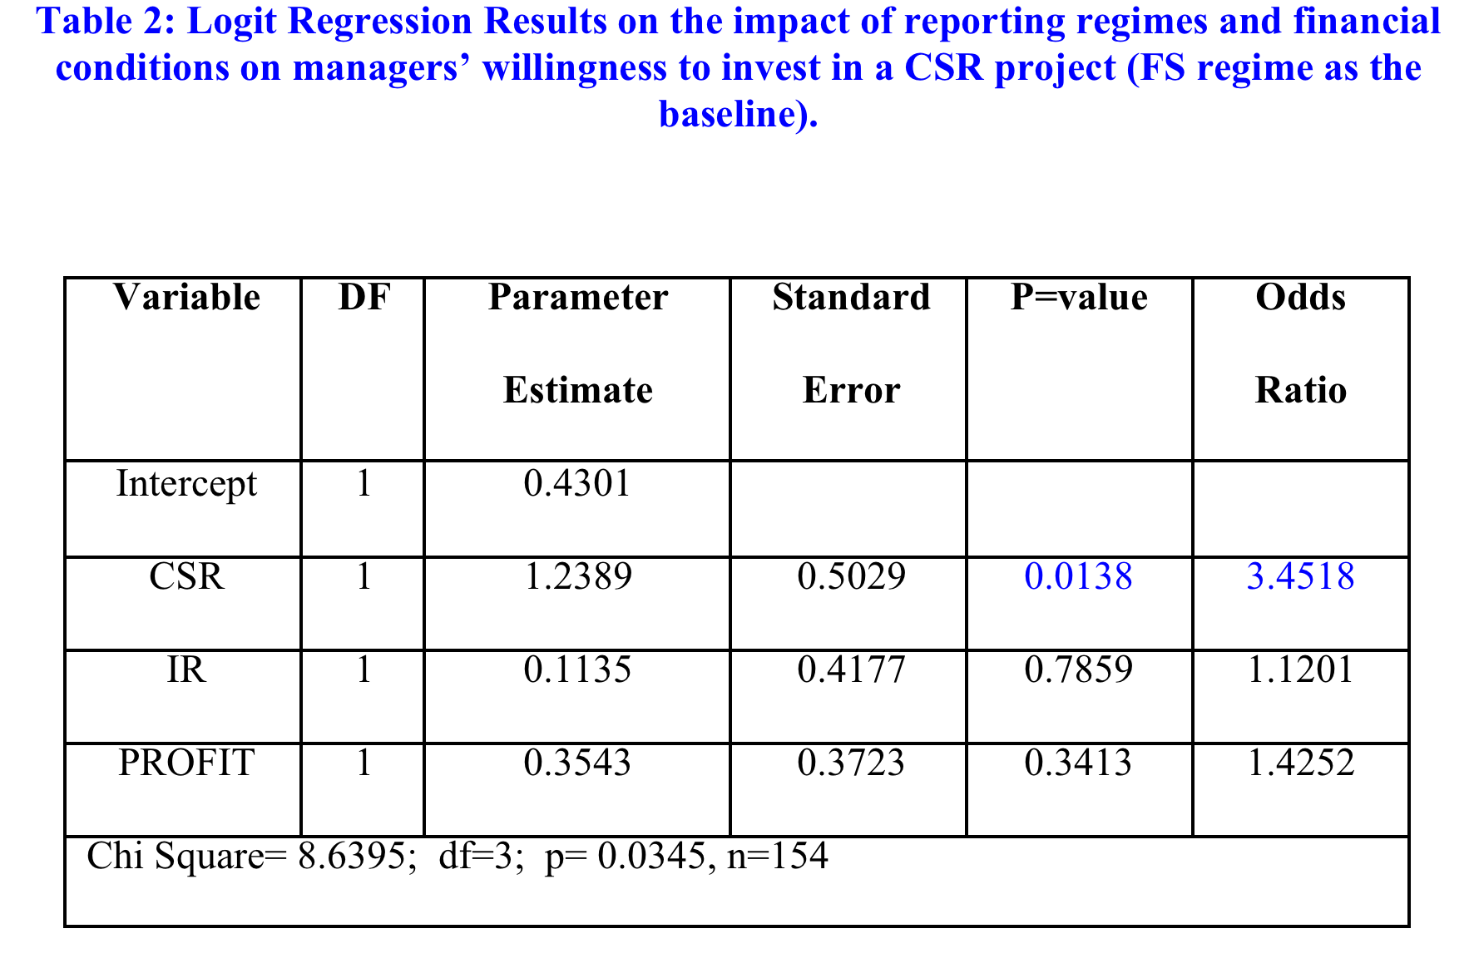

Slide 15
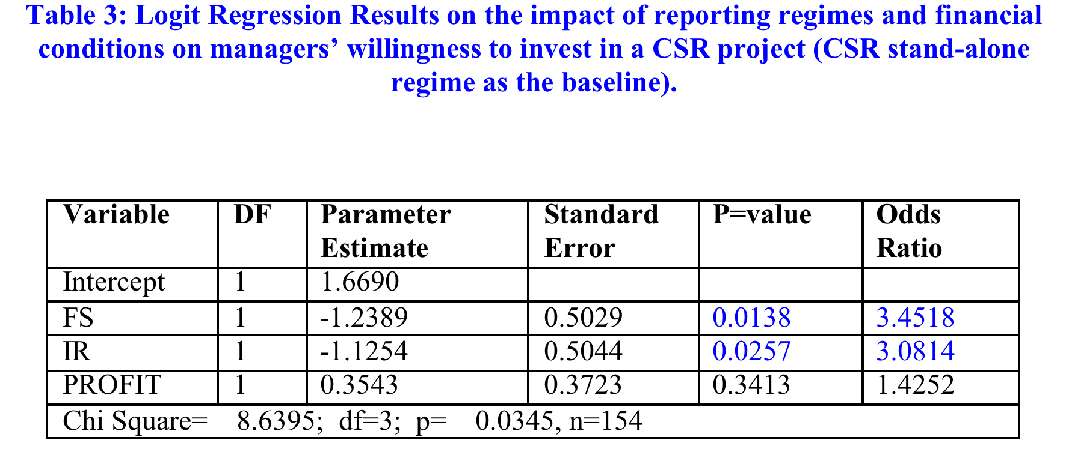

Slide 16
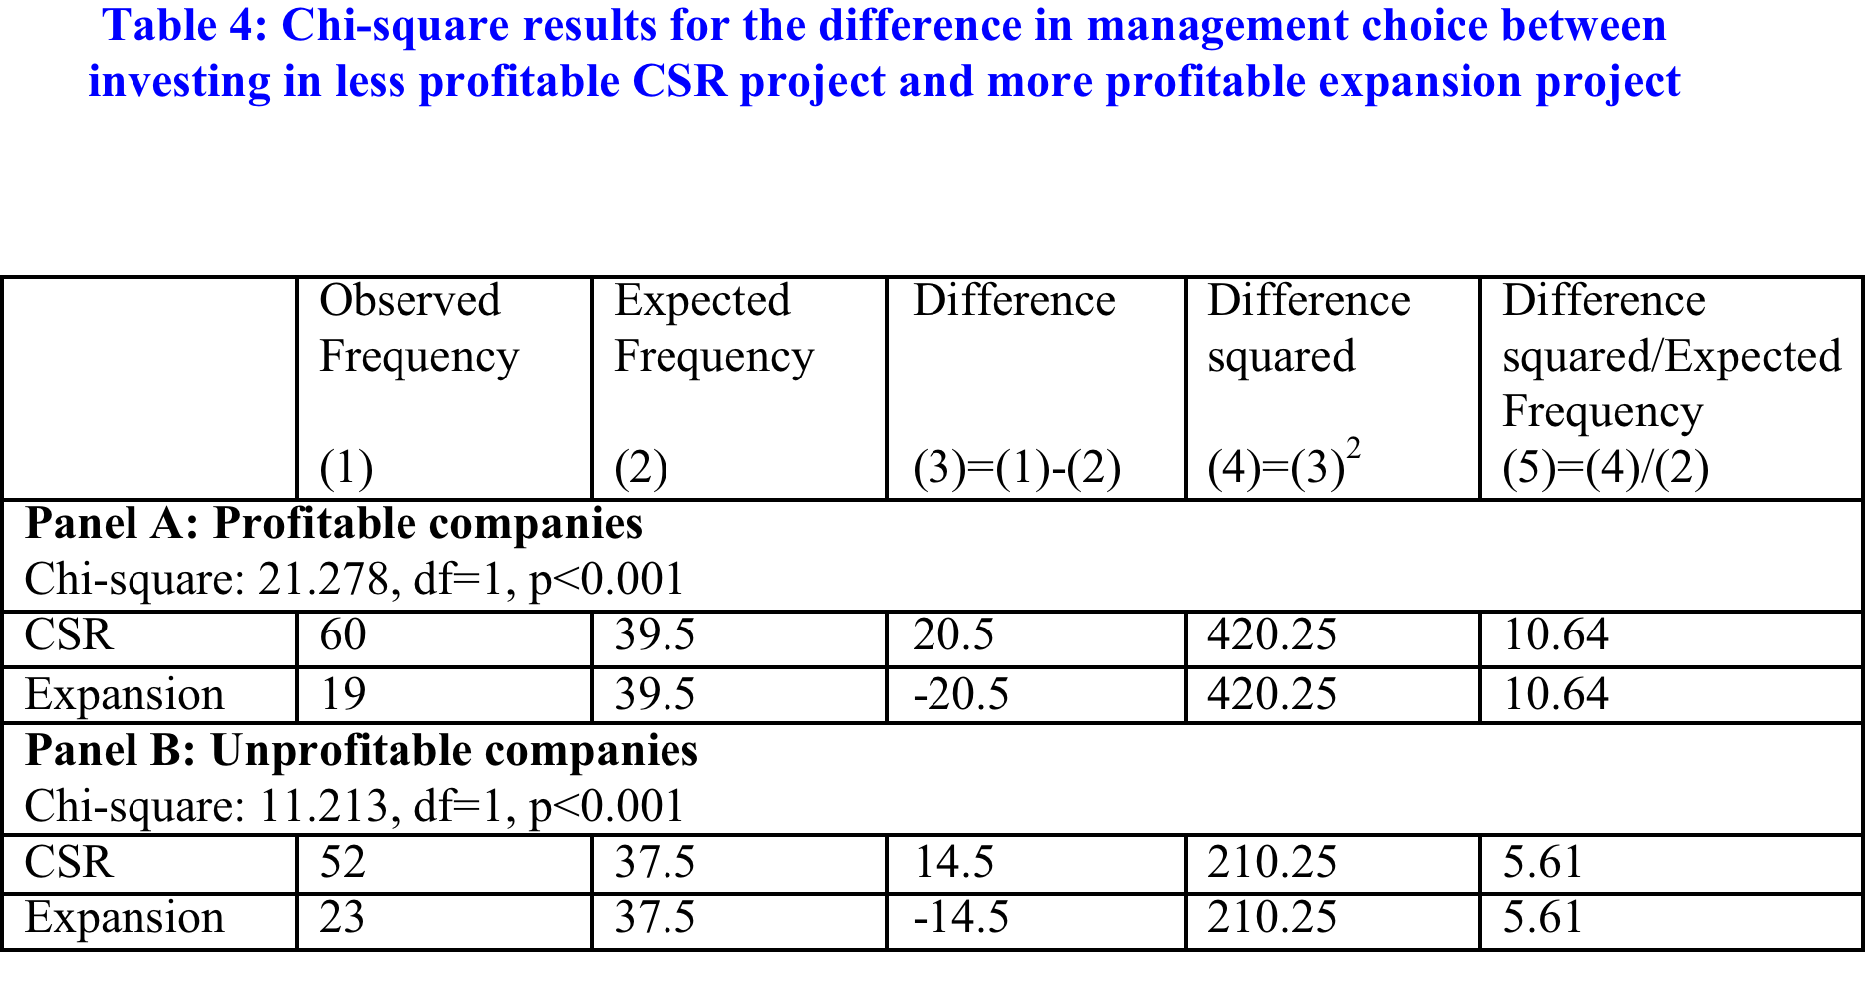

Slide 17
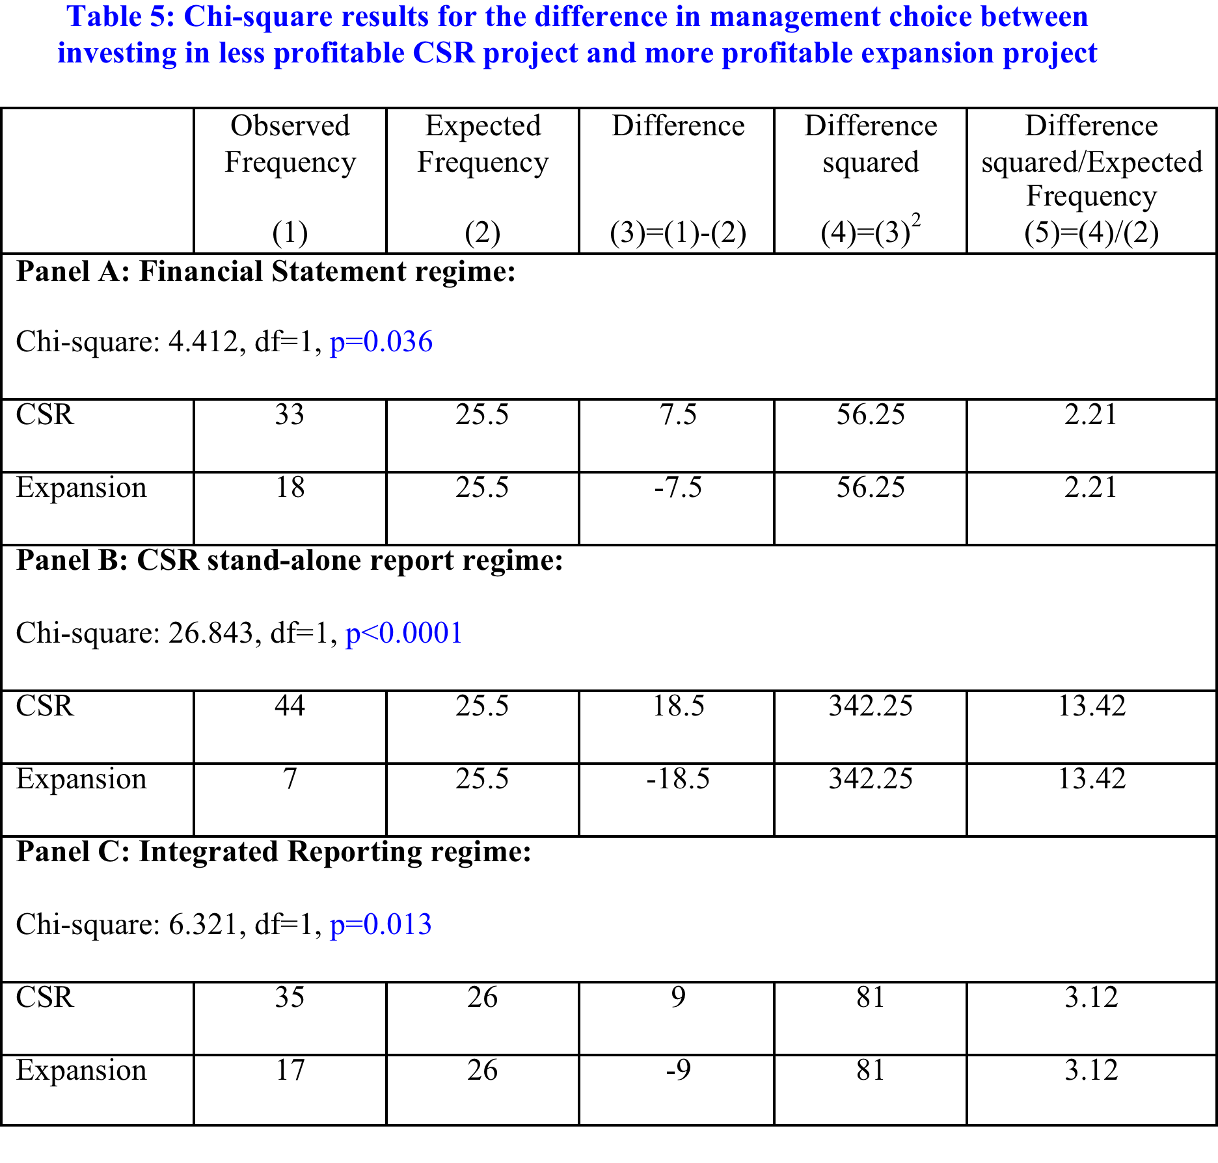

Slide 18
Discussion
Questions ?

