Slide 1

Opioids, cannabis, and Cyclic Vomiting syndrome
Narrative literature review
Pilot Study
Retrospective Chart Review
Conclusions
Future Research
Phd. nursing Science Program Goals
Notes:
Why did the PhD dissertation hire a security team?
Because it was tired of defending itself!

Slide 2
PhD Committee Members
Margaret Heitkemper, PhD RN FAAN
Professor, Department of Biobehavioral Nursing & Health Informatics, School of Nursing
Diana Buchanan, PhD RN
Affiliate Associate Professor, Department of Biobehavioral Nursing & Health Informatics, School of Nursing
Kendra Kamp, PhD RN
Gastroenterology and Assistant Professor, and Biobehavioral Nursing & Health Informatics, School of Nursing
Sheldon Rosen, MD
Clinical Associate Professor, Division of Gastroenterology, School of Medicine
Megan Moore, PhD
Faculty at the Harborview Injury Prevention and Research Center, and
Faculty affiliate at The Mack Center on Mental Health and Social Conflict at the University of California, Berkeley
Notes:
Megan Moore, School of Social Work

Slide 3
- THANK YOU -
Margaret Heitkemper, PhD RN FAAN
Professor, Department of Biobehavioral Nursing & Health Informatics, School of Nursing
Diana Buchanan, PhD RN
Affiliate Associate Professor, Department of Biobehavioral Nursing & Health Informatics, School of Nursing
Kendra Kamp, PhD RN
Gastroenterology and Assistant Professor, and Biobehavioral Nursing & Health Informatics, School of Nursing
Sheldon Rosen, MD
Clinical Associate Professor, Division of Gastroenterology, School of Medicine
Megan Moore, PhD
Faculty at the Harborview Injury Prevention and Research Center, and
Faculty affiliate at The Mack Center on Mental Health and Social Conflict at the University of California, Berkeley
Notes:
Megan Moore, School of Social Work

Slide 4
Cyclic Vomiting Syndrome (CVS)
An Enigma in Gastroenterological Care
CVS remains a mystery in terms of its causes and cure
Onset in childhood or adulthood
CVS vs. cannabis hyperemesis syndrome (CHS)
The Endocannabinoid System
Notes:
A narrative review of CVS is provided including its relationship to CHS:
CVS remains a mystery in terms of its causes and cure … despite a century and a half of clinical advancement,
The ECS is reviewed, and these syndromes are considered in the context of … Endocannabinoid dysregulation

Slide 5
Historical Context
1843
Dr. H. Dr. Gruère 1843 – Is this first published description?
Maybe, but identifying a new syndrome was missed …
1861
H. Cl. Lombard, 1861 “a neurosis of digestion”
Narrative case series. Describes a previously unrecognized syndrome
1882
Dr. Samuel Gee, 1882 “fitful or recurrent vomiting”
9 children as a case series. Describes an unrecognized syndrome.
Notes:
describes an unidentified pediatric syndrome, which shares features with modern-day CVS.
establishes "fitful or recurrent vomiting" as a distinct condition.
Due to an English-language bias Dr. Lombard’s paper was lost as a reference, and even the CVSA and the ANMS cite Dr. Gee as the original publication.
Consideration is given to Dr. Gruère, also a French language case study of likely pediatric CVS, 1843.
Although he notes the curiosity of this periodic vomiting without any apparent cause, in closing statements Dr. Gruère highlights the efficacy of quinine sulfate in treating the vomiting in this particular case, even in absence of typical symptoms such as fever

Slide 6
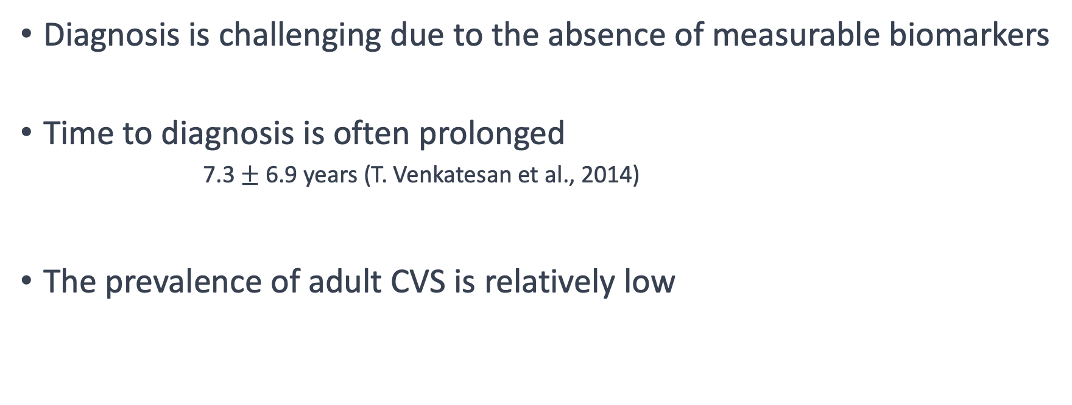
Adult Cyclic Vomiting Syndrome:
Prevalence and Diagnostic Challenges
Diagnosis is challenging due to the absence of measurable biomarkers
Time to diagnosis is often prolonged
    7.3 $±$ 6.9 years (T. Venkatesan et al., 2014)
The prevalence of adult CVS is relatively low
Notes:
Adult-onset CVS is a rare condition … characterized by predictable and recurrent emetic episodes. … CHS is also rare but the prevalence is in flux
Diagnosis is challenging due to the absence of measurable biomarkers … relying on symptom patterns and exclusion of other conditions.
The diagnostic journey is often prolonged … leading to unnecessary healthcare utilization, including emergency department visits and surgeries.

Slide 7
The Global Epidemiology Study of Functional Gastrointestinal Disorders
(Sperber & Drossman et al., Gastroenterology, 2021)
Combined Survey Data of 73,076 adults from 33 countries
22 functional GI disorders, including CVS and CHS
Anonymous internet survey in 26 countries (n = 54,127)
Face-to-face household surveys in 9 additional countries (n = 18,949).
Notes:
In looking at prevalence:
The Global Epidemiology Study of Functional Gastrointestinal Disorders (FGID) surveyed 73,076 adults from 33 countries to identify the prevalence of meeting criteria for at least one of 22 functional GI disorders, including CVS (Sperber et al., 2021). The study used an anonymous internet survey in 26 countries (n = 54,127) and conducted face-to-face household surveys in 9 additional countries that tended to be more rural and with less access to communication technology (n = 18,949). From the internet-based portion of the survey, the overall prevalence of adult CVS was 1.2% with a slightly higher rates in women versus men (1.2% vs 1.1%) and decline in incidence with age.
Face-to-face household surveys in 9 additional countries that tended to be more rural and with less access to communication technology (n = 18,949).

Slide 8
Prevalence Rates of CVS and CHS -- (Sperber et al., 2021)
Pooled prevalence rates by percentage (95% CI) for CVS and CHS
Population-based internet survey sample in 26 countries, and
Household interview survey sample involving 9 countries
Notes:
Pooled prevalence rates by percentage (95% CI) for CVS and CHS
Population-based internet survey sample in 26 countries, and
Household interview survey sample involving 9 countries

Slide 9
Adult Cyclic Vomiting Syndrome (contd.)
Key Features
Triggers include food sensitivities, health conditions, and emotional stressors.
CVS follows a cyclic pattern:
  inter-episodic wellness periods,
  prodromal phase,
  emetic phase, and
  recovery phase.
Psychiatric comorbidities are common in CVS patients.
Notes:
CVS episodes involve intense nausea, vomiting, and abdominal pain, lasting from hours to weeks.
Psychiatric comorbidities, …. such as depression and anxiety, …. are common in CVS patients.

Slide 10
Adult Cyclic Vomiting Syndrome (contd.) Pathogenesis
Autonomic dysfunction (Hejazi et al., 2011; Venkatesan, Prieto, et al., 2010)
Dysregulation of the brain-gut axis (Drossman & Hasler, 2016; Levinthal & Bielefeldt, 2014)
Stress-mediated activation of the corticotrophin-releasing factor signaling system (Adamiak & Jensen, 2015; Venkatesan, Prieto, et al., 2010)
Dysfunction of the hypothalamic-pituitary-adrenal axis (Bhandari, Jha, Thakur, et al., 2018; Donnet & Redon, 2018; Richards, 2017),
Mitochondrial DNA mutations (Boles et al., 2009; Gelfand & Gallagher, 2016; Zaki et al., 2009)
Polymorphisms involving the cannabinoid receptor type-1 and mu-opioid receptor genes (Wasilewski et al., 2017),
Dysfunction or dysregulation of the endocannabinoid system (Venkatesan et al., 2016).

Slide 11
Adult Cyclic Vomiting Syndrome (contd.) Pathogenesis
Autonomic dysfunction (Hejazi et al., 2011; Venkatesan, Prieto, et al., 2010)
Dysregulation of the brain-gut axis (Drossman & Hasler, 2016; Levinthal & Bielefeldt, 2014)
Stress-mediated activation of the corticotrophin-releasing factor signaling system (Adamiak & Jensen, 2015; Venkatesan, Prieto, et al., 2010)
Dysfunction of the hypothalamic-pituitary-adrenal axis (Bhandari, Jha, Thakur, et al., 2018; Donnet & Redon, 2018; Richards, 2017),
Mitochondrial DNA mutations (Boles et al., 2009; Gelfand & Gallagher, 2016; Zaki et al., 2009)
Polymorphisms involving the cannabinoid receptor type-1 and mu-opioid receptor genes (Wasilewski et al., 2017),
Dysfunction or dysregulation of the endocannabinoid system (Venkatesan et al., 2016).

Slide 12
Guidelines | Treatment
American Neurogastroenterology and Motility Society &
Cyclic Vomiting Syndrome Association (CVSA.org)
(Venkatesan, Levinthal, Tarbell, et al., Neurogastroenterology Motility, 2019)
“Migraine Variant” (Hayes et al., 2018; Irwin et al., 2017; LenglarT et al., 2021; Yu et al., 2018)
Mild: < 4 episodes / year & episodes lasting < 2 days
Moderate to Severe: > 4 episodes / year lasting > 2 days,
prolonged recovery, or ED visits and / or hospitalizations
Notes:
For prevention and treatment considerations one therapeutic approach is to consider CVS a migraine variant
mild cases with quick recovery periods can be treated with abortive medications only
Imitrex / sumatriptan / antiemetics. IV benzodiazepines plus fluid hydration. Because of the complexity in treating these patients, and the surprising failure of standard antiemetics in this population, having a written treatment plan can be facilitative for both the patient and the ED clinician
may need prophylactic treatment in addition to abortive therapy

Slide 13
Clinical Pearl
Proton pump inhibitors (IV pantoprazole in particular) may result in a false positive cannabis toxicology.
Felton, D., Zitomersky, N., Manzi, S., & Lightdale, J. R. (2015). 13-Year-Old Girl With Recurrent, Episodic, Persistent Vomiting: Out of the Pot and Into the Fire. Pediatrics, 135(4), e1060-1063.
Gomila, I., Barceló, B., Rosell, A., Avella, S., Sahuquillo, L., & Dastis, M. (2017). Cross-Reactivity of Pantoprazole with Three Commercial Cannabinoids Immunoassays in Urine. J Anal Toxicol, 41(9), 760-764.
Notes:
Clinicians assessing for cannabis use in CVS patients (in attempts to differentiate CHS) should note that proton pump inhibitors (IV pantoprazole* in particular) may result in a false positive cannabis toxicology screen during the ED or inpatient workup
Felton, D., Zitomersky, N., Manzi, S., & Lightdale, J. R. (2015). 13-Year-Old Girl With Recurrent, Episodic, Persistent Vomiting: Out of the Pot and Into the Fire. Pediatrics, 135(4), e1060-1063.
Gomila, I., Barceló, B., Rosell, A., Avella, S., Sahuquillo, L., & Dastis, M. (2017). Cross-Reactivity of Pantoprazole with Three Commercial Cannabinoids Immunoassays in Urine. J Anal Toxicol, 41(9), 760-764.

Slide 14
Cannabis Hyperemesis Syndrome (CHS)
CHS is a newly recognized syndrome (Allen et al. 2004)
Typical presentation similar but subtle differences with CVS
Cannabis use predates the onset of cyclic vomiting symptoms
Diagnosis is by resolution of symptoms with the cessation of cannabis
Notes:
CHS is a newly recognized syndrome …. characterized by cyclic vomiting associated with a history of daily cannabis use.
Presentation: prodromal phase of early morning nausea and occasional vomiting for months or years, followed by sudden onset of emesis lasting 24-48 hours, then resolution back to baseline morning nausea prodrome.
cannabis use predates the onset of cyclic vomiting symptoms. … Initial cannabis use not for self-treatment of nausea and vomiting
Diagnosis is by resolution of symptoms with cessation of cannabis … however the length of abstinence is not defined and is likely to have a large individual variability

Slide 15
Prevalence of Cannabis Use in CVS Patients
Internet survey: 81% of CVS patients reported cannabis use
(T. Venkatesan et al., 2014)
Milwaukee Hospital-based survey: 14% of CVS patients reported cannabis use, versus 3% of non-CVS patients.
(Bhandari & Venkatesan, 2017)
Mayo Clinic: 79% of their adult CVS patients reported cannabis use
(Choung et al., 2012)
Notes:
Large anonymous internet survey: 81% of CVS patients reported cannabis use for symptom relief, including nausea and pain.
Hospital-based survey in Milwaukee: 14% of CVS patients reported cannabis use, versus 3% of non-CVS patients.
Mayo Clinic retrospective chart review: cannabis more significantly associated with CVS than with functional vomiting (OR 2.9).
CVS clinic survey in Milwaukee: 41% of CVS patients reported using cannabis in the prior 6 months.
An odds ratio is a measure of the association between two categorical variables in a case-control study or cross-sectional study. An odds ratio of 3 means that the odds of the event occurring are three times as high in one group compared to the other group. An odds ratio of 1 indicates no association between the variables, meaning the odds of the event occurring are equal in both groups.

Slide 16
Under-Recognition of CHS
CHS is often not mentioned in published cases of adult-onset CVS,
Global Epidemiology Survey very small prevalence at 0.05% - 2%
Compulsive hot water bathing is associated with both CVS and CHS, but not specific enough to CHS alone
Notes:
CHS is often not mentioned in published cases of adult-onset CVS, and it is likely under-recognized and underdiagnosed.
Global market survey: overall prevalence of CHS at 0.1%; Global Epidemiology Survey of FGID noted even smaller prevalence at 0.01% - 0.05%.
Many CVS case studies either do not mention cannabis use or list it as a recreational or therapeutic measure without considering it as a possible cause of symptoms.
Compulsive hot water bathing is associated with both CVS and CHS, but not specific enough to CHS alone.

Slide 17
Prevalence Rates of CVS and CHS -- (Sperber et al., 2021)
Pooled prevalence rates by percentage (95% CI) for CVS and CHS
Population-based internet survey sample in 26 countries, and
Household interview survey sample involving 9 countries
Notes:
Pooled prevalence rates by percentage (95% CI) for CVS and CHS
Population-based internet survey sample in 26 countries, and
Household interview survey sample involving 9 countries

Slide 18
Cannabis Hyperemesis Syndrome (cont.)
Increase in published cases of CHS
Increased cannabis availability and potency
Additional Therapeutics:
  Haloperidol (IV Haldol, antipsychotic)
  Capsaicin Topical
Notes:
Increase in published cases of CHS, including fatal cases and associations with synthetic cannabis use.
Possible factors contributing to the rise in cases: increased cannabis availability and potency.
Treatment options: RCTs for CHS treatment include Haloperidol Versus Ondansetron for CHS (HaVOC) trial and a pilot trial of topical capsaicin cream.
HaVOC trial: intravenous haloperidol demonstrated superiority over ondansetron in relieving nausea, vomiting, and abdominal pain.
Topical capsaicin cream: some evidence supports its use in aborting acute cyclic vomiting in CHS patients, but the overall evidence is low.

Slide 19
Endocannabinoid System Vanilloid Interaction
Cannabinoid Receptors (CB₁, CB₂)
  CB₁ present throughout the CNS
  CB₂ located on the cells of the immunologic system
  Co-located with the opioid and vanilloid receptors
  Notable absence of receptors in the brainstem
  Complex structure
Notes:
(TRPV1-4, TRPA4, and TRPM8) (Muller et al., 2018)
Complex Structure: Allowing it to receive a variety of molecules for various effects.

Slide 20
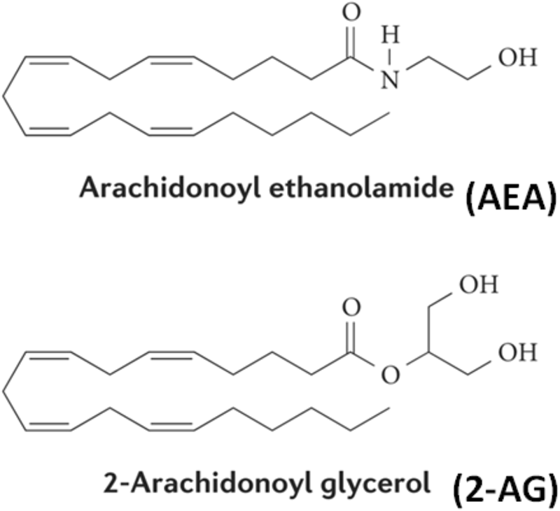
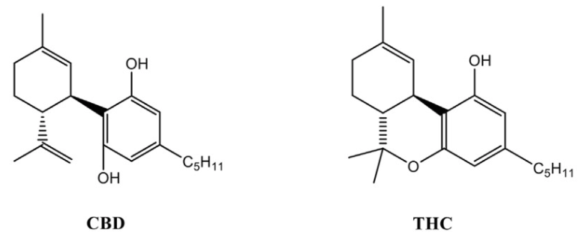
Phenol group (-OH)
Hydrophobic tail
Similar molecular weight
Notes:
Complex Structure: Allowing it to receive a variety of molecules for various effects.
Functional Groups: Both THC and AEA contain an aromatic ring system with a phenol group (-OH) attached. This phenol group is thought to be important for their interaction with cannabinoid receptors.
Hydrophobic Tail: Both THC and AEA possess a hydrophobic tail, which consists of a long alkyl chain. In THC, this tail is a pentyl (5-carbon) chain, while in AEA, it is an ethyl (2-carbon) chain. This hydrophobic tail contributes to their ability to interact with the cell membrane and affect the endocannabinoid receptors.
Similar Molecular Weight: THC and AEA have similar molecular weights, with THC having a molecular weight of 314.46 g/mol and AEA having a molecular weight of 347.52 g/mol. This similarity in molecular weight may contribute to their ability to bind to cannabinoid receptors.

Slide 21
Endocannabinoid System Vanilloid Interaction
Vanilloid Receptor (TRPV₁) - “Capsaicin Receptor”
  Nociceptive neurons of the PNS (but also present in the CNS)
  Involved in the transmission and the modulation of pain
  Pro-emetic action through substance P
  Anti-emetic action through stimulated desensitization
  CBD exhibits and action on TRPV₁ as a “capsaicin analog”
Notes:
Vanilloid Receptor (TRPV₁) - “Capsaicin Receptor”
Nociceptive neurons of the PNS (but also present in the CNS)
Involved in the transmission and the modulation of pain
Pro-emetic action through substance P
Anti-emetic action through stimulated desensitization (topical capsaicin for acute CHS).
CBD exhibits and action on TRPV₁ similar to capsaicin (in vitro)
Aromatic Ring System: Both CBD and capsaicin contain an aromatic ring system. CBD has a resorcinol ring, while capsaicin has a vanillin ring. The presence of these aromatic rings contributes to their chemical properties and potential interactions with receptors in the body.
Hydrophobic Tails: CBD and capsaicin both possess hydrophobic tails, which are responsible for their lipophilic nature. CBD has a long aliphatic tail, typically a pentyl (5-carbon) chain, whereas capsaicin has a shorter aliphatic tail, usually an 8-carbon chain. These hydrophobic tails allow them to dissolve in lipid-based substances and interact with receptors on cell membranes.
Molecular Weight: CBD and capsaicin have somewhat similar molecular weights. CBD has a molecular weight of 314.46 g/mol, while capsaicin has a slightly higher molecular weight of 305.41 g/mol.

Slide 22
Theory Proposal for treating CHS with CBD
Very high THC strains do not produce CBD in any measurable amounts
CBD is anti-emetic, anti-anxiety, anti-inflammatory, and neuroprotective
CBD engages in with TRPV₁ in a similar manner as capsaicin
CBD is considered non-psychoactive when consumed
CBD alone does not induce vomiting (Parker et al, 2004)
Transitioning from THC-dominant to CBD-dominant strains has promise
Resolution of CHS symptoms w/ CBD cannabis (Venkatesan et al., 2020)
Notes:
Very high THC strains do not produce CBD in any measurable amounts. -- CBG – A (Cannabigerolic Acid)
CBD is anti-emetic, anti-anxiety, anti-inflammatory, and neuroprotective
CBD engages in with TRPV₁ in a similar manner as capsaicin
CBD is not psychoactive and is considered non-psychoactive when consumed
CBD alone does not induce vomiting
Transitioning from THC-dominant to CBD-dominant strains of cannabis may have potential benefits in treating intractable CHS in cannabis-dependent individuals.
There is limited clinical research on the use of CBD-dominant strains in CHS patients, but one case reported complete resolution of symptoms with higher CBD proportion in cannabis use.
recent survey evaluating a cohort of CVS patients from a specialty GI clinic did identify one patient with complete resolution of CVS symptoms after an abstinence from cannabis and a prior history of heavy cannabis use. The authors report, “This was the only cannabis-using patient in our study who could be reclassified as having CHS based on Rome IV criteria. This patient subsequently resumed using cannabis with a higher proportion of cannabidiol vs THC and reportedly remains episode-free.” (Venkatesan et al., 2020, pp. 1087-1089).

Slide 23
State of the Science
Evidence for recommending CBD-dominant strains of cannabis for CVS is without any clinical evidence (even case studies).
Studying this is limited by the continued Schedule I status of cannabis
Evidence for recommending topical capsaicin in CVS/CHS is very low
The evidence on diagnostic and therapeutic approaches to CVS (and CHS) are moderate at best
There is a near absence of Level I evidence within the CVS literature for either children or adults.
Notes:
In 2018 the first and only RCT for CVS was published and involved 64 children between the ages of 3-15 and investigated the difference between amitriptyline and cyprohepatadine (Periactin: Antihistamine with additional anticholinergic, anti-serotonergic properties) in prevention of future attacks; no difference was noted.
Evidence for recommending CBD-dominant strains of cannabis for CVS is without any clinical evidence (even case studies). Studying this is limited by the continued Schedule I status of cannabis.
Evidence for recommending topical capsaicin in CVS/CHS is very low as this relies entirely on a small number of case reports (CHS only); a prospective RCT is warranted based on the improvements noted.
The evidence on diagnostic and therapeutic approaches to CVS (and CHS) are moderate at best as the science is based entirely on case-series publications and expert opinion (such as the Rome IV clinical experts).
There is a near absence of Level I evidence within the CVS literature for either children or adults.

Slide 24

Retrospective Chart Review: Research Aims
Describe
Describe the cohort in relation to cannabis and opioid use.
Evaluate
Evaluate the impact of cannabis and / or opioid use on healthcare utilization.
Measure
Measure if opioid use by morphine equivalence differs between cannabis-using and non-cannabis-using groups.
Explore
Explore coalescence as a clinical parameter.
Notes:
This aim involves comparing four user groups (non-users, cannabis-only users, opioids-only users, and cannabis plus opioid users) to examine demographic and clinical characteristics, such as age, gender, partner status, employment status, disability status, comorbid conditions, and CVS history.
This aim focuses on analyzing healthcare utilization measures, including clinic visits, emergency department (ED) visits, and hospital days, over a two-year period for the four user groups mentioned above.
This aim involves comparing the cannabis plus opioids group and the opioids-only group based on the Morphine Equivalent Dose (MED)/day and Morphine Milligram Equivalent dose (MME)/day values obtained from prescription monitoring programs.
This aim aims to examine the subset of variables with statistical significance from the demographic and clinical characteristic section to identify differences between the coalescence group (patients with both CHS and CVS) and the non-coalescence group. Additionally, a narrative case series is generated to provide detailed descriptions of the coalescent cases.

Slide 25
IRB and Pilot Study
IRB for the pilot study was gained
Initial list of ~ 300 patients with potential CVS
  ICD-10 billing codes G43.A0, G43.A1, and R11.15 (new in 2019)
Random number generator for 10 cases
10 cases reviewed, data collection tool tested, rebuilt
IRB modified to cover the full study

Slide 26
Data Collection Tool
Built in REDCap using variables considered significant from the literature.
Re-built as informed by the pilot
With completion of the study, the tools were uploaded to the REDCap consortium

Slide 27
Design and Sample
Retrospective chart review, descriptive design.
Initial cohort: 164 adult patients
  Diagnosis code of CVS seen between 2014-2020 at the University of Washington (UW) Digestive Health Center
All patients were either evaluated by, or referred to, a co-investigator (S.N.R.)
The visit used for data collection was the most recent CVS visit identified in the patient chart.
After the initial chart review, 34 cases were excluded from the analysis.
130 cases that met the inclusion criteria
Notes:
Retrospective chart review: The study conducted by the first author involved a retrospective analysis of medical records of 164 adult patients diagnosed with cyclic vomiting syndrome (CVS) at the University of Washington Digestive Health Center between 2014 and 2020.
Data collection: Data were collected using a secure remote server linked to the center's electronic medical record system (Epic). The cases were identified using specific diagnostic codes (ICD-10 codes: G43.A0, G43.A1, and R11.15). A data collection form was developed for the study using the REDCap system hosted by the UW Institute of Translational Health Sciences.
Exclusion criteria: After the initial chart review, 34 cases were excluded from the analysis. Three cases were excluded due to the patients being under 18 years old at the time of the most recent CVS visit, and 31 cases did not meet the diagnostic criteria for CVS as determined by the treating physician.
Final data analysis: The study analyzed data from a total of 130 cases that met the inclusion criteria, and these cases were used for the final analysis of the study.

Slide 28
Study Variables
Demographics and Clinical Characteristics
Cannabis Use
Opioid Dose and Frequency
Healthcare Utilization
Notes:
Demographic variables included age, self-reported gender and ethnicity, partner status, as well as disability status and comorbid conditions. CVS history was characterized by length of time with CVS diagnosis, age at onset of first symptoms, frequency of episodes, and change in frequency over time. Comorbid psychiatric diagnoses included conditions such as depression, anxiety, suicide ideation, and possible addiction (identified by self-report of early-age cannabis use, concurrent tobacco use, heavy alcohol use, and other drug use). Past medical history included migraine, CVS history as a child, previous surgeries, other functional bowel disorders such as irritable bowel syndrome, and any temporal relationship with menstruation (catamenial CVS). Cannabis use was based on the patient’s self-report. Information such as amount, route of administration, and frequency of use was collected during chart review, but for statistical analysis the variable was reduced to yes or no. Non-pharmacological symptom management including the use of hot water bathing behaviors or the use of sleep to abort an episode were set as dichotomous yes or no variables. Possible CHS and possible CVS coalescence were determined by the physician notes in the EMR and noted as yes or no.
Opioid use was determined by whether the patient had an active prescription for opiates in the UW EMR system within the previous 30 days of the most recent CVS-related healthcare visit, or evidence of administration of opiates either during a hospital inpatient stay or ED visit within that same 30-day period. Opioid dosing was standardized between patients using a Morphine Equivalent Dose (MED)/day, calculated by the Washington State Agency Medical Directors' Group online calculator [40]. The MED value was calculated as a daily average for the 30-day period prior to the reviewed CVS visit. Additionally, an equivalent variable, the Morphine Milligram Equivalent dose (MME)/day was also gathered from the Washington State Prescription Monitoring Program for the same 30-day period

Slide 29
Statistical Analysis
IBM® SPSS® Statistics version 27
4 group Comparison:
  non-users,
  cannabis-only users,
  opioid-only users,
  cannabis & opioid users.
Healthcare Utilization Analysis
Opioid – Cannabis Interaction Analysis
Exploratory Aim – Coalescence of CVS Symptoms
Notes:
Demographic and descriptive data were quantified by mean and standard deviation for continuous variables, and number and percentage for categorical variables. Statistical significance was set at p < 0.05.
Aim 1: To answer the primary aim of describing the cohort in relation to cannabis and opioid use, 4 groups 1) non-users, 2) cannabis-only users, 3) opioid-only users, and 4) cannabis plus opioid users were compared using one-way ANOVA for continuous variables and Fisher’s exact test for categorical variables.
Aim 2: For the second aim evaluating if cannabis or opioid use impacts healthcare utilization, a count of clinic days, emergency department (ED) visits, and number of hospital days over a two-year period was compared against the 4 user groups.
Aim 3: To explore the third aim evaluating if opioid use by morphine equivalence differed between cannabis-using and non-cannabis-using groups, the cannabis + opioids and the opioids-only groups were compared against the Prescription Monitoring Program MME values.
Exploratory Aim 4: For the exploratory aim of coalescence, the subset of variables with statistical significance from the demographic and clinical characteristic section were compared for differences between the coalescence group and the non-coalescence group, as well as a narrative case series was generated.

Slide 30
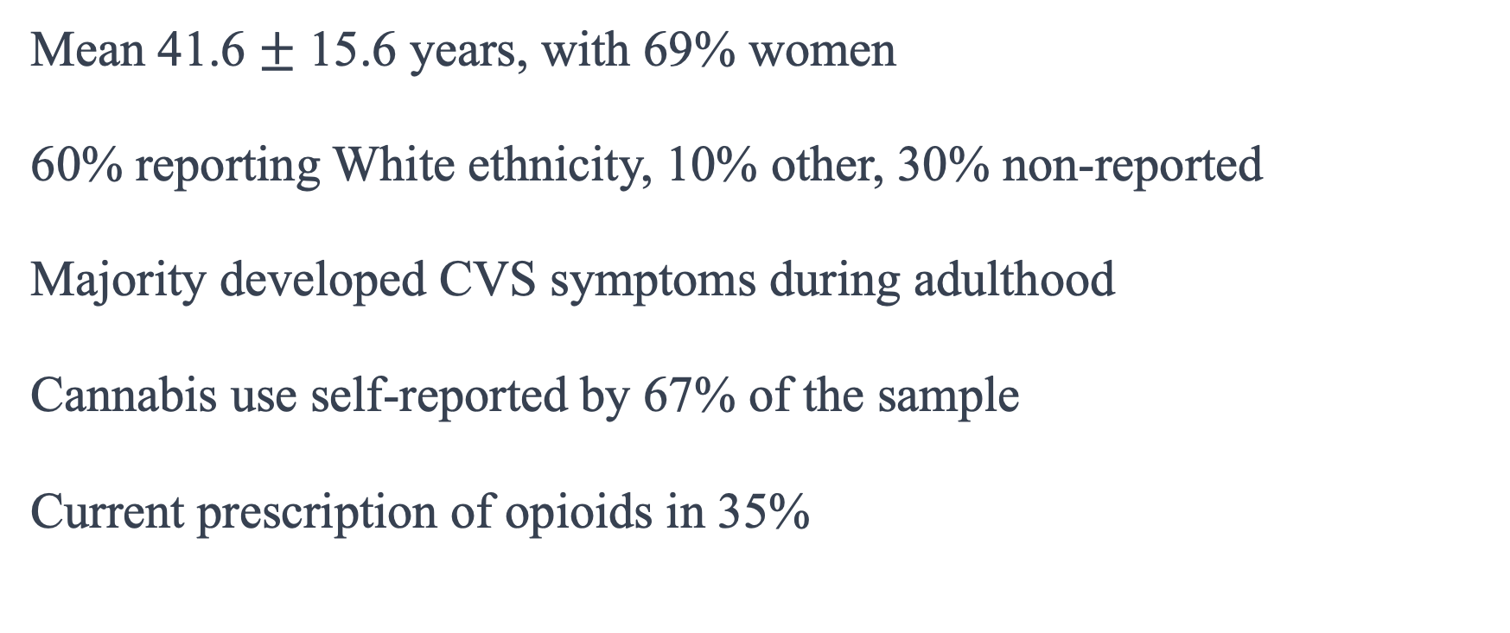
Results: Demographics
Mean 41.6 $±$ 15.6 years, with 69% women
60% reporting White ethnicity, 10% other, 30% non-reported
Majority developed CVS symptoms during adulthood
Cannabis use self-reported by 67% of the sample
Current prescription of opioids in 35%
Notes:
A majority of the cohort (65%) developed their first CVS symptoms during adulthood with no childhood history of CVS. Nearly half of the cohort (49%) had an onset of symptoms in their 2nd or 3rd decade of life. For the later decades, 8.5% reported an onset in the 40’s, 7% reported an onset in their 50’s, 2% reported an onset in 60’s, and 2% had an onset at age 70 or greater. Conversely, 30% reported continuous symptoms since either childhood or teenage years, and 7% patients reported an onset of symptoms in childhood or teenage years that resolved and then returned with a renewed onset later in life.

Slide 31
Results: Demographics
Possible CHS in reported 11% of the cohort
Early-age cannabis use noted in 13%
Reports of abdominal pain in 68%
48% described a personal history of migraine
Family history of migraine 45%
Two cases with a past family history of CVS (1.5%)

Slide 32
Results: Group Comparison
Cannabis-only consumers younger (37.5 vs. 45.6, p = 0.047)
Gender differences were noted (w, opioids & cannabis; m, cannabis-only) (p = 0.026).
No difference across racial groups
Employed 44%, unemployed 25%, unknown 32%
Self-report of disability status was 17%; highest in the cannabis + opioids group (p = 0.003).
Notes:
Demographic characteristics were examined across four groups: non-users, cannabis-only, opioids-only, and opioids + cannabis. Fisher’s exact calculation of age by the user groups demonstrated a difference between groups with a mean age of the cannabis-only consumers 8-years younger than the average of the other three groups
There was also a significant effect of gender across the groups with more women in the opioid + cannabis group than men, and more men in the cannabis-only group vs. women
Employment status differed with more employed in the non-user group and more unemployed in the cannabis + opioids group (p = 0.013).
Self-report of disability status was 17% for the total cohort and was highest in the cannabis + opioids group (p = 0.003).

Slide 33
Results: Group Comparison
Hot water bathing, 45%, no differences across the 4 groups
Sleep improved symptoms 35%, no differences across the 4 groups
Depression (25%) and anxiety disorder (35%) did not differ across the 4 groups.
Tobacco smoking was noted in 18.5%; highest cannabis + opioid group (p = 0.017).
Possible opioid use disorder, 14%; highest in the 2 opioid groups (p < 0.001).
Notes:
For symptom management, 45% of the cohort reported at least partial relief with hot water bathing with no significant difference across the 4 groups.
Sleep was reported to improve symptoms or terminate a cycle in 35% of the sample, with no difference across the 4 groups.
Tobacco smoking was noted in 18.5% of the sample with a higher grouping in the cannabis + opioid group (p = 0.017).
A possible history of opioid use disorder was noted in 14% of the sample and was highest in the 2 opioid groups (p < 0.001).

Slide 37
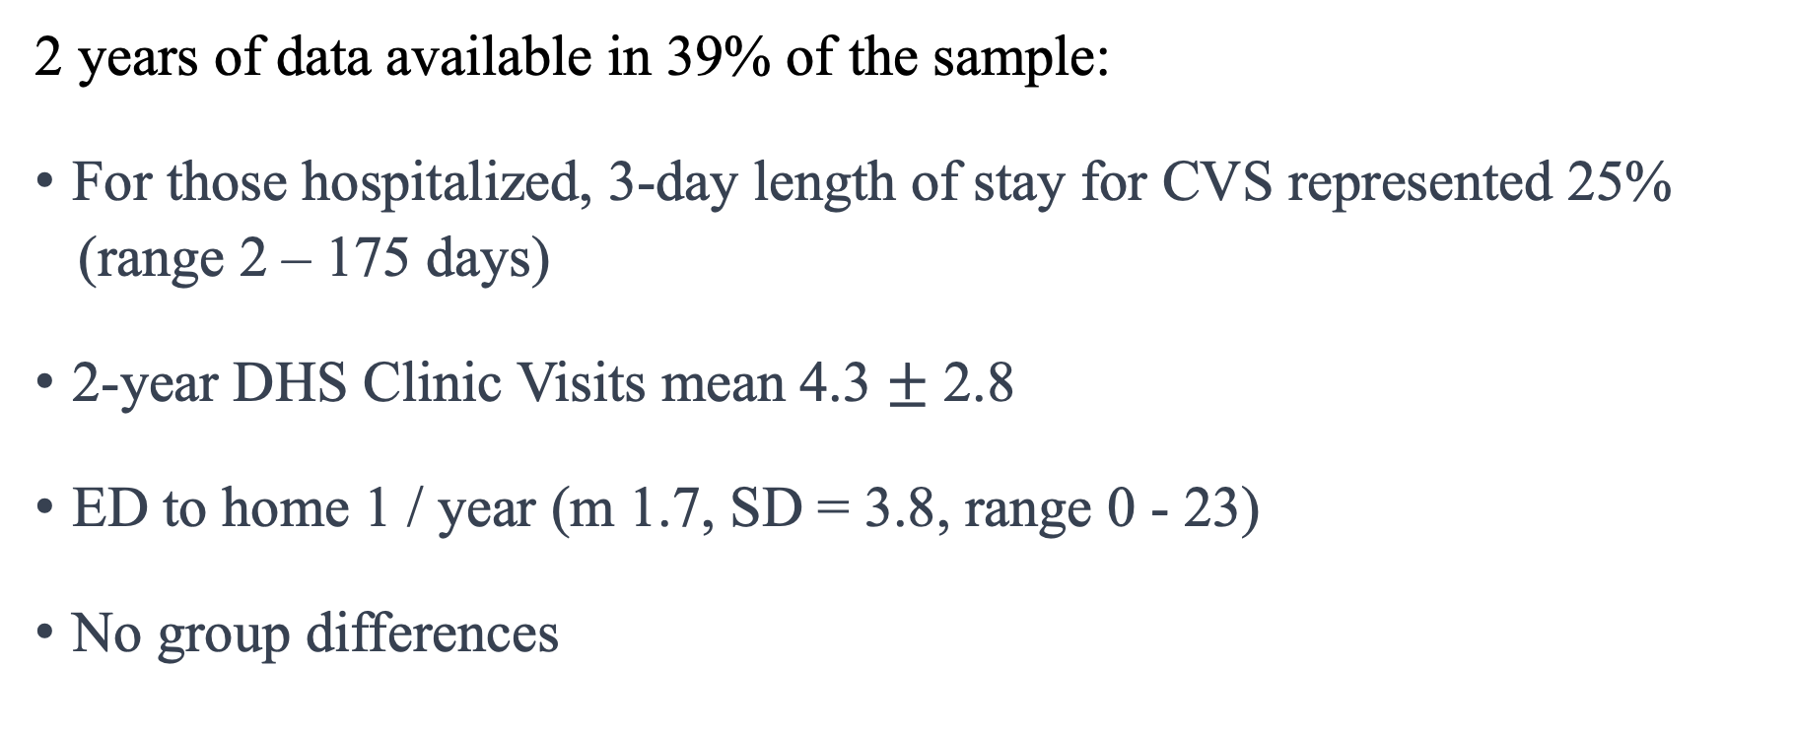
Results: Healthcare Utilization
2 years of data available in 39% of the sample:
For those hospitalized, 3-day length of stay for CVS represented 25%
(range 2 – 175 days)
2-year DHS Clinic Visits mean 4.3 $±$ 2.8
ED to home 1 / year (m 1.7, SD = 3.8, range 0 - 23)
No group differences
Notes:
Fifty-one patients (39% of the sample) had two years or more of EMR data available immediately prior to the most recent CVS-related encounter. For those hospitalized with CVS symptoms, a 3-day length of stay represented 25% of the sample (n = 16, mean 21.4, median 8, mode 3, range 2 – 175 days). The mean number of Digestive Health Center clinic visits was 4.3 ± 2.8 over 2 years with CVS-related ED-discharge-to-home at approximately 1 visit / year (m 1.7, SD = 3.8, range 0 - 23). When compared across the four groups, there initially appeared to be a group difference in number of all-cause hospital days (and the subgroup of CVS – only hospital days) within the opioids-only column. However, this significance was due to an outlier case with 210 hospital days (for all cause) and 177 days (for CVS-related hospitalization) representing 5 standard deviations above the next highest value at 46 days. A sensitivity analysis removing the outlier from the relevant column resulted in no statistical significance across the groups

Slide 39
Results: Cannabis – Opioid Interaction
There was no significant difference between the opioids only and cannabis + opioids groups:
(n = 5, m = 35.7 mg, SD = 37.7 mg, range 2.5 mg – 100.0 mg)
(n = 29, m = 33.9 mg, SD = 40.1 mg, range 1.3 mg – 172.5 mg)
(p = 0.925).
Notes:
Within the cohort, 46 (35.4%) participants had morphine equivalent data available for consideration of inclusion in the cannabis – opioid interaction analysis. Correlation between the chart review MED values and the prescription monitoring program MME numbers demonstrated a significant linear relationship (R² Linear = 0.405, see Figure 1), between daily MED (n = 21, m = 53.04 mg, SD = 72.43 mg) and daily MME for the same review period (n = 34, m = 34.15 mg, SD = 38.18 mg), r(53) = 0.637, p = 0.008. As the prescription monitoring program provided the highest number of participants with data, the MME values used for the interaction analysis evaluating for group difference between the opioids only and the cannabis + opioids group.

Slide 40
Notes:
Figure 1: Correlations Between Calculated MED from the Chart and Calculated MME from the Washington State Prescription Monitoring Program (PMP).
R2 value ranges between 0 and 1. It provides an indication of the strength and quality of the linear relationship between the two variables being analyzed. An R2 value closer to 1 indicates a strong linear relationship, suggesting that a large portion of the variance in one variable can be explained by the other variable.

Slide 41
Results: Coalescence
Coalescent pattern reported in 22% of the sample
Significant history of opioid use and higher unemployment rates in the coalescent group
No differences in probable CVS, early-age cannabis use, or nicotine use
Case series description provided for the coalescent group
Notes:
A coalescent pattern was reported in the physician narrative in 22% of the sample. Group comparison was performed between the coalescent group (n = 29) and the non-coalescent group (n = 101) across the variables previously noted as significant from Table 1.
As this was an exploratory aim, no correction was made for multiple comparisons.
There were no differences in groups with probable CHS, early-age cannabis use, or nicotine use, but those with coalescence had a significant history of opioid use (p = 0.028) and were more likely to be not employed (p = 0.024).
Among the opioid users of the coalescence group, the mean MME was 28.2 mg / day (n = 13, 44.8%, SD = 24.6 mg, range 2.3 mg – 80.0 mg).
Of the 29 cases considered to be exhibiting coalescent CVS, 8 of the cases were seen most recently in the ED or by one of the other providers in the clinic, while 4 cases were possible or likely CVS but still undergoing workup. The remaining 17 cases (59%) were most recently seen by the same physician (SNR), and a case series description of these cases is provided in Appendix C.

Slide 43
Discussion
Female, White, middle-aged, and unemployed.
A prolonged time from symptom onset to diagnosis.
Three subtypes of CVS onset were identified.
Younger, unmarried individuals were more likely to use cannabis only.
Current disability and unemployment were more likely to use both cannabis and opioids.
Notes:
- This study conducted a retrospective chart review of patients with cyclic vomiting syndrome (CVS) over a 6-year period.
- The study found that the majority of CVS patients were female, White, middle-aged, and unemployed.
- Patients with CVS experienced a prolonged time from symptom onset to diagnosis and had a history of abdominal surgeries, migraines, anxiety, depression, and substance use.
- Three subtypes of CVS onset were identified: adult onset, childhood onset, and reemergence of childhood CVS in adults.
- The study examined the differences in CVS characteristics and symptoms between opioid and/or cannabis users and found that younger, unmarried individuals were more likely to use cannabis only, while those with current disability and unemployment were more likely to use both cannabis and opioids.
- There were no significant differences in healthcare utilization between the different substance use groups.
- Contrary to the hypothesis, there was no difference in opioid consumption between the opioid-only group and the opioid + cannabis group.

Slide 44
Discussion
17% noted an association with their menstrual cycle (catamenial CVS)
25 out of the 90 women in the cohort were age 51 or greater
23% of pre-menopausal women in our sample reported some element of menstrual-related CVS
Singular case report of resolved catamenial CVS in a 16-year-old with estrogen therapy (Hannani et. al, 2019)
Notes:
Among the women in our study, nearly 17% (n = 15) reported an association of their CVS symptoms with their menstrual cycle. There was not sufficient data in the medical record to separate out menopausal women, though of the 90 women in the sample, 25 were of the age 51 or greater. Therefore, using age 51 as the average age for menopause in the United States [50] and subtracting them from the total, nearly a quarter (23%) of pre-menopausal women in our sample reported some element of menstrual-related CVS. In 2005 Fleisher and colleagues performed a retrospective chart review of 41 adults with CVS with an age range of 20 – 64 years, 24 men and 17 women. Seven of the women (41%) reported menstrual periods as trigger for CVS [14]. In 2019 Hassani and colleagues provided a case report of successfully treating a 16-year-old girl with severe, recurrent catamenial CVS with estrogen therapy [51]. Therefore, given that 20-25% or more of female patients with CVS might have components of catamenial CVS (although this needs further validation), hormonal therapy for CVS in pre-menopausal women warrants further study.

Slide 45
Discussion
Hot water bathing was was not exclusive to cannabis use
Some CVS patients used sleep as a method to abort acute episodes
There were no differences in healthcare utilization between the different substance use groups.
There was no difference in opioid consumption between the opioid-only group and the opioid + cannabis group
Coalescent CVS is explored
Notes:
- Hot water bathing was found to provide relief for CVS symptoms and was not exclusive to cannabis use.
- Some CVS patients used sleep as a method to abort acute episodes.
- The study identified a small subgroup of CVS patients who experienced coalescent CVS, which may be related to cannabis and/or opioid use.
- The study had limitations, including a small sample size, lack of sample diversity, and reliance on a single medical provider for chart review.
- The findings of this study contribute to the understanding of CVS characteristics and provide directions for future research and treatment.

Slide 46
Next Steps
RCT of 8% capsaicin patch for both CHS and CVS
RCT of CBD topically in CHS
RCT of hormone therapy trial for catamenial CVS
Notes:
- The next step in future research is to establish randomized clinical trials based on potential treatments identified in Manuscript One and Manuscript Two.
- Trials should be conducted to evaluate the effectiveness of an 8% capsaicin patch and CBD as potential treatments for both cyclic vomiting syndrome (CVS) and cannabis hyperemesis syndrome (CHS).
- The role of sleep in improving or aborting acute phases of CVS should be further explored, and its impact on CHS should also be investigated.
Involving sleep researchers in a prospective cohort study could provide insights into the relationship between sleep and CVS/CHS.
Hormone therapy trials should be conducted to explore the potential benefits of treating catamenial CVS in pre-menopausal women.
- Further chart reviews and prospective longitudinal cohort studies are needed to validate new clinical descriptions of adults with CVS, such as ongoing CVS from childhood to adulthood and new-onset cases in different decades of life.
- The existence of resolved CVS cases with longer cycles or an intermittent pattern should be investigated.
- The question of coalescence, whether it is a natural course of CVS or influenced by variables like cannabis or opioid use, needs to be addressed through a large longitudinal prospective cohort study.

Slide 47
Next Steps
Validate new clinical descriptions of adults with CVS.
The question of coalescence, whether it is a natural course of CVS or influenced by variables like cannabis or opioid use, needs to be addressed through a large longitudinal prospective cohort study.
Notes:
- The next step in future research is to establish randomized clinical trials based on potential treatments identified in Manuscript One and Manuscript Two.
- Trials should be conducted to evaluate the effectiveness of an 8% capsaicin patch and CBD as potential treatments for both cyclic vomiting syndrome (CVS) and cannabis hyperemesis syndrome (CHS).
- The role of sleep in improving or aborting acute phases of CVS should be further explored, and its impact on CHS should also be investigated.
Involving sleep researchers in a prospective cohort study could provide insights into the relationship between sleep and CVS/CHS.
Hormone therapy trials should be conducted to explore the potential benefits of treating catamenial CVS in pre-menopausal women.
- Further chart reviews and prospective longitudinal cohort studies are needed to validate new clinical descriptions of adults with CVS, such as ongoing CVS from childhood to adulthood and new-onset cases in different decades of life.
- The existence of resolved CVS cases with longer cycles or an intermittent pattern should be investigated.
- The question of coalescence, whether it is a natural course of CVS or influenced by variables like cannabis or opioid use, needs to be addressed through a large longitudinal prospective cohort study.

Slide 48
Ph.D. in Nursing Science: Program Goals
Generate Knowledge that is inventive and rigorously tested within a selected area of nursing science
Have multiple perspectives of knowing and also acknowledge multidisciplinary contributions to knowledge generation
Be informed by social, cultural, and political issues related to their area of scholarship;
Provide leadership in nursing as well as various professional and public groups;
Test, generate, and extend knowledge relevant to nursing science and practice.
Demonstrate critical interrogation of positionality, recognition of implicit biases, as well as knowledge and application of anti-racism principles to promote health equity.

Slide 49
Fin
Notes:
My research resolves around cannabis, opioids, and the clinical characteristics of cyclic vomiting syndrome and cannabis hyperemesis syndrome. Can you write a joke for me involving elements of my research?
Why did the cannabis and opioids go to therapy?
Because they couldn't stop arguing about who causes more cyclic vomiting: cannabis with its hyperemesis syndrome or opioids with their side effects!

