Slide 1
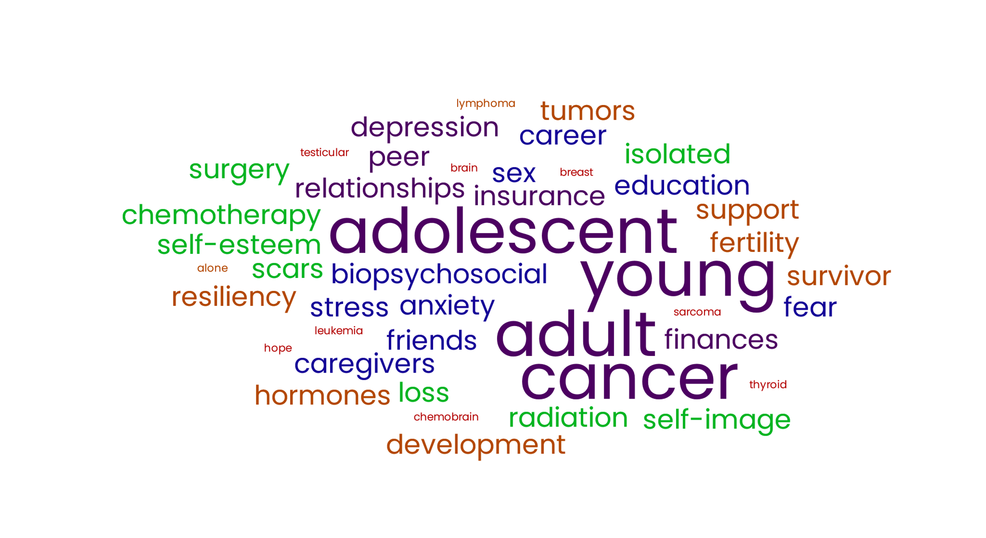
Lunch and Learn: Addressing Needs and Resources of Adolescent and Young Adult Cancer Patients
Notes:
Remind everyone to sign in on the attendance sheet and to grab a lunch if they haven’t yet

Slide 2
Introductions
Who am I?
Who are you?
  Name
  Preferred Pronouns
  Role
  What is one thing you hope to learn today?
Notes:
Take a few minutes to introduce yourself as the trainer with your name, pronouns, and role (include experience with AYA oncology patients).
Prompt the participants to take turns introducing themselves using the prompts. (Should take 10 minutes or less).

Slide 3

Adolescent Young Adult (AYA) Oncology Statistics
Age range
  No standard global definition
  United States- Age range encompasses 15-39 years
Around 89,500 AYAs in the United States diagnosed with cancer each year (Cheung et al., 2021).
Notes:
Point out that AYA is the abbreviation for adolescent young adult
Review the statistics

Slide 4

Adolescent Young Adult (AYA) Oncology Statistics
Common cancers affecting the AYA oncology population
  Lymphomas
  Leukemias
  Cancers of the reproductive tracts (ovarian, cervical, uterine, testicular)
  Neurological tumors (brain and spinal cord)
  Sarcomas
  Thyroid
  Melanoma
  Colorectal
  Breast
Notes:
Review the statistics

Slide 5
AYA Oncology Patients
Cancer rates for this population are increasing but historically, survival rates have not, relative to other age groups
  BIPOC AYA oncology patients have especially poorer long term survival outcomes
AYA patients are developmentally unique and have different needs as compared to pediatric patients or older adult patients

Slide 6

AYA Developmental Stage
Lifespan Developmental Theory: Maturation and change, including psychological changes, are ongoing throughout one’s life (Albritton et al., 2009).
Cancer affects progression through a developmental stage; developmental stages affect how someone experiences the stressors of cancer.
Notes:
Review slide and take about 3-5 minutes to engage class in discussion in how adolescent patients may differ from young pediatric and older patients.
Points to bring up if the class doesn’t:
-Young children are generally dependent on caregivers to navigate issues, and this population needing to be taken care of is normal.
-It is not entirely unexpected for older adults to get cancer or other significant medical diagnoses as they age. Additionally, older adults have generally been established in their careers, identities, and relationships, and have already had children if they want to.

Slide 7

Food for Thought
Think back to when you were 23 years old.
What was going on in your life?
How would a cancer diagnosis have affected you?
Notes:
Take about 5-7 minutes to engage the group in these questions.
Try to encourage thinking/discussion regarding physical impact, emotional impact, educational/career impact, impact on relationships, etc.

Slide 8
AYA Biopsychosocial Developmental Changes
Biological
Hormones
Brain Development
Psychological
Establishing identity
Developing abstract and higher reasoning skills
Social
Becoming independent
Education/careers
Forming peer groups
Exploring sexuality
Forming romantic relationships
Having children and starting families
Notes:
Biological
Hormones: Talk about hormones especially in regards to sexual development and fertility
Psychological:
-Talk about this being the time when people start working on figuring out who they are and who they want to be
- Talk about the brain still developing the area responsible for abstract thinking and reasoning
Social:
-Talk about AYAs and the listed common life events/activities listed

Slide 9
AYA Oncology Patients Survival Outcomes
One reason for decreased survival outcomes for AYA patients may be poor treatment compliance.
Reasons for poor treatment compliance may be:
Difficulty affording treatments
Struggles with attending appointments
Not tolerating side effects well
Not understanding the importance of completing prescribed treatment
Notes:
Discuss AYA developmental issues in relation to the topics:
-Difficulty affording treatment due to a variety of financial issues such as AYA patients in school or at the start of their career not having much extra income. Also, individuals in jobs earning lower wages early in their career may not have access to insurance with good coverage for specialty care.
-Due to still working on developing logic and reasoning skills, AYAs may not connect long term consequences to actions like skipping prescribed treatment, not following up with a provider, or doing something a provider specifically advised against

Slide 10
AYA Oncology Patient Needs
Don’t expect that your patients will always ask for help if they need it
AYAs may not be comfortable seeking help with biopsychosocial needs
  In a recent study, more than half of AYA oncology patients reported not seeking help for a biopsychosocial concern (Jones et al., 2020).
Cancer is an overwhelming and complex stressor.
Notes:
Follow up point to: “Cancer is a major and complex stressor”
- When a patient is dealing with the stress from a cancer diagnosis, it can be difficult to know what they need and/or how to ask for it due to the focus on survival.

Slide 11
When AYA Needs Are Not Met…
AYA patients whose needs are not met may feel poor rapport with their care team.
AYA patients who feel poor rapport with their treatment team may be less compliant with their medical appointments and treatment
AYA patients not compliant with medical care are at higher risk of poor outcomes.
Notes:
Review slide

Slide 12

How Can Oncology Providers Help AYAs?
Get to know your patient as a person during their first visit with you.
Preferred pronouns
Regular activities, partners, families, and interests
Who do they want involved in their care?
Is there anything else they want you to know about them? (Spirituality, religion, culture, etc.)
Notes:
Patients trust providers more that get to know them as people, not just people with a disease

Slide 13

How Can Oncology Providers Help AYAs?
Throughout care:
Talk to your patient in a clear and straightforward manner.
Help patients make informed choices.
Respect patient choices
If a patient has supports with them, offer the opportunity to talk privately during the appointment, especially if discussing sensitive topics.
Proactively address common areas of concern affecting AYAs
Notes:
Regarding “Talk to your patient in a clear and straightforward manner.”
-Avoid jargon
-Avoid talking to patients like children
Regarding “Help patients make informed choices.”
-AYAs do better when they understand why they are asked to do something. Providing a reason for treatments and recommendations will increase the likelihood of treatment compliance.
-Facilitate referrals to specialists as appropriate (reproductive health specialists for fertility, dieticians for concerns regarding weight and nutrition, etc.)
Regarding “Respect patient choices”
-Patients may make treatment choices you disagree with for reasons that are important to them (example: turning down a medication with side effects that affect an important part of their lives when the treatment does not offer significantly increased chances of improved outcomes)

Slide 14

AYA Biological Concerns
Fertility
The AYA age range encompasses the peak age range for fertility, especially for women.
Many of the treatments for cancer can interfere with future fertility.
It is important to be up front about these risks to patients prior to treatment
Notes:
Fertility is an important concern to many AYA pantients

Slide 15
AYA Biological Concerns
If AYA patients think they may want to have children in the future, refer them to a reproductive specialist for further follow up (urology for males, reproductive gynecology for females).
Respect your patient’s choices and allow them dignity of risk.
Resources are available to assist with costs and fertility preservation.
Notes:
Regarding “Respect your patient’s choices and allow them dignity of risk”
-Providers may sometimes have hesitation about delaying treatment or choosing a different treatment protocol for fertility preservation. It is important to ensure your patient is aware of the risk but give them the space to make choices according to their values and goals for their lives.

Slide 16

AYA Biological Concerns
Sexual Health
Don’t assume your patient’s sexuality
  Use gender neutral language unless your patient has specified their sexuality
Cancer treatment may interfere with sexual arousal and enjoyment
Discussing this can be awkward for both patients and providers
Refer patients to specialists as needed
  Endocrinology
  Urology
  Gynecology
Notes:
Regarding “Discussing this can be awkward for both patients and providers”
-Become comfortable with the uncomfortable
-Blushing is a normal and involuntary response
-If other supports are in the room, offer the patient a chance to have a private discussion
-Your patients may not want to discuss this with you and that’s fine, it’s important to know they can if they want to
-Your patients may be more comfortable having this discussion with a provider of a different gender. If this is so, facilitate this conversation with a provider of the appropriate gender
If your patient wants to discuss sexual health, take the opportunity to discuss safe sex and birth control during treatments

Slide 17

AYA Biological Concerns
Diet and Exercise
AYA patients may benefit from education and encouragement of healthy diet and exercise
  May reduce side effects from treatments
  May reduce the chances of developing cancer or other chronic conditions in the future
Refer to dietician and/or physical therapy as needed
Notes:
Encourage and educate but meet your patient where they are at.

Slide 18

AYA Psychological Concerns
Cancer and resulting effects often cause a multitude of psychological stressors
Poor self-image/self-esteem
Depression
Anxiety
Increased feelings of distress
Providers should regularly assess for depression and anxiety at appointments and refer patients to the oncology social worker
Notes:
Regarding “Poor self-image/self-esteem”
-Cancer and associated treatments have a range of visible effects including scars, hair loss, changes in weight, and missing body parts. These are especially difficult to deal with during a time when AYAs are trying to fit in with peers and find or maintain romantic relationships.
These issues in addition to fear of death, uncertainty for the future, and grief for losses associated with cancer are associated with depression, anxiety, and increased feelings of distress.
These feelings may increase around scans, tests, and other appointments
Patients’ mental health may also benefit from utilizing peer support resources

Slide 19

AYA Social Concerns
Education and Careers
Side effects from cancer treatment can make it difficult to attend school or work
Ongoing long-term effects into survivorship can lead to a change in, reduction, or inability to continue these activities
Resources are available to help
  Oncology Social Worker
  Occupational Therapy
  School Disability Resources
  Community Resources
Notes:
One major issue that can occur during chemotherapy are cognitive changes that are commonly referred to as “chemobrain.”
A referral to occupational therapy can help with this.

Slide 20

AYA Social Concerns
Peer Relationships
Feeling isolated from healthy peers
Disruption to partner relationships
Resources are available
  Number of AYA organizations
  Social media groups
Notes:
Cancer disrupts peer relationships with friends and romantic partners.
-It can be difficult to watch healthy peers continue with life as usual while AYAs may not be able to keep up
-Cancer can make it difficult to date and can drive a wedge into established relationships
-If there is a peer support group in the hospital, refer patients to this.
-If there is not a peer support group in the hospital but patients start bringing up interest in this, let the oncology clinic social worker know

Slide 21

Group Activity
Think about the various topics we just discussed.
What are some questions you can ask your patients to assess these topics?
Topic Recap
  Getting to know your patient
  Biological Needs
  Psychological Needs
  Social Needs
Notes:
Have people break into groups of 3-5 people (depending on how many people showed up for the session, ideally there should be about 4 groups) and discuss the topic and record answers (should take about 10 minutes). Ask for 1-2 questions per topic area, or if time is an issue, shorten the activity by giving each group 1 topic to focus on)
Groups should share answers with the class

Slide 22
AYA Cancer Patient Needs and Resources: Summary
AYA patients have unique needs as compared to pediatric or older populations.
Get to know your patient and what is important to them.
Providers should proactively ask AYA patients about biopsychosocial needs.
Resources exist within the hospital and within the community to address AYAs biopsychosocial needs
  You don’t have to be aware of and memorize every single resource, but you need to know that resources DO exist.
  Take some resources and pass them on to your patients!!!
Notes:
Summarize the main points of the training as discussed on the slide
-Hand out the resource sheets and ask providers to make copies and distribute these to their AYA patients when they see them next. Let them know there are more in the clinic social work office if they need more.
Patients may not know what they need, or may not use every resource, but they have a right to know that resources exist and are available

Slide 23

Questions???
[Insert name and email address for future questions]
Short Post-Test
  Please complete the short post-test and turn these in before leaving
  THANK YOU FOR COMING!
Notes:
Take 5-10 minutes to answer questions and encourage providers to email if they have questions later
Ask providers to take their short post-test and turn them in prior to leaving
Thank providers for coming to your training

Slide 24
References
Abrams, A. N., Hazen, E. P., & Penson, R. T. (2007). Psychosocial issues in adolescents with cancer. Cancer Treatment Reviews, 33(7), 622–630. https://doi.org/10.1016/j.ctrv.2006.12.006
Albritton, K., Barr, R., & Bleyer, A. (2009). The adolescence of young adult oncology. Seminars in Oncology, 36(5), 478–488. https://doi.org/10.1053/j.seminoncol.2009.07.007
Bleyer, A. (2007). Young adult oncology: The patients and their survival challenges. CA: A Cancer Journal for Clinicians, 57(4), 242–255. https://doi.org/10.3322/canjclin.57.4.242
Burkart, M., Sanford, S., Dinner, S., Sharp, L., & Kinahan, K. (2019). Future health of AYA survivors. Pediatric Blood & Cancer, 66(2), e27516. https://doi.org/10.1002/pbc.27516
Cheung, C. K., Tucker-Seeley, R., Davies, S., Gilman, M., Miller, K. A., Lopes, G., Betz, G. D., Katerere-Virima, T., Helbling, L. E., Thomas, B. N., & Lewis, M. A. (2021). A call to action: Antiracist patient engagement in adolescent and young adult oncology research and advocacy. Future Oncology, 17(28), 3743–3756. https://doi.org/10.2217/fon-2020-1213
D’Agostino, N. M., Penney, A., & Zebrack, B. (2011). Providing developmentally appropriate psychosocial care to adolescent and young adult cancer survivors. Cancer, 117(S10), 2329–2334. https://doi.org/10.1002/cncr.26043
Jones, J. M., Fitch, M., Bongard, J., Maganti, M., Gupta, A., D’Agostino, N., & Korenblum, C. (2020). The needs and experiences of post-treatment adolescent and young adult cancer survivors. Journal of Clinical Medicine, 9(5), 1444. https://doi.org/10.3390/jcm9051444
Moke, D. J., Tsai, K., Hamilton, A. S., Hwang, A., Liu, L., Freyer, D. R., & Deapen, D. (2019). Emerging cancer survival trends, disparities, and priorities in adolescents and young adults: A California cancer registry-based study. JNCI Cancer Spectrum, 3(2), pkz031. https://doi.org/10.1093/jncics/pkz031
Smith, L. A. M., Critoph, D. J., & Hatcher, H. M. (2020). How can health care professionals communicate effectively with adolescent and young adults who have completed cancer treatment? A systematic review. Journal of Adolescent and Young Adult Oncology, 9(3), 328–340. https://doi.org/10.1089/jayao.2019.0133
Zebrack, B., Kent, E. E., Keegan, T. H. M., Kato, I., Smith, A. W., & Aya Hope Study Collaborative Group. (2014). “Cancer sucks,” and other ponderings by adolescent and young adult cancer survivors. Journal of Psychosocial Oncology, 32(1), 1–15. https://doi.org/10.1080/07347332.2013.855959

