Slide 1
Best Practices for Teachers and Providers: A Cross Systems Training to Support Gender-Variant Youth
Kathyrn Chociej, University of Washington – Tacoma, School of Social Work
MSW Candidate, Class of 2013

Slide 2
Module I
Educators Training Module

Slide 3
Introductions and check-in
What do you hope to learn and/or gain from this workshop?
  What part of the state do you work in?
  What age youth do you typically work with?
  Have you attended similar trainings to this one?

Slide 4
Teachers will gain an understanding of gender identity and expression, learn about and how to support implementation of anti-discrimination laws enacted in the state of Washington; and will gain resources and tools to create safe spaces in school settings for gender-variant youth and support Gay-Straight Alliances in schools.
Notes:
Gain an understanding of gender identity and expression,
Learn about and how to support implementation of anti-discrimination laws enacted in the state of Washington;
Gain resources and tools to create safe spaces in school settings for gender-variant youth
Support Gay-Straight Alliances in schools
Gay-Straight Alliances (GSAs) are student-led, school-based clubs that aim to provide a safe environment in the school context for lesbian, gay, bisexual, and transgender (LGBT) students, as well as their straight allies (Toomey, Ryan, Diaz & Russell, 2011).
Understand how to support and affirm youth, and decrease isolation youth experiences at school

Slide 5
Group norms and creating a safe training space
No interrupting
No side conversations – cross talk
Give the benefit of the doubt – look for learning
No judgment – we are all in different places
Commitment to the process- stay through the hard stuff
Own your stuff – apologize
“I” statements
Stay humble
Focus is: to explore, to encourage a deeper understanding of complex topics
To engage in an analysis of the topic

Slide 6
When are we first gendered?
Notes:
Challenges We Face
From the moment of our birth we are identified by others. They define our sex identity by looking at our genitals when we are born. Our parent(s) choose our name and dream of how we will "turn out." The record of our birth is the binding legal statement that says who we are.
We are socialized immediately, and later taught "proper" behavior. We learn to recognize our parent(s) and siblings, and learn how to eat, speak, walk, and move our bladder and bowels, all within the first three years of life! We learn what is important. We learn that we are part of a family. We learn loyalty to the family culture, including the family’s race and ethnicity. We also learn about our family secrets and learn to keep them secret. We are praised for doing "good," and punished for being "bad." In general, "socialization" efforts by those around us are very intensive, especially between birth and age five. And when we are not being actively taught, we watch and listen, and integrate everything we see and hear within the very core of ourselves, so that we can know just how to "be." Like everyone else, we desperately want to please and receive praise.
Then, there comes this feeling, this desire to be the other sex. This frightens us and challenges everything that we have learned. We worry about ourselves. We fear others might find out. Prayers do not help. We become angry with ourselves in having these thoughts and desires. Yet, we must press on hoping it will go away. But it doesn’t go away. It just gets "worse." We wonder, ‘Am I crazy?’ ‘Am I gay or lesbian?’ ‘Why do I enjoy "dressing up?" (Source: http://community.pflag.org/page.aspx?pid=702 )

Slide 7
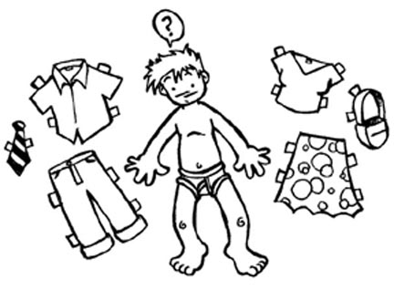
TRANSGENDER
  A person whose internal sense of gender doesn’t match the gender identity that society expects of them based on their anatomy
GENDER IDENTITY
  A person’s internal, deeply-felt sense of being either male, female, something other, or in between

Slide 8


GENDER EXPRESSION
  An individual’s characteristics and behaviors such as appearance, dress, mannerisms, speech patterns, and social interactions that are perceived as masculine or feminine, or neither.
Affirmed male or affirmed female
  Someone who transitions from one gender to another
    Change in style of dress
    New name and new pronouns
    May or may not include hormone therapy, counseling, and/or surgery
    MTF (male to female)
    FTM (female to male)

Slide 9
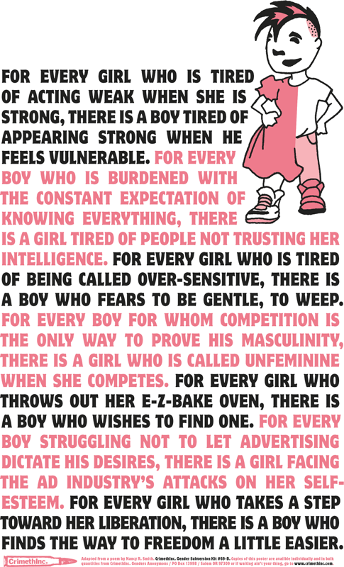
GENDER NON-CONFORMING
  A person who is or is perceived to have gender characteristics and/or behaviors that do not conform to traditional or societal expectations.
    “The discrimination in society toward children who do not behave or look the way we expect them to look and behave according to their gender can be even more extreme than anti-gay discrimination” (Baker, 2002).

Slide 10
GENDER QUEER
  People who do not identify as, or who do not express themselves as completely male or female. Gender Queer people may or may not identify as transgender
SEXUAL ORIENTATION
  A person’s emotional and sexual attraction to other people based on the gender of the other person.
    “GID can be conceptualized as an end-point of a continuum of cross-gender identification and it is conceivable that there are now more individuals who identify within this broader spectrum of cross-gender identity” (Zucker & Lawrence, 2009).

Slide 11
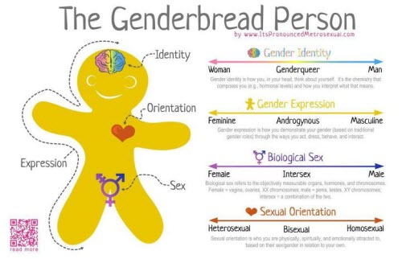
http://jessthanthree.site11.com/genderbread.html
Notes:
How is this different than sexual orientation?
How is gender identity different from gender expression?
Terminology - Differences between youth and adults
Pronoun preference

Slide 12
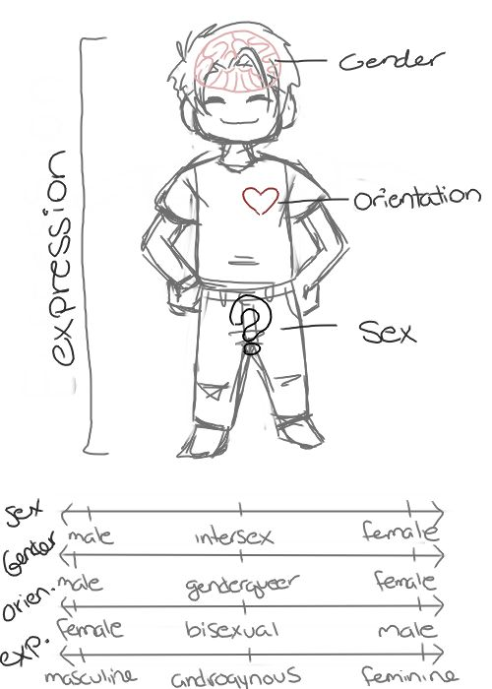
Notes:
“In post-modern Western culture, it has been claimed that more and more individuals are rejecting the traditional binary of male versus female, suggestive of greater evidence of normative gender fluidity” (Singh, Peterson-Badali, Johnson, Bradley, Kibblewhite, Owen-Anderson, Deogracias & Zucker, 2010).

Slide 13
Statistics – they aren’t just numbers!
Gender non-conformity is attributed to decreased coping and resilience and social rejection, which places youth at a higher risk for suicidal symptoms.
  While adolescents in general are a high-risk group for suicidal ideation and self-harm, with suicide being the third cause of death for young adults ages 15-24, there is increasing evidence that transgender youth are at increased risk for low self-esteem, depression, suicide, substance abuse, school problems, family rejection and discord running away, homelessness, and prostitution.

Slide 14
Risk factors
    “Young people who do not conform to heteronormative societal values are at risk for victimization during adolescence” (Russell, Ryan, Toomey, Diaz & Sanchez, 2011).
    “The more young people present as gender non-conforming, the more likely they will be victimized or abused at school” (Russell, Ryan, Toomey, Diaz & Sanchez, 2011).
Gender-nonconforming youth are at elevated risk levels for experiencing victimization and negative psychosocial adjustment.
The shame felt by gender-nonconforming adolescents may be compounded by the reactions from their peers and family.
Peer reactions to gender nonconforming behavior are often negative, ranging from verbal questioning of another’s biological sex to physical abuse.

Slide 15
Risk factors
    Emotional distress, isolation, internalized homophobia/transphobia, depression, substance abuse, suicide, violence/victimization, family conflict, school performance, sexually transmitted diseases and/or pregnancy or other health risk behaviors (Elze, 2007; Kitts, 2010).
    “Teenagers who believe they alone are responsible for family conflicts may feel overwhelmed by the constant stress and may perceive suicide as the best solution for everyone” (Kanel, 2012, p. 85)
    There is an increased risk of suicidal thinking and attempts during the coming-out process (Kanel, 2012).
    Additional risk factors are attributed to lack of training among service providers.

Slide 16
Protective factors include:
    Unconditional support of a child’s identity
    Access to safe health care
    Ensuring that the child’s school is safe and welcoming
    Ensuring service providers are well trained and sensitive to transgender issues
    Ensuring that service agencies implement explicit policies that prohibit all forms of discrimination; and
    Supporting a child’s transition at a younger age at home and at school.
      For adolescents, this could include pubertal suspension, to be discussed more later in the presentation
Notes:
Suspension of the youth’s biological puberty reduces their preoccupation with it, and affords the adolescent greater opportunity to explore their longer-term gender identity options in a more reflective and less pressured way (Zucker, Bradley, Anderson, Blanchard & Bain, 2011).

Slide 17
Protective factors
    Resilience, positive and supportive family relationships, stable intellectual functioning, self-confidence, high self-esteem, a socially appealing disposition/personality and social competence, a supportive and validating faith, special talent (e.g., athletic or musical skills) and/or educational achievement, sustainable hope, and supportive school and other peer relationships.
    Family support is associated with greater self-acceptance, which contributes to fewer mental health problems (Elze, 2007).
    Youth Empowerment programs and events
      Provides a sense of community to fight against isolation
    It is important to identify and use these protective factors as client strengths in social work practice with LGBTQIS2-S youth (Zubernis, Snyder & McCoy, 2011).

Slide 18
Supporting families in supporting their child
      Promoting family involvement can be affected by a few different factors, including emotional responses as they learn to adjust and accept their child’s status (Spencer, 2005):
        Stage 1: shocked and dejected, may experience grief and fear
        Stage 2: confused, feny their child’s status, reject their child, or avoid dealing with the issue by looking for other explanations
        Stage 3: anger, self-pity, disappointment, guilt and a sense of powerlessness that may be expressed as rage or withdrawal
        Stage 4: begin to understand and accept their child’s status and impact on the family
        Stage 5: families may accept, love, and appreciate their child unconditionally
        Stage 6: families may begin to focus on living on the benefits accrued, on the future, and on working with others to teach and provide support services for their child

Slide 19
School protective factors
    Welcoming environment
    Obvious safe zone/peer-based support programs (Like GSAs)
    All staff is trained
    Curricula is inclusive of LGBTQ issues and people
    Staff are representative
    Information is accurate and easy to access
    Forms are inclusive
    There is an appropriate response to bullying and harassment
    Heterosexist and homophobic and transphobic remarks are not condoned
    There are positive reactions to youth coming out
    Teachers and staff identify themselves as LGBTQ-friendly
    There are LGBTQ inclusive policies.
Notes:
The presence of a GSA was associated with greater levels of school safety, fewer reports of missing school due to fear, and greater awareness of a safe adult in the school context. A few studies have documented that the presence of a GSA is associated with reduced suicide risk for sexual minority youths (Toomey, Ryan, Diaz & Russell, 2011).
Stop harassment of students by enforcing anti-discrimination policies
Normalize through the use of language
Train all staff, especially the school nurse and librarians; and incorporate acceptance messages into other subjects such as English, Science

Slide 20
    “Most social service providers, schools, and families are ill-equipped to help transgender youth and many remain hidden to be accepted” (Grossman, D’Augelli, Howell & Hubbard, 2005).

Slide 21
Entering the Discomfort Zone
Why this is so much harder for adults than children?
How do I help others understand?
Why are pronouns so hard to switch?
Cultural/ethnic differences and their impact on potential child acceptance
Understanding the daily implications of having an atypical gender presentation
How homophobia and ridid gender role norms affect the acceptance of trans kids

Slide 22
Confronting Biases
  Does a five-year-old know their gender?
  Is this a phase?
  Aren’t they too young to understand?
  Are they confused?
  Maybe this child is “just gay”
  http://www.oprah.com/own-our-america-lisa-ling/Transgender-Child-A-Parents-Difficult-Choice

Slide 23
Confronting Biases
Age we have a sense of our gender identity
  Age we have a sense of our sexual orientation is different!
  Gender does not equal sexual orientation!

Slide 24
Know your resources
      Gender Diversity trainings in schools for both students and educators and administrators www.genderdiversity.org
      Trans Youth & Family Allies trainings for educators and administrators http://www.imatyfa.org/
      Welcoming Schools trainings in schools for both students and educators http://www.welcomingschools.org/
      Safe Schools Coalition http://www.safeschoolscoalition.org/
      Gay Lesbian Straight Educators Network (GLSEN) http://www.glsen.org/cgi-bin/iowa/all/home/index.html

Slide 25
Developmental stages
    The two age groups that are associated with the most self-harm, distress and suicidality are five to seven year-olds who are being forced to fit into social gender roles that aren’t true to who they are, and self-harm and suicidality for kids entering puberty, whose bodies are betraying them.
    The internalization of homophobic and heterosexist messages begins very early—often before transgender youth fully realize their gender identity.
    Transgender youth who disclose their gender identity to their parents are at risk for parental rejection, withdrawal of financial support, authoritative restrictions of their social lives, forced counseling, and even violence and removal from the home.
Notes:
How a child is supported at home and at school may impact how successful they are in meeting this developmental milestone.
Children diagnosed with GID may have a developmental delay in establishing gender constancy. Researchers speculate that this delay may occur because of a parent who does not help the child label gender correctly or correct “inappropriate” behaviors. Or, these children may have achieved an understanding of gender as flexible. Much of the attention to GID children comes from parents intolerant of gender variance, not from the children themselves, as is the case with most childhood psychological problems. It has been noted repeatedly in the literature that almost all referrals of GID youth to gender treatment centers come from parents and other adults, such as teachers, who are not comfortable with their gender expressive behaviors.

Slide 26
    “The passage through puberty, peer group acceptance, and the establishment of a personal identity are all developmental tasks of the adolescent years. For the youth who is lesbian, gay, bisexual, or transgender, self-acceptance and identity formation in the face of a heterosexist society are difficult tasks associated with many risks to physical, emotional, and social health” (Kreiss & Patterson, 1997).

Slide 27
Interventions

Slide 28
Safe spaces
    Research suggests that the presence of a GSA in middle school and high school can serve as a protective factor for LGBTQ adolescents. The presence of a GSA is associated with reduced suicide risk for sexual minority youths.
      Creating a safe zone is a means of support for students who are LGBTQ. This can consist of a teacher or counselor with training concerning issues related to these students. Teacher preparation programs and in-service training should emphasize the importance of avoiding anti-biased language, particularly concerning students who are LGBTQ. Using a curricular focus, schools can assist children in becoming more comfortable with diversity in all its human forms. GLSEN proposes the use of early intervention to facilitate acceptance of sexual diversity by targeting elementary school students.
        Gender neutral bathrooms are another visual cue for transgender youth that this is a safe zone
        Support students in dressing and expressing consistent with their internalized identity

Slide 29
Accommodating and affirming transgender students
Use of preferred name and pronoun
  Schools are required to maintain a student record that lists the student’s legal name
  This requirement does not prevent or prohibit a school from using a student’s preferred name and pronoun
  The school should develop a reliable method of ensuring that a transgender student’s preferred name and pronoun is used that addresses circumstances such as substitute teachers
(Asaf Orr, National Center for Lesbian Rights, 2012)

Slide 30
Accommodating and affirming transgender students
Access to gender-affirming bathrooms
  Transgender students should be permitted to use the bathrooms of their affirmed gender
  If a transgender student would prefer access to a gender-neutral or single stall bathroom, that request should be accommodated
Access to locker rooms for physical education
  Arrangements should be made to ensure that transgender students are provided safe and gender-affirming locker room access
A school’s failure to provide accommodations for transgender students may constitute a violation of state or federal anti-discrimination laws.
(Asaf Orr, National Center for Lesbian Rights, 2012)

Slide 31
What laws apply in schools
U.S. and state constitutions protect individuals against government, including public and charter schools
Federal, state, and local statutes – public accommodations, school non-discrimination laws – can apply both to government and private
(Asaf Orr, National Center for Lesbian Rights, 2012)

Slide 32
Protections in schools
Anti-Bullying — In 2002 the Washington state Legislature passed an anti-bullying law requiring schools to adopt an anti-bullying policy covering all the protected classes in Washington’s hate crimes law, including sexual orientation.
2007 the anti-bullying law was expanded to prohibit cyber-bullying
In 2009 the definition of sexual orientation was amended to include gender identity and expression.
The legislature commissioned a report to study the effectiveness of the state’s anti-bullying law. The 2008 Report found that bullying in Washington Schools had not diminished.
The legislature responded in 2010 by unanimously passing HB 2801, “an act relating to anti-harassment strategies in public schools”.
  Among its provisions, the new law requires that school districts’ anti-harassment policies and procedures meet minimum standards and be made available to the public.
Source: http://www.equalrightswashington.org/?page_id=286

Slide 33
Protections in schools
In 2010, the legislature passed HB 3026, giving the Superintendent authority to investigate allegations of all kinds of discrimination and to enforce laws when violations occur.
  We have taken the opportunity to show all of our students – including students of color and gay, lesbian, bisexual and transgender students – that we will not tolerate any kind of discrimination in our schools.
Compliance with Civil Rights Laws — Washington schools are some of the nation’s most diverse, yet discrimination has remained a persistent problem.
  Under previous law, the Superintendent of Public Instruction had broad authority to investigate only sex discrimination in school districts.
Source: http://www.equalrightswashington.org/?page_id=286

Slide 34
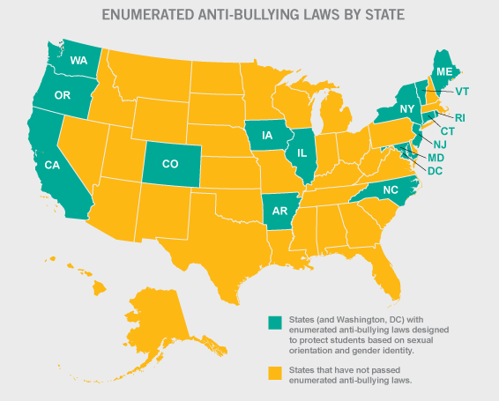
Source: http://www.glsen.org/cgi-bin/iowa/all/library/record/2344.html?state=policy

Slide 35
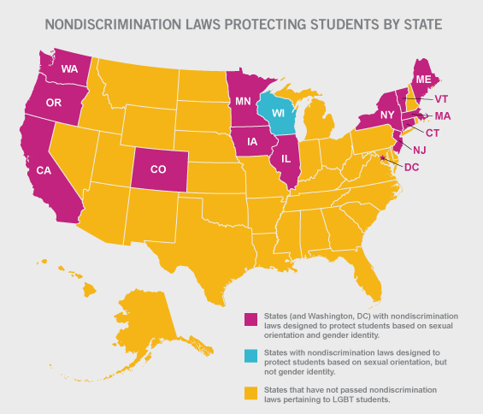
Source: http://www.glsen.org/cgi-bin/iowa/all/library/record/2344.html?state=policy

Slide 36
The right to free expression
The First Amendment of the U.S. Constitution protects students’ rights to free speech and expression
The right to free expression has been found to include the following:
  Clothing
  Prom dates
  Senior pictures
Depending on the circumstances, schools may be able to discipline a student for cyberbullying as it may not be protected as free speech
(Asaf Orr, National Center for Lesbian Rights, 2012)

Slide 37
The Right to Privacy
The right to privacy is protected by the federal and many state constitutions
Students have a right to keep their transgender status private
Just because a student has disclosed in one context does not eliminate their right to privacy as long as they have a “reasonable expectation of privacy”
This right applies to what people say, what people do, and what appears on school records
(Asaf Orr, National Center for Lesbian Rights, 2012)

Slide 38
Family Educational Rights & Privacy Act
Parents or students over the age of 18 can request to change school records if they believe them to be inaccurate, misleading, or violating student’s rights of privacy
School districts are permitted to deny those requests, but must offer parents or eligible student an opportunity to present evidence at a hearing
(Asaf Orr, National Center for Lesbian Rights, 2012)

Slide 39
Right to be Free from Harassment: Title IX
Title IX of the Education Amendments of 1972 applies to all schools that receive federal funding and prohibits discrimination based on sex
The U.S. department of Education recently issued guidance explaining that sex discrimination includes peer-to-peer harassment and discrimination based on gender stereotyping
(Asaf Orr, National Center for Lesbian Rights, 2012)

Slide 40
The Title IX Claim Based on Harassment
Gender nonconforming and transgender youth fit under Title IX under two theories:
  Failure to meet stereotypes of masculinity and/or femininity
  Change of sex
The standard requires schools to:
  Act on all reports of harassment
  Craft a response that fits the nature of the problem and surrounding circumstances
  Refrain from exacerbating the problem
Mechanisms for enforcing Title IX include:
  File an administrative complaint with OCR and/or DOJ
  File a complaint in state or federal court
(Asaf Orr, National Center for Lesbian Rights, 2012)

Slide 41
Right to Access Sex-Separated Spaces
Most states have laws that permit schools to have separate locker rooms, restrooms, and activities for boys and girls
This does not exempt schools from the requirement to not discriminate on the basis of gender identity or sex stereotypes
Several major school districts (SFUSD & LAUSD) already permit students to access sex-separated facilities based on gender identity
(Asaf Orr, National Center for Lesbian Rights, 2012)

Slide 42
The Equal Access Act and Gay-Straight Alliances
If a public secondary school that receives federal funding allows any voluntary, non-curricular, student-initiated and student-led group to meet, it must allow all such groups to meet
This law also requires schools to treat all groups equally (equal access to facilities and advertisement on campus)
(Asaf Orr, National Center for Lesbian Rights, 2012)

Slide 43
        Office of Superintendent of Public Instruction (OSPI)
        Policies and Procedures (February 2012)

Slide 44
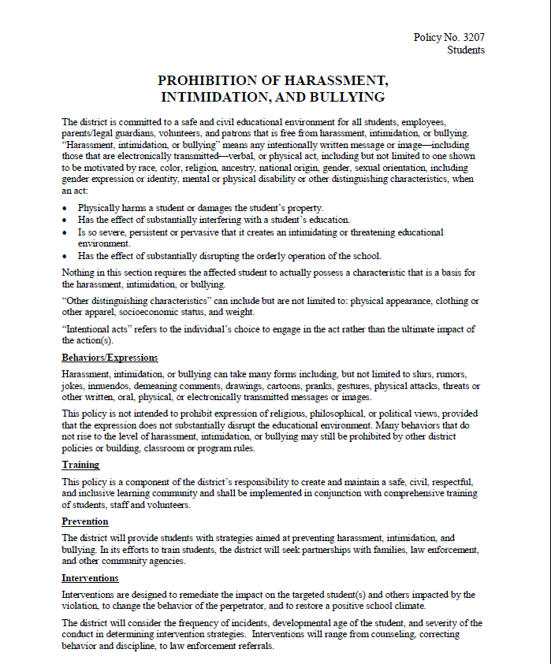
Notes:
OSPI Bullying Policy – review document

Slide 45
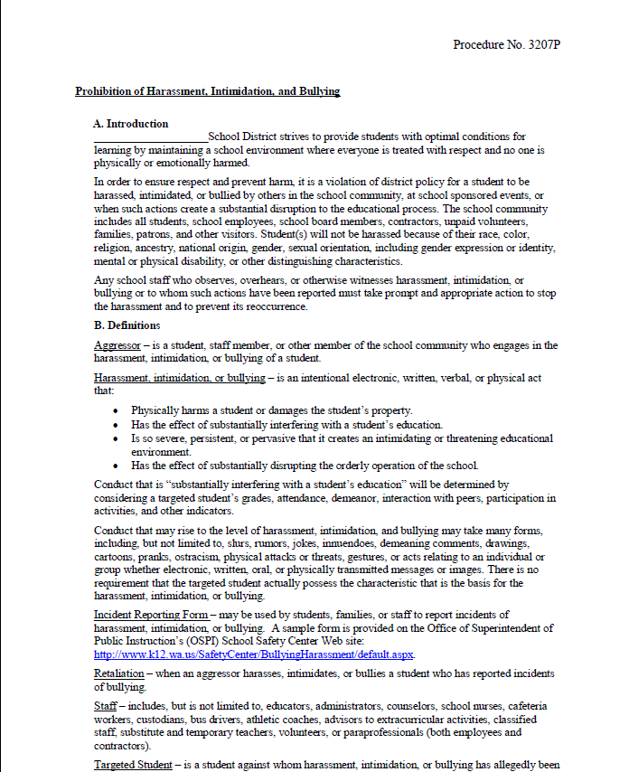
Notes:
OSPI Bullying Procedures – review document

Slide 46
OSPI Guidelines –
Prohibiting Discrimination in Washington Public Schools (February 2012), pp 28-31.

Slide 47
            What terms are commonly used to describe gender identity or gender expression?
              Individuals use a number of words to describe their gendered experiences. Some people may refer to themselves as trans, transsexual, transgender, male-to-female (MTF), female-to-male (FTM), two-spirit, and a variety of other terms. Terminology can differ based on region, language, race, ethnicity, age, culture, and many other factors. Some common terms are defined below.
                Gender identity is a person’s deeply felt internal sense of being male or female, regardless of their sex assigned at birth.
                Gender expression is the manner in which a person represents or expresses gender to others, often through behavior, clothing, hairstyles, activities, voice, or mannerisms.
                Transgender is a general term used to describe a person whose gender identity or expression is different from that traditionally associated with the person’s sex assigned at birth.
                Transitioning is the process in which a person changes their gender expression to better reflect their gender identity.
                Gender nonconforming is a term for people whose gender expression differs from stereotypical expectations about how they should look or act based on the sex they were assigned at birth. This includes people who identify outside traditional gender categories or identify as both genders.

Slide 48
Example 1
              Alexis was assigned female at birth, but she identifies as gender nonconforming. Alexis prefers to express herself like a tomboy - she enjoys playing sports with boys in her class, and she prefers that her friends call her Alex. While Alex currently uses female pronouns, she is questioning her gender identity and is considering transitioning to a male role. Currently, Alex is consistently presenting as female at school, but that will change if she decides to transition.

Slide 49
Example 2
              Although Casey attended kindergarten and first grade as a boy, about midway through first grade, she and her family decided that Casey would transition and begin presenting as a girl. Casey prefers to dress in stereotypically feminine attire such as dresses and skirts. Although she is growing her hair out, it is still in a rather short, typically boyish haircut. Casey, her parents, and school administrators have asked her friends and teachers to use female pronouns to address her. Casey is consistently presenting as female at school.

Slide 50
            Should transgender and gender nonconforming students have the right to express their gender identity in school?
              Yes. Washington state law prohibits discrimination in public schools based on gender expression and identity (RCW 28A.642.010).
              Students must be permitted to dress according to the gender in which they consistently identify and should be addressed and treated using the name and pronouns of their choice (i.e., “he” and “him” or “she” and “her”).
              School districts are encouraged to adopt gender-neutral dress codes that do not restrict a student’s clothing choices on the basis of gender.
              Dress codes should be based on educationally relevant considerations, apply consistently to all students, include consistent discipline for violations, and make reasonable accommodations when the situation requires an exception.

Slide 51
            How should school districts address a student’s name and sex on official records?
              School districts maintain permanent student records that include a student’s legal name and legal gender.
              To the extent that the school district is not legally required to use a student’s legal name and gender on school records or documents, the district should use the name and gender by which the student identifies.
              School IDs, for example, are not legal documents and should use the student’s preferred name.
              The school district should change a student’s official record to reflect a change in the student’s legal name or gender upon receipt of documentation that such change has been made pursuant to a court order or through amendment of state- or federally-issued identification.
              In situations where school staff or administrators are required by law to use or report a student’s legal name or gender, such as for standardized testing, school staff should adopt practices to avoid the inadvertent disclosure of such confidential information.

Slide 52
            Should schools inform staff, students, or parents about a student’s transgender status?
              Information about a student’s transgender status, legal name, or gender assigned at birth may constitute confidential medical or education information.
              Disclosing this information to other students, their parents, or other third parties may violate privacy laws, such as the federal Family Educational Rights and Privacy Act (FERPA) (20 U.S.C. § 1232g; 34 C.F.R. Part 99).
              School staff should not disclose information that may reveal a student’s transgender status to others, including parents and other school staff, unless legally required to do so or unless the student has authorized such disclosure.

Slide 53
            Should a school district require proof of medical treatments as a prerequisite for respecting a student’s gender identity or expression?
              No. School districts should not require proof of medical treatments in order to respect a student’s gender identity or expression.
              If a school district has an objective basis that would justify questioning whether a student’s asserted gender identity is genuine, it may ask for information to show that the student’s gender identity or expression is sincerely held.
              No particular type of information (such as medical history information) should be specifically required.

Slide 54
            Should school districts allow transgender students to use the restroom of their choice?
              Yes. School districts should allow students to use the restroom that is consistent with their gender identity consistently asserted at school.
              Any student – transgender or not - who has a need or desire for increased privacy, regardless of the underlying reason, should be provided access to an alternative restroom (e.g., staff restroom, health office restroom).
              This allows students who may feel uncomfortable sharing the facility with the transgender student(s) the option to make use of a separate restroom and have their concerns addressed without stigmatizing any individual student.
              No student, however, should be required to use an alternative restroom because they are transgender or gender nonconforming.
Notes:
If school administrators have legitimate concerns about the safety or privacy of students as related to a transgender student’s use of the restroom, school administrators should bring these concerns to the school district compliance coordinator. Such privacy or safety issues should be immediate and reasonably foreseeable, not speculative. School administrators and/or compliance coordinator should meet with the student and/or parents to determine if there is a need for an alternative facility. Determination to provide an alternative facility for any student should be on a case-by-case basis.

Slide 55
            How should school districts address physical education and athletic participation by transgender students?
              School districts should allow students the opportunity to participate in physical education and athletic activities in a manner that is consistent with their gender identity.
              For interscholastic athletics, should any questions arise as to whether a student’s request to participate in a sex-segregated activity consistent with his or her gender identity is bona fide, a student may seek review of his or her eligibility for participation by working through the Gender Identity Participation procedure set forth by the Washington Interscholastic Athletic Association (WIAA), available at http://www.wiaa.com/subcontent.aspx?SecID=350.

Slide 56
            Should school districts allow a transgender student to use the locker room of their choice?
              The use of locker rooms by transgender students should be assessed on a case-by-case basis, with the goals of maximizing the student’s social integration and equal opportunity to participate in physical education classes and sports, ensuring the student’s safety and comfort, and minimizing the stigmatization of the student.
              In most cases, transgender students should have access to the locker room that corresponds to their gender identity consistently asserted at school.
              Any student who has a need or desire for increased privacy, regardless of the underlying reason, should be provided with a reasonable alternative changing area, such as the use of a private area (e.g., a nearby restroom stall with a door), or a separate changing schedule. Any alternative arrangement should be provided in a way that protects the student’s ability to keep his or her transgender status private.
              No student, however, should be required to use a locker room that conflicts with his or her gender identity.

Slide 57
Discriminatory Harassment - Are school districts required to adopt a Harassment, Intimidation, and Bullying policy and procedure?
Yes. Under RCW 28A.300.285, each school district is required to adopt the state’s model Harassment, Intimidation, and Bullying (HIB) policy and procedure, available at http://www.k12.wa.us/safetycenter/BullyingHarassment/default.aspx.

Slide 58
            What is discriminatory harassment?
                Harassment may be discrimination when it is:
                Based on sex, race, creed, religion, color, national origin, sexual orientation, gender expression or identity, veteran or military status, disability, or the use of a trained dog guide or service animal;
                Sufficiently serious to create a hostile environment; and
                Encouraged, tolerated, ignored, or not adequately addressed by school employees.
                Harassing conduct may include verbal acts and name-calling, graphic and written statements, or other conduct that may be physically threatening, harmful or humiliating.
                Harassment does not have to include intent to harm, be directed at a specific target, or involve repeated incidents.

Slide 59
            When does discriminatory harassment create a hostile environment?
                Discriminatory harassment creates a hostile environment when the conduct is sufficiently severe, pervasive, or persistent so as to interfere with or limit a student’s ability to participate in or benefit from the services, activities, or opportunities offered by a school district.
Notes:
For example, a hostile environment may cause a student to experience emotional distress, physical illness, or declining grades and attendance.

Slide 60
            When is a school district responsible for addressing discriminatory harassment?
                A school district is responsible for addressing discriminatory harassment about which it knows or reasonably should have known.
                In some situations, harassment may be in plain sight, widespread, or well‐known to students and staff, such as harassment occurring in hallways, during classes, during extracurricular activities, at recess or lunch, on a school bus, or through graffiti in public areas.
                In these cases, the obvious signs of the harassment are sufficient to put the school district on notice.
                In other situations, the school district may become aware of misconduct, triggering an investigation that could lead to the discovery of additional incidents that, taken together, may constitute a hostile environment.

Slide 61
            How should school districts respond to allegations of discriminatory harassment?
                A school district must take prompt and appropriate action to investigate or otherwise determine what occurred. School districts that receive an allegation of discriminatory harassment may need to respond using the discrimination complaint and appeal procedures outlined in WAC 392-190-065, 392-190-070, and 392-190-075 (see page 62).
                If an investigation reveals that discriminatory harassment has occurred, the school district must take prompt and effective steps reasonably calculated to end the harassment, eliminate any hostile environment and its effects, and prevent the harassment from recurring.
                These duties are a school district’s responsibility even if the misconduct is also covered by the school district’s HIB policy, and regardless of whether a student has complained, asked the school district to take action, or identified the harassment as a form of discrimination.

Slide 62
            What are appropriate steps to end discriminatory harassment?
                A school district’s responsibility is to eliminate the hostile environment created by the harassment, address its effects, and take steps to ensure that harassment does not recur.
                The unique effects of discriminatory harassment may demand a different response than would other types of bullying.
                Appropriate steps to end harassment may include separating the accused harasser and the target, providing counseling for the target and/or harasser, or taking disciplinary action against the harasser.
                These steps should not penalize the student who was harassed – for example, not requiring the target to change his or her class schedule.
Notes:
School and district administrators should look beyond simply disciplining the perpetrators. While disciplining the perpetrators is likely a necessary step, it often is insufficient.

Slide 63
Additional steps needed
                A school district may also be required to provide additional services to the student who was harassed in order to address the effects of the harassment, particularly if the school initially delays in responding or responds inappropriately or inadequately to information about harassment.
                An effective response may include revising the procedures by which students, parents, and employees may report allegations of harassment (or wide dissemination of existing policies and procedures), as well as wide distribution of the contact information for the school district’s compliance coordinator.
Notes:
In addition, depending on the extent of the harassment, the school district may also need to provide training or other interventions not only for the perpetrators, but also for the larger school community, to ensure that all students, their families, and school staff can recognize harassment if it recurs and know how to respond.

Slide 64
            What steps should a school district take to stop future harassment and prevent retaliation?
                A school district should take steps to stop further harassment and prevent any retaliation against the person who made the complaint (or was the subject of the harassment) or against those who provided information as witnesses.
                At a minimum, the school district’s responsibilities include making sure that the harassed students and their families know how to report any subsequent problems, conducting follow‐up inquiries to discover if there have been any new incidents or any instances of retaliation, and responding promptly and appropriately to address continuing or new problems.
                This law falls under sexual orientation, although sexual orientation and gender identity are two separate aspects for a person’s identity.

Slide 65
            EXAMPLE – SEXUAL ORIENTATION (AS MISLABELED BY STATE)
              Over the course of a school year, a gay high school student was called names (including anti-gay slurs and sexual comments), physically assaulted, threatened, and ridiculed because he did not conform to stereotypical notions of how teenage boys are expected to act and appear. As a result, the student missed school to avoid further harassment. The school did not recognize that the misconduct was discriminatory harassment. The school responded to complaints from the student by reprimanding the perpetrators consistent with its HIB policy. The reprimands of the identified perpetrators stopped the harassment by those individuals. It did not, however, stop others from undertaking similar harassment of the student.
Notes:
As noted in the example, the school failed to recognize the pattern of misconduct as a form of discriminatory harassment based on the student’s sexual orientation and gender expression. It may be discriminatory if students are harassed for their sexual orientation, for not exhibiting what is perceived as a stereotypical characteristic for their sex, or for failing to conform to stereotypical notions of masculinity and femininity. In this example, the school had an obligation to take immediate and effective action to eliminate the hostile environment. By responding to individual incidents of misconduct on an ad hoc basis only, the school failed to confront and prevent a hostile environment from continuing. Had the school recognized the conduct as a form of discriminatory harassment, it could have employed the full range of sanctions (including progressive discipline) and remedies designed to eliminate the hostile environment. For example, this approach could have included a more comprehensive response to the situation that involved notice to the student’s teachers so that they could ensure the student was not subjected to any further harassment, more aggressive monitoring by staff of the places where harassment occurred, increased training on the scope of the school’s harassment and discrimination policies, notice to the target and harassers of available counseling services and resources, and educating the entire school community on civil rights and expectations of tolerance, specifically as they apply to gender stereotypes. The school also should have taken steps to clearly communicate the message that the school does not tolerate harassment and will be responsive to any information about such conduct.

Slide 66
  Bullying prevention strategies and policies include:
    Conduct a survey to determine the nature and extent of bullying problems
    Establish school rules that prevent bullying, and enforce them
    Use a confidential message box to report incidents of bullying
    Hold meetings with students to discuss bullying incidents
    Identify locations where bullying is likely to occur and increase supervision in those areas
    Model respectful behavior toward others
    Create a school environment that does not tolerate bullying and have students make “No Bullying Zone” posters
    Confront and discipline bullying quickly and firmly by addressing inappropriate behavior and using the situation to teach pro-social behaviors
    Address victims of bullying by being supportive
    Refer bullies and their victims for counseling and other appropriate services
    Foster communication among and between teachers and families
    Help bullies develop empathy for others
(Spencer, 2005)

Slide 67
  Simple steps schools can take:
    Include sexual orientation and gender identity in school administration policies
    Provide diversity training to students and faculty
    Designate a liaison at each school in each school district to be available to LGBTQ students and to the committee
    Designate a “safe zone” for LGBTQ students at each school
  Demonstrate your support with visual cues
    Hang a rainbow flag
    Safe space signs or stickers
    Have books or magazines in your library pertaining to anti-oppression and LGBTQ issues
    Advocate for gender neutral bathrooms
    Have a policy that everyone who comes into your office or classroom is asked what gender pronouns they prefer
    Request anti-oppression trainings for yourself and your colleagues
    If your school does not have a GSA, create one!

Slide 68
Make your action plan
    What can I do to support gender-variant students?
    What can I do to educate students and school staff?
    What can I do to advocate for changes within the school?
What further resources, information, or help do I need?

Slide 69
Resources
    Dear Colleague Letter (October 26, 2010) - Harassment and Bullying (U.S. Department of Education): http://www2.ed.gov/about/offices/list/ocr/letters/colleague-201010.html
    Cis-gender privilege checklist
    List of LGBTQ youth centers
    List of transgender books www.glsen.org/booklink
    Support groups and advocacy organizations
    Safe Schools Coalition www.safeschoolscoalition.org
    www.glsen.org/educator
    Jump-start guide for GSAs www.glsen.org/jumpstart
    Educators Allies Network http://edallies.ning.com
    WPATH Standards of Care

Slide 70
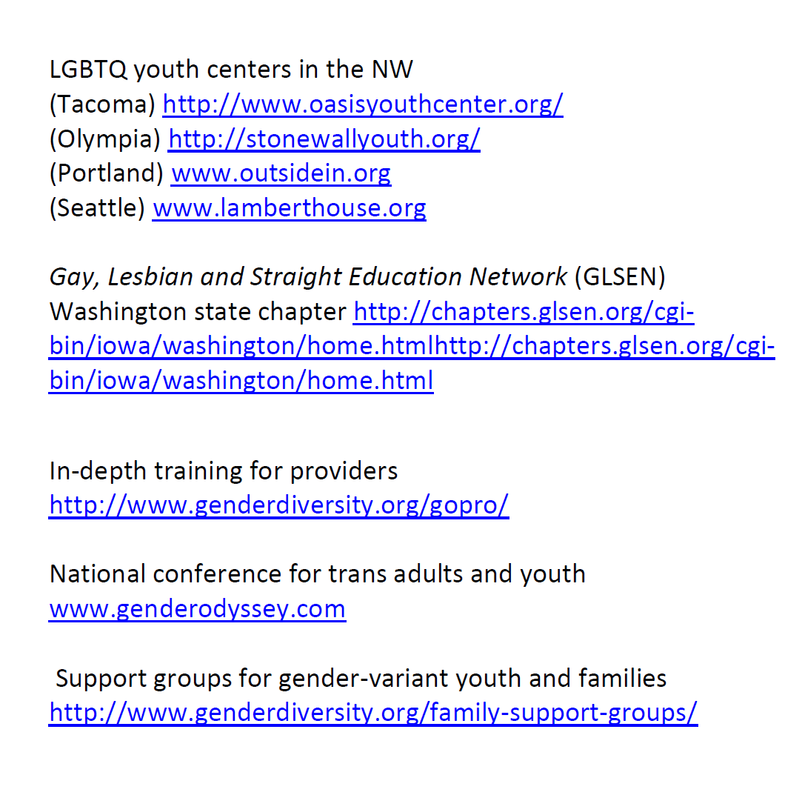

Slide 71


Slide 72
Thank you!
Any questions or comments?

Slide 73
Complete Survey

Slide 74
      Subscribe to the Gender Odyssey mailing list to learn about training events, such as professional Day: https://app.e2ma.net/app2/audience/signup/28753/17074/?v=a
      Register for more in-depth training at Gender Odyssey’s annual Professional Day: http://www.genderdiversity.org/event-registration/?ee=2

