Slide 1
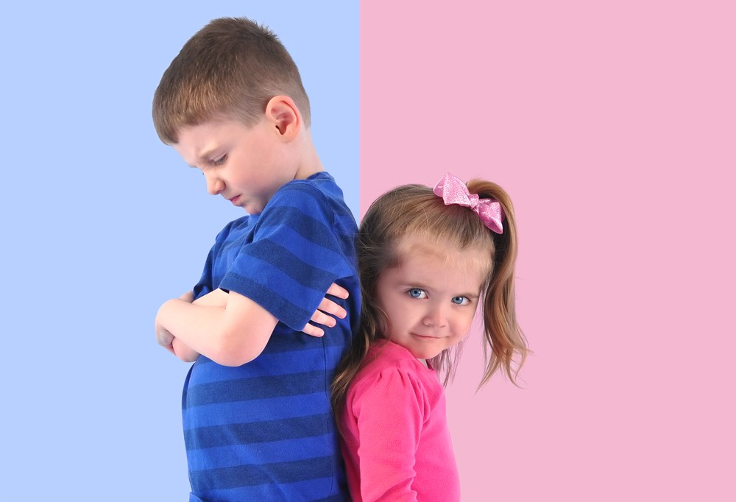
Let clothes be clothes!
Stop the gender pushing!
Ashlee Shelton
TSOC 455 Winter 2017-2018
Page 1 of 8
Notes:
Image from Google

Slide 2
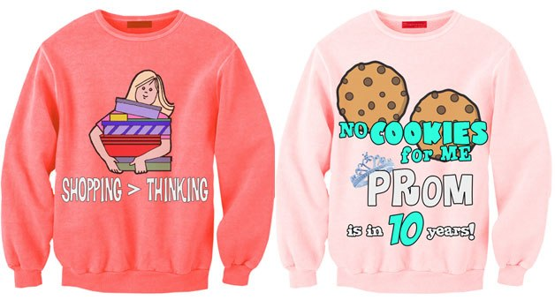
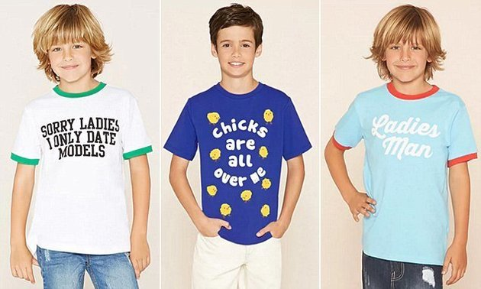
Page 2 of 8
The issue with kids’ clothing is that it sends the wrong message to kids that makes them think they have to live up to the expectations that the clothes reflect. Designers are able to use a basic necessity as a means for gender socialization and implementing stereotypes into the brains of innocent beings. The clothing also tends to only represent two and only two genders, “boy” and “girl”. What about the kids who do not identify with either? Where does this leave them with?
Girls are made to think that their purpose is to be pretty and that they cannot be smart because only the boys can be. Boys are made to think that they are superior and should only show affection to girls who fit society’s image of “pretty”. Both boys and girls at are risk of believing these stereotypes and acting on them. As early as age 6, girls start believing these stereotypes. The gendered clothing also leaves little to no room for kids who do not necessarily align themselves with a specific gender.
Notes:
Images from Google

Slide 3
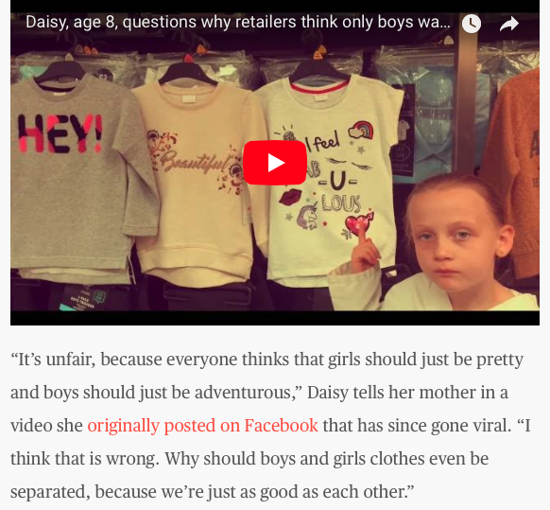
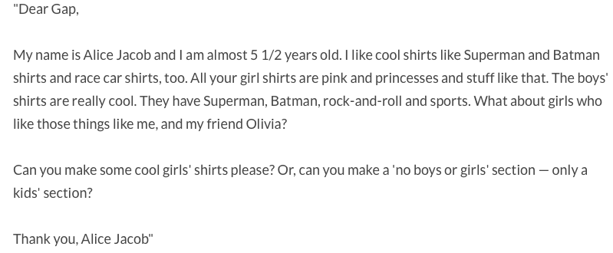
There is hope however. Here are a couple of examples of two girls who are fed up with the stereotypical “girl’s clothes”.
Page 3 of 8
Notes:
Images from : https://www.today.com/style/watch-8-year-old-explain-what-s-wrong-most-kids-t103565 and https://www.care.com/c/stories/9925/little-girl-pens-letter-to-gap-about-pink-an/

Slide 4
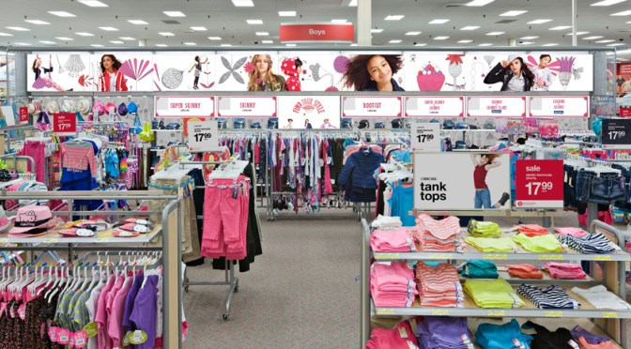
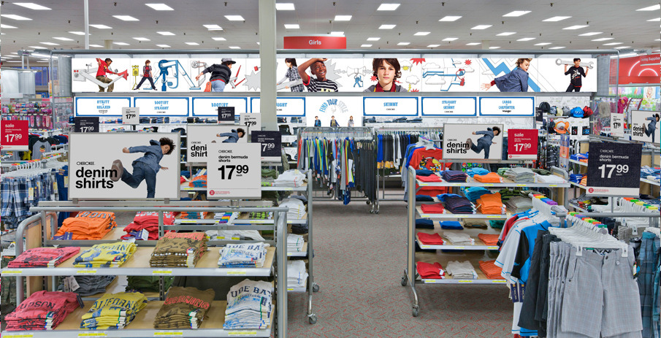
Imagine walking into a store and seeing this…
Page 4 of 8
What if you feel as if you “look” and “feel” like a girl, but do not like the clothes in that section? Maybe you prefer blue or green clothes or something with superheroes on it. What if you feel as if you “look” and “feel” like a boy, but do not care for the clothes you see in that section? Maybe you like the color pink or purple and want something with sweet sayings on it. Imagine being a kid and having all of these conflicting and confusing situations. As adults we may not be intimated to wander into a different clothing section, but as children they are typically only given a “girl’s” and “boy’s” section.
Notes:
Images from Google

Slide 5
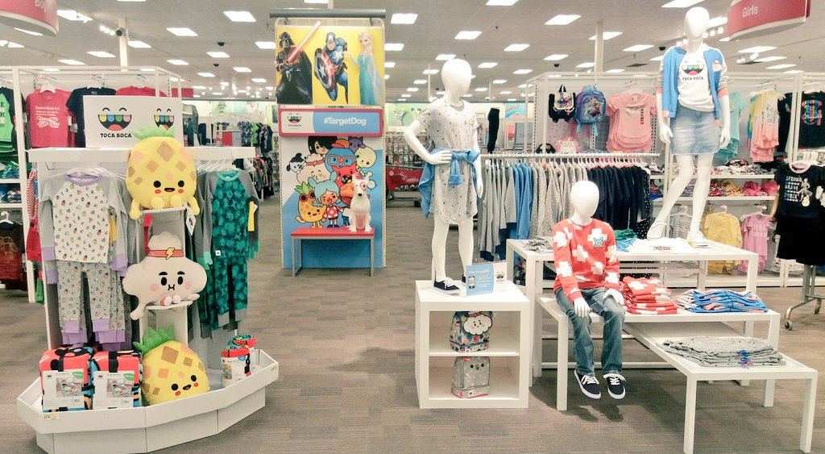
Some may wish for a section that was more neutral…Something like this maybe…
This type of clothing section provides a variety of options for all kids. There are no obvious signs of gender and this gets rid of the stress of gender socialization. A good thing about this type of clothing section is that for kids who identify as transgender and maybe have not yet started the transition, do not have to feel pressure to go into a specific section to avoid uncomfortable stares and whispers. These options allow room for children to be children and find their own unique and individual style without feeling the pressure of gender socialization. Every child deserves the right to create their own style of identity.
There is no division of gender sections, just a variety of colors and options!
Page 5 of 8
Notes:
Image from Google

Slide 6

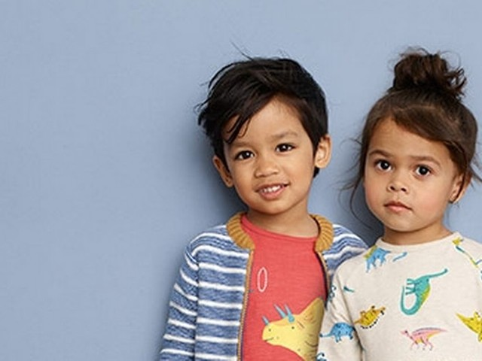
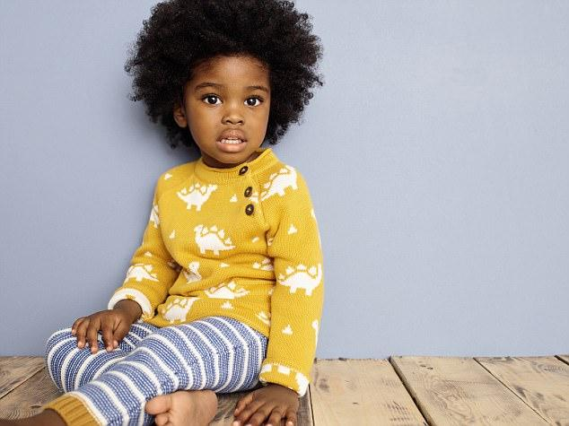
John Lewis, a U.K. retailer, announced that he will be removing gender labels from his clothing. He wants to eliminate the gender stereotyping on clothing and provide a variety of clothing for parents and children to choose from.
Page 6 of 8
Notes:
Images from Google

Slide 7
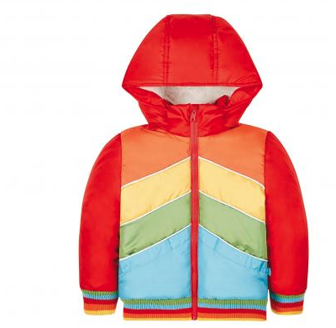
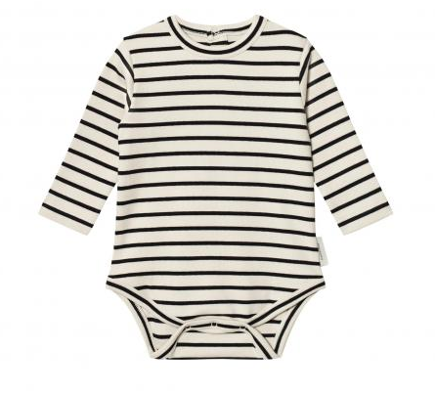
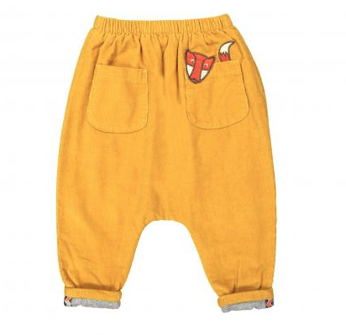
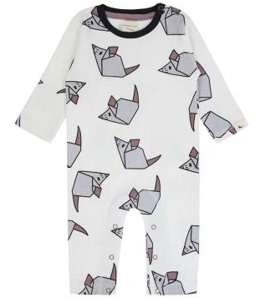
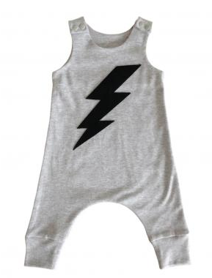
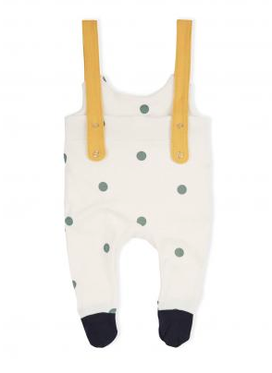
Good news! There are even brands providing gender neutral clothing options!
-“Is this boy’s or girl’s?”
-”Neither!”
-”Now my kid can finally be an individual”
-”Yeah! No more pink and blue. Finally!”
Page 7 of 8
Notes:
Images from : http://www.independent.co.uk/extras/indybest/kids/clothing-footwear/best-gender-neutral-clothing-babies-baby-clothes-place-for-to-buy-kids-a7952641.html

Slide 8
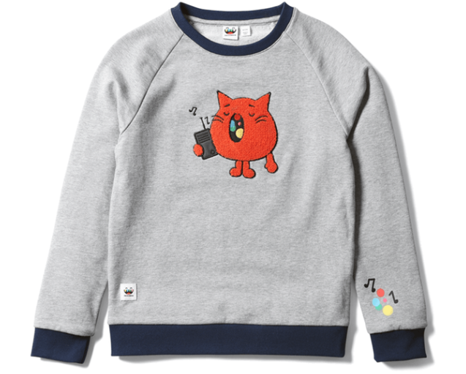
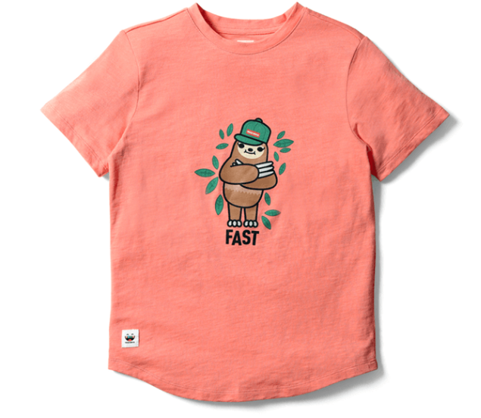
Even Target is introducing gender neutral clothing.
“This is what makes the Toca Boca gender neutral clothing line at Target so vital for kids who might be trans and are still in the process of defining their own gender”
– Keiko Zoll
Gender-less, neutral clothing leaves room for children to create their own identities. It alleviates the stress of them feeling like they have to fit into these boxes that society has created. With colors other than blue and pink, kids have a variety of colors, patterns and designs that they can choose from. A huge benefit of the clothing is that kids who have not yet identified with a gender are able to freely test their own unique styles until they find one that fits. Another big benefit is that this decreases the likelihood of children being taunted or shamed for not picking clothes that represents their gender according to others.
“But your child doesn’t have to be trans to appreciate clothing that don’t fall within such stubborn traditions of ‘girl = pink’ and ‘boy = blue’ and every variation on these tired fashion themes.”
–Keiko Zoll
Page 8 of 8
Notes:
Images and quotes from: https://www.romper.com/p/this-new-childrens-clothing-at-target-is-going-to-make-a-huge-difference-for-kids-70101

