Slide 1
Happy Together?
Communication & Collaboration Between
Technical Services and IT
Erin Grant, Director, Cataloging and Metadata Services (egrant2@uw.edu)
Anne Pepitone, Integrated Library System Coordinator and Systems Librarian (annepep@uw.edu)
Morag Stewart, Acquisitions Librarian/Classics Librarian (mkstew@uw.edu)

Slide 2
Thank You:
ALCTS Program Committee
  Co-Chairs Richard Guajardo and Sarah Wallbank as well as Committee members
  Program Committee Liaison Millicent Fullmer
Library and Information Technology Association (LITA) for co-sponsoring our original program
ALA Virtual organizers for providing a venue for this program

Slide 3
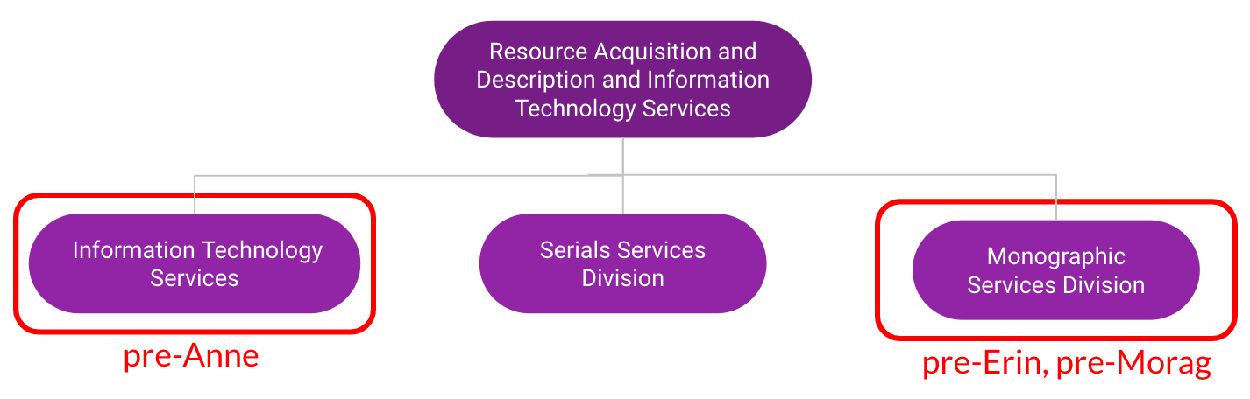
UW Libraries org chart
(c. 2012)

Slide 4
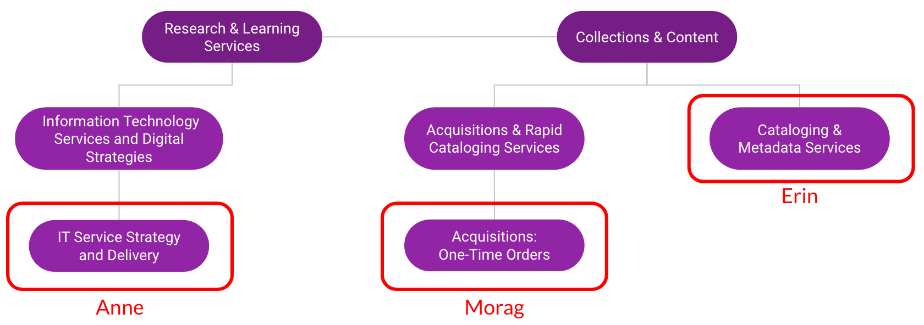
Organizational chart
(2016-present)

Slide 5
Information Technology Services & Digital Strategies(ITS&DS) and Technical Services

Slide 6
Systems Collaboration in one person...
Libraries Organizational Review Initiative
Identified a need to reduce inefficiencies and duplication of efforts
This position was created (Integrated Library Systems Coordinator and Systems Librarian)
  The position broke down into three areas:
    Coordination of efforts around the ILS
    Technical support/system development
    Institutional Representative
      Consortial work
      Vendor

Slide 7
Discovery & Integrated Library System Operations Group (DILS)
Membership is broken into leads by area:
  Discovery
  Resource Management
  Acquisitions
  Fulfillment
  User accounts
  ILL
  Central index
  Analytics
  Collections and Content
  Law
What this group does:
  Coordinating administration
  Establishing recommendations, policies and procedures
  Support training efforts and maintaining documentation
  Communication to staff and users

Slide 8
Additional Collaborations with Technical Services
  Orbis Cascade Alliance (Our Consortium)
    System changes
    Discovery enhancements chair
    Representative for Discovery, Systems, institutional voting, and vendor voting
  Question Point (Chat with a librarian service)
    E-Resources Troubleshooting queue
    ITS queue
    Personal queue
  Technical Support Dashboard
    Forms for configuration changes
    Forms for enhancement requests
    Best practices documentation
  Vendor ticketing coordinator
    Attached to every ticket filed by UW
    Consulted on whether or not to file a case
    Best practices for filing cases
  PWOG (Public Web Operations Group)
    Vetting FAQ pages/Creating FAQ pages
    Breaking down releases and upcoming changes to online catalog
    Vetting features

Slide 9
Communication Lessons Learned
Shifting away from being a culture of no
Working with departments to centralize contact points
Reforming groups to be less reactionary to being more proactive
Stop assuming and try to keep an open mind
Forcing the focus back on who the user is and why we are doing the work
Understanding and care go a long way

Slide 10
Cataloging and IT

Slide 11
Collaboration with IT
Collaboration at previous institution
(had more bandwidth for providing this level and depth of IT support)
ILS migration, set up authority processing workflow with vendor
Streamlined marking/work order removal via APIs, web form, and SpineOMatic
Automated adding monographic OCLC holdings for new books via APIs
Collaboration at UW
Orbis Cascade Alliance shared ILS
  System changes, e.g. testing and vetting Primo norm rules changes
  Resource Management enhancement voting coordination
DILS participation - representative for Cataloging & Metadata Services, Resource Management
SalesForce requests - copying Anne as central UW SF coordinator

Slide 12
Communication
Lessons Learned
Scrum roles of Product Owner (cataloging)/Dev Team (IT) worked for collaborative projects
Be conscious of and sympathetic to IT bandwidth issues
For day-to-day interactions, funneling cataloger questions/requests to IT through single gatekeeper (department director) to reduce stress/overload on IT
Advance communication, especially with tight deadlines
Even though departments have different priorities and objectives, try to remember we’re all on the same team
Focus on Libraries Strategic Plan to find common ground

Slide 13
Acquisitions and IT

Slide 14
Collaboration with IT
E-resources Troubleshooting
  Acquisitions and Rapid Cataloging Services (ARCS) staff involved in e-resource subscription management and record loading respond to QuestionPoint queries
Libraries Intranet Operations Group (LIOG) and Public Web Operations Group (PWOG)
  Intranet policy recommendation and review
  Interaction of multiple systems and user groups
Orbis Cascade Alliance
  Alliance annual enhancement voting process and local input from DILS and other sources
  Shared content and impacts across the local institution

Slide 15
Wrap Up

Slide 16
Key Points/Communication Strategies:
Reduce or manage points of interaction - point person for projects or main email channel to funnel questions
Automate where possible
  Ex. use forms to generate emails for consistency of information, especially for frequent types of requests
Try to think proactively rather than reactively (perhaps always a goal rather than reality)

Slide 17
Questions?
Discussion questions to the audience:
How are tech services and IT organized at your institution?
What challenges do you perceive to effective interdepartmental communication or collaborative initiatives between tech services and IT?
What opportunities do workflows or organizational structure offer for strengthening collaboration or communication between tech services and IT at your institution?

Slide 18
THANK YOU!

