Slide 1




Measuring City of Seattle’s progress on Digital Equity
2018 Impact Summit
David Keyes, City of Seattle
Stacey Wedlake, TASCHA
Notes:
David and Stacey introduce themselves.

Slide 2
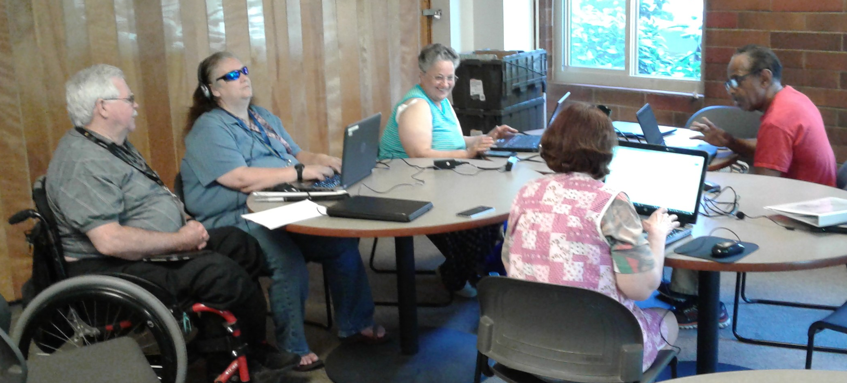
Outline
Overview of City of Seattle Digital Equity Initiative
Indicator Framework
Putting the indicators to work

Slide 3
Digital Equity means...
We envision Seattle as a city where technology’s opportunities equitably empower all residents and communities - especially those who are historically underserved or underrepresented.
Notes:
Started from question of What is technologically healthy community?
All Seattle residents have the tools and ability to necessary to be successful in employment, entrepreneurship and technology leadership, lifelong learning, civic engagement, and use of essential online services.
Digital equity, digital inclusion, broadband adoption are different contexts & elements. Also see the NDIA definitions.

Slide 4
Background
For the last 20 years, Seattle IT has partnered with community organizations to implement programs to increase technology access and skills.
The Digital Equity Initiative, based on broad community input, created a city-wide strategy to continue and expand this work.
Other cities, such as Austin, and Portland, have digital equity strategies. More coming...
Notes:
Local, national context, public engagement in development.
This plan was developed with more than 100 community leaders, non-profit organizations, companies, and members of the public participating. They helped identify needs, a vision and possible strategies (See first vision and strategies report). Our digital equity initiatives are closely aligned with and further the City of Seattle broadband efforts, Race and Social Justice Initiative, and other education, neighborhood, equitable development, technology, cultural and human service goals.

Slide 5
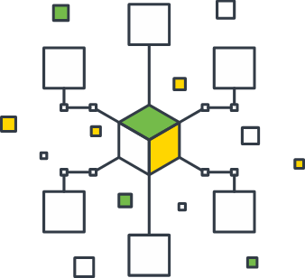
Digital Equity Goals & Strategies
Connectivity
Skills training
Devices & technical support
Applications & online services
Community capacity building
Notes:
•iSchool researchers compiled an inventory of Seattle IT internal and external data points. This allowed the use of existing indicators, informed the creation of the new indicators, and helped identify other indicator sources.

Slide 6
Initiative Theory of Change
Activities
Outcomes
Vision
Organizational
Digital Equity for All
Digital Equity Strategies
Individual
Structural
Notes:
David last slide.
Structural elements include Policies, systems, communications, collaborations, resource investments, and on-line services

Slide 7
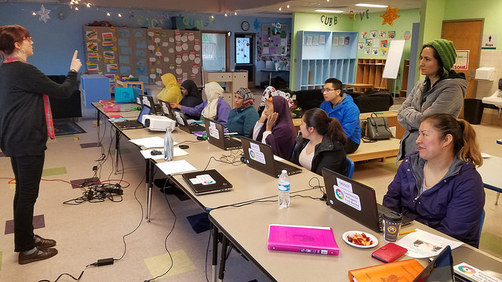
Process for creating indicators
Inventory of internal and external data points
Develop theories of change
Indicator framework
Data collection and reporting strategy development
Notes:
Stacey starts here.

Slide 8
Inventory of internal and external data points
Identified and assessed Seattle IT’s existing indicators from sources such as
  Population: Community indicators survey
  Program: Grant applications and reports
  Services data (eg wi-fi use)
External data points came from other surveys and indicator projects
Notes:
We evaluated existing indicators from the city and other community sources for possible use in the evaluation plan. Using five source documents provided by Seattle IT, we extracted and tagged indicators according to Digital Equity Initiative’s goals: Connectivity, Devices and Technical Support, and Skills Training. In addition, we examined community indicators from twelve other sources, and when possible, tagged the indicators to a goal area. These indicators informed the evaluation plan’s indicator framework.

Slide 9
Example Connectivity Indicator Framework
Activity: Internet to individuals
Expand and improve internet programs for low-income residents
Short-term Outcomes
Intermediate Outcomes
End Outcomes
Structural
Structural
Individual
Individual
Improved options in the Wave franchise
Equitable, high quality low-income programs
People sign up for low-income programs
Low-income residents have broadband
Launch of Wave low-income program
# of programs available
Broadband speed
Scope of eligibility
Awareness of programs
# of subscribers of low-income programs
% of low-income households with home Internet
% of low-income households signed up for low-income Internet programs
Notes:
Edited outcomes & indicators slightly to be it more slide friendly
Will use animation to limit the amount of text visible at once (check the timing)
The framework itself details the data source, frequency, and which activity and outcome the indicator measures.
If time, mention organizations assisting with sign-ups.

Slide 10
Example: Connectivity Indicators w/ results
Activity: Internet to individuals
Expand and improve internet programs for low-income residents
Short-term Outcomes
Intermediate Outcomes
End Outcomes
Structural
Structural
Individual
Individual
Improved options in the Wave franchise
Equitable, high quality low-income programs
People sign up for low-income programs
Low-income residents have broadband
Wave program launched in late 2016
3 programs available
Speed 10-15 Mbps down / 4G LTE
Eligibility varies by program
Awareness of programs
# of subscribers of low-income programs
% of low-income households with home Internet
% of low-income households signed up for low-income Internet programs
Notes:
Edited outcomes & indicators slightly to be it more slide friendly

Slide 11
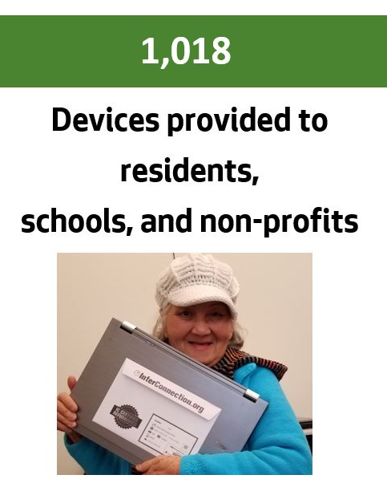
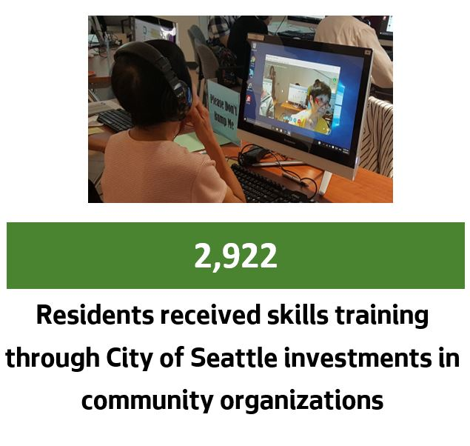
Examples: what we know so far
1st comprehensive report produced using 2017 data
6,584
Wi-Fi Hotspot check-outs from the Seattle Public Library
Notes:
1st DE report - comprehensive report came out - of 2017 data (Report w/graphics at http://www.seattle.gov/tech/initiatives/digital-equity/digital-equity-progress-report)
Could take graphic from PPT/website of the data points
Stacey’s last slide.

Slide 12
How indicators are being used
Investment guidelines & decisions - grant program
Community data collection (Survey)
Data storage and design work
Public education
Annual digital equity report
Strategic consulting to others on planning and surveying
Notes:
David here
Changed guidelines in Tech Matching Fund, applying to the reporting. Used it with ARC RecTech to help their participant data collection.
Also used for Seattle IT Performance measures

Slide 13
Want to measure digital equity?
National sources
  Community Survey/Census computer questions
  NTIA supplemental questions
  Robert Gallardo’s Digital Divide Index
  FCC form 477 data, and NDIA research
  Health survey CDC National Health Interview Survey (NHIS)
Potential local sources
  Government & libraries, CBO’s
Notes:
Other info:
Common Sense Media, Pew
Mobile Beacon
Sometimes company research or marketing data may be made available.

Slide 14
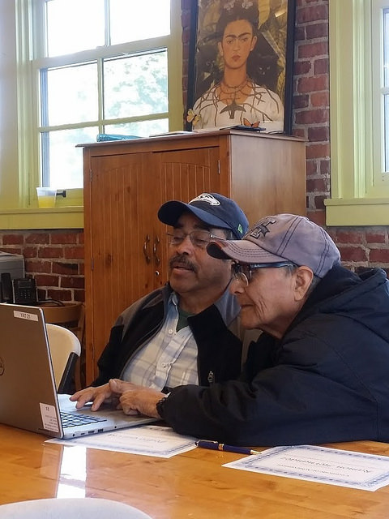
Lessons learned
Helpful to produce iterative drafts of measures and get feedback from stakeholders
Process of identifying and collecting indicators is hard, can help partnerships
Notes:
Seeing some evolution in what data points are used and are emphasized.
May want to use simpler proxies for some.

Slide 15
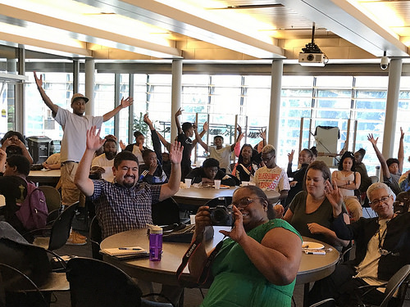
Wrapping up...
Next steps
  Community Survey
  Implement new grant systems with integrated indicators
  Further develop collection and reporting tools
Our message to you -
  Apply digital equity indicators to other indicator projects

Slide 16
Thank you!
Slides and supporting documents uploaded to Sched
David Keyes
Digital Equity Manager
City of Seattle
David.Keyes@seattle.gov
@diginclusion
Stacey Wedlake
Research Coordinator
Technology & Social Change Group
staceyaw@uw.edu
@staceyawe

